Slide 1
系統晶片設計實習
指導老師：陳朝烈
學號：F107112112
姓名：施辰佑

Slide 2
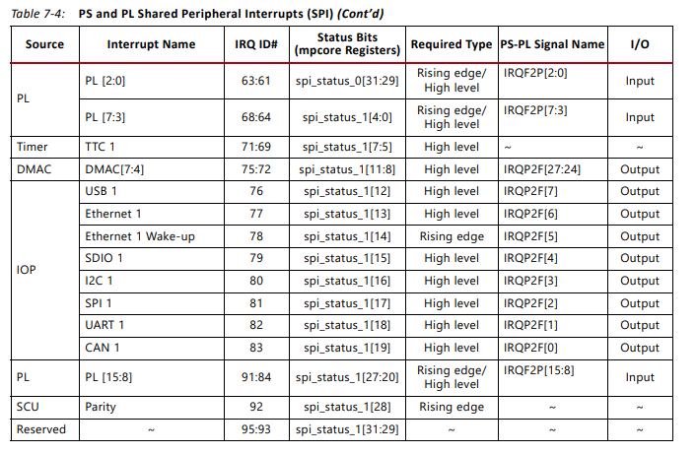
IRQ
Zynq-7000 SoC Technical Reference Manual
p.231

Slide 3
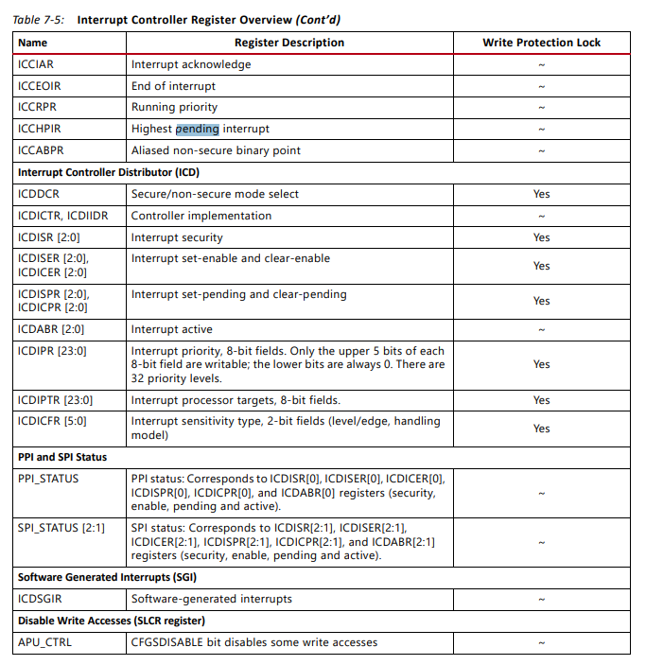
Pending
Zynq-7000 SoC Technical Reference Manual
p.234

Slide 4
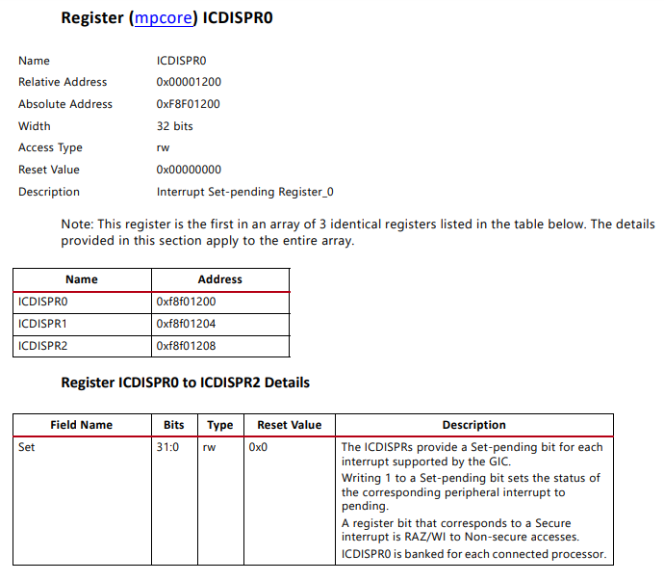
Pending-ICDISPR
Zynq-7000 SoC Technical Reference Manual
p.1468

Slide 5
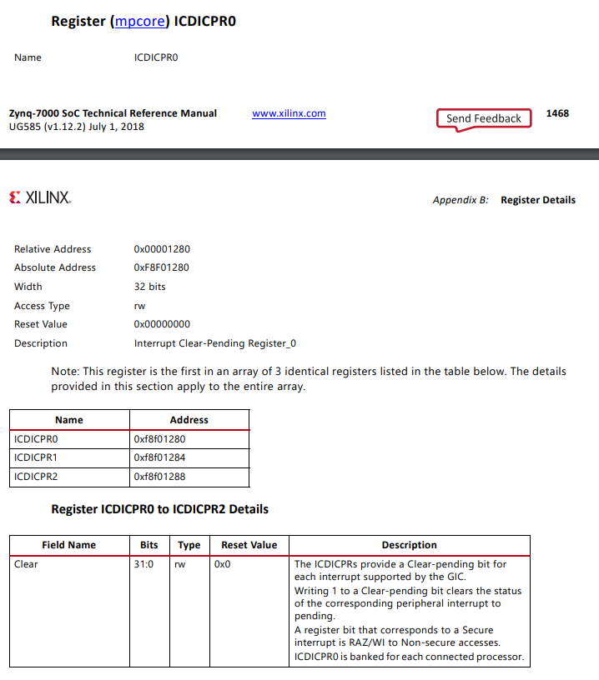
Pending-ICDICPR
Zynq-7000 SoC Technical Reference Manual
p.1469

Slide 6
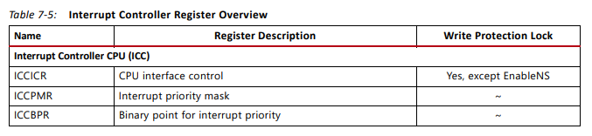
Mask
Zynq-7000 SoC Technical Reference Manual
p.233

Slide 7
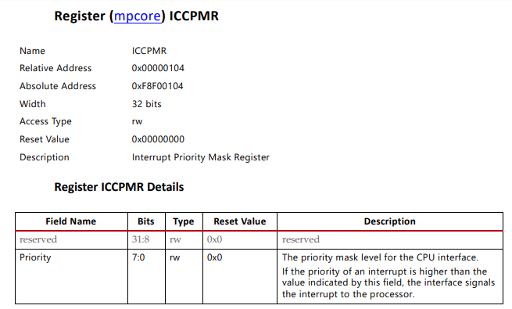
Mask-ICCPMR
Zynq-7000 SoC Technical Reference Manual
p.1444

