Slide 1
Predicting Reviews an User Generated Content
Andy Acs
WeddingWire
DAT7

Slide 2
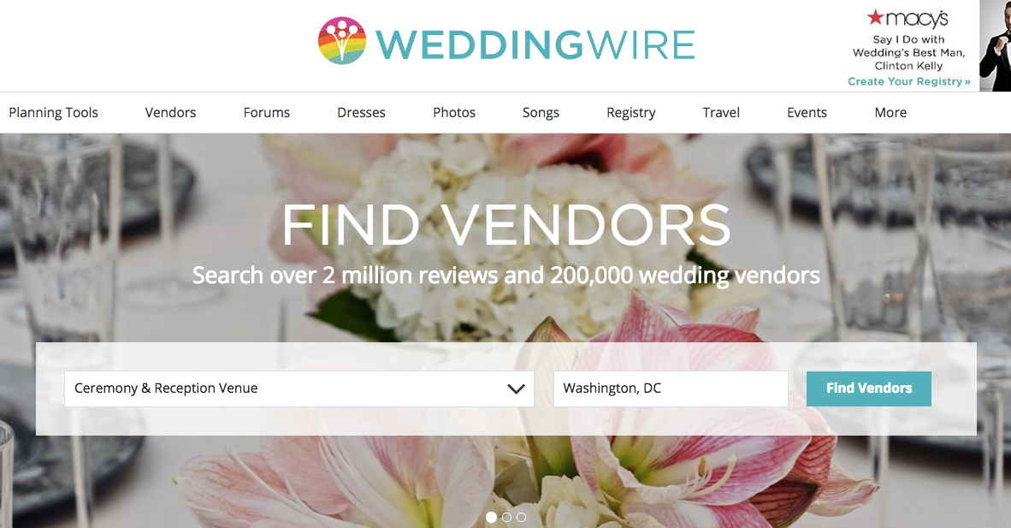

Slide 3
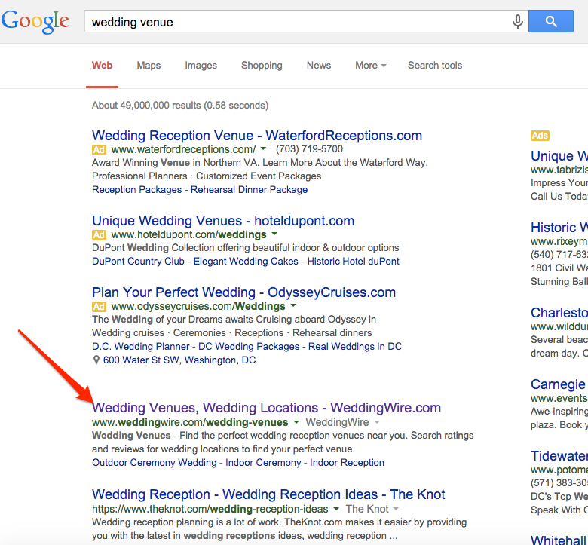

Slide 4
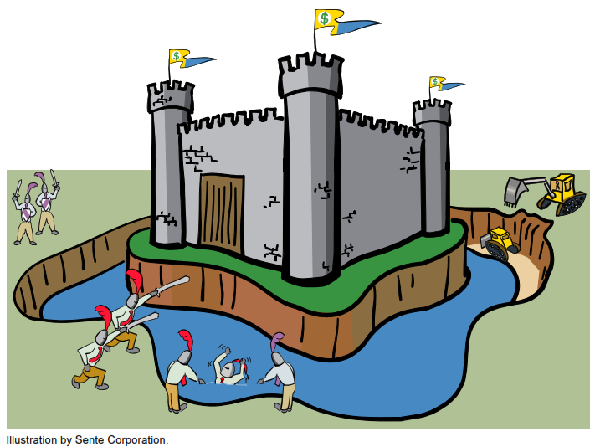
Competitors that shall remain nameless…
REVIEWS

Slide 5
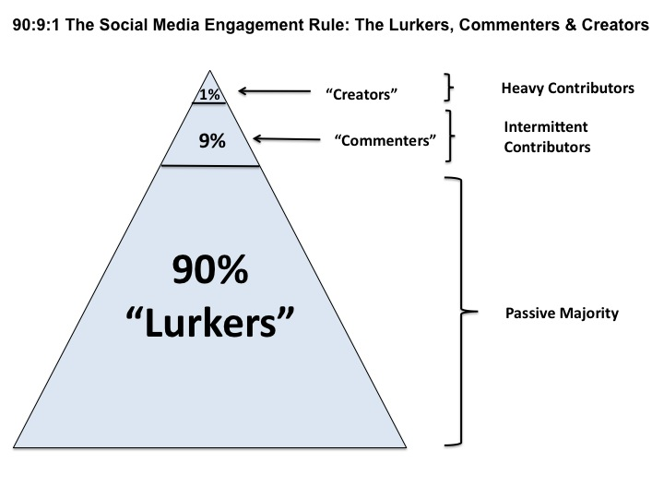
Check out post on Yelp's blog....

Slide 6
How do we identify and focus on the 10% of content creators before they write reviews?

Slide 8
Working Theories
Community Forums is an indication that a user is a commenter or creator.
Storefront Visits = user has interacted with reviews on the site.
Checklist Tasks = user is willing to follow our recommendations.

Slide 9
Created a data set containing registered users on WeddingWire.
Data included important user data, such as signup date, wedding date as well as behavorial data regarding usage of different features.
Cleaned data to remove potential anomalies and fidelity issues around tracking.
Removed users that joined less than 6 months before their wedding date
Removed users that have not yet had their wedding.
55,000 users remaining in data set

Slide 10
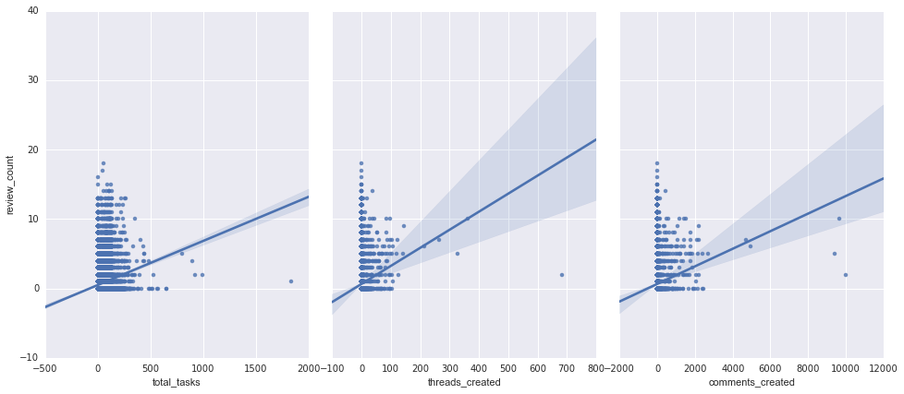
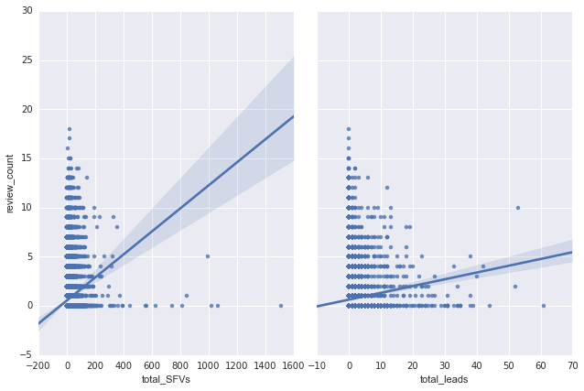

Slide 11
Next Steps
Work through feature selection and model evaluation.
Decide on classification or regression:
Will a user write a review?
How many reviews is a user likely to write?

