Slide 2
1ai Two Food Tours
Andy
Hakki
Philipp
David
Joseph

Slide 3
Andy
Hakki
Italian (1)
Döner, Italian (2)
Philipp
Nothing (0)
David
Korean (1)
Joseph

Slide 4
Andy
Hakki
Philipp
David
Joseph

Slide 5
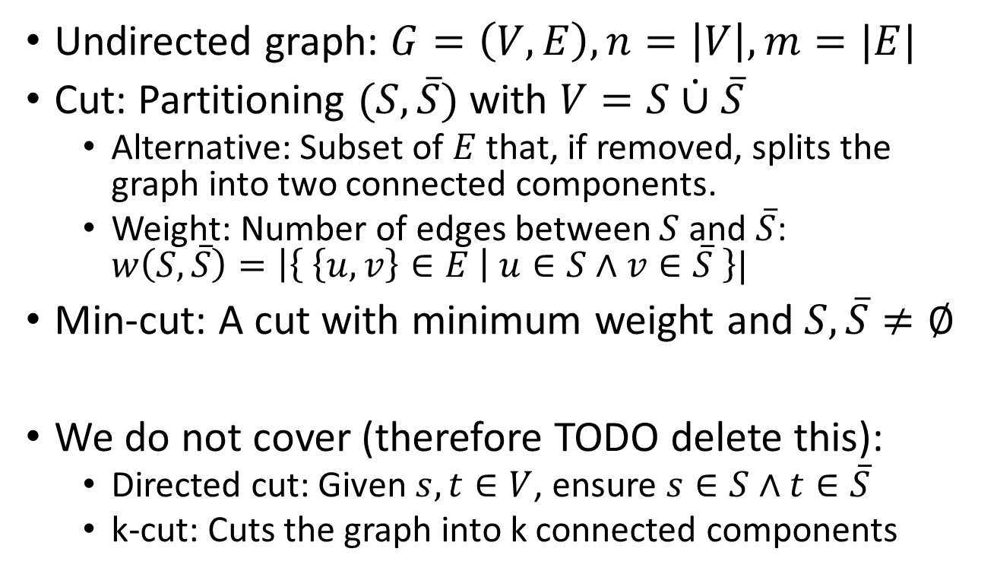
1aii
Undirected graph: $G=\left(V,E\right), n=\left|V\right|, m=|E|$
Cut: Partitioning $(S,\overline{S})$ with $V=S\dot{∪}\overline{S}$
Alternative: Subset of $E$ that, if removed, splits the graph into two connected components.
Weight: Number of edges between $S$ and $\overline{S}$: $w\left(S,\overline{S}\right)=\left|\left\{ \left\{u,v\right\}∈E \right| u∈S∧v∈\overline{S} \right\}|$
Min-cut: A cut with minimum weight and $S,\overline{S}≠∅$
We do not cover (therefore TODO delete this):
Directed cut: Given $s,t∈V$, ensure $s∈S∧t∈\overline{S}$
k-cut: Cuts the graph into k connected components

Slide 6
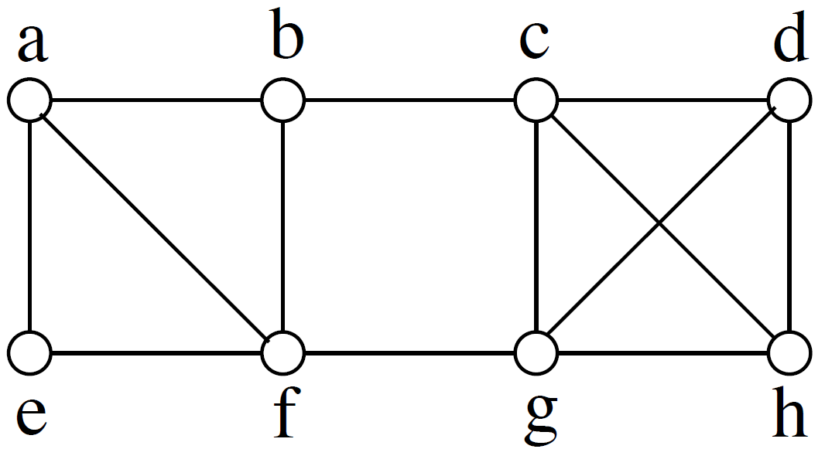
1aiii Examples
TODO Prepare stuff to draw on the whiteboard

Slide 7
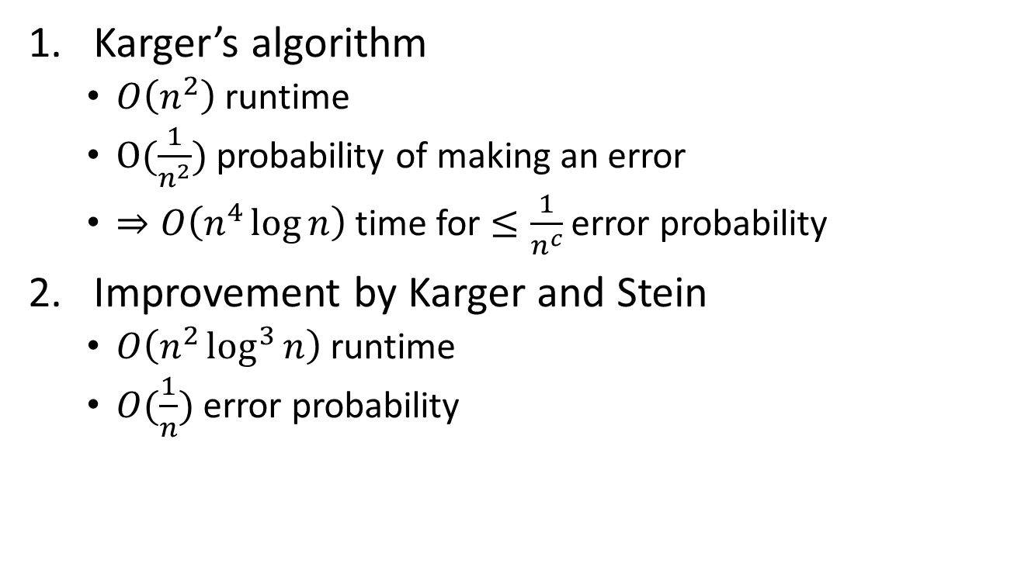
1bi Preview
Karger’s algorithm
$O\left(n^{2}\right)$ runtime
$O(\frac{1}{n^{2}})$ probability of making an error
$⇒O\left(n^{4}\log{n}\right)$ time for $≤\frac{1}{n^{c}}$ error probability
Improvement by Karger and Stein
$O\left(n^{2}\log^{3}{n}\right)$ runtime
$O(\frac{1}{n})$ error probability

Slide 8
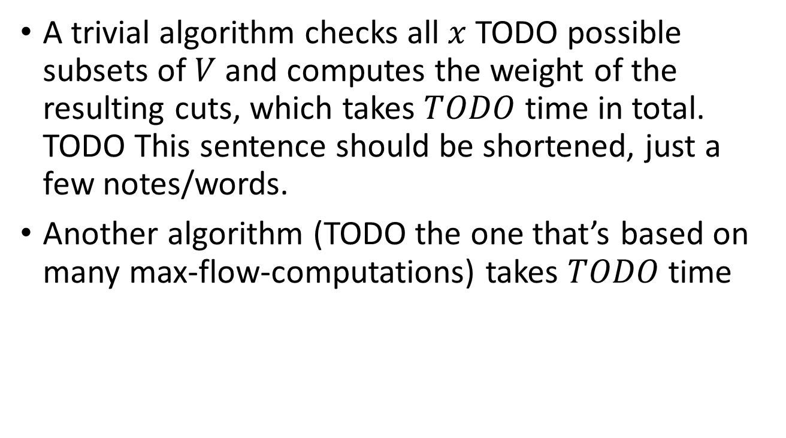
1bii Comparison
A trivial algorithm checks all $x$ TODO possible subsets of $V$ and computes the weight of the resulting cuts, which takes $TODO$ time in total. TODO This sentence should be shortened, just a few notes/words.
Another algorithm (TODO the one that’s based on many max-flow-computations) takes $TODO$ time

Slide 9
1biv Karger’s Algorithm
TODO need the algo here

Slide 10
1bv TODO Karger running example

Slide 11

1bviii Running Time
The running time so far is $O(n^{2})$, but we have to show why. TODO

Slide 12
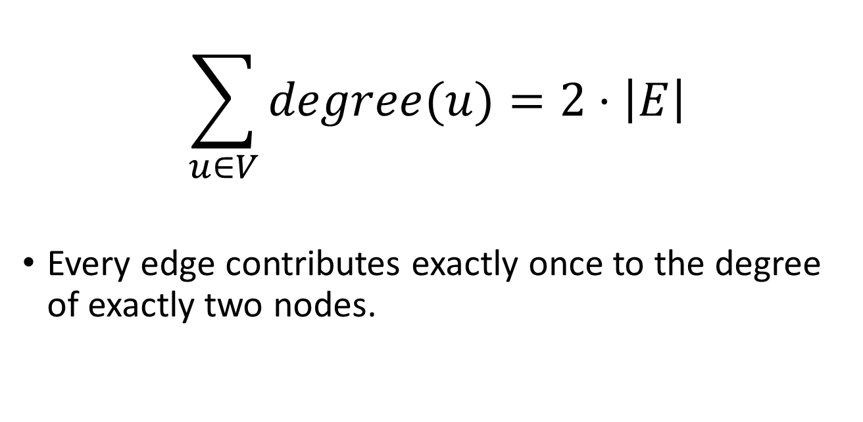
Fact 1 – Sum of Node Degrees
$$\sum_{u∈V}{degree(u)}=2⋅\left|E\right|$$
Every edge contributes exactly once to the degree of exactly two nodes.

Slide 13

Fact 2 – Average Node Degree
$$E\left[degree\left(X\right)\right]=\sum_{u∈V}{\operatorname{Pr}\left(X=u\right)⋅degree\left(u\right)}$$
$$=\frac{1}{n}\sum_{u∈V}{degree\left(u\right)}=\frac{2\left|E\right|}{n}$$

Slide 14
Fact 3 – Min-cut Size
The size of a min-cut is at most $\frac{2\left|E\right|}{n}.$

Slide 15

Fact 3 – Min-cut Size
The size of a min-cut is at most $\frac{2\left|E\right|}{n}.$
$$\left|cut\right|=degree(u)$$
u

Slide 16
Fact 4 – TODO
The slide should already be in LaTeX.

Slide 17
2e Contracting = Not Cutting
TODO show the running example again and explain how an edge that has been contracted will never be cut.
And that the edges that remain in the end, because they have never been contracted, are exactly the ones that are cut.

Slide 18
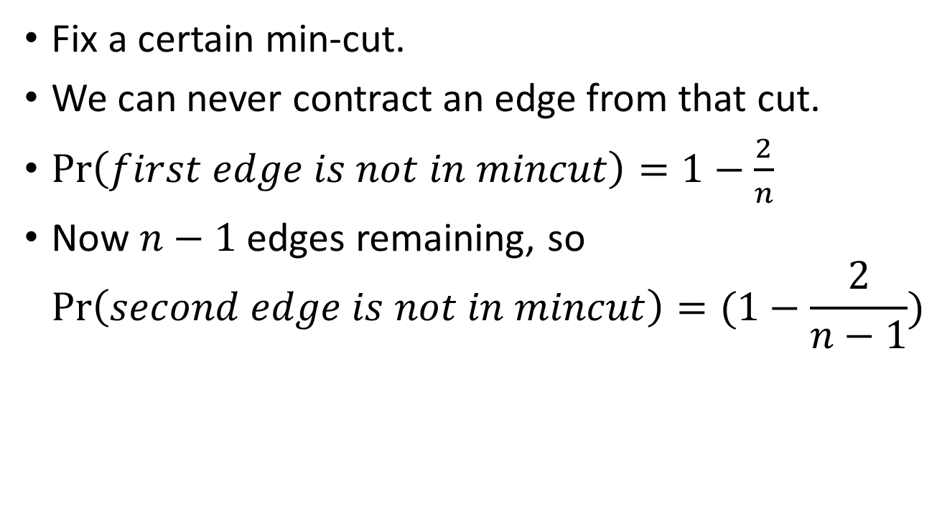
2f Success Probability
Fix a certain min-cut.
We can never contract an edge from that cut.
$\operatorname{Pr}\left(first edge is not in mincut\right)=1−\frac{2}{n}$
Now $n−1$ edges remaining, so $\operatorname{Pr}\left(second edge is not in mincut\right)=(1−\frac{2}{n−1})$

Slide 19
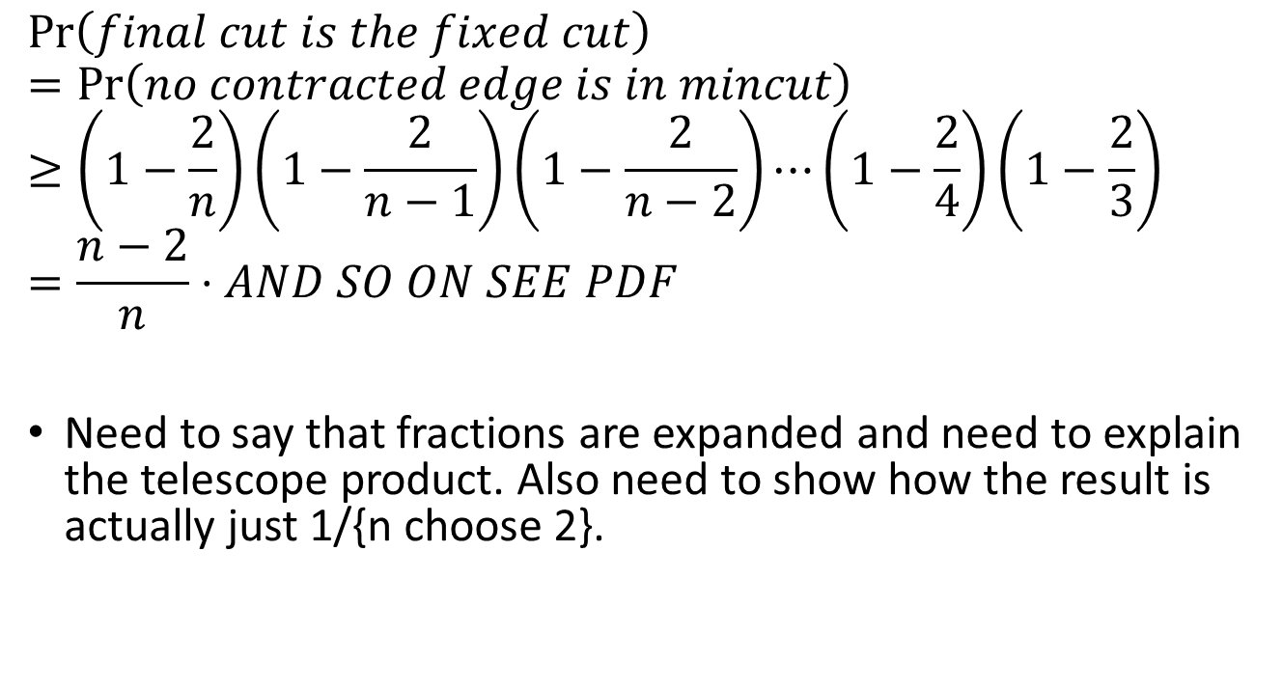
2f Success Probability
$$\operatorname{Pr}\left(final cut is the fixed cut\right) \\ =\operatorname{Pr}\left(no contracted edge is in mincut\right) \\ ≥\left(1−\frac{2}{n}\right)\left(1−\frac{2}{n−1}\right)\left(1−\frac{2}{n−2}\right)⋯\left(1−\frac{2}{4}\right)\left(1−\frac{2}{3}\right) \\ =\frac{n−2}{n}⋅AND SO ON SEE PDF$$
Need to say that fractions are expanded and need to explain the telescope product. Also need to show how the result is actually just 1/{n choose 2}.

Slide 20
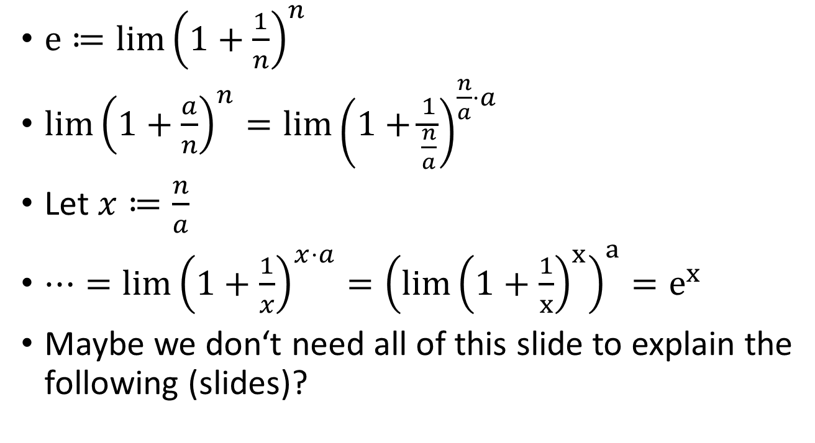
2g Series converging to e
$e≔lim⁡{\left(1+\frac{1}{n}\right)}^{n}$
$lim{\left(1+\frac{a}{n}\right)}^{n}=\lim{{\left(1+\frac{1}{\frac{n}{a}}\right)}^{\frac{n}{a}⋅a}}$
Let $x≔\frac{n}{a}$
$⋯=\lim{{\left(1+\frac{1}{x}\right)}^{x⋅a}}={\left(lim{\left(1+\frac{1}{x}\right)}^{x}\right)}^{a}=e^{x}$
Maybe we don‘t need all of this slide to explain the following (slides)?

Slide 21
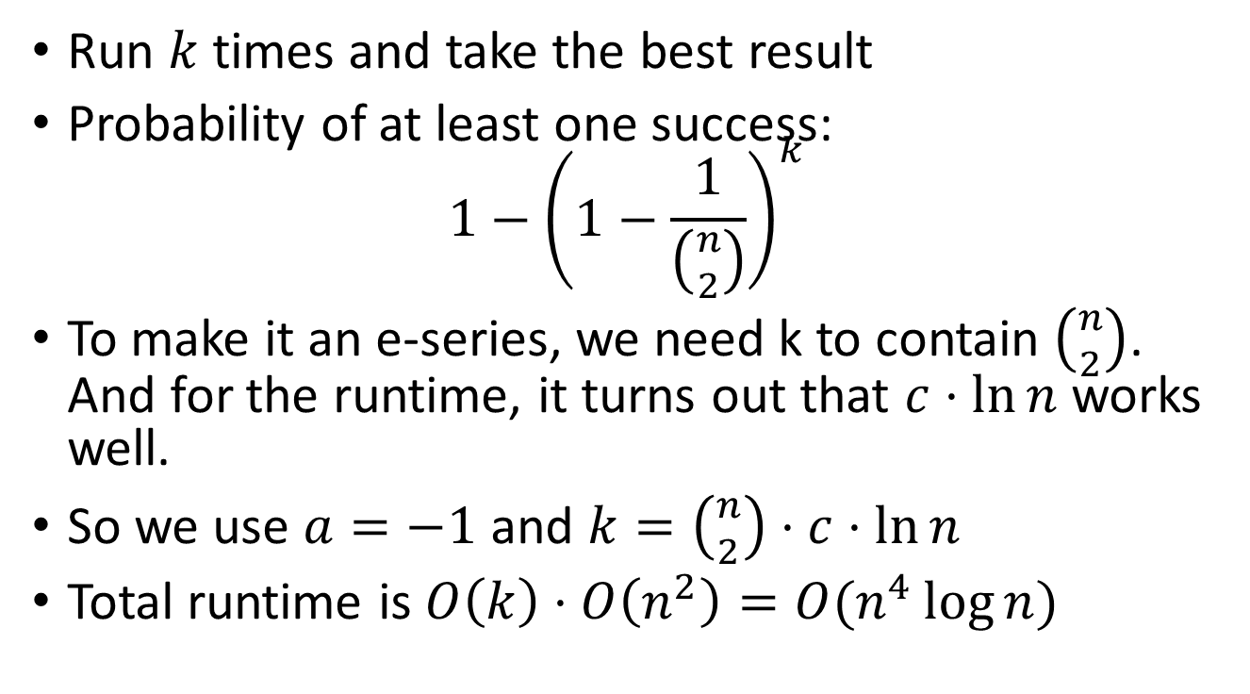
2g Boosting Success Probability
Run $k$ times and take the best result
Probability of at least one success: $1−{\left(1−\frac{1}{\left({n \atop 2}\right)}\right)}^{k}$
To make it an e-series, we need k to contain $\left({n \atop 2}\right)$. And for the runtime, it turns out that $c⋅\ln{n}$ works well.
So we use $a=−1$ and $k=\left({n \atop 2}\right)⋅c⋅\ln{n}$
Total runtime is $O\left(k\right)⋅O\left(n^{2}\right)=O(n^{4}\log{n})$

Slide 22
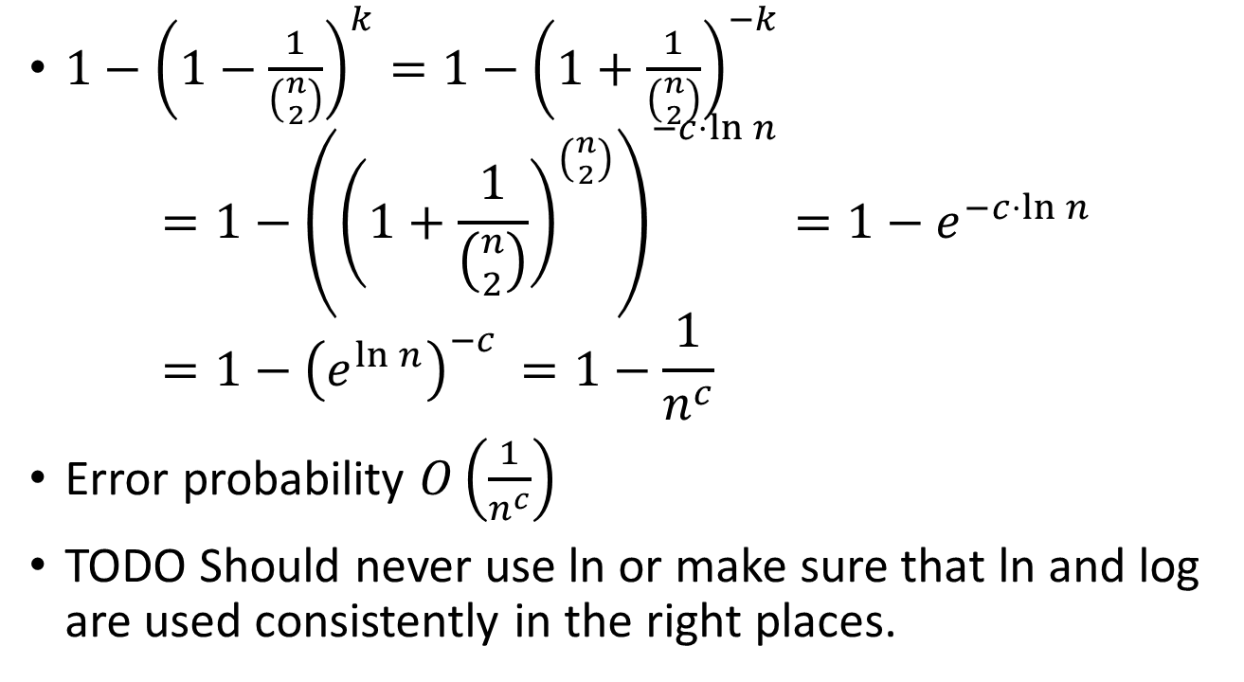
2g Boosting Success Probability
$1−{\left(1−\frac{1}{\left({n \atop 2}\right)}\right)}^{k}=1−{\left(1+\frac{1}{\left({n \atop 2}\right)}\right)}^{−k}$ $=1−{\left({\left(1+\frac{1}{\left({n \atop 2}\right)}\right)}^{\left({n \atop 2}\right)}\right)}^{−c⋅\ln{n}}=1−e^{−c⋅\ln{n}}$ $=1−{\left(e^{\ln{n}}\right)}^{−c }=1−\frac{1}{n^{c}}$
Error probability $O\left(\frac{1}{n^{c}}\right)$
TODO Should never use ln or make sure that ln and log are used consistently in the right places.

Slide 23
3a/b TODO
There will be some slides with the sqrt(2) thing and some more math.

Slide 24
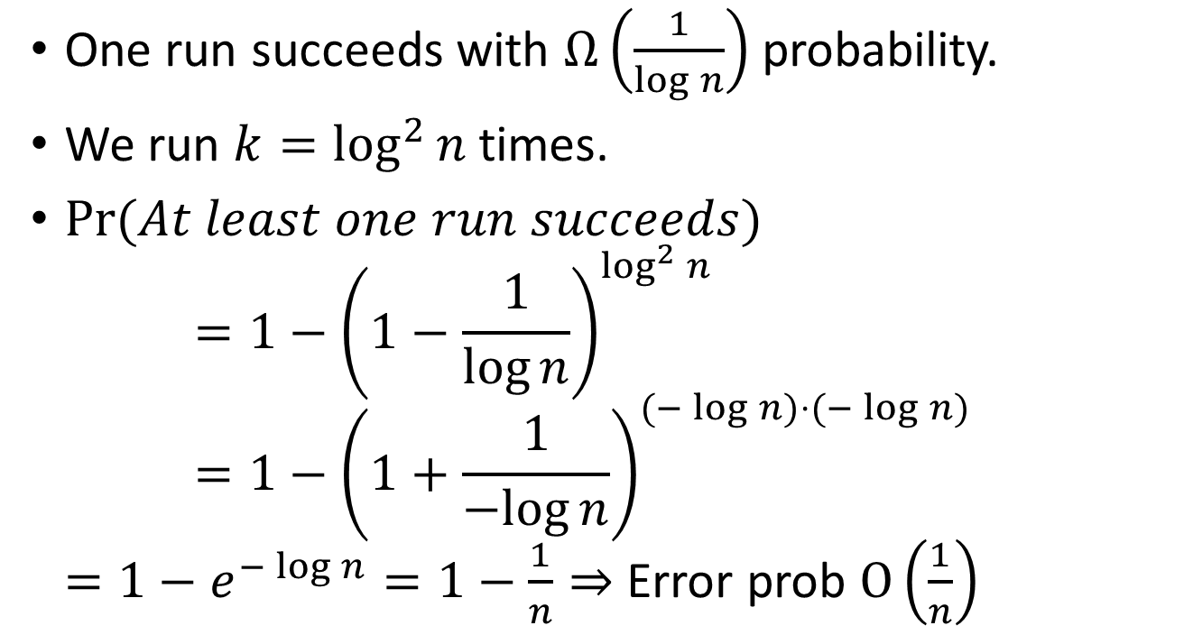
3h Success Probability (NOTE This is for the extended version)
One run succeeds with $Ω\left(\frac{1}{\log{n}}\right)$ probability.
We run $k=\log^{2}{n}$ times.
$\operatorname{Pr}{(At least one run succeeds})$ $=1−{\left(1−\frac{1}{\log{n}}\right)}^{\log^{2}{n}}$ $=1−{\left(1+\frac{1}{−log{n}}\right)}^{(−\log{n)⋅(−\log{n)}}}$ $=1−e^{−\log{n}}=1−\frac{1}{n}⇒$ Error prob $O\left(\frac{1}{n}\right)$

