Slide 1
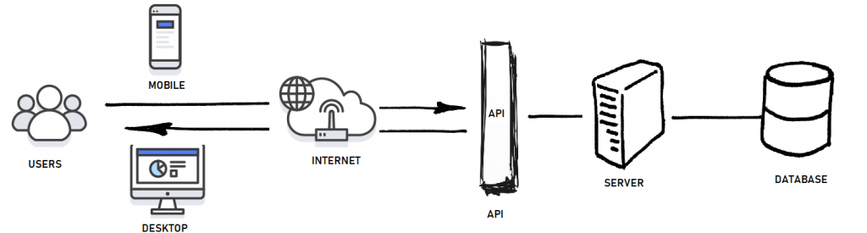

Slide 2
Variable Declare /Өгөгдөл таниулах
Variable VS Value / Өгөгдөл VS Утга
Int, float, char /Бүхэл тоо, Бутархай тоо, Үсэг
Data Type | Size | Description
int | 4 bytes | Stores whole numbers, without decimals
float | 4 bytes | Stores fractional numbers, containing one or more decimals. Sufficient for storing 7 decimal digits
double | 8 bytes | Stores fractional numbers, containing one or more decimals. Sufficient for storing 15 decimal digits
boolean | 1 byte | Stores true or false values
char | 1 byte | Stores a single character/letter/number, or ASCII values

Slide 3
Cout/Cin
Escape sequence
String /Тэмдэгтүүдийн цуглуулга
Comment /Тэмдэглэл
Double, bool, void /Бутархай тоо, Шалгах, Хоосон

Slide 4
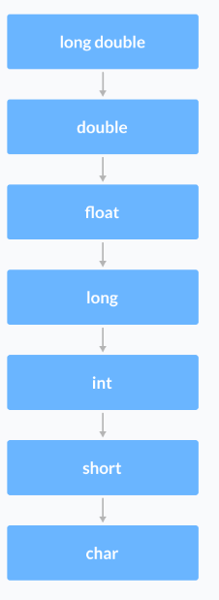
Modifier / Өөрчлөх (signed,unsigned,short,long)
Input / Output / Return
Conversation: (Type)Variable

Slide 5
Operators
Arithmetic Operators /Арифметик үйлдэлүүд
Assignment Operators / Суулгаж өгөх үйлдэлүүд
Relational Operators / Хамаарлы үйлдэлүүд
Logical Operators / Логик үйлдэлүүд
Bitwise Operators

Slide 6
Arithmetic Operators
+ | Addition
- | Subtraction
* | Multiplication
/ | Division
% | Modulo Operation (Remainder after division)
Float/int=float

Slide 7
Increment - Decrement / Өсөлт – бууралт (pre,post)
Assignment/Суулгаж өгөх
Operator | Example | Адил үйлдэл
= | a = b; | a = b;
+= | a += b; | a = a + b;
-= | a -= b; | a = a - b;
*= | a *= b; | a = a * b;
/= | a /= b; | a = a / b;
%= | a %= b; | a = a % b;

Slide 8
Relational Operators/Хамаарал
Operator | Meaning | Example
== | Is Equal To | 3 == 5 gives us false
!= | Not Equal To | 3 != 5 gives us true
> | Greater Than | 3 > 5 gives us false
< | Less Than | 3 < 5 gives us true
>= | Greater Than or Equal To | 3 >= 5 give us false
<= | Less Than or Equal To | 3 <= 5 gives us true

Slide 9
Logical Operators / Логик
Operator | Example | Meaning
&& | Өгөгдөл1 && Өгөгдөл2 | Logical AND. тэмдэгтийн 2 тал хоёуулаа үнэн тохиолдолд ҮНЭН
|| | Өгөгдөл1 || Өгөгдөл2 | Logical OR. ядаж нэг нь л үнэн байвал нийтдээ үнэн
! | ! Өгөгдөл | Logical NOT. үгүйсгэх.

Slide 10
Bitwise Operators
Operator | Description
& | Binary AND
| | Binary OR
^ | Binary XOR
~ | Binary One's Complement
<< | Binary Shift Left
>> | Binary Shift Right

Slide 11
Comment
Нэг мөрийг
Олон мөрийг
Тайлбар
Debuging

