Slide 1
SAML10 Low Power Touch

Slide 2
SAML10 Features
Core
Arm Cortex-M23 Core
32MHz (2.62 CoreMark/MHz and up to 31 DMIPS)
1.62-3.63V Operating Voltage
Memory
64/32/16KB Flash, 16/8/4KB SRAM, 2KB Data Flash
WLCSP Package Details
32 pin, 25 I/Os
.4mm lead pitch
2.79x2.79x.482 mm

Slide 3
SAML10 Low Power Features
Active, Idle, Standby with partial or full SRAM retention and off standby modes
Active mode (< 25 μA/MHz)
Idle mode (< 10 μA/MHz) with 1.5 μs wake-up time
Standby with Full SRAM Retention (0.5 μA) with 5.3 μs wake-up time
Off mode (< 100 nA)
Sleepwalking peripherals
Embedded Buck/LDO regulator with on-the-fly selection

Slide 4
SAML10 PTC Touch Controller
Up to 20 self, 100 mutual channels
Hardware noise filtering
Driven Shield Plus for moisture tolerance and noise immunity
Parallel Acquisition through Polarity control
Supports wake-up on touch from standby mode

Slide 5
SAML10 Xplained Pro
Integrated programmer/debugger
On board current measurement circuitry and interface
Xplained Pro headers for peripheral boards

Slide 6
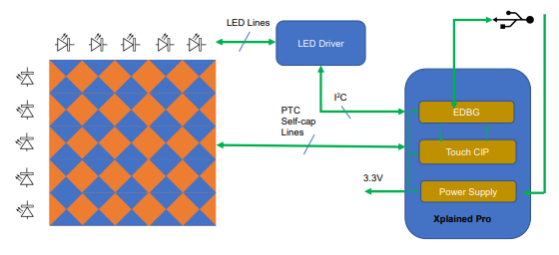
QT8 Xplained Pro - 2D Touch Sensor
5x5 2D Touch Surface Sensor and Driven Shield
Indicator LEDs for gesture visualization

Slide 7
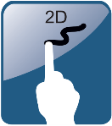



2D Touch Library Features
2D touch position decoding
Gesture decoding
1 finger touch coordinate detection
1 and 2 finger gesture detection

Slide 8










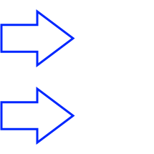





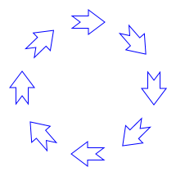



2D Touch Library Gestures
One finger
Two finger
Tap, tap and hold
Two finger tap, tap and hold
Double tap, palm detect
Two finger swipe, swipe and hold
Swipe, swipe and hold
Two finger edge swipe, swipe and hold
Edge swipe, swipe and hold
Pinch zoom in and zoom out
Touch wheel, CW and CCW
Two finger wheel, CW and CCW

Slide 9
SAML10 Touch Surface Low Power
CPU
16MHz internal oscillator, no DFLL
32KHz internal oscillator
3.3Vdc
Buch regulator during active, LPVREG in sleep
Active w/ 16MHz internal oscillator = 415uA avg
Sleep w/ 32mS auto-scan = 29uA avg
Adjustable inactivity timeout to enter low power standby mode
Adjustable touch drift period for environmental recalibration

Slide 10
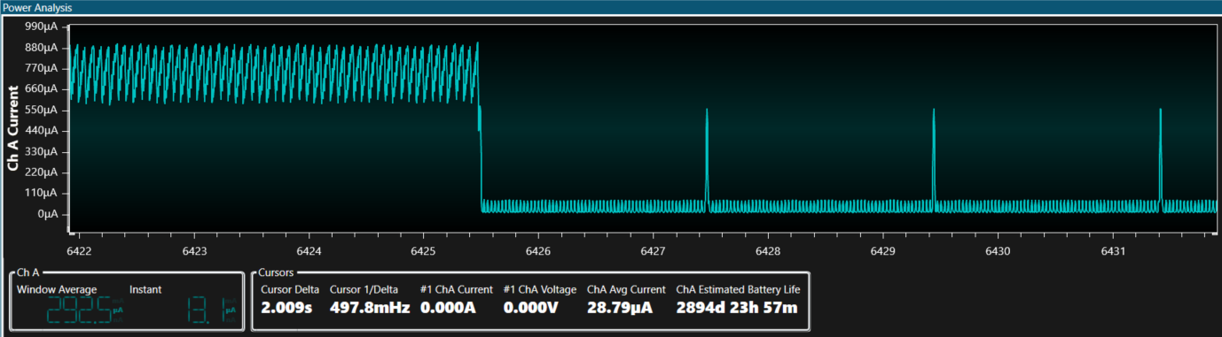
Touch Surface Standby Operation
Active Mode
Touch Timeout Event
Standby Auto-scan
Drift Calibration

Slide 11
Standby Auto-scan Power Comparison
Auto scan trigger period while in standby
QTM_AUTOSCAN_TRIGGER_PERIOD
Range: 8ms – 1024ms
@3.3Vdc

Slide 12
Drift Recalibration Power Comparison
Drift measurement period to wake and recalibrate reference values
DEF_TOUCH_DRIFT_PERIOD_MS
Range: 1 – 65535
32mS auto-scan rate
@3.3Vdc

Slide 13
Metal over Capacitive

