Slide 1







Software Developer Survey 2019 Analysis
Andrew Hayes
08/10/2023

Slide 2

INTRODUCTION
The report is an investigation on data given from over 90,000 individuals who are in software engineering, analysis the data to find in which software is increasing or declining in popularity. The data is taken from 2019 stack overflow developer survey, areas covered are.
Language
Database
Platform
Location
Gender

Slide 3

METHODOLOGY
Data was downloaded via API using python requests and processed in python pandas library.
Data visualization was done in matplotlib and
IBM Cognos and Watson studio

Slide 4
RESULTS
Programming Languages Trends Charts g.5
Programming Languages Finding p.12
Database Trends p.8
Database Findings. p.13
Popular Languages Salaries Chart p.7
Demographics Chart p.8
Current Software chart p.9
Future in Demand Software 10.
Skills required in jobs Posting Chart p.11
Current v future trends p.6

Slide 5
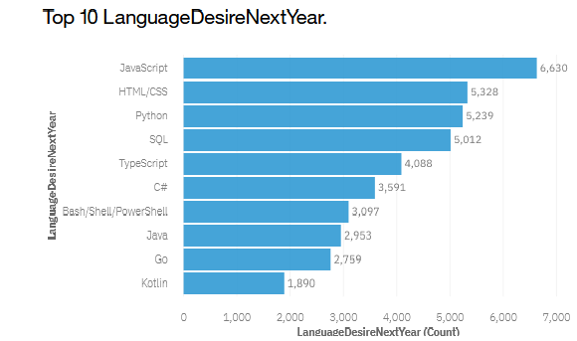
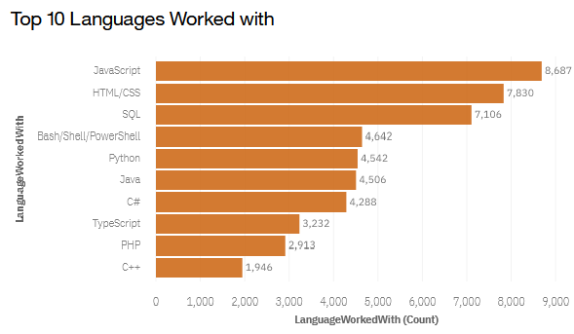
PROGRAMMING LANGUAGE TRENDS
Current Year
Next Year
<Bar chart of top 10 programming languages for the current year goes here.>
< Bar chart of top 10 programming languages for the next year goes here.>
Notes:
Go and kotlin in now in top 10 future
C++ ,php is out

Slide 6
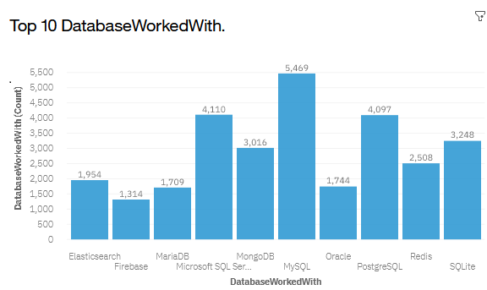
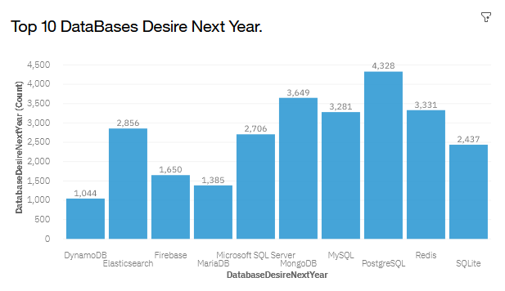
Current Database v Future Trends
Current Year
Next Year
< Bar chart of top 10 databases for the current year goes here >
< Bar chart of top 10 databases for the next year goes here.>
Notes:
Elastisearch increased a lot

Slide 7
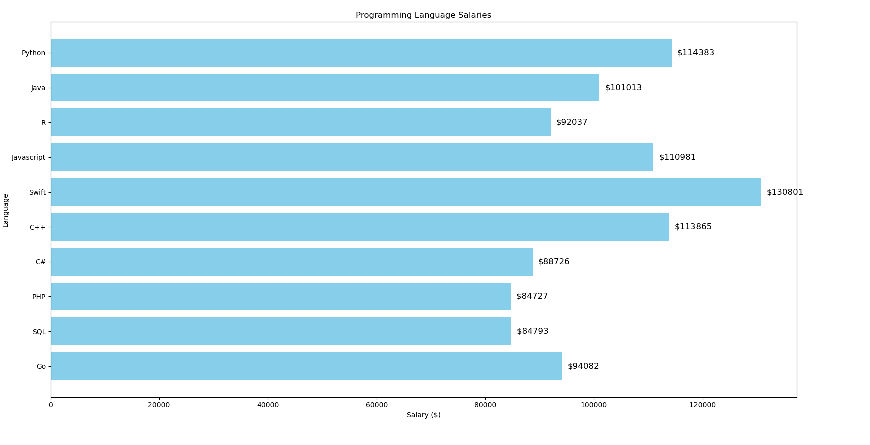
POPULAR LANGUAGES Salaries
In Module 1 you have collected the job postings data using web scraping in a file named “popular-languages.csv”. Present that data using a bar chart here. Order the bar chart in the descending order of salary.

Slide 8
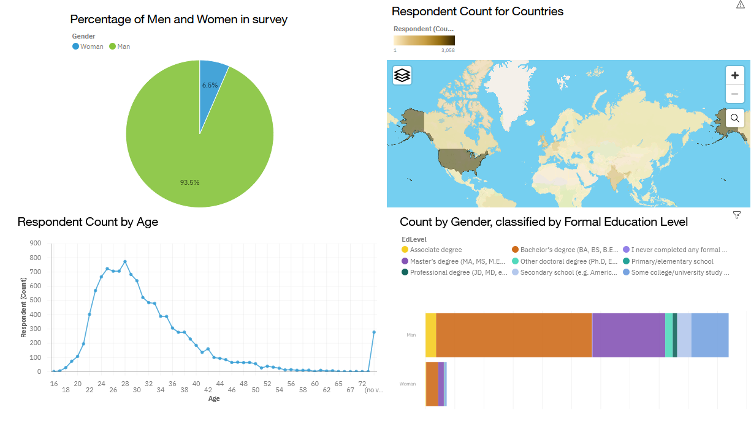
Demographics
Screenshot of dashboard tab 1 goes here

Slide 9
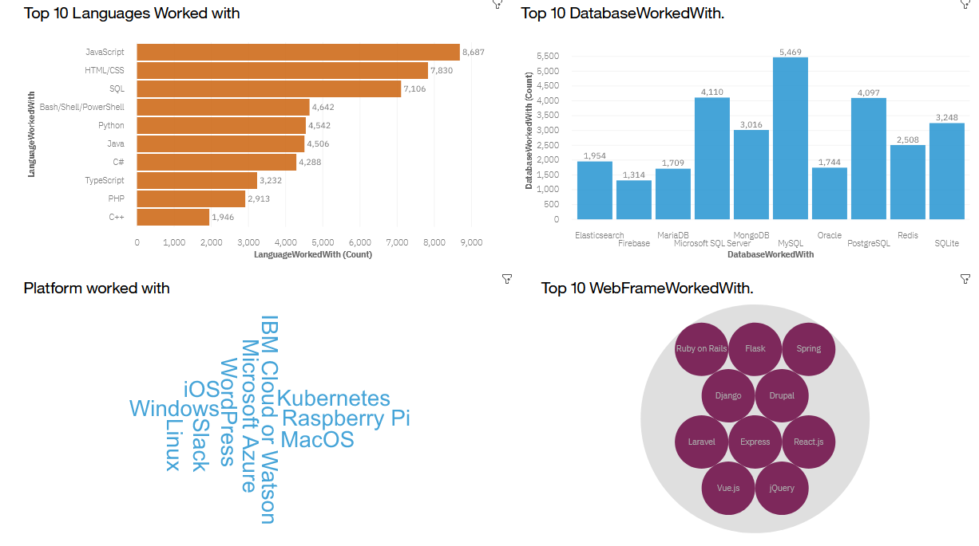
Current Software
Screenshot of dashboard tab 2 goes here

Slide 10
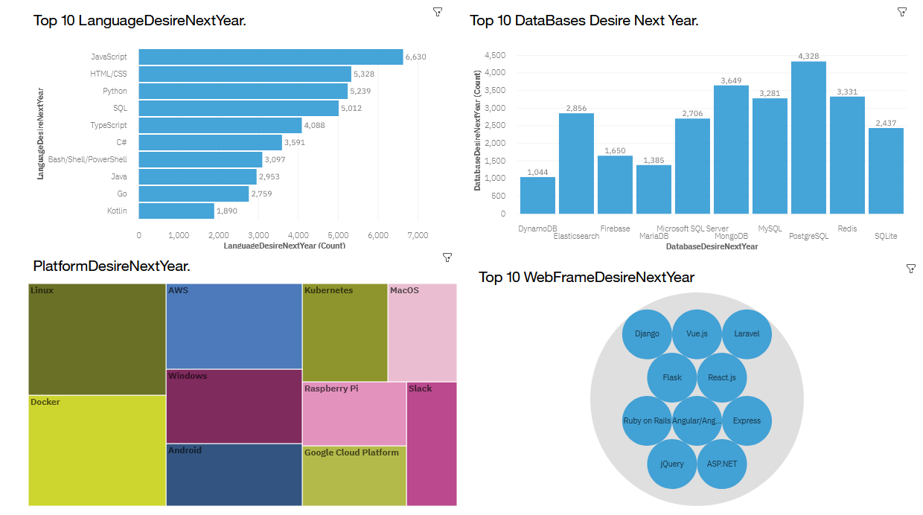
Future In Demand Software
Screenshot of dashboard tab 3 goes here
Notes:
Javascript skill number 1 language in demand
Postgres has overtaken MySql but this could be because Mysql was their first entry to SQL
Docker,Linus followed by AWS still in high demand

Slide 11
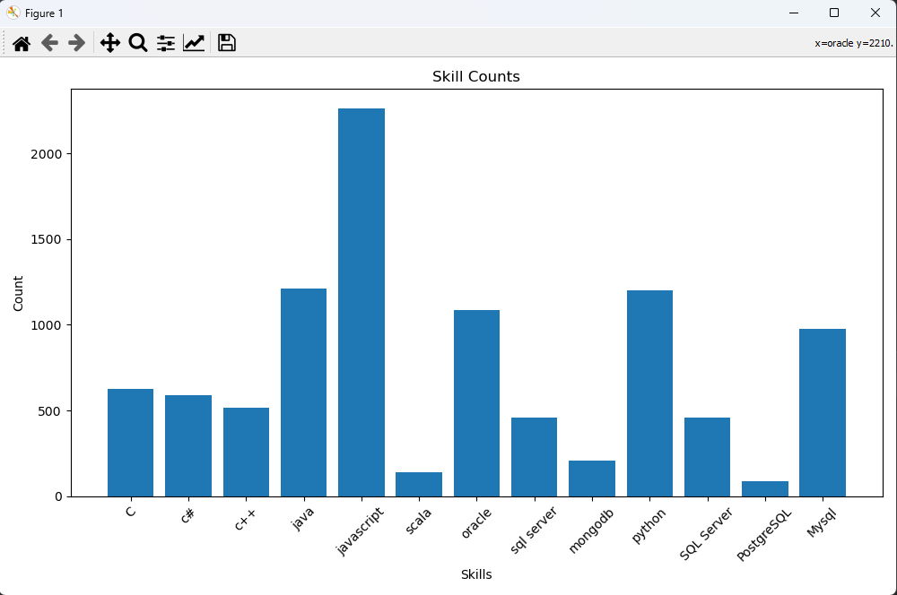
Skills required in Job Postings
In Module 1 you have collected the job posting data using Job API in a file named “job-postings.xlsx”. Present that data using a bar chart here. Order the bar chart in the descending order of the number of job postings.

Slide 12
PROGRAMMING LANGUAGE TRENDS - FINDINGS & IMPLICATIONS
Findings
JavaScript, html and CSS have stayed at the top.
Languages - C++ and replaced into 10 desired by go and Koltin.
Databases - Dynamodb on the rise and oracle dropped from top 10,demand more Elasticsearch more than doubled in demand, showing there's an increase in demand for NoSQL databases.
Iso has dropped from platforms and replaces by azure.
Implications
These Languages are still in high demand
Go has increased, possibly due to more demand for cloud services
Kotin is becoming a big player in mobile app development
C++ numbers dropping while Python increasing could indicate more data and general-purpose developers switching to python language

Slide 13
DATABASE TRENDS - FINDINGS & IMPLICATIONS
Findings
PostgreSQL is most in demand database language next year
Databases - DynamoDB is on the rise while Oracle has dropped from top 10. Demand for Elasticsearch has more than doubled.
ISO has dropped from platforms and replaces by azure
Implications
PostgreSQL is either growing in popularity or after learning MySQL first, developers then move onto PostgreSQL
Indicating there is an increase in demand for NoSQL databases
Azure popularity has grown

Slide 14

DASHBOARD
Interactive Dashboard
https://eu-de.dataplatform.cloud.ibm.com/dashboards/c6670be1-21fa-4c4a-8f92-9954d9a545b6/view/6721f5076ebe2df577edc8e407907d5074652d59e7bb830789807b490b347597f36e1194c82c4a5a8b165162a1b9470a9a

Slide 15
DISCUSSION
JavaScript stands out by far as skill required in job postings, followed by java, oracle, python and MySQL
Although not in the top 10, swift is the highest paid of skills
C++, Python and JavaScript remain the highest paid languages

Slide 16

CONCLUSION
JavaScript has remained at the top of the software pile.
A trend of less structured and more NoSQL databases is happening.
Young males dominate the software market.
USA employes the most software developers.

