Slide 1
AWS Isolated Environment
Running a sysadmin challenge lab in AWS

Slide 2
Business Problem
Need “challenge lab” for candidates
No cost to candidates
Easy to spinup / spindown
Leverage existing infrastructure for policy only
Deny egress to existing infrastructure for everything else!

Slide 3




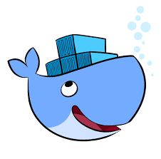
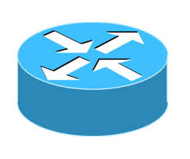
The “Challenge Lab”
CentOS
Windows
Ubuntu
Puppet
Docker
Networking
Test sysadmins on claimed technical proficiencies
Not really the point of our presentation…
...but a great way to talk about the general problem...
Spin up a virtual lab quickly, cost-effectively, and securely!

Slide 4
Our Hosting Options?
Candidate's systems? That implies cost, high bar to entry, difficult sharing.
On-premises? That implies we want the candidate anywhere near our network (not!)
Cloud? This sounds good – we can leverage standard screen-sharing and remove all cost from the candidate. So which cloud provider?
AWS is the Winner!!!
(We have a contract and $$ :)
See https://github.com/open-guides/og-aws

Slide 5
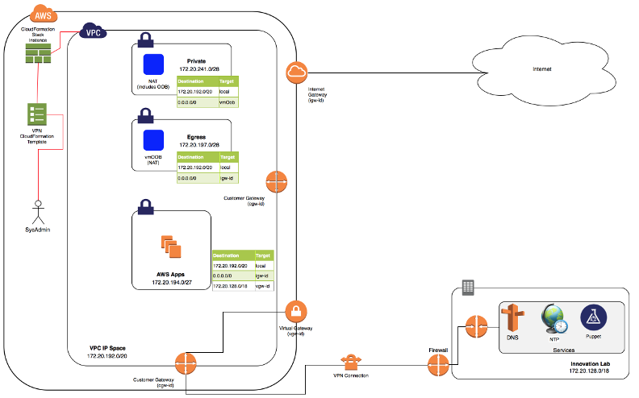
AWS Architecture

Slide 6
AWS Architecture - Notes
Assumes the existence of networking (and VPN connection) to on-premises environment.
A completely isolated network for the running VMs
Egress directly to the Internet for most things
For specialized services, we permit egress to our environment:
DNS – So that automation agents (Puppet) can locate policy masters (PuppetMaster)
NTP – Consistent time management
Puppet – The selected automation agent.
Now – how shall we build this??
AWS CloudFormation!

Slide 7

AWS CloudFormation
Automate creation of AWS resources
NOT a substitute for true orchestration: “CloudFormation is to orchestration like using a chainsaw to cut a wedding cake.”
Limitations and problems:
Can lag behind AWS capabilities (AWS::EC2::NatGateway)
Quota restrictions can stop an update in its tracks
Not every element can be named (e.g. SecurityAccess rule)
Upper limits on CloudFormation text (51,200 characters total)
See https://aws.amazon.com/cloudformation/faqs/

Slide 8
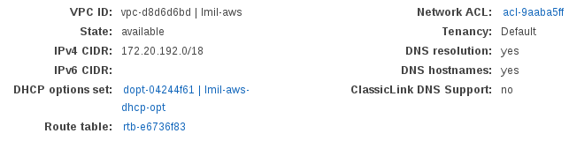
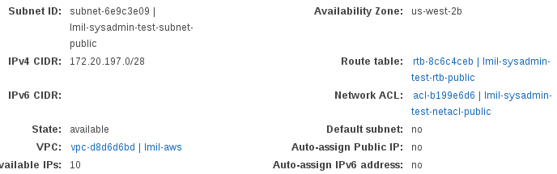
AWS Networking...
Tie into our existing Virtual Private Cloud (VPC)
Carve off subnets from the overall range.
Be sure to look at limitations when setting up a VPC!
http://docs.aws.amazon.com/general/latest/gr/aws_service_limits.html

Slide 9
Some S3 Storage...
Part of our challenge is network simulation.
We can store router configs and other data files on S3
How to access this data without putting in AWS credentials?

Slide 10
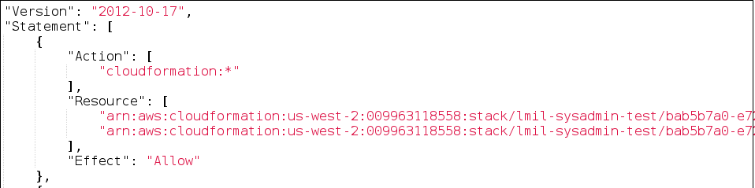
Instance Profiles
Permits access to AWS resources from running VMs
Assigned by the designer by creating and assigning a “role” to the VM during creation
See http://docs.aws.amazon.com/IAM/latest/UserGuide/id_roles_use_switch-role-ec2_instance-profiles.html
Requires AWS CLI to be available on the instance...

Slide 11
Let's AWS Script!
AWS CLI is your friend – used by you (the developer / admin) and by VMs within AWS
See https://aws.amazon.com/cli/ for details
Supports powerful 'jquery' processing on results to let you hone in on what you want
Also provides...our stepping stone into CloudFormation and automation.
A quick example: find the internal AWS ID used by our customer VPN gateway. Get the output in text, and be sure to trim any trailing whitespace / newline characters from it.
aws-cli ec2 describe-vpn-gateways \
--filter Name=tag:Name,Values=$AWS_VGW_NAME \
--query 'VpnGateways[].VpnGatewayId' --output text \
| sed -e 's#\s##g'
http://opensourceconnections.com/blog/2015/07/27/advanced-aws-cli-jmespath-query/

Slide 12
The CloudFormation Template
Describes each of the AWS elements
Permits use of replaceable parameters
Possible to build so many things...we use it to:
Create our underlying VPC
Manage developer-specific environments (create user with granular permissions, create subnets, routes and access control lists)
Handle changes between AWS versions
http://docs.aws.amazon.com/AWSCloudFormation/latest/UserGuide/best-practices.html

Slide 13
CloudFormation - Parameters
Can define a name, type, description, and default value.
Permits CloudFormation templates to be generic and reusable.
Somewhat limited (e.g. cannot get displayable list of KeyPair names).
"KeyName": {
"Type": "AWS::EC2::KeyPair::KeyName",
"Description": "Required: Specify your AWS EC2 Key Pair",
"Default": "aws-devenv-key"
},
http://docs.aws.amazon.com/AWSCloudFormation/latest/UserGuide/parameters-section-structure.html

Slide 14
CloudFormation - Mapping
Allows even more abstraction when defining elements.
We use it to handle “outdated” Amazon Machine Images (AMIs) and to select particular Linux versions for a specific Amazon “Region”
Example shows how we map Windows Server 2012 R2 AMIs for a set of AWS regions, with effective dates for the mapping.
"Mappings": {
"RegionToAmiW2K12R2": {
"ap-south-1": {
"20161123": "ami-79255216",
"20160914": "ami-f90f7b96"
},
"eu-west-2": {
"20161123": "ami-bb353fdf",
"20160914": "**N/A**"
},
…
"ImageId": {
"Fn::FindInMap": [
{ "Fn::FindInMap": [ "Parameters", "W2K12AmiMapName", "value" ] },
{ "Ref": "AWS::Region" },
{ "Fn::FindInMap": [ "Parameters", "W2K12AmiVersion", "value" ] }
]
},

Slide 15
CloudFormation – Auto-Scaling!
Permits you to define logical groups of VMs – and how many of each VM to create.
Great for building clustered solutions (think: Hadoop Data nodes)
AWS will take care of making sure that – if one node fails – another is started to keep the count.
"asasgUbuntu": {
"Type": "AWS::AutoScaling::AutoScalingGroup",
"Properties": {
"LaunchConfigurationName": { "Ref": "aslcUbuntu" },
"MinSize": "0",
"MaxSize": { "Ref": "InstanceCount" },
"AvailabilityZones": [ { "Fn::GetAtt": [ "subnetPrivate", "AvailabilityZone" ] } ],
"VPCZoneIdentifier": [ { "Ref": "subnetPrivate" } ],
"Tags": [
{ "Key": "Name", "Value": { "Fn::Join": [ "", [{ "Ref": "AWS::StackName" },"-asasgUbuntu"]]}, "PropagateAtLaunch": "true"}
],
"DesiredCapacity": "1"
},
"CreationPolicy": {
"ResourceSignal": {
"Count": { "Ref": "InstanceCount" },
"Timeout": { "Fn::FindInMap": [ "Parameters", "StackCreationTimeout", "default" ] }
}
},
"DependsOn": "aslcUbuntu"
}

Slide 16
CloudFormation – Cloud-Config!
Code which runs at startup for each VM.
Supported on every AMI I've ever used
Can be tied to CloudFormation Update (OOTB for AWS Linux, easy to install for others).
"UserData": { "Fn::Base64": { "Fn::Join": [ "", [
"#!/bin/bash -v\n",
"# boilerplate: install epel/pip, AWS CLI, and AWS CFN tools\n",
"echo install epel\n",
"l_rc=1; while [ $l_rc -ne 0 ]; do yum -y install epel-release; l_rc=$?; sleep 10; done\n",
"echo install pip\n",
"l_rc=1; while [ $l_rc -ne 0 ]; do yum -y install python-pip; l_rc=$?; sleep 10; done\n",
"echo install tools\n",
"/bin/easy_install --script-dir /opt/aws/bin https://s3.amazonaws.com/cloudformation-examples/aws-cfn-bootstrap-latest.tar.gz\n",
"yes | cp -f `pip show aws-cfn-bootstrap 2>/dev/null|grep -E \"^Location\"|awk -F: '{print $2}'`/init/redhat/cfn-hup /etc/init.d/\n",
"chmod 755 /etc/init.d/cfn-hup; chkconfig --add cfn-hup && chkconfig cfn-hup on\n",
"l_rc=1; while [ $l_rc -ne 0 ]; do yum -y groupinstall \"X Window System\"; l_rc=$?; sleep 10; done\n",
"/opt/aws/bin/cfn-init --stack ", { "Ref": "AWS::StackName" }, " --resource vmOob --region ", { "Ref": "AWS::Region" }, "\n"
]]}}

Slide 17
CloudFormation – Updates (1)
Multiple Layers:
Updates allowed / denied for the template as a whole
Updates for individual elements within the template – high degree of granularity
*New* elements added to a template and automatically created on AWS
Updates for *metadata* within an element (e.g. additional VM commands)
http://docs.aws.amazon.com/AWSCloudFormation/latest/APIReference/API_UpdateStack.html

Slide 18
CloudFormation – Updates (2)
Updates to VM metadata:
Changes to ‘UserData’ require instance to be recreated
Changes to AWS::CloudFormation::Init (“cfn-hup”) do not cause instance to be recreated.
The CentOS instance in the reference stack demonstrates how to create cfn-hup in a non-AWS Linux deployment.
http://docs.aws.amazon.com/AWSCloudFormation/latest/UserGuide/cfn-hup.html

Slide 19
More Information
Complete instructions on the github.com site
Demonstrates extensive usage of VM auto-configuration via UserData, AWS::CloudFormation::Init, and manual creation of “cfn-hup”
Thanks and Happy Computing!
https://github.com/andybrucenet/aws-env-sysadmin

