Slide 1
The Role of inventors in the patent application process
Andy Golden
11/8/3
golden@bu.edu

Slide 2
Two Messages
Patents aren’t commodities and weak patents can hurt you
You can significantly improve your patents with a little training

Slide 3
Talk Outline
Quick Patent Law Overview
2. How to Improve your Patent Applications

Slide 4
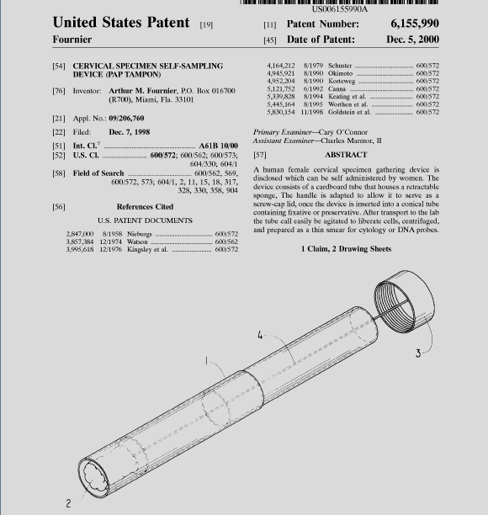
Patents Vary in Quality

Slide 5
Protecting Inventions
Trade Secrets (e.g. Coke’s secret recipe)
Patents
  Limited-Term monopoly in exchange for increasing the knowledge of society

Slide 6
Typical Patent-Based Business Strategies
Commercialize
License
Defensive Patent
Marketing Tool

Slide 7
7 Patent Laws
New
Non-obvious
Enabled
Prior Art disclosure
Best Mode disclosure
Patent provisional
Publishing before filing patent application
Reference: Patent Law Essentials, A. Durham

Slide 8
Sections of a Patent
General Information
Abstract
Claims (independent and dependent)
Figures
Specification (background, summary, example, detailed description, description of figures)

Slide 9
Outline
Quick Patent Law Overview
How to Improve your Patent Applications

Slide 10

Electric Hammer?
Picture copied from: http://www.bbc.co.uk/cult/simpsons/episodeguide/season10/page1.shtml

Slide 11
Constructing a Patent Application
Identify Points of Novelty
-Brainstorm!!
-Think about new aspects of preferred embodiment, design-arounds, and alternative embodiments
Mechanizing the hammer head
Generalize: mechanize any tool (i.e. power tools)
Consider Minor Aspects: Variable power settings
Alternate Embodiment: mechanized paper punch

Slide 12
Constructing a Patent Application
B. Prior Art Research
-Focus on points of novelty
-Do Literature and Patent Searches
-Send all Prior Art to Attorney
You find Mechanized Screw Drivers without Variable Power Settings

Slide 13
Constructing a Patent Application
C. Evaluate Points of Novelty
-Let Attorney Evaluate Prior Art unless it’s Obvious
-BU Patentability Opinion: Can I patent it? If yes, how broad/narrow are the points of novelty?
Can’t patent power tools because of prior art (power screw driver)
Can still patent mechanized hammer, mechanized paper punch, variable power settings for any power tool.

Slide 14
Constructing a Patent Application
D. Choose most valuable Point of Novelty
-All points of novelty should be included, but focus on most valuable.
-Considerations include: business value, patentability likelihood, strength in light of design-arounds.
You decide that mechanizing the hammer head is most valuable

Slide 15
Constructing a Patent Application
Write Patent Disclosure for Attorney
-Background
-Detailed Example
-Benefits
-Detailed Description of main embodiment of invention, with focus on chosen point of novelty
-Alternate Embodiments. Continue to Brainstorm!
-Points of Novelty. Continue to Brainstorm!
-Figures
-Prior Art

Slide 16
Constructing a Patent Application
Patent Attorney Begins Drafting Application
-Ask for Claims, Background first.

Slide 17
Constructing a Patent Application
Review Claims
-Are independent claims as broad as possible?
-Clarity? Grammar?
-Do dependent claims focus on most important aspects of invention?
-Are terms consistent, exact, and defined in specification?
-Are alternative embodiments claimed?
Note: Patent attorney probably will reorganize concepts and terms.

Slide 18
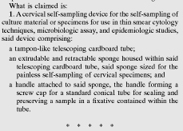
Constructing a Patent Application
G. Review Claims

Slide 19
Constructing a Patent Application
Review Entire Patent Application
-Is business value of invention clear?
-Are all the claimed ideas discussed in specification?
-Is specification as broad as possible, but focused on main embodiment(s)?
-Clarity? Grammar? Consistency?
-Are alternative embodiments discussed?
-Is anything claimed that is not true?

Slide 20
Constructing a Patent Application
I. All inventors review entire application and provide feedback.
Attorney files patent application.
Patent prosecution
Patent issues after about 1-3 years.

Slide 21
Protect Yourself
Notarize inventions
Keep track of inventorship
“That kills it!”
Use the phone
Encrypt confidential emails
Confidential footers on documents
Yellow highlighters

Slide 22
Protect Yourself
Post-it notes
May, might vs. must, will. Be wishy-washy.
Keep track and organize all documents that you get. Make copies of all legal documents that you send out for your files.
After patent issues, throw away rough drafts and handwritten notes, but keep the correspondence with the patent office.

