Slide 1
Canadian Wildfires and Their Effect on Air Quality in US Cities
Abbeer Wani, Andy Cherney, Kexin Shang, Robert Logovinsky

Slide 2
Team Introduction
Andy
Background in Data Science and Statistics
Statistical Inference, Modeling and Analysis
Focus on Data Collection
Kexin
Background in Data Science and Statistics
Statistical Inference, Modeling and Analysis
Focus on Cleaning and Structuring the Data
Abbeer
Background in Computer Science and Engineering
Analytical Foundation specializing in Arithmetic and Combinatorics
Focus on Data Visualization
Robert
Background in Data Analysis and IT Support
Adept at Project Management and Presentations
Focus on Organizing Workload, Creating the Presentation and Assisting team members as needed

Slide 3
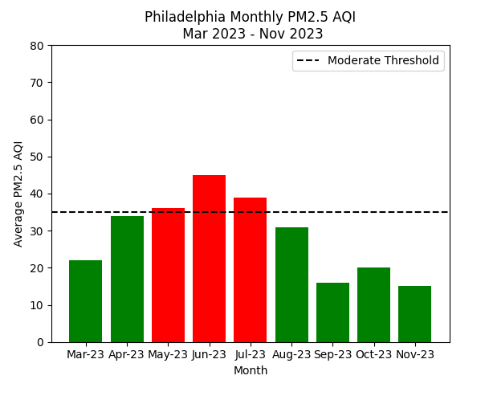
Purpose of Dataset
To help understand how the Canadian Wildfires affected Air Quality in US cities
Assessing the return to normal air quality levels post-wildfire containment

Slide 4
Potential Users and Applications
Environmental Researchers and Scientists
Understand broader impacts of wildfires on air quality.
Guide effective strategies for wildfire management, climate change mitigation efforts, and long-term environmental and ecological consequences.
Public Health Officials and Epidemiologists
Deal with the health impacts of air pollution on the population
Advising public health interventions, issuing warnings, and preparing healthcare systems for potential increases in respiratory and other health issues
Government Agencies and Policy Makers
Creating and implementing policies to mitigate the impact of wildfires on air quality
Shape regulations and allocate resources for emergency responses

Slide 5
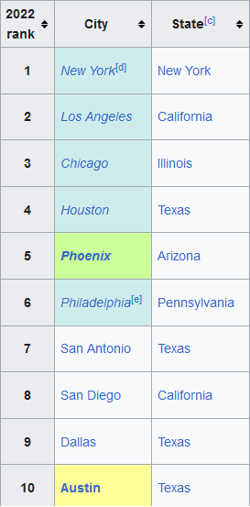
Source of Data And Acquisition
Scraped Wikipedia for Top 20 most populous US Cities
Initially attempted to use Open Weather, but rate limited or had to pay money for more data
Used two separate endpoints from Open-Meteo API to acquire weather data and air quality data

Slide 6
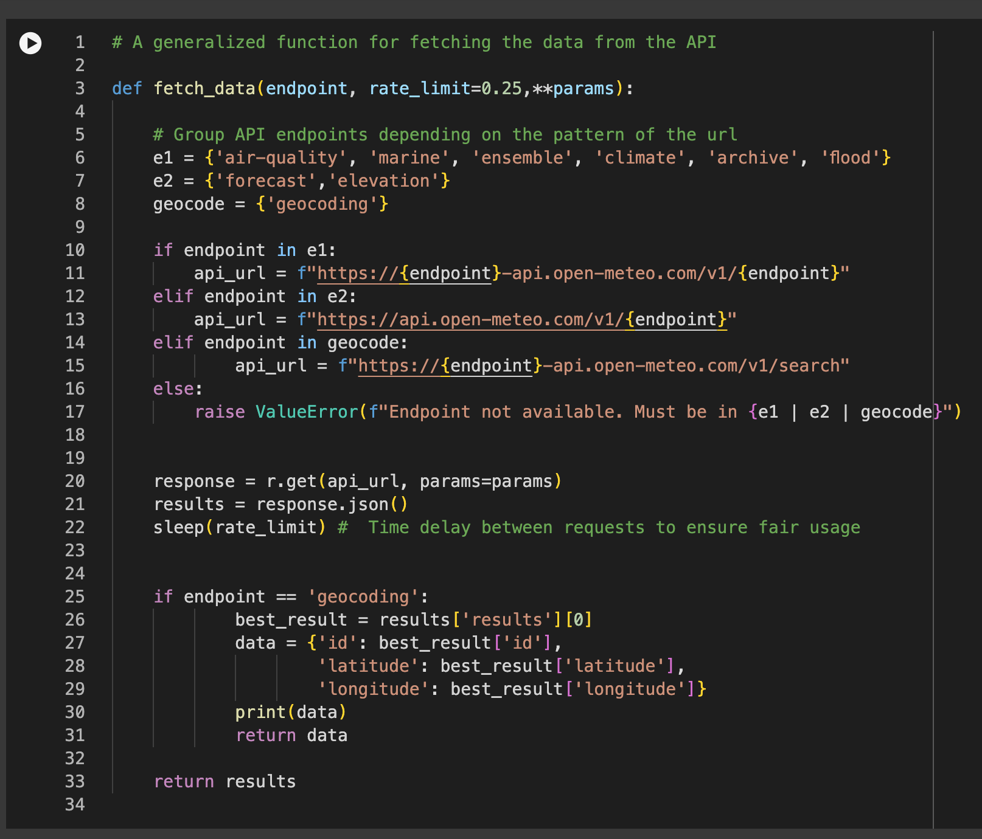
Fields Acquired
Temperature
Precipitation
Humidity
UV Index
Wind speed
AQI level by Pollutant level
PM 2.5 and PM 10
CO
Ozone

Slide 7
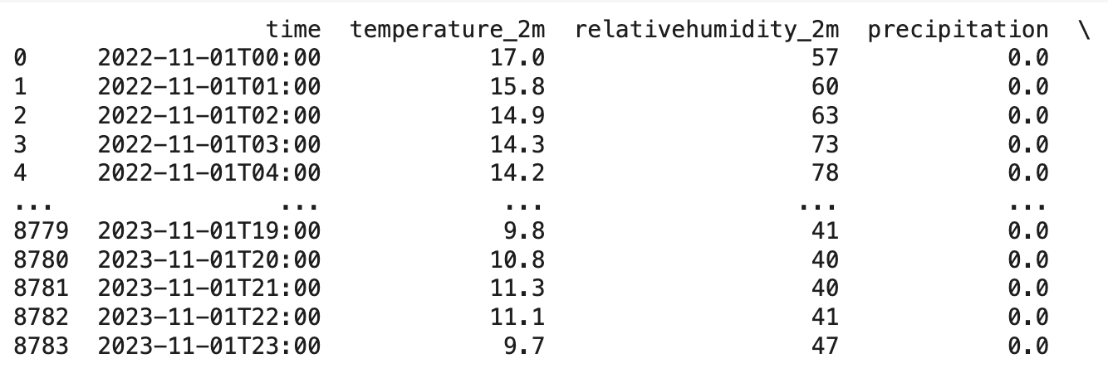
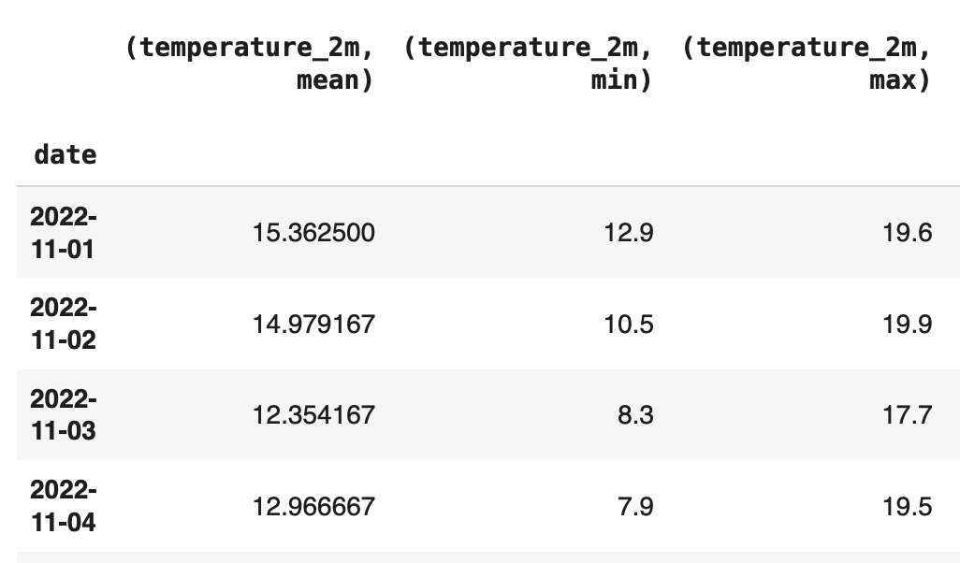
Approach to Preprocessing Data
<- data scraped from API
data after cleaning (NYC)
Data Organization Strategy
Nested JSON files with city as keys
Store historical data for a one-year span for each city, categorized by date and month in two separate dictionaries.

Slide 8
Cont. Approach to Preprocessing Data
Extract 'cityID' as the key to new dictionary by looping the whole data.
Use dt.to_peorid to parse the hourly time into two separate columns “date” and “month”.
Different preprocess of continuous and categorical variables:
Continuous: temperature, humidity, wind speed, ect. -> will calculate min, max and avg within one day or one month
Categorical: all the air quality index (pm 2.5, 03, and co) -> use pd.cut() to create 5 levels: from good to hazardous.
Daily Data Dictionary: group columns by “date”
Monthly Data Dictionary
Similar Structure but grouped by “month”
Facilitates a broader view and analysis of trends over each month.

Slide 9
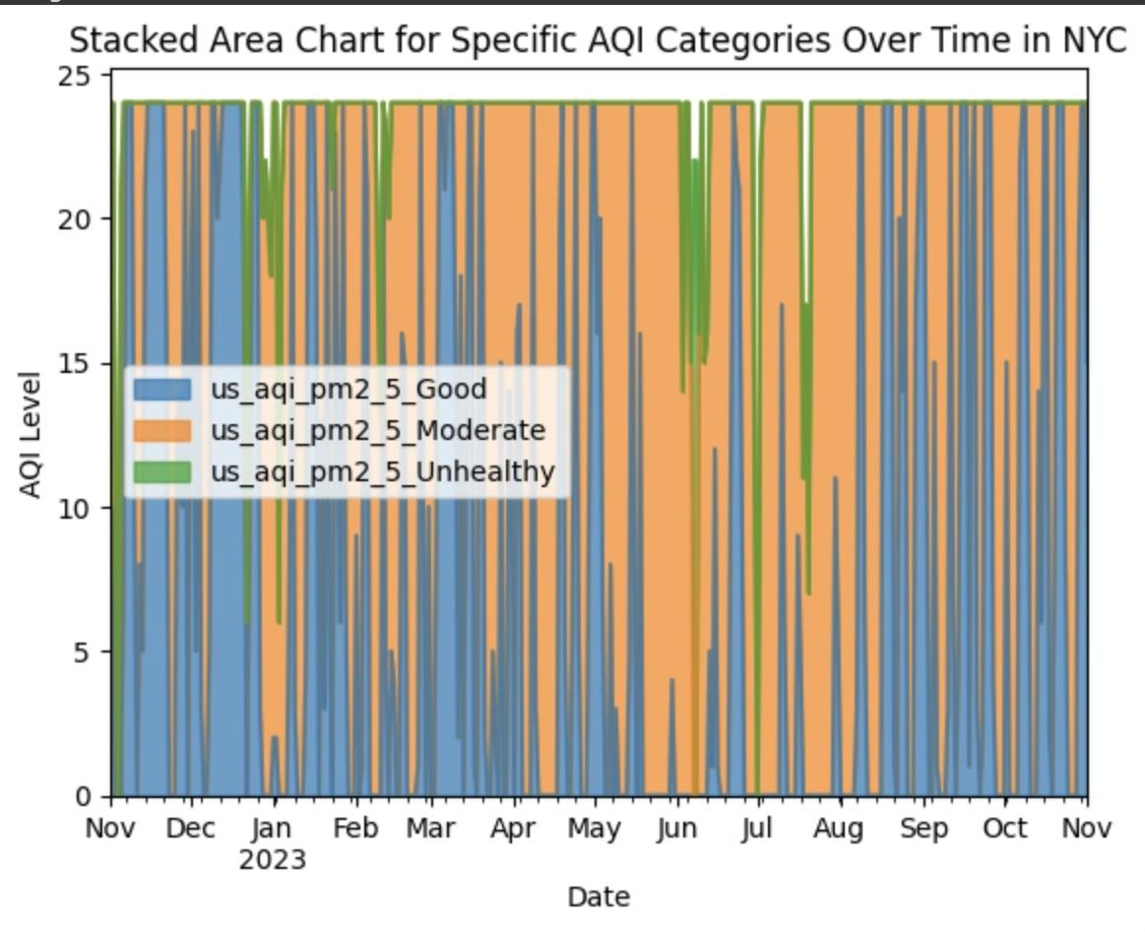
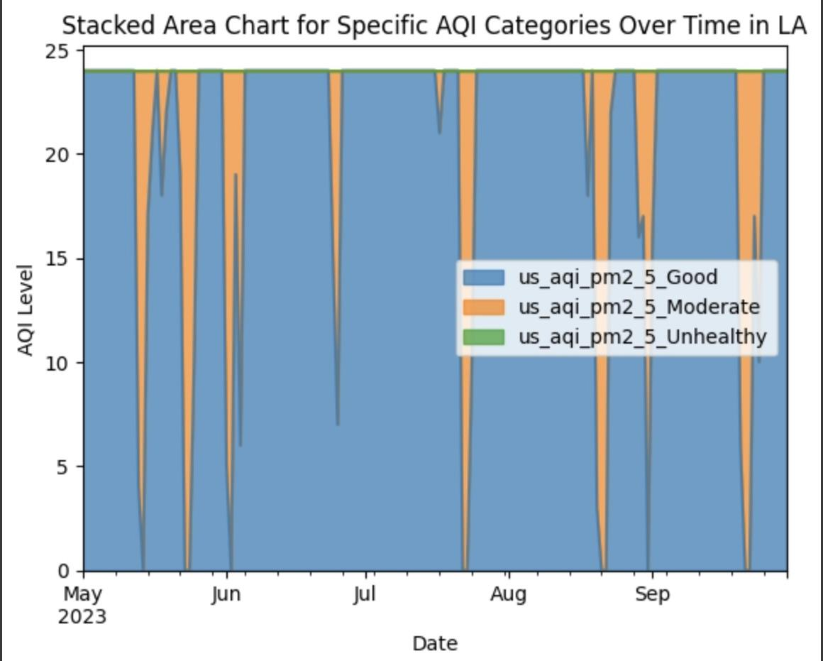
City AQI comparisons NYC vs LA

Slide 10
Distribution Approach
Share on GitHub and Kaggle
Other people can explore and expand
People can look into different cities using our model
Include proper licensure documentation from both Wikipedia and Open-Meteo
This would allow individuals to adhere to the Terms of Service for this data

Slide 11
Discussion of Access Rights
Open-Meteo & Wikipedia
CC BY 4.0 DEED license
Free for non-commercial use
Share & Adapt
Attribution
Share Alike (for Wikipedia)
No Additional Restrictions
GNU Free Documentation License
Copy, redistribute, and modify (except for "invariant sections") a work
Requires all copies and derivatives to be available under the same license

Slide 12
Issues and Limitations
Open-Weather was not usable causing us to pivot and find a different source
This allowed us to think about our project and hone in on the Canadian Wildfires
How accurate is the weather data coming from a free access API vs a paid one like Open-Weather?
Difficult to explain what is causing observed spikes or dips
Wildfire, seasonal variation, changes in activity patterns?
Hard for visuals alone to demonstrate causality

Slide 13
Questions

