Slide 1
Music: Vincent (Starry, Starry Night)
Composed & Performed by Don Mclean
V I N C E N T
VAN GOGH
(1853-1890)
Enjoy the paintings with the music and lyrics.
For the greatest impact and the most enjoyment,
please just let the slides advance
automatically in sync with the music.
You’ll definitely want your speakers turned on for this.
Now, press the space bar or mouse click to begin, then
sit back and let the show run itself.

Slide 2
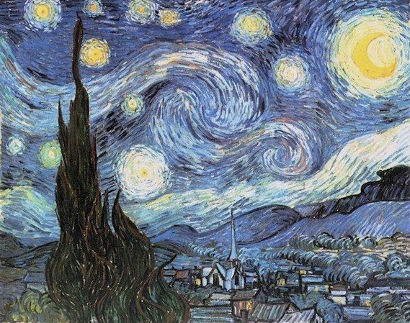

Starry, starry night,
paint your palette blue and grey.

Slide 3
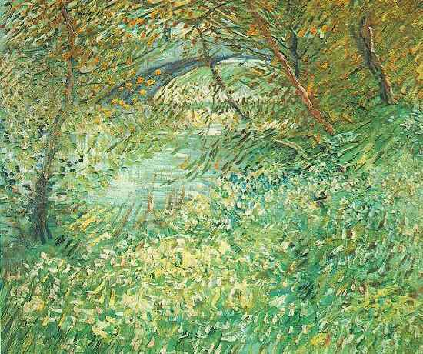
Look out on a summer's day

Slide 4
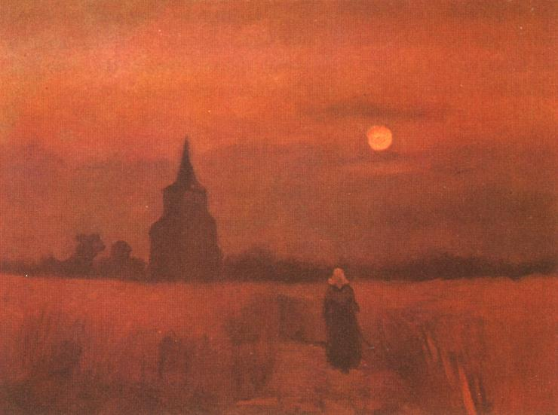
with eyes that know the darkness in my soul.
Shadows on the hills,

Slide 5
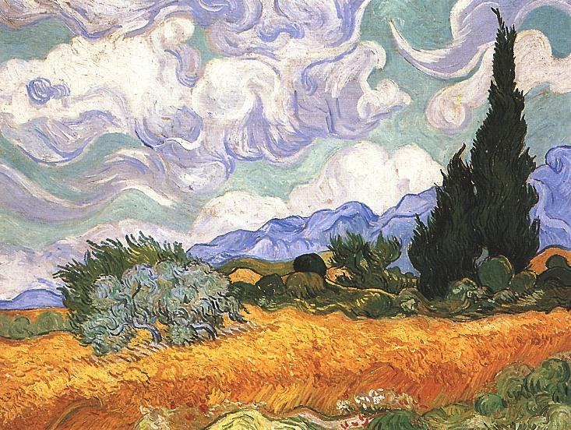
sketch the trees and the daffodils,
catch the breeze and the winter chills

Slide 6
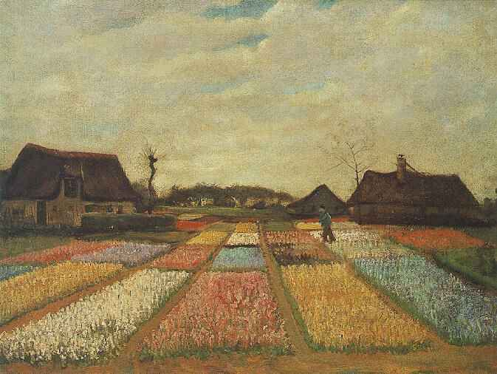
in colors on the snowy linen land.
Now I understand

Slide 7
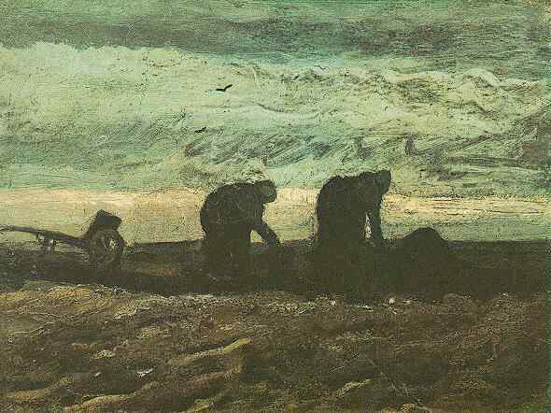
what you tried to say to me,

Slide 8
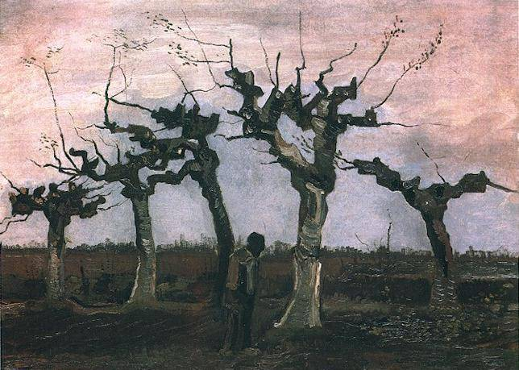
how you suffered for your sanity,
how you tried to set them free.

Slide 9
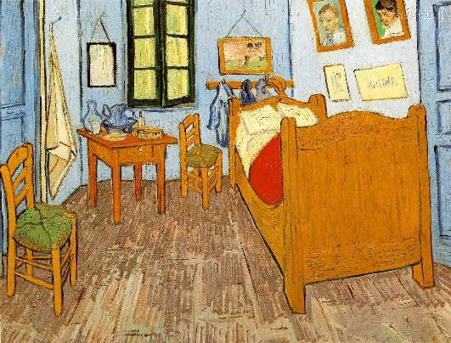
They would not listen,
they did not know how.

Slide 10
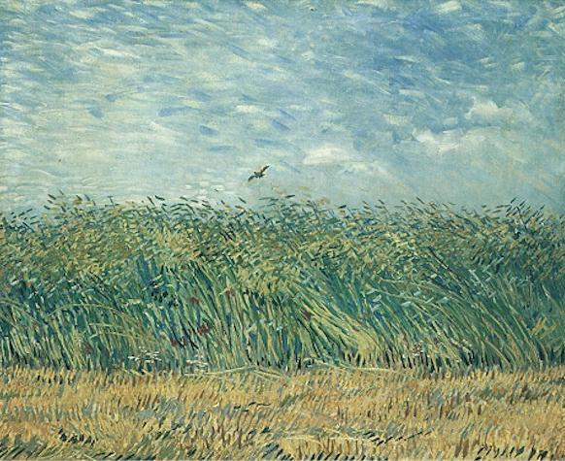
perhaps they'll listen now.

Slide 11
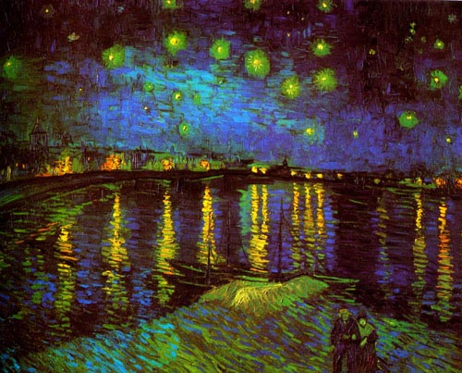
Starry, starry night,

Slide 12
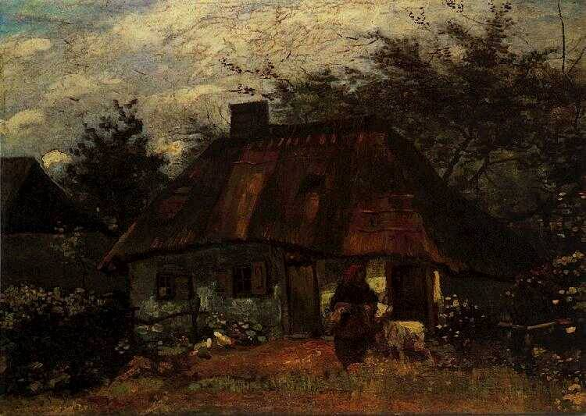
flaming flowers that brightly blaze,

Slide 13
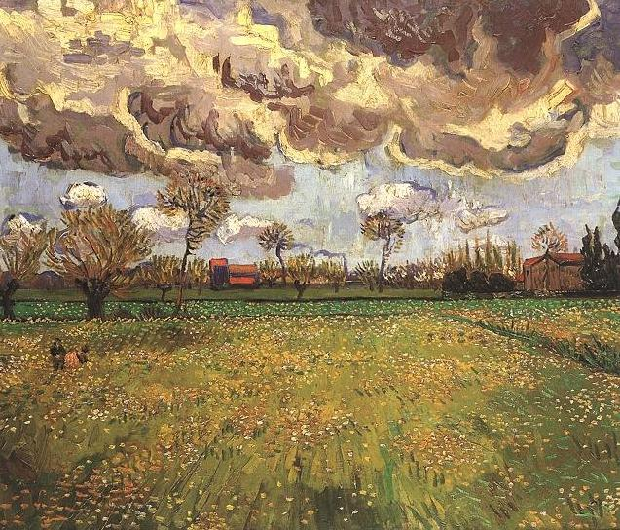
swirling clouds in violet haze
reflect in Vincent's eyes of China blue..

Slide 14
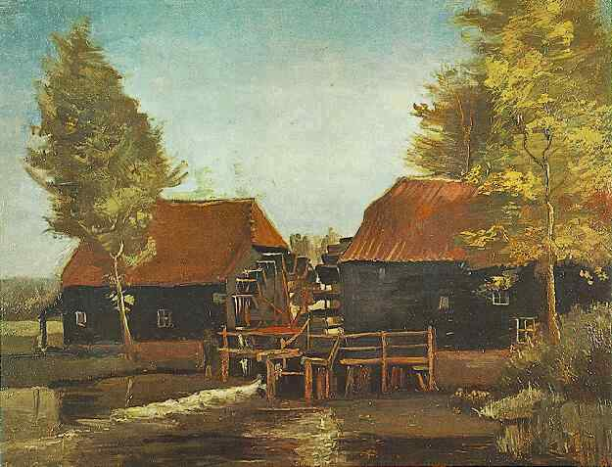
Colors changing hue,

Slide 15
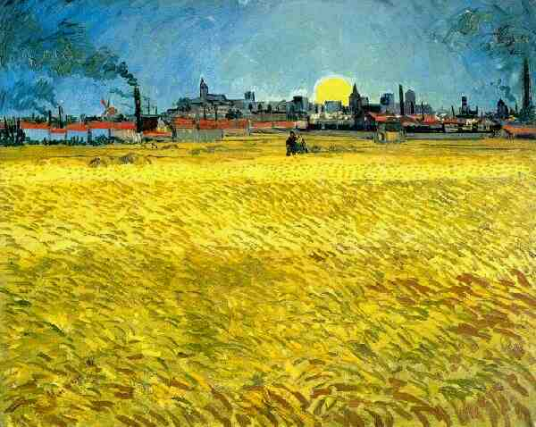
morning fields of amber grain,

Slide 16
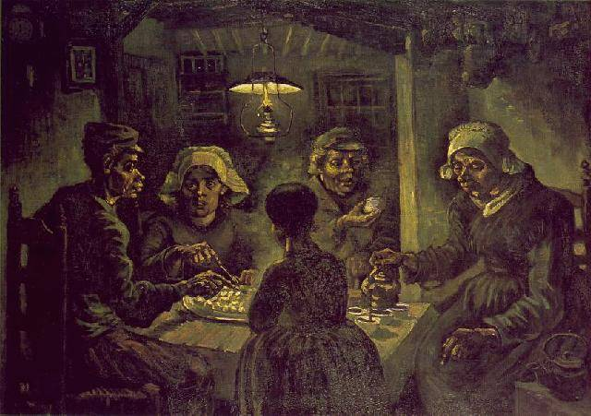
weathered faces lined in pain
are soothed beneath the artist's loving hand.

Slide 17
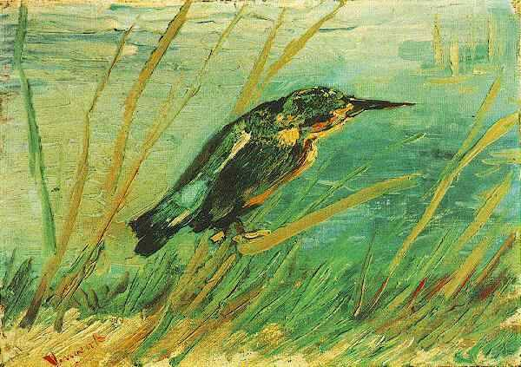
.
Now I understand

Slide 18
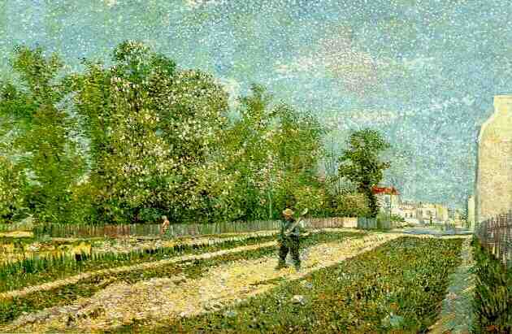
what you tried to say to me,
how you suffered for your sanity,
how you tried to set them free.

Slide 19
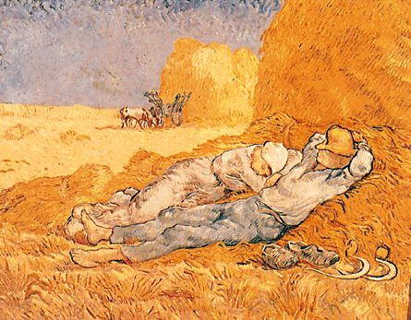
They would not listen.
They did not know how.
Perhaps they'll listen now.

Slide 20
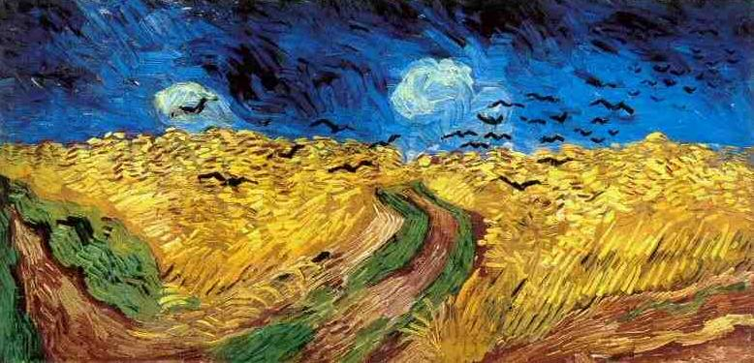
For they could not love you,

Slide 21
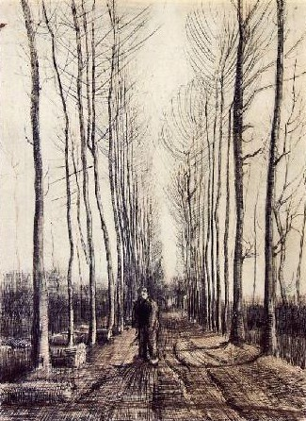
but still your love was true,
and when no hope
was left in sight
on that starry, starry night,

Slide 22
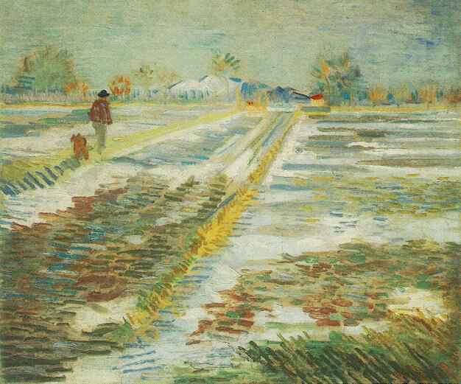
You took your life as lovers often do;
But I could have told you, Vincent,
this world was never meant
for one as beautiful as you.

Slide 23
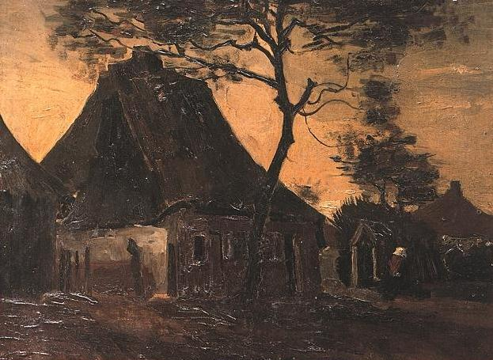
Starry, starry night,

Slide 24
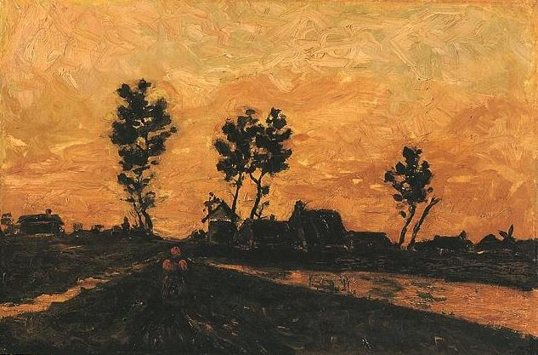
portraits hung in empty halls,

Slide 25
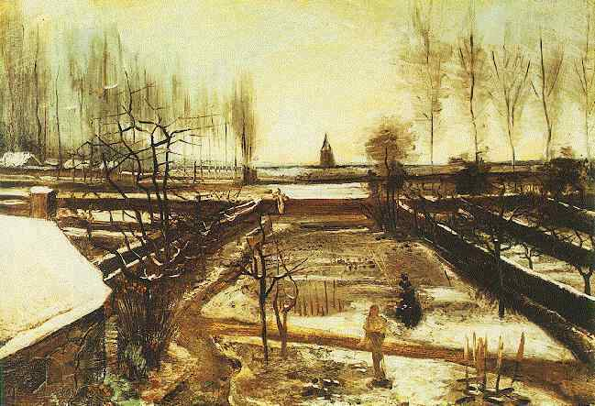
frameless heads on nameless walls,

Slide 26
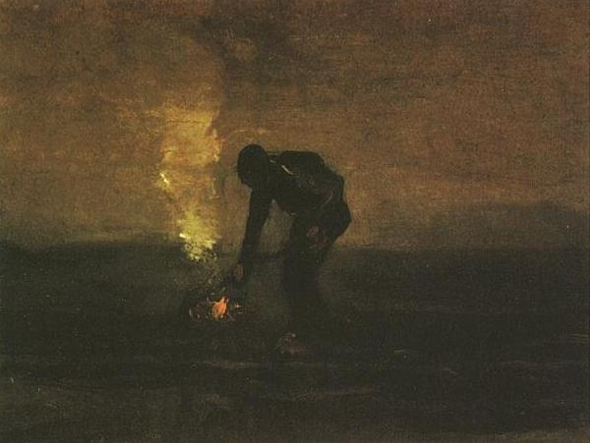
with eyes that watch the world and can't forget.
Like the strangers that you've met,

Slide 27
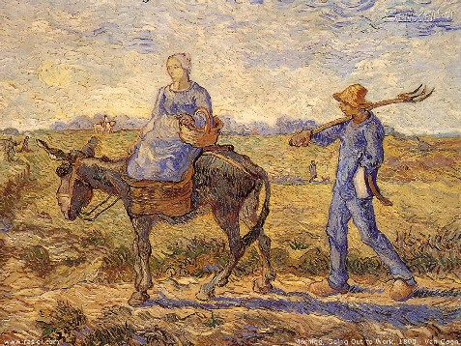
the ragged men in ragged clothes,

Slide 28
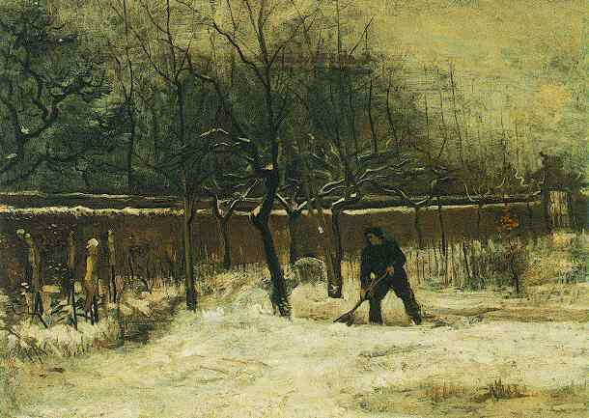
the silver thorn of bloody rose
lie crushed and broken on the virgin snow.

Slide 29
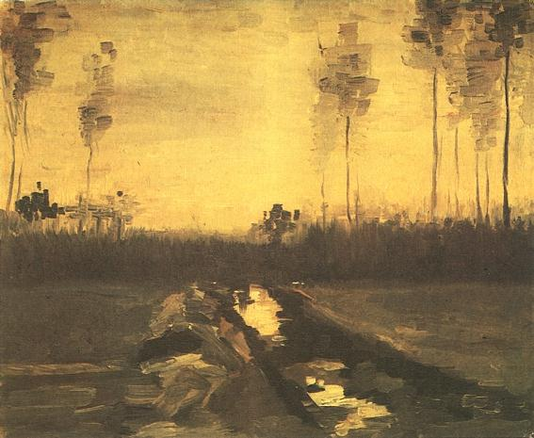
Now I think I know
what you tried to say to me,
how you suffered for your sanity,

Slide 30
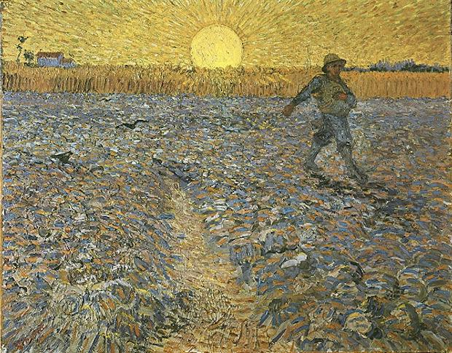
how you tried to set them free.
They would not listen.
They're not list’ning still.

Slide 31
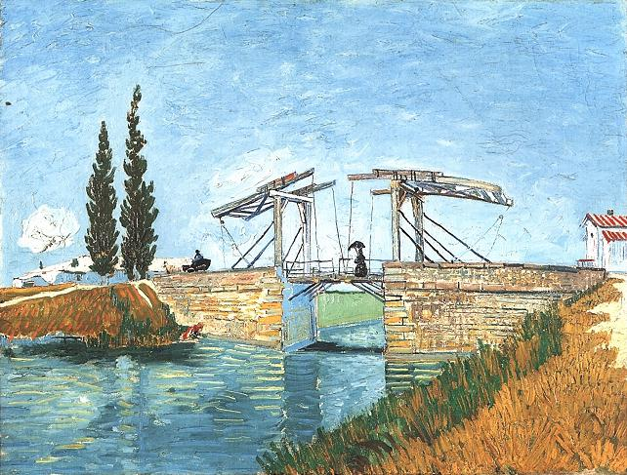
Perhaps,
they never will.

Slide 32
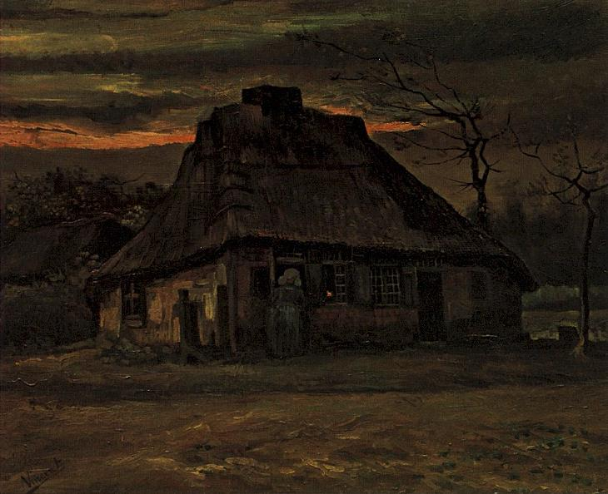
V I N C E N T
VANGOGH
I hope you enjoyed the show. Feel free to share it with others.

