Slide 1
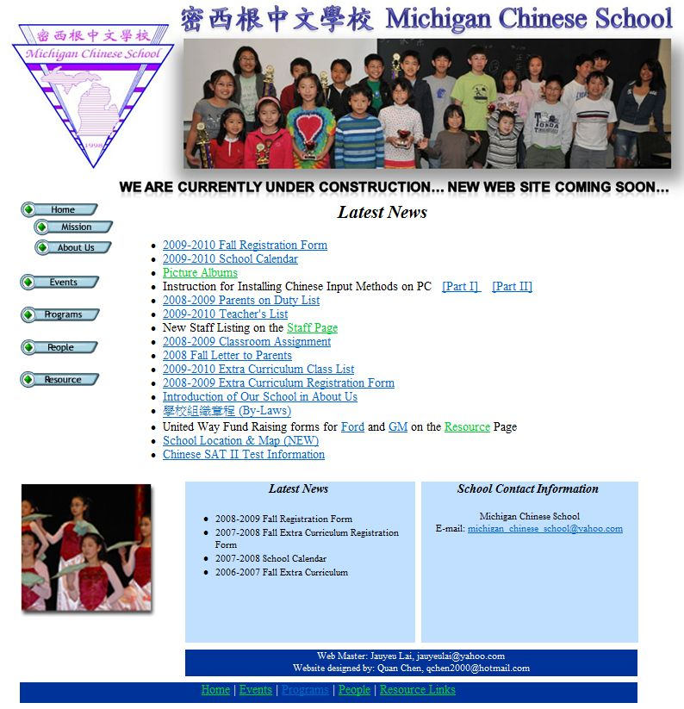
Move to “學習資源” as top list item
Move to “Hot Links” as fourth item
(2009~2010 data available later)
Move to “我們的師長”
Move to “Hot Links” as fifth item
(See the new “Letter to Parents”)
Move to “Hot Links” as sixth item (file forwarded)
Move to “課程介紹”
Move to “Hot Links” as second item
Move to “Hot Links” as last item
Move to “Hot Links” as seventh item
Move to “學習資源” as second item

Slide 2
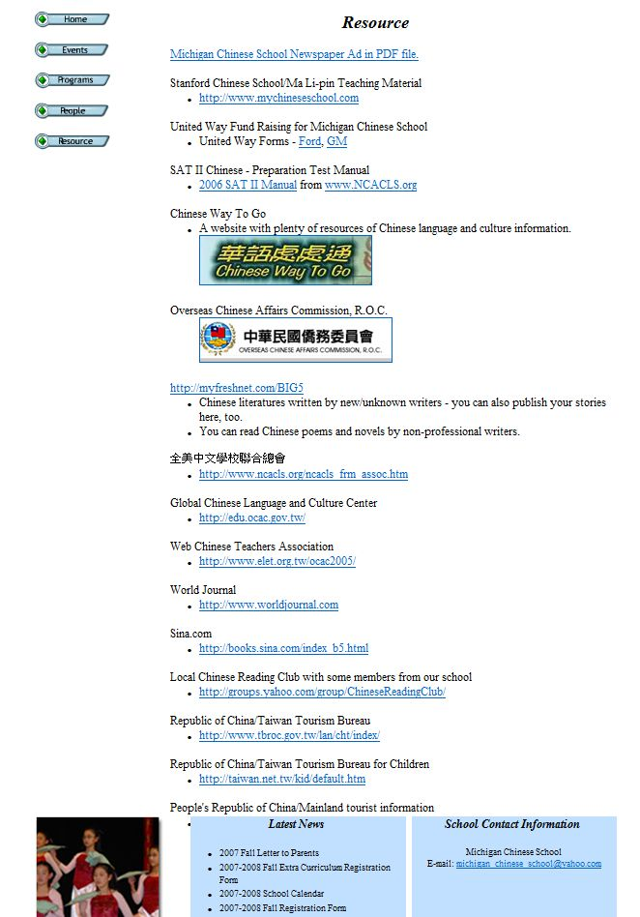
Remove
Remove
Remove

