Slide 1
Medical Imaging – CAMELYON 16
Andy Cho – yc2956
COMS 4995 – Applied Deep Learning
Professor Joshua Gordon
December 22, 2020

Slide 2
Motivation
1 in 12 breast cancer biopsies is misdiagnosed
False negatives are very dangerous (resulting in no treatment for cancer patients)
While doctors still diagnose the patients themselves, have an accurate DNN model that can assist with the doctor’s decisions
Images of cells with tumors - train with different patches within the same image to predict whether a patch has a tumor -> the cell has a tumor

Slide 3
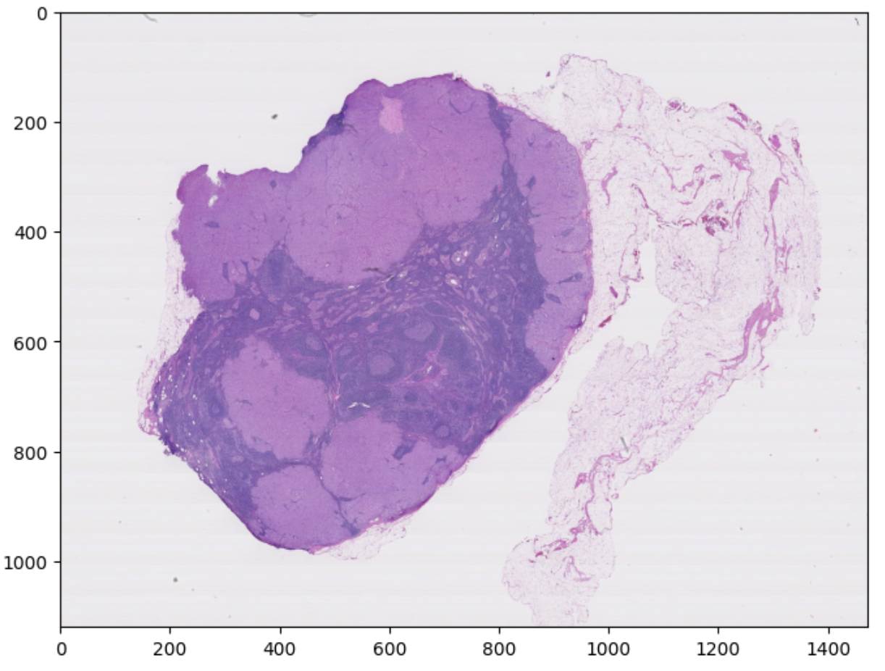
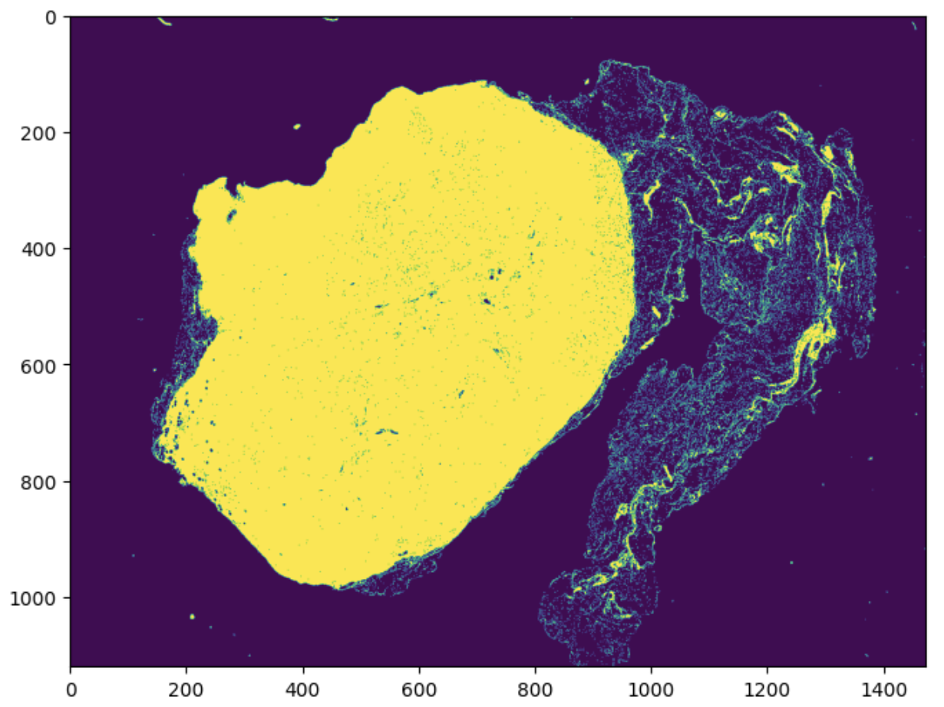
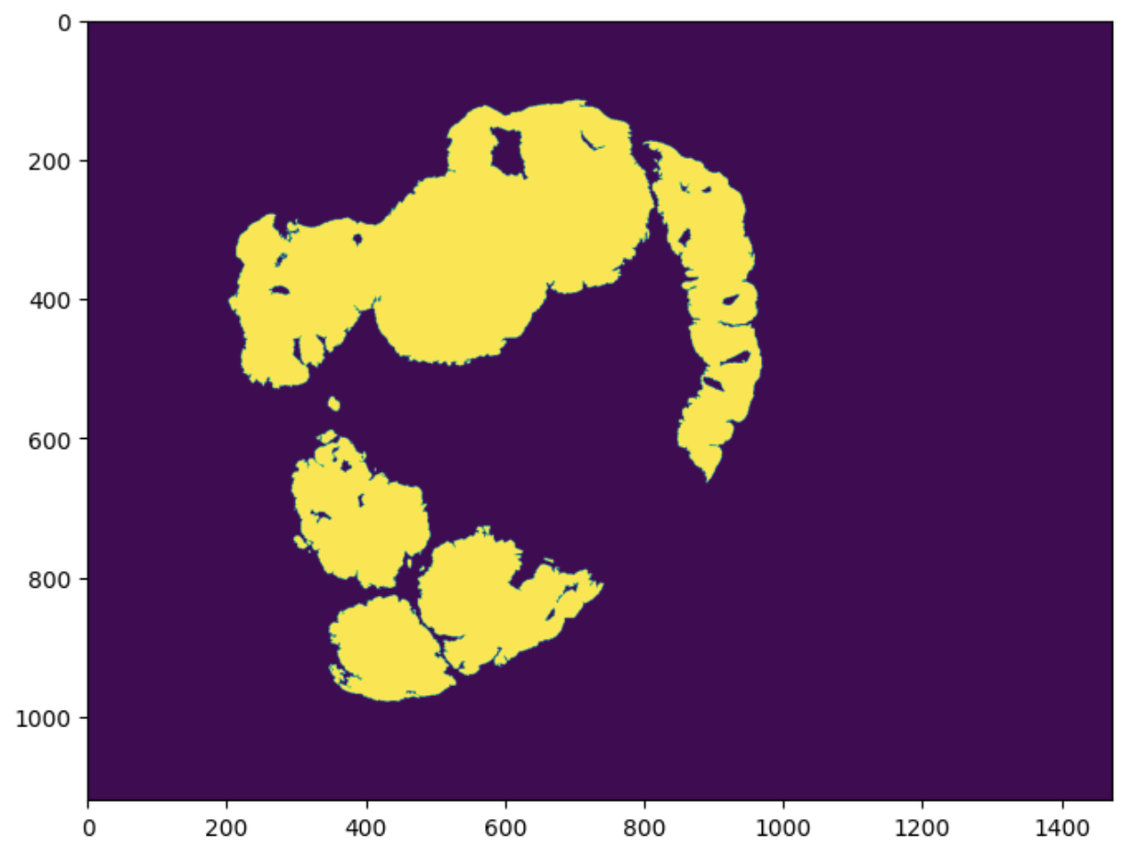
Data Processing
Each image has 9 different levels
Highest magnification has 100,000s of pixels on each axis, the lowest magnification has 100s of pixels
For the relevant magnification levels (with memory limitations) for each image:
Process the slide
Process the tissue mask (1 if there is tissue for the pixel, 0 else)
Process the tumor mask (1 if there is tumor for the pixel, 0 else)

Slide 4
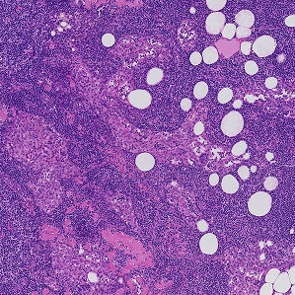
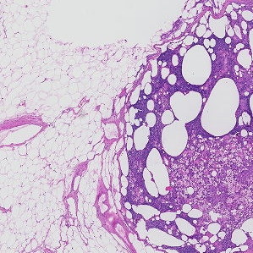
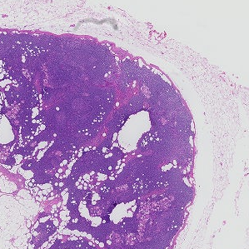
Data Processing - continued
Fetch the 299x299 patches from the slide
With the condition that at least 10% of the slide has tissues
Not necessary to fetch patches with no tissue
For each patch, we note if it has tumor or not (if the tumor patch has any 1s)
Ideally, we fetch as many patches as possible, but we limit by a multiplier
image.extract_patches_2d function from Scikit learn for extracting patches
ImageDataGenerator from Keras for training and testing datasets

Slide 5
Modeling
Due to memory limitations we trained 3 models with images from magnification levels 4,5, and 6
We tried transfer learning on ResNet50, and built from scratch using convolutional layer and max pooling
Transfer learning performed better
We also added 2 Dense layers and a final Dense layer with1 node (binary)
Combine the results from the 3 models, weighed by their individual validation accuracies

Slide 6
Model Prediction Examples

Slide 7
Model Prediction Examples - continued

Slide 8
Challenges
Memory Intensive Procedure with high-pixel images
Connecting with GCP VM for extra memory
Disk storage (Google Drive has 15GB)

Slide 9
Future Work
Due to limitation in disk storage, more data augmentation could definitely help
Random rotation
Hue
Contrast
Brightness
Transfer learning from different models (Inception models as in the paper)
Train with more computing power (multiple GPUs)
Train with highest magnification levels

