Slide 1
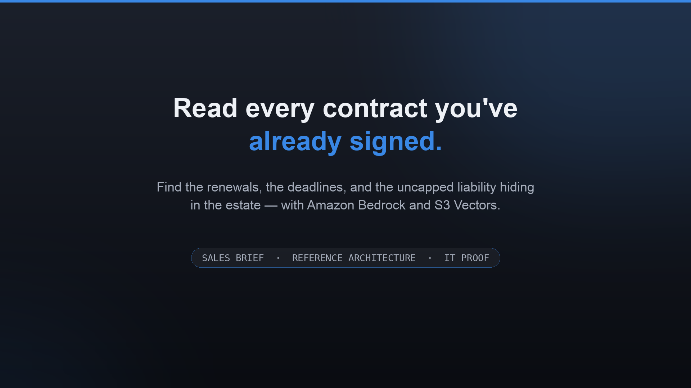
Notes:
Frame it for the room: this is one build with three audiences. For the buyer it's money and risk hiding in contracts you've already signed. For solution architects it's a clean AWS reference architecture. For IT it's data that never leaves your account, graded accuracy, and a cost of about a dollar. We'll go through all three.

Slide 2
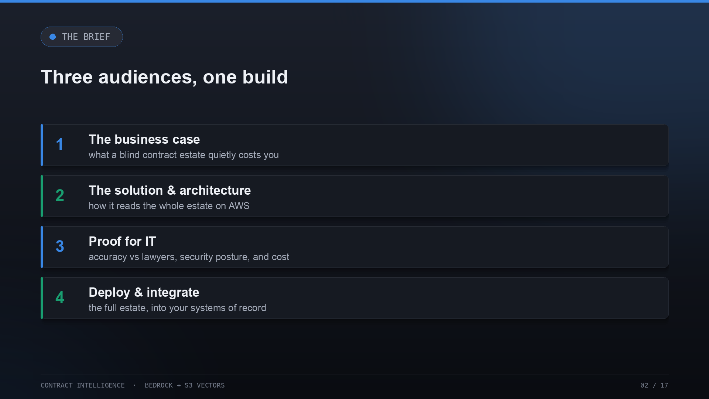
Notes:
Three acts. First the business case — what a blind estate quietly costs. Then the solution and the architecture, in enough detail for your SAs to sketch it. Then the proof IT needs — accuracy, security, and cost. And we close on how it deploys into your environment and integrates with your systems of record.

Slide 3
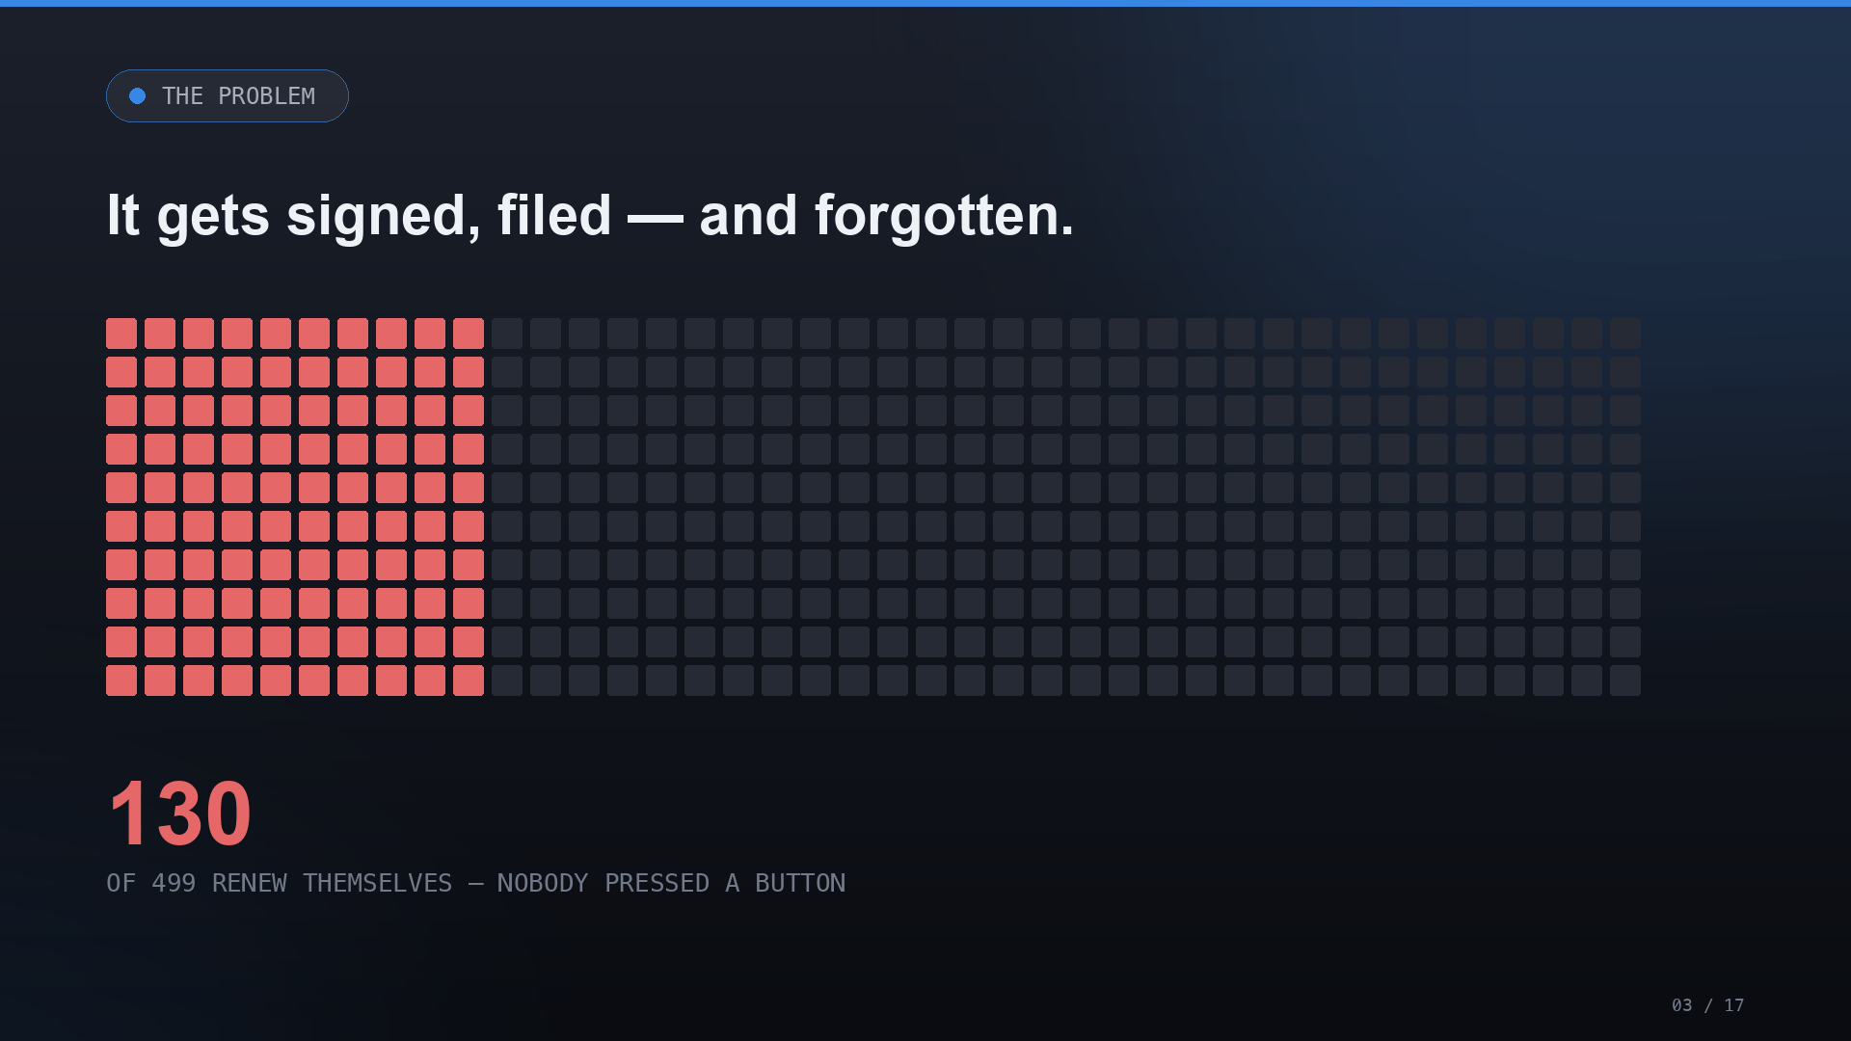
Notes:
Every square is a real agreement filed with the SEC. 130 of these 499 renew automatically — nobody presses a button, nobody signs anything, the term just rolls over and the invoice arrives. This is the pain: obligations that act on their own, on an estate nobody has time to re-read.

Slide 4
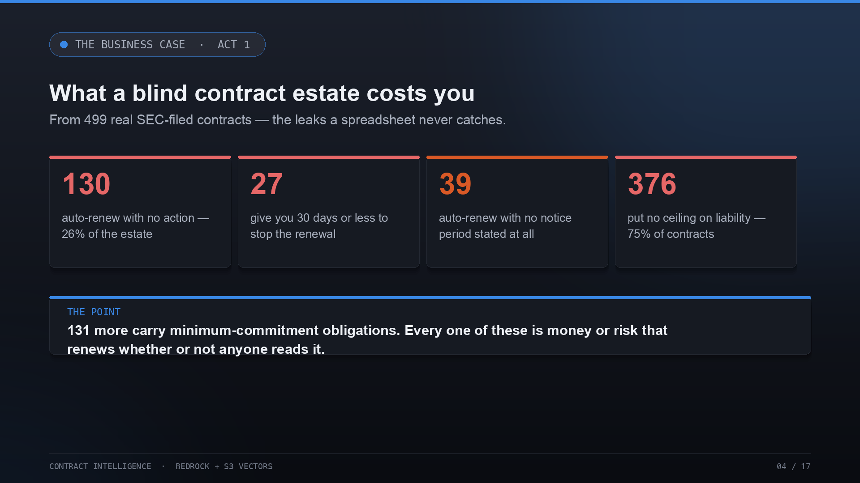
Notes:
Put numbers on it. 130 auto-renew. Of those, 27 give you 30 days or less to stop it, and 39 state no notice period at all — so you can't even tell when the window closes. 376 of the 499 — three quarters — put no ceiling on liability. And 131 carry minimum-commitment obligations. This is money and risk renewing whether or not anyone reads it.

Slide 5
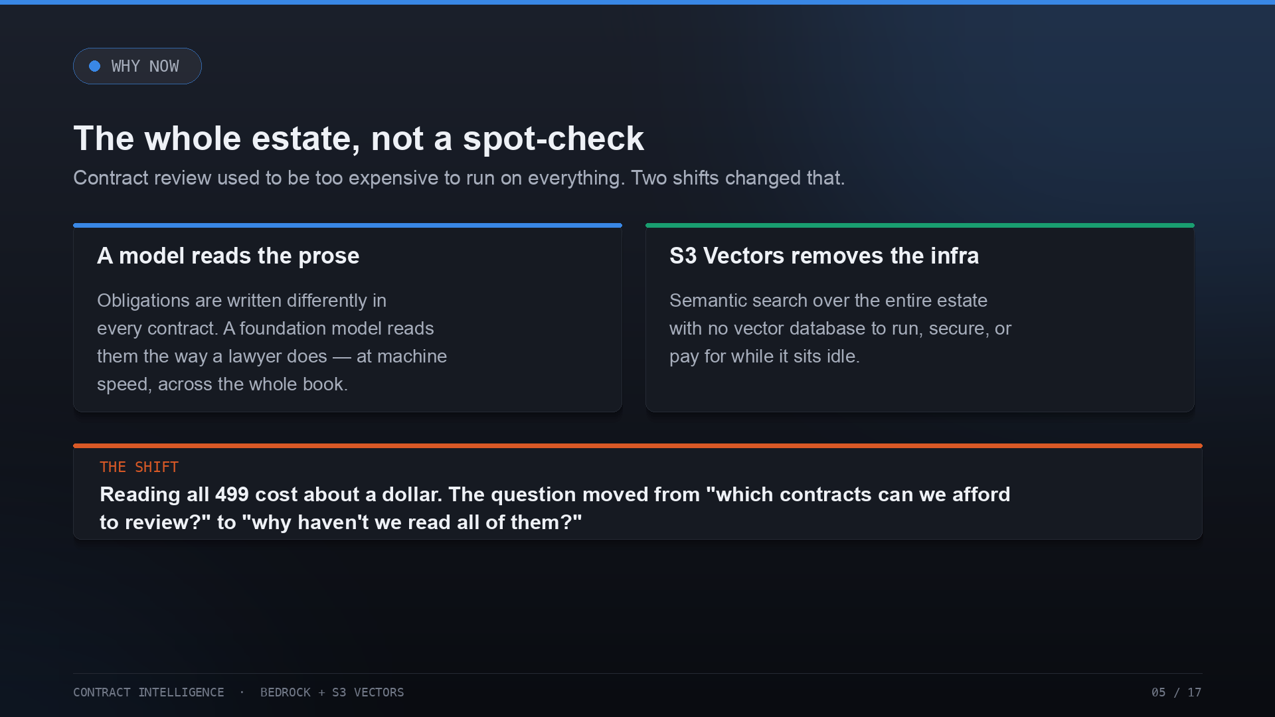
Notes:
Why is now the moment? Two things changed. A foundation model reads legal prose the way a lawyer does, so obligations written differently in every contract can finally be read at machine speed. And S3 Vectors removes the infrastructure — semantic search over the whole estate with no vector database to run. Together they drop the cost enough to read everything, not just spot-check.

Slide 6
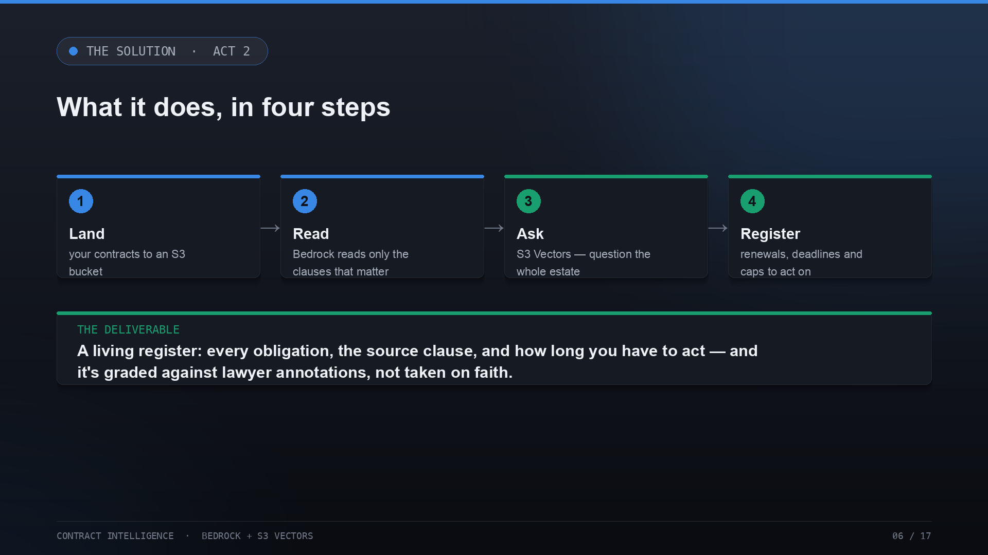
Notes:
The build is four steps. Land the contracts in S3. Read them with Bedrock — but only the clauses that matter. Ask the whole estate a question through S3 Vectors. And produce the register: every obligation, the source clause, and how long you have to act. The register is the deliverable, and it's graded against lawyers, not taken on faith.

Slide 7
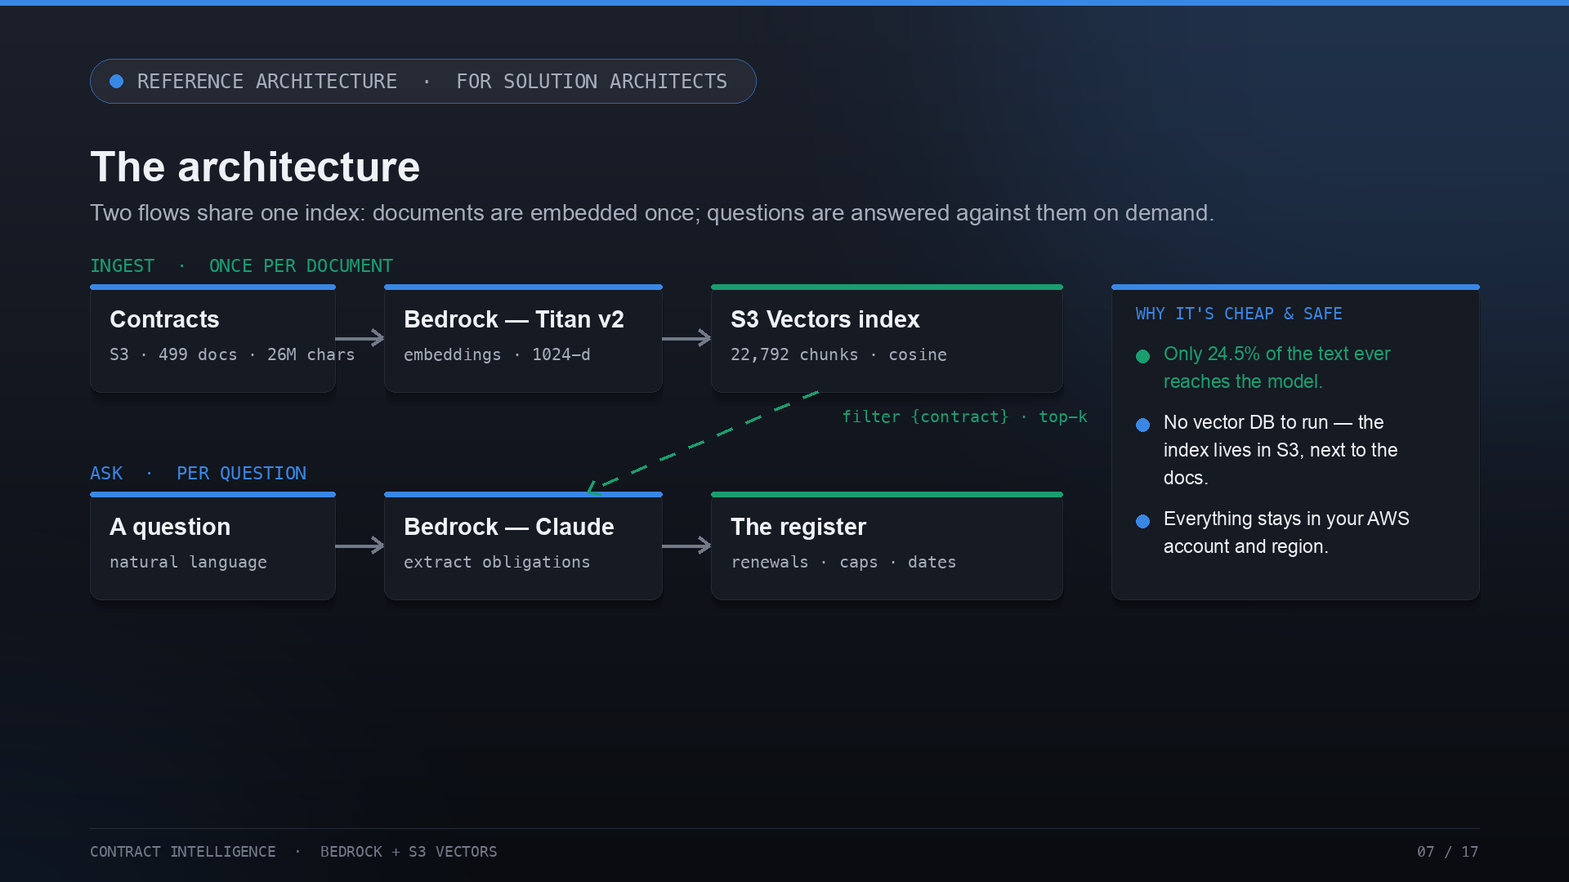
Notes:
Here's the architecture your SAs will want. Two flows share one index. Ingest, once per document: contracts in S3, embedded by Bedrock Titan v2 into 1024-dimension vectors, indexed in S3 Vectors — 22,792 chunks, cosine distance. Ask, per question: a natural-language question retrieves the top-k clauses from that index with a metadata filter scoped to the contract, Bedrock Claude extracts the obligations, and they land in the register. The key: only 24.5% of the text ever reaches the model, there's no vector database to run, and it all stays in your account.

Slide 8
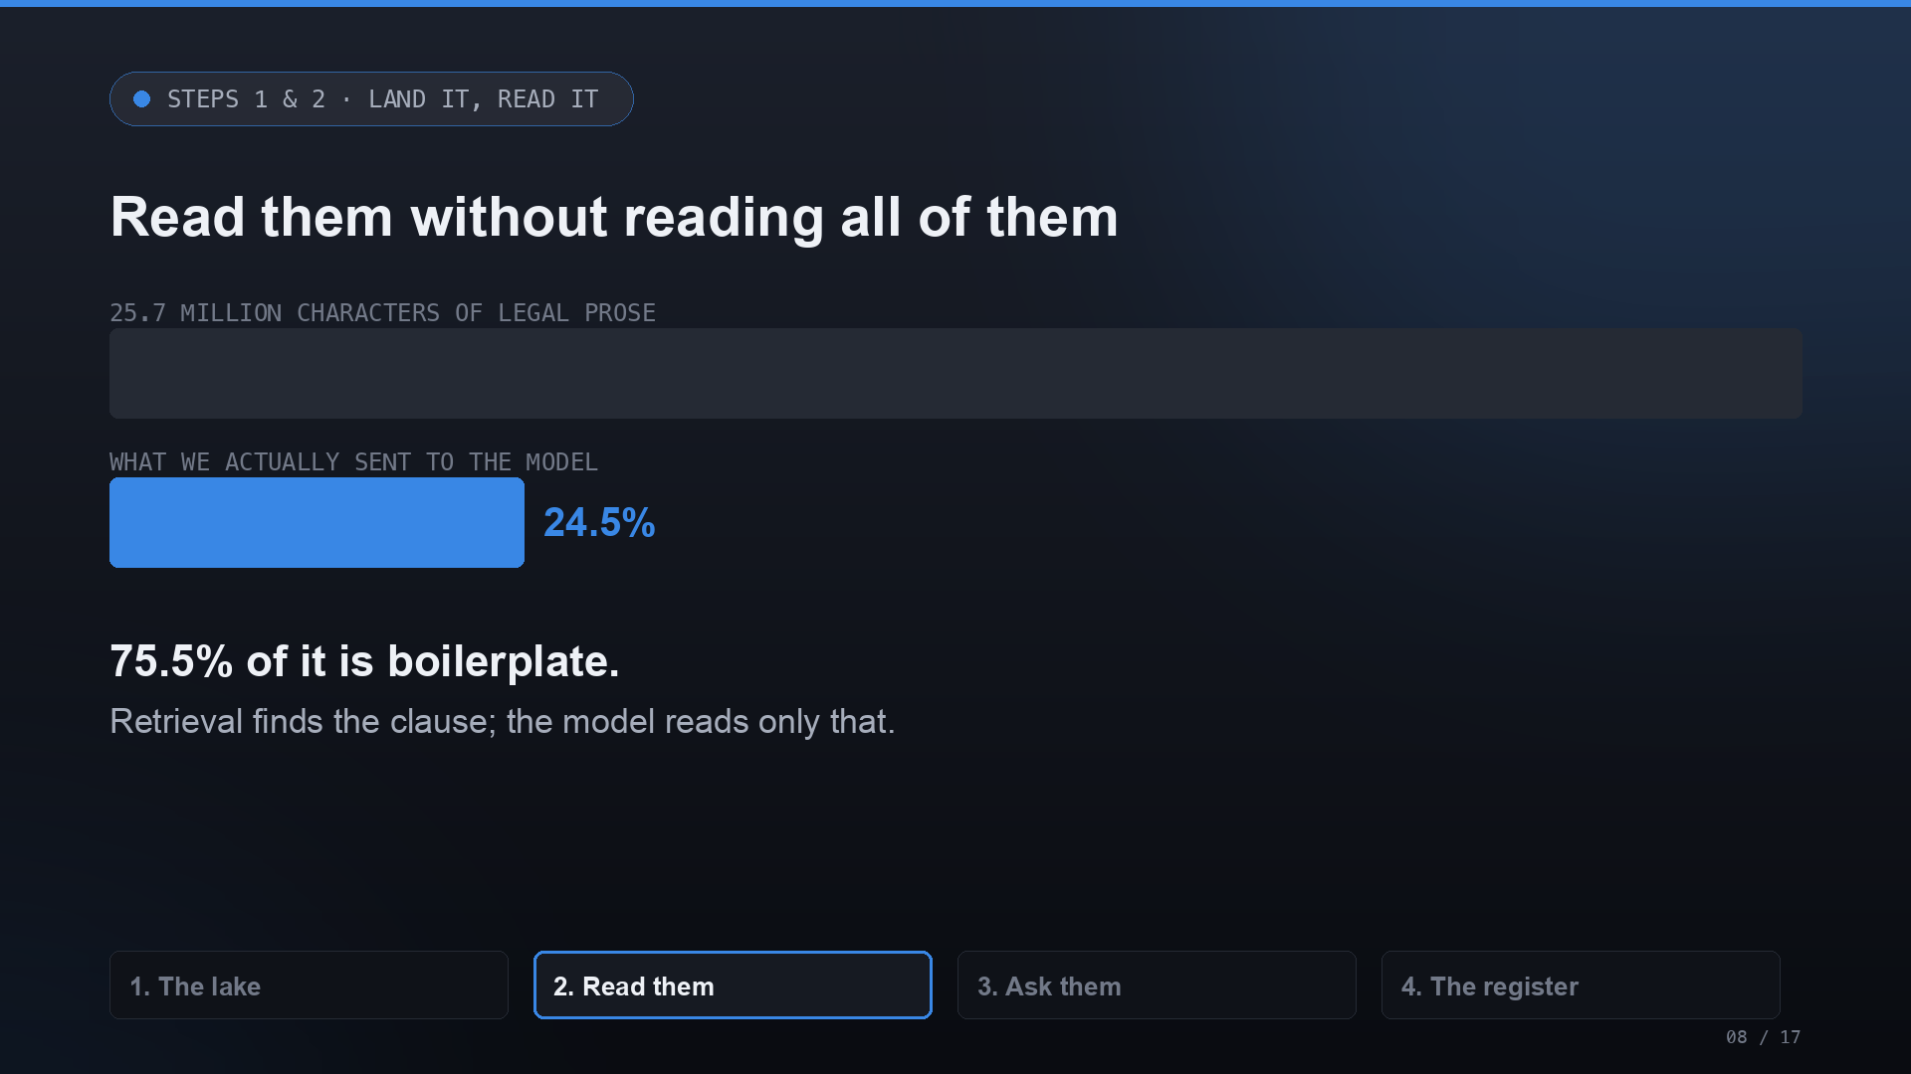
Notes:
This is the retrieval economics. A contract is fifty thousand characters of boilerplate around about six sentences that matter. We retrieve the clauses first and send the model only 24.5% of the text. That's cheaper — and it keeps the model honest, because it's reading the clause, not guessing from the whole document.

Slide 9
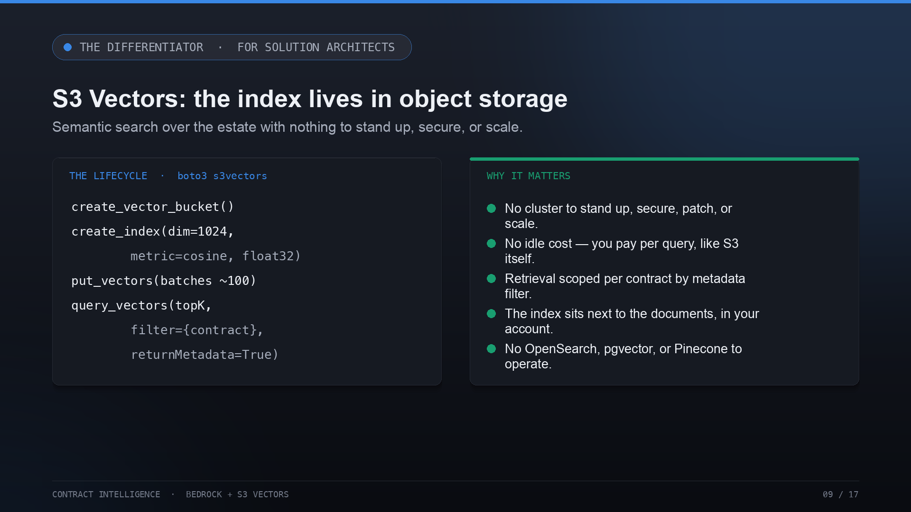
Notes:
The differentiator, in SA terms. S3 Vectors is a lifecycle you already understand: create a vector bucket, create an index at 1024 dimensions with cosine distance, put your vectors in batches, and query with a top-k and a metadata filter. Why it matters: no cluster to stand up, secure, patch, or scale; no idle cost; retrieval scoped per contract; and no OpenSearch, pgvector, or Pinecone to operate. The index lives next to the documents.

Slide 10
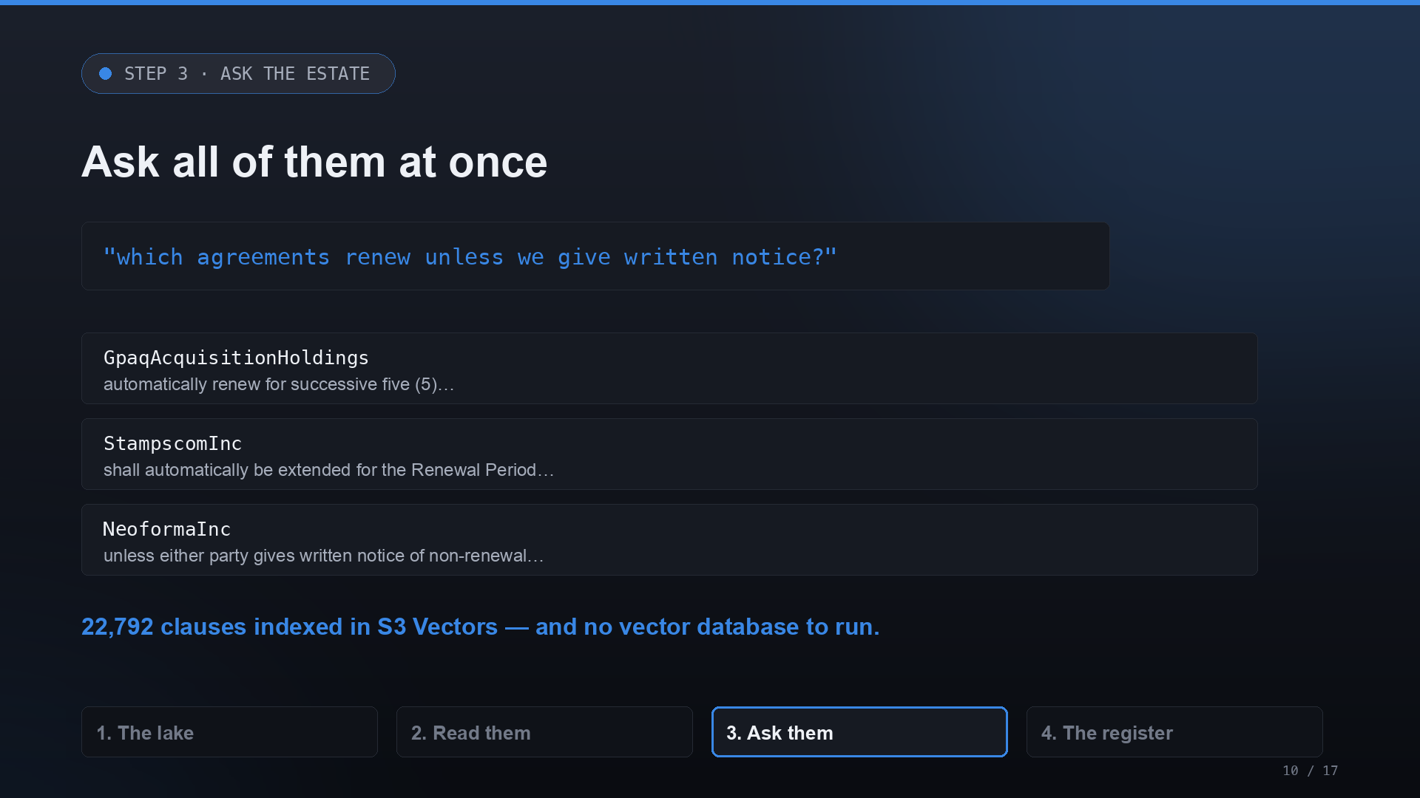
Notes:
And this is what the search actually does. Nobody files auto-renewal in a searchable field — they write two paragraphs of legal prose, differently every time. Ask the whole estate in natural language and it finds them: 22,792 clauses indexed in S3 Vectors, queried in under a second, with no database to keep running.

Slide 11
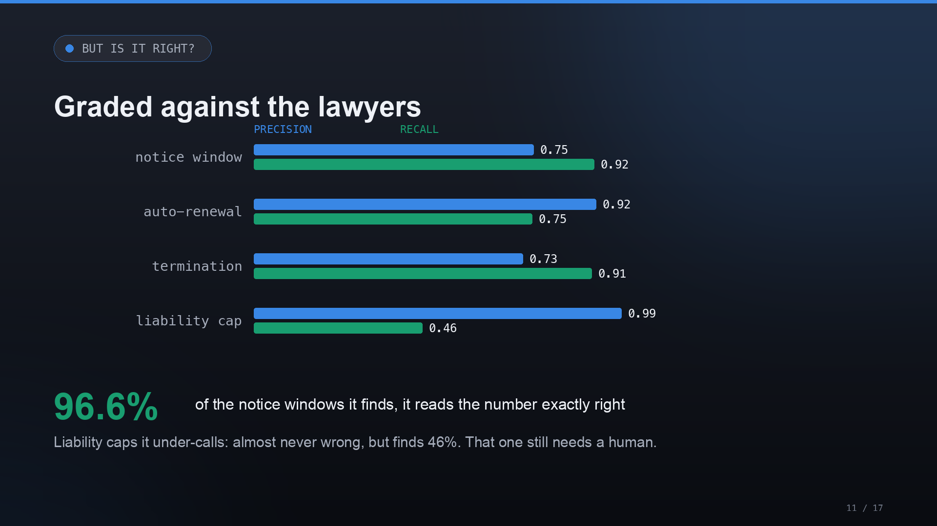
Notes:
Now the question IT always asks: is it right? The lawyers who built CUAD annotated every clause, so we grade the machine instead of trusting it. On the notice window — the clause that actually costs money — it finds 92% of them, and when it finds one it reads the day-count exactly right 96.6% of the time. It under-calls liability caps — almost never wrong, but only finds half. That one still needs a human.

Slide 12
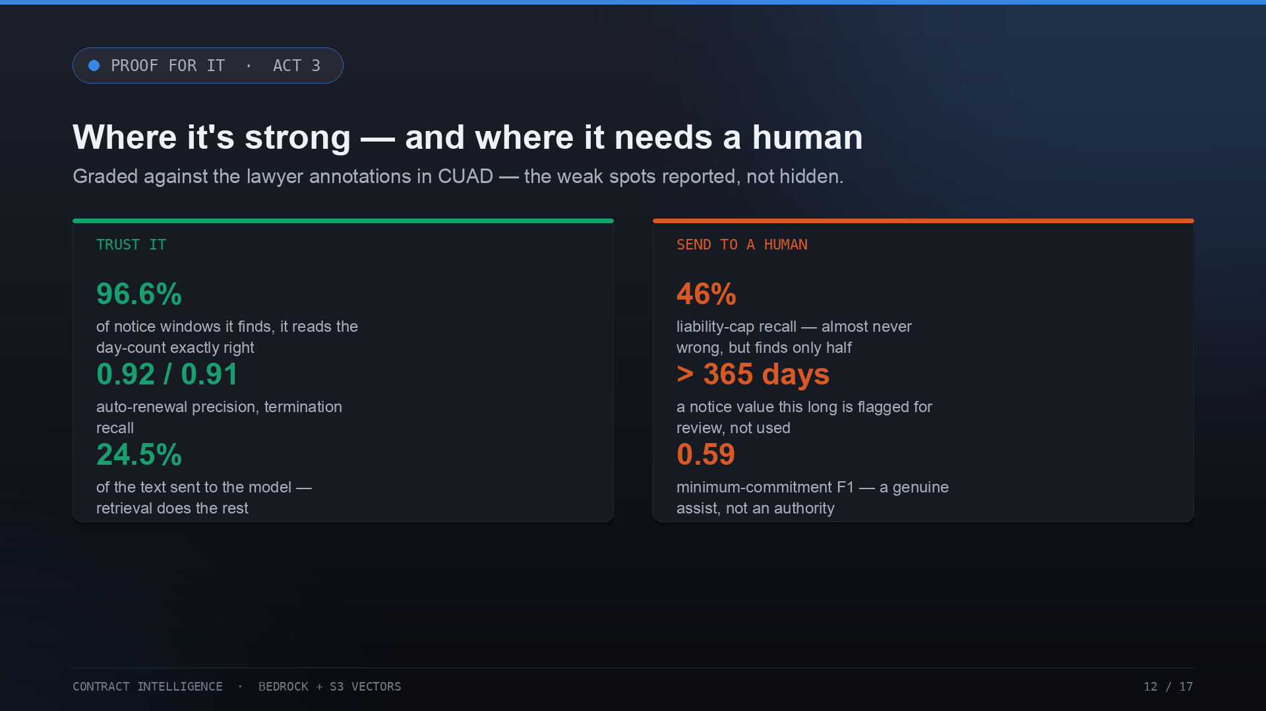
Notes:
Read that as a routing rule, not a report card. Trust it on notice windows, auto-renewal, and termination — that's most of the value, and it's measured. Send liability caps and minimum commitments to a human, and note the plausibility guard: a notice value over 365 days is flagged for review rather than used. A system that surfaces doubt instead of inventing a deadline is exactly what an audit wants.

Slide 13
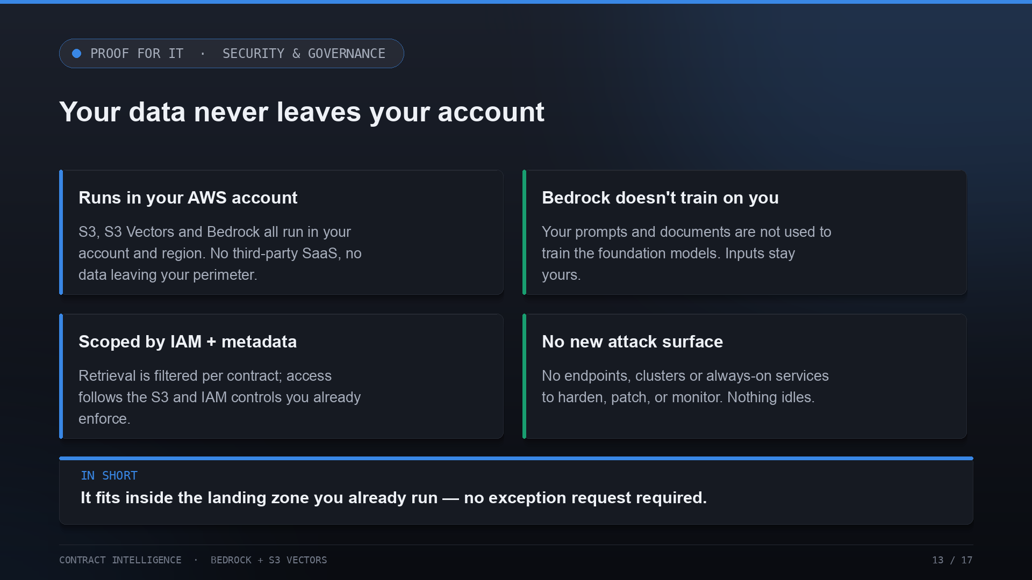
Notes:
The governance answer. Everything runs in your AWS account and region — S3, S3 Vectors, Bedrock — with no third-party SaaS and no data leaving your perimeter. Bedrock doesn't train on your inputs. Retrieval is scoped per contract by metadata and follows your existing IAM. And there's no new attack surface — nothing always-on to harden or patch. It fits inside the landing zone you already run.

Slide 14
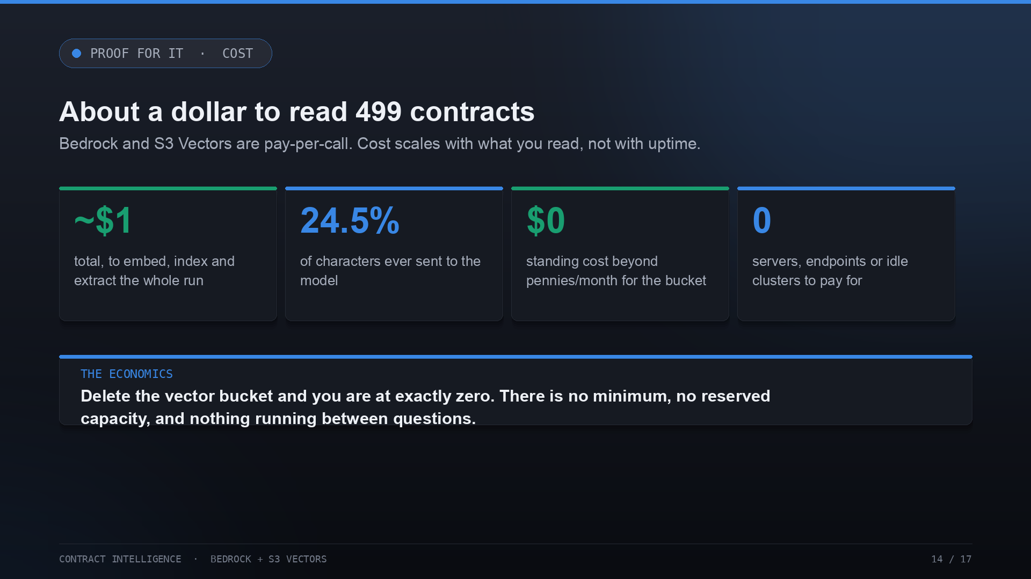
Notes:
And the cost, plainly. About a dollar to embed, index, and extract all 499 contracts, because only a quarter of the text reaches the model. Standing cost is effectively zero — pennies a month for the vector bucket, and nothing else running. Bedrock and S3 Vectors are pay-per-call; delete the bucket and you're at zero. Cost scales with what you read, not with uptime.

Slide 15
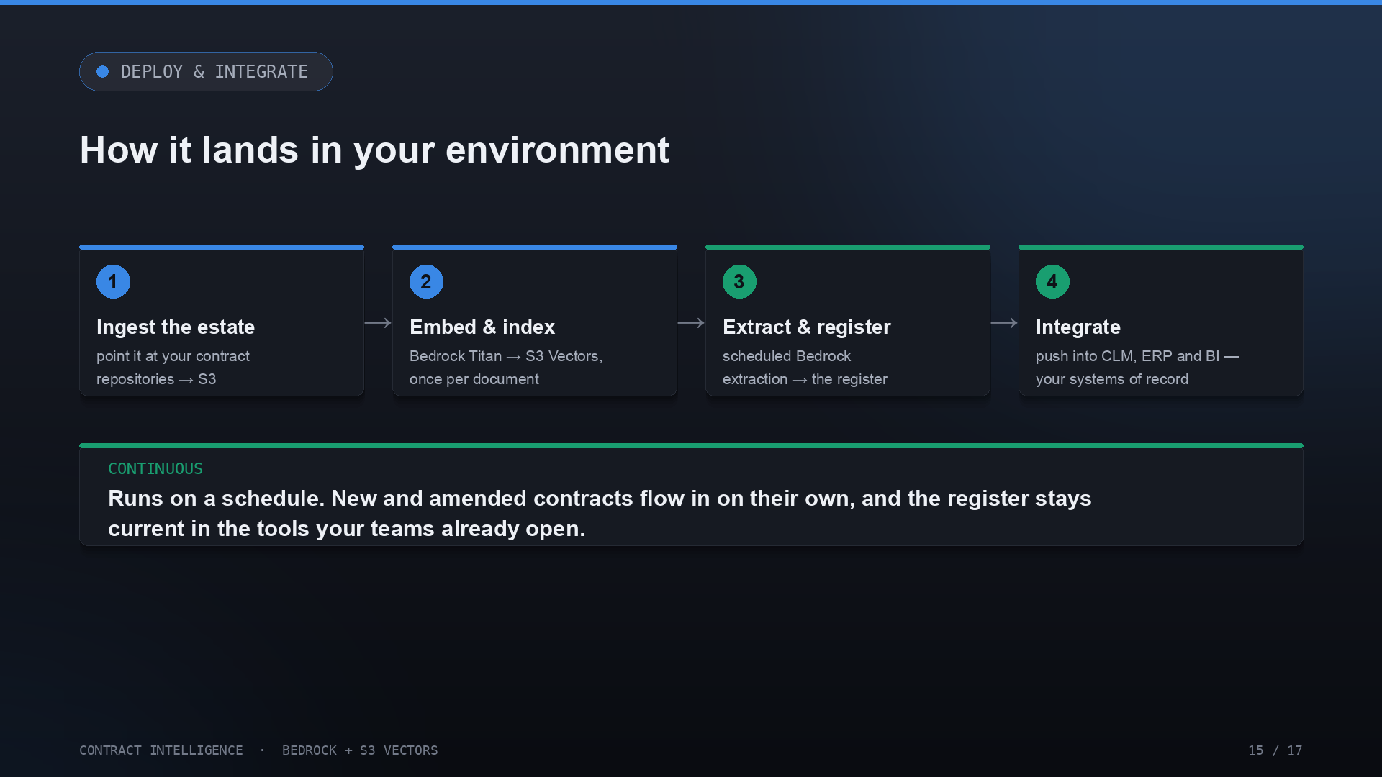
Notes:
How it lands. Point it at your contract repositories into S3; embed and index once per document; run extraction on a schedule to keep the register current; and integrate — push the register into the CLM, ERP, and BI tools your teams already open. New and amended contracts flow in continuously, so the register never goes stale.

Slide 16
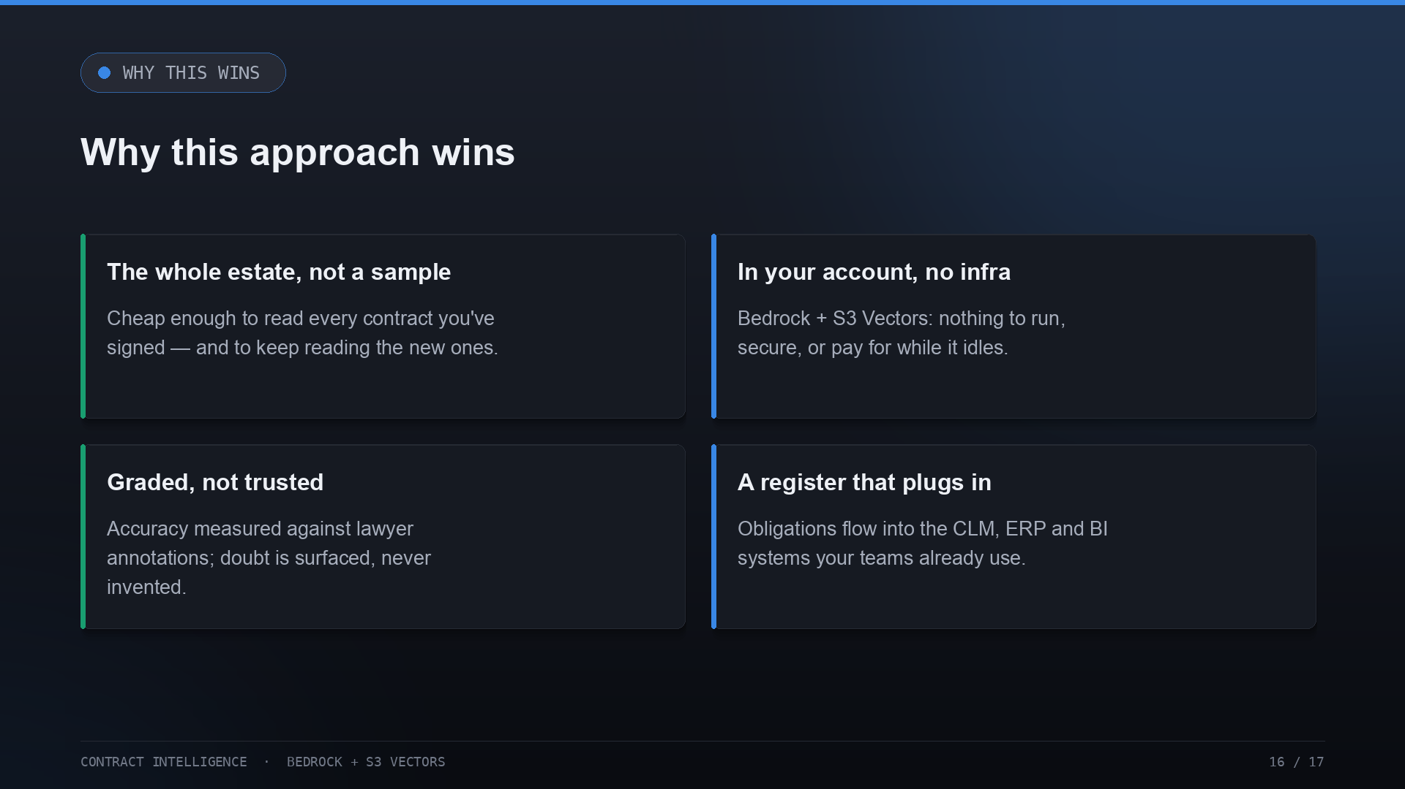
Notes:
So why this approach. It reads the whole estate, not a sample, and keeps reading. It runs in your account with no infrastructure to operate. It's graded against lawyers rather than trusted. And it produces a register that plugs into the systems your teams already use. Cheap, safe, measured, and integrated.

Slide 17
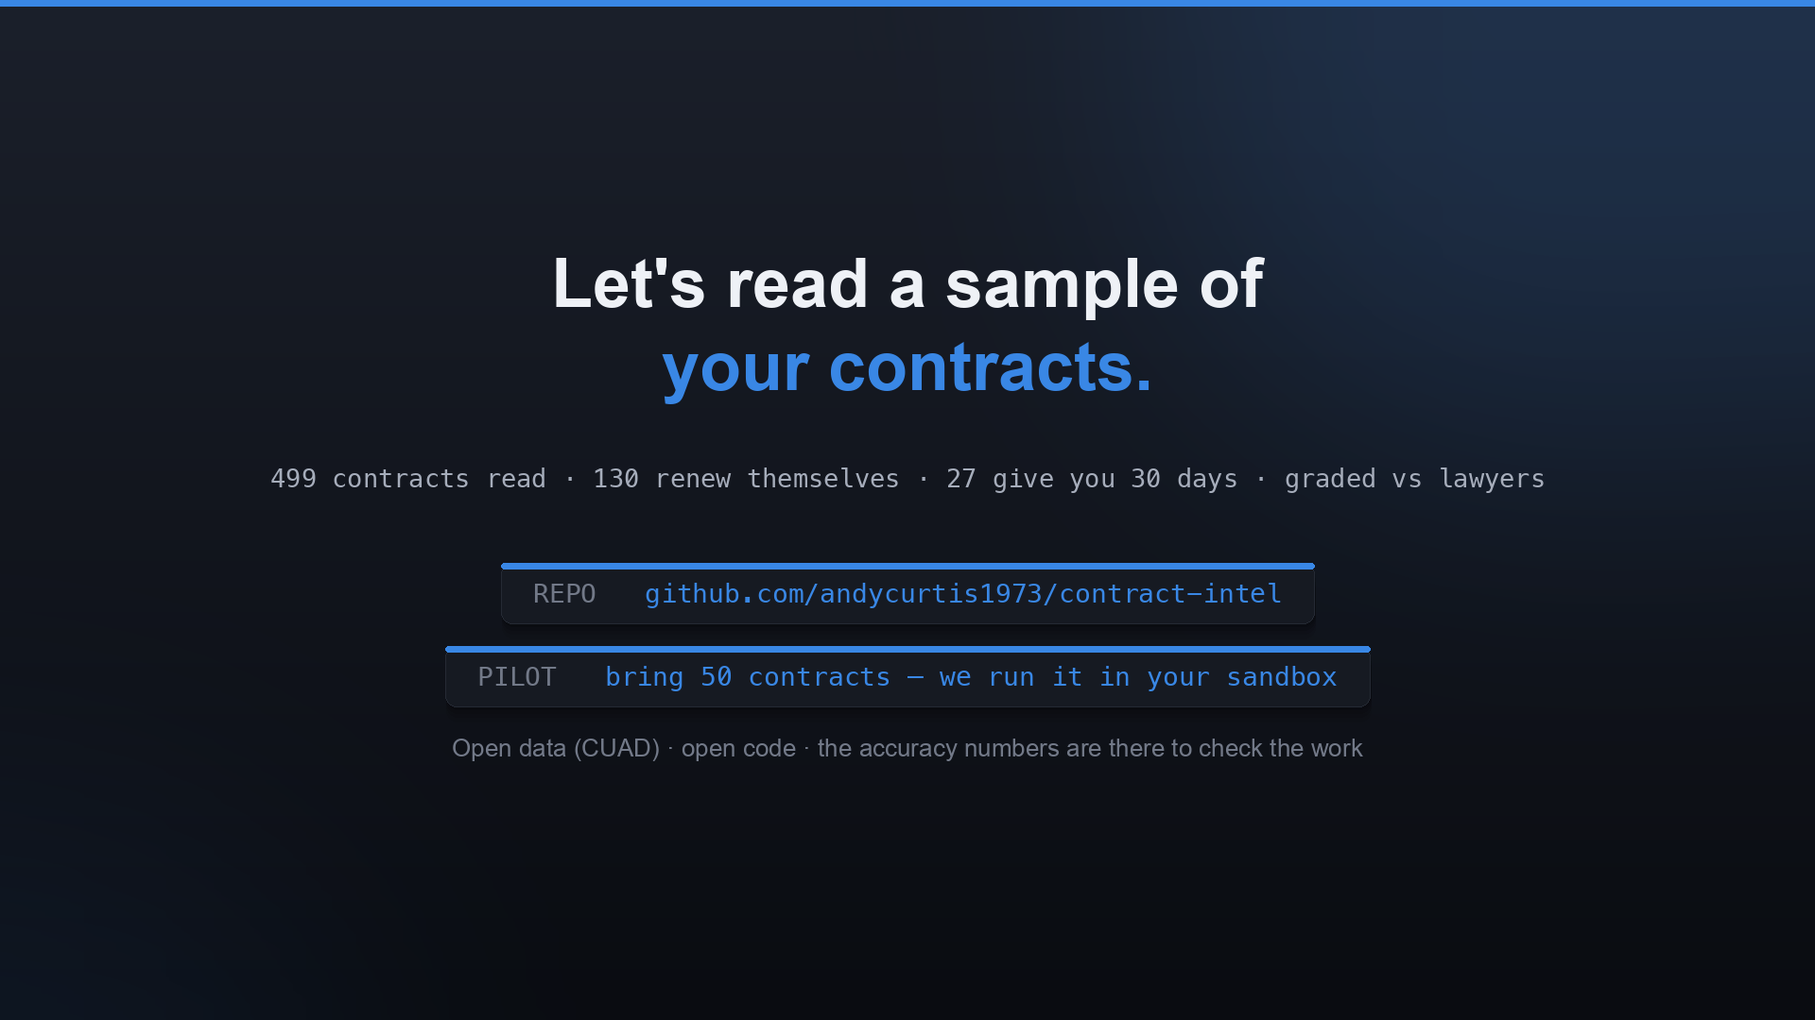
Notes:
That's the brief. The data is public, the code is open, and the accuracy numbers are there to check the work. The best next step is small and concrete: bring us fifty of your own contracts and we'll show you what renews, when the windows close, and where the liability is uncapped — running in a sandbox in your account.

