Slide 1
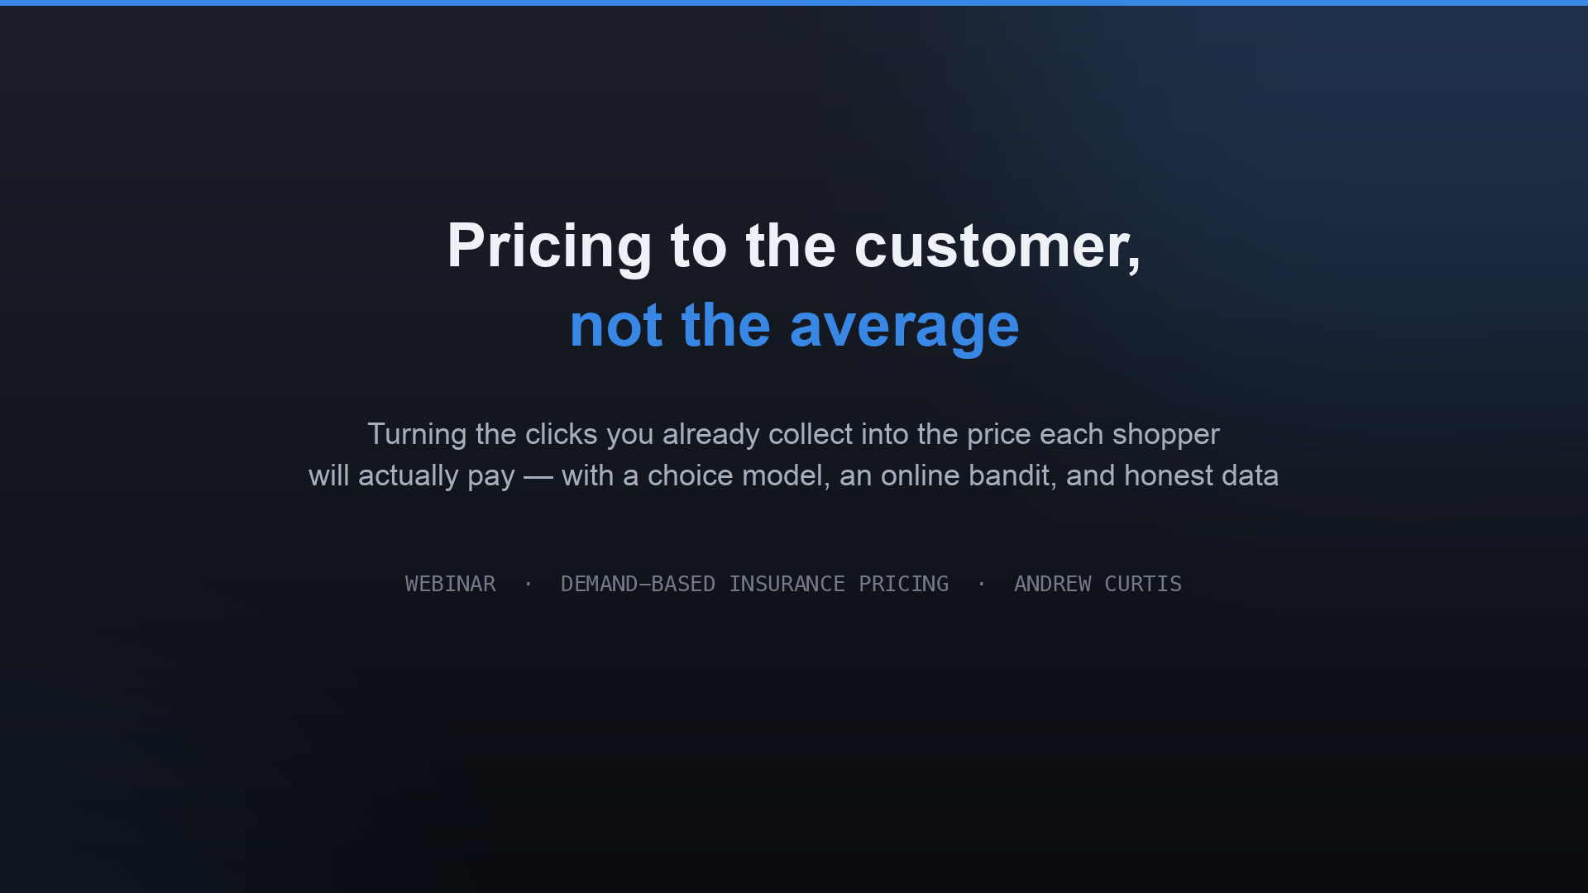
Notes:
Welcome. Today we're looking at how an auto insurer can price to who a shopper actually is, instead of to the average. Three ingredients: a choice model, an online learning engine, and — importantly — an honest line between what's real data and what's modeled. Everything you'll see is built on 97,000 real shopping sessions.

Slide 2
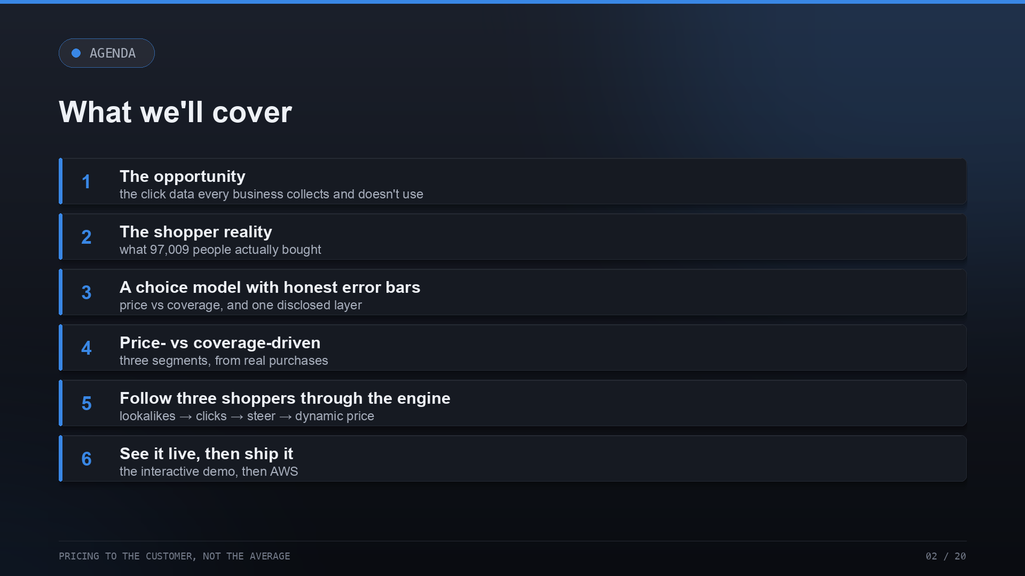
Notes:
Here's the path. We start with what shoppers actually do, build a model that explains it, split them into segments, then draw a clear line around the one simulated piece before we ever talk about money. Then the engine and its lift, how it learns online, and how it would deploy. Save questions for the end, or drop them in the chat.

Slide 3
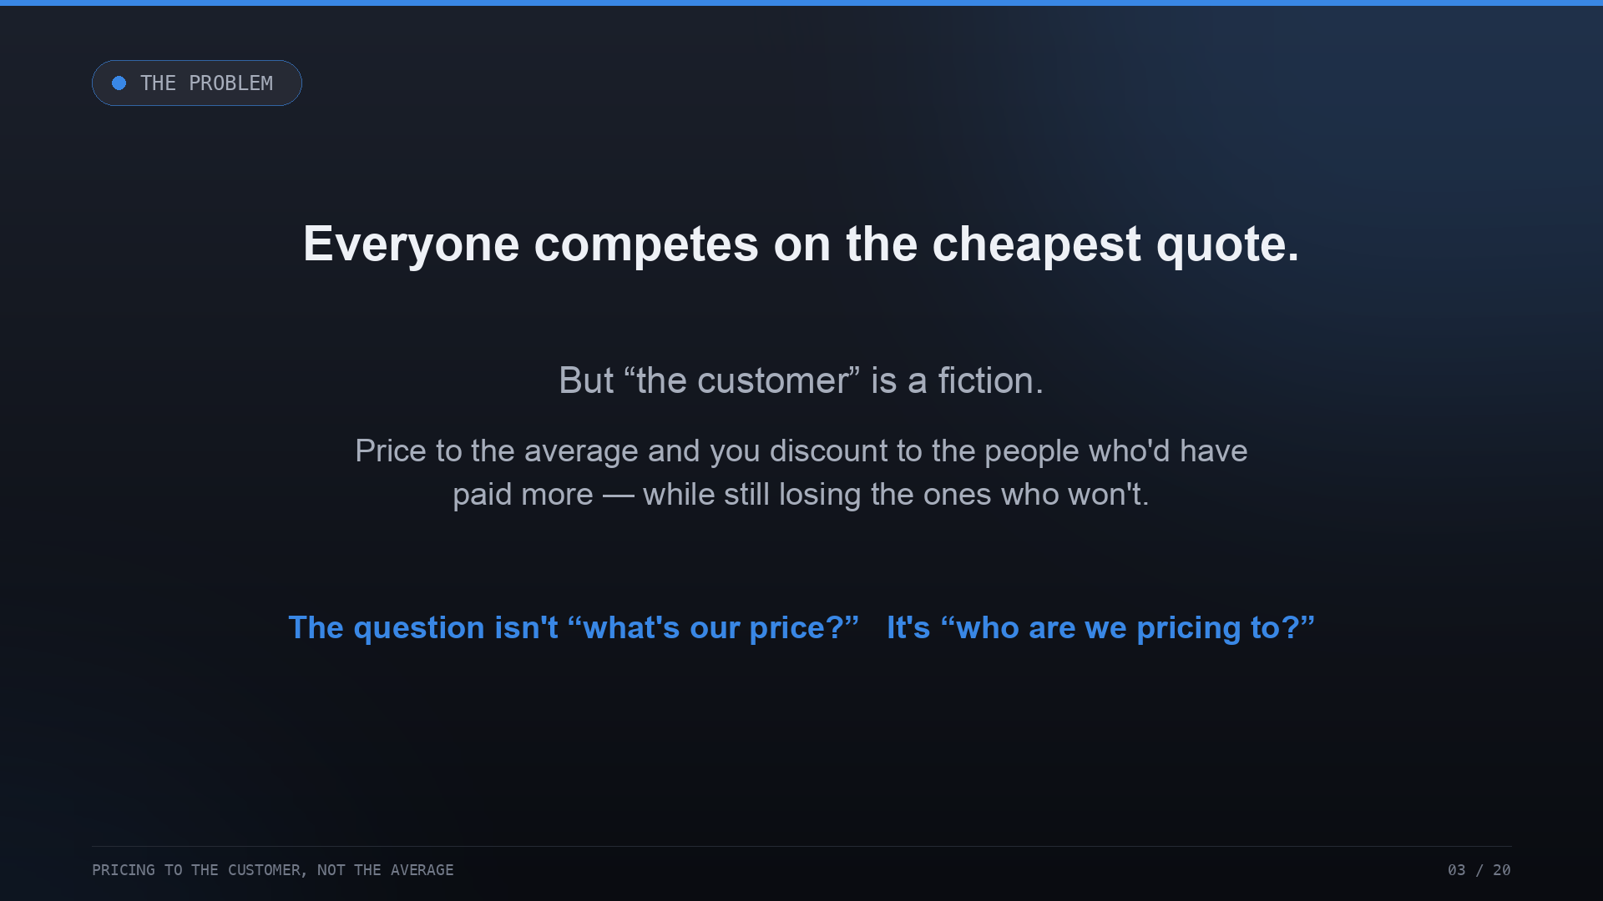
Notes:
Start with the framing. Every insurer competes on the cheapest quote — but 'the customer' is a fiction. When you price to the average, you hand a discount to the people who would happily have paid more, and you still lose the ones who won't pay up. So the real question isn't 'what's our price?' — it's 'who are we pricing to?' Everything that follows is about answering that from data.

Slide 4
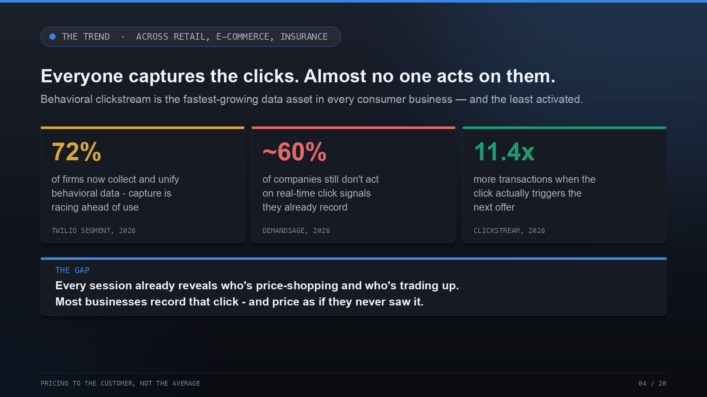
Notes:
Here's the bigger pattern, and it's not just insurance. Across retail, e-commerce and financial services, everyone is now capturing behavioral clickstream — 72% of firms unify it — but roughly 60% still don't act on those signals in real time. The click that tells you someone is price-shopping versus trading up is recorded in every session, and then thrown away. That gap between collecting behavior and acting on it is the cheapest growth most businesses have left.

Slide 5
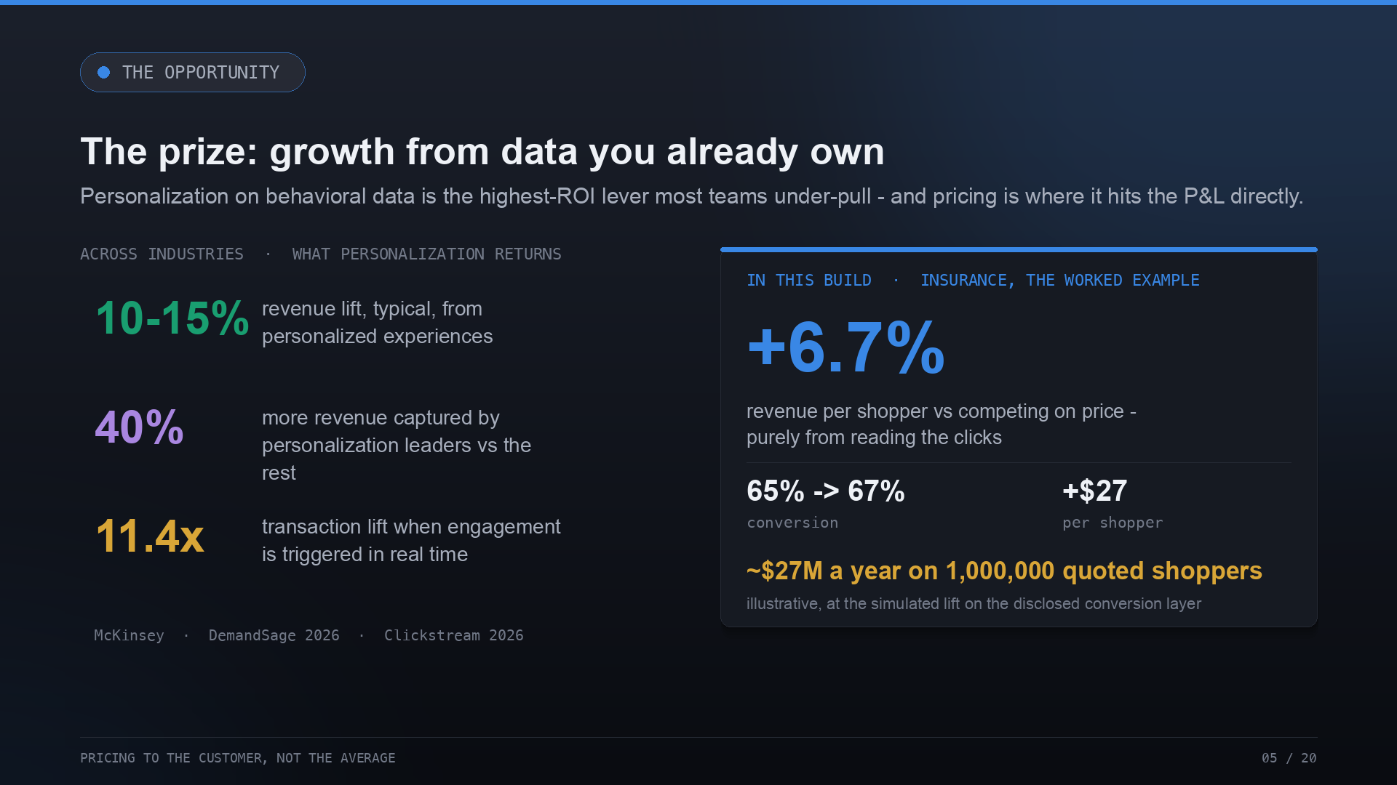
Notes:
And the prize is large. Personalization built on that behavioral data typically returns a 10 to 15% revenue lift; the leaders pull 40% more revenue from it than everyone else; and when you trigger on engagement in real time, transaction rates jump. Pricing is where this hits the P&L most directly — so insurance is our worked example. Reading the clicks lifts revenue per shopper 6.7% and conversion from 65 to 67%, about $27 a head — which on a million quoted shoppers is roughly $27M a year. That last number is illustrative, at the simulated lift, but the mechanism is the point.

Slide 6
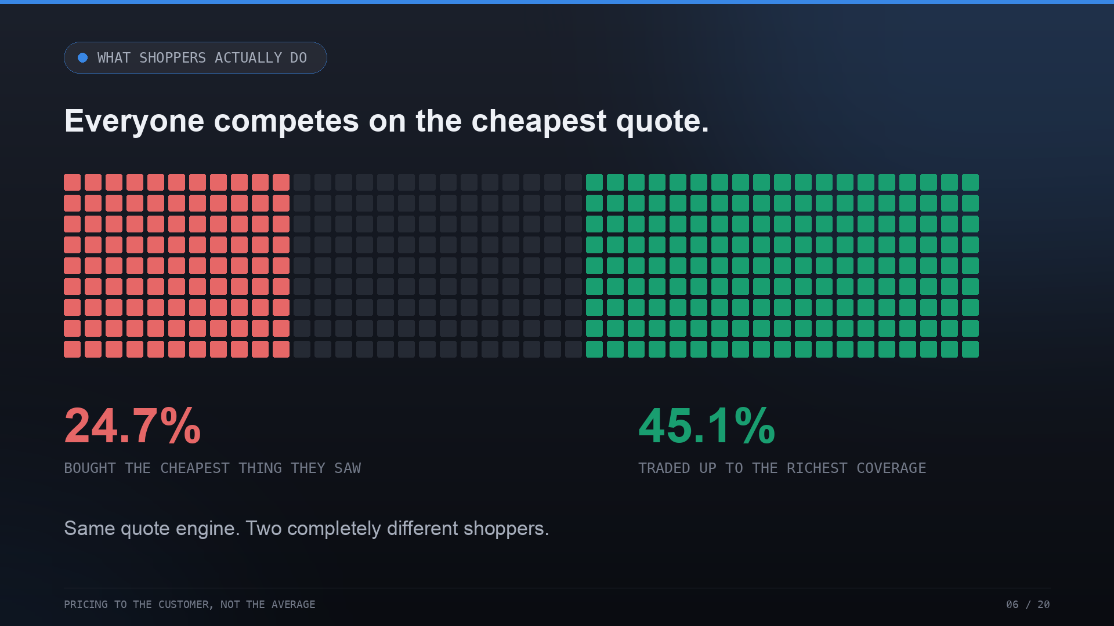
Notes:
Every square is a real person shopping for car insurance. Only about a quarter bought the cheapest option they saw. Nearly half traded up to richer coverage and paid more. Same quote engine, two completely different shoppers — and if you lead with the cheapest quote for everyone, you're discounting to the half who'd have paid more.

Slide 7
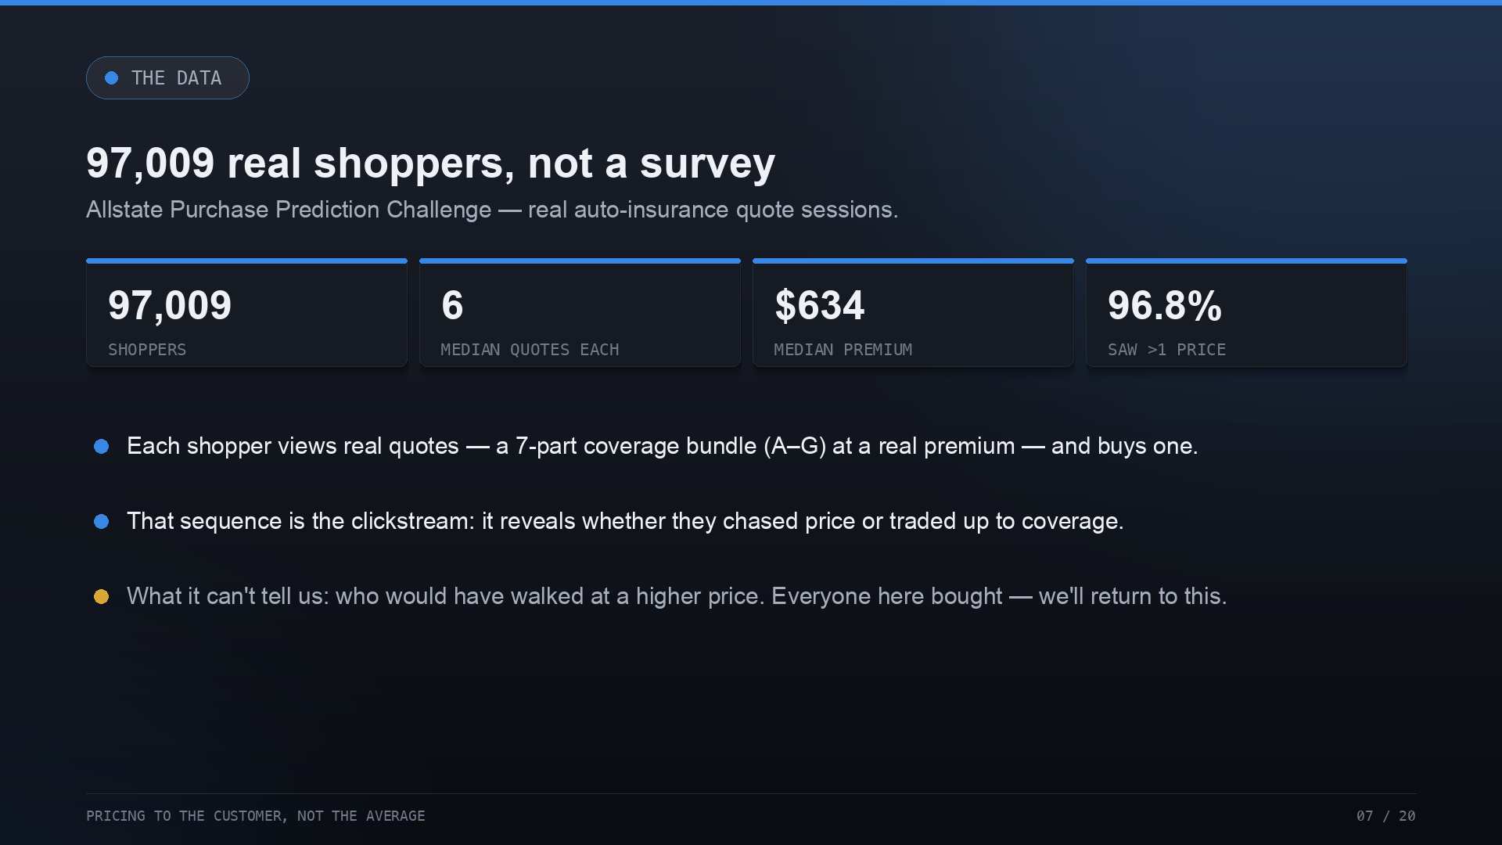
Notes:
The credibility rests on the data. This is the Allstate Purchase Prediction dataset — real quote sessions, real coverage bundles A through G, real premiums, a median of six quotes each. Crucially, note the last point: everyone in this data bought something. So it cannot tell us who would have walked away at a higher price. Hold that thought.

Slide 8
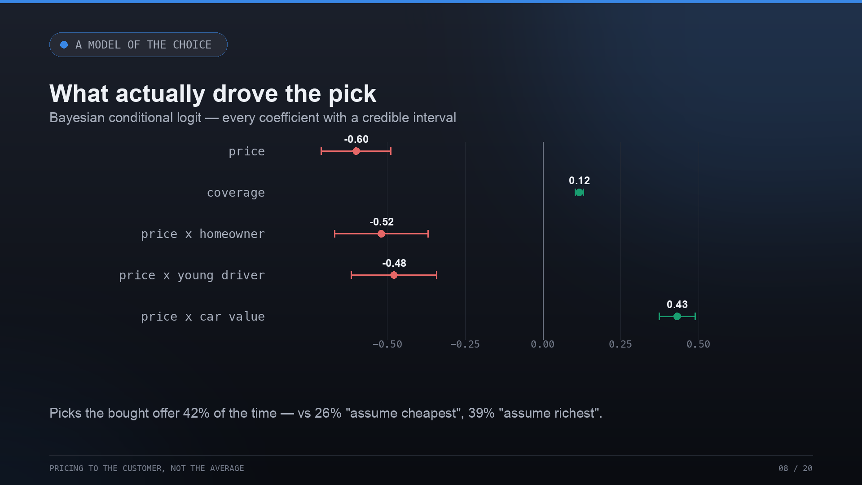
Notes:
To explain the choices we fit a Bayesian conditional logit. Price pushes people toward cheaper; coverage pulls them richer. And price sensitivity isn't one number — it's sharper for homeowners and young drivers, and it flips for expensive cars. It predicts the bought offer 42% of the time, versus 26 and 39 for the naive baselines.

Slide 9
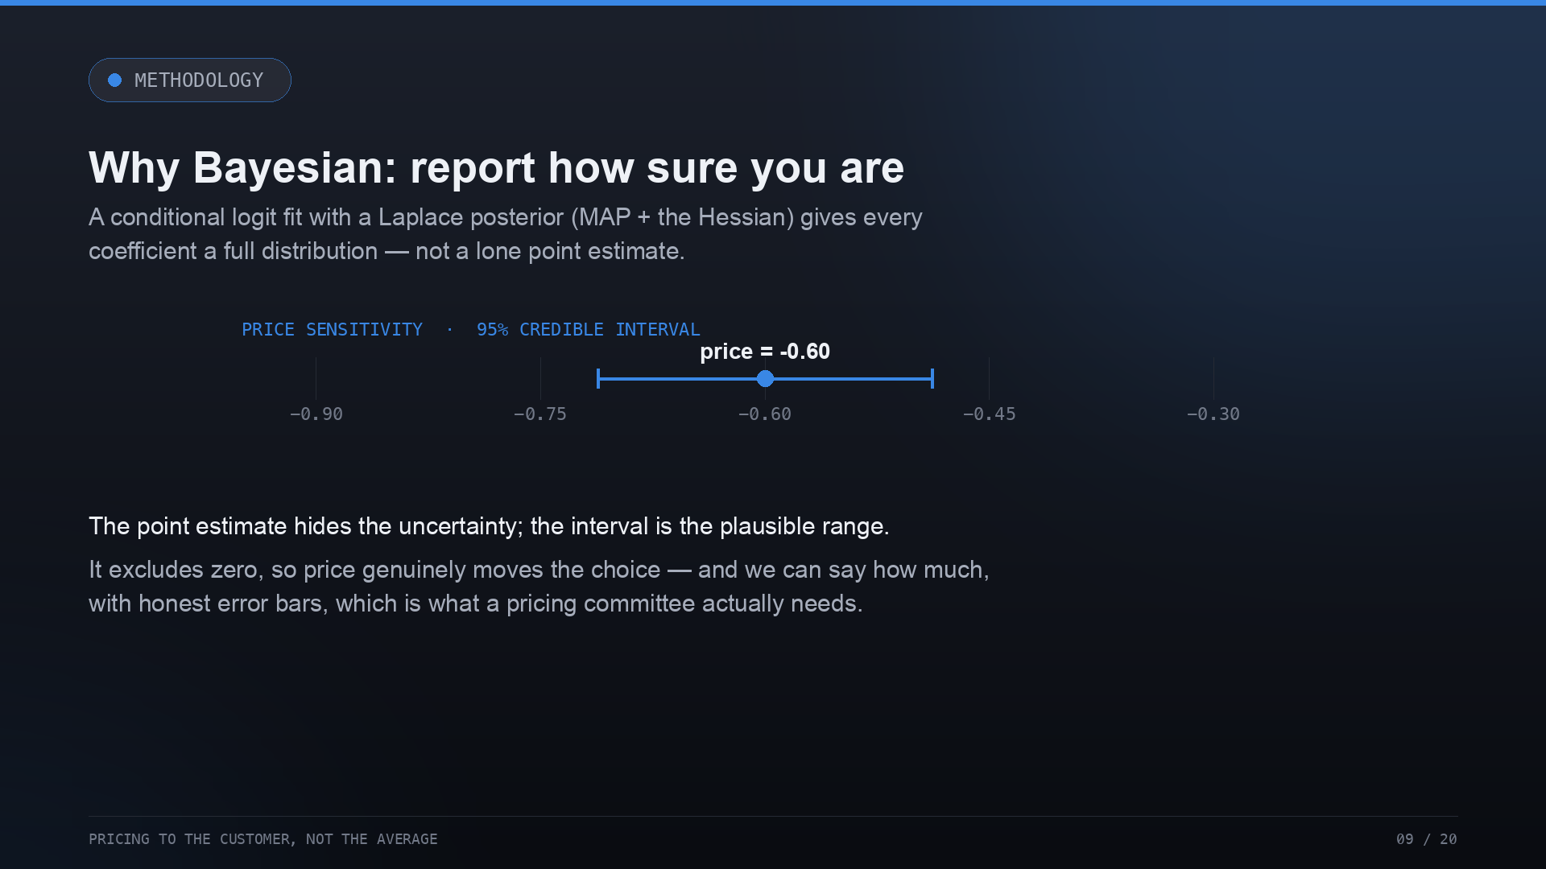
Notes:
Why Bayesian rather than a plain regression? The Laplace posterior gives each coefficient a full distribution, so we get credible intervals. The price coefficient is minus 0.60, and the interval clearly excludes zero. A pricing committee needs the range and the confidence, not just a point estimate — this reports how sure we are.

Slide 10
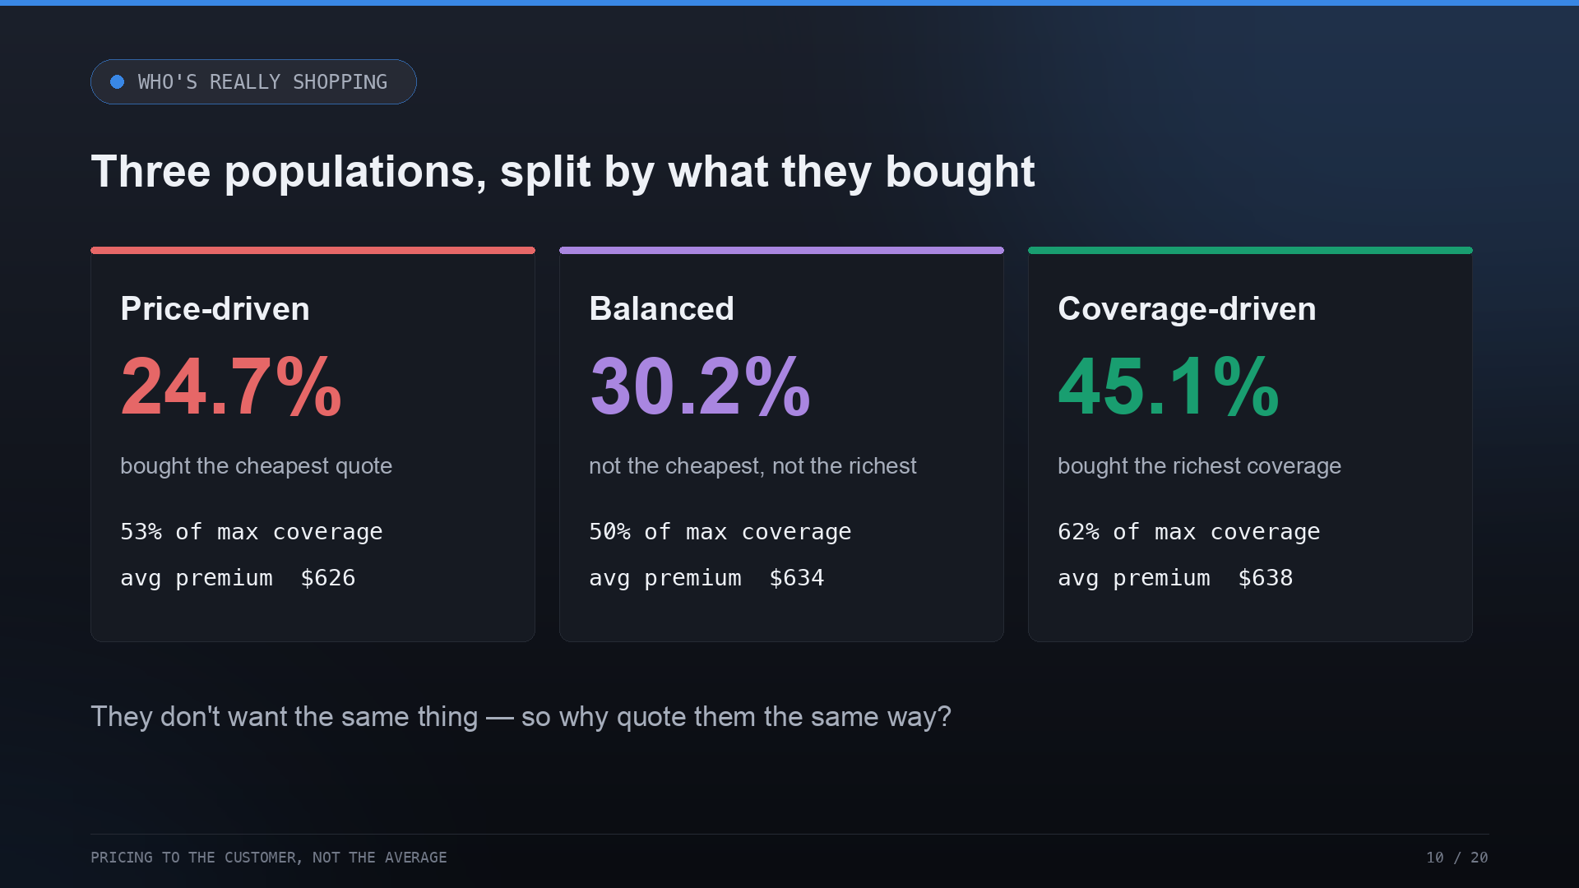
Notes:
Split people by what they actually bought and three populations fall out: price-driven, coverage-driven, and balanced in between. They don't want the same thing — the coverage-driven buy 62% of max coverage versus 53% for the price-driven. So why would you quote them the same way?

Slide 11
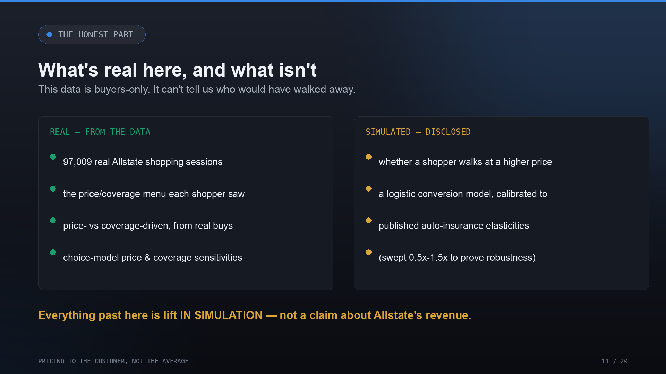
Notes:
Now the honest part, before a single dollar of lift. Because the data is buyers-only, we can't observe walk-away. So we add it: a conversion model, and we label it clearly. The shoppers, menus, preferences and segments are real; the walk-away response is a disclosed model. Everything past here is lift in simulation — not a claim about Allstate's revenue.

Slide 12
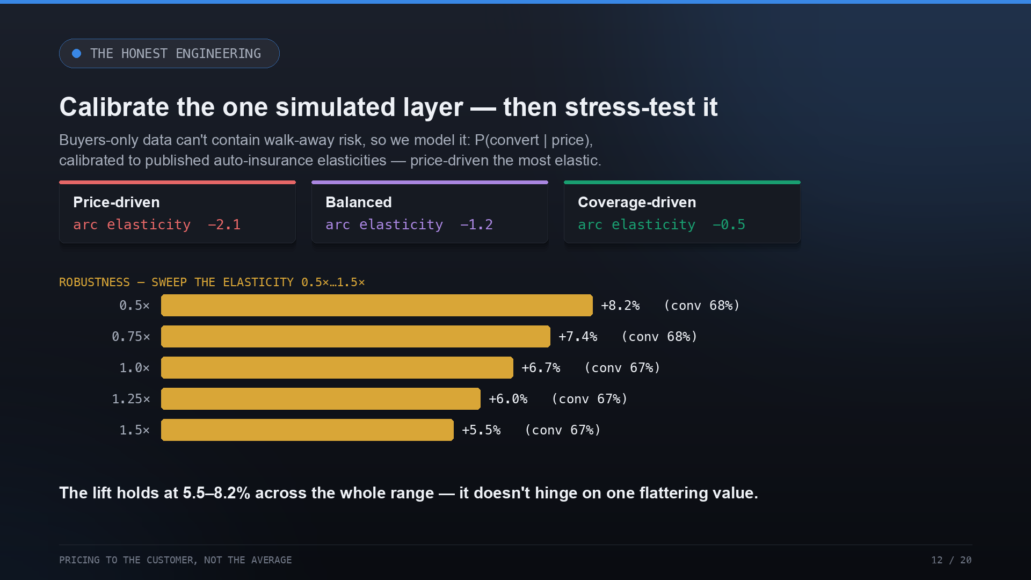
Notes:
We don't just make up the elasticity. We calibrate it to published auto-insurance figures — price-driven shoppers around minus two, coverage-lovers around minus one-half — and then we sweep it from half to one-and-a-half times. The lift holds between 5.5 and 8.2% across the whole range. That's the difference between a calibrated simulator and a flattering guess.

Slide 13
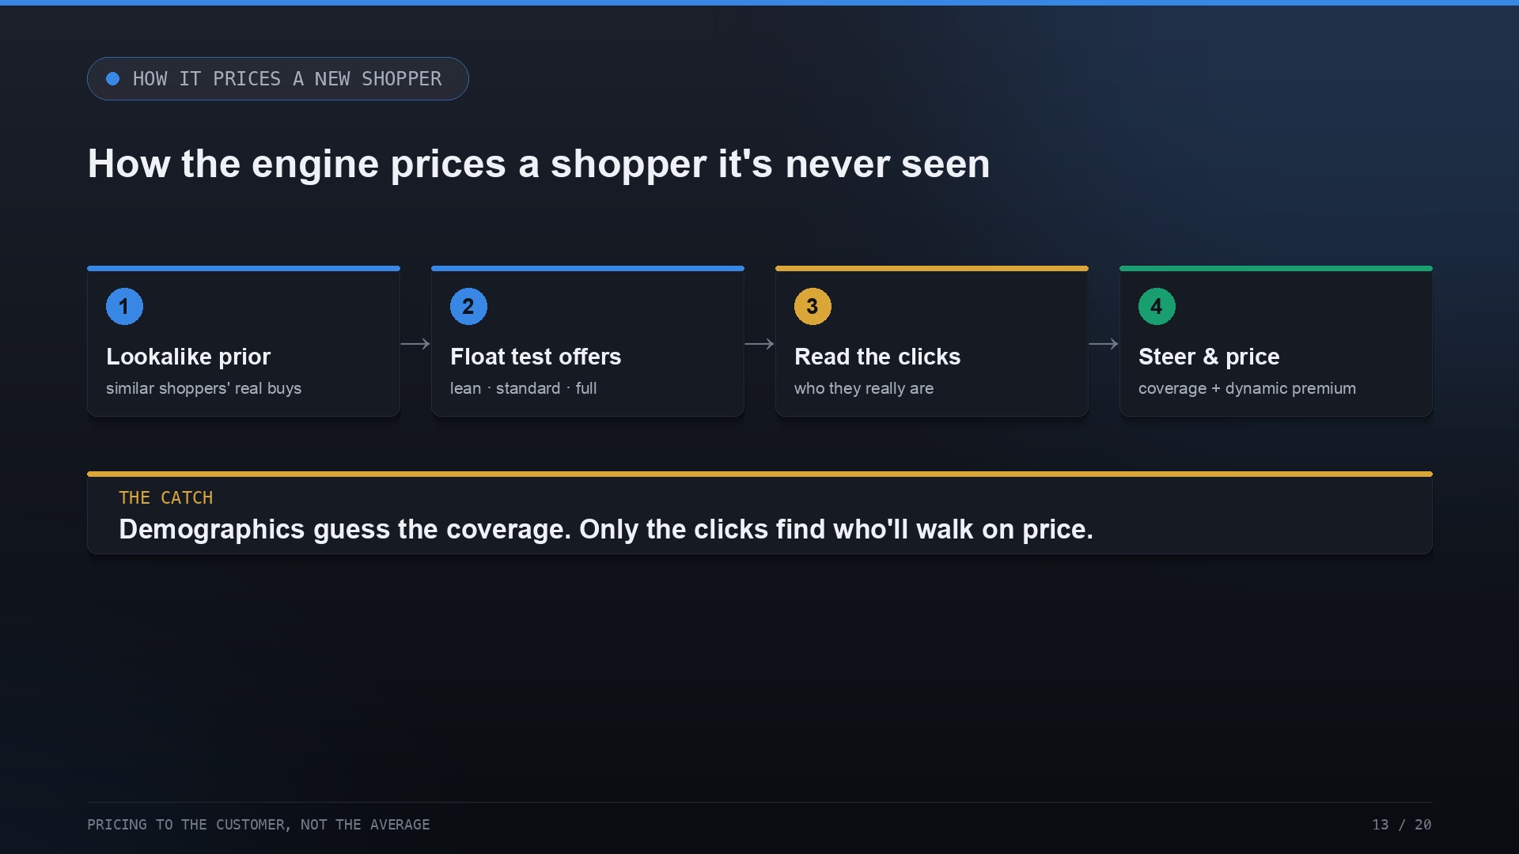
Notes:
Here's how the engine prices a shopper it's never seen. Step one: look up what real lookalikes bought — a warm start on coverage. Step two: float a few test offers. Step three: read the clicks. Step four: steer the coverage and set the price. The catch is the whole point — demographics can guess the coverage, but only the clicks reveal who'll walk on price.

Slide 14
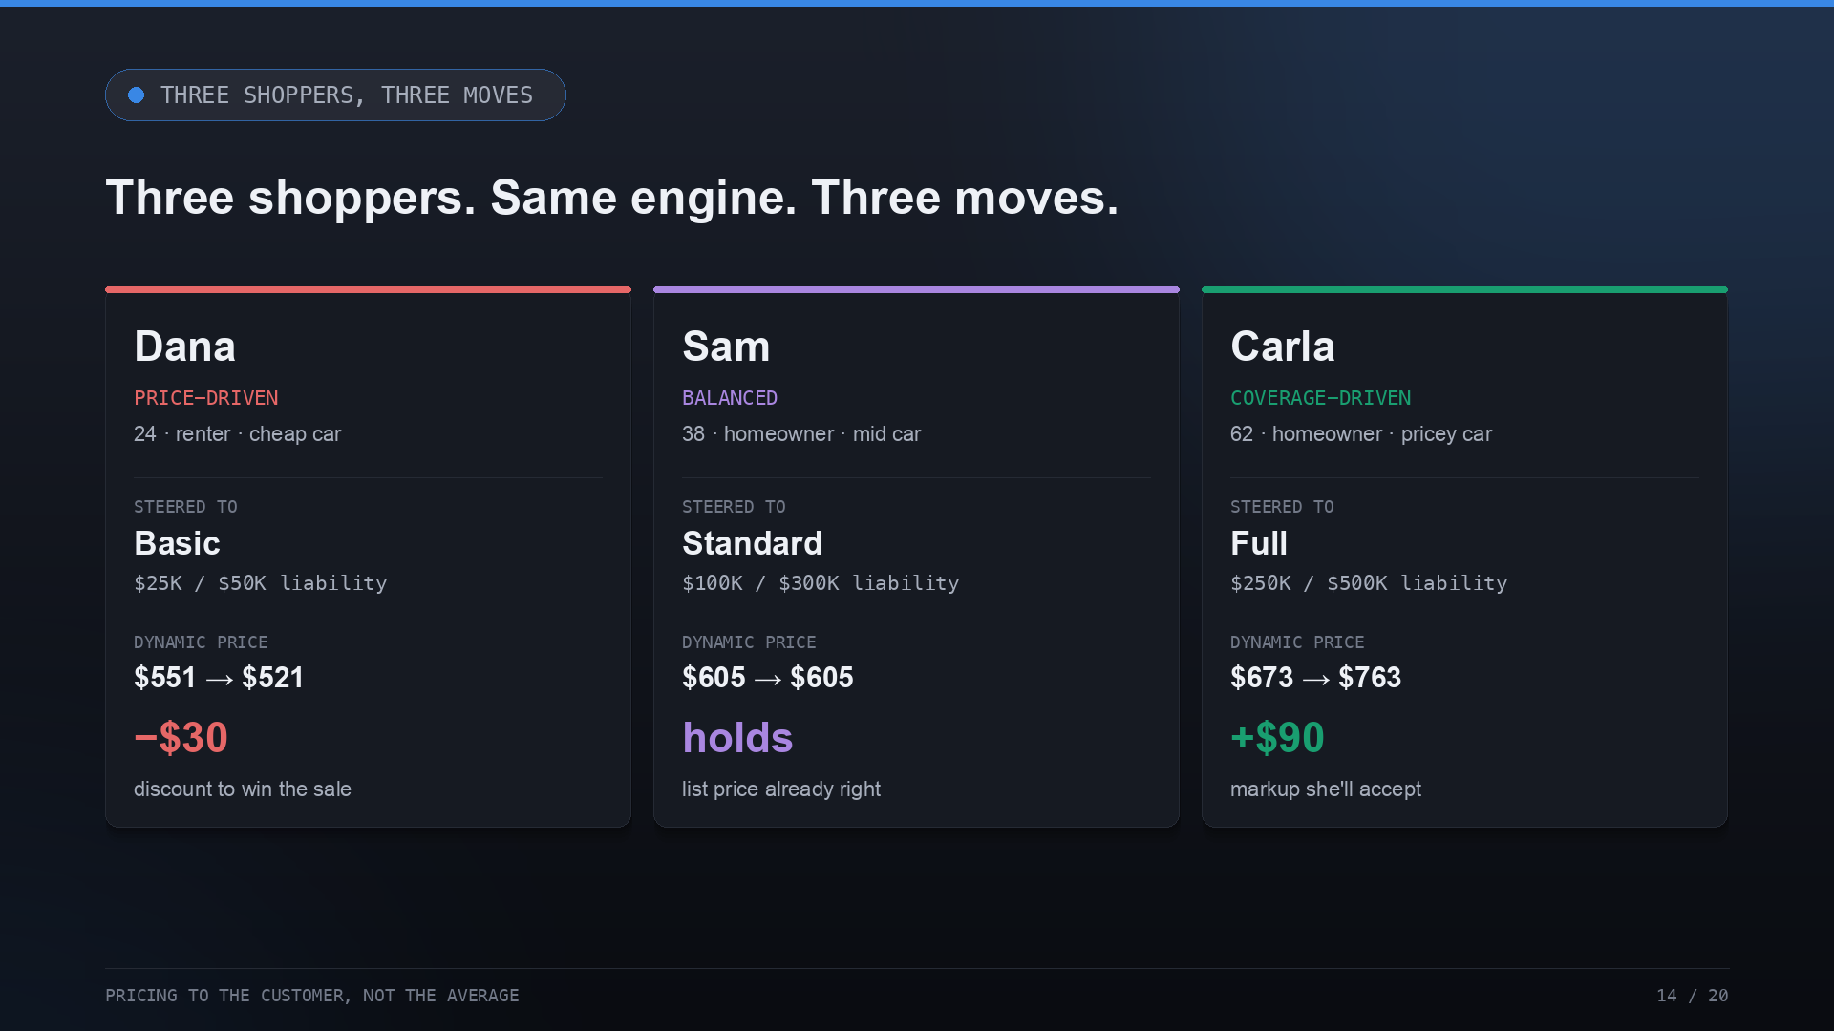
Notes:
Watch it run on three real profiles. Dana, a young renter, clicks the cheapest option — she's price-driven, so the engine steers her to Basic and prices it DOWN, $551 to $521, to win a sale she'd otherwise walk from. Carla, an older homeowner, reaches for full coverage — steered to Full and priced UP, $673 to $763, because she'll pay. Sam is in between: he takes the standard plan, and the engine holds at the list price. Same engine, three different moves.

Slide 15
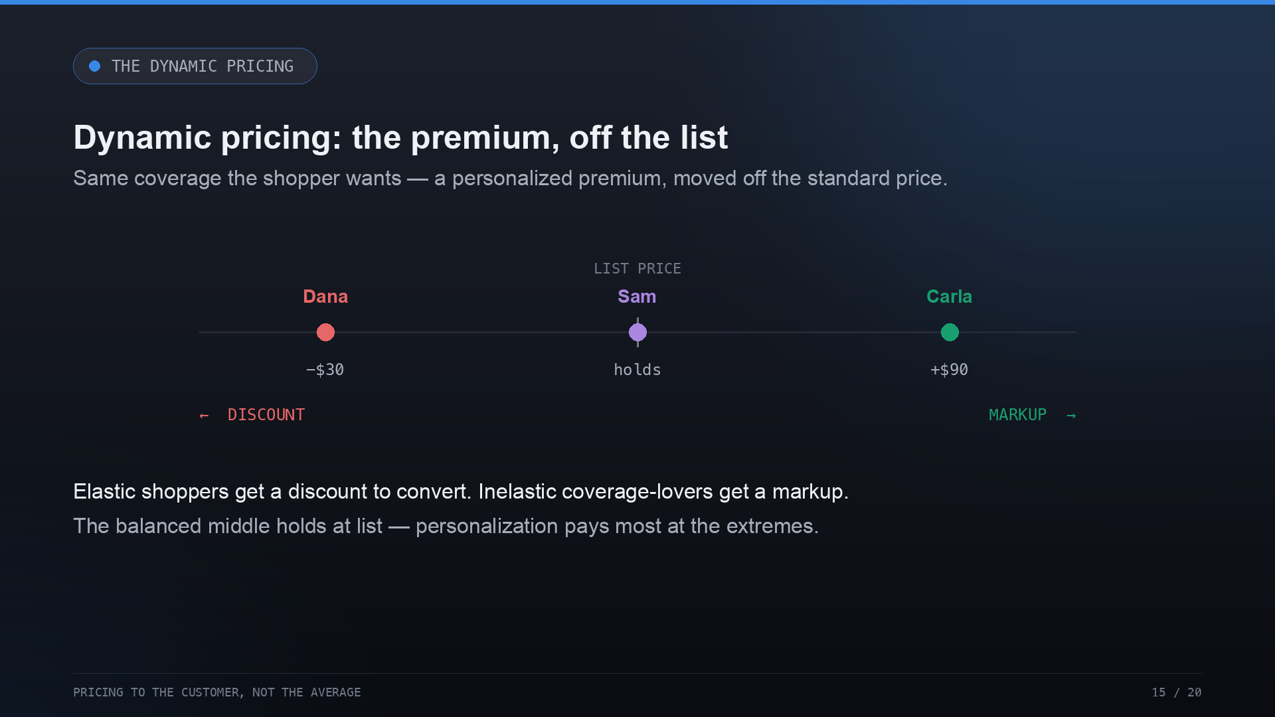
Notes:
This is where the dynamic pricing actually happens. It's not the tier — those list prices are cost-based. It's the personalized premium the engine sets on the tier the shopper wants: a discount to convert the price-sensitive, a markup for the coverage-lover who'll pay, and — for the balanced middle — no move at all. Personalization pays most at the extremes; in the middle, the standard price is already right. That's the honest shape of it.

Slide 16
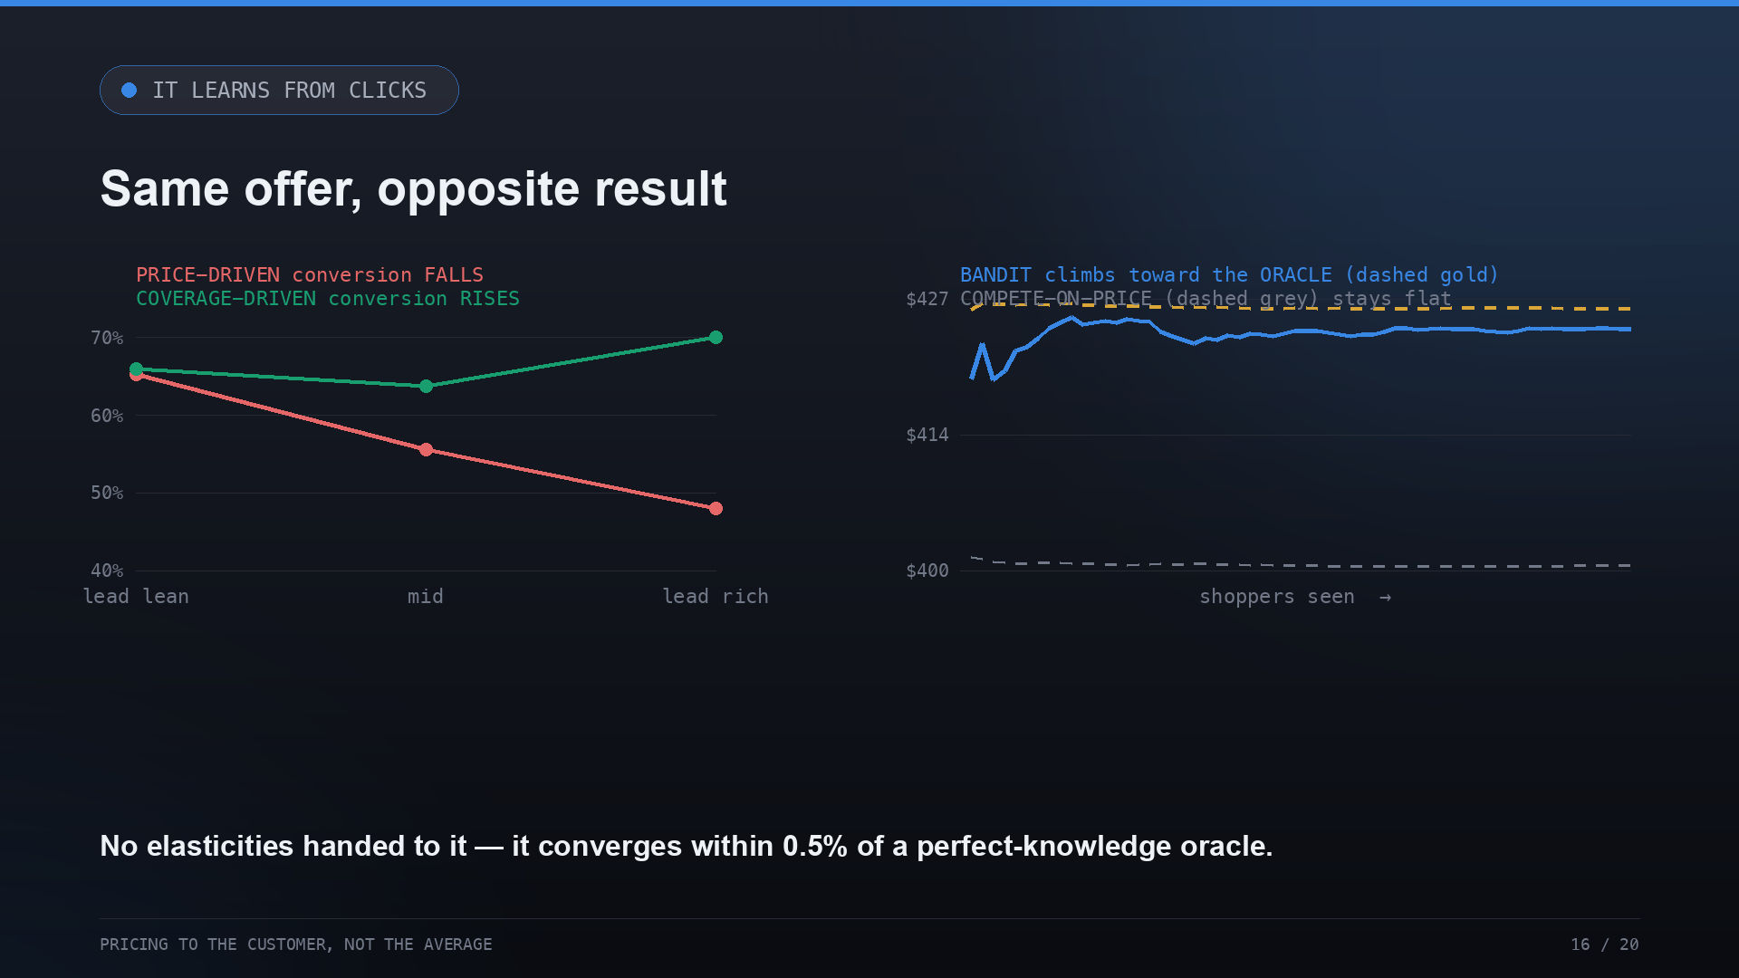
Notes:
In the real world you don't know a shopper's elasticity up front — you learn it from clicks. Push a price-driven shopper to richer coverage and conversion falls; push a coverage-driven one and it rises. Same offer, opposite result. A Thompson Sampling bandit finds each segment's best offer on its own, converging to within half a percent of a perfect-knowledge oracle.

Slide 17
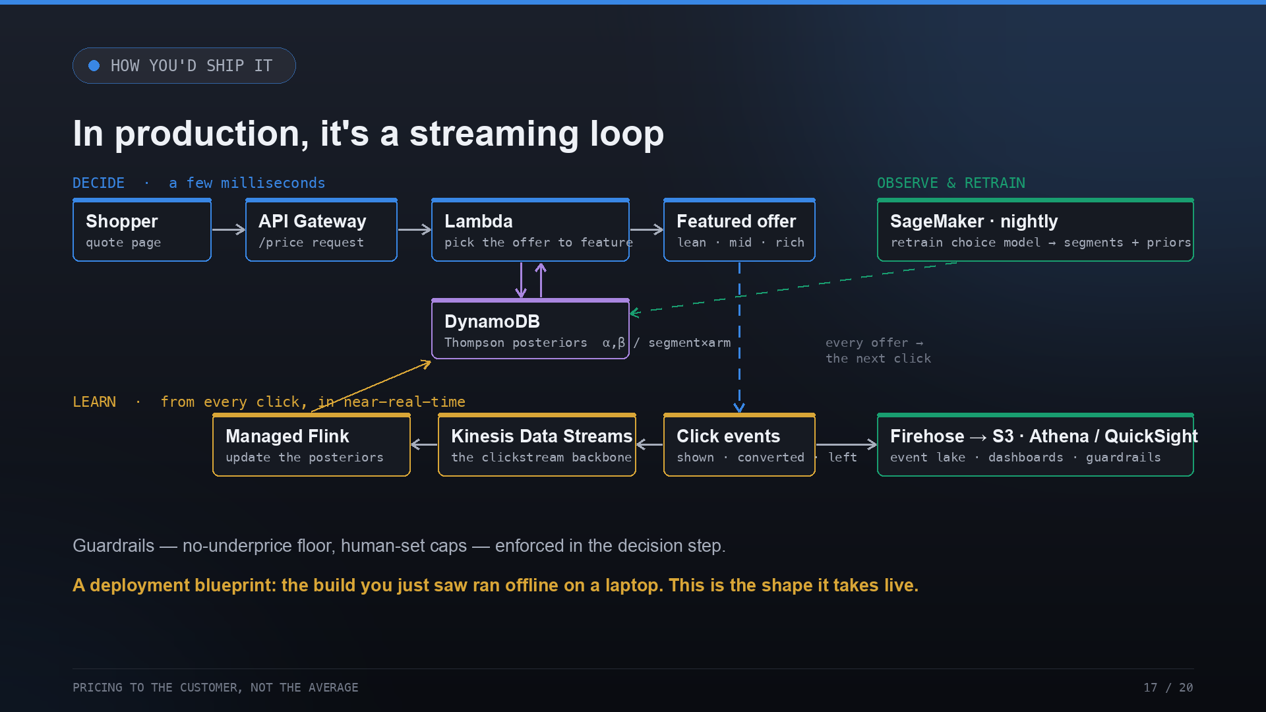
Notes:
How would this ship? In production it's a streaming loop. Every quote and click flows through Kinesis; a decision service — API Gateway and Lambda with the posteriors in DynamoDB — picks the offer in milliseconds; Flink folds conversions back in near-real-time; Firehose lands events in S3 for dashboards and a nightly SageMaker retrain. To be clear, this is a blueprint — the build itself ran offline on a laptop.

Slide 18
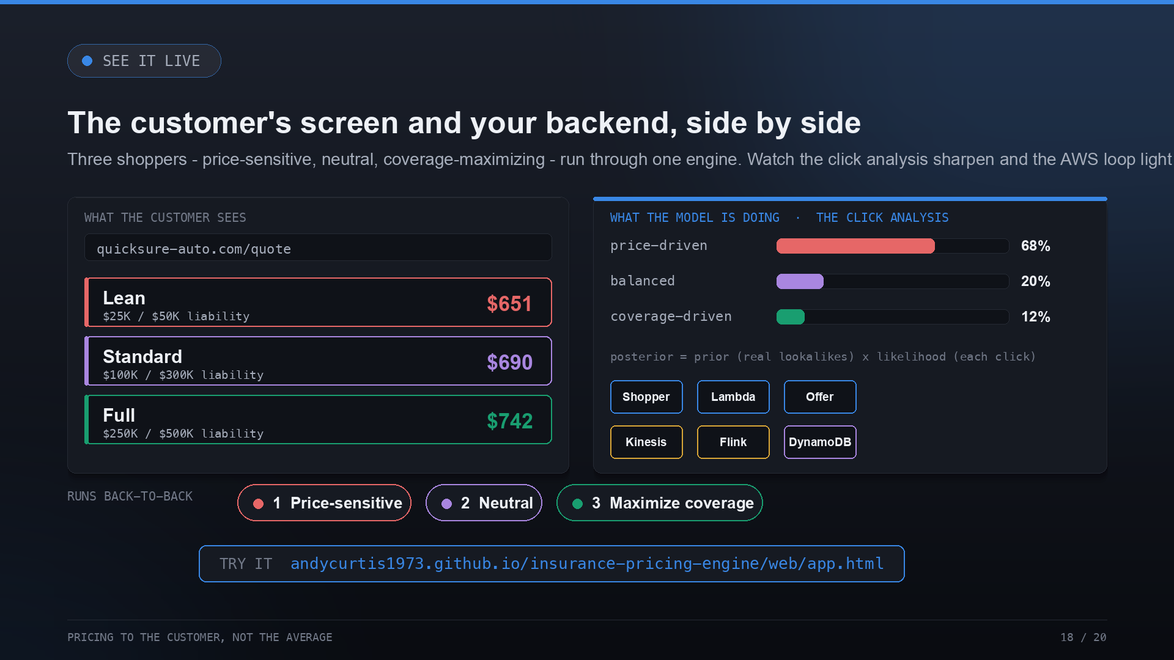
Notes:
And you can watch the whole thing run. This is the interactive demo: on the left is exactly what the customer sees — a quote site, three offers; on the right is what the model is doing — the belief bars over price-driven, balanced and coverage-driven sharpening with each click, and the AWS streaming loop lighting up as events flow. It runs three shoppers back to back: price-sensitive, neutral, and coverage-maximizing. It's a standalone web page — the link is on the slide and on the closing slide, so anyone can click through it themselves.

Slide 19
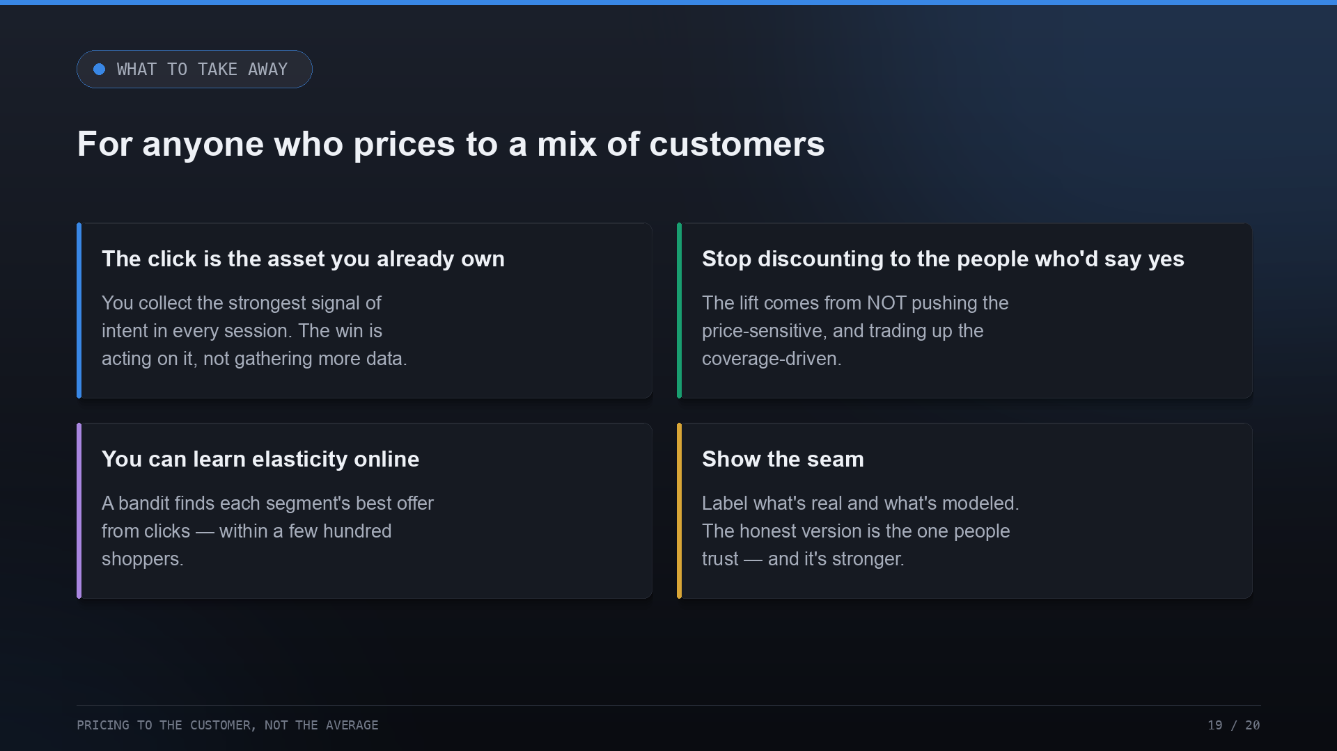
Notes:
Four things to take home. Heterogeneity is the whole game — 'the customer' is a fiction. The lift comes from not pushing the price-sensitive and trading up the coverage-driven. You can learn elasticity online, cheaply. And show the seam: labeling the modeled layer is what makes the rest believable.

Slide 20
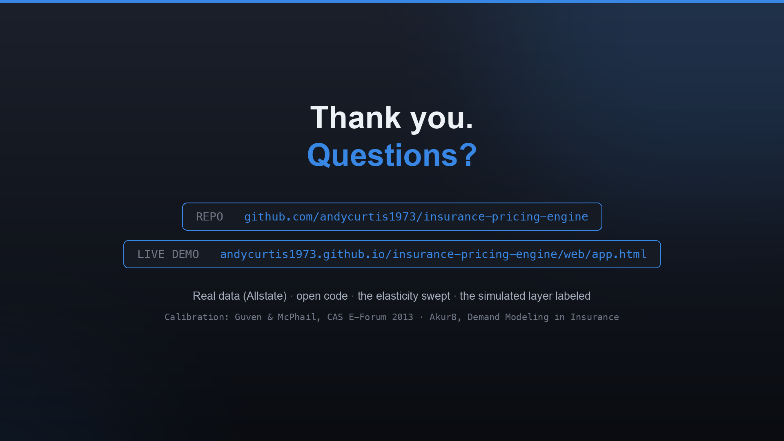
Notes:
That's the build. It's real data, open code, the elasticity swept, and the one simulated layer labeled. The repo and an interactive walkthrough are on screen. Happy to take questions — including the obvious one about deploying this against a live book with a real conversion signal.

