Slide 1


Andrew Daly
C11710699
DT211
Home Based Rehabilitation System for People with Cardio-Vascular Diseases

Slide 2

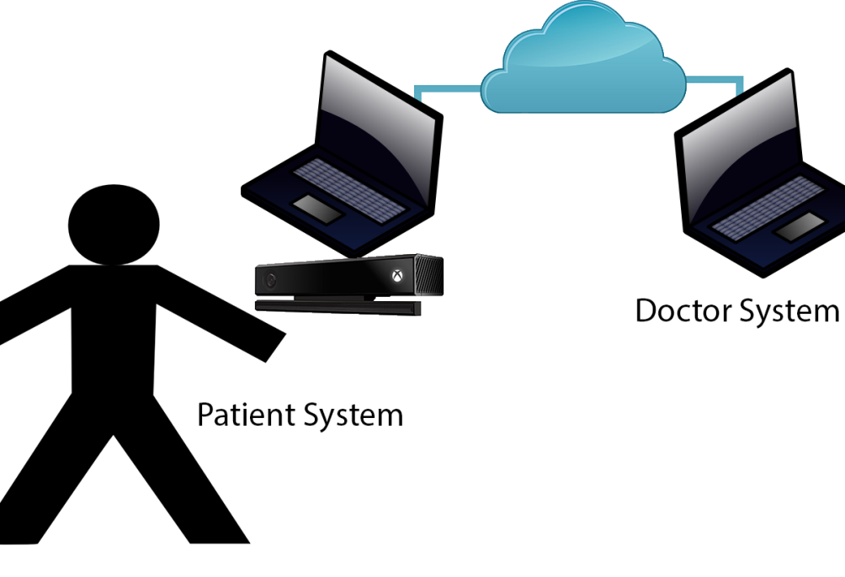
Introduction
2 systems, Doctor (Physio) system, Patient system
Geared towards patients in rehabilitation of cardio-vascular diseases
Patient uses patient system to perform workouts or play game
Doctor / Physioterapist monitors patient’s results
This eliminates the need for continuous check-ups to the Doctor’s Office
Uses Kinect 2, which has ability to monitor patients heart-rate

Slide 3
Project Objectives
1. Research if project feasible.
2. Research similar technologies to determine user requirements for this project.
3. Research technologies to determine the most appropriate implementation of this project.
4. Implement exercise tracking in patient system.
5. Implement serious game in patient system.
6. Implement doctor system.
7. Implement Heart-rate tracking in patient system.

Slide 4
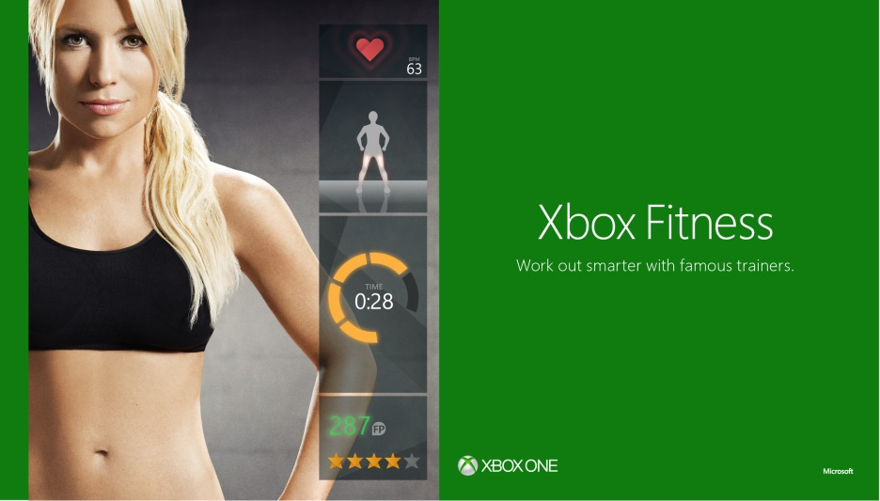
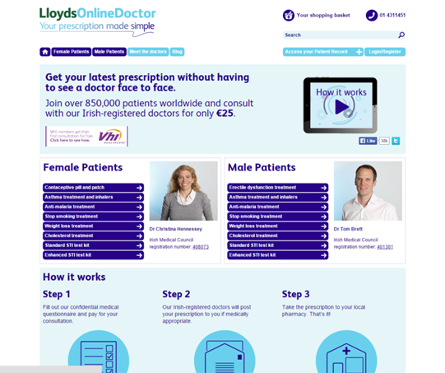
Research – Similar Systems
Xbox Fitness
Lloyds Online Doctor

Slide 5
Additional Research
Heart Rates
Resting Heart Rate
Maximum Heart Rate
Fetal Heart Rate
Heil Heart Rate
Target Heart Rate
Karvonen Heart Rate

Slide 6



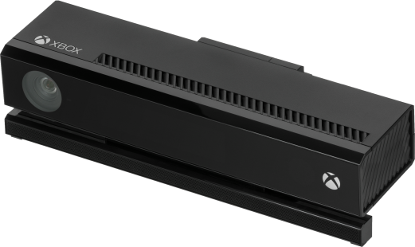


Original Technologies

Slide 7

Final Technologies

Slide 8
User Requirements
Patient System
Log in
Perform Basic Exercise
Play Game
View Records (Workout)
Doctor System
Log in
Create Patient Account
Select Patient
Edit Patient Details
Send Message
View Records (Workouts)
Comment on Workout

Slide 9
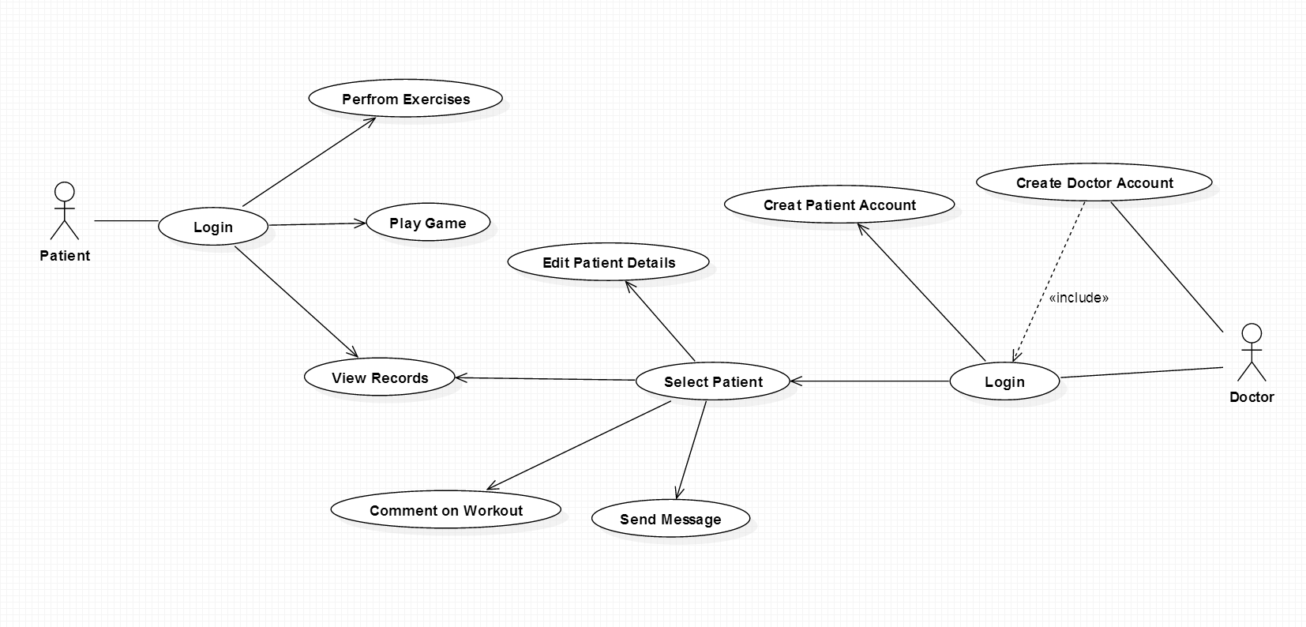
Use-Case Diagram

Slide 10
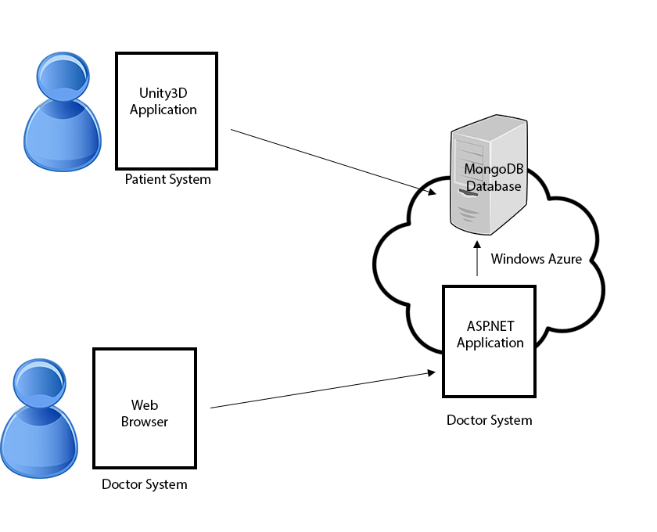
System Architecture

Slide 11
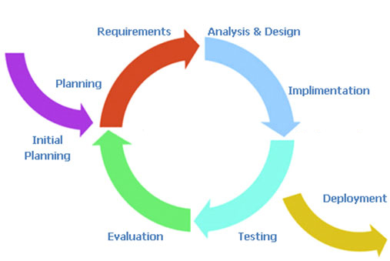
Methodology
Iterative and Incremental Model

Slide 12
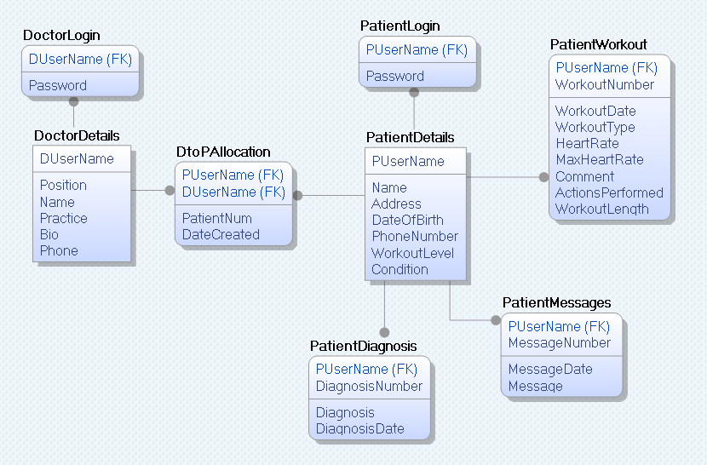
MongoDB ERD

Slide 13
Main System Components
Heart Health Application (HeartHealthKinect)
Health Health Website (HeartHealthWebsite)
Database Connection DLL (MongoConnectApp)

Slide 14
Implementation
Project began with getting acquainted with MongoDB
Initially Python with Django decided
Unity only uses C#, best to stick with it
ASP.NET

Slide 15
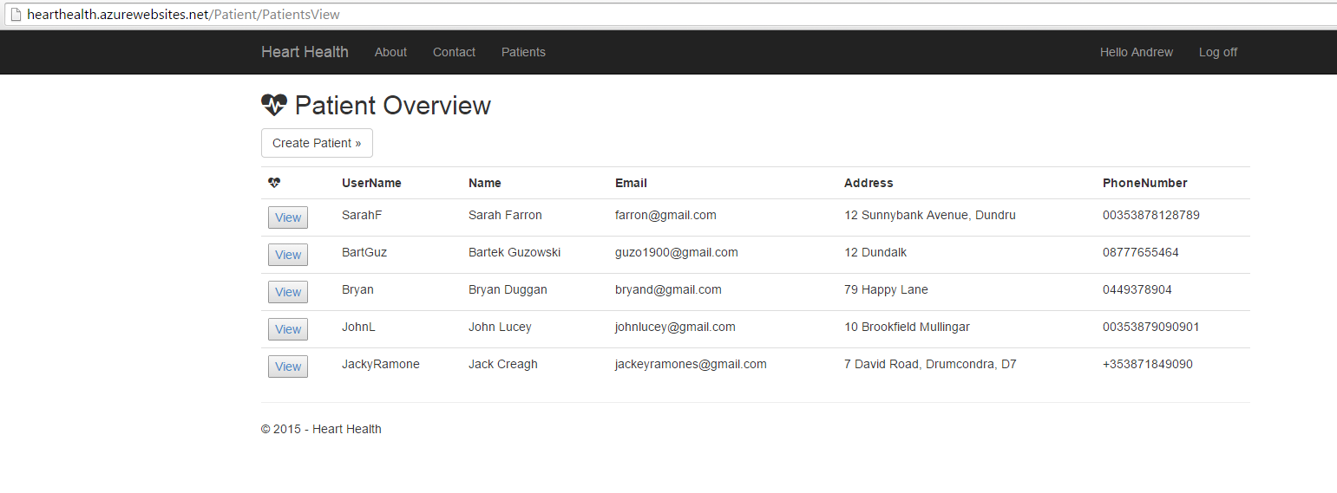
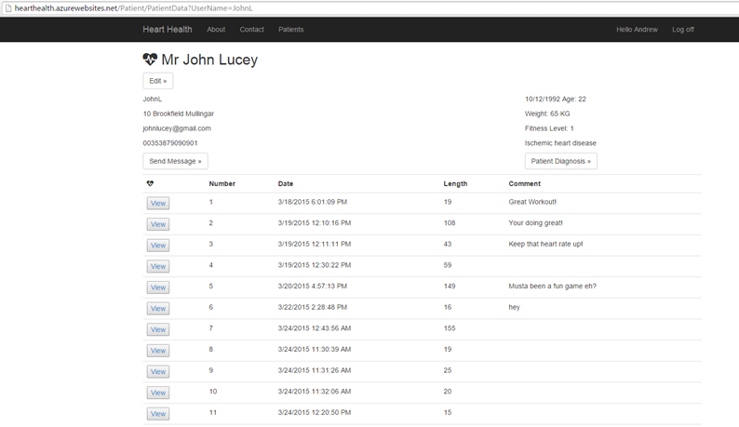
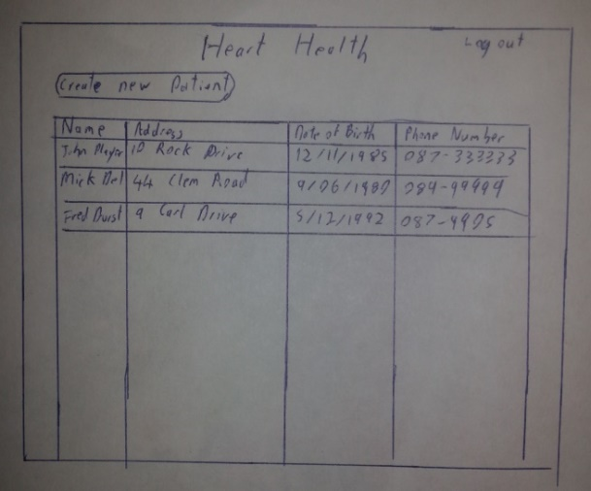
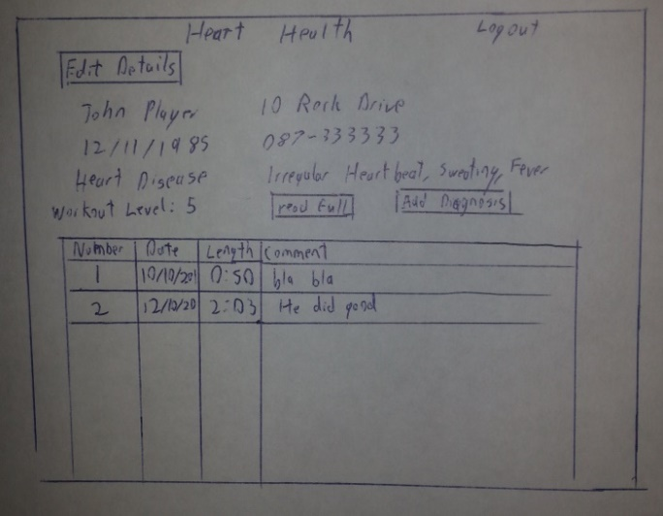
Implementation
User Interface Prototype Implementation

Slide 16
Implementation
Heart Rate Monitoring
Heart Rate Estimation
Fetal Heart Rate
Heil Heart Rate
Database Has been altered
{
"_id" : ObjectId("55061623ee97182214c35f00"),
"PUserName" : "SarahF",
"Name" : "Sarah Farron",
"Email" : "farron@gmail.com",
"Address" : "12 Sunnybank Avenue, Dundrum",
"DateOfBirth" : ISODate("1981-09-25T21:00:00.000Z"),
"PhoneNumber" : "00353878128789",
"FitnessLevel" : 3,
"Condition" : "Ischemic heart disease",
"WeightKG" : 71,
"IsMale" : false,
"Workout s" : [],
"Diagnosis" : [],
"Messages" : []
}

Slide 17
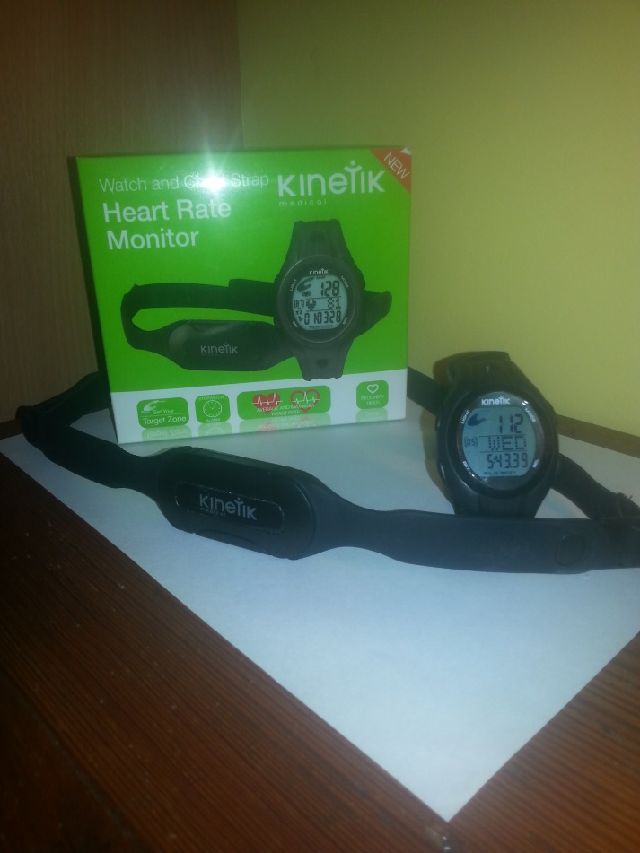
Implementation
No Equations for how heart rate is raised based on workouts performed (Squats, Jumping jacks)
Kinetik Heart Rate Monitor
Results:
At the beginning of the workout the heart rate raises quite slowly, doesn’t properly raise normally until around 5 or more actions performed (Squats or Jumping Jacks).
Heart rate increases faster if actions are perform in succession. Actions are performed immediately after one another.
Cool down decreases slowly but after a while of decreasing, it decreases fast.
Once the Heart rate reaches the Target Heart Rate depending on the user’s fitness level, it increases more slowly, which means more work must be done to increase which puts strain on the body.

Slide 18
Testing
Unit Tests
Test# | Result | Test# | Result | Test# | Result
1.1 | Pass | 3.5 | Pass | 5.11 | Pass
1.2 | Pass | 3.6 | Pass | 6.1 | Pass
1.3 | Fail | 3.7 | Fail | 6.2 | Pass
1.4 | Pass | 3.8 | Pass | 6.3 | Pass
1.5 | Pass | 3.9 | Pass | 6.4 | Pass
1.6 | Pass | 4.1 | Pass | 6.5 | Pass
1.7 | Pass | 4.2 | Pass | 6.6 | Pass
1.8 | Pass | 4.3 | Pass | 7.1 | Pass
1.9 | Pass | 4.4 | Pass | 7.2 | Pass
1.10 | Pass | 4.5 | Pass | 7.3 | Pass
1.11 | Pass | 4.6 | Pass | 8.1 | Pass
1.12 | Pass | 4.7 | Pass | 8.2 | Pass
1.13 | Pass | 4.8 | Pass | 8.3 | Pass
2.1 | Pass | 4.9 | Pass | 8.4 | Pass
2.2 | Pass | 5.1 | Pass
2.3 | Pass | 5.2 | Pass
2.4 | Pass | 5.3 | Pass
2.5 | Fail | 5.4 | Pass
2.6 | Pass | 5.5 | Pass
2.7 | Pass | 5.6 | Pass
3.1 | Pass | 5.7 | Pass
3.2 | Pass | 5.8 | Pass
3.3. | Pass | 5.9 | Pass
3.4 | Pass | 5.10 | Fail

Slide 19

Project Objectives
1. Research if project feasible.
2. Research similar technologies to determine user requirements for this project.
3. Research technologies to determine the most appropriate implementation of this project.
4. Implement exercise tracking in patient system.
5. Implement serious game in patient system.
6. Implement doctor system.
7. Implement Heart-rate tracking in patient system.
~ (Estimation)

Slide 20
Critical Evaluation
Actual Heart Rate monitoring implementation
Cleaner UI in Application
Allow Application to be used offline

Slide 21
Future Work
Unity Web Player
Heart Rate Monitoring

Slide 22
Heart Health
http://hearthealth.azurewebsites.net/
https://www.youtube.com/watch?v=4cBeFzicoqI

