Slide 1

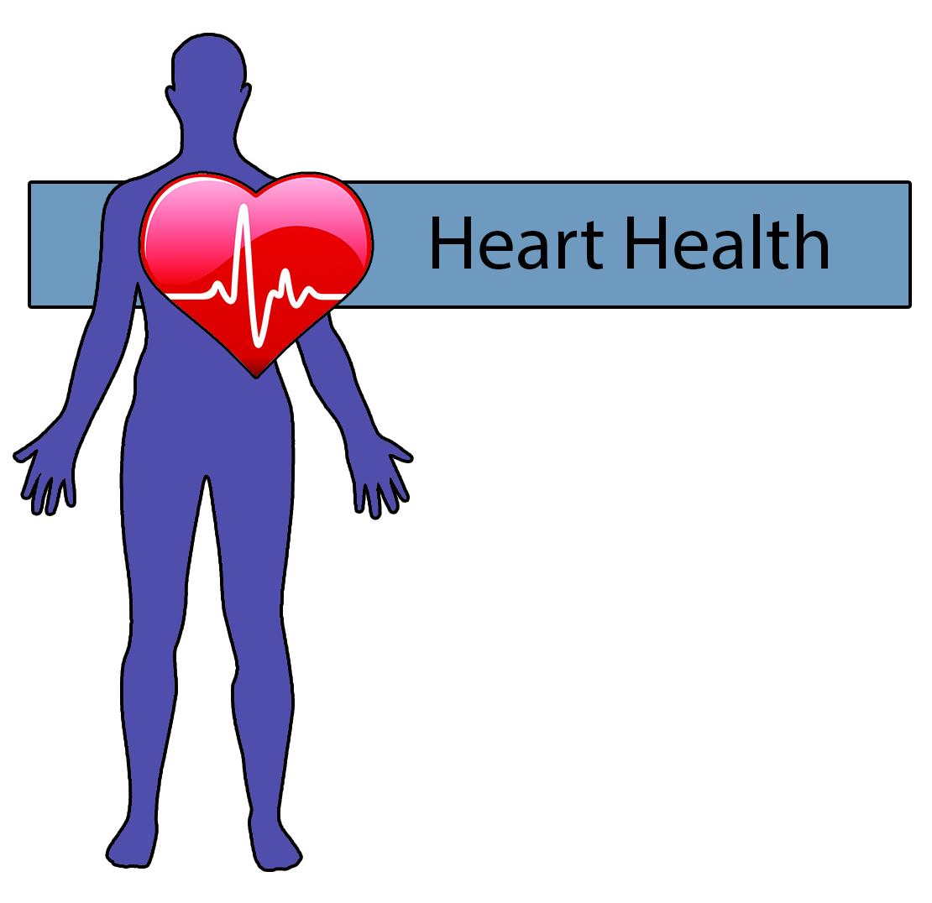
School Of Computing
Home Based Rehabilitation System for People with Cardio-Vascular Diseases
Andrew Daly
DT211
Heart Health is system used by both Patients and their Physiotherapists.
Patients carry out their exercises as part of rehabilitation using the Kinect Motion Capture Sensor.
Physiotherapists track Patients progress without the need of continuous check-ups.

