Slide 1

UvA – SNE/OS3
Security of Systems and Networks
“SSL key extraction from Android”
Stamatis Maritsas, Kenneth van Rijsbergen, Yadvir Singh

Slide 2
Introduction
Research question:
“How can we obtain the SSL sessions keys from the process memory of a running Android application?”
1st Approach: heap dumping
    Eclipse Memory Analyzer
    VisualVM
2nd Approach: hooking functions calls
    Frida, JDB
    OpenSSL library

Slide 3
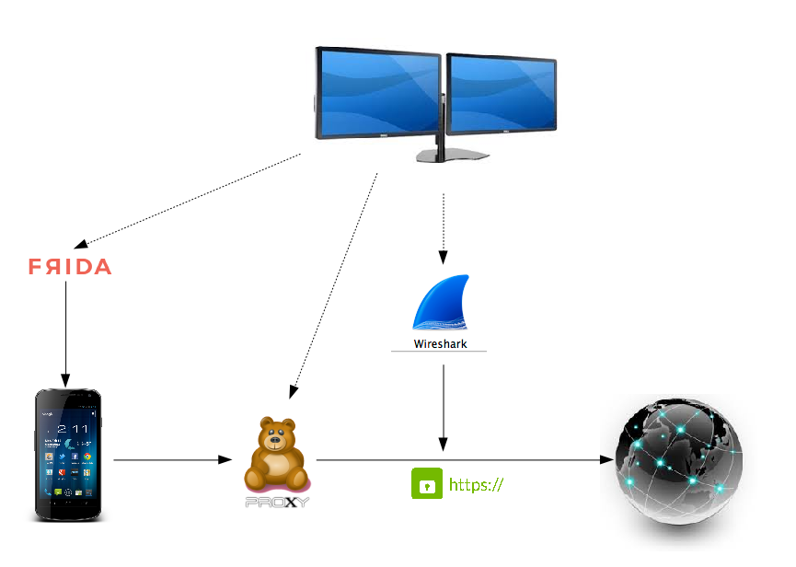
Setting up the experimental environment

Slide 4
Overview of modules
Desktop machine: indicates our experimental machine used for applying the tests
Smartphone with Android version 4.4.2 (KitKat)
Frida: a dynamic code instrumentation toolkit. We used it to trace OpenSSL library functions and also to inject modified JavaScript into built-in browser application of Android
Proxy server (tinyproxy): service running on desktop machine, to help us capture the TLS/SSL network traffic between smartphone and web interaction
Wireshark: a powerful network packet analyzer used for capturing the network packets that being exchanged during a TLS/SSL session. Wireshark needs the session ID and master key or only the private key to decrypt data
Websites: experiments took place on websites that use TLS/SSL (through HTTPS)

Slide 5
Exploring OpenSSL
Look for function that accept the Session-ID and Master key as arguments
Master-key = 48 bytes
Session-id = 32 bytes

Slide 6
Interesting functions
EVP_DigestUpdate(s1, s->session->master_key,s->session->master_key_length);
OPENSSL_cleanse(ss->master_key, sizeof ss→master_key);

Slide 7
Alternative approach
void SSL_SESSION_free(SSL_SESSION *ss)
{
.
.
OPENSSL_cleanse(ss->master_key, sizeof ss->master_key);
OPENSSL_cleanse(ss->session_id, sizeof ss->session_id);
.
.
}
SSL_SESSION *ss
+ 20
ss->master_key
+72
ss->session_id

Slide 8
The script
int SSL_CTX_add_session(SSL_CTX *s, SSL_SESSION *c)
onEnter(log, args, state) {
a = args[1].toInt32() + 20
b = new NativePointer(a)
key = Memory.readByteArray(b, 48)
//The ArrayBuffer needs to be converted to decimals
tempConvert = new Uint8Array(key)
arr = []
//Convert decimal to hex.
for(i = 0; i < 48; i++){
arr[i] = ("0" + tempConvert[i].toString(16).toUpperCase()).substr(-2)
}
//Print the key
log (arr[0] +arr[1] +arr[2] +arr[3] +arr[4] + . . . . . .

Slide 9
Tested HTTPS websites
NAME | HTTPS WEBSITE | DECRYPTION LEVEL
VU Blackboard | https://bb.vu.nl | Partial / Password obtained
DigiD | https://www.digid.nl | Partial / Password obtained
Dienst Uitvoering Onderwijs | https://duo.nl | Entire page
Microsoft Outlook | https://hotmail.com | Entire / Password obtained
ING – My Login | https://mijn.ing.nl | Partial / Password obtained
Top-up credit on UvA card | https://uva-hva.mynetpay.nl/ | Entire / Password obtained

Slide 10
Conclusion
We were able to extract TLS/SSL master key and session ID from the process memory
Using the found data pair we were able to decrypt most of the HTTPS traffic using Wireshark
(!) Some of the decrypted data contain sensitive information :) or :(

Slide 11
Attack limitations
A rooted Android smartphone is needed
Frida limitations: experimental, with limited documentation, not all functions traceable?
Intercepting the network traffic
Smartphone needs to be physically connected to computer

Slide 12
Future work
Wireless connection to smartphone's Frida server
Using Frida without root access
    Cedric Van Bockhaven: “By decompiling, injecting a shared object, and then repackaging the apk.”

Slide 13

References
“Extracting RSAPrivateCrtKey and Certificates from an Android Process”, http://blog.opensecurityresearch.com/2013/10/extracting-rsaprivatecrtkey-and.html
Frida, http://www.frida.re/
Cedric Van Bockhaven creator of the project
Wireshark SSL Wiki, https://wiki.wireshark.org/SSL
OpenSSL GIT repository, https://github.com/openssl/openssl

