Slide 1
Introduction to Hive
Bigdata Analytics

Slide 2
What is Hive?
Hive is a framework designed for data warehousing that runs on top of Hadoop.
It enables users to run queries on the huge volumes of data.
Its basic function is to convert SQL queries into MapReduce jobs.
Initially Hive was developed by Facebook, later the Apache Software Foundation took it up and developed it further as an open source under the name Apache Hive.

Slide 3
What is Hive?
Hive is not
A relational database
A design for OnLine Transaction Processing (OLTP)
A language for real-time queries and row-level updates
Hive makes job easy for performing operations like
Data encapsulation
Ad-hoc queries
Analysis of huge datasets

Slide 4
Important characteristics of Hive
In Hive, tables and databases are created first and then data is loaded into these tables.
Hive as data warehouse designed for managing and querying only structured data that is stored in tables.
While dealing with structured data, Map Reduce doesn't have optimization and usability features but Hive framework does.
Query optimization refers to an effective way of query execution in terms of performance.
Hive's SQL-inspired language separates the user from the complexity of Map Reduce programming.
It reuses familiar concepts from the relational database world, such as tables, rows, columns and schema, etc. for ease of learning.
Hadoop's programming works on flat files.
So, Hive can use directory structures to "partition" data to improve performance on certain queries.

Slide 5
Hive Vs Relational Databases
Relational databases are of "Schema on READ and Schema on Write". First creating a table then inserting data into the particular table. On relational database tables, functions like Insertions, Updates, and Modifications can be performed.
Hive is "Schema on READ only". So, functions like the update, modifications, etc. don't work with this. Because the Hive query in a typical cluster runs on multiple Data Nodes. So it is not possible to update and modify data across multiple nodes.
Also, Hive supports "READ Many WRITE Once" pattern.
Which means that after inserting table we can update the table in the latest Hive versions.

Slide 6
Hive Components
High-level language (HiveQL)
Set of commands
Two Main Components
Two execution modes
Local: reads/write to local file system
Mapreduce: connects to Hadoop cluster and reads/writes to HDFS
Interactive mode
Console
Two modes
Batch mode
Submit a script

Slide 7
Hive deals with Structured Data
Hive Data Models:
The Hive data models contain the following components:
Databases : 3-Levels: Tables → Partitions → Buckets
Tables : maps to a HDFS directory
Partitions : maps to sub-directories under the table
Buckets or clusters : maps to files under each partition
Very similar to SQL and Relational DBs

Slide 8
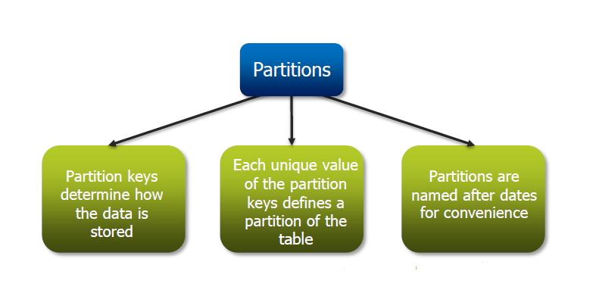
Partitions:
Partition means dividing a table into a coarse grained parts based on the value of a partition column such as ‘data’. This makes it faster to do queries on slices of data.
The Partition keys determine how data is stored. Here, each unique value of the Partition key defines a Partition of the table. The Partitions are named after dates for convenience. It is similar to ‘Block Splitting’ in HDFS.
Allows users to efficiently retrieve rows

Slide 9
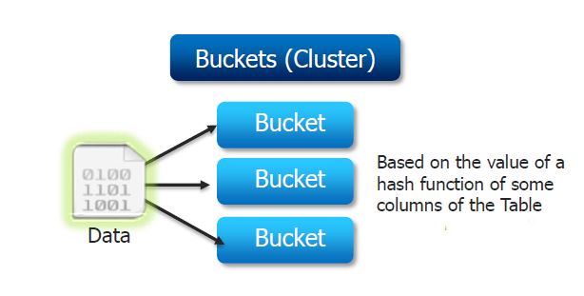
Buckets:
Buckets give extra structure to the data that may be used for efficient queries.
Split data based on hash of a column – mainly for parallelism
Data in each partition may in turn be divided into Buckets based on the value of a hash function of some column of a table.

Slide 10
Hive Architecture
Hive Consists of Mainly 3 core parts
1. Hive Clients
2. Hive Services
3. Hive Storage and Computing

Slide 11
Hive Clients
Hive provides different drivers for communication with a different type of applications. For Thrift based applications, it will provide Thrift client for communication.
For Java related applications, it provides JDBC Drivers.
Other than any type of applications provided ODBC drivers.
These Clients and drivers in turn again communicate with Hive server in the Hive services.

Slide 12
Hive Services
Client interactions with Hive can be performed through Hive Services.
If the client wants to perform any query related operations in Hive, it has to communicate through Hive Services.
CLI is the command line interface acts as Hive service for DDL (Data definition Language) operations.
All drivers communicate with Hive server and to the main driver in Hive services as shown in above architecture diagram.
Driver present in the Hive services represents the main driver, and it communicates all type of Thrift, JDBC, ODBC, and other client specific applications.
Driver will process those requests from different applications to meta store and field systems for further processing.

Slide 13
Hive Storage and Computing
Hive services such as Meta store, File system, and Job Client in turn communicates with Hive storage and performs the following actions
Metadata information of tables created in Hive is stored in Hive "Meta storage database".
Query results and data loaded in the tables are going to be stored in Hadoop cluster on HDFS.

Slide 14
Component diagram depicts the architecture of Hive

Slide 15
Component diagram depicts the architecture of Hive

Slide 16
Job exectution flow

Slide 17
Job exectution flow (cont..)
The data flow in Hive behaves in the following pattern;
1. Executing Query from the UI( User Interface)
2. The driver is interacting with Compiler for getting the plan. (Here plan refers to
query execution) process and its related metadata information gathering.
3. The compiler creates the plan for a job to be executed. Compiler communicating with
Meta store for getting metadata request
4. Meta store sends metadata information back to compiler
5. Compiler communicating with Driver with the proposed plan to execute the query
6. Driver Sending execution plans to Execution engine

Slide 18
Job exectution flow (cont..)
7. Execution Engine (EE) acts as a bridge between Hive and Hadoop to process the query. For DFS operations.
EE should first contacts Name Node and then to Data nodes to get the values stored in tables.
EE is going to fetch desired records from Data Nodes. The actual data of tables resides in data node only.
While from Name Node it only fetches the metadata information for the query.
It collects actual data from data nodes related to mentioned query
Execution Engine (EE) communicates bi-directionally with Meta store present in Hive to perform DDL (Data Definition Language) operations. Here DDL operations like CREATE, DROP and ALTERING tables and databases are done.
Meta store will store information about database name, table names and column names only. It will fetch data related to query mentioned.
Execution Engine (EE) in turn communicates with Hadoop daemons such as Name node, Data nodes, and job tracker to execute the query on top of Hadoop file system

Slide 19
Job exectution flow (cont..)
8. Fetching results from driver
9. Sending results to Execution engine. Once the results fetched from data nodes to the EE, it will send results back to driver and to UI ( front end)
Hive Continuously in contact with Hadoop file system and its daemons via Execution engine.
The dotted arrow in the Job flow diagram shows the Execution engine communication with Hadoop daemons.

Slide 20
Metastore
Database: namespace containing a set of tables
Holds table definitions (column types, physical layout)
Holds partitioning information
Can be stored in MySQL, and many other relational databases

Slide 21
Physical Layout
• Warehouse directory in HDFS
• E.g., /user/hive/warehouse
• Tables stored in subdirectories of warehouse
• Partitions form subdirectories of tables
• Each table has a corresponding HDFS directory
• Actual data stored in flat files
• Users can associate a table with a serialization format
• Control char-delimited text, or SequenceFiles
• With custom SerDe, can use arbitrary format

Slide 22
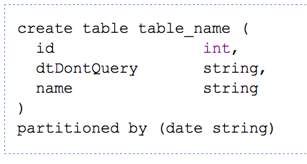
Hive DDL Commands
CREATE TABLE sample (foo INT, bar STRING) PARTITIONED BY (ds STRING);
SHOW TABLES '.*s';
DESCRIBE sample;
ALTER TABLE sample ADD COLUMNS (new_col INT);
DROP TABLE sample;
A table in Hive is an HDFS directory in Hadoop
Schema is known at creation time (like DB schema)
Partitioned tables have “sub-directories”, one for each partition

Slide 23
Hive DML
Load data from local file system
Delete previous data from that table
LOAD DATA LOCAL INPATH './sample.txt' OVERWRITE INTO TABLE sample;
LOAD DATA INPATH '/user/falvariz/hive/sample.txt’ INTO TABLE partitioned_sample PARTITION (ds='2012-02-24');
Load data from HDFS
Augment to the existing data
Must define a specific partition for partitioned tables
Loaded data are files copied to HDFS under the corresponding directory

Slide 24
Hive QL – Join
page_view
user
pv_users
pageid | userid | time
1 | 111 | 9:08:01
2 | 111 | 9:08:13
1 | 222 | 9:08:14
pageid | age
1 | 25
2 | 25
1 | 32
userid | age | gender
111 | 25 | female
222 | 32 | male
X
=
SQL:
INSERT INTO TABLE pv_users
SELECT pv.pageid, u.age
FROM page_view pv JOIN user u ON (pv.userid = u.userid);

Slide 25
Hive QL – Join in Map Reduce
page_view
pv_users
pageid | userid | time
1 | 111 | 9:08:01
2 | 111 | 9:08:13
1 | 222 | 9:08:14
key | value
111 | <1,1>
111 | <1,2>
222 | <1,1>
key | value
111 | <1,1>
111 | <1,2>
111 | <2,25>
pageid | age
1 | 25
2 | 25
Shuffle
Sort
user
Map
Reduce
userid | age | gender
111 | 25 | female
222 | 32 | male
key | value
111 | <2,25>
222 | <2,32>
key | value
222 | <1,1>
222 | <2,32>
pageid | age
1 | 32

Slide 26
Hive QL – Group By
pv_users
pageid_age_sum
pageid | age
1 | 25
2 | 25
1 | 32
2 | 25
pageid | age | Count
1 | 25 | 1
2 | 25 | 2
1 | 32 | 1
SQL:
INSERT INTO TABLE pageid_age_sum
SELECT pageid, age, count(1)
FROM pv_users
GROUP BY pageid, age;

Slide 27
Hive QL – Group By in Map Reduce
pageid_age_sum
pv_users
pageid | age
1 | 25
2 | 25
key | value
<1,25> | 1
<2,25> | 1
key | value
<1,25> | 1
<1,32> | 1
pageid | age | Count
1 | 25 | 1
1 | 32 | 1
Shuffle
Sort
Map
Reduce
pageid | age
1 | 32
2 | 25
key | value
<1,32> | 1
<2,25> | 1
key | value
<2,25> | 1
<2,25> | 1
pageid | age | Count
2 | 25 | 2

Slide 28
Hive QL – Group By with Distinct
page_view
result
pageid | userid | time
1 | 111 | 9:08:01
2 | 111 | 9:08:13
1 | 222 | 9:08:14
2 | 111 | 9:08:20
pageid | count_distinct_userid
1 | 2
2 | 1
SQL
SELECT pageid, COUNT(DISTINCT userid)
FROM page_view GROUP BY pageid

