Slide 1
Frito Lay Attrition
Andy Bui
Notes:
Hello everyon. I'm Andy Bui from DDSAnalytics. Today I'll be presenting our findings on employee attrition at Frito Lay, including what's driving it, how we can predict it, and what it's costing the company

Slide 2
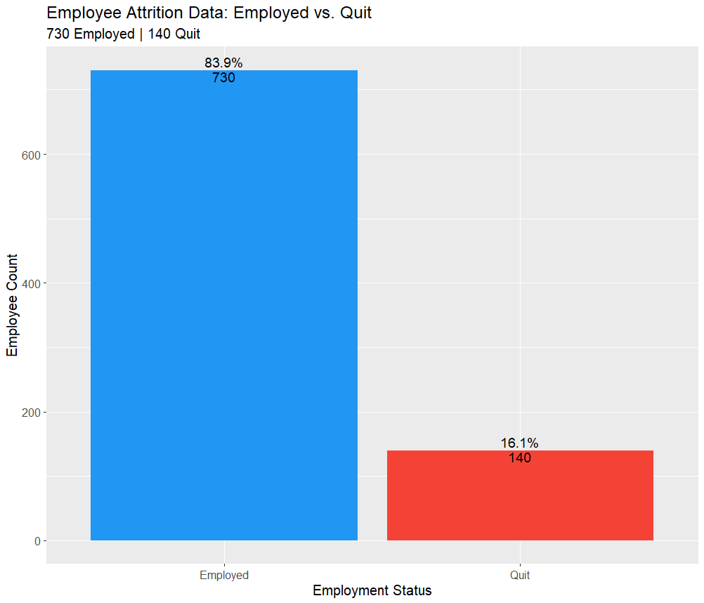
Employee Attrition Data
Frito Lay’s has a total of 870 employees
730 Still Employed
About 84%
140 Quit
About 16%
Notes:
We analyzed 870 frito lays employee. 730 are still with the company but 140 have quit. That's a 16% attrition rate. On the surface that might not sound alarming, but when you factor in replacement costs, that number becomes very significant

Slide 3
Possible Attrition Factors
Notes:
What's actually driving people to leave? We analyzed over 30 variables across your workforce to identify which ones matter most.

Slide 4
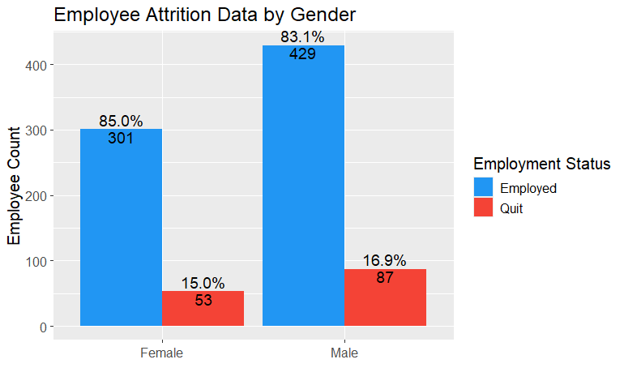
Gender
Attrition By Gender
Female
15%
Male
16.9%
Attrition percentage within gender group is similar to the opposite gender
Gender plays minimal roll in attrition
Can remove Gender as a factor for attrition
Notes:
The first thing we checked was gender. Female attrition is 15%, male is 16.9% essentially identical. Gender is not a meaningful driver of attrition at your company, so we can set that aside and focus on factors that actually matter.

Slide 5
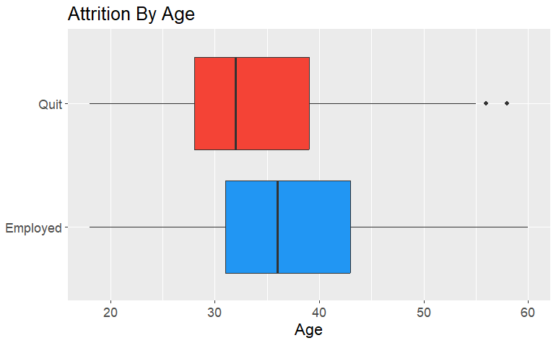
Age
Majority of Frito Lay's turnover occurs among younger employees
Older Frito Lay’s employees tend to stay with the company
Age can be used to determine the likeliness of attrition
Average age of employees who quit: 33 vs 37 for those who stayed
Notes:
Age is a clear signal. Employees who quit averaged an age of 33, while those who stayed averaged 37. Your younger workforce is significantly more likely to leave. This is important because younger employees are often in entry-level roles, which connects with other factors

Slide 6
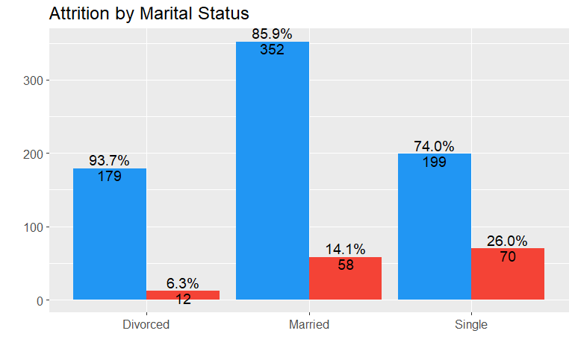
Marital Status
Marital status has 3 categories that show distinct attrition patterns
Attrition occurs within married and single employees
Single employees having the highest attrition
Divorced Employees show the lowest attrition rate
Marital status can be used to determine attrition
Notes:
Marital status shows a distinct pattern. Single employees have the highest attrition rate, while divorced employees actually show the lowest. Our theory is that single employees have fewer financial and lifestyle obligations keeping them tied to a stable job, making them more willing to take risks and switch employers.

Slide 7
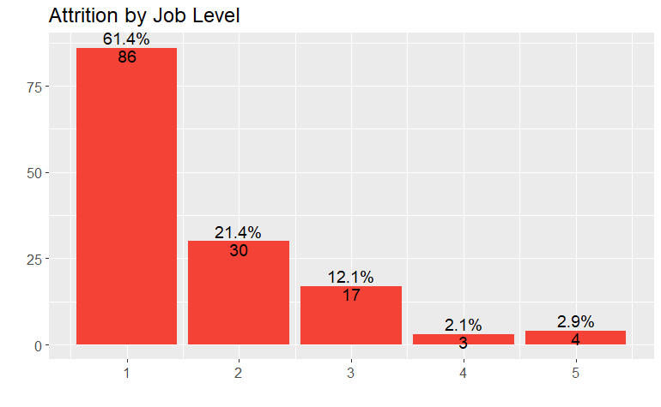
Job Level
Job level is another strong indicator
Entry level employees account for 61.4% of all attrition
Attrition drops sharply as employees advance to high level jobs
Notes:
Job Level, this is one of our strongest findings. Job Level 1, entry level employees, account for 61.4% of attrition. A great portion of your attrition sets at the bottom of your organization. As employees move up attrition drops sharply.

Slide 8
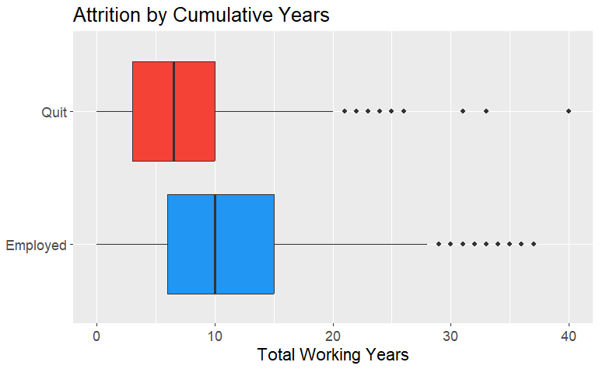
Total Years of Work Experience
Employees with fewer total working years are significantly more likely to quit
This likely correlates with age, Younger employees naturally have fewer working years and also show higher attrition
Employees who quit had an average experience of 7 years vs 10 years for those who stayed
Notes:
Employees who quit had an average of 7 years total work experience, vs 10 years for those who stayed. This is likely a tied with age. Your younger employees are the highest flight risk. You seasoned employees tend to be more settled in their careers

Slide 9
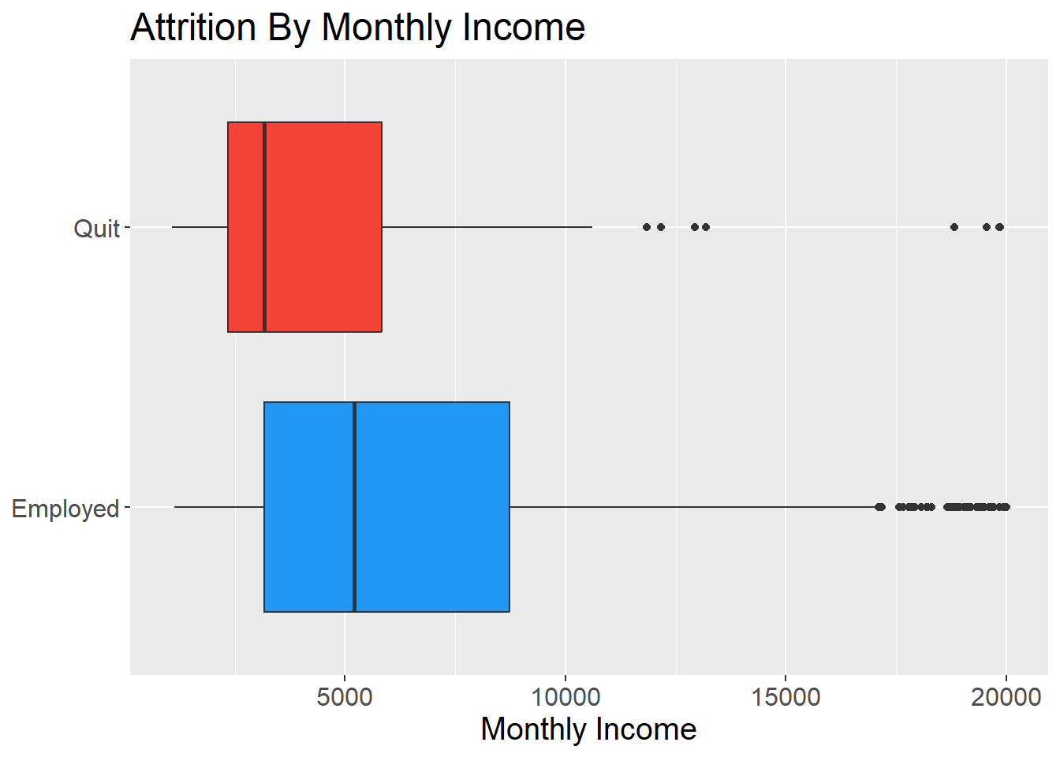
Monthly Income
Lower paid, entry-level employees show much higher attrition
Money and career progression matters
Employees who quit had an average monthly salary for $3,000 and those who stayed had a average monthly salary of $5,500
Notes:
Money matters. Employees who quit were earning around $3,000 per month on average, compared to $5,500 for those who stayed. That's nearly double. Combined with the job level finding, this suggests that relatively modest salary increases or faster promotion pathways for entry-level employees could help with retention

Slide 10
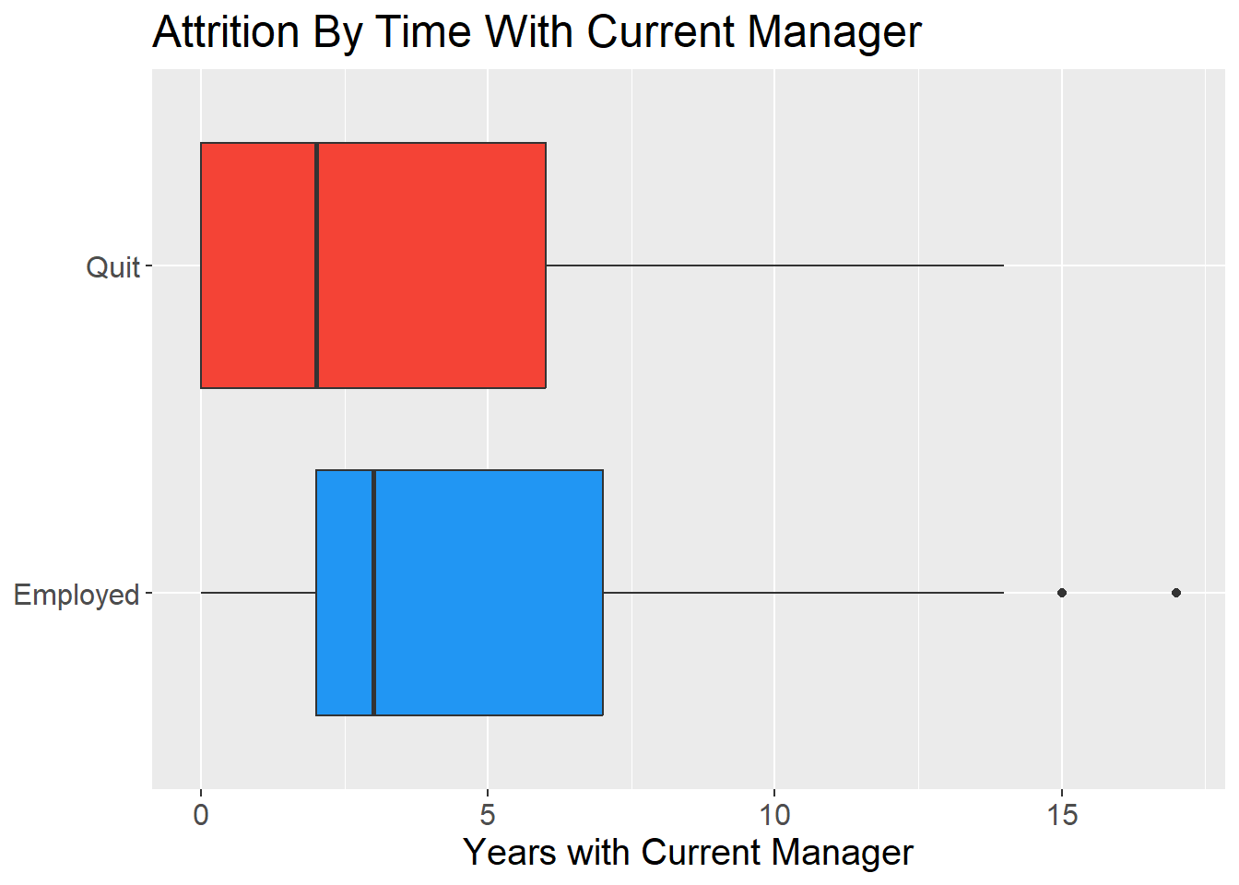
Years With Current Manager
Employees with less time under their current manager show higher attrition
Longer tenure with a manger is associated with higher retention
Employees who quit had an average of 2 years with their manager
Employees who stayed had an average of 3 years with their manager
Notes:
Employees who quit had spent an average of only 2 years with their current manager, versus 3 years for those who stayed. Manager relationships matter. Your company can actively promote healthier manager and employee work relations to increase relation and reduce attrition

Slide 11
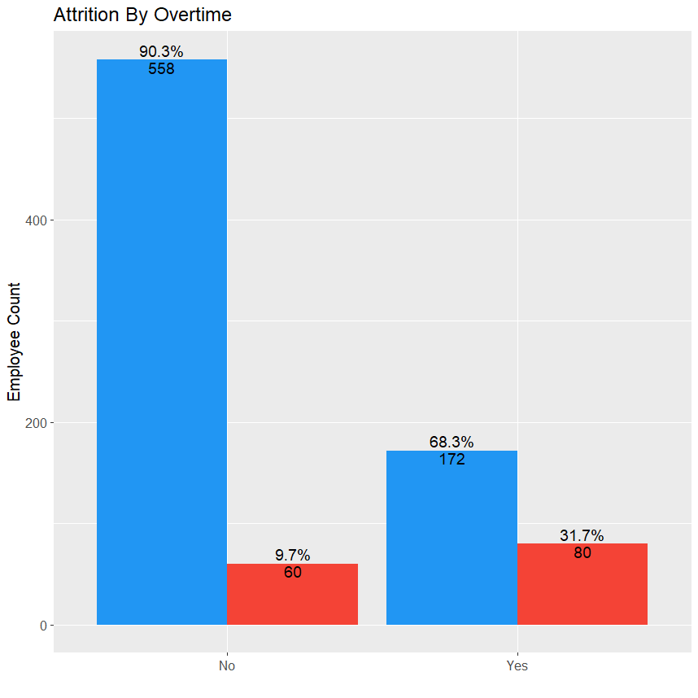
Overtime
Employees that are working overtime are more likely to quit
This seems to be a strong indicator as those that do over time are quitting more than those that don’t
Indicating that employees are burnt out and leave
Notes:
Overtime is one of our top 3 factors. Employees working overtime quit at a dramatically higher rate than those who don't. The data suggests burnout is a real issue. If your company can identify what is causing overtime, you can significantly reduce turnovers

Slide 12
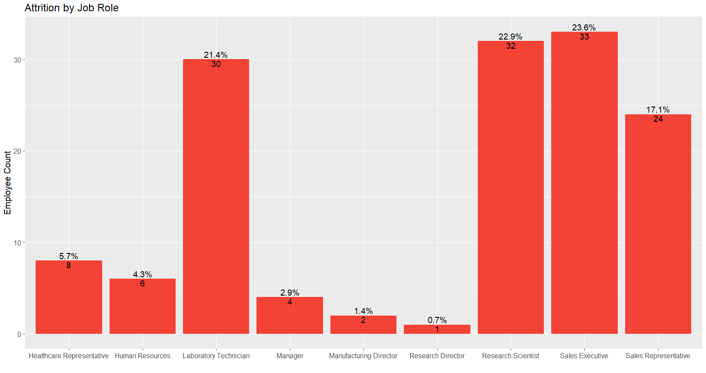
Job Role
Sales Department, Research Scientist and Lab Technician have the highest turn over
Notes:
Looking at job roles, the Sales department, Research Scientists, and Lab Technicians account for the highest number of departures overall. These are your highest volume turnover roles.

Slide 13
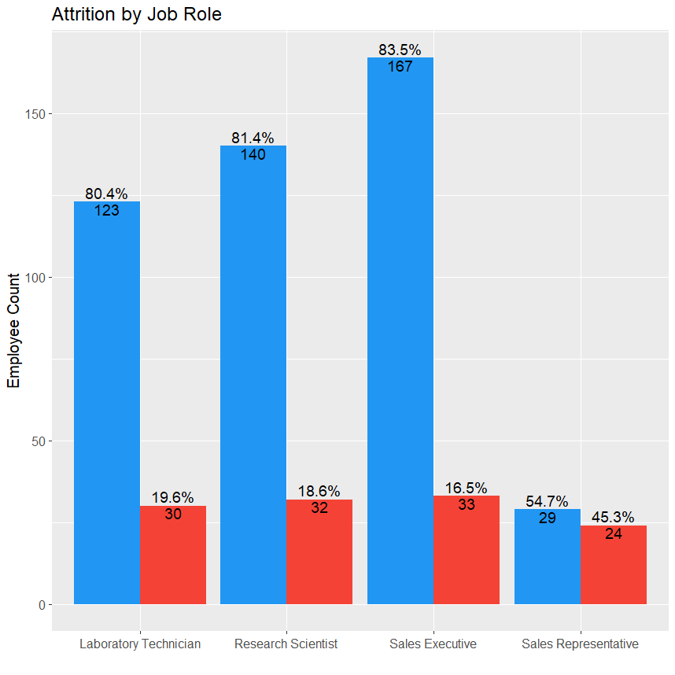
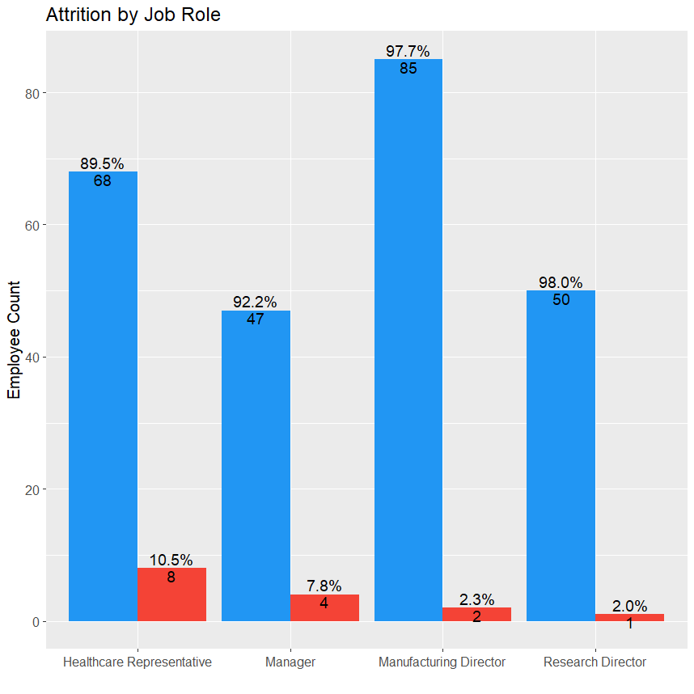
Job Role
Sales Representative has the highest attrition rate at 45.3%, followed by Laboratory Technician (19.6%) and Research Scientist (18.6%)
Jobs in the left chart are high risk group worth targeting retention efforts
Notes:
But when we look at attrition rate within each role, Sales Representatives stand out at 45.3%. Nearly half of your Sales Representatives quit. Laboratory Technicians at 19.6% and Research Scientists at 18.6% are also elevated. These three roles are your priority targets for retention investment.

Slide 14
Key Takeaways
3 Major Factors for Attrition
Overtime
Monthly Income
Marital Status
Other Helping Indetifiers
Age
Job level
Total Years of Work Experience
Years with their current manager
Job Role
Notes:
Pulling it all together, the factors most strongly associated with attrition are overtime, monthly income, marital status, age, job level, work experience, manager tenure, and job role. Our top 3 are overtime, monthly income, and marital status. These are the variables that driving our predictive models

Slide 15
Prevention and Cost
Notes:
Now let's talk about what this actually costs and you can assist

Slide 16
Cost breakdown
Average Employee Salary
Average salary of level 1
Level 1 Monthly income ~ $2744
Average salary of level 2
Level 2 Monthly income ~ $5544
Level 2 Yearly income ~ $66,528
Retention Incentive Program
Per employee intervention cost
$200
Level 1 Yearly income ~ $32,928
Total Average of both level 1 and 2 ~ $49,728
Cost for Attrition
It costs up to 50% - 400% of that employee's salary to have them replaced
Our analysis will use 200%
Notes:
Replacing an employee costs between 50% and 400% of their annual salary when you factor in recruiting, onboarding, lost productivity, and training. For our analysis we used 200% as a conservative estimate. The average salary across your highest-risk Job Levels 1 and 2, is $49,728 per year. We also assumed a $200 per-employee intervention cost. This a retention conversation, a small bonus, or a check-in program.

Slide 17
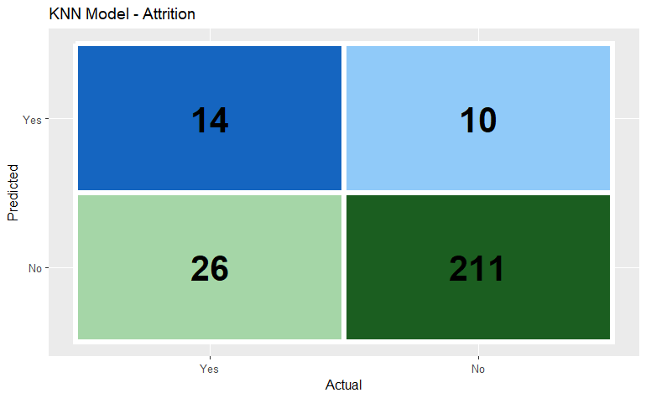
Employee Turnover with KNN Model
With this model we use the 5 most similar employees to determine attrition
We were able to correctly identify 35% sensitivity of those that would quit
Correctly predicted 14 turnovers
Missed 26 turnovers
We were also able to predict 95% specificity of those that didn’t quit
Correctly predicted 211 employees not quitting
Flagged 10 employees as flight risks who actually stayed, false alarms
Notes:
We built two predictive models. The first is called KNN, it works by finding the 5 most similar employees in your workforce and using their outcomes to predict whether someone will quit. In its baseline, it correctly identified 35% of employees who would quit. While that sounds low, it's a starting point and I'll show you how we improved it significantly. It’s also predicted up 95% of employees do didn’t quit. While this number may be big the model we’d like to have both true’s high

Slide 18
Cost using this KNN to prevent turnover
(14 true positives + 10 false alarms) * $200 = $4,800
26 missed * $49,728 avg salary * 200% replacement cost = $ 2,585,856
Total cost = $ 2,590,656
Notes:
With the baseline KNN model, the total estimated cost is $2.59 million, mostly driven by the 26 employees it missed, who then quit, and had to be replaced.

Slide 19
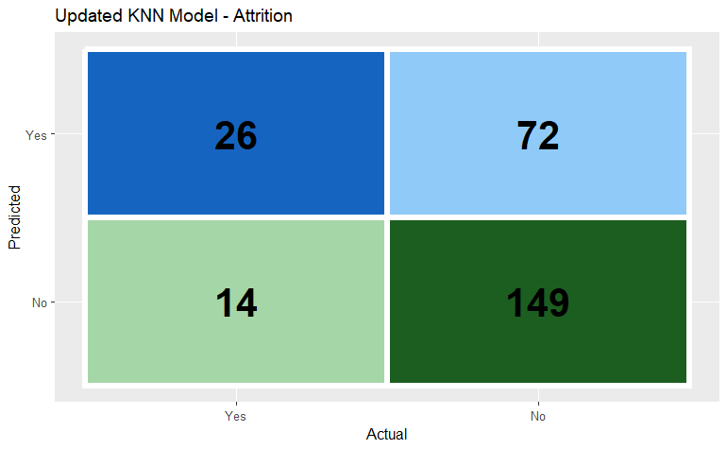
KNN Model with lowered threshold
Lowering the threshold, we can predict more possible turnovers
Predicting with the same number of employees with most similar qualities (5)
With this model, we achieved 65% sensitivity
Correctly predicted 26 turnovers
Missed 14 turnovers
We also achieved 67% specificity
Correctly predicted 149 employees not quitting
Incorrectly predicted 72 false alarms
Notes:
We improved the model by adjusting threshold, essentially making the model more aggressive about flagging potential quitters. Instead of only acting when the model is 50% confident someone will quit, we lowered that to 30%. This pushed sensitivity up to 65%, meaning we now catch 65% of employees who would quit, nearly double the previous model.

Slide 20
New Cost for lowering threshold
(26 true positives + 72 false alarms) * $200 = $ 19,600
14 missed * $49,728 avg salary * 200% replacement cost = $1,392,384
Total cost = $1,411,984
Cost difference between KNN Model 1 and KNN Model 2
$2,590,656 - $1,411,984 =
Savings $1,178,672
Threshold tuning save $1,178,672 compared to the baseline KNN model
Notes:
With the improved KNN model, total cost drops to $1.41 million, saving the company, $1.18 million compared to the previous model. The tradeoff is more false alarms, 72 employees flagged who weren't actually going to quit, but at $200 per intervention, that's a small price to pay

Slide 21
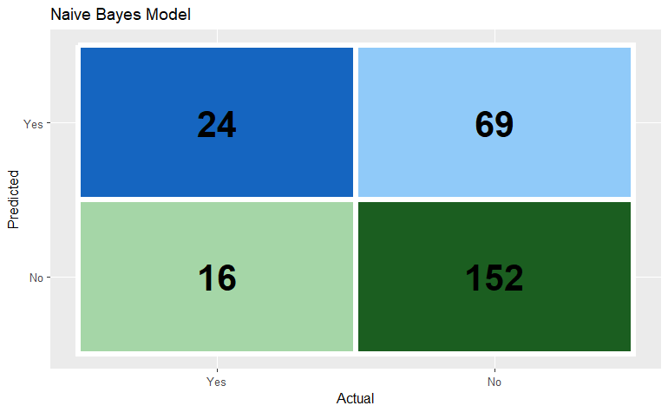
Employee Turnover with Naïve Bayes
Naïve Bayes model calculates probability based on each factor independently then combines them to make a prediction
With Naïve Bayes model we achieved 60% sensitivity
Correctly predicted 24 turnovers
Missed 16 turnovers
We also achieved 68.8% specificity
Correctly predicted 152 employees not quitting
Incorrectly predicted 69 false alarms
Notes:
Our second model, Naïve Bayes, takes a different approach. Instead of finding similar employees, it calculates the statistical probability of quitting based on each factor independently, then combines them. It achieved 60% sensitivity and 68.8% specificity, stronger predictions than our first KNN model

Slide 22
Cost for using Naïve Bayes Model to prevent turnover
(24 true positive + 69 false alarms) * $200 = $18,600
16 missed * $49,728 average salary * 200% replacement cost = $1,591,296
Total cost = $1,609,896
Notes:
The baseline Naïve Bayes cost comes in at $1.61 million, already better than the baseline KNN model's $2.59 million

Slide 23

Naïve Bayes with Lowered threshold
Lowering threshold allows the model to flag more potential quitters
With Naïve Bayes model we achieved 68% sensitivity
Correctly predicted 27 turnovers
Missed 13 turnovers
We also achieved 61% specificity
Correctly predicted 134 employees not quitting
Incorrectly predicted 87 false alarms
Notes:
Applying the same threshold idea to Naïve Bayes pushed sensitivity to 68% and maintained 61% specificity. We're now catching attrition more than any other version of our models

Slide 24
Naïve Bayes Model with Lower Threshold
(27 true positives + 87 false alarms) * $200 = $22,800
13 missed * $49,728 average salary * 200% replacement cost = $1,292,928
Total cost = $1,315,728
Comparison: KNN vs Naïve Bayes (both with lowered threshold)
KNN lower = $1,411,984
Naïve Bayes lower = $1,315,728
Savings = $96,256
Savings using Naïve Bayes model is $96,256
Notes:
The optimized Naïve Bayes model comes in at $1.32 million total, the lowest cost of all four models. Compared to the optimized KNN, that's an additional $96,000 in savings. The reason is simple: Naïve Bayes catches one more quitter and misses three fewer, and since each missed quitter costs nearly $100,000 to replace, that adds up fast.

Slide 25
Conclusion
Notes:
So what does this all mean for Frito Lay

Slide 26
Closure
Using Naïve Bayes Model with a lowered threshold to catch possible attrition would be beneficial to Frito Lay
Our highest model total cost $2,590,656 was a KNN model without a lowered threshold
Naïve Bayes Model with a lower threshold cost was $1,315,728
Saving the company $1,274,928
Using these factors in our model gives us a better chance of predicting attrition
Age
Job level
Marital Status
Total Working Years
Monthly Income
Overtime
Years with their current manager
Job Role
Notes:
Our recommendation is to deploy the Naïve Bayes model with a lowered threshold. It is the most cost effective solution, reducing your estimated attrition cost from $2.59 million to $1.32 million, saving Frito Lay $1.27 million. The model works best when it has access to these eight employee attributes: age, job level, marital status, total work experience, monthly income, overtime status, years with current manager, and job role. We recommend your company review flagged employees quarterly and intervene early, the data shows that catching a flight risk before they walk out the door is far cheaper than replacing them after.

