Slide 1
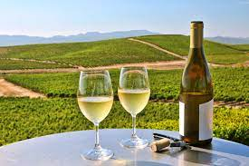

White Wine Quality Prediction using Machine Learning Project members : Karin Ferrada and Andy de Wind

Slide 2
PROJECT OBJECTIVE
This project will use a Machine Learning technique to predict the quality of white wine.
This will be done in the following steps:
Collect data
Load the data
Clean and Transform the data
Select wine characteristics to train the data on
Scale and Normalise the data
Choose a machine learning model
Fit the Model to the scaled training data
Quantify the model and compare the fit of trained to test data
Save the model to enable predictions using the scaled test data

Slide 3
DATA SOURCE
Data was sourced from :
https://archive.ics.uci.edu/ml/datasets/wine+quality
The white wine dataset was downloaded in CSV format. The dataset contained 4898 samples. There were 11 characteristics in each sample.
These are:
Input variables (based on physicochemical tests): 1 - fixed acidity 2 - volatile acidity 3 - citric acid 4 - residual sugar 5 - chlorides 6 - free sulfur dioxide 7 - total sulfur dioxide 8 - density 9 - pH 10 - sulphates 11 - alcohol 12 - quality (score between 3 and 9)

Slide 4
DATA PREPARATION 1 : Clean and Transform
The csv file was read into a Pandas data frame and the following done to the data frame :
# Drop the null columns where all values are null
white_wine_df = white_wine_df.dropna(axis='columns', how='all')
# Drop the null rows
white_wine_df = white_wine_df.dropna()
Columns were renamed to remove spaces in the column names
white_wine_df.rename(columns={'fixed acidity': 'fixed_acidity’,
'volatile acidity': 'volatile_acidity’,
'citric acid': 'citric_acid'
,'residual sugar': 'residual_sugar'
,'free sulfur dioxide': 'free_sulfur_dioxide'
,'total sulfur dioxide': 'total_sulfur_dioxide' }, inplace=True)
Min and Max values for each characteristic were extracted using the describe() function and written to a file. This was to be used later in the prediction web page.

Slide 5
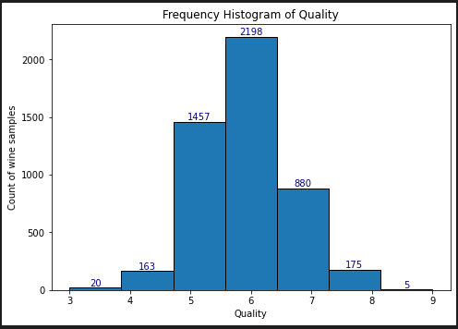
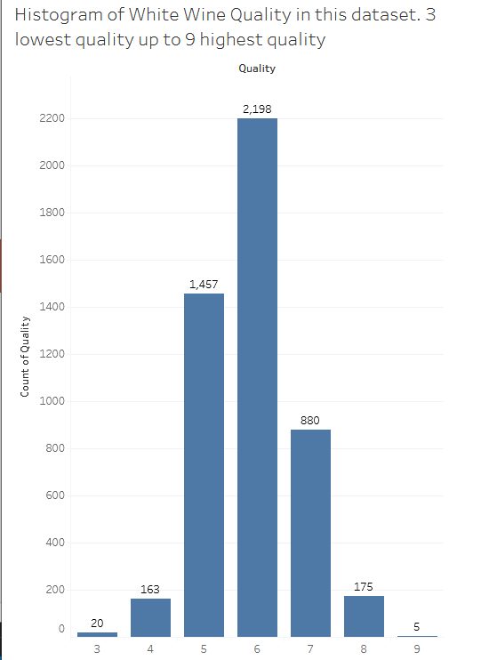
DATA PREPARATION 2 : Explore the data
Using Matplotlib and Tableau a Frequency histogram was drawn to see the range of quality: Most of the wine samples were in the 5-7 quality range

Slide 6
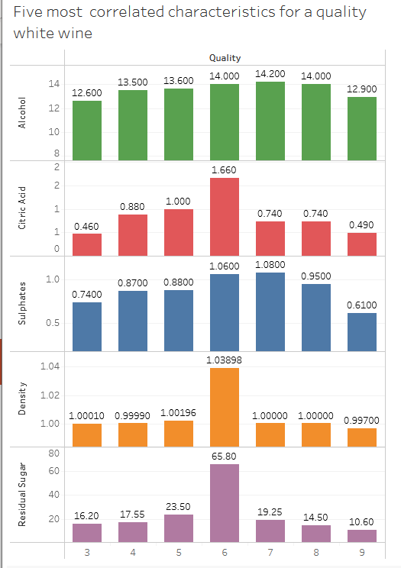
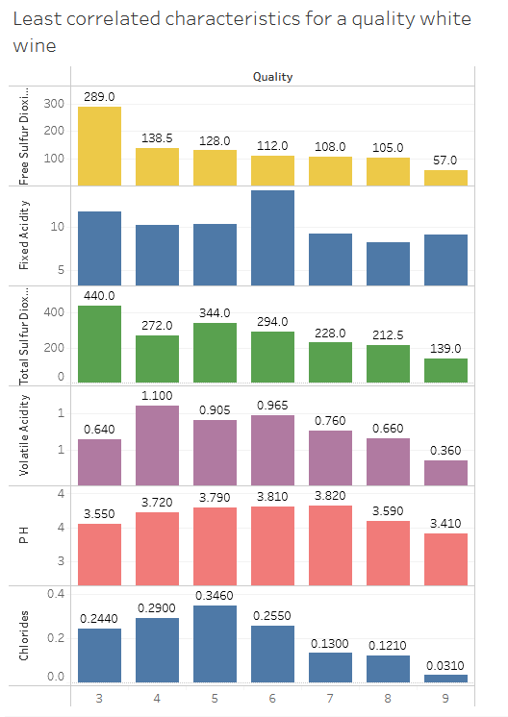
Explore the data : Tableau Visualisations
Using Tableau bar charts were created by plotting quality against each of the 11 characteristics
Below are a sample of the bar charts of quality plotted against the various characteristics
What was uncovered was that : Alcohol, Citric Acid , Sulphates, Density and Residual Sugar were highest in the most
common quality wines i.e. the 5-7 bracket
The lowest rating characteristics in this quality bracket are : Fixed Acidity, Volatile Acidity, Chlorides, Free Sulfur Dioxide,
Total Sulfur Dioxide and pH

Slide 7
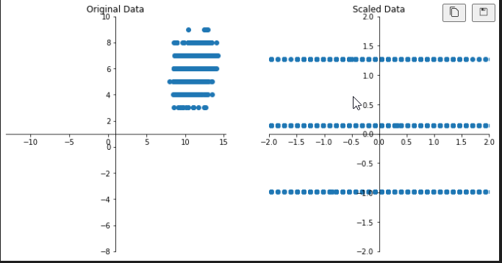
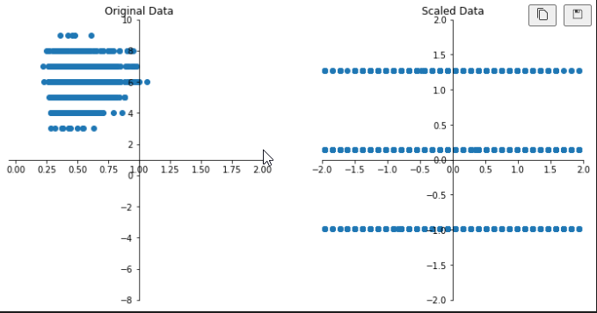
Data Preparation: Scale and Normalise the Data
1. It was decided that all 11 characteristics would be used to train the model (X_train and X_test) and quality would be the y value
2. sklearn’s train_test_split was used on the X and y data to train the data. A random percentage of the dataset would be used for
training and the rest for testing.
3. Next a StandardScaler was used to normalise and transform the data so that all X characteristics values would
be scaled to have similar means and standard
deviations.
Here is an example of the Alcohol values
before and after Scaling and Normalisation
Here is an example of the Sulphates values
before and after Scaling and Normalisation

Slide 8
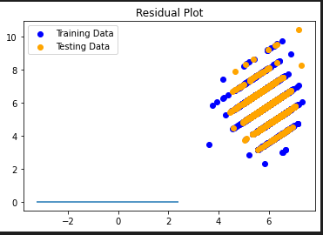
Train and Fit the model
4. Next step was to fit the Model to the scaled training data and make predictions using the scaled test data
5. The model chosen was the LinearRegression supervised model. It was chosen because
the data had independent values (characteristics) which led to a single discrete value (quality)
Each of the characteristics were independent but together they resulted in a single value. Below is a plot of
the model comparing the fit between the training and test data. Pretty good fit !
6. The model and the X_scaler were then saved for future use using the python library joblib.

Slide 9
Deploy the model
Once the model and X_scaler were saved they were reused in flask app to allow a wine maker to predict the quality of their wine using values for the 11 (X value) characteristics.
The flask app consisted of a web page deployed using Heroku.

Slide 10
CONCLUSION:

