Slide 1
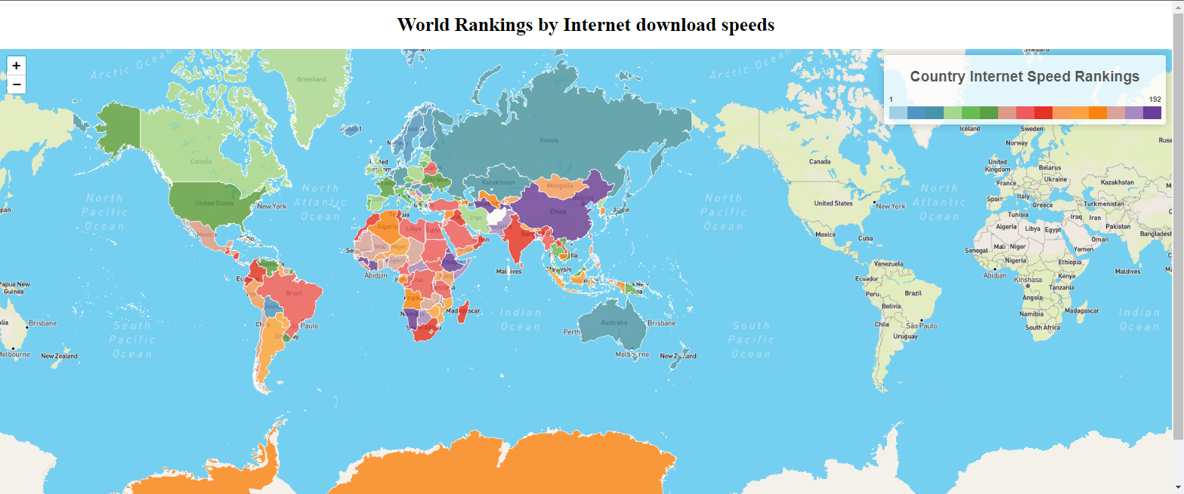

The Great Digital Divide Project member: Andy de Wind

Slide 2
PROJECT OBJECTIVE
This project will examine the digital divide which refers to the gap between the demographics of countries that have access to the internet.
This will be done by Extracting, Transforming/Cleaning, Loading (ETL) and Visualising data in order to answer the following questions:
1. List of countries ranked by internet speed. Who are the leaders?
2. Use scatter plots to explore the demographics listed below with a country's internet speed rank
and pick if there are any correlations between :
-Income per person
-Internet user rate
-Urban rate of population
3. Use bar charts to compare a demographic data between countries
- Speed Rank
- Upload Speed MBPS
- Download Speed MBPS
- Income per person
- Internet Usage rate

Slide 3
DATA SOURCES
Collect datasets that will help in answering the above questions by web scraping and downloading csv files from various sites such as:
-Boot Camp Repository : countries.geoJson file.
-https://www.fastmetrics.com/internet-connection-speed-by-country.php#median-internet-speeds-2020
-https://www.worldometers.info/world-population/population-by-country/
-https://www.kaggle.com/datasets/sansuthi/gapminder-internet?resource=download?gap_minder.csv
country : Full name of country
incomeperperson: Gross Domestic Product per capita in constant 2000 US$.
The inflation but not the differences in the cost of living
between countries has been taken into account.
internetuserate: Internet users (per 100 people).
Internet users are people with access to the worldwide network.
urbanrate: Urban population (% of total) Urban population refers to people
living in urban areas as defined by national statistical offices
(calculated using World Bank population estimates and urban ratios
from the United Nations World Urbanization Prospects)

Slide 4
DATA PREPARATION : Extract
1. Scrape country, download, upload speed, rank, country data from
https://www.fastmetrics.com/internet-connection-speed-by-country.php#median-internet-speeds-2020
using Flask API, Python and Beautiful Soup and store it in MongoDB and also write to file in html and csv formats.
2. Download world population data in csv format from
https://www.worldometers.info/world-population/population-by-count
3 Download data in csv format from
https://www.kaggle.com/datasets/sansuthi/gapminder-internet?resource=download?gap_minder.csv
country : Full name of country
incomeperperson : Gross Domestic Product per capita in constant 2000 US$.
The inflation but not the differences in the cost of living
between countries has been taken into account.
internetuserate : Internet users (per 100 people).
Internet users are people with access to the worldwide network.
urbanrate : Urban population (% of total) Urban population refers to people
living in urban areas as defined by national statistical offices
(calculated using World Bank population estimates and urban ratios
from the United Nations World Urbanization Prospects)

Slide 5
DATA PREPARATION : Transform/Clean & Load
1 Use Excel to remove erroneous data i.e foreign words and non-UTF-8 symbols
2. Create ERD diagram and resultant SQL scripts using https://www.quickdatabasediagrams.com/
3 Run SQL scripts into a PostGres database, create a new table with data combined from other tables
4. Export new table into csv format for use in bar charts and scatter plots
Merge new csv file and countries.geojson file into a new geojson file using a tool at this
website tool https://funkeinteraktiv.github.io/geo-data-merger/ Geo Data Merger
Link using ISO 3 letter county code.

Slide 6
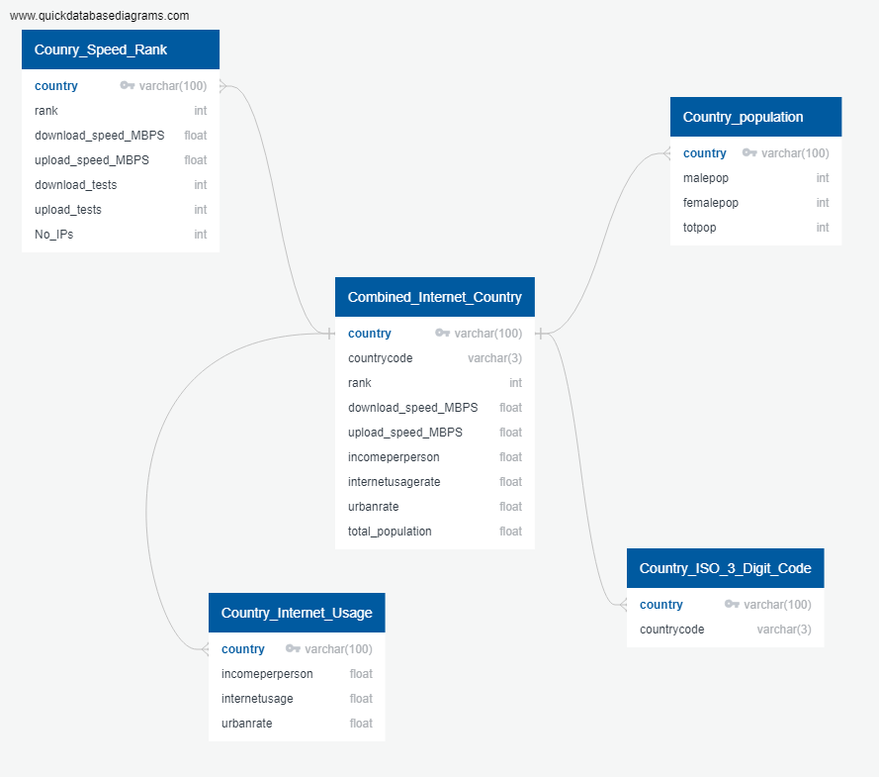
Solution Design Architecture : ERD Diagram

Slide 7
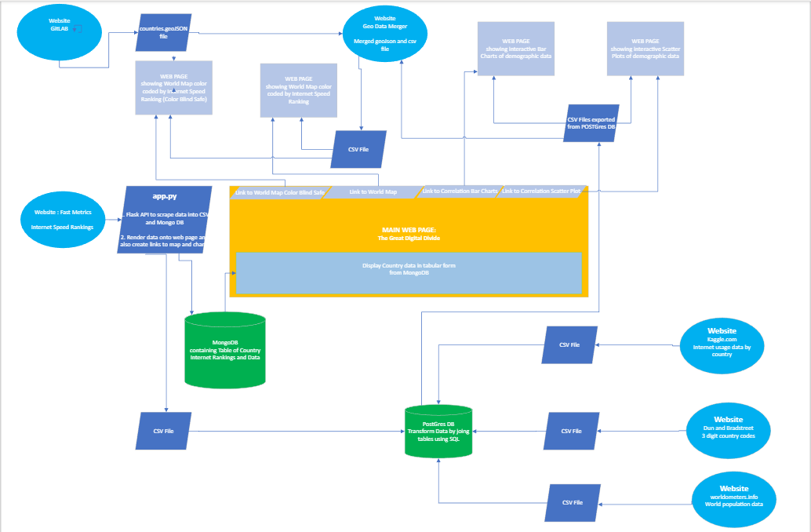
Solution Design Architecture

Slide 8
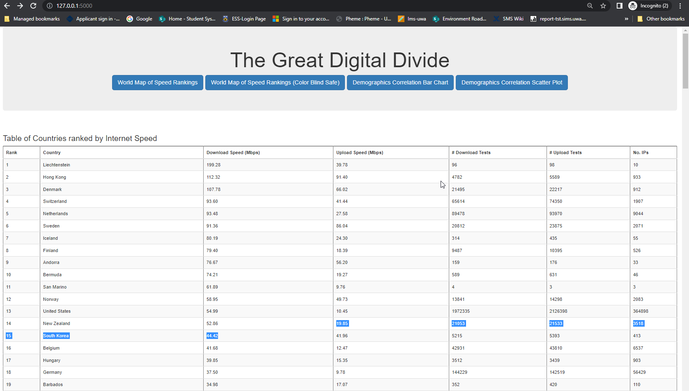
Main Web Page

Slide 9
Output : World Map

Slide 10
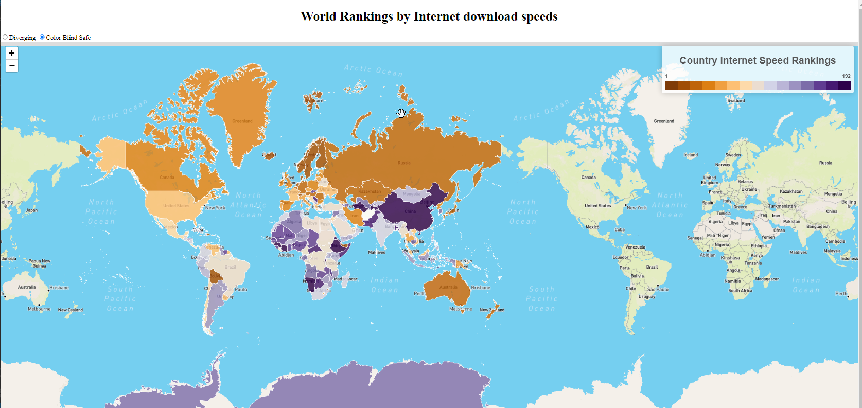
Output : World Map

Slide 11
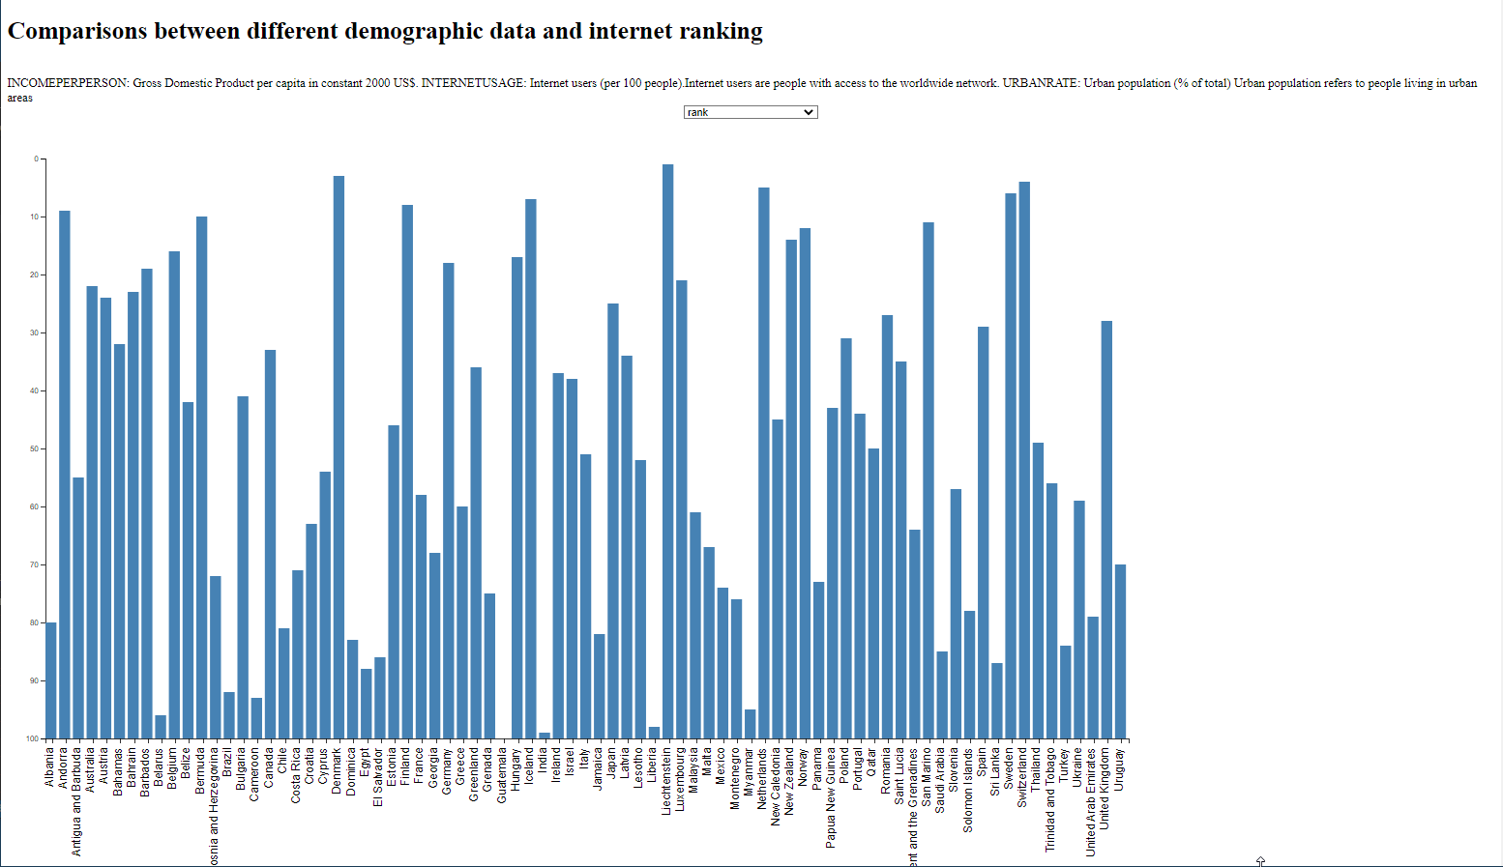
Output : Bar Chart : Country vs Speed Rank

Slide 12
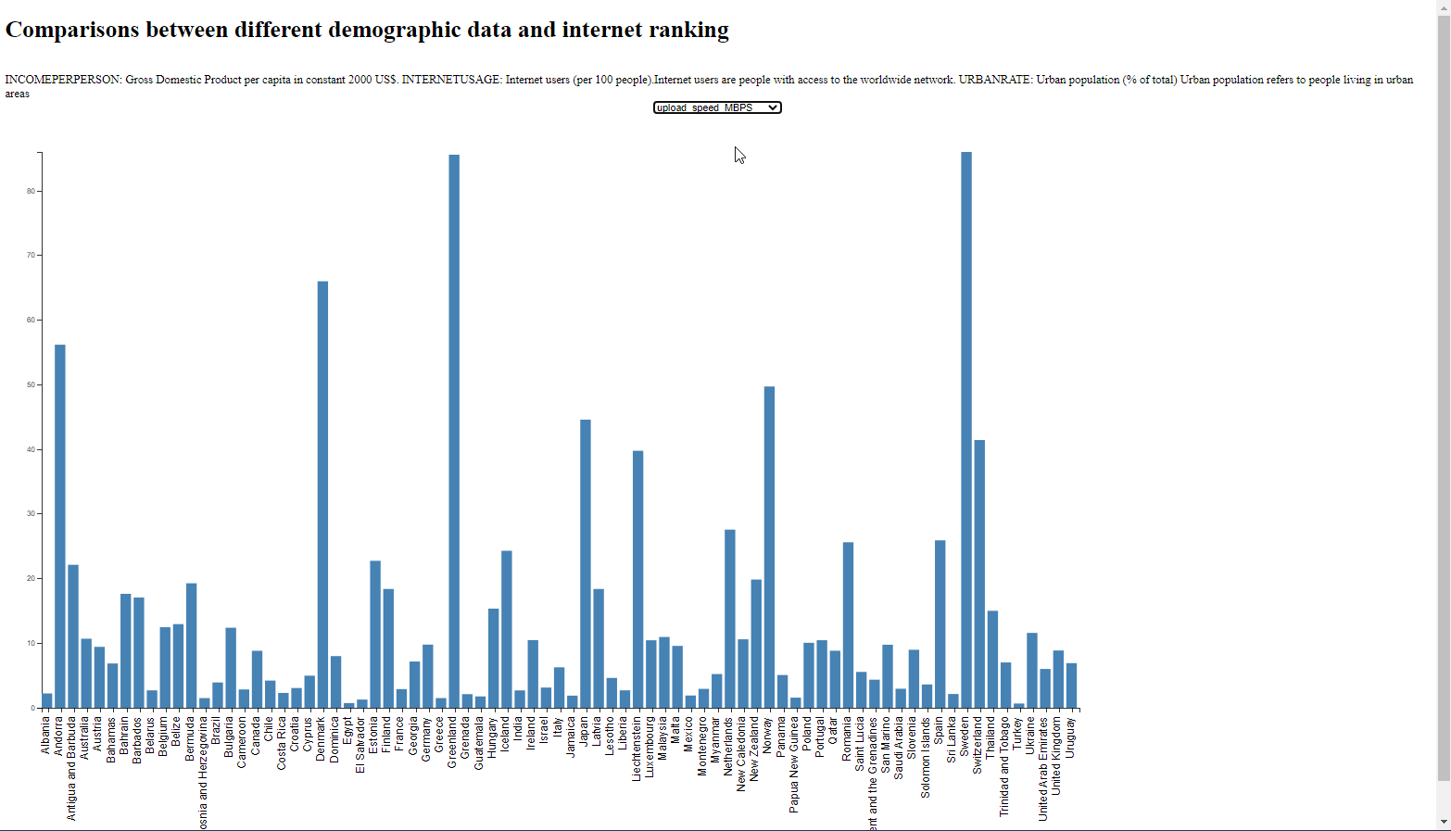
Output : Bar Chart : Country vs Upload Speed MBPS

Slide 13
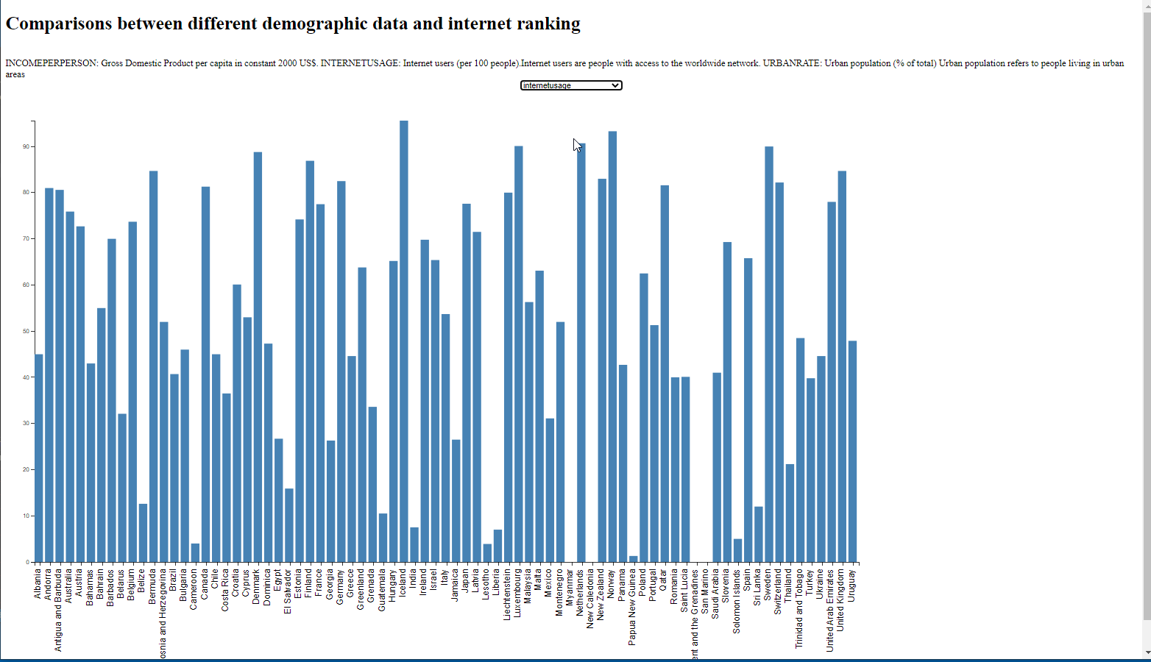
Output : Bar Chart : Country vs Internet Usage

Slide 14
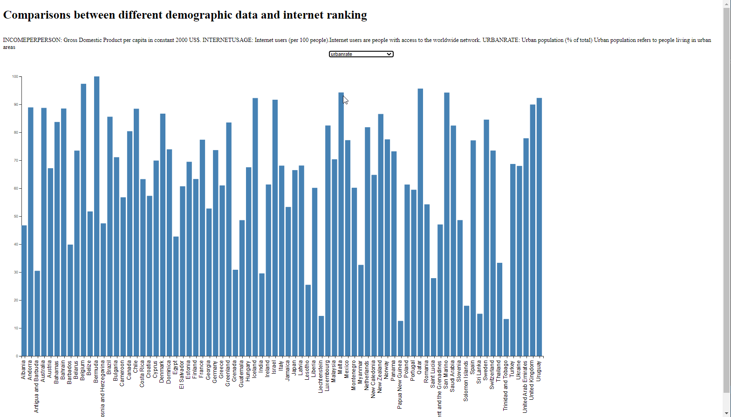
Output : Bar Chart : Country vs Urban Rate

Slide 15
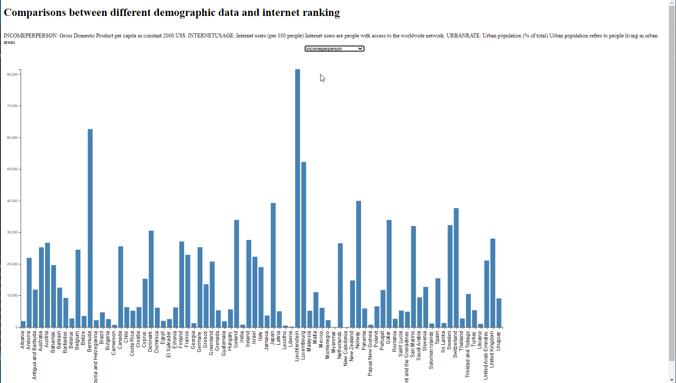
Output : Bar Chart : Country vs Income per person

Slide 16
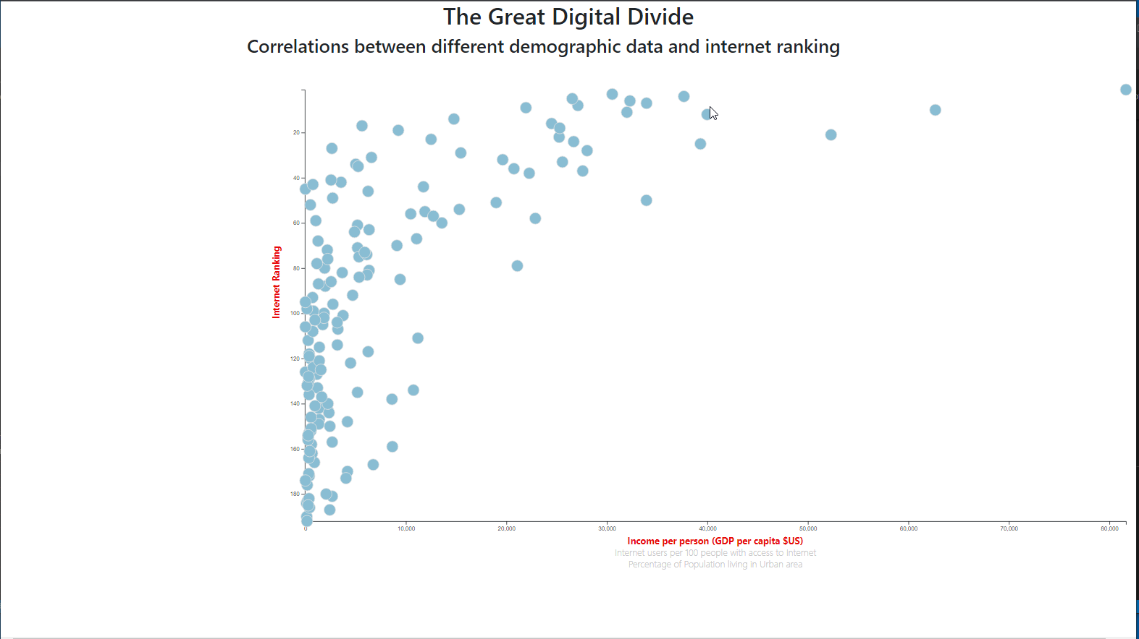
Output : Scatter Plots : Rank vs Income per Person

Slide 17
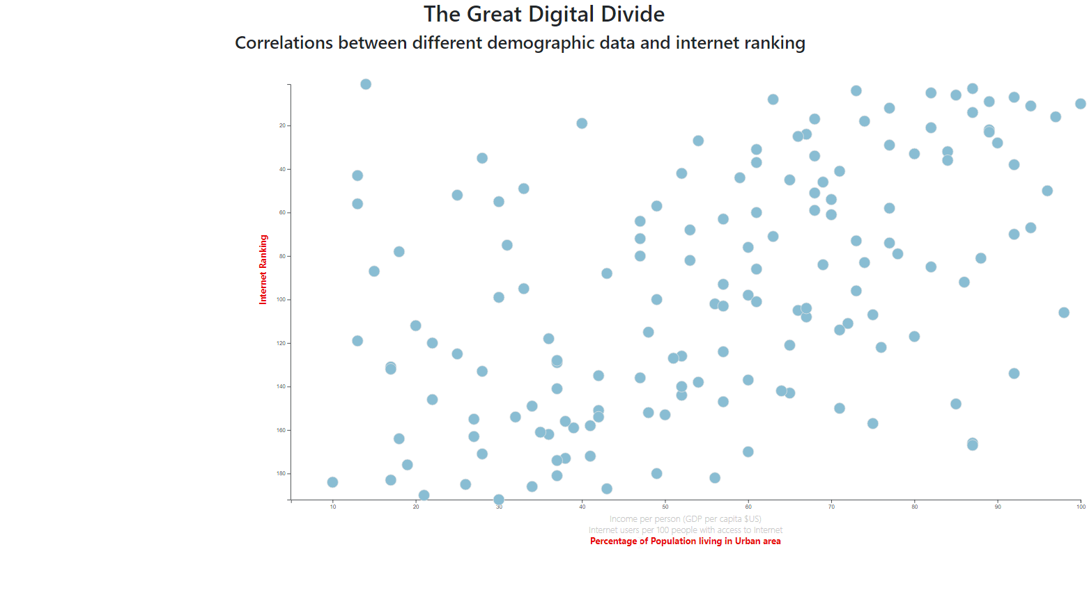
Output : Scatter Plots : Rank vs Urban Rate

Slide 18
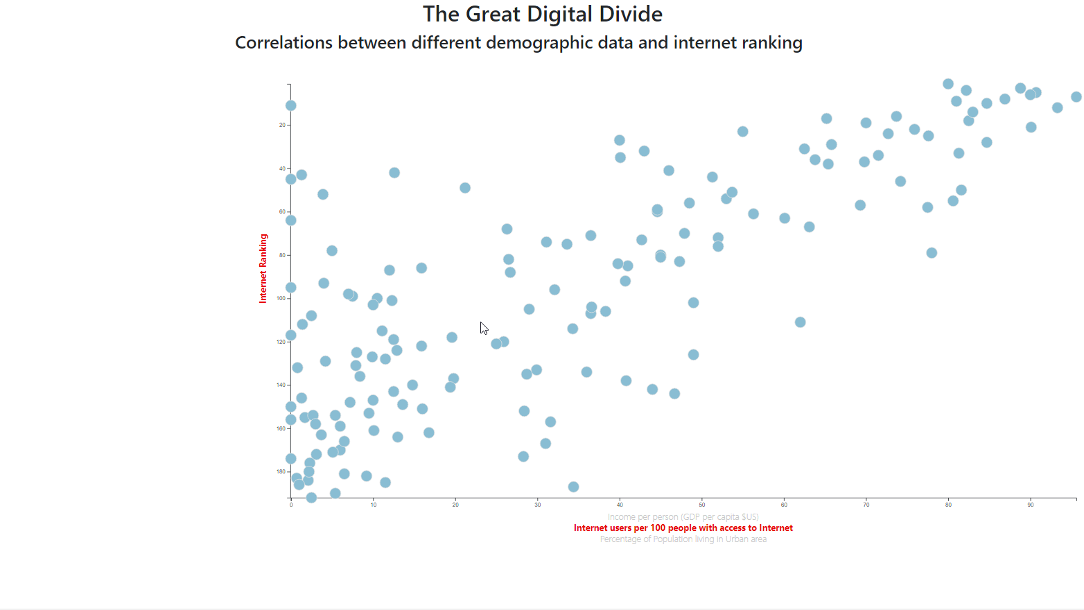
Output : Scatter Plots : Rank vs Internet Usage

Slide 19
CONCLUSION:
The great digital divide between countries can be attributed based on the data in this study:
Income per person
Urban Density/ Rate
Internet Usage rate i.e. Access to Internet infrastructure
There a lot of other factors such as geography, politics, religious and cultural issues and education which can also account for this divide.

