Slide 1
Kernel Coherence Encoders
Data Science Master’s Thesis Report
by Fangzheng (Andy) Sun
Adviser: Professor Randy C. Paffenroth
Reader: Professor Jian Zou

Slide 2
Overview
Our research
Modifies Autoencoders (special neural networks mapping data to back to itself)
Explores Canonical Correlation Analysis(CCA) and Kernel CCA(KCCA)
Introduces element-wise coherence
Three models
Non-Coherence Encoder (NCE)
Coherence Encoder (CE)
Kernel Coherence Encoder (KCE)
Motivation
reconstruct one data set from another dependent data set

Slide 3
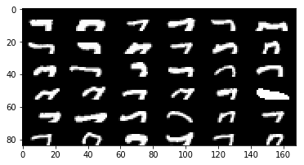
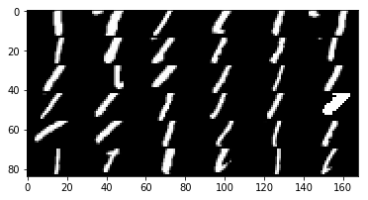
Experiment
MNIST Digit images

Slide 4
Overview
Canonical
Correlation
Analysis (CCA)
Deep Learning
(Autoencoders)
Kernel Canonical
Correlation
Analysis (KCCA)

Slide 5
Overview
Canonical
Correlation
Analysis (CCA)
Coherence Encoder
Deep Learning
(Autoencoders)
Kernel Canonical
Correlation
Analysis (KCCA)
Non-Coherence Encoder
Kernel Coherence Encoder

Slide 6


Overview
Mathematically
Well-principled,
But linear!
Canonical
Correlation
Analysis (CCA)
Coherence Encoder
Deep Learning
(Autoencoders)
Non-linear, but not
Mathematically
Well-principled!
Mathematically
Well-principled,
And non-linear!!
Kernel Canonical
Correlation
Analysis (KCCA)
Non-Coherence Encoder
Kernel Coherence Encoder

Slide 7
Contribution
People try to connect Autoencoders, kernel methods and other mathematical approaches for data reconstruction.
We come up with NCE, CE and KCE.
NCE is not mathematically well principled and CE is based on linear CCA.
KCE is the only one to be non-linear and mathematically well-principled model.
Moreover, experimental results demonstrate that KCE has the best performance among the three models.

Slide 8
Background
Principal Component Analysis (PCA)
Canonical Correlation Analysis (CCA)
Kernel methods
Kernel Canonical Correlation Analysis (KCCA)
Artificial Neural Networks
Autoencoders

Slide 9
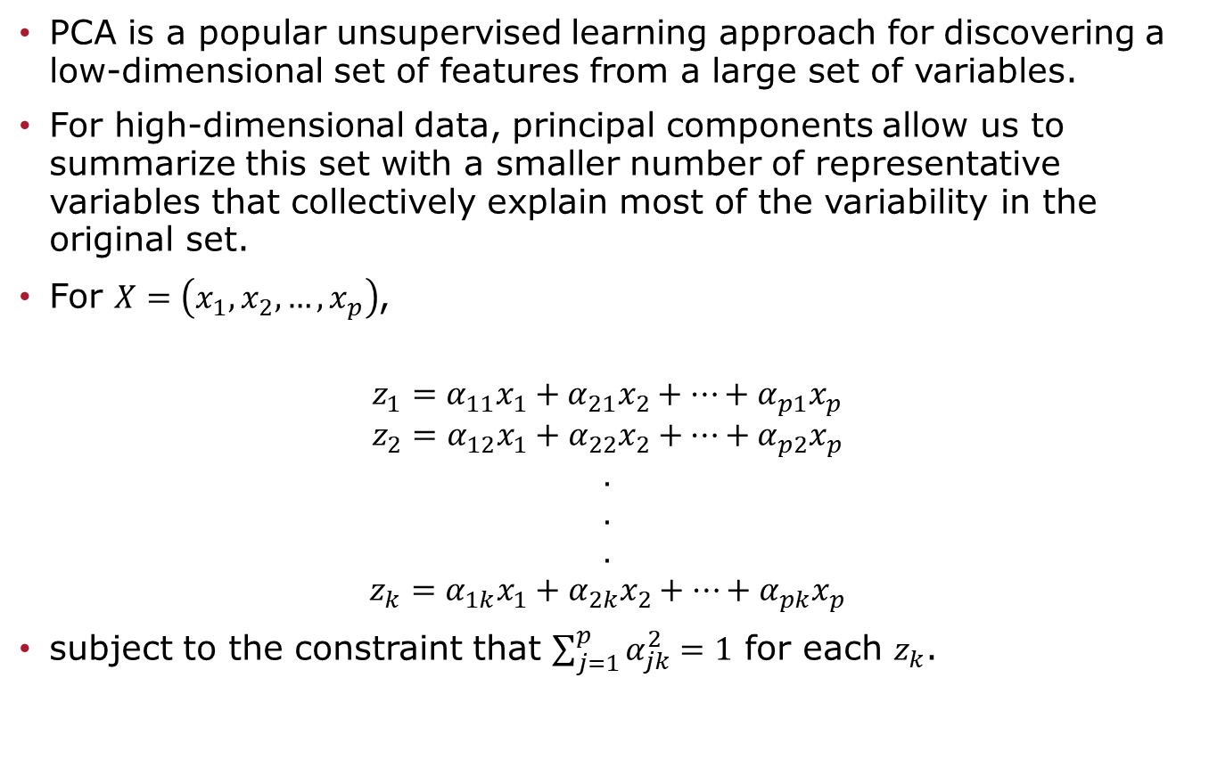
Principal Component Analysis (PCA)
PCA is a popular unsupervised learning approach for discovering a low-dimensional set of features from a large set of variables.
For high-dimensional data, principal components allow us to summarize this set with a smaller number of representative variables that collectively explain most of the variability in the original set.
For $X=\left(x_{1},x_{2},…,x_{p}\right)$,
$$z_{1}=α_{11}x_{1}+α_{21}x_{2}+…+α_{p1}x_{p}$$
$$z_{2}=α_{12}x_{1}+α_{22}x_{2}+…+α_{p2}x_{p}$$
$$.$$
$$.$$
$$.$$
$$z_{k}=α_{1k}x_{1}+α_{2k}x_{2}+…+α_{pk}x_{p}$$
subject to the constraint that $\sum_{j=1}^{p}{α_{jk}^{2}=1}$ for each $z_{k}$.

Slide 10

PCA – Optimization
Each principal component vector $z_{k}$ solves the following optimization problem:
$$\min_{D^{′} }{|\left|D−D^{′}\right||_{F}} subject to rank(D^{′})≤r$$
Where D is data matrix and r is a desired rank.
This can be solved via an singular value decomposition of the data matrix, a standard technique in linear algebra.

Slide 11

Canonical Correlation Analysis (CCA)
Infers information from cross-covariance matrices
Given two vectors of random variables of random variables with correlations among them:
$$X=\left(x_{1},x_{2},…,x_{m}\right), Y=(y_{1},y_{2},…,y_{n})$$
CCA finds linear combinations of $x_{i}$ and $y_{j}$ which have maximum correlation with each other. (canonical variables of X and Y)

Slide 12
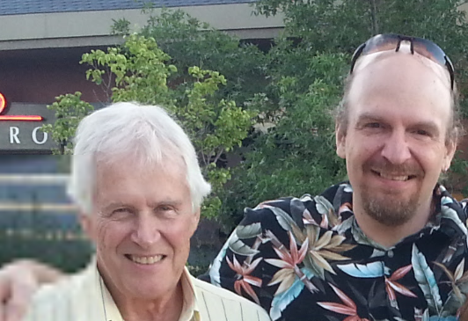
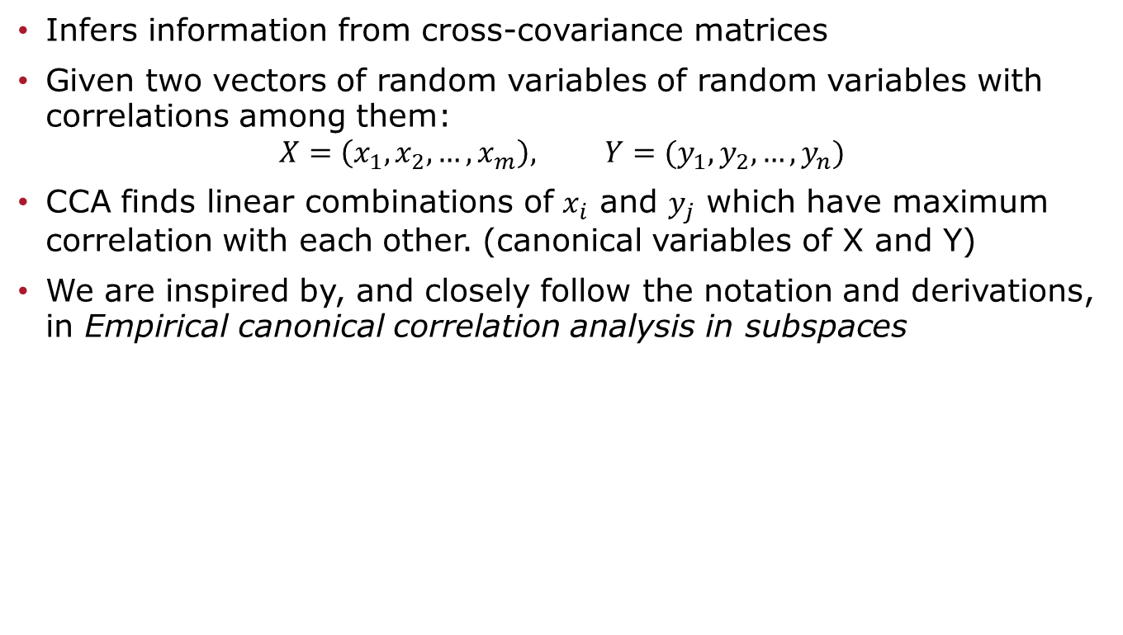
Canonical Correlation Analysis
Infers information from cross-covariance matrices
Given two vectors of random variables of random variables with correlations among them:
$$X=\left(x_{1},x_{2},…,x_{m}\right), Y=(y_{1},y_{2},…,y_{n})$$
CCA finds linear combinations of $x_{i}$ and $y_{j}$ which have maximum correlation with each other. (canonical variables of X and Y)
We are inspired by, and closely follow the notation and derivations, in Empirical canonical correlation analysis in subspaces
Picture provided by professor Randy Paffenroth

Slide 13
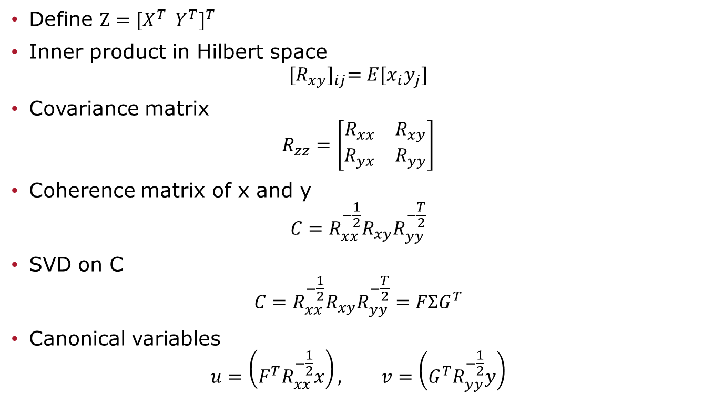
CCA – Linear Algebra (Canonical Variables)
Define $Z={[X^{T} Y^{T}]}^{T}$
Inner product in Hilbert space
$${[R_{xy}]}_{ij}=E[x_{i}y_{j}]$$
Covariance matrix
$$R_{zz}=\left[\begin{matrix}R_{xx} & R_{xy} \\ R_{yx} & R_{yy}\end{matrix}\right]$$
Coherence matrix of x and y
$$C=R_{xx}^{−\frac{1}{2}}R_{xy}R_{yy}^{−\frac{T}{2}}$$
SVD on C
$$C=R_{xx}^{−\frac{1}{2}}R_{xy}R_{yy}^{−\frac{T}{2}}=FΣG^{T}$$
Canonical variables
$$u=\left(F^{T}R_{xx}^{−\frac{1}{2}}x\right), v=\left(G^{T}R_{yy}^{−\frac{1}{2}}y\right)$$

Slide 14
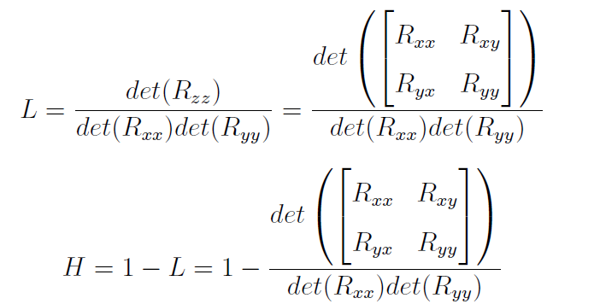

CCA – Optimization (Coherence)
By Hadamard ratio, dependence
$$L=\det\left(I−ΣΣ^{T}\right)=\prod_{i=1}^{m}{(1−σ_{i}^{2})}$$
Linear Coherence
$$H=1−L=1−\det\left(I−ΣΣ^{T}\right)=\prod_{i=1}^{m}{(1−σ_{i}^{2})}$$

Slide 15
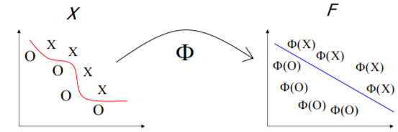
Kernel Methods
Map data into a (possibly high dimensional) vector space (Reproducing Kernel Hilbert Space)* where linear relations exist among the data, then apply a linear algorithm in this space
http://bioinfo.icgeb.res.in/lipocalinpred/algorithm.html
*See back-up slide for completely monotonic function definition

Slide 16


Positive-Definite Kernel
Makes sure there is a corresponding inner product space for x and y of any type.*
Mercer's theorem* provides a mathematical foundation for the kernel methods and infers significance of positive definite kernel.
Definition: A symmetric function is called a positive definite kernel on X if only if
holds for any
*See back-up slides for more explanation on positive definite kernel and Mercer’s Theorem

Slide 17
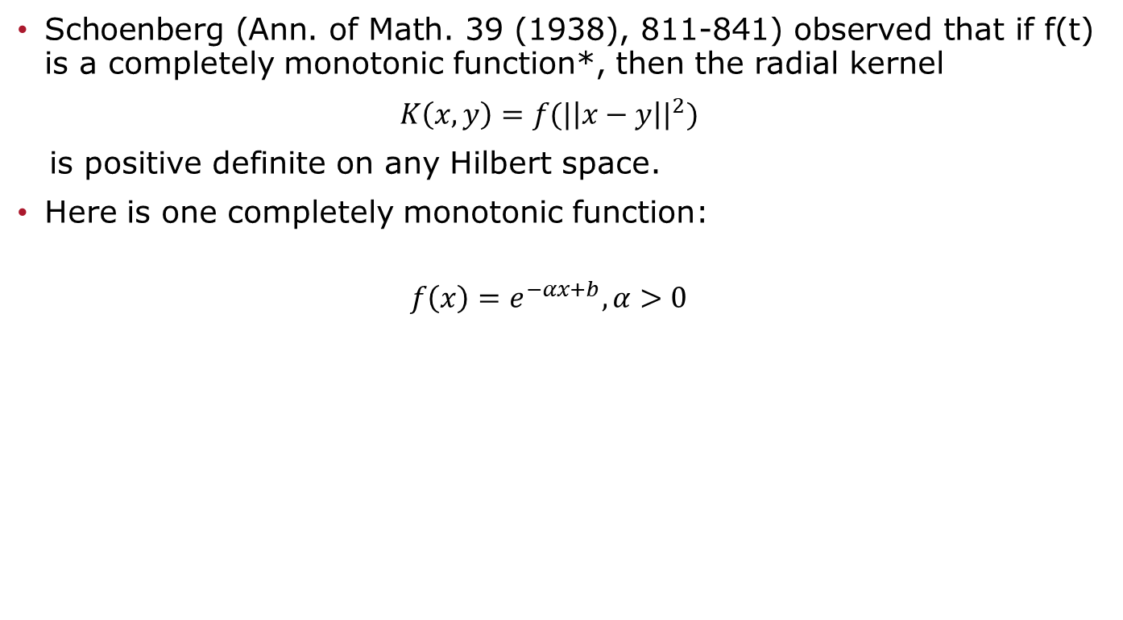
Schoenberg’s Theorem
Schoenberg (Ann. of Math. 39 (1938), 811-841) observed that if f(t) is a completely monotonic function*, then the radial kernel
$K\left(x,y\right)=f({|\left|x−y\right||}^{2})$
is positive definite on any Hilbert space.
Here is one completely monotonic function:
$$f\left(x\right)=e^{−αx+b},α>0$$
*See back-up slide for completely monotonic function definition

Slide 18
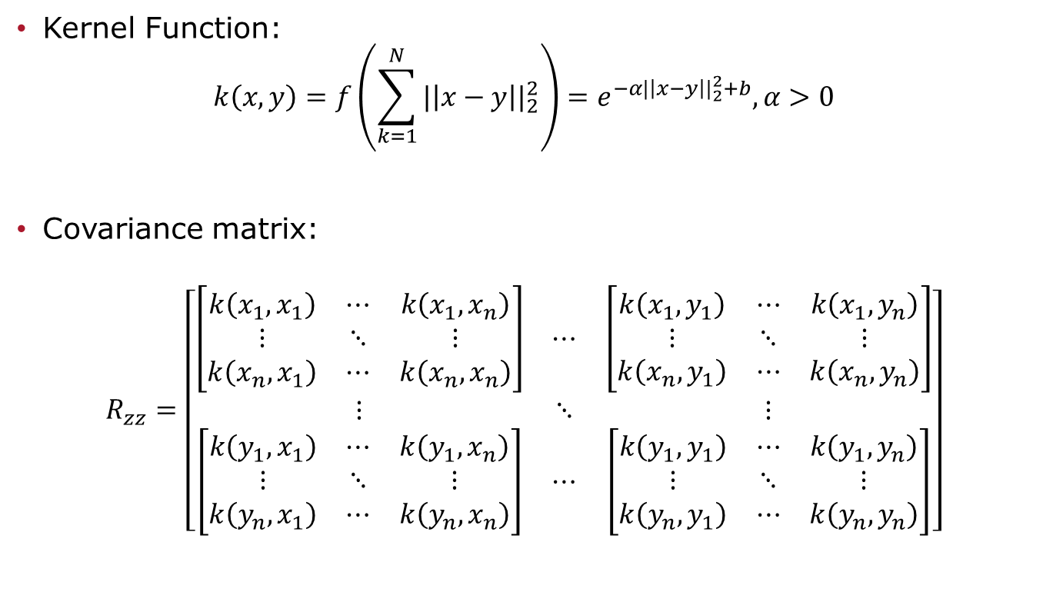
KCCA – Linear Algebra
Kernel Function:
$$k\left(x,y\right)=f\left(\sum_{k=1}^{N}{{|\left|x−y\right||}_{2}^{2}}\right)=e^{−α{|\left|x−y\right||}_{2}^{2}+b},α>0$$
Covariance matrix:
$$R_{zz}=\left[\begin{matrix}\left[\begin{matrix}k\left(x_{1},x_{1}\right) & ⋯ & k\left(x_{1},x_{n}\right) \\ ⋮ & ⋱ & ⋮ \\ k\left(x_{n},x_{1}\right) & ⋯ & k\left(x_{n},x_{n}\right)\end{matrix}\right] & ⋯ & \left[\begin{matrix}k\left(x_{1},y_{1}\right) & ⋯ & k\left(x_{1},y_{n}\right) \\ ⋮ & ⋱ & ⋮ \\ k\left(x_{n},y_{1}\right) & ⋯ & k\left(x_{n},y_{n}\right)\end{matrix}\right] \\ ⋮ & ⋱ & ⋮ \\ \left[\begin{matrix}k\left(y_{1},x_{1}\right) & ⋯ & k\left(y_{1},x_{n}\right) \\ ⋮ & ⋱ & ⋮ \\ k\left(y_{n},x_{1}\right) & ⋯ & k\left(y_{n},x_{n}\right)\end{matrix}\right] & ⋯ & \left[\begin{matrix}k\left(y_{1},y_{1}\right) & ⋯ & k\left(y_{1},y_{n}\right) \\ ⋮ & ⋱ & ⋮ \\ k\left(y_{n},y_{1}\right) & ⋯ & k\left(y_{n},y_{n}\right)\end{matrix}\right]\end{matrix}\right]$$
Rxx
Rxy
Ryx
Ryy

Slide 19
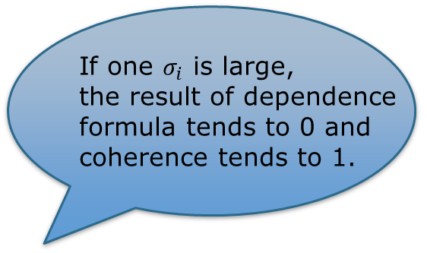
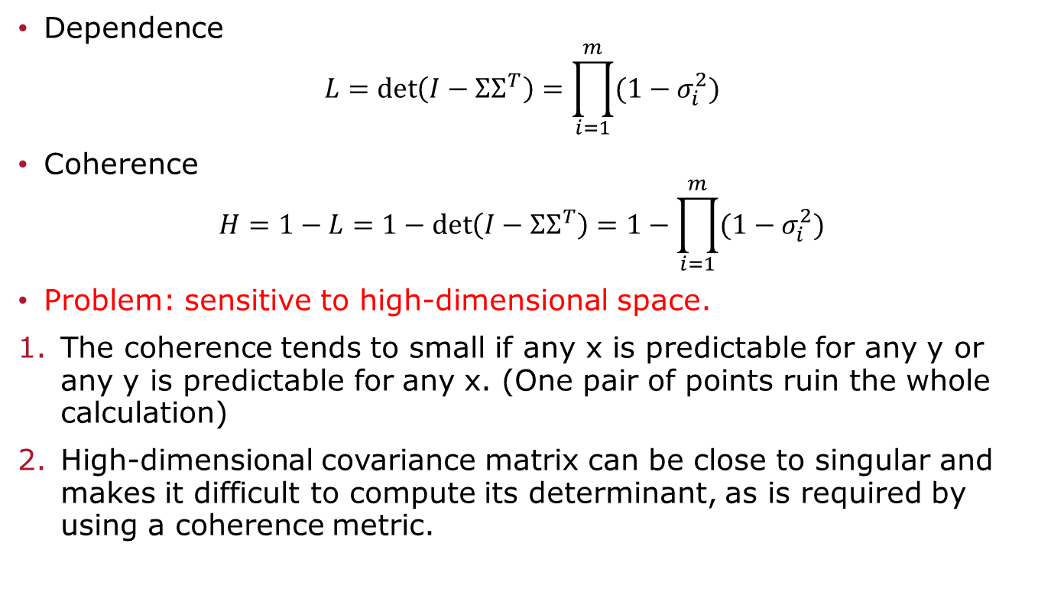
KCCA – Optimization
If one $σ_{i}$ is large,
the result of dependence
formula tends to 0 and
coherence tends to 1.
Dependence
$$L=\det\left(I−ΣΣ^{T}\right)=\prod_{i=1}^{m}{(1−σ_{i}^{2})}$$
Coherence
$$H=1−L=1−\det\left(I−ΣΣ^{T}\right)=1−\prod_{i=1}^{m}{(1−σ_{i}^{2})}$$
Problem: sensitive to high-dimensional space.
The coherence tends to small if any x is predictable for any y or any y is predictable for any x. (One pair of points ruin the whole calculation)
High-dimensional covariance matrix can be close to singular and makes it difficult to compute its determinant, as is required by using a coherence metric.

Slide 20
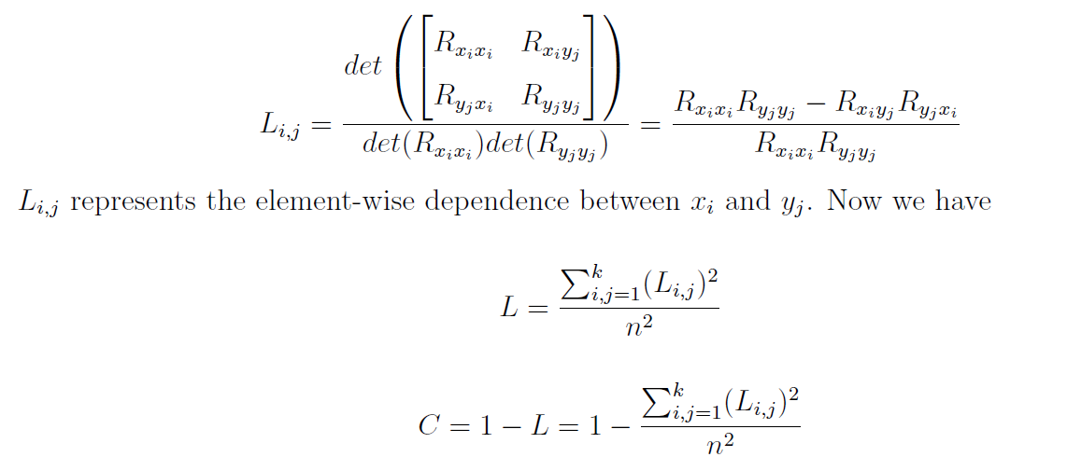
KCCA – Optimization
An element-wise modification to the calculation of dependence and coherence

Slide 21
KCCA – Optimization
Coherence is small if and only if all x is predictable from all y and all y is predictable from all x.
No problem with determinant calculation.

Slide 22
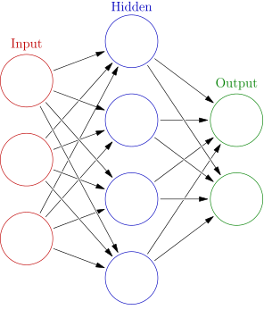

Artificial Neural Networks
An ANN is an interconnected group of nodes
An circular node represents an artificial neuron and an arrow represents a connection between two layers
$h_{i+1}=σ({W_{i}h}_{i}+b_{i})$
https://commons.wikimedia.org/w/index.php?curid=24913461

Slide 23
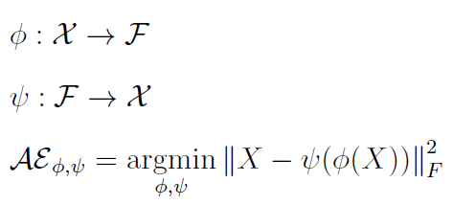
Autoencoders
Contains encoding phase and decoding phase
Maps data back to original feature space

Slide 24
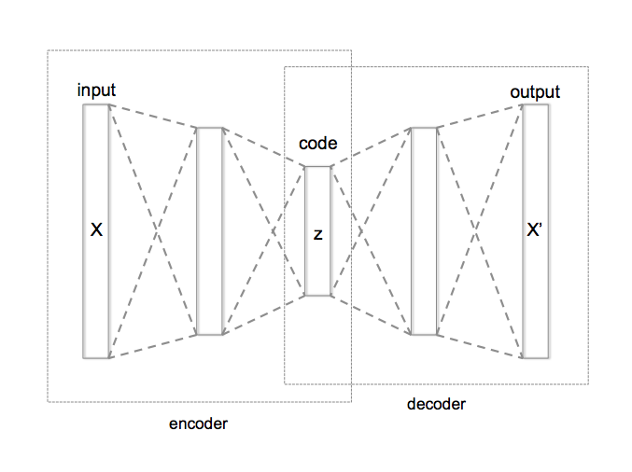
Model Design
Non-Coherence Encoder (NCE)
Coherence Encoder(CE)
Kernel Coherence Encoder (KCE)
https://commons.wikimedia.org/w/index.php?curid=45555552

Slide 25


Model Design
Non-Coherence Encoder (NCE)
Coherence Encoder(CE)
Kernel Coherence Encoder (KCE)
$$y^{′}$$
https://commons.wikimedia.org/w/index.php?curid=45555552

Slide 26
Non-Coherence Encoder (NCE)
Encoder Phase
PCA
Decoder Phase
Linear ANNs
PCA Reconstruction
Non-linear ANNs

Slide 27
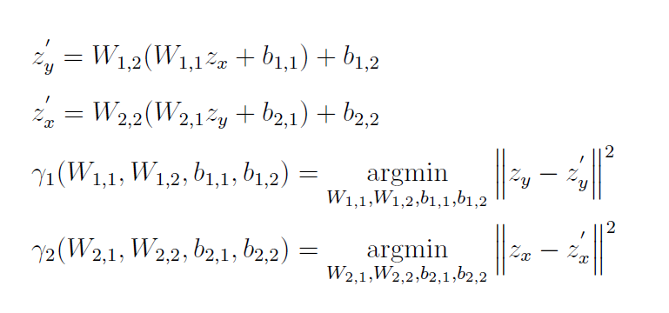

Linear ANNs
a pair of two-layer linear ANNs
map $z_{x}$ to $z_{y}^{′} and z_{y}$ to $z_{x}^{′}$

Slide 28
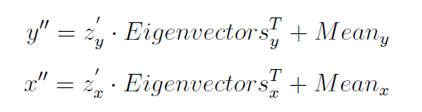

PCA Reconstruction
Principal components mapped back to the original feature space
$$PCA reconstruction=Principal Components ∙ {Eigenvectors}^{T}+ Mean$$

Slide 29
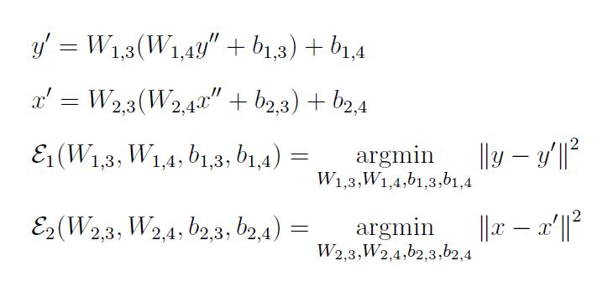

Non-linear ANNs
a pair of two-layer non-linear ANNs
Similar to 2-layer autoencoders
map $y^{′′}$ to $y^{′}$ and $x^{′′}$ to $x^{′}$

Slide 30






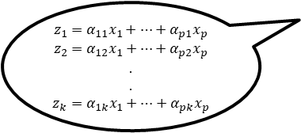


Flowchart of NCE
x
y
Encoder Phase
$$z_{1}=α_{11}x_{1}+…+α_{p1}x_{p}$$
$$z_{2}=α_{12}x_{1}+…+α_{p2}x_{p}$$
$$.$$
$$.$$
$$z_{k}=α_{1k}x_{1}+…+α_{pk}x_{p}$$
PCA
$$z_{x}$$
$$z_{y}$$
Linear ANNs
$$z_{y}^{′}$$
$$z_{x}^{′}$$
PCA Reconstruction
Decoder Phase
$$y^{′′}$$
$$x^{′′}$$
Non-linear ANNs
$$y^{′}$$
$$x^{′}$$

Slide 31
Coherence Encoder (CE)
Encoder Phase
PCA
CCA
Decoder Phase
Linear ANNs
PCA Reconstruction
Non-linear ANNs

Slide 32
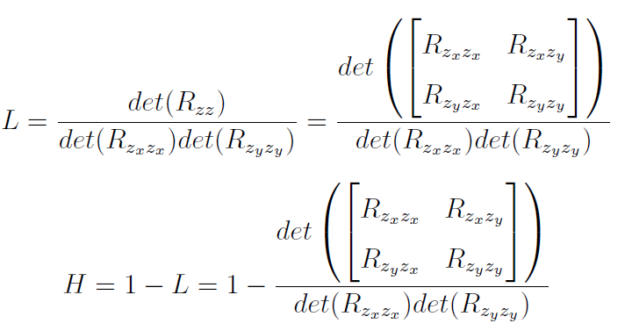

CCA
$Z={[{z_{x}}^{T} {z_{y}}^{T}]}^{T}$
Covariance matrix
$$R_{zz}=\left[\begin{matrix}R_{z_{x}z_{x}} & R_{z_{x}z_{y}} \\ R_{z_{y}z_{x}} & R_{z_{y}z_{y}}\end{matrix}\right]$$
Canonical variables
$$u=\left(F^{T}R_{z_{x}z_{x}}^{−\frac{1}{2}}z_{x}\right), v=\left(G^{T}R_{z_{y}z_{y}}^{−\frac{1}{2}}z_{y}\right)$$
Dependence
Coherence

Slide 33
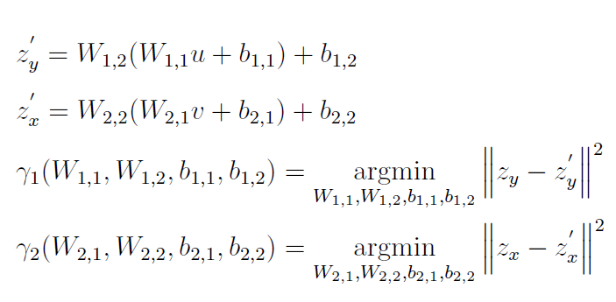

Linear ANNs
maps $u$ to $z_{y}^{′}$ and $v$ to $z_{x}^{′}$

Slide 34





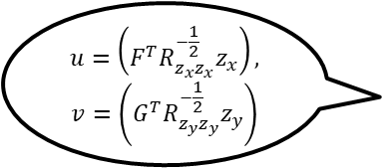
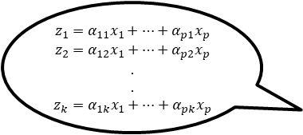



Flowchart of CE
$$z_{1}=α_{11}x_{1}+…+α_{p1}x_{p}$$
$$z_{2}=α_{12}x_{1}+…+α_{p2}x_{p}$$
$$.$$
$$.$$
$$z_{k}=α_{1k}x_{1}+…+α_{pk}x_{p}$$
x
y
PCA
Encoder Phase
$$z_{x}$$
$$z_{y}$$
$$u=\left(F^{T}R_{z_{x}z_{x}}^{−\frac{1}{2}}z_{x}\right),$$
$$v=\left(G^{T}R_{z_{y}z_{y}}^{−\frac{1}{2}}z_{y}\right)$$
CCA
$$u$$
$$v$$
Linear ANNs
$$z_{y}^{′}$$
$$z_{x}^{′}$$
PCA Reconstruction
Decoder Phase
$$y^{′′}$$
$$x^{′′}$$
Non-linear ANNs
$$y^{′}$$
$$x^{′}$$

Slide 35
Kernel Coherence Encoder (KCE)
Encoder Phase
PCA
KCCA
Decoder Phase
Linear ANNs
PCA Reconstruction
Non-linear ANNs

Slide 36

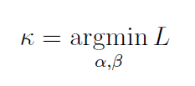

KCCA
obtains canonical variables u and v
trains an optimal kernel function
Element-wise coherence calculation
We define $κ$ as the kernel function training process

Slide 37

Element-wise Coherence
Proposing KCCA method and the element-wise coherence calculation to autoencoders in this way is novel.
The connection between x and y comes only from the element-wise coherence between $z_{x}$ and $z_{y}$in the Reproducing Kernel Hilbert Space.

Slide 38
Flowchart of KCE
$$z_{1}=α_{11}x_{1}+…+α_{p1}x_{p}$$
$$z_{2}=α_{12}x_{1}+…+α_{p2}x_{p}$$
$$.$$
$$.$$
$$z_{k}=α_{1k}x_{1}+…+α_{pk}x_{p}$$
x
y
PCA
Encoder Phase
$$z_{x}$$
$$z_{y}$$
$$u=\left(F^{T}R_{z_{x}z_{x}}^{−\frac{1}{2}}z_{x}\right),$$
$$v=\left(G^{T}R_{z_{y}z_{y}}^{−\frac{1}{2}}z_{y}\right)$$
KCCA
$$u$$
$$v$$
Linear ANNs
$$z_{y}^{′}$$
$$z_{x}^{′}$$
PCA Reconstruction
Decoder Phase
$$y^{′′}$$
$$x^{′′}$$
Non-linear ANNs
$$y^{′}$$
$$x^{′}$$

Slide 39
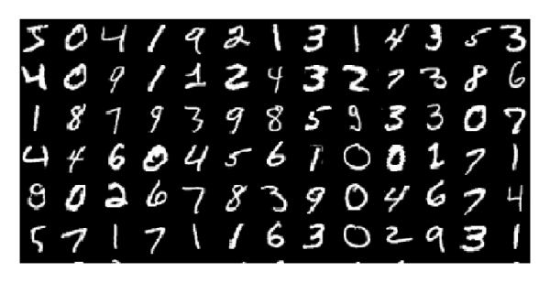
Experiment – MNIST Data Set
MNIST data set, 55000 for training and 10000 for testing
28 * 28 = 784 pixels for each image, grayscale 0-1
Picture resource: Cheng, Chunling, et al. "A multilayer improved RBM network based image compression method in wireless sensor networks." International Journal of Distributed Sensor Networks 12.3 (2016): 1851829.

Slide 40
Experiment – MNIST Data Set
Cut each image to upper and lower parts - x and y
Group by digit
Each image 14 * 28 = 392 dimension

Slide 41
Training
TensorFlow*
Gradient Descent Optimization*
tf.train.GradientDescentOptimizer(learning rate).minimize(cost)
Training parameters:
hidden layer dimension = 100
learning rate = 0.01
training epochs = 2000
batch size = 100
*See back-up slides for TensorFlow and Gradient Descent Optimization

Slide 42
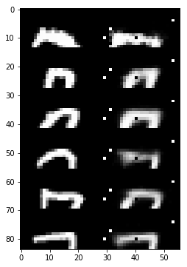
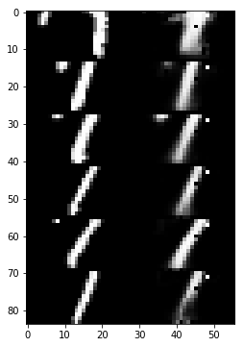

Experiment – MNIST Data Set
For each digit, 6 random samples for test (12 reconstructed images)
“Paired Autoencoders”
NCE
CE
KCE

Slide 43
Experiment – MNIST Data Set
Mimic Autoencoders
Directly mapping between x and y
Two independent ANNs

Slide 44
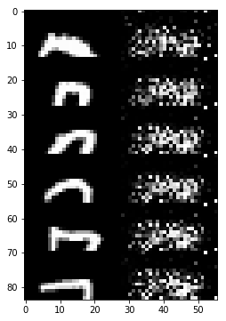
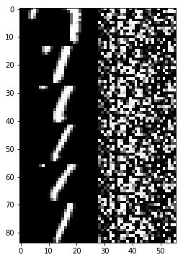
NCE Reconstruction
Patterns are hardly reconstructed

Slide 45
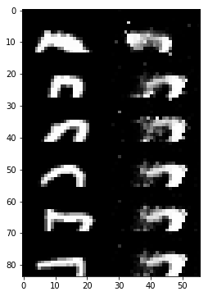
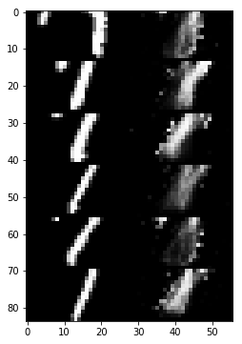
CE Reconstruction
Patterns are reconstructed, with some flaws

Slide 46
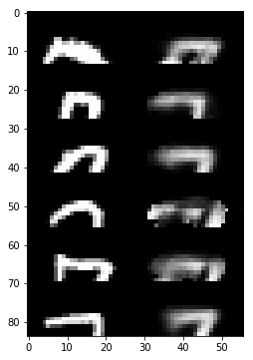
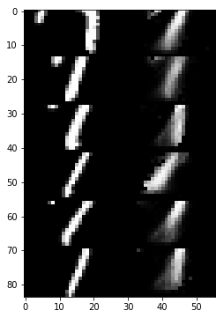
KCE Reconstruction
Patterns are reconstructed, with fewer flaws

Slide 47
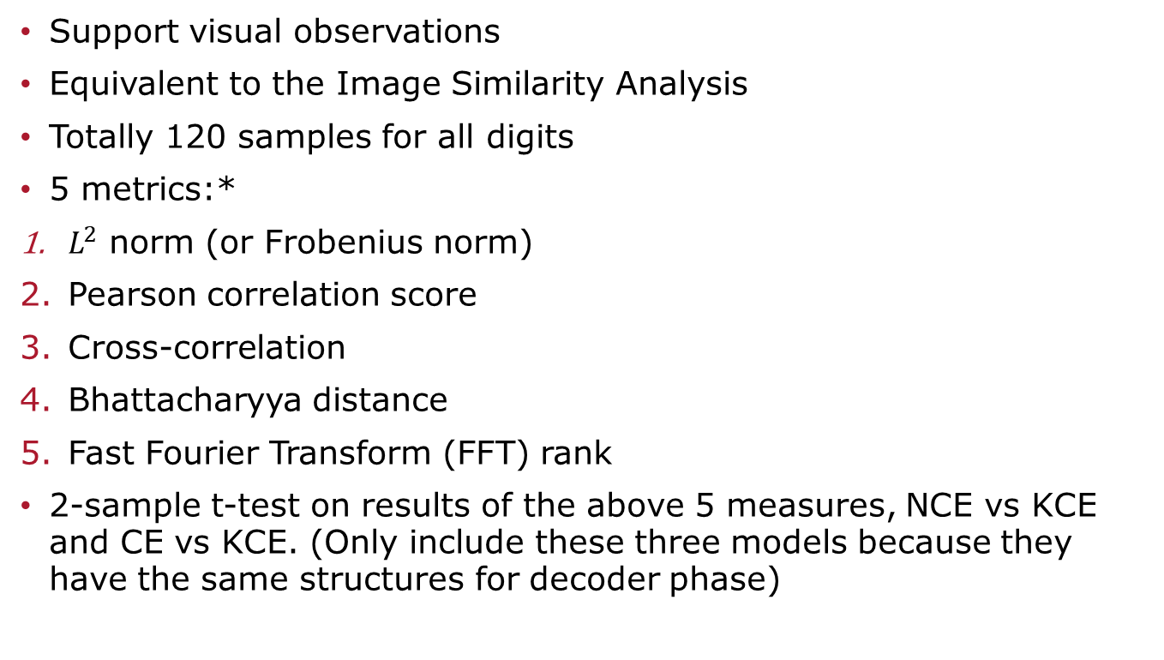
Quantitative Measures
Support visual observations
Equivalent to the Image Similarity Analysis
Totally 120 samples for all digits
5 metrics:*
$L^{2}$ norm (or Frobenius norm)
Pearson correlation score
Cross-correlation
Bhattacharyya distance
Fast Fourier Transform (FFT) rank
2-sample t-test on results of the above 5 measures, NCE vs KCE and CE vs KCE. (Only include these three models because they have the same structures for decoder phase)
*See back-up slides for detailed descriptions of the 5 metrics

Slide 48
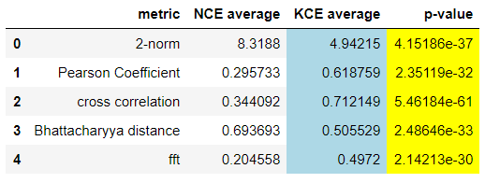
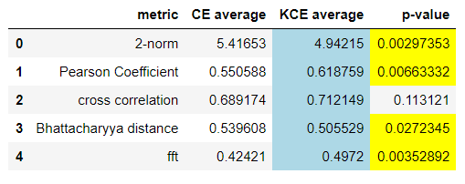
Quantitative Measures (For All Digits)

Slide 49
Summary
We developed 3 novel models
NCE leverages the non-linear abilities of autoencoders, but is not mathematically well principled
CE is mathematical well principled, but linear
KCE combines the advantages of both
It leverages the full power of non-linear autoencoders and kernel methods
It mathematically well-founded
In an example of mathematical rigor being useful, KCE actually works better than the other two models

Slide 50
Future Works
First, we believe that during the PCA projection, some information of original data gets lost. We will run more experiments to explore the dimensionality trade-off for better reconstruction results.
Second, we have observed that our model is able to avoid the “black-to-white” mapping error problem. It is worth exploring its reason and continuing to produce a mathematical proof.
Third, the current kernel function might be too simple (one layer with 2 parameters). We are going to explore the positive definite kernel functions with multiple layers (true “deep learning”).
Finally, so far we have only done the experiments on MNIST data. We should explore more samples including face images or even other types of data to justify the effectiveness of our proposed model KCE.

Slide 51


Future Works
Reconstruct more complicated images!!!
Randy at 20
Picture provided by professor Randy Paffenroth

Slide 52
Thanks!

Slide 53
Reproducing Kernel Hilbert Space (RKHS)
In KPCA or KCCA, a kernel function maps data from original space to an inner product space RKHS to ensure both the existence of an inner product and the evaluation of every function in this space at every point in the domain.
The corresponding kernel function should be both symmetric and positive definite

Slide 54
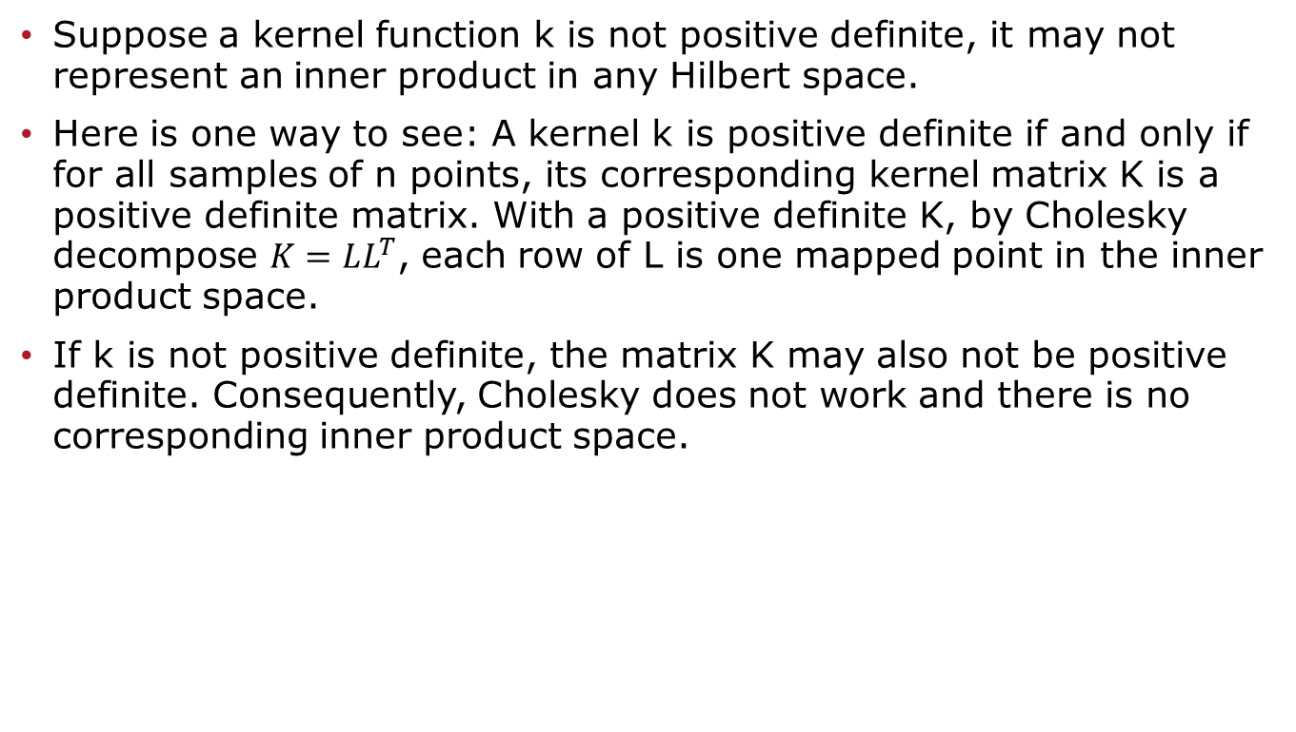
Positive Definite Kernel
Suppose a kernel function k is not positive definite, it may not represent an inner product in any Hilbert space.
Here is one way to see: A kernel k is positive definite if and only if for all samples of n points, its corresponding kernel matrix K is a positive definite matrix. With a positive definite K, by Cholesky decompose $K=LL^{T}$, each row of L is one mapped point in the inner product space.
If k is not positive definite, the matrix K may also not be positive definite. Consequently, Cholesky does not work and there is no corresponding inner product space.

Slide 55
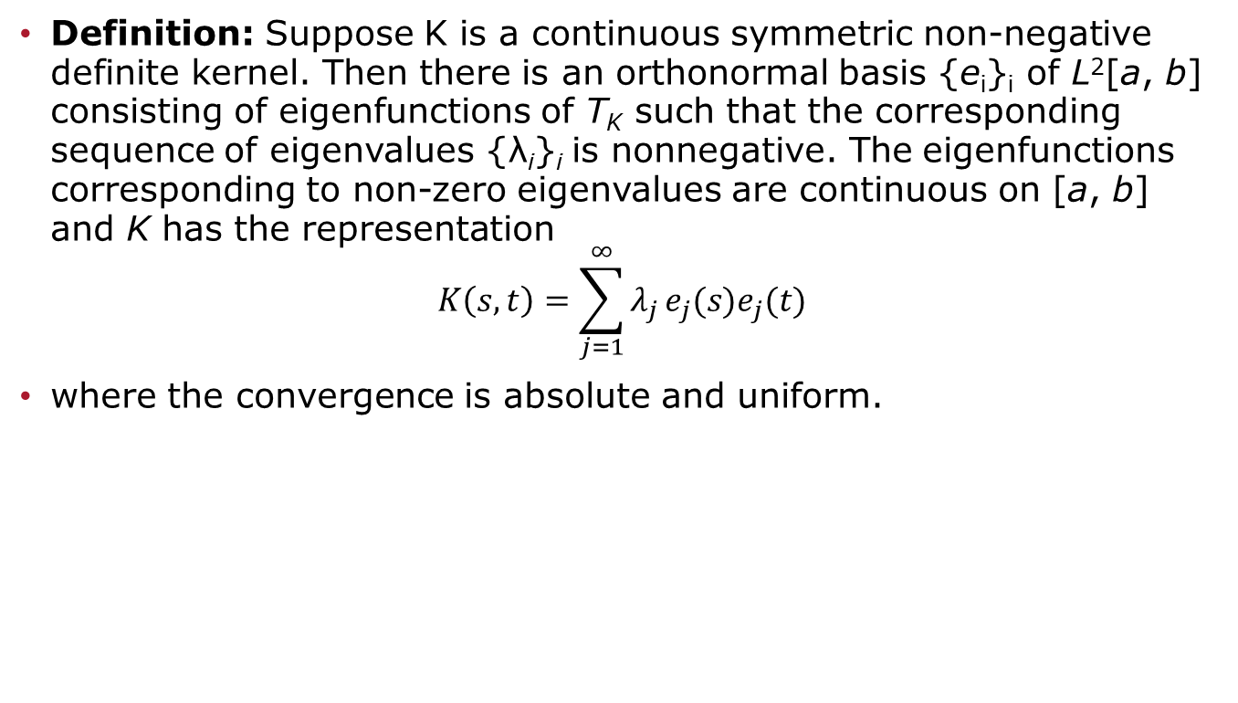
Mercer’s Theorem
Definition: Suppose K is a continuous symmetric non-negative definite kernel. Then there is an orthonormal basis {e_{i}}_{i} of L²[a, b] consisting of eigenfunctions of T_{K} such that the corresponding sequence of eigenvalues {λ_{i}}_{i} is nonnegative. The eigenfunctions corresponding to non-zero eigenvalues are continuous on [a, b] and K has the representation
$$K\left(s,t\right)=\sum_{j=1}^{∞}{λ_{j}}e_{j}(s)e_{j}(t)$$
where the convergence is absolute and uniform.

Slide 56

Completely Monotonic Function
Definition: A function $f(x)$ with domain $(0,∞)$ is said to be completely monotonic, if it possesses derivatives $f^{\left(n\right)}(x)$ for all n=0,1,2,3,... and if ${(−1)}^{n}f^{\left(n\right)}(x)≥0$.

Slide 57
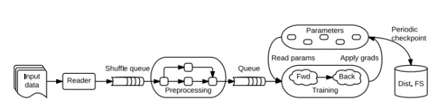
TensorFlow
an open source software library for numerical computation using data flow graphs, machine learning system that operates at large scale and in heterogeneous environments.
comes with strong support for machine learning and deep learning and the flexible numerical computation core is used across many other scientific domains.
gives great flexibility to the application developer and enables developers to experiment with novel optimizations and training algorithms.

Slide 58


Gradient Descent Optimization
the most common way to optimize artificial neural networks
Batch gradient descent is applied by TensorFlow class

Slide 59


$L^{2}$ Norm

Slide 60

Pearson Correlation Score
Pearson Correlation Coefficient is a measure of the linear correlation between two variables x and y. It has a value between -1 and +1, where 1 indicates total positive linear correlation, 0 is no linear correlation, and −1 is the total negative linear correlation.
Accordingly, Pearson Correlation score measures how highly correlated are two variables. A score of 1 indicates that the data objects are perfectly correlated but in this case, a score of -1 means that the data objects are not correlated.
In other words, the Pearson Correlation score quantifies how well two data objects fit a line.

Slide 61

Cross-Correlation
In signal processing, cross-correlation measures similarity of two series as a function of the displacement of one relative to the other.
For 1-dimensional data, it’s same as Pearson Correlation Coefficient.
For 2-dimensional data, this measure has one advantage: it takes care of the data shifting just like cross-correlation method takes care of the time-delay between signals in signal processing.
Here cc2d are two arrays containing cross-correlation coefficients (range -1 to 1) in different phases. We select the maximum values

Slide 62

Bhattacharyya Distance
Measures the similarity of two discrete or continuous probability distributions.
In image processing, this measure can be used to determine the relative closeness of the two samples being considered.
A zero Bhattacharyya distance means that two data are exactly the same. Larger Bhattacharyya distance refers to greater gap or difference between them.

Slide 63


FFT Rank
FFT is an algorithm that samples a signal (or signal-like data) over a period of time (or space) and transforms it into its frequency domain.
In the frequency domain, each point represents a particular frequency contained in the spatial domain. We use the real part of FFT results (magnitude).
represent the average frequency values in frequency domain.
A rank ranges from -1 to 1, where 1 is obtained if two datasets are exactly the same and -1 if they are fully independent from each other.

