Slide 1
Generating Ideas and Outlining
Pre-writing stage
1- considering audience & purpose
2- choosing the appropriate tone & style
3- generating ideas and gathering information
4- outlining
Techniques for generating ideas:
brainstorming, clustering or mapping, using questions, cubing, free-writing or note-taking, etc (read at home). → Be careful: avoid plagiarism

Slide 2
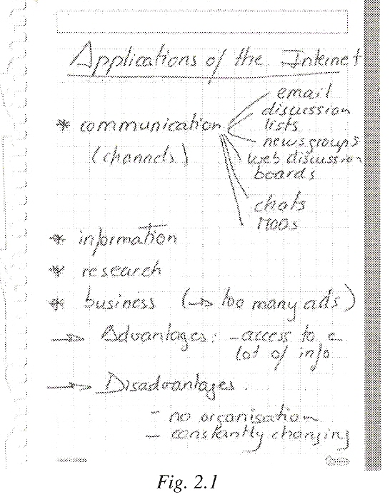
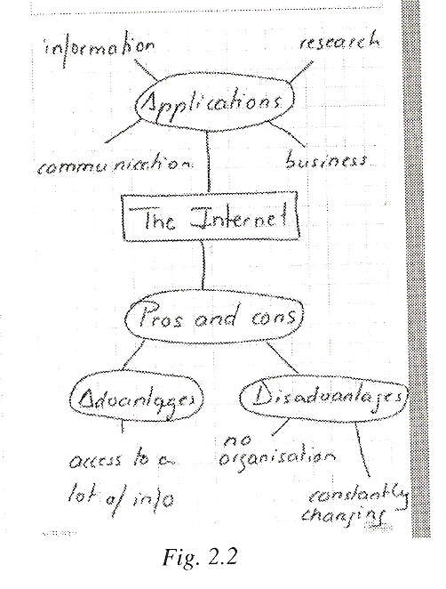
Techniques
 Brainstorming  Clustering/mapping

Slide 3
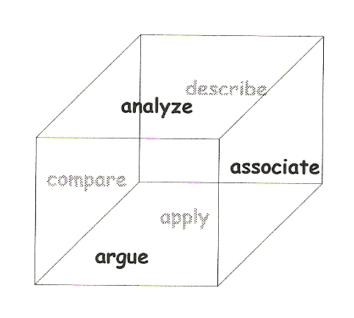
Purpose statements
Techniques
 Using questions
  Ask/answer Qs:
    Who? 4. When?
    What? 5. Why?
    Where? 6. How?
    Cubing

Slide 4
Purpose statements
Avoiding Plagiarism
Defining plagiarism
Discuss with your partners first. What is plagiarism? Can you give an example?
2. Listen to this short talk and answer these questions:
What does citing mean?
    Why is it necessary to cite?
    What are citation styles?
  http://libguides.richmond.edu/citingsources/
Analyzing cases
Visit the following website and the section on plagiarism and do Exercise 1.
http://www.uefap.net/writing/writing-plagiarism/writing-plagiarism-advice

Slide 5
OUTLINING: designing the plan of the document
After having researched and gathered info→ sketch an outline to filter and group your ideas according to some criterion (your approach or pattern of organization):
--pick good ideas,
--choose main ideas,
--discard the unnecessary, tangential or irrelevant ones
Benefits
1- Arrange main ideas and secondary ideas
2- Guideline: you see how ideas are related and prevent you from getting lost
3- Make partitions and allocate parts if the document is written by several people
4- Save time: omissions and imbalance can be identified at such a preliminary stage

Slide 6
Types of outlines
Traditional outlines:
Roman numerals, decimals or letters are used to show the sequence in which ideas appear; indentation reflects which ideas are equal, which are subordinate
Visual outlines:
Nucleus or tree node; information is displayed visually and synthetically
Choose the kind of outline that
makes you feel more at ease

Slide 7
TASKS
Do task 2-27 “ Computer Storage Devices”
(Collaborative) “The Use of New Technologies in the Information Age”
Generating ideas (general first; then narrow down)
Do task 2-32 Outline. Based on 2-27
(Collaborative)

