Slide 1

Writing approaches
Discuss your writing habits:
Do you do any action before beginning to write?
What do you do when you write?
What do you do once you have completed your first draft?

Slide 2
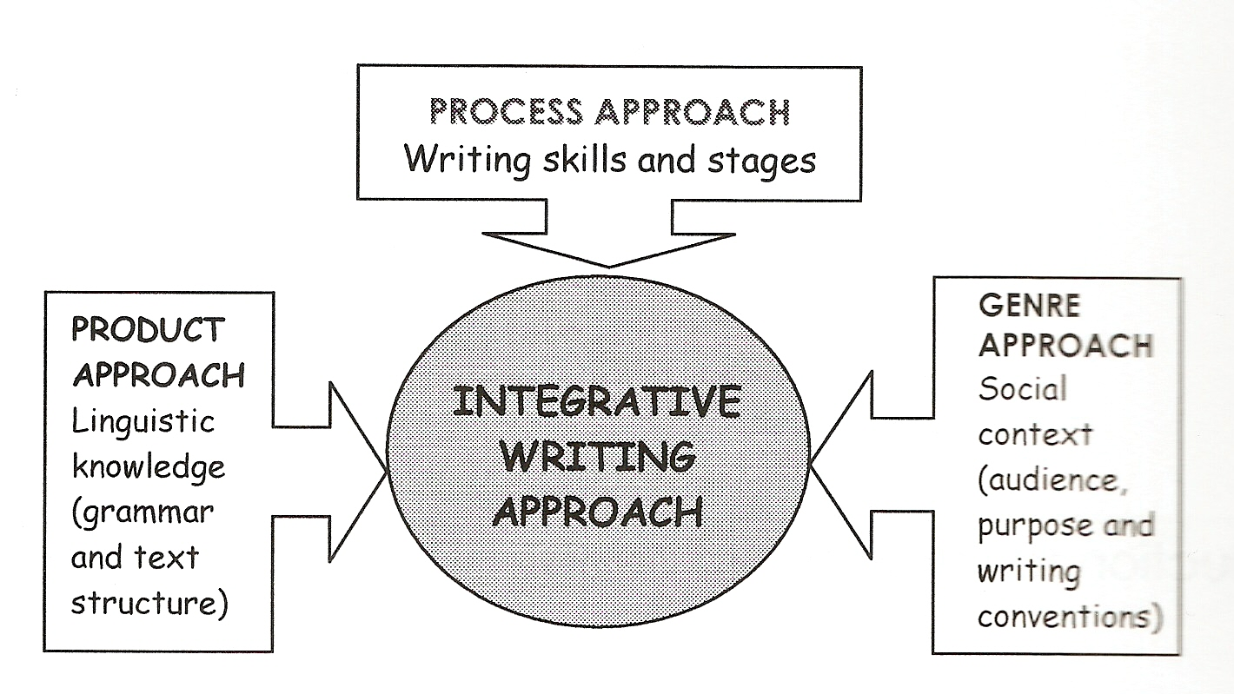
Integrative writing approach

Slide 3
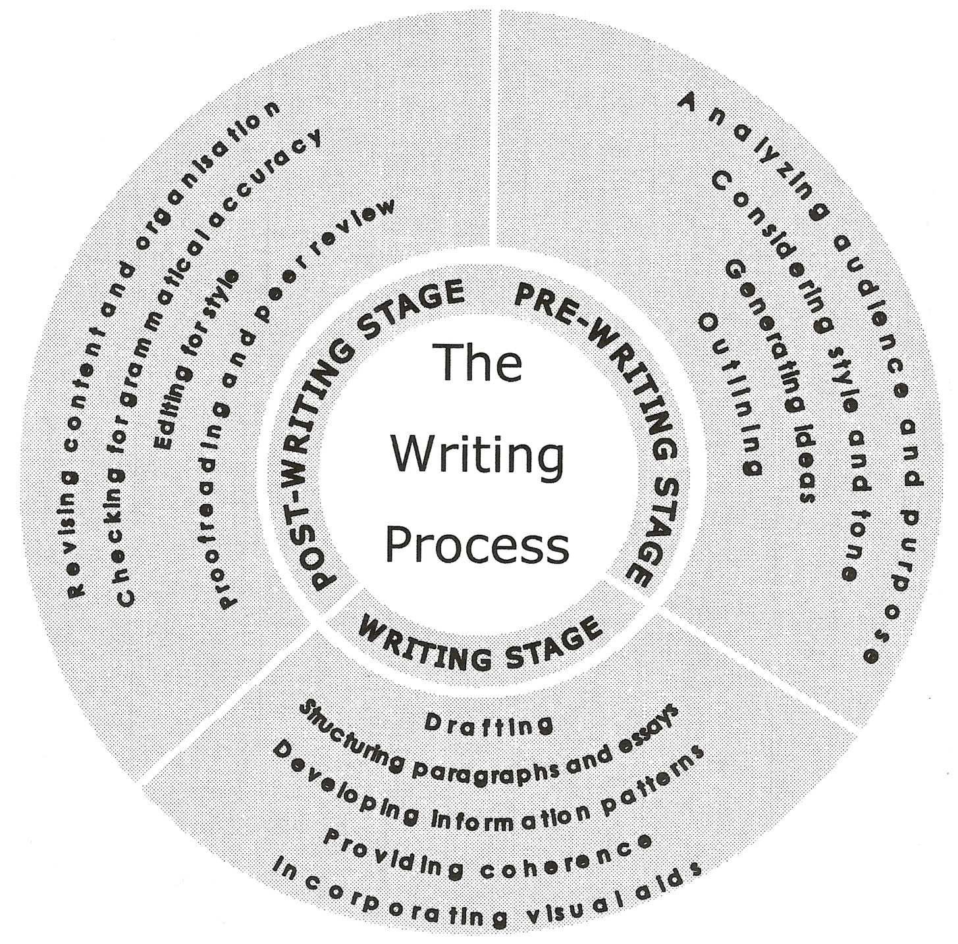
Process writing

Slide 4
Pre-writing stage
Reflecting on…
By and large, writers are usually recommended to bear in mind ‘contextual factors’ when it comes to writing a text. Can you guess what these ‘contextual factors’ can be?
How may vary a document distributed within a company to describe a latest improvement on a product from a document on the same product written to persuade the general public to buy it?
How would you address a close colleague in the same organisation and your boss when sending her an email (Dear Madam / Dear Mrs Brown / Dear Ms Brown / Dear Emma / Hello Emma / Hi)? Explain the reasons for your choice.
Can you think of different ways of organising ideas before writing a document? Which method do you usually prefer? Why?

Slide 5
PRE-WRITING STAGE (Planning):
•Who addressed and why?
→ audience and purpose.
How to transmit information?
→ tone and style.
What ideas to include in document?
→ collect info:
- brainstorming
- sourcing
How to organize/structure info so as to:
  suit audience needs?
  accomplish purpose?
  → outlining

Slide 6
ANALYZING AUDIENCE (i)
Who is going to read the document?
  Educational and cultural background
  Position within company
  English competence
  Single reader or mixed / secondary audiences
Why do they need to read the document?
  Audience objectives and needs
  Actions to be taken

Slide 7
ANALYZING AUDIENCE (ii)
How much do they know about the topic?
Level of expertise:
  Introductory conceptual background?
  Examples, definitions?
  Technical jargon?
What is their attitude towards the topic?
  Positive/negative: receptivity?
  Reading conditions?
  Importance?

Slide 8
AUDIENCE TYPES (i)
1.Technical experts:
Read to know about latest discoveries (update).
Understand jargon, acronyms, abbreviations.
Show interest in theory and want details.
Resort to graphical info.
Read critically and expect well-supported claims.
Are interested in method and conclusion.

Slide 9
AUDIENCE TYPES (ii)
2. Technicians:
Want to know how to perform technical tasks.
Are interested in practical aspects rather than theoretical.
Have a limited knowledge of theory?
Seek background info to increase understanding?
Need & want visual information.
Read & follow explanations to the letter.

Slide 10
AUDIENCE TYPES (iii)
3. Executives and administrators:
Read to make decisions.
Want conclusions & recommendations (time pressure).
Want essential information easily
Are familiar with technical terms?
Look for graphics and other visuals.
Want generalizations, not details.
Want info in plain terms.

Slide 11
AUDIENCE TYPES (iv)
4. Laypeople:
Are interested in topics with impact on their lives.
Cannot understand acronyms, technical jargon, etc.
Need background information.
Require simple explanations, definitions, descriptions.
Want graphics to understand info better.
Are more interested in practice than in theory.

Slide 12
AUDIENCE TYPES (v)
5. Students:
Read for learning.
Need and want theory.
Understand some technical jargon.
Expect numerical & graphical info.
Require clear explanations: definitions & exemplifications.
Are interested in generalizations and detail.
Appreciate a friendly and didactic presentation of info.

Slide 13
AUDIENCE TYPES (vi)
6. Mixed expertise & purposes:
Should include background info
Should include definitions of technical terms
Should use a matter-of-fact, business-like tone
Should be clear and to-the-point
Primary vs. Secondary readers:
Action-bound or not?

Slide 14
What’s the target audience? (i)
To laypeople:
Nowadays we are immersed in the digital era, we are surrounded by computers. But do we really know how they work? Computers use what we call ‘programming languages’, which consist of (...).
To laypeople:
A mechanical engine is somehow what a heart is to the human body. Its main function would be to metaphorically ‘give life to’ some machine. Cars, jets, or industrial machines are examples of machinery that require a mechanical engine to work. Like the human heart, mechanical engines need energy to work and carry out their function (...).

Slide 15
What’s the target audience?(ii)
To an executive:
After studying the case of the river Spree, we have reached the conclusion that it is necessary to build a bridge which facilitates going from one side to the other. The bridge would be the best way to move goods from one factory to another (...)

Slide 16
What’s the target audience? (iii)
To students:
A steering wheel is a round object made of plastic materials. It can be found both in machines and in vehicles, such as cars, lorries or vans. Let us see in more detail these two main groups and their main technical characteristics.
1)Vehicles: the steering wheel is used to change its direction. The bigger the vehicle, the bigger the steering wheel. This kind of steering wheels comprises (...) See Figure 1.
2) Machines: the steering wheel is mainly used to open and close valves which control how much water /liquid/... passes through a pipe. This type of steering wheels is composed of (...) (See Fig. 2)

Slide 17
What’s the target audience? (iii)
Exam sample
A radar is an electromagnetic system for the detection and location of objects. It operates by transmitting a particular type of waveform, a pulse-modulated sine wave for example, and detects the nature of the echo signal. Radar is used to extend the capability of one’s sense for observing the environment, especially the sense of vision.
The value of radar lies not in being a substitute for the eye, but in doing what the eye cannot do. Radar cannot resolve detail as well as the eye, nor is it capable of recognizing the “color” of objects to the degree of sophistication of which the eye is capable. However, radar can be designed to see through those conditions impervious to normal human vision such as darkness, haze, fog, rain and snow. In addition, radar has the advantage of being able to measure the distance or range to the object. This is probably the most important attribute.

Slide 18
Tasks (i)
Do task 2-1 (pp. 44-5):
- Text 1 = lay audience:
Low complexity.
Few sub-technical terms.
Definition of more complex terms.
Clarifying picture.
- Text 2 = student audience:
Higher complexity.
Many technical terms.
Many definitions & examples.
Block diagram, table, figure.

Slide 19
Tasks (ii)
Work in pairs.
Choose an audience in the list of categories.
Find an extract of a technical text that would be addressed to this audience. Justify by referring to any features of the text.
Get ready to show and explain

