Slide 1
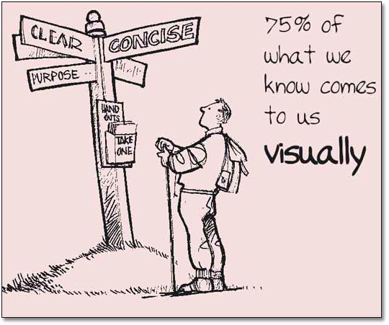
Document Design
Formatting for clarity and readability:
  Follow conventions
  Use of paragraphs
  Use of headings
  Use of white spaces
  Use of different typeface
  Use of bold and italics
  Use of visual aids:
    Clear
    Concise
    Break up monotony

Slide 2
Integrating visuals
Complementary to the text:
  Add
  Summarize
  Explain
  Confirm, etc.
Informative, not redundant
Located after pertinent text
Well referenced
Format suits data
Readable and neat
Types:
Tables
Line graphs
Bar graphs
Pie charts
Line drawings
Photos etc.
Assess strengths and weaknesses of each format!

