Slide 1
Assembling paragraphs into a text: from smaller units to a larger one
A text is a larger unit dealing with a theme that has more than one paragraph and that displays a structure.
What we saw at the paragraph level at text level:
  Structure of paragraph ------ structure of the text
  Paragraph patterns ----------- text (or essay) patterns (body para.)
  Coherent paragraph (intra-coherence) ----- coherent text (inter- coherence)
  (connecting devices -----------------> transition signals)

Slide 2
Structure of the essay (i)
Structure: a text (or essay) is a group of paragraphs which are headed by an introduction and closed by a conclusion.
  Introduction
  Body paragraphs (usually longer than introductory and concluding paragraphs)
  Conclusion
(Different documents have different structures or formats)

Slide 3
The structure of the essay (ii)
Parallelism between paragraph structure and essay structure
Introduction Topic sentence
Body paragraphs
-paragraph 1 Supporting sentences
-paragraph 2 Supporting sentences
- paragraph 3 Supporting sentences
Conclusion Concluding sentence

Slide 4
The introduction
Important part of the essay: attract readers
Begin with general info about the topic, giving background to the reader and arousing the reader’s interest
Background:
a summary of related literature, description of analogous products, explanation of the state of the art
Proceed with more specific info that leads to the thesis statement.

Slide 5
Thesis statement
We can define a thesis statement as a statement that:
is the most important and specific in the introduction
is placed at the end of the introduction
introduces the topic of the essay
may state the subtopics (which will be later found in the topic sentences of the body paragraphs)
may indicate the pattern of organization of the body
may be restated again in the conclusion
is usually expressed in one sentence

Slide 6
Common ways to begin an introduction
1. A paragraph consisting of some background info and a thesis statement
2. A purpose statement introducing the main objective of text
3. Some numerical or graphical information
4. An anecdote or some surprising information
5. A definition

Slide 7
Introduction with a thesis statement (with and without the subtopics)
A person born in the twentieth century saw a lot of changes take place in almost all areas of human life. Some people are excited by the challenges that these changes offer; others want to return to the simpler, less automated lifestyle of the past. Living in the twenty-first century has certain advantages but it also has some disadvantages.
…………………………………………………………..
Living in the twenty-first century has certain advantages, such as a higher standard of living, but is also has some disadvantages, such as a polluted environment, the depersonalization of human relationships, and the weakening of spiritual values.

Slide 8
Can you identify the thesis statement?
When the first Europeans began to settle the North American continent, they encountered a completely new culture: the native American tribes of North America. Native Americans, who had a highly developed culture in many respects, must have been as curious about the strange European manners and customs as were the Europeans about native Americans. As it always happens when two cultures come into contact, there was a cultural exchange. Native Americans adopted some of the Europeans’ ways and the Europeans adopted some of their ways.

Slide 9
Assess these introductory paragraphs
(Student a)
- Many people think that nuclear power is very dangerous for people’ s health. However, nuclear power has had not only military applications but peaceful applications as well . 75 % of the energy that Catalonia uses is from nuclear power.
(Student b)
- Nowadays all the information we listen or read on the media about nuclear power shows us the problems of using it for military applications. Nevertheless, we can’t forget all the advantages of this kind of energy. Thus, nuclear power has not only military applications but peaceful applications as well.

Slide 10
Introductory paragraph in a letter: purpose statement
Dear Ms Jansen,
I wish to apply for an internship position in the management accounting department at Shell as advertised on your webpage. My name is ---------, and am currently studying industrial engineering at Universitat Politècnica de Catalunya. At the moment I am in my fourth-year, and I expect to get my degree by June 20--

Slide 11
The body: body paragraphs
The number of paragraphs will be determined by :
  the number of topics and subtopics to be tackled
  the pattern of organization chosen
  the kind of document (and its length)
At the outlining stage: preliminary an intuitively you decided on your ‘approach’. Now, check whether the essay pattern is the most suitable or reconsider. (The same at the paragraph level).

Slide 12
Essay patterns
chronological or sequential order
cause and effect
comparison and contrast / analogy
specific to general
general to specific
problem and solution
listing / order of importance
A combination of two or more

Slide 13
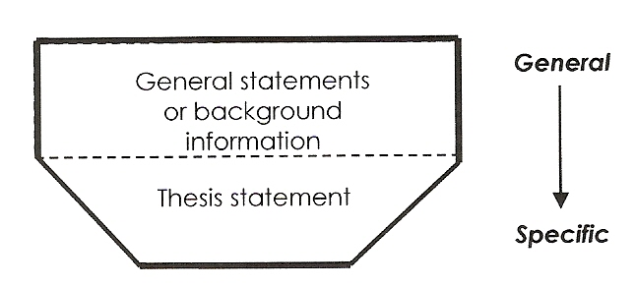
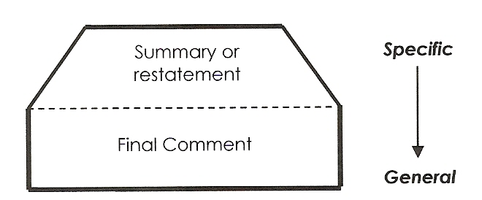
The conclusion
It signals the essay has come to an end and no more new ideas will be tackled.
Aspects to bear in mind:
  length
  usually headed by transitional markers (e.g. To sum up,)
  differences across different documents
It has two parts:
    Summary or restatement of main points
    And a final comment (recommendation, prediction, solution, personal comment, question, quotation)

Slide 14
Introduction or conclusion?
It is an undeniable fact that mobile phones have shaped modern lifestyle. In the early 90s one could hardly imagine that those tiny devices would be everywhere in less than a decade. Continuous technological development has led to new methods of production, and consequently to lower consumer prices, which together with the marketing done by retailers have created the “mobile phone hype” as it exists today. However, the focal point that has made mobile phones irresistible to users of all ages is the appealing advantages they display.

Slide 15
Introduction or conclusion?
It is reasonable to say that the great impact that mobile phones are having on our society is mainly due to their advantages. Mobile phones have made it possible not only to call somebody from almost anywhere thanks to their wireless technology but also to obtain information from the Internet or have fun playing games. Yet some may argue that some of the implications may not be advantageous

Slide 16
Concluding remarks
Not all documents must necessarily be entirely based on the essay patterns above. Sometimes they may have some full sections or chunks of text following no specific pattern.
As with paragraph patterns, it is quite common to find an essay with two or even several patterns embedded.
It is usually worthwhile to pay special attention to connecting devices. For example, in a cause-and-effect pattern, you are very likely going to use connective devices that signal causes or effects (e.g. for this reason, since, therefore).

