Slide 1
Analyzing Personal Productivity Data with Power BI Andy Green
Objective: To gain insights into daily activities and time allocation to identify patterns and optimize productivity
Tools used: Excel (data entry, data manipulation, data cleaning), Python (data manipulation), PowerBI (visuals, dashboard)

Slide 2
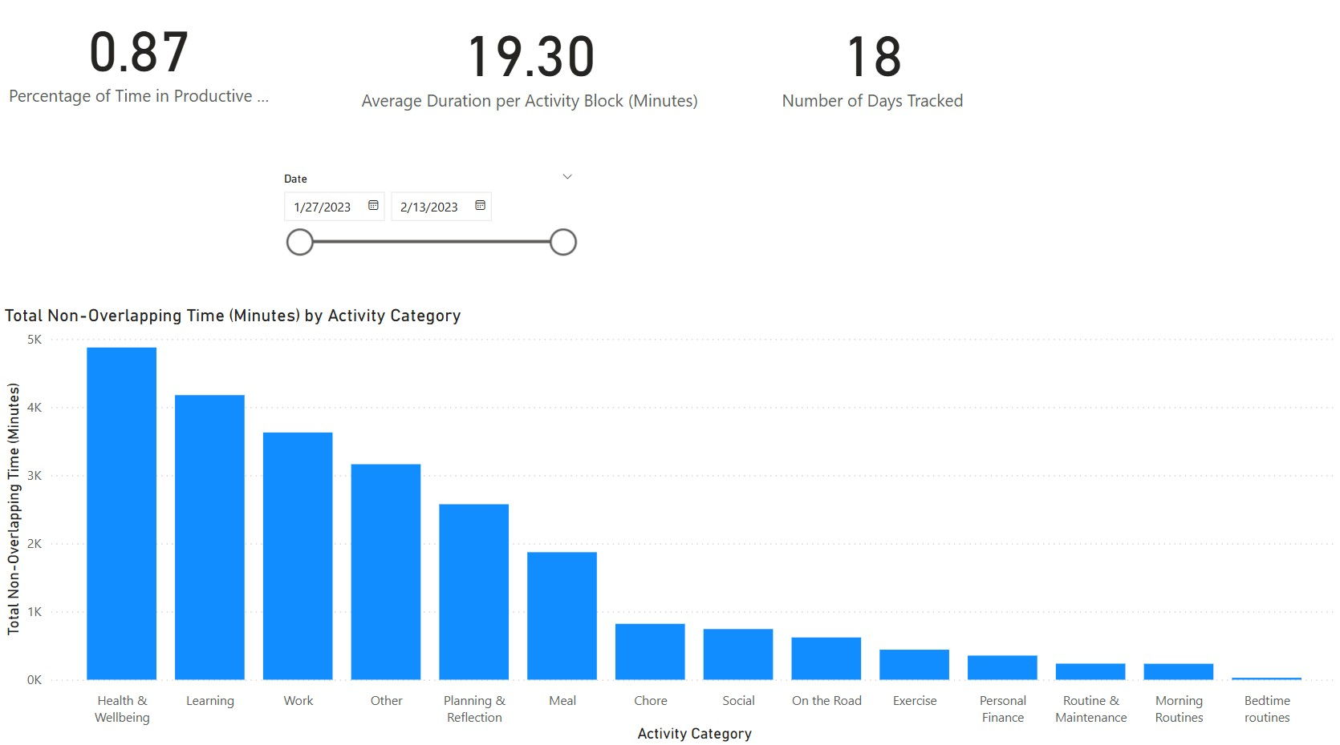

Slide 3
