Slide 2
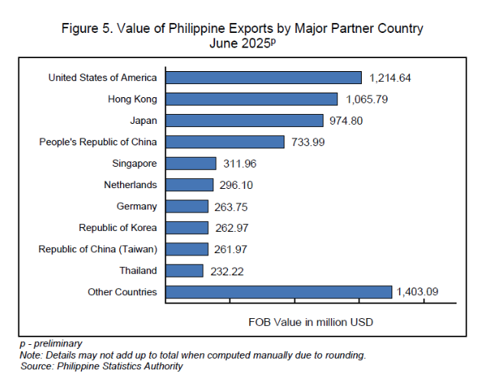
https://psa.gov.ph/statistics/export-import/monthly

Slide 3
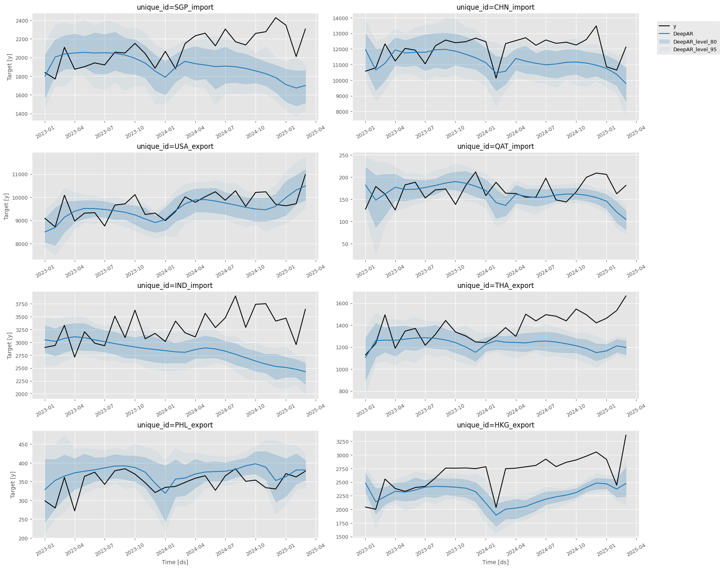
Model A captures trends in the import/export activity for select countries such as USA and PHL. However, the prediction intervals are large.
It missed to estimate high-frequency variations in the activity.
For the case of Indonesia, Model A seems to have drifted in its forecast.

Slide 4
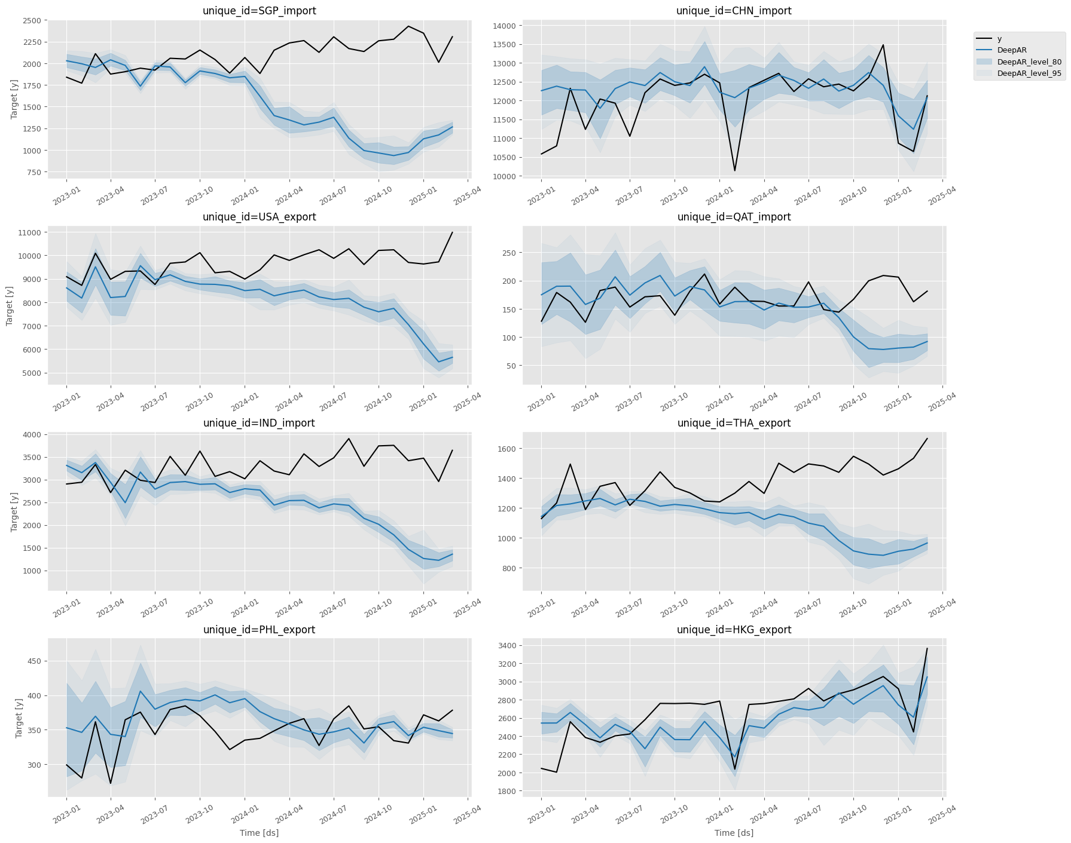
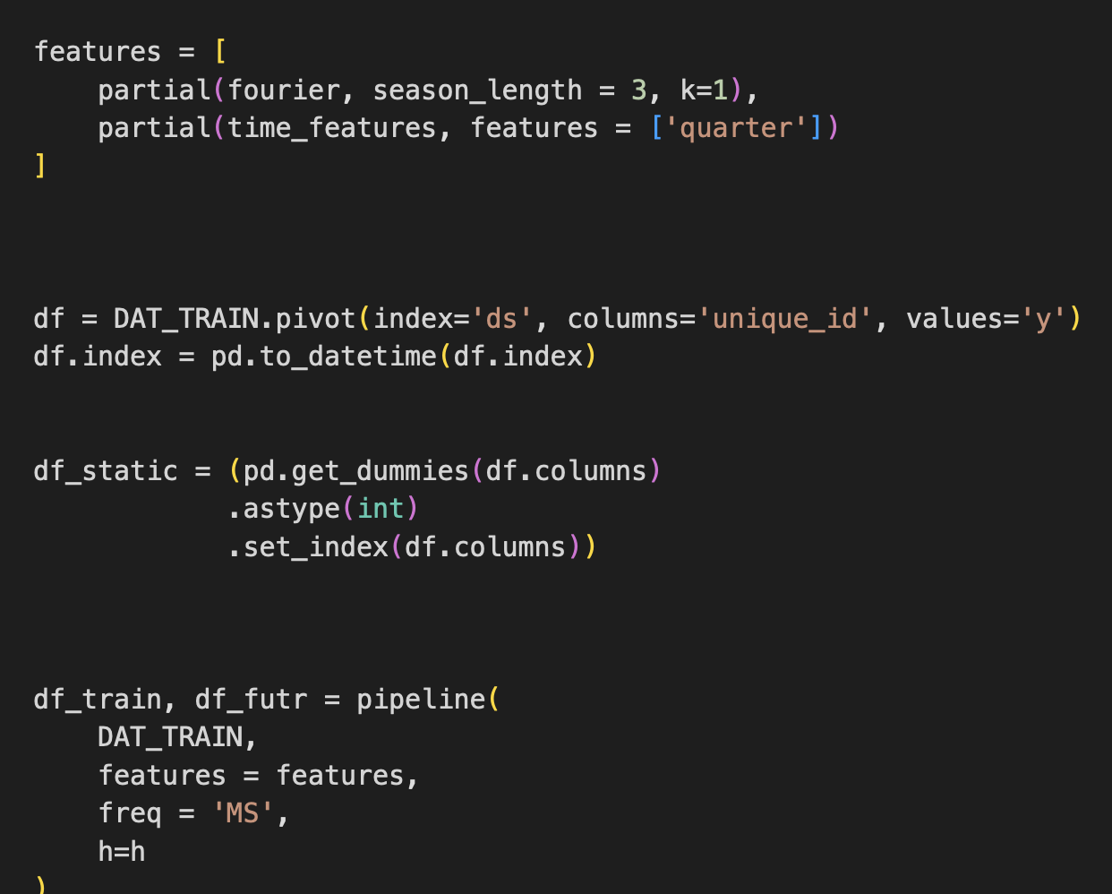
Model B

