Slide 1
Computer Language Design and Engineering
A scripting language for web API design and testing
Jakab Zeller

Slide 2
Computer Language Design and Engineering
A scripting language for web API for design and testing
Motivations
Intro to sttp
Test programs
Reports
Development of sttp

Slide 3
Motivations
HTTP/REST clients
The big three: Postman, Insomnia, or Paw
All have similar features
Some have simple control flow. Such as executing in a sequence
No looping or conditionals
Limited variable definition
Frequently come across use cases that require these constructs

Slide 4
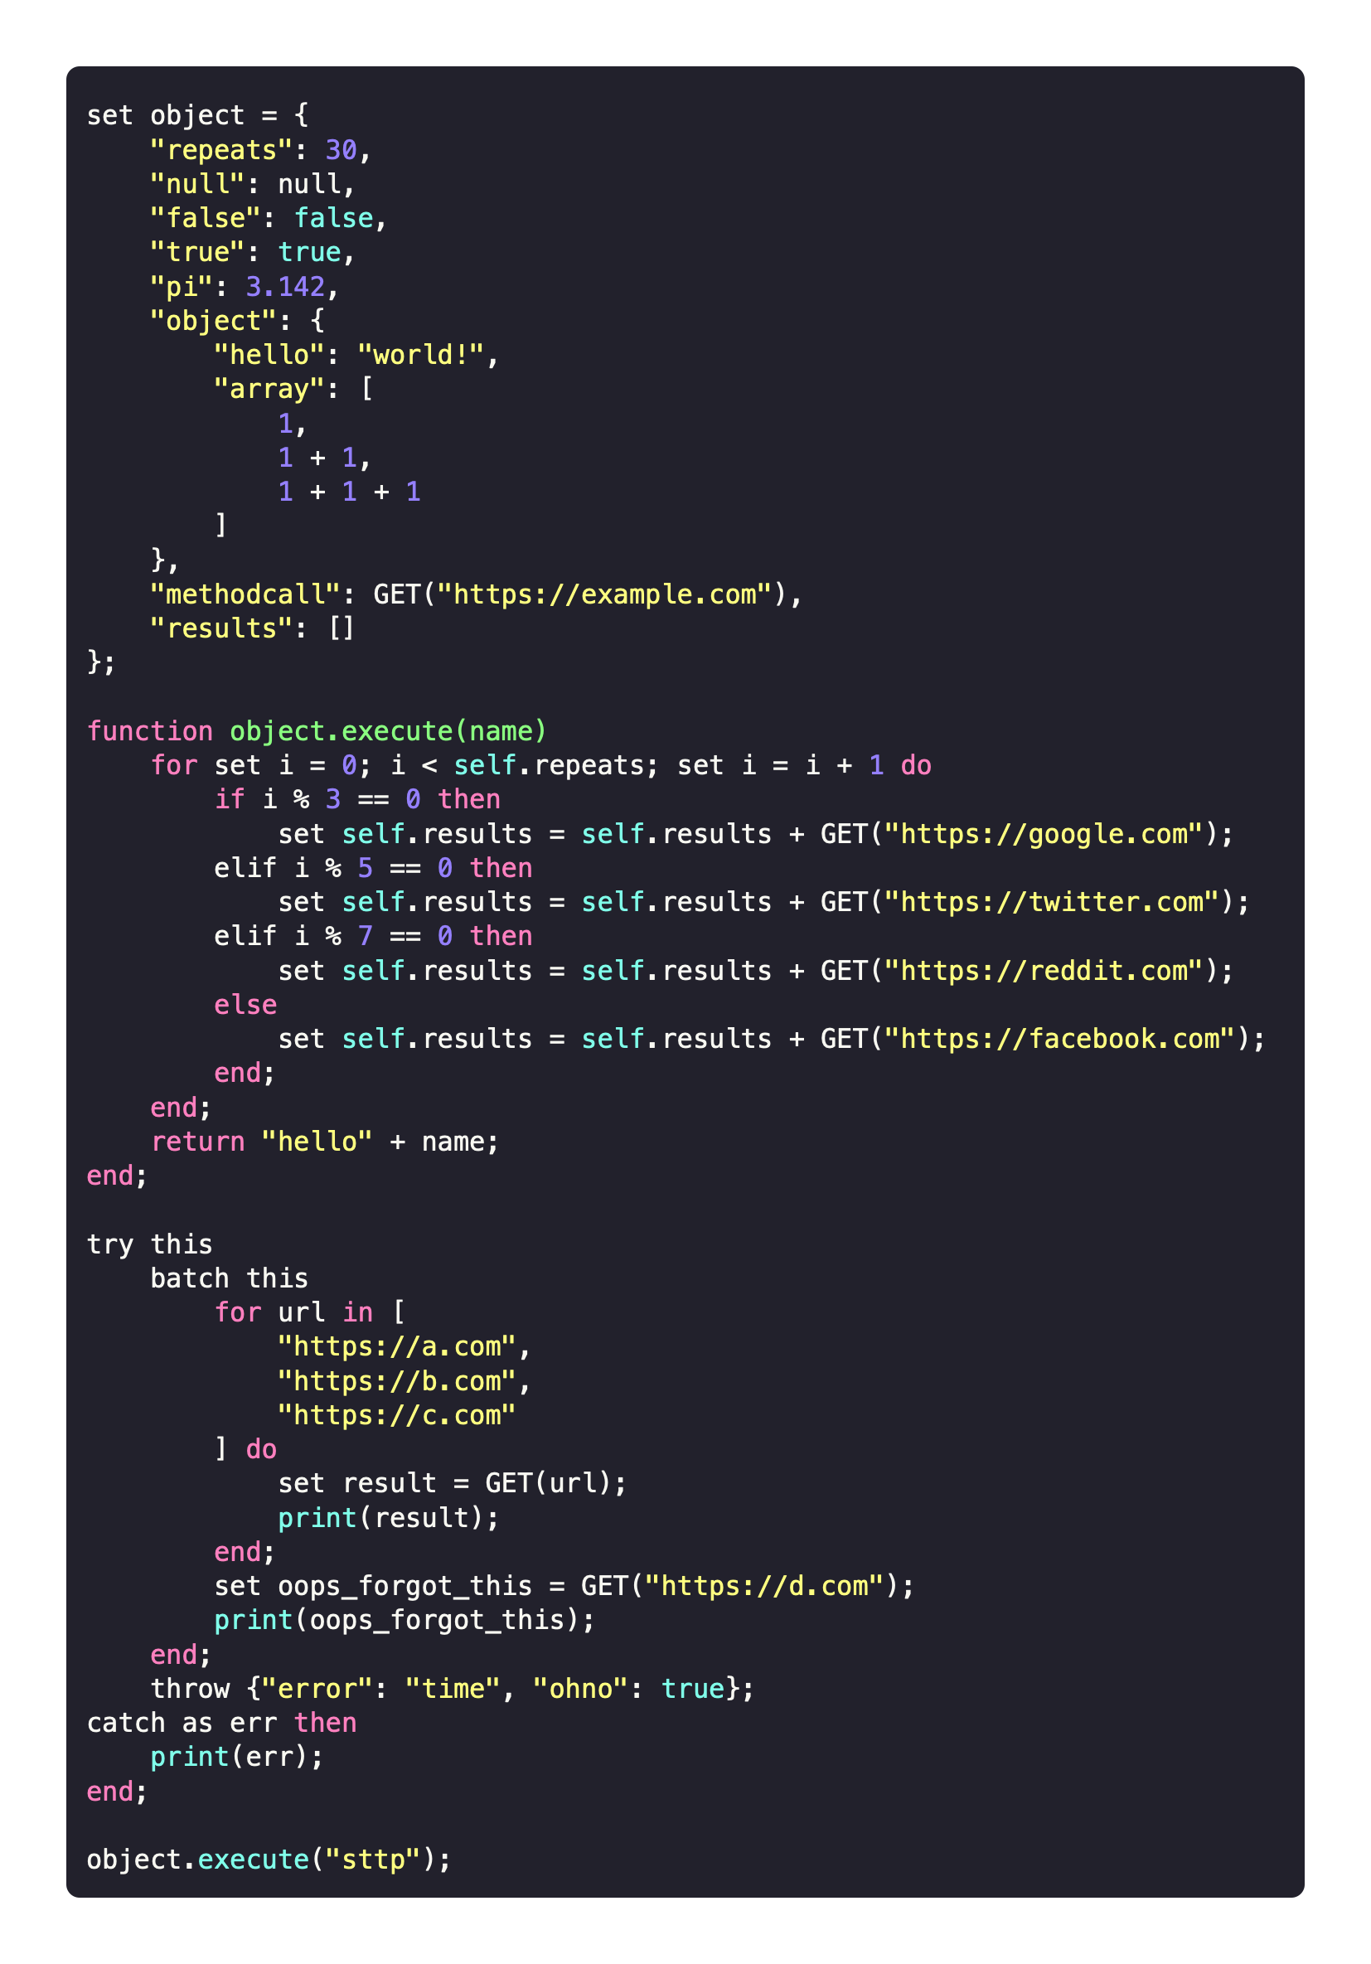
Intro to sttp
Amalgamation of “scripting” and “HTTP”
A HTTP client within a scripting language
JSON setting/accessing with JSON path
HTTP method calls builtin
HTTP request batching
Conditionals, loops and exception handling
Construct a test suite from your directory structure
Non-whitespace dependant
Example code

Slide 5
Test Programs

Slide 6
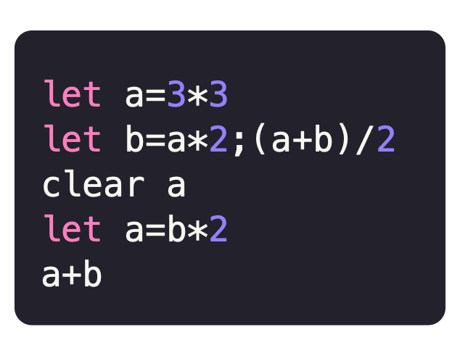
1 — Four Function Calculator
With REPL and variable assignment
Getting used to Go and the participle parser generator
Supports
Addition, Subtraction, Multiplication, and Division
Variable assignment and deletion
REPL mode
Grammar defined within AST node “struct”s using field annotations
Example script

Slide 7
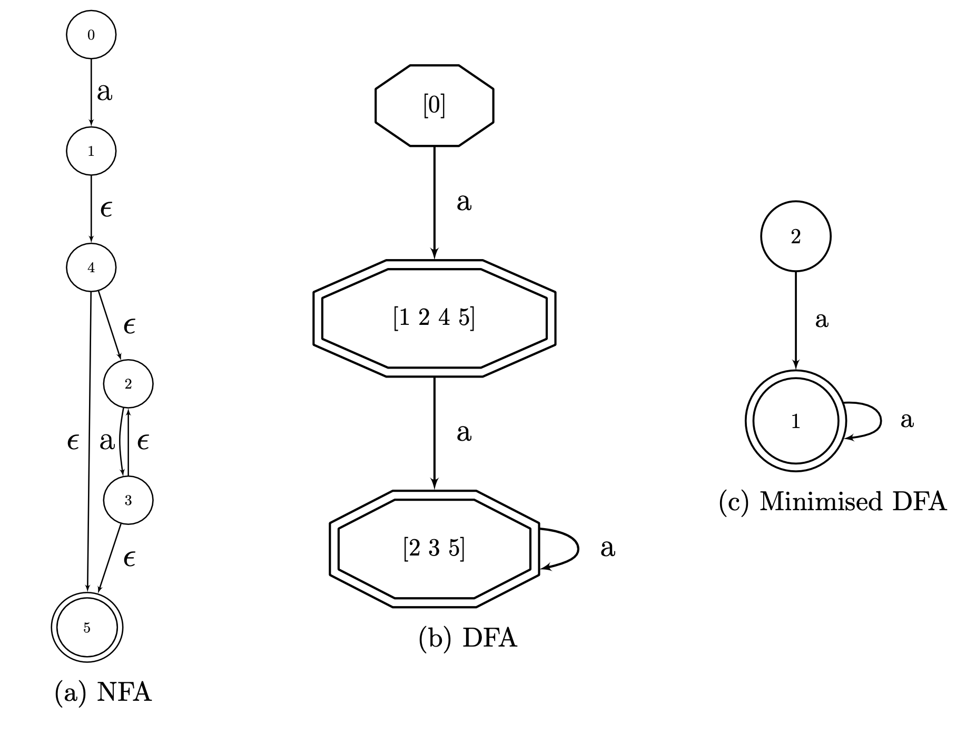
2 — Regex Parser
Constructs a minimal DFA from an input regular expression
Interest from content covered in CS3470
Thompson’s construction, subset construction, then Dead State minimisation
Graphviz is used to display visualisations of each stage
NFA, DFA and minimised DFA for the regular expression: aa*

Slide 8
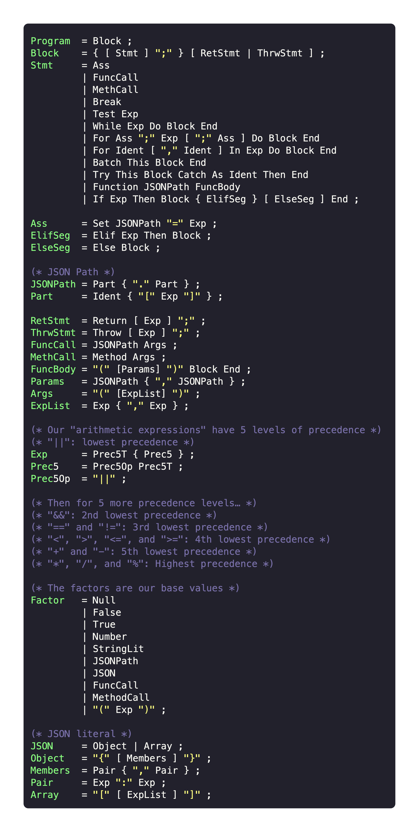
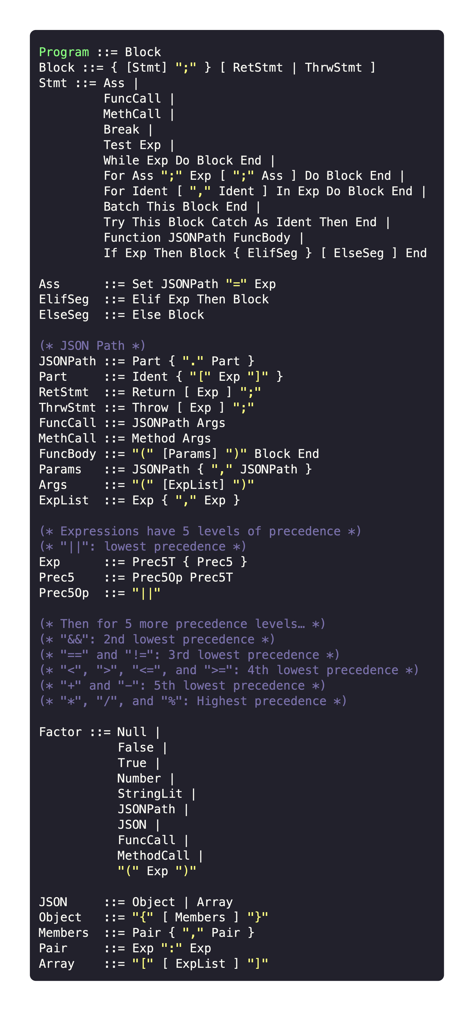
3 — sttp grammar
Implementation within participle
Defining a grammar within the project specification
Defining the AST nodes within participle and annotating with the grammar
Precedence is encoded within grammar

Slide 9
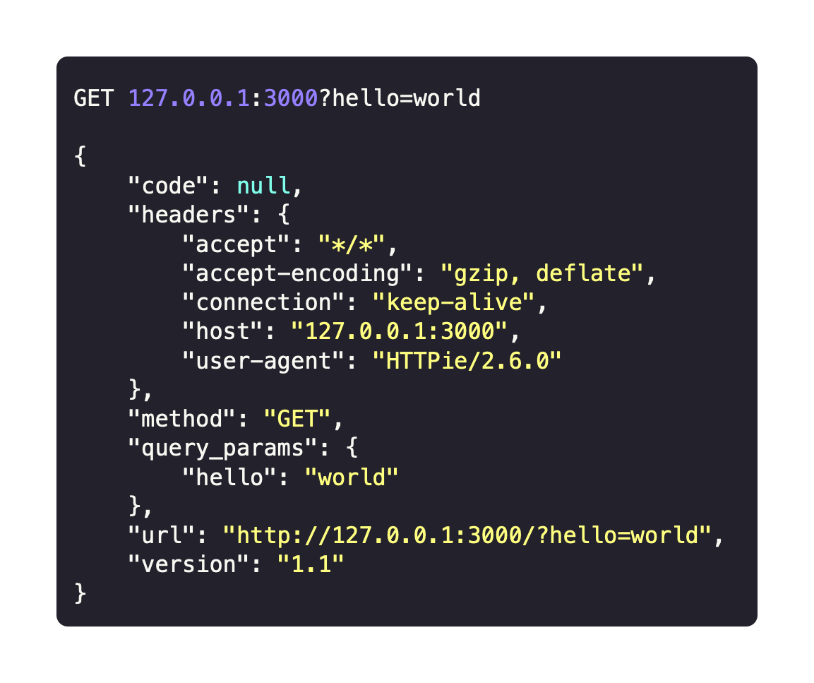
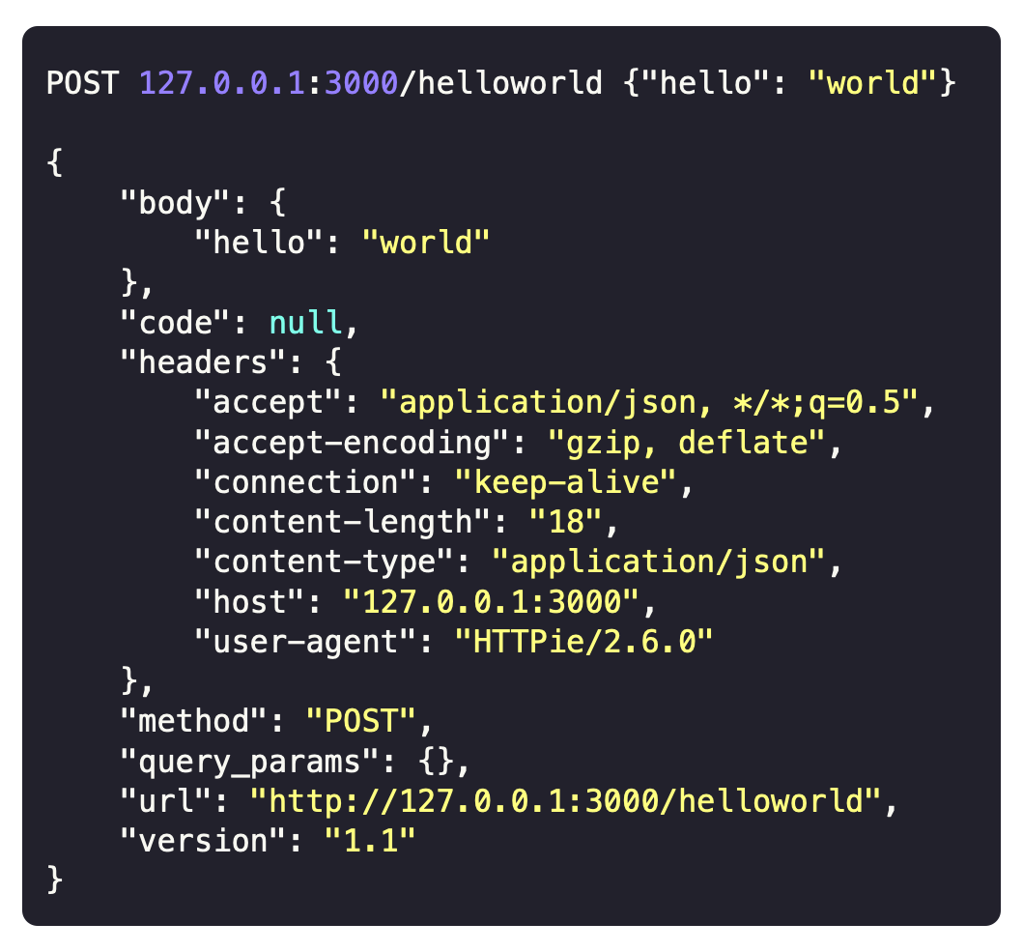
4 — Echo-chamber Web API
For testing purposes
Node.js web server
Echoes request info back
For testing sttp HTTP request batching and general use
Example requests and responses

Slide 10
Reports

Slide 11
Context-free grammars and manual procedures for parsing languages
October
Written before much of the material that was taught in CS3470
Some background information on formal languages
Manual parsing techniques: top-down and bottom-up
Example grammars and derivations
A note on parser generators and sttp

Slide 12
The use derivation rules, and grammar idioms to capture notions of associativity and precedence in arithmetic expressions
November
Explanation of associativity and precedence in formal mathematics
How to encode each one into your grammar
Getting around possible pitfalls of recursive descent parser generators
Affected my choice of encoding precedence into the sttp grammar

Slide 13
“Developers, developers, developers, developers, developers, developers, developers, developers, developers, developers, developers, developers, developers, developers, developers.”
Steve Ballmer

Slide 14
sttp development

Slide 15
Development timeline
So far…
Mid-October: grammar definition, AST node type definitions, AST dump as sttp source code
End of October: Exception handling and the batch statement
November: Implementation of some data structures, operator action lookup and cast function lookup

Slide 16
Any Questions?

