Slide 1
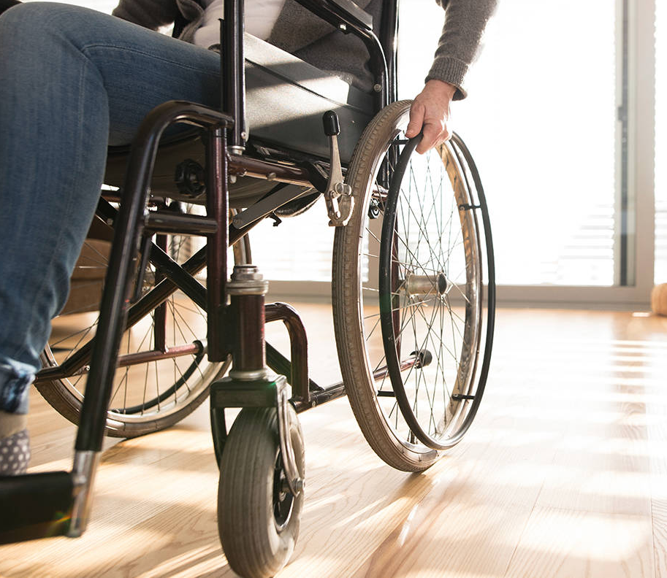
Accessibility: Building Design Tool
Using Artificial Intelligence to Create a More Inclusive World
Project Team 152: Andrey Golovanov, Dua Mojib, Luke Heydon, William Shao,
Yifei Zhang
Notes:
Hello everyone and thank you for coming to hear our presentation. And we’d also just like to thank our team lead Garv and our project mentor Bryce for supporting us throughout this project, so thank you guys.

Slide 2
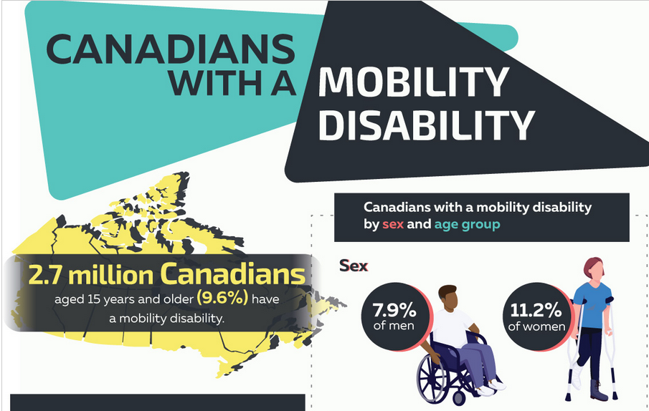
Introduction
Did you know over 2.7 million Canadians live with some type of mobility disability as of 2017?
(This includes anyone with a cane, a wheelchair, crutches, etc.)
(Statistics Canada,
Canadian Survey on
Disability, 2017.
https://www150.statcan.gc.ca/
n1/pub/11-627-m/
11-627-m2020085-eng.htm.)
Notes:
My name is Luke, I’ll be starting us off. First of all, we’d like to share with you an unfortunate fact: According to Statistics Canada, over 2.7 million Canadians live with some type of mobility disability. This includes those who are blind, or require a wheelchair or perhaps crutches; anyone whose mobility is impaired somehow. These impairments can often have a profound impact on the everyday lives of these individuals, especially for more severe conditions. They may have trouble moving even short distances because of exhaustion or pain, or they may have difficulty navigating tight spaces, or they may require a number of accommodations just for parts of their daily routine, like using the restroom. Now we think this is tragic and we want to help, and we believe that Artificial Intelligence will be a very useful tool in helping us build a more inclusive world. We hope to show you how that is the case, and we hope to illuminate some of the great potential of AI.

Slide 3
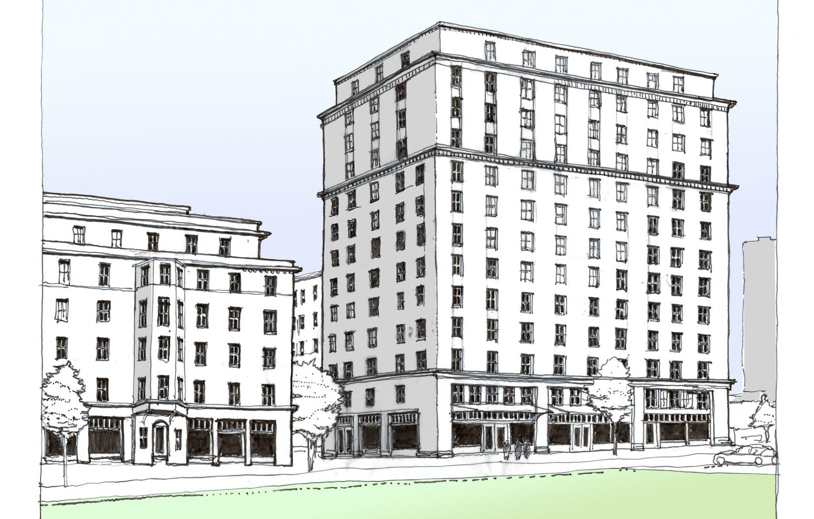
The Problem We Want to Solve
Architects may meet the bare minimum standards for accessibility, but do no more than that
We want everyone’s experiences to be considered equally
We will focus on those with mobility issues
Those who have trouble navigating buildings
Those who struggle in crowded elevators, hallways, etc.
Notes:
The problem we will focus on is this: Architects often think of average people when designing buildings, but those with disabilities are easily forgotten. The architects may include the bare minimum standards for accessibility as required by law, but fail to create pleasant experience for everyone. For example, an architect might use lots of glass to make the space feel more open, but someone who is visually impaired will not be able to experience this in any way. Or the architect may try to create interesting sightlines through the building, but these sightlines can only be seen by those of average height, so someone in a wheel won’t be able to appreciate them. We want everyone to be considered equally when buildings are designed.
We are especially concerned about the use of space in buildings. By that we are referring to narrow hallways, crowded elevators, narrow thresholds, poorly located bathrooms, or anything that makes the building difficult to navigate. Those with mobility impairments will be disproportionately affected by such difficulty, and given that statistic we cited earlier, that’s a lot of people. For example, someone in a wheelchair might feel very embarrassed to take up so much space in a crowded elevator, or a blind person using a cane may have difficulty trying to get through crowded hallways and tight doorways, since they can’t go at the same pace as everyone else. These are the types of issues we plan to address with our AI solution.

Slide 4
What We Will Cover
Our proposed solution in brief. (Dua)
Where our data will come from. (William)
What our business will look like. (William)
Measuring the impact of our solution. (Andrey)
Ethical considerations of both architectural data and personal information. (Andrey)
The next steps for turning our solution into a reality. (Yifei)
Finally we will end with any potential questions.
Notes:
Hi guys, my name is Dua. I want to show what we’ll be discussing before we get right into our solution. First, I’ll go over our proposed solution in brief. Then William will talk about where our data will come from for training our AI model, and he will also discuss the business side of things. After that, Andrey will cover some ethical concerns to be aware of as we move forward, and how we will measure the impact of our solution. And finally, Yifei will discuss the next steps we need to take to turn our solution into a reality, and then we’ll take any questions you guys might have at the end of our slide show.

Slide 5
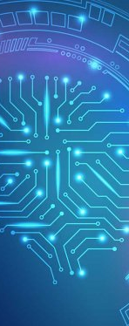
Our Proposed Solution
AI-assisted program that predicts the traffic flow of people through corridors, elevators, rooms, and other parts of a building, to predict areas of congestion.
The AI could improve the design to allow for people with mobility issues to traverse the structure with less difficulty, and ultimately feel more included in the overall dynamic of society.
Our proposed solution could be explained better using a few examples. Here are a few predictions that the AI might make:
“This hallway is too narrow, there will be lots of people moving through regularly, so it will be hard for someone with a mobility disability to get through.”
“There are too few elevators, which will cause them to become crowded and may cause distress to those who require a lot of space in the elevator.”
Notes:
So what is our proposed solution? We plan to develop an AI-assisted program that essentially predicts the traffic flow of people through corridors, elevators, rooms, and other parts of a building, to predict areas of congestion. I think our solution is best explained using examples, so as an architect designs a building using some design software, the AI would make predictions like:
“This hallway is too narrow, there will be lots of people moving through regularly, so it will be hard for someone with a mobility disability to get through.”
“There are too few elevators, which will cause them to become crowded and may cause distress to those who require a lot of space in the elevator.”
“This intersection will get congested at certain times of the day, which will make it difficult for people with certain disabilities to navigate.”
To make these predictions, the AI will make use of floorplans, employee schedules, number of scheduled appointments at a certain time, typical number of customers throughout the day, and any other details specific to the type of business using the tool. We hope that, as an architect designs a building, the AI could improve the design to allow for people with mobility issues to traverse the structure with less difficulty, and ultimately feel more included in the overall dynamic of society.

Slide 6
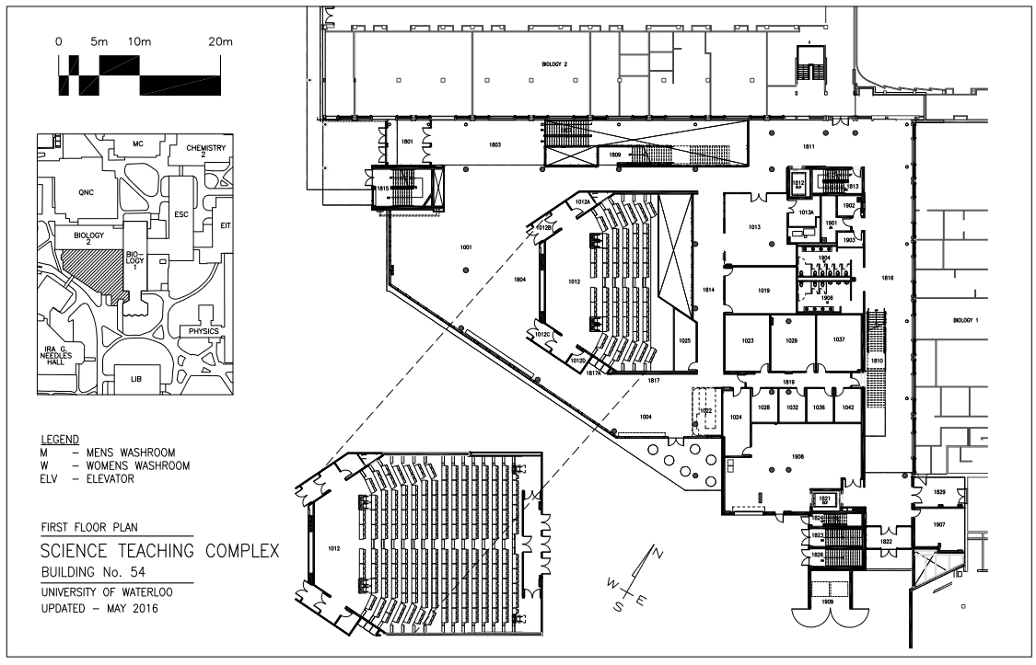
Data Sources
From businesses who choose to participate:
Position of people in the building throughout the day
Floor plans, worker schedules, number of appointments in the day, typical number of customers, etc.
Notes:
Our primary source of data will be from businesses who choose to offer theirs. We will provide a business with a simple Object Detection AI tool that can locate people in security camera footage. We will also provide the business with software that maps their camera footage to floorplans. The reason we will provide businesses with these tools instead of just doing the analysis of the footage ourselves is so that we can protect their privacy: they can just give us the position of people in the building throughout the day, without actually giving us their security footage. The business can also choose to provide us other details relevant to the specific business, like employee schedules, appointment times, hourly customers, and stuff like that.

Slide 7
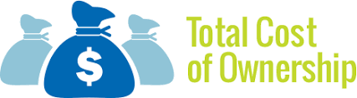

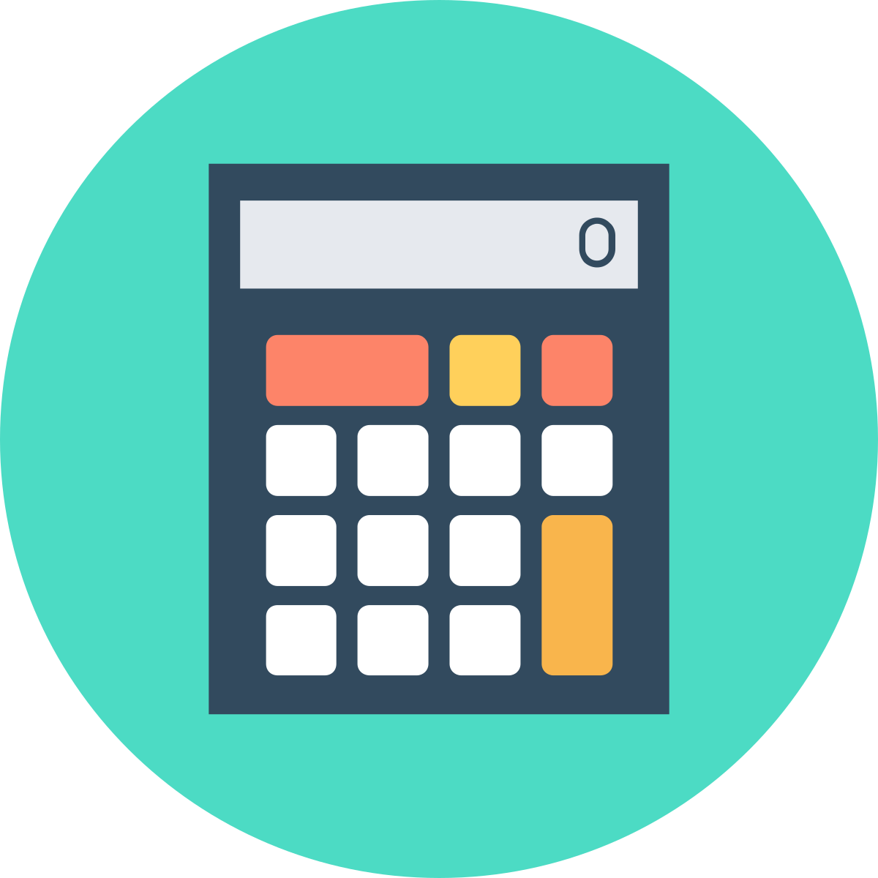
The Business Case
Azure TCO Calculator
Azure Advisor
Fundraisers
Notes:
Since our focus is on helping people, we think it would be appropriate to be a non-profit organization. Therefore, our goal will be to continue the development of our project with the funds we receive from donations. Our largest use of funds will include the Azure services we need to operate, more fundraising, and the payrolls of those who work at the organisation. To optimize costs, we will use Azure TCO for the initial cost and then use Azure adviser to further increase cost efficiency and help us stay financially stable.
Because we are non-profit, and we want our AI solution to be widely used, it will be distributed as a feature of already-existing architectural design programs such as Revit or AutoCAD. We plan to add it as a plugin, at no addition cost to the user.
When working with businesses to collect data, we have two options in mind: We could purchase data from the companies’ using funds from donations, or we could ask businesses to donate their data for free, and we would just write them a tax receipt for the value of their data. We feel the latter option might be more appealing to businesses because they get to feel good about themselves without actually donating cash.
There are some AI architectural programs that exist out there, but none have a primary focus on helping those with disabilities. A company with our building tool could potentially experience an increase in talented workers with disabilities, or they can bring in new customers who have disabilities, or generally show others how inclusive their company is, providing more incentives to use our product.

Slide 8
Measuring Impact/Positive Benefits
What are some positive benefits?
How will we measure impact?
Open Minded Business
Improved lives for people with mobility disabilities
Happier workplace
Less congestion in hallways
Survey:
Architects
Businesses
People with disabilities
Users
Notes:
We believe that our project will have many positive impacts on society. Our project shows that a company is willing to put effort into making people with disabilities comfortable. A business with our solution will create easier-to-navigate hallways and improve the traffic flow of their buildings. This would result in an improved life for people with disabilities and everyone in the building in general. An open-minded business using our project would open the company to increased diversity and allow many of the talented people with mobility issues to come work for their business. Since our project aids with traffic flow, it will result in an overall happier workplace because people will be able to get through the hallways with more efficiency. Since our main goal is to aid with traffic flow for disabled people our project would allow these people to navigate through the building with ease and let them experience a normal work environment without any delays. Allowing them to increase their productivity and remove a stressful factor from their days. This would also improve the lives of customers and users of the building built with our application. Many times, it is very stressful to navigate through a full building and even more stressful if you are not a regular in this building. Since our project improves areas of congestion that means that people with disabilities can be less stressed about through an unknown building and not have to worry too much about getting lost.
We will measure our impact through various surveys. Specifically asking architects about features they’d like to see and their opinions on the program. Along with businesses about their satisfaction with the service and finally people with disabilities on what their thoughts of the building. We are considering using an online rating system to measure our product. We will do our best to respond to negative social impacts quickly that way they do not affect people, since our program is a simulation, we hope to prevent social impacts before they are a concern. Our product isn’t very related to the environment, however in the future we could add a feature that can suggest environmentally friendly materials.

Slide 9
Ethical Considerations
Privacy and safety
Azure security services
Transparent
Service based on trust
Notes:
Currently, ethical thinking is a major priority of major companies, and our project aims to follow this forward way of thinking. We hope to ensure our users and partners anonymity, confidentiality, and safety. We ensure the privacy and safety of those who send us their data through azure security services. Using features from azure storage service encryption and multifactor and role-based access. Along with using Azure SQL services to ensure a secure connection. After all, this is data we highly value and we do not want to lose trust by accidentally misusing or leaking this information. Our project heavily relies on trust from our stakeholders and the data they give us. We aim to ensure that we are transparent with what we use our data for and ensure to follow a code of ethics. We also want the tool's target audience to feel safe and respected, so we will ensure that our tool does not potentially harm the people we are trying to assist. We would be open with what data we collect, where we use this data, and will consistently monitor ways in which we can improve. Once again, our user's trust is incredibly important to us, so we ensure to be user-friendly and understandable along with being open to suggestions and concerns. We regularly check for feedback ourselves through surveys to the architects, businesses, and the people with disabilities that we aim to help.

Slide 10
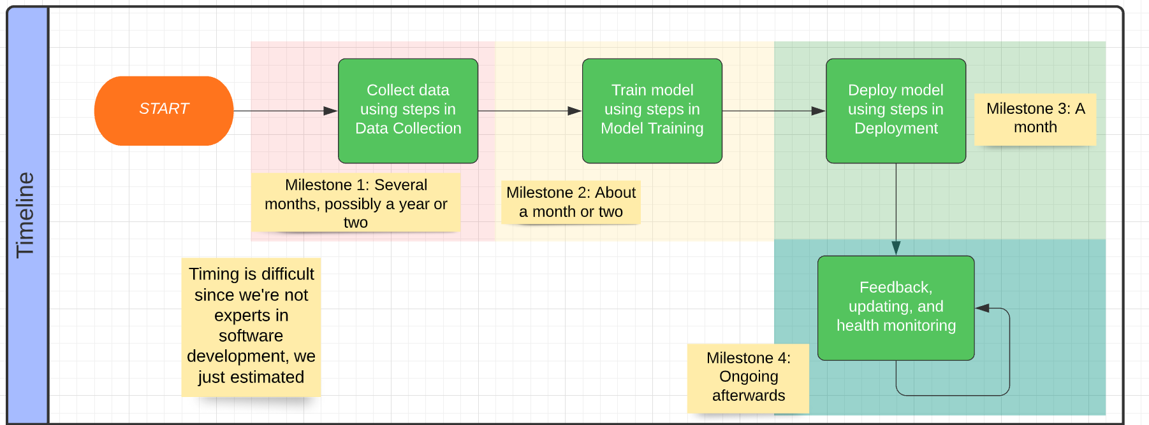
Tasks to Complete
Register non-profit
Establish funds
Begin networking/Hiring
Collect Data
Deploy solution
Measure impact
Notes:
Back in Week 2, we made a very detailed plan to turn our ideas into a reality. But that’s a little too much detail for this presentation, so we’ll just go over some of the more major components:
First, we would need to start and register our non-profit.
Then we could either begin fundraising or get a loan to help us get our feet off the ground.
After that we would need to hire some professionals, like software engineers, architects, experts in fundraising or marketing, accountants, and anyone else required to run the non-profit.
Then we could start developing our AI tools and begin collecting data from businesses.
And finally, once our AI solution is ready, we deploy it and begin measuring impact.
Once the product is deployed, we would continue to monitor its impact and update it as necessary.

Slide 11
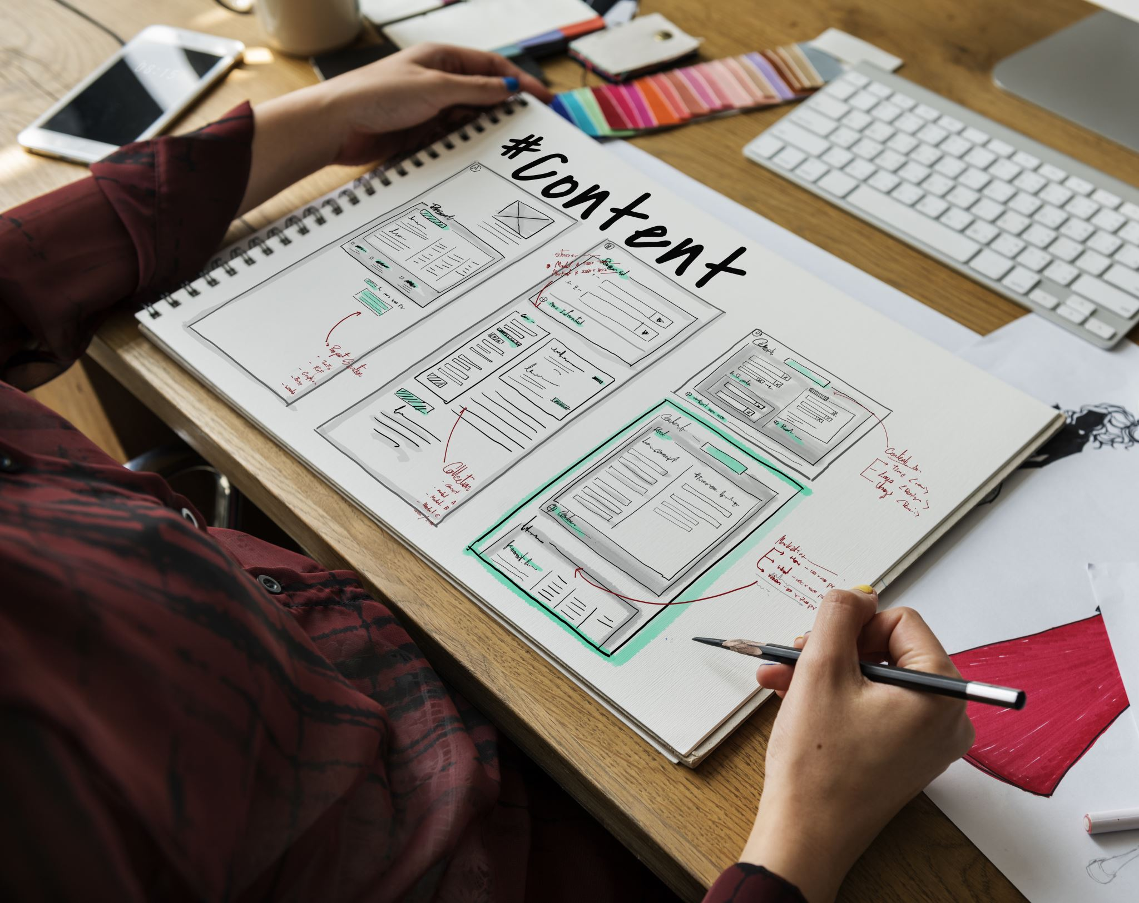
Future research
Create software
Different standards
Architects view
Different methods of accessibility
Notes:
Currently, we do not have the skill to turn this solution into a reality. We do not have the skill or time needed to create an application that can be used to aid people with designing buildings. Obviously, to make this solution into reality we would need to create this software or find a program that we could potentially integrate with. Along with our research is currently exclusive to Canada so if we wanted to expand globally, we would need to conduct research on the standard of different countries or make it so that our standard for accessibility can be accepted internationally meaning that it would result in the best standard. We would also need aid from an architect's point of view, we currently do not have much experience in that field and would need assistance and more experience in that regard. Perhaps with more research on what we can do to make buildings more accessible and how we can improve the lives of people with disabilities.

Slide 12
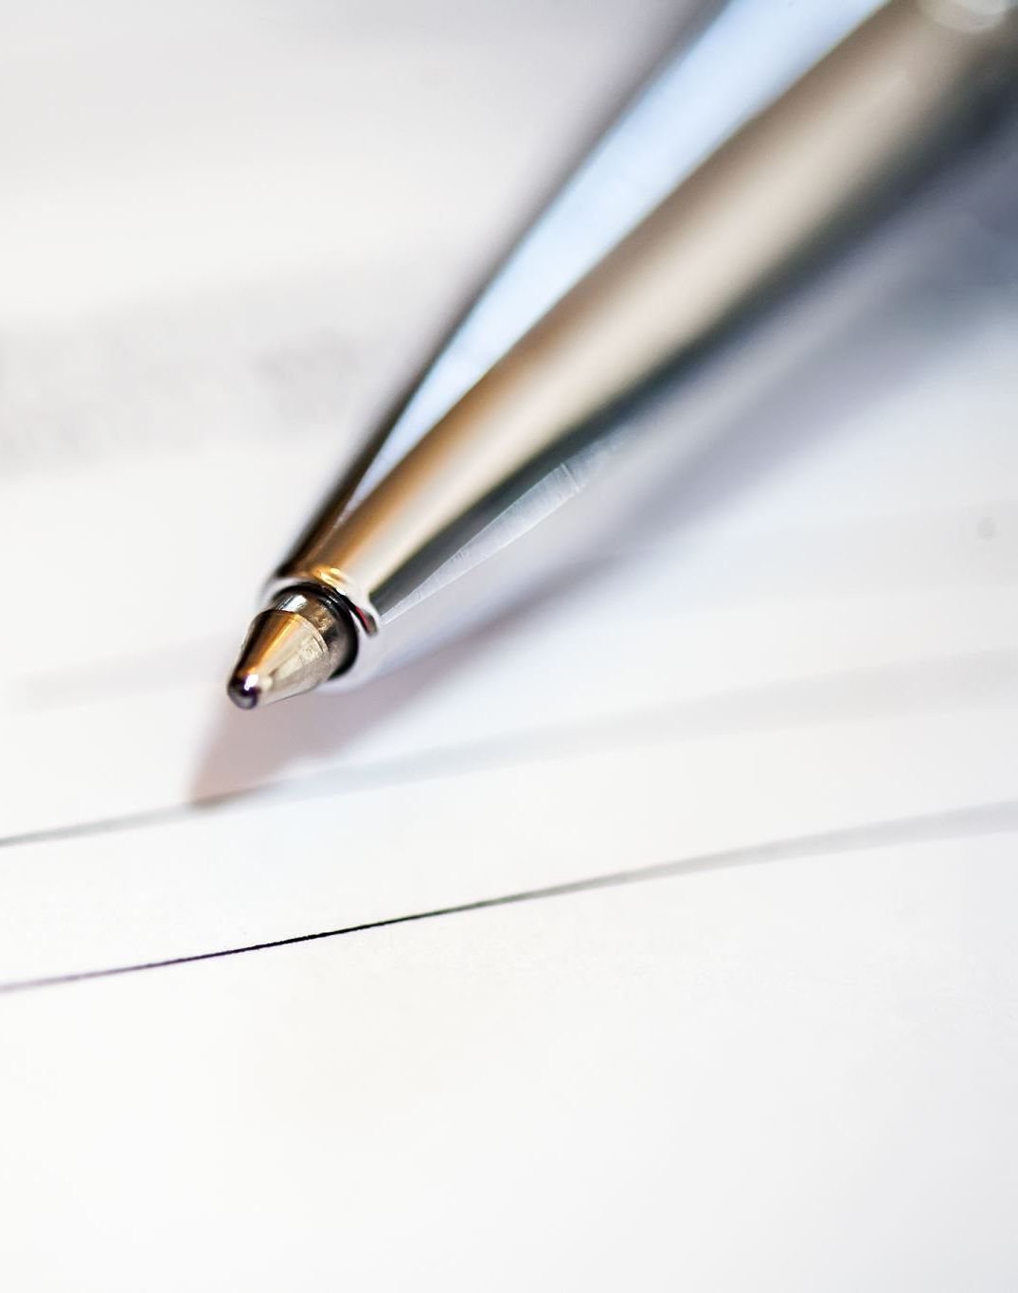
Conclusion and QNA
Notes:
To summarize, we believe that Artificial Intelligence can really help create a more accessible and inclusive world. Our solution will help architects be more aware of those with mobility issues as they design new buildings. We also hope that those of you listening were able to get a better understanding of the incredible potential of AI, and how it can be used to aid people who might otherwise be forgotten about. That’s all for our presentation, thanks for listening. Are there any questions?

