Slide 1
Tensorflow Demystified
What happens in the black box

Slide 2
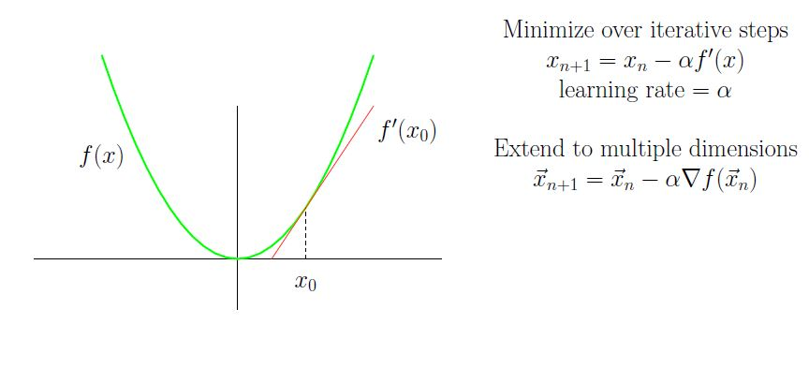
Gradient Descent

Slide 3
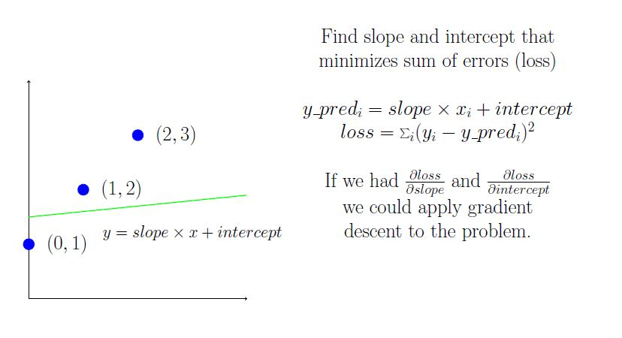
Fitting a line

Slide 4
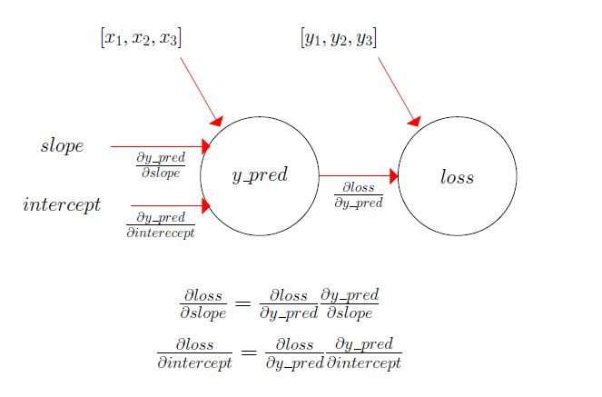
Graph of line fit

Slide 5
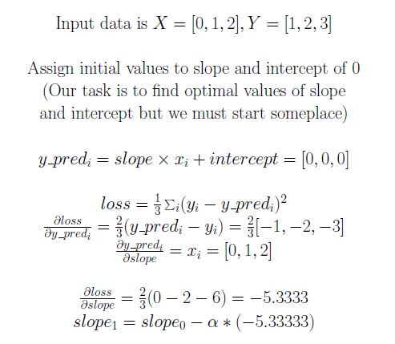
Applying Real Numbers

Slide 6
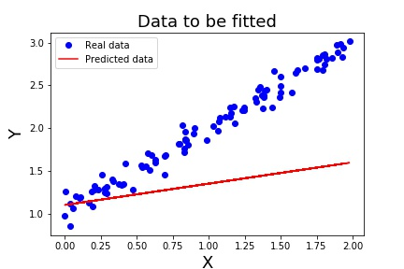
Batch Fit
N points to be fitted
Break into m batches and upgrade slope and intercept for each batch.
Each batch takes approximately 1/m the time to calculate gradient.

Slide 7
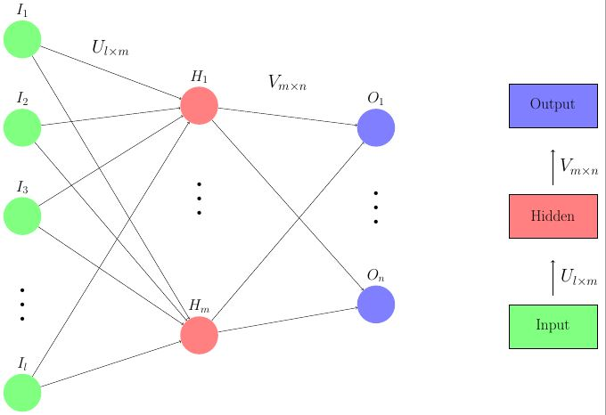
Feed forward Neural Network

Slide 8
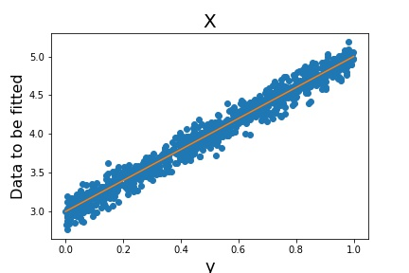

Slide 9
