Slide 1

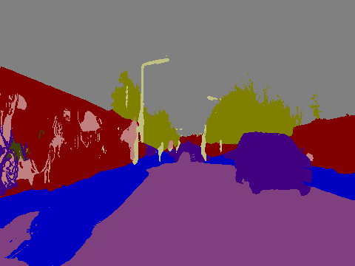


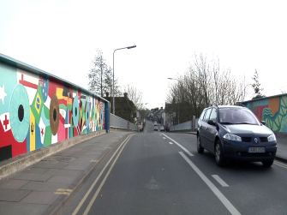

Bayesian
Segmentation Model
Bayesian
Segmentation Model
Input
Prediction
Input
Prediction
.….
Mean
t - 2
}
.….
N
Moving Average
.….
Mean
t - 1
}
.….
N
Moving Average
.….
Mean
t
}
.….
N
time
MC dropout
RTA-MC dropout (Ours)

