Slide 1
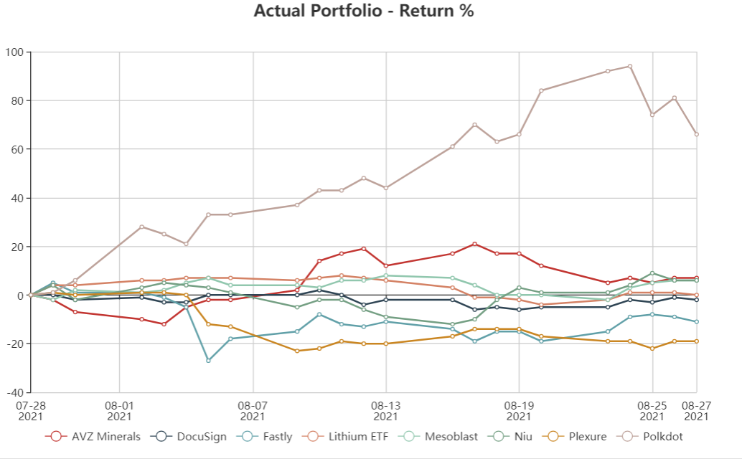

SMDA Aug Update
-10.56%
-10.56%
DocuSign

Slide 2
Company | Month Change | Total Change
DocuSign | -1.41 | 39.67
AVZ Minerals | 9.76 | 18.42
Niu | 1.55 | -2.02
Lithium ETF | -3.90 | -4.01
Fastly | -14.73 | -24.30
Polkdot | 64.91 | -34.60
Plexure | -20.00 | -59.71
Mesoblast | 7.26 | -60.02
Company | Month Change | Total Change
Nvidia | 13.65 | 76.41
Paladin Energy | -5.88 | 32.58
Connexion | 18.75 | 18.75
Deep Yellow | -6.21 | 6.25
Tyro Payments | 9.33 | -0.53
Micron | -4.76 | -16.68
CureVac | 35.20 | -26.42

