Slide 1








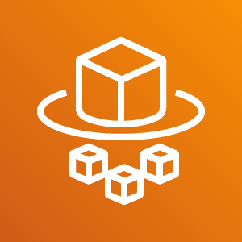
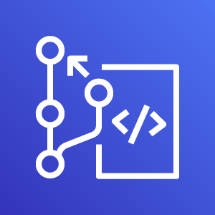
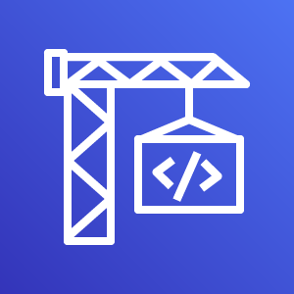


AWS Cloud
Virtual Private Cloud
Internet Gateway
Public Subnet 1
Public Subnet 2
NAT Gateway
NAT Gateway
CodePipeline
Private Subnet 1
Private Subnet 2
ECS Service
CodeCommit
CodeBuild
CodeDeploy
Fargate Task
Fargate Task
Build
Artifacts

