Slide 1
Iterative Set Expansion of Named Entities using the Web
Richard C. Wang and William W. Cohen
Language Technologies Institute
Carnegie Mellon University
Pittsburgh, PA 15213 USA

Slide 2
Outline
Introduction to Set Expansion
  SE System – SEAL
Current Issue with SEAL
Proposed Solution
  Iterative SEAL (iSEAL)
Evaluation Setting
Experimental Results
Conclusion

Slide 3
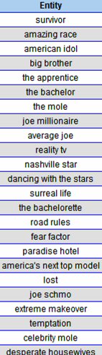
Set Expansion (SE)
For example,
  Given a query (seeds):
    { survivor, amazing race }
  The answer is:
    { american idol, big brother, etc. }
A well-known example of a SE system is Google Sets™
  http://labs.google.com/sets
Notes:
Suppose there is a set expansion system, and someone inputs the words spit, boogers, and ear wax (which we’ll refer to them as seeds)
Then the system should return other disgusting words such as puke, toe jam, and sweat.
More formally, we assume there exist some target set S_t, and when given a small number of seeds where each is a member of the target set S_t,
Then the answer is a listing of other probable elements where each is also a member of that target set S_t.
A popular and famous example of a web-based set expansion system is Google Sets.

Slide 4
SE System: SEAL (Wang & Cohen, ICDM 2007)
Features
  Independent of human/markup language
    Support seeds in English, Chinese, Japanese, Korean, ...
    Accept documents in HTML, XML, SGML, TeX, WikiML, …
  Does not require pre-annotated training data
    Utilize readily-available corpus: World Wide Web
Based on two research contributions
  Automatically construct wrappers for extracting candidate items
  Rank candidates using random walk
Try it out for yourself at www.BooWa.com
Notes:
We propose our set expansion system, called SEAL, which stands for Set Expander for Any Language.
As hinted by its name, SEAL is completely independent of human language.
Unlike Google Sets, which only supports English, SEAL supports English, Chinese, Japanese, Korean, and I’ve even seen Russian, Portuguese, and Spanish in the log file too, all produces decent results.
It is also completely independent of markup language, that means it can process documents written in HTML, XML, SGML, etc.
Another important feature is that it does not require any pre-annotated training data at all.
Since we already have a enormously huge and readily-available corpus on the Internet, why don’t we utilize it?
Based on this idea, we designed SEAL to learn wrappers from web documents on the fly, by using only a few input seeds.
SEAL is based on two research contributions.
The first one is that it can automatically construct wrappers to extract lists of entities from semi-structured web documents.
The second one is that it uses random graph walk to rank extracted entities such that the ones that are most probable to be in the target set are ranked higher.

Slide 5
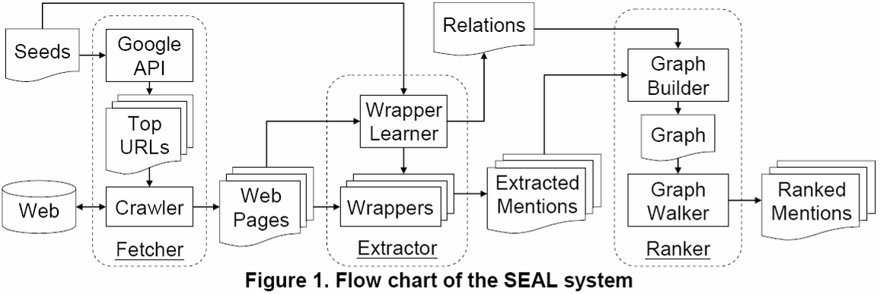
SEAL’s Pipeline
Pentax
Sony
Kodak
Minolta
Panasonic
Casio
Leica
Fuji
Samsung
…
Canon
Nikon
Olympus
Fetcher: Download web pages containing all seeds
Extractor: Construct wrappers for extracting candidate items
Ranker: Rank candidate items using Random Walk
Notes:
SEAL is composed of three primary components.
<@> The first one is the Fetcher, which downloads web documents from the Internet
<@> The second one is the Extractor, which learns wrappers from those web documents.
<@> The third one is the Ranker, which ranks candidate entities extracted by those wrappers.
I will explain in detail what each component does.

Slide 6
How to Build a Graph?
Wrapper #2
extract
“honda”
26.1%
“chevrolet”
22.5%
contain
curryauto.com
contain
Wrapper #1
northpointcars.com
extract
Wrapper #4
Wrapper #3
“acura”
34.6%
“volvo”
8.4%
“bmw”
8.4%
A graph consists of a fixed set of…
  Node Types: { document, wrapper, item }
  Labeled Directed Edges: { contain, extract }
    Each edge asserts that a binary relation r holds
    Each edge has an inverse relation r⁻¹ (graph is cyclic)
Notes:
I will go through the steps of building a graph that contains all elements of interest: seeds, document, wrapper, and mentions.
First, the seeds find some documents from the Web. <@>
Then the documents derive some wrappers; <@> they are also found by the seeds.
The wrappers then extract some entity mentions; <@> they are also derived by the documents.
<@> Lastly, the mentions are extracted by the wrappers.
In brief, a graph consists of a fixed set of node types: seeds, document, wrapper, mention, and a fixed set of labeled directed edges: find, derive, extract.
Each edge asserts that a binary relation holds, and also asserts that the inverse of that binary relation holds, with the edge directed in the opposite direction.
This also ensure that the graph is cyclic.
This framework for building graphs was previously published in Einat and William’s SIGIR 2006 paper.
The percentage on the mention nodes are the probabilities assigned due to graph walk.
As expected, noisy entity mentions volvo chicago and bmw pittsburgh are assigned the least weight.
One of many reasons is that they have fewer incoming edges.
I will explain to you how these probability weights are computed in the next slide.
Intuition
Good document derives good wrapper (and vice versa)
Good wrapper extracts good mention (and vice versa)

Slide 7
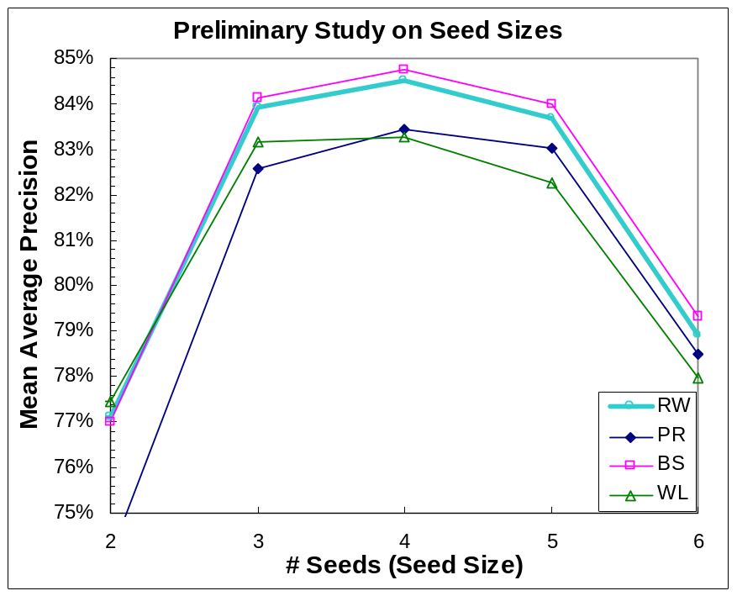
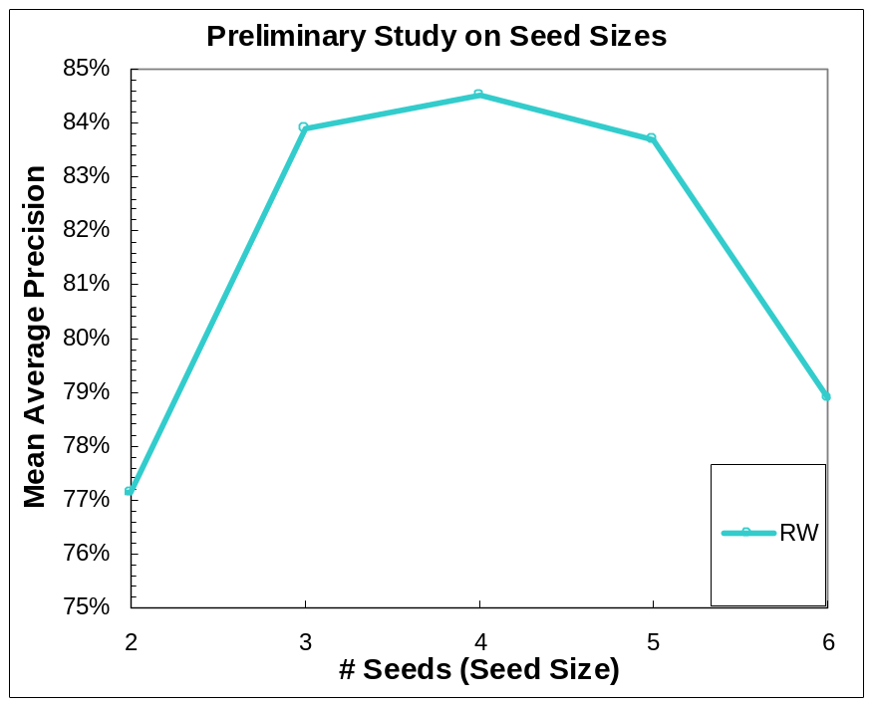
Limitation of SEAL
Evaluated using Mean Average Precision on 36 datasets
For each dataset, we randomly pick n seeds (and repeat 3 times)
Performance drops significantly when given more than 5 seeds
  The Fetcher downloads web pages that contain all seeds
  However, not many pages has more than 5 seeds

Slide 8
Motivation
Can SEAL be made to handle many seeds?
Can SEAL bootstrap given only a few seeds?
How well does SEAL’s ranker perform?

Slide 9
Proposed Solution: Iterative SEAL
iSEAL makes several calls to SEAL
  In each call (iteration)
    Expands a few seeds
    Aggregates statistics
We evaluated iSEAL using…
  Two iterative processes
  Two seeding strategies
  Five ranking methods

Slide 10
Iterative Process & Seeding Strategy
Iterative Processes
  Supervised
    At every iteration, seeds are obtained from a reliable source (e.g. human)
  Bootstrapping
    At every iteration, seeds are selected from candidate items (except the 1st iteration)
Seeding Strategies
  Fixed Seed Size
    Uses 2 seeds at every iteration
  Increasing Seed Size
    Starts with 2 seeds, then 3 seeds for next iteration, and fixed at 4 seeds afterwards

Slide 11
Ranking Methods
Random Walk with Restart
  H. Tong, C. Faloutsos, and J.-Y. Pan. Fast random walk with restart and its application. In ICDM, 2006.
PageRank
  L. Page, S. Brin, R. Motwani, and T. Winograd. The PageRank citation ranking: Bringing order to the web. 1998.
Bayesian Sets
  Z. Ghahramani and K. A. Heller. Bayesian sets. In NIPS, 2005.
Wrapper Length
  Weights each item based on the length of common contextual string of that item and the seeds
Wrapper Frequency
  Weights each item based on the number of wrappers that extract the item

Slide 12
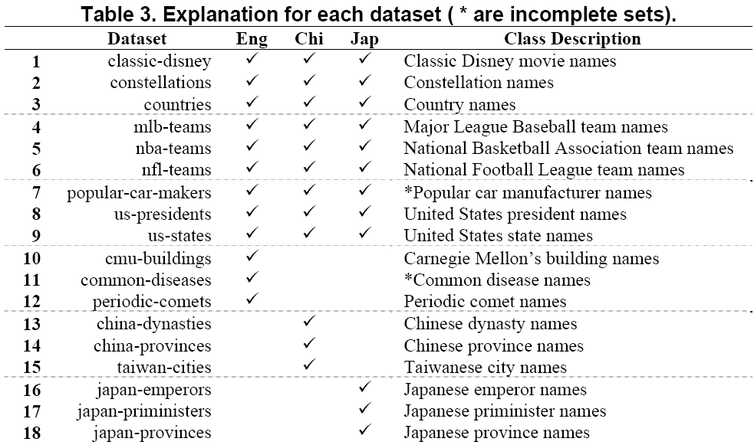
Evaluation Datasets
Notes:
Our evaluation datasets are presented here.
We constructed 36 datasets evenly over three languages: English, Chinese, and Japanese; so there are 12 datasets per language.
The datasets consists of 18 classes; such as…. Half of them were constructed in all three languages and the other half in just one language only.
The intention is to diversity the datasets such that some are culture-specific while some are not.
Note that each entity can be referred to by different mentions. For example America, United States of America, US, USA all refer to this country.

Slide 13
Evaluation Metric / Procedure
Evaluation metric: Mean Average Precision
  Contains recall and precision-oriented aspects
  Sensitive to the entire ranking
Evaluation procedure:
  For every combination of iterative process, seeding strategy, and ranking methods
    Perform 10 iterative expansions for each of the 36 datasets (and repeat 3 times)
    At every iteration, compute and report MAP

Slide 14
Fixed Seed Size (Supervised)
Initial Seeds

Slide 15
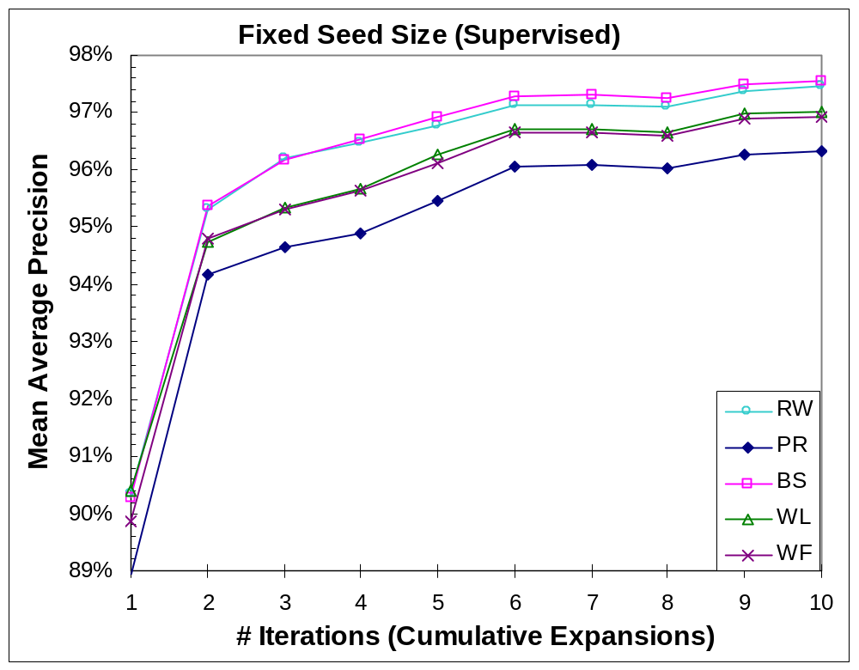

Slide 16
Fixed Seed Size (Bootstrap)
Initial Seeds

Slide 17
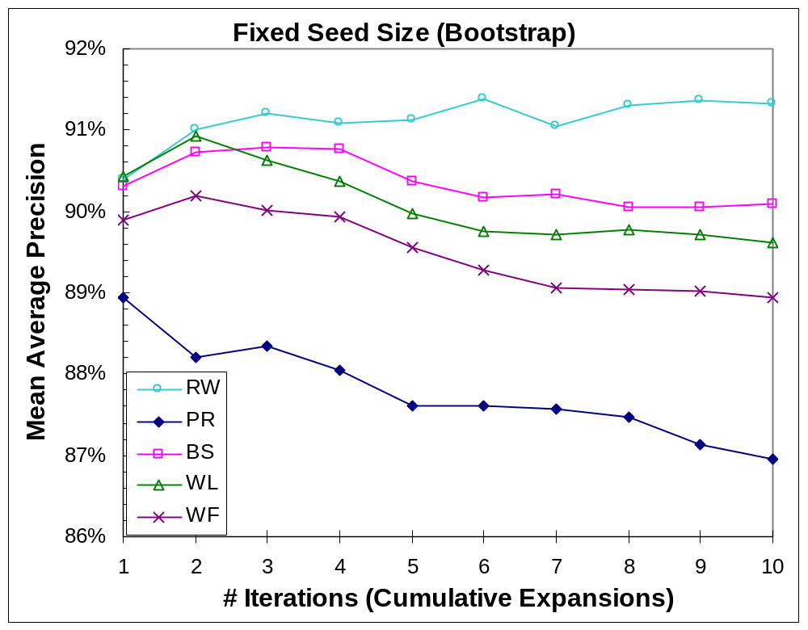

Slide 18
Increasing Seed Size (Bootstrap)
Initial Seeds
Used Seeds

Slide 19
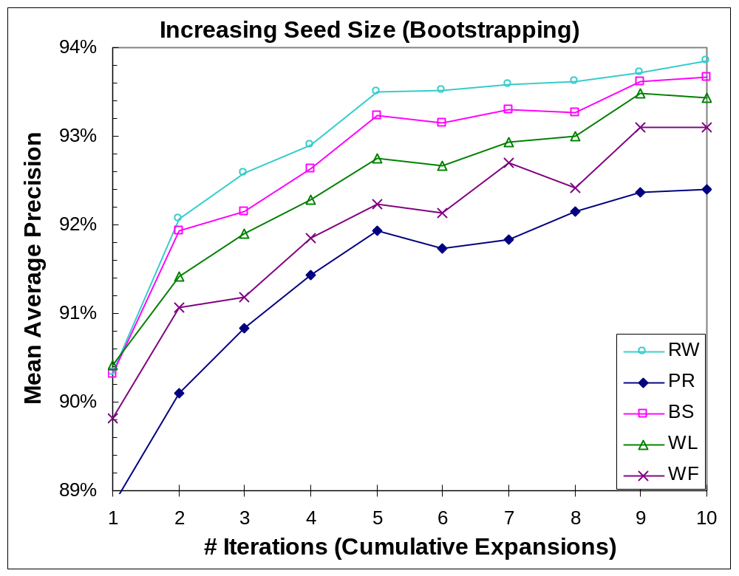

Slide 20
Conclusion
Can SEAL be made to handle many seeds?
  Yes, by Fixed Seed Size (Supervised).
Can SEAL bootstrap given only a few seeds?
  Yes, by Increasing Seed Size (Bootstrapping).
How well does SEAL’s ranker perform?
  In supervised, RW is comparable to the best (BS)
  In bootstrapping, RW outperforms others
    Robust to noisy seeds

Slide 21
The End – Thank You!
Try out Boo!Wa! at www.BooWa.com
  A SEAL-based list extractor for many languages
  Send any feedback to: rcwang@cs.cmu.edu

Slide 22
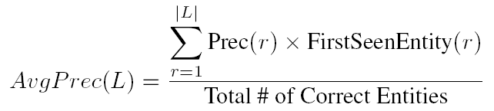
Evaluation Method
Mean Average Precision
  Commonly used for evaluating ranked lists in IR
  Contains recall and precision-oriented aspects
  Sensitive to the entire ranking
  Mean of average precisions for each ranked list
If a list contains multiple synonyms of an entity e, then we only evaluate e once.
A binary function that returns 1 iff (a) and (b) are true:
(a) Synonym at r is correct
(b) It’s the highest-ranked synonym of its entity in the list
where L = ranked list of extracted items, r = rank
Evaluation Procedure
(per combination of iterative process, seeding strategy, and ranker – 20 in total)
  Perform 10 iterative expansions on each of the 36 datasets 3 times
  At each iteration, compute MAP for the 108 (3 x 36) ranked lists
Notes:
We use Mean Average Precision to evaluate our ranked list.
Because it is commonly used for evaluating ranked results in the field of IR, and it contains recall and precision-oriented aspects.
MAP is defined as the mean of average precisions for each ranked list.
We calculate average precision using the formula shown, where L is the ranked list of extracted mentions, and r is the rank.
<@> Precision r is the precision at rank r
<@> NewEntity r is a binary function, which returns 1 if conditions (a) and (b) are true.
Basically, it ensures that, as we go down a ranked list, we are only evaluating the first encountered mention of every entity.
<@> True Entities is the total number of true entities in this particular dataset that is used for evaluation.
The evaluation procedure goes like this:

Slide 23
Increasing Seed Size (Supervised)
Initial Seeds
Used Seeds

Slide 24
