Slide 2
Improving Mean Time to Resolution and Root Cause Analysis for complex SAS® environments
Christopher Blake, Boemska
Chris is a long time SAS user and Administrator with a passion for making the life of the SAS Admin just that little bit easier.

Slide 3
Introduction
What is Mean Time to Resolution?
What is Root Cause Analysis?
Notes:
During this presentation I'd like to achieve a few things:
For those that have never heard of either of root cause analysis or mean time to resolution I want to introduce and explain these concepts. Then, I want to explain why I think that they are important and why teams of all sizes should be implementing them, and finally I want to take you through some resources and tips for helping you, and your teams improve your performance by making your root causes analyses more efficient and effective, and some general tips for how you could close issues faster.

Slide 4
Mean Time To Resolution
Resolution includes the time spent understanding what happened and implementing changes to ensure that the same issues doesn’t happen again
mttr = time spend resolving issues / # of issues
Typically only includes “business hours”
Why is it used?
Proven correlation between MTTR and customer satisfaction
Simple to calculate with know specific domain or technology knowledge required

Slide 5
Root Cause Analysis
Delivered in a report form with the following sections:
A clear problem statement
A timeline from normal operations to when the problem occurred
Distinguish between the root cause and other causal factors
Identify the corrective actions required

Slide 6
5-WHY
Root Cause Analysis Methodology
Easily applicable method that involves asking “why?”
Example: Flow didn’t complete properly. Error was that there was a lock on a table.
Why was there a lock on the dataset?
Why was another program using the dataset at the same time?
Why did the program take 5 times longer to run than normal?
Why did the program need to process so much data?
Why had the program not been run for 7 days?

Slide 7
Tips and Tricks
For improving Mean Time to Resolution
Put SLAs (deadlines) on customers too
SAS is hard – things do take time
Glacial paced teams
Resolution time outliers

Slide 8
Tips and Tricks
For improving Root Cause Analysis
Don’t include the parties involved in the analysis
Use a multi-disciplinary team
Frame questions around facts, not hypotheses
Use the right tools to help you conduct the analyses

Slide 9
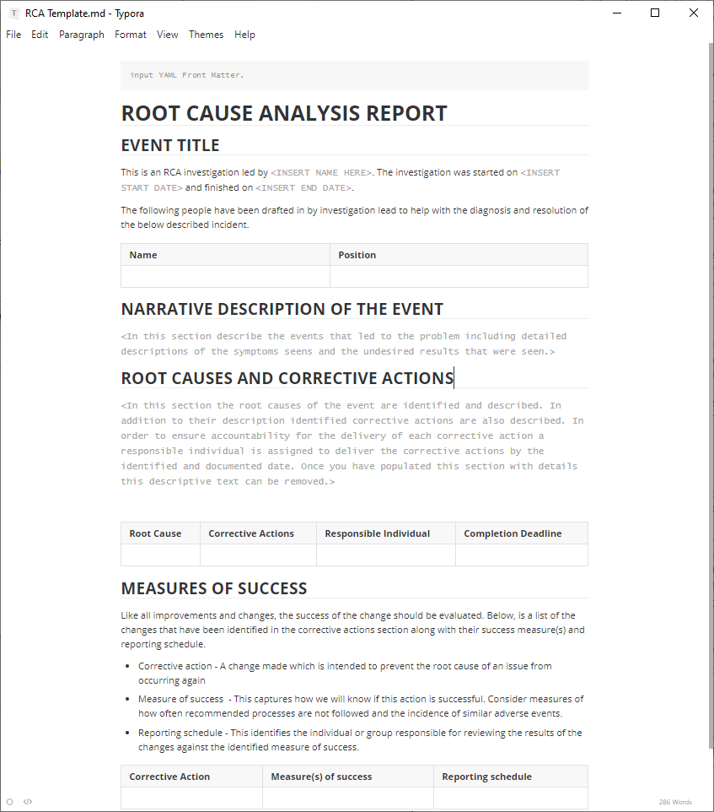
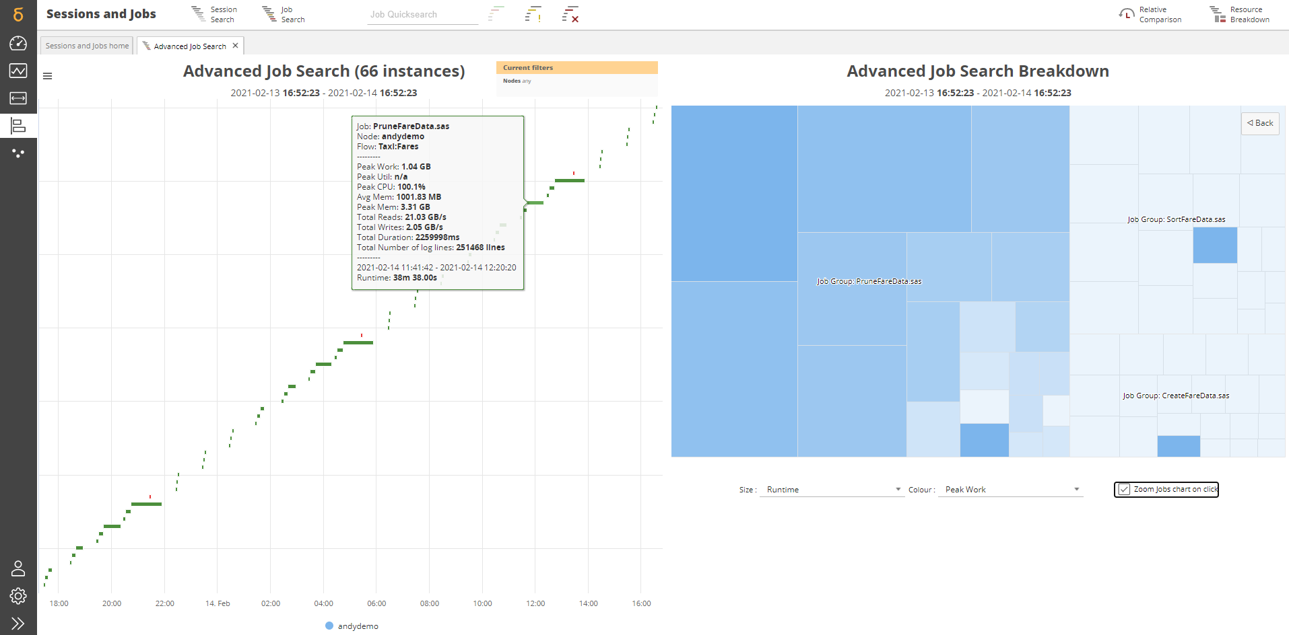
Helpful resources

Slide 10
Thank you!
Contact Information chris@boemskats.com
GitHub / Twitter @cj13579

