Slide 1
Flip-Flops and Related Devices
Wen-Hung Liao, Ph.D.
3/27/2002

Slide 2
Objectives
Construct and analyze the operation of a latch flip-flop made from NAND or NOR gates.
Describe the difference between synchronous and asynchronous systems.
Understand the operation of edge-triggered flip-flops.
Analyze and apply the various flip-flop timing parameters specified by the manufacturers.
Understand the major differences between parallel and serial data transfers.
Draw the output timing waveforms of several types of flip-flops in response to a set of input signals.

Slide 3
Objectives
Recognize the various IEEE/ANSI flip-flop symbols.
Use state transition diagrams to describe counter operation.
Use flip-flops in synchronization circuits.
Connect shift registers as data transfer circuits.
Employ flip-flops as frequency-division and counting circuits.
Understand the typical characteristics of Schmitt triggers.
Apply two different types of one-shots in circuit design.
Design a free-running oscillator using a 555 timer.
Recognize and predict the effects of clock skew on synchronous circuits.
Troubleshoot various types of flip-flop circuits.
Program a PLD using CUPL's state transition format for circuit description.

Slide 4
Introduction
General digital system diagram: consists of combinational logic gates and memory elements.
The most important memory element is the flip-flop, which is made up of an assembly of logic gates.
General flip-flop symbol (Figure 5.2)
Q: normal FF output, Q’:inverted FF output
SET/CLEAR(RESET) input

Slide 5
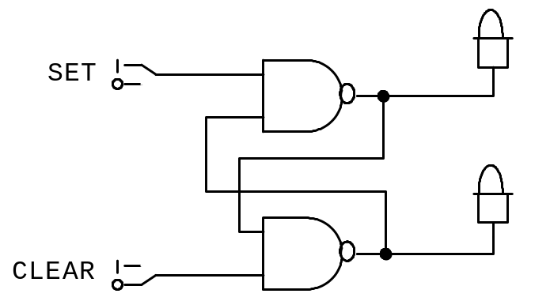
NAND Gate Latch
Constructed using two NAND gates.
Active-LOW
Set | Clear | Output
1 | 1 | No change
0 | 1 | Q=1
1 | 0 | Q=0
0 | 0 | Invalid
Q

Slide 6
Applications
Example 5-1 shows that the latch output remembers the last input that was activated and will not change states until the opposite input is activated.
Example 5-2: switch debouncing circuit

Slide 7
NOR Gate Latch
Constructed using two NOR gates.
Active-HIGH
Set | Clear | Output
0 | 0 | No change
1 | 0 | Q=1
0 | 1 | Q=0
1 | 1 | Invalid

Slide 8
Flip-Flop State on Power-up
Do not know the starting state of a flip-flop’s output.

Slide 9
Clock Signals and Clocked FFs
Asynchronous system: outputs of logic circuit can change state any time one or more of the inputs change. More difficult to design and troubleshoot.
In synchronous systems, the exact times at which any output change change states are determined by a signal commonly called the clock.

Slide 10
Clock
System outputs can change states only when the clock makes a transition.
Positive-going transition
Negative-going transition
Most digital systems are principally synchronous.

Slide 11
Clocked Flip-Flops
Controlled inputs + CLK
Setup and Hold times
Clocked S-C Flip-Flop
Clocked J-K Flip-Flop
Clocked D Flip-Flop

