Slide 1
Interfacing with the Analog World
Wen-Hung Liao, Ph.D.

Slide 2
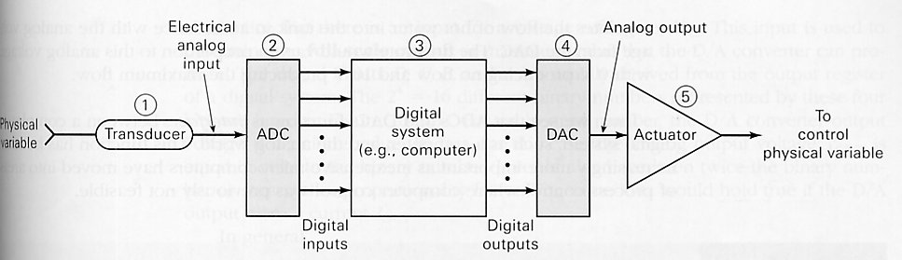
Interfacing with the Analog World
Transducer: converts physical variable to electrical variable.
Analog-to-digital converter(ADC)
Computer
Digital-to-analog converter (DAC)
Actuator

Slide 3
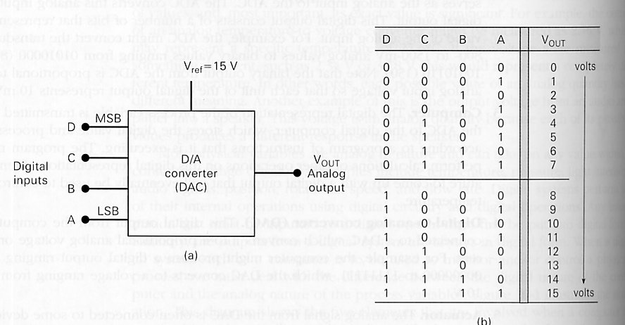
Digital-to-Analog Conversion
Many ADC methods utilize DAC
Four-bit DAC with voltage output (Figure 10-2)

Slide 4
DAC
V_{ref} is used to determine the full-scale output.
In general,
analog output = K x digital input
Example 10-1A, 10-1B

Slide 5
Analog Output
The output of a DAC is technically not an analog quantity because it can take on only specific values.
But as the number of possible output values increases, the output is more and more like an analog quantity.
Input weights: 1 2 4 8

Slide 6
Resolution (Step size)
Resolution of a D/A converter is defined as the smallest change that can occur in the analog output as a result of change in the digital input.
N bit DAC: number of different level =2^N,
number of steps=2^N-1
Resolution=K=A_{fs}/(2^N-1)

Slide 7
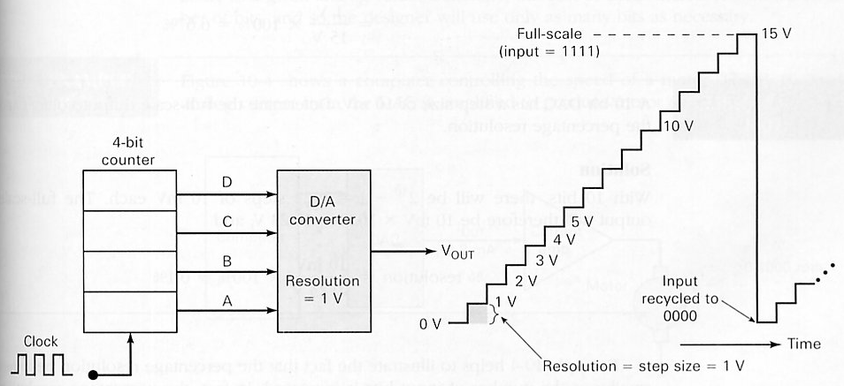
Resolution: Illustration
Figure 10-3: resolution=1V

Slide 8
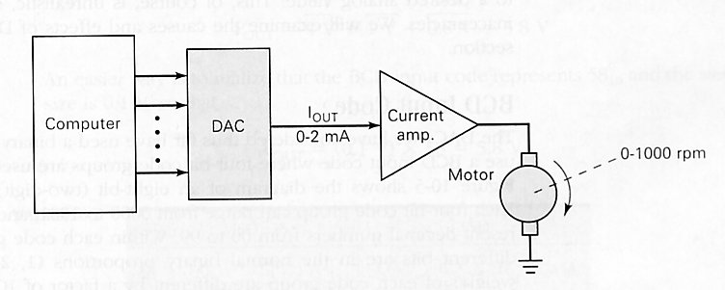
Percentage Resolution
Resolution can also be represented as a percentage of the full scale output.
% resolution = 100% x (1/total number of steps)
What does resolution mean?
Example 10-5, Figure 10-4

Slide 9
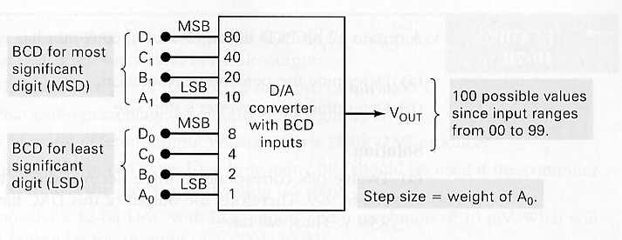
BCD Input Code
Weights are different
Two-digit BCD: 80 40 20 10 8 4 2 1

Slide 10
Examples
Example 10-7A, 10-7B
Bipolar DACs: output takes both positive and negative values.

Slide 11
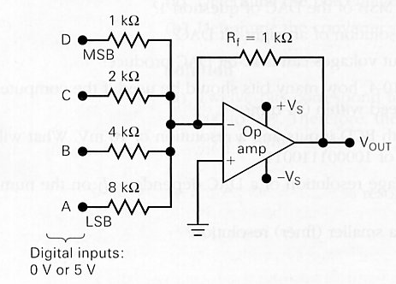
D/A Converter Circuitry
Will focus on the performance characteristics instead of the detailed circuitry.
Figure 10-6: uses operational amplifier as a summing amplifier:
V_{out} = - (V_{D} + ½ V_{C}+ ¼ V_{B}+ 1/8 V_{A})
Resolution is equal to the weighting
on the LSB.

Slide 12
Conversion Accuracy
Actual output V_{out} depends on
  The precision of the input and feedback resistors
  The precision of the input voltage levels
Digital inputs cannot be taken directly from the output of the FFs or logic gates since the output logic levels are not precise values like 0V or 5V.
Use precision reference supply (Figure 10-7).

Slide 13
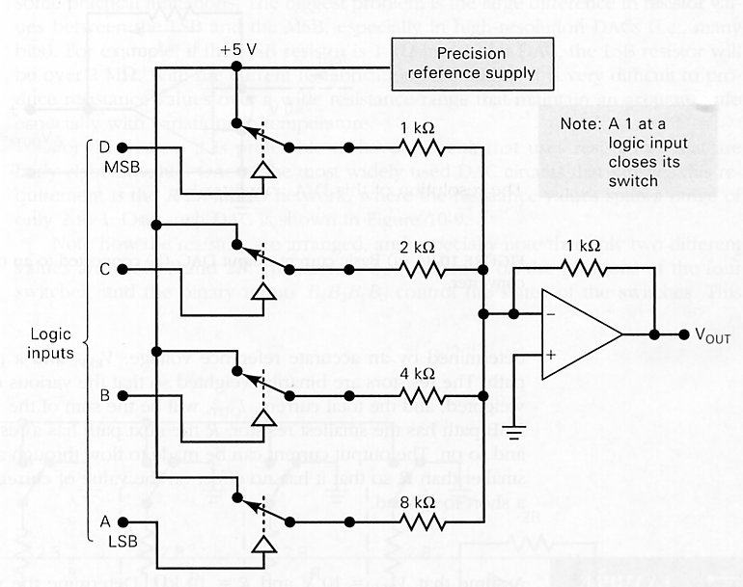
Figure 10-7

Slide 14
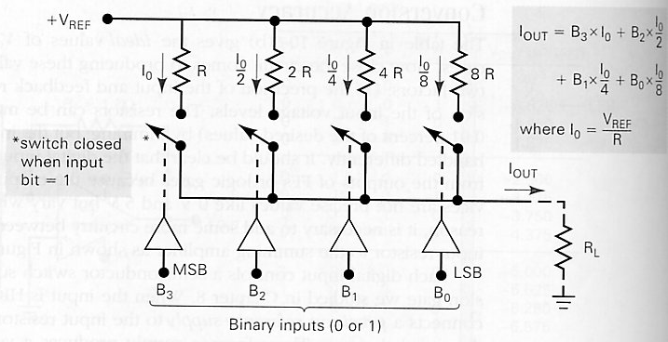
DAC with Current Output
MSB has smallest R, LSB has largest R

Slide 15
R/2R Ladder
Problem: high resolution DAC requires large range of R
Example: 12 bit DAC
MSB resistor = 1 K ohm
LSB resistor = 1Kx2^12 ohm = 2M ohm
Use a R/2R ladder network instead

Slide 16
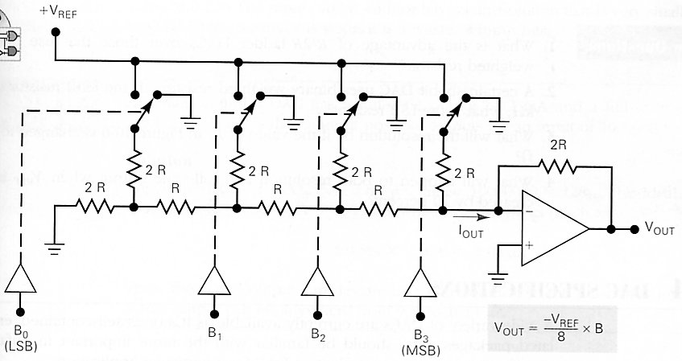
R/2R Ladder Network

Slide 17
DAC Specifications
Resolution
Accuracy
  Full-scale error: maximum deviation of the DAC’s output from its ideal value, expressed as a percentage of full scale
  Linearity error: maximum deviation in step size from the ideal step size
Accuracy and resolution must be compatible.

Slide 18
DAC Specifications (Cont’d)
Offset error: output of a DAC when input is all 0s.
Settling time: the time required for the DAC output to go from zero to full scale as the binary input is changed from all 0s to all 1s.
Monotonicity: output increases as the binary input is incremented from one value to the next.

Slide 19
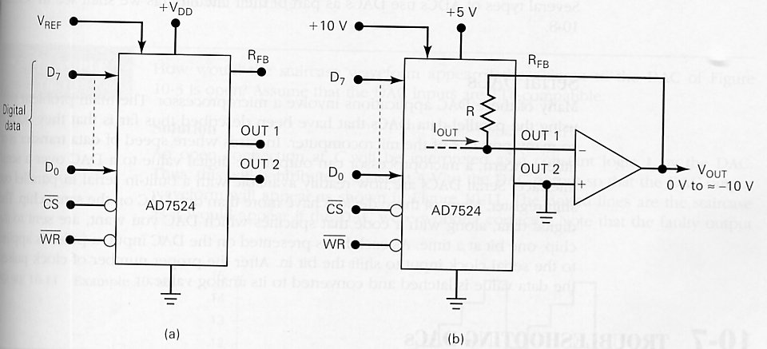
An Integrated-Circuit DAC
AD7524(CMOS IC): an eight-bit D/A converter that uses an R/2R ladder network.
Settling time: 100ns, Accuracy: 0.2%F.S.

Slide 20
DAC Applications
Control
Automatic testing
Signal reconstruction
A/D conversion
Serial DACs

Slide 21
Analog-to-Digital Conversion
Takes an analog input voltage and after a certain amount of time produces a digital output code that represents the analog input.
A/D conversion is more complex and time consuming than D/A process.
Several important types of ADC uses DAC as part of their circuitry. (Figure 10-12).

Slide 22
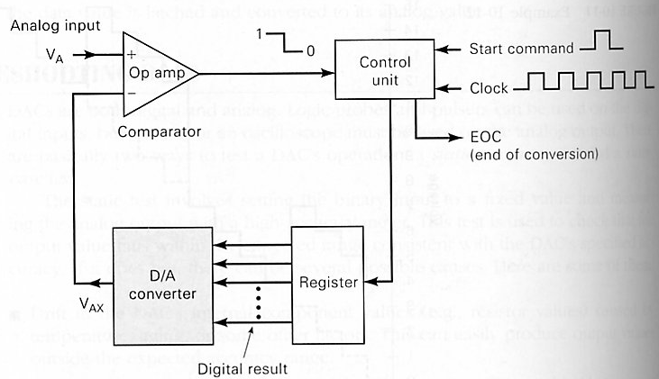
General Diagram of ADCs

Slide 23
Basic Operation of ADCs
START command initiates the operation.
Control unit modifies the binary number stored in the register.
The binary number in the register is converted to an analog output V_{AX} by the DAC.
The comparator compares V_{AX} with the analog input V_{A}. As long as V_{AX} < V_{A}, the comparator output stays HIGH. When V_{AX} exceeds V_{A} by at least an amount equal to VT, the comparator output goes LOW ad stop modifying the register number.
The control logic activates the end-of-conversion signal, EOC.

Slide 24
Digital-Ramp ADC
Also known as a counter-type ADC.
Uses a binary counter as the register and allows the clock to increment the counter one step at a time until V_{AX} >= V_{A}.
Example 10-13A,B.

Slide 25
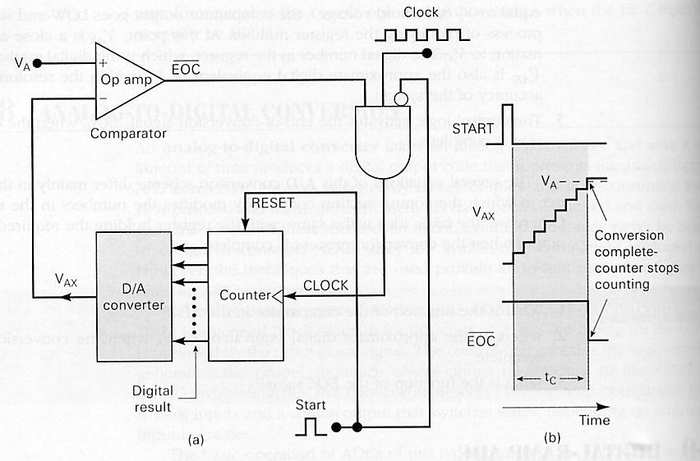
Figure 10-13

Slide 26
A/D Resolution and Accuracy
Source of error: step size of the internal DAC.
Quantization error: difference between the actual (analog) quantity and the digital values assigned to it.
Accuracy is dependent on the accuracy of the circuit components.
Example 10-14.

Slide 27
Conversion Time t_{c}
The time interval between the end of the START pulse and the activation of the EOC output.
For an N-bit converter,
t_{c}(max)=2^N-1 clock cycles
t_{c}(average)= (2^N-1)/2 ~= 2^(N-1) clock cycles
Digital-ramp method: conversion times doubles for each additional bit.

Slide 28
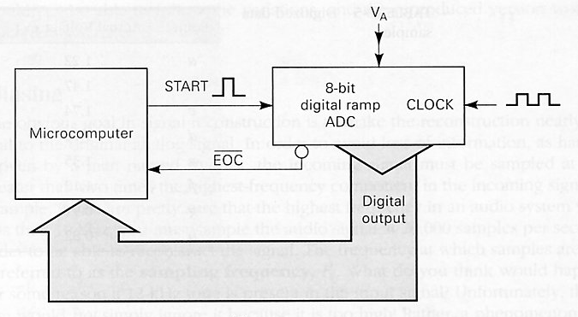
Data Acquisition
Analog data digitized and transferred into a computer’s memory.
Figure 10-15, typical computer data acquisition system.
Conversion time is not constant.

Slide 29
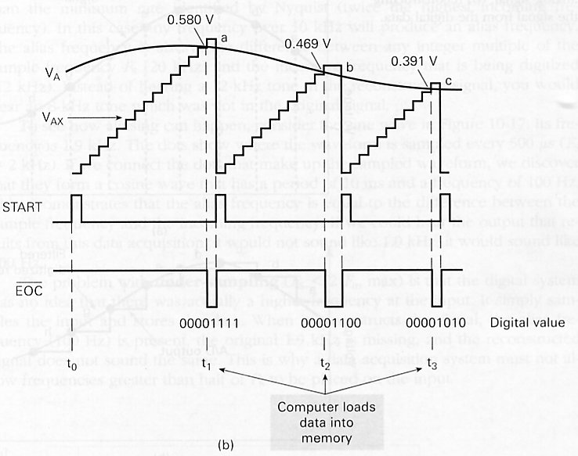
Figure 10-15

Slide 30
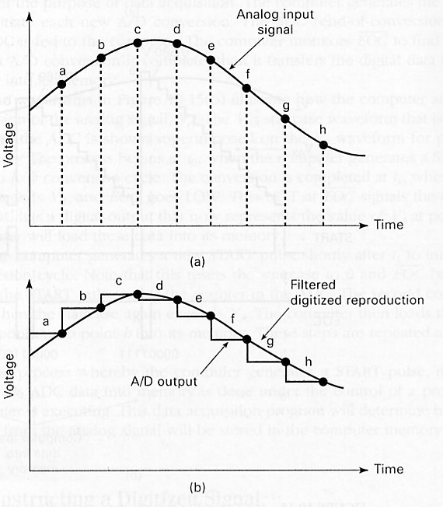
Figure 10-16
digitizing an
analog signal
and reconstructing
the signal from
the digital data

Slide 31
Aliasing
Occurs due to under-sampling
Figure 10-17

Slide 32
Successive-Approximation ADC
One of the most widely used types of ADC.
Figure 10-18(a): simplified block diagram.
Figure 10-18(b): flow chart of operation.
Conversion time is proportional to the number of bits.
t_{c} for SAC = Nx1 clock cycles
Actual IC: ADC0804 8 bit ADC

Slide 33
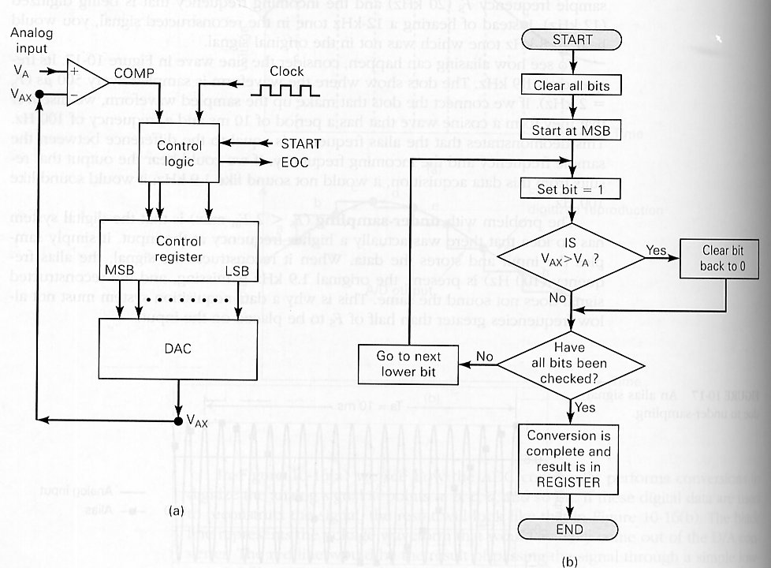
Figure 10-18

Slide 34
Flash ADCs
Highest speed ADC
Requires 2^N-1 comparators for a N bit converter.
Figure 10-21: do the comparisons at the same time and use priority encoder to generate the proper output.
Conversion time: < 20ns.

Slide 35
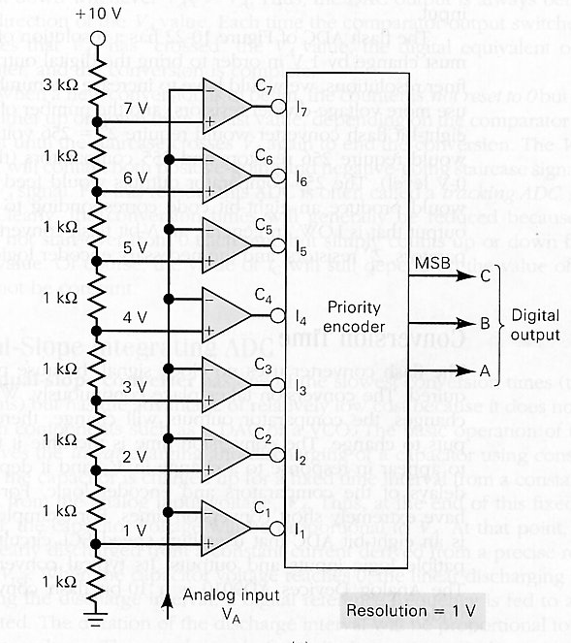
3-Bit Flash ADC

Slide 36
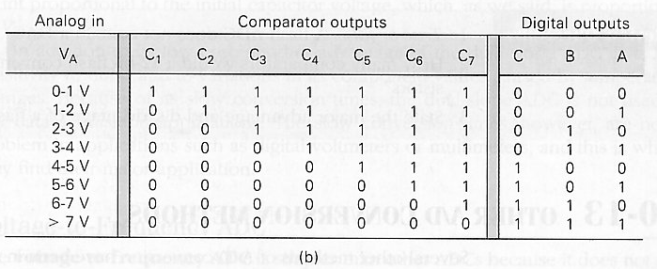
Truth Table

Slide 37
Other A/D Conversion Methods
Up/Down Digital-Ramp ADC (tracking ADC)
Dual-slope integrating ADC
Voltage-to-frequency ADC
Sigma-delta modulation

Slide 38
Applications and Other Issues
Digital Voltmeter
Sample-and-Hold circuit
Multiplexing
Digital storage oscilloscope
Digital signal processing

