Slide 1
Digital Systems:
Combinational Logic Circuits
Wen-Hung Liao, Ph.D.

Slide 2
Objectives
Convert a logic expression into a sum-of-products expression.
Perform the necessary steps to reduce a sum-of-products expression to its simplest form.
Use Boolean algebra and the Karnaugh map as tools to simplify and design logic circuits.
Explain the operation of both exclusive-OR and exclusive-NOR circuits.
Design simple logic circuits without the help of a truth table.

Slide 3
Objectives (cont’d)
Implement enable circuits.
Cite the basic characteristics of TTL and CMOS digital ICs.
Use the basic troubleshooting rules of digital systems.
Deduce from observed results the faults of malfunctioning combinational logic circuits.
Describe the fundamental idea of programmable logic devices (PLDs).
Outline the steps involved in programming a PLD to perform a simple combinational logic function

Slide 4
Combinational Logic Circuits
The logic level at the output depends on the combination of logic levels present at the inputs.
A combinational circuit has no memory, so its output depends only on the current value of its inputs.
We will not spend a great deal of time discussing how to troubleshoot the combinational circuits. (That’s what the lab is for.)

Slide 5
Sum-of-Products Form
Sum → OR
Product → AND
Each of the sum-of-products expression consists of two or more AND terms that are ORed together.
Examples: ABC+A’BC’
AB+A’BC’+C’D’+D
Note that one inversion sign cannot cover more than one variable in a term. AB is not allowed.

Slide 6
Product-of-Sums Form
Each of the product-of-sums expression consists of two or more OR terms that are ANDed together.
Examples: (A+B’+C)(A+C)
(A+B’)(C’+D)F
Will use sum-of-products form in logic circuit simplification.

Slide 7
Simplifying Logic Circuits
Goal: reduce the logic circuit expression to a simpler form so that fewer gates and connections are required to build the circuit.
Example: 4.1(a) and 4.1(b) are equivalent, but 4-1(b) is much simpler.

Slide 8
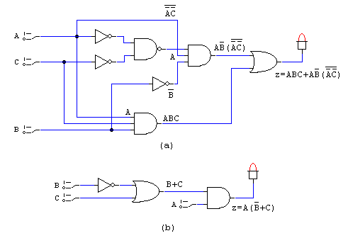
Example 4.1

Slide 9
Circuit Simplification Methods
Boolean algebra: greatly depends on inspiration and experience.
Karnaugh map: systematic, step-by-step approach.
Pros and Cons

Slide 10
Algebraic Simplification
Use the Boolean algebra theorems introduced in Chapter 3 to help simplify the expression for a logic circuit.
Based on experience, often becomes a trial-and-error process.
No easy way to tell whether a simplified expression is in its simplest form.

Slide 11
Two Essential Steps
The original expression is put into the sum-of-products form by repeated application of DeMorgan’s theorem and multiplication of terms.
The product terms are checked for common factors, and factoring is performed whenever possible.

Slide 12
Examples 4-1 to 4-4
Original | Simplified
ABC+AB’(A’C’)’ | A(B’+C)
ABC+ABC’+AB’C | A(B+C)
A’C(A’BD)’+A’BC’D’+AB’C | B’C+A’D’(B+C)
(A’+B)(A+B+D)D’ | BD’

Slide 13
Examples 4-5, 4-6
(A’+B)(A+B’): equivalent form A’B’+AB
AB’C+A’BD+C’D’: cannot be simplified further.

Slide 14
Designing Combinational Logic Circuits
Set up the truth table.
Write the AND term for each case where the output is a 1.
Write the sum-of-products expression for the output.
Simplify the output expression.
Implement the circuit for the final expression.

Slide 15
Example 4-8
Design a logic circuit that is to produce a HIGH output when the voltage (represented by a four-bit binary number ABCD) is greater than 6V.

Slide 16
Example 4-9
Generate the STOP signal and energize an indicator light whenever either of the following conditions exists: (1) there is no paper in the paper feeder tray; or (2) the two micro-switches in the paper path are activated, indicating a jam.

Slide 17
Karnaugh Map Method
A graphical device to simplify a logic expression.
Will only work on examples with up to 4 input variables.
From truth table to logic expression to K map.
Figure 4.11 shows the K map with 2,3 and 4 variables.

Slide 18
Looping
The expression for output X can be simplified by properly combining those squares in the K map which contain 1s. The process of combining these 1s is called looping.
Looping groups of two (pairs) → eliminate 1 variable
Looping groups of four (quads) → eliminate 2 variables
Looping groups of eight (octets)→ eliminate 3 variables
See Figure 4-12 to 4-14.

Slide 19
Complete Simplification Process
Step 1: Construct the K map and places 1s in those squares corresponding to the 1s in the truth table. Places 0s in the other squares.
Step 2: Examine the map for adjacent 1s and loop those 1s which are not adjacent to any other 1s. (isolated 1s)
Step 3: Look for those 1s which are adjacent to only one other 1. Loop any pair containing such a 1.
Step 4: Loop any octet even when it contains some 1s that have already been looped.

Slide 20
Complete Simplification Process
Step 5: Loop any quad that contains one or more 1s that have not already been looped, making sure to use the minimum number of loops.
Step 6: Loop any pairs necessary to include any 1s have not already been looped, making sure to use the minimum number of loops.
Step 7: Form the ORed sum of all the terms generated by each loop.

Slide 21
Filling K Map from Output Expression
What to do when the desired output is presented as a Boolean expression instead of a truth table?
Step 1: Convert the expression into SOP form.
Step 2: For each product term in the SOP expression, place a 1 in each K-map square whose label contains the same combination of input values. Place a 0 in other squares.
Example 4-14: y=C’(A’B’D’+D)+AB’C+D’

Slide 22
Don’t-Care Conditions
Some logic circuits can be designed so that there are certain input conditions for which there are no specified output levels.
A circuit designer is free to make the output for any don’t care condition either a 0 or a 1 in order to produce the simplest output expression.
Figures 4-18,19.

Slide 23

Exclusive-OR
Exclusive-OR (XOR)
x = A’B+AB’
Timing diagram
XOR
A | B | x
0 | 0 | 0
0 | 1 | 1
1 | 0 | 1
1 | 1 | 0
=1

Slide 24

Exclusive-NOR
Exclusive-NOR (XNOR)_x000b_
x = (A’B+AB’)’
XNOR
A | B | x
0 | 0 | 1
0 | 1 | 0
1 | 0 | 0
1 | 1 | 1
=1

Slide 25
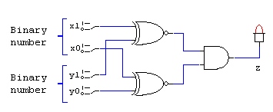
Example 4-17
Design a logic circuit, using x₁, x₀, y₁ and y₀ inputs, whose output will be HIGH only when the two binary numbers x₁x₀ and y₁y₀ are equal.
Hint: use XNOR gates (Figure 4-23)

Slide 26
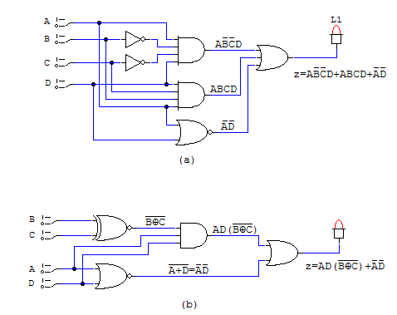
Using XNOR to Simplify Circuit Implementation
Example 4-18

Slide 27
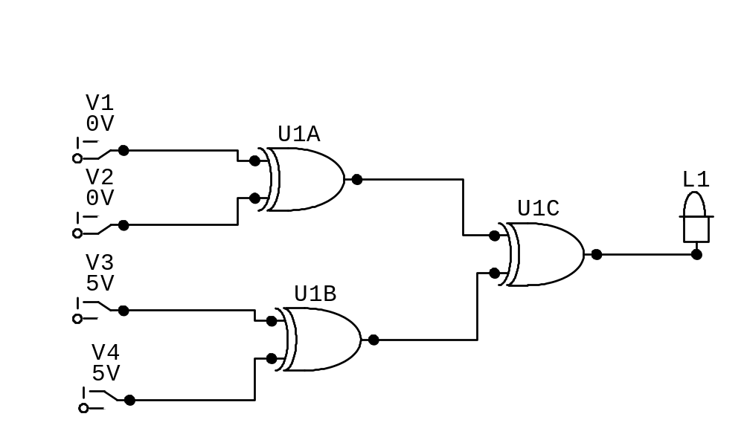
Parity Generator

Slide 28
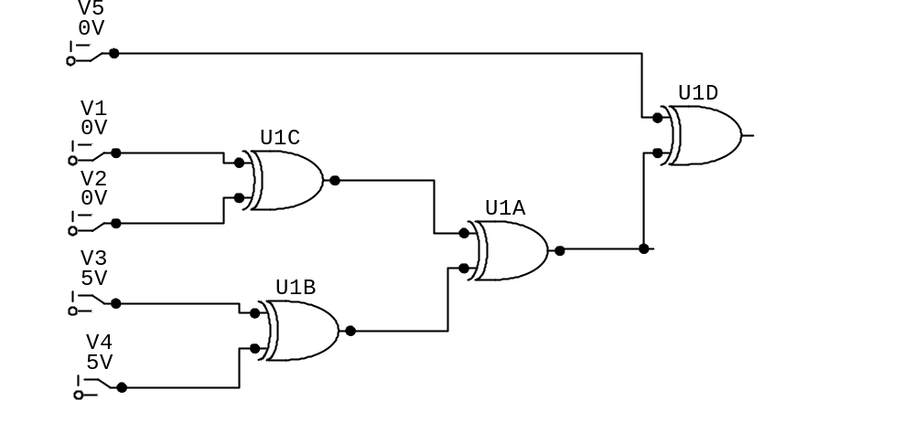
Even-parity Checker
Error

Slide 29
Enable/Disable Circuits
Each of the basic logic gates can be used to control the passage of an input logic signal through to the output.
A: input, B: control (Figure 4-26)
The logic level at the control input determines whether the input signal is enabled to reach the output or disabled from reaching the output.

Slide 30
Basic Characteristics of Digital ICs
Digital ICs are a collection of resistors, diodes and transistor fabricated on a single piece of semiconductor material called a substrate, which is commonly referred to as a chip.
The chip is enclosed in a package.
Dual-in-line package (DIP)

Slide 31
Integrated Circuits
Complexity | Number of Gates
Small-scale integration(SSI) | <12
Medium-scale integration(MSI) | 12 to 99
Large-scale integration(LSI) | 100 to 9999
Very large-scale integration(VLSI) | 10,000 to 99,999
Ultra large-scale integration(ULSI) | 100,000 to 999,999
Giga-scale integration (GSI) | 1,000,000 or more

Slide 32
Bipolar and Unipolar Digital ICs
Categorized according to the principal type of electronic component used in their circuitry.
Bipolar ICs are those that are made using the bipolar junction transistor (PNP or NPN).
Unipolar ICs are those that use the unipolar field-effect transistors (P-channel and N-channel MOSFETs).

Slide 33
IC Families
TTL Family: bipolar digital ICs (Table 4-6)
CMOS Family: unipolar digital ICs (Table 4-7)
TTL and CMOS dominate the field of SSI and MSI devices.

Slide 34
TTL Family
TTL Series | Prefix | Example IC
Standard TTL | 74 | 7404 (hex inverter)
Schottky TTL | 74S | 74S04
Low-power Schottky TTL | 74LS | 74LS04
Advanced Schottky TTL | 74AS | 74AS04
Advanced low-power Schottky TTL | 74ALS | 74ALS04

Slide 35
CMOS Family
CMOS Series | Prefix | Example IC
Metal-gate CMOS | 40 | 4001
Metal-gate, pin-compatible with TTL | 74C | 74C02
Silicon-gate, pin-compatible with TTL, high-speed | 74HC | 74HC02
Silicon-gate, high-speed, pin-compatible and electrically compatible with TTL | 74HCT | 74HCT02
Advanced-performance CMOS, not pin or electrically compatible with TTL | 74AC | 74AC02
Advanced-performance CMOS, not pin but electrically compatible with TTL | 74ACT | 74ACT02

Slide 36
Power and Ground
To use digital IC, it is necessary to make proper connection to the IC pins.
Power: labeled V_{cc} for the TTL circuit, labeled V_{DD} for CMOS circuit.
Ground

Slide 37
Logic-level Voltage Ranges
For TTL devices, V_{CC} is normally 5V.
For CMOS circuits, V_{DD} can range from 3-18V.
For TTL, logic 0 : 0-0,8V, logic 1:2-5V
For CMOS, logic 0 : 0-1.5V, logic 1:3.5-5V

Slide 38
Unconnected Inputs
Also called floating inputs.
A floating TTL input acts like a logic 1, but measures a DC level of between 1.4 and 1.8V.
A CMOS input cannot be left floating.

Slide 39
Logic-Circuit Connection Diagrams
A connection diagram shows all electrical connections, pin numbers, IC numbers, component values, signal names, and power supply voltages.
See Figure 4-32.

Slide 40
Troubleshooting Digital Systems
Fault detection
Fault isolation
Fault correction
Good troubleshooting techniques can be learned only through experimentation and actual troubleshooting of faulty circuits.

Slide 41
Troubleshooting Tools
Logic probe
Oscilloscope
Logic pulser
Current tracer
… and your
BRAIN!
Indicator Light | Logic Level
OFF | LOW
ON | HIGH
DIM | INTERMEDIATE
FLASHING | PULSING

Slide 42
Internal IC Faults
Malfunction is the internal circuitry.
Inputs or outputs shorted to ground or Vcc (Figure 4.34, 4-35)
Inputs or outputs open-circuited (Figure 4.36)
Short between two pins (other than ground or Vcc): whenever two signals that are supposed to be different show the same logic-level variations.

Slide 43
External Faults
Open signal lines:Broken wire, Poor solder connection, Crack or cut trace on a printed circuit board, Bend or broken pin on a IC, faulty IC socket.
Shorted signal lines: sloppy wiring, solder bridges, incomplete etching.
Faulty power supply
Output loading: when an output is connected to too many IC inputs.

Slide 44
Programmable Logic Device
PLD is an integrated circuit that contains a particular arrangement of logic gates. (Figure 4.41)
Useful in implementing complex circuits containing tens or thousands of logic gates.
Sum-of-products form

