Slide 1
Counters and Registers
Wen-Hung Liao, Ph.D.

Slide 2
Objectives
Understand the operation and characteristics of synchronous and asynchronous counters.
Construct counters with MOD numbers less than 2N.
Identify IEEE/ANSI symbols used in IC counters and registers.
Construct both up and down counters.
Connect multistage counters.
Analyze and evaluate various types of presettable counters.
Design arbitrary-sequence synchronous counters.

Slide 3
Objectives (cont’d)
Understand several types of schemes used to decode different types of counters.
Anticipate and eliminate the effects of decoding glitches.
Compare the major differences between ring and Johnson counters.
Analyze the operation of a frequency counter and of a digital clock.
Recognize and understand the operation of various types of IC registers.

Slide 4
Asynchronous (Ripple) Counters
FFs do not change states in exact synchronism with the applied clock pulses.
In Figure 7-1, FF B must wait for FF A to change states before it can toggle.
Similarly, FF C must wait for FF B to change states before it can toggle.
Delay of 5-20 ns per FF→ Ripple Counter.

Slide 5
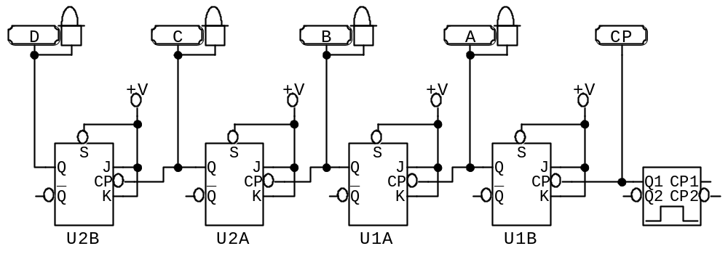
Figure 7-1: Four-Bit Ripple Counter

Slide 6
Signal Flow
Convention: draw the circuits such that signal flow is from left to right.
In this chapter, we often break this convention.
For example, in Figure 7-1:
  FF A: LSB
  FF D: MSB

Slide 7
MOD Number
The MOD number is equal to the number of states that the counter goes through in each complete cycle before it recycles back to its starting state.
N flip-flops → MOD number=2^N
Frequency division
Problem: How to convert a 60Hz signal to a 1Hz signal using frequency division?

Slide 8
Counters with MOD number < 2^N
Use asynchronous inputs to force the FFs to skip states.
Refer to Figure 7-4, the NAND output is connected to the asynchronous CLEAR inputs of each FF.
When A=0, B=C=1, (CBA = 110₂= 6₁₀) the NAND output become active, resetting the FFs to 0.

Slide 9
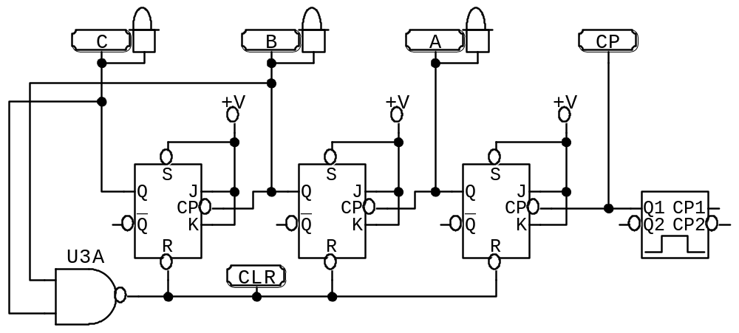
Figure 7-4: MOD-6 Counter

Slide 10
Temporary State
Notice that in Figure 7-4, 110 is a temporary state, so the state transition diagram for a MOD 6 counter does not stay at 110, but goes to 000 instead.
000→001→010→011→100→101→000
FF C output has a frequency equals to the one-sixth of the input frequency.

Slide 11
Construct a MOD X Counter
Step 1: Find the smallest number of FFs such that 2^N >= X, and connect them as a counter. If 2^N=X, do not do steps 2 and 3.
Step 2: Connect a NAND gate to the asynchronous CLEAR inputs of all the FFs.
Step 3: Determine which FFs will be in the HIGH state at count = X; then connect the normal outputs of these FFs to the NAND gate inputs.

Slide 12
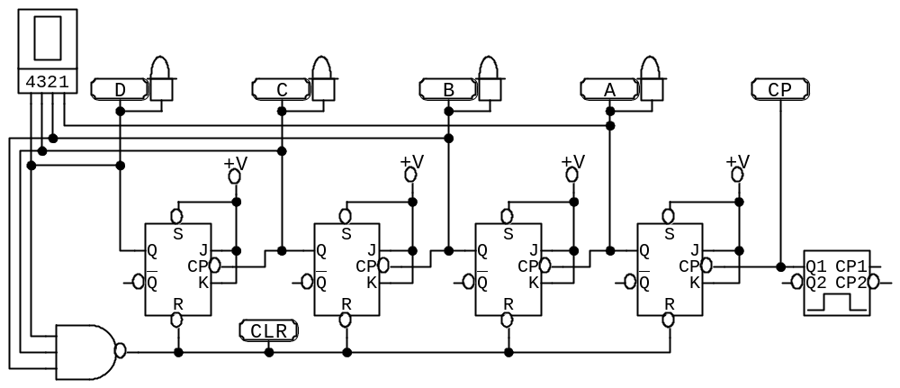
Examples
Figure 7-6 (a): MOD-14 ripple counter

Slide 13
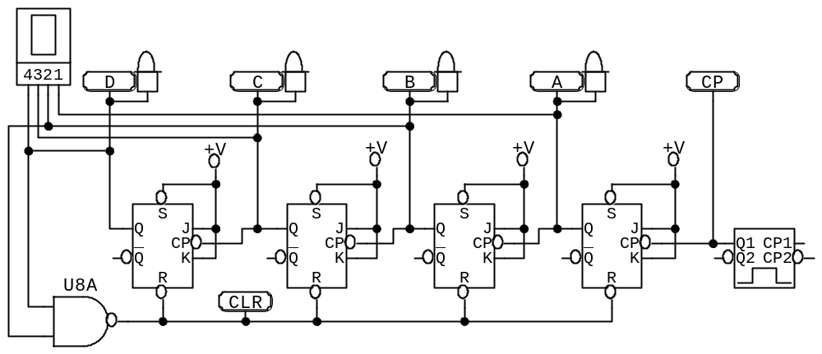
More Examples
Figure 7-6 (b): MOD-10 ripple counter

Slide 14
Decimal/BCD Counter
Widespread uses in applications where pulses and events are to be counted and the results displayed on some type of decimal numerical readout.

Slide 15
IC Asynchronous Counters
TTL type: 74LS293:
  Four J-K flip-flops, Q₃Q₂Q₁Q₀
  Each FF has a CP (clock pulse) input, just another name for CLK. The clock inputs to Q₁ and Q₀ are externally accessible (pin 11 and 10, respectively).
  Each FF has an asynchronous CLEAR input. These are connected together to the output of a two-input NAND gate with inputs MR₁ and MR₂.
  Q₃Q₂Q₁ are connected as a 3-bit ripple counter.
  Q₀ is not connected to anything internally.

Slide 16
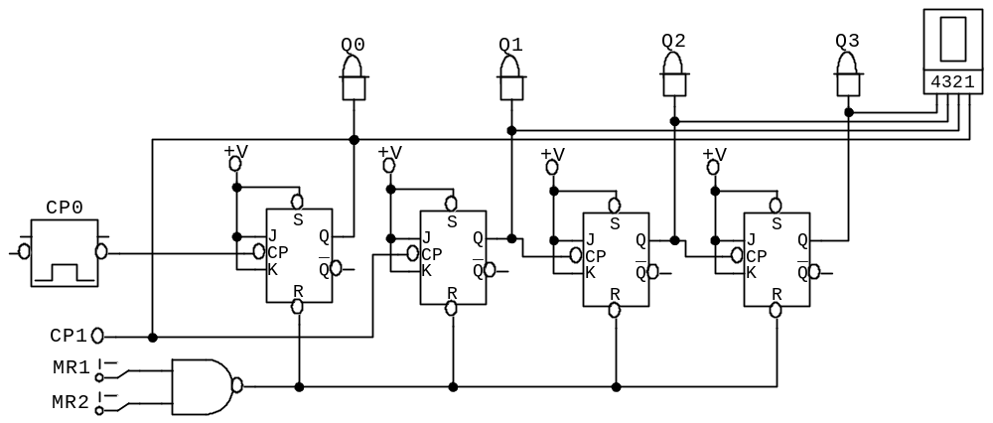
Figure 7-8: 74LS293

Slide 17
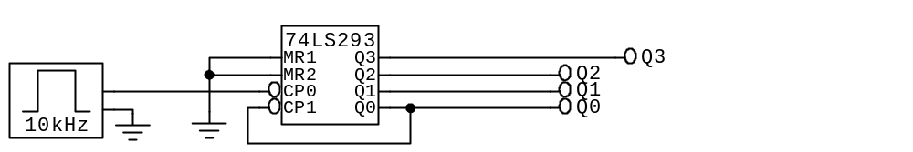
Example: Figure 7-9
74LS293 wired as a MOD-16 counter.

Slide 18
More Examples
Example 7-9: MOD-10 counter.
Example 7-10: MOD-14 counter (an external AND gate is required in this case.)
Example 7-11: cascading two 74LS293s to provide a MOD-60 counter.
IEEE symbol: Figure 7.13
CMOS counter: 74HC4024 (7-bit counter)

Slide 19
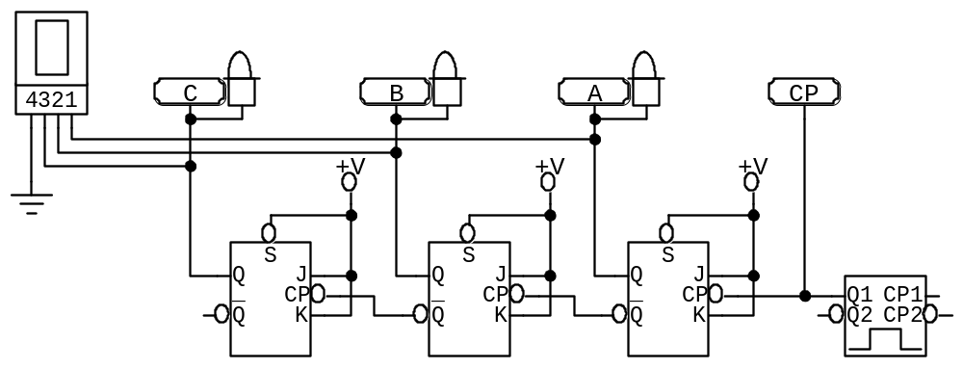
Asynchronous Down Counter
111→110→101→100→011→010→001→000
Driving each FF clock input from the inverted output of the preceding FF..

Slide 20
Propagation Delay
Each FF introduces a delay of t_{pd}
Nth FF cannot change state until a time equal to Nxt_{pd} after the clock transition occurs.
Refer to Figure 7-16.
Limit the maximum clock frequency.

Slide 21
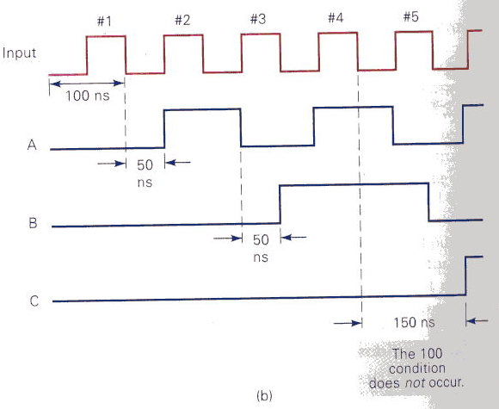
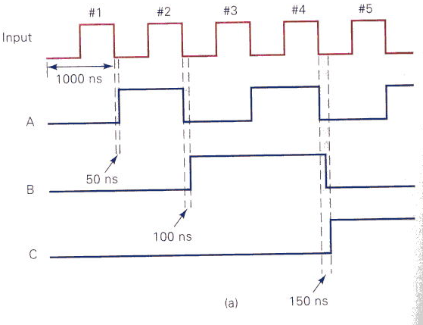
Figure 7-16

Slide 22
Synchronous Counters
All FFs are triggered simultaneously by the clock pulses.
Figure 7-17.
The CLK inputs are connected together.
Only FF A has its J and K connected to HIGH, others are driven by some combination of FF outputs.
Requires more circuitry than the asynchronous counterpart.

Slide 23
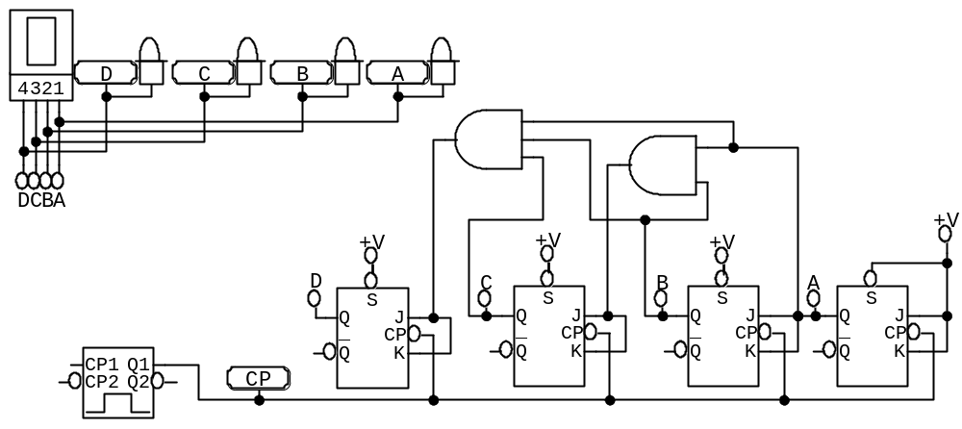
Synchronous MOD-16 Counter

Slide 24
Circuit Operation of Parallel Counter
B must change state on each NGT that occurs while A=1
C must change state on each NGT that occurs while A=B=1
D must change state on each NGT that occurs while A=B=C=1
Design Principle: Each FF should have its J and K inputs connected such that they are HIGH only when the outputs of all lower-order FFs are in the HIGH state.

Slide 25
Advantages of Parallel Counter
Total delay = FF t_{pd} + AND gate t_{pd}
Actual IC:
  74LS160/162, 74HC160/162: synchronous decade counters.
  74LS161/163,74HC161/163: synchronous MOD-16 counters.
Example 7-12.

Slide 26
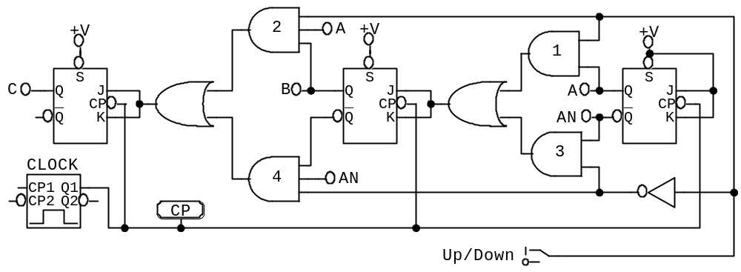
Synchronous Down and Up/Down Counters
Synchronous down counter: modify the connections in Figure 7-17. A →A’, B→B’…
Up/Down counter: Figure 7-18.

Slide 27
Presettable Counters
Starting state can be preset asynchronously or synchronously.
The presetting operation is also referred to as parallel loading the counter.
Refer to Figure 7-19.

Slide 28
The 74ALS193/HC193
MOD-16, presettable up/down counter with synchronous counting, asynchronous preset and asynchronous master reset.
Figure 7-20:
  Clock inputs CP_{U} and CP_{D}
  Master reset (MR)
  Preset inputs
  Count outputs
  Terminal count outputs (when connecting two or more 74ALS193s.)

Slide 29
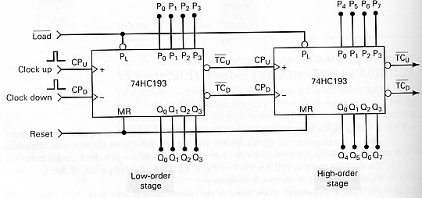
Figure 7-25
Multistage arrangement.

Slide 30
Decoding a Counter
Use LEDs for small-size counter.
Active-HIGH decoding (Figure 7-27)
Active-LOW decoding

Slide 31
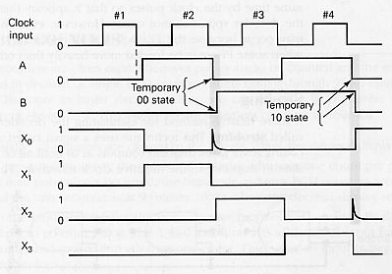
Decoding Glitches
Caused by propagation delay. Temporary states are generated and may be detected by the AND decoder.
Refer to Figure 7-30.

Slide 32
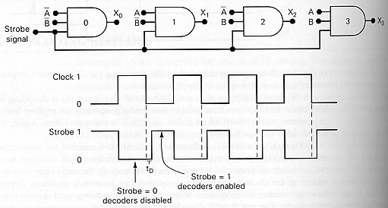
Solution
Use parallel counters
Strobing: use a strobe signal to keep the decoding AND gates disabled until all of the FFs have reached a stable state. (Figure 7-31)

