Slide 1
Digital Systems:
Introductory Concepts
Wen-Hung Liao, Ph.D.

Slide 2
Objectives
Analog vs. digital representation: definition and comparison
Analog-to-Digital and Digital-to-Analog converters
Decimal and binary numbers
Timing diagram
Parallel vs serial transmissions
Major parts of digital computers
Microcomputer, microprocessor, microcontroller

Slide 3
Numerical Representations
Analog representation: a quantity that can vary over a continuous range of values.
Digital representation: a quantity that changes in discrete steps.
Analog == Continuous
Digital == discrete (step by step)

Slide 4
Example 1-1
Which of the following involves analog quantities and which involve digital quantities?
Ten-position switch
Current flowing out of an electrical outlet
Temperature of a room
Sand grains on the beach
Automobile speedometer

Slide 5
Digital Systems
A digital system is a combination of devices designed to manipulate logical information or physical quantities that are represented in digital form.
Examples: digital computers, calculators, digital audio/video equipment, telephone system…

Slide 6
Advantages of Digital Techniques
Digital systems are generally easier to design.
Information storage is easy.
Accuracy and precision are greater.
Operation can be programmed.
Digital circuits are less affected by noise.
More digital circuitry can be fabricated on IC chips.

Slide 7
Limitations of Digital Techniques
The real world in mainly analog.
To deal with analog inputs, three steps must be followed:
  Convert the real-world analog inputs to digital form
  (analog-to-digital converter, ADC)
  Process (operate on) the digital information
  Convert the digital output back to real-world analog form (digital-to-analog converter,DAC)

Slide 8
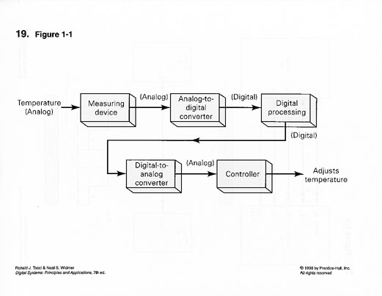
Temperature Control System

Slide 9
Compact Disks
Sounds from instrument and human voices produce an analog voltage signal in a microphone
This analog signal is converted to digital form
The digital information is stored on the CD’s surface
During playback, the CD player takes the digital information from the CD surface and converts it into an analog signal which is then amplified and fed to a speaker.

Slide 10
Digital vs. Analog
Added complexity and expense due to ADC, DAC
Extra time required to perform conversions
In most applications, digital techniques are favored because of the advantages discussed before.
One notable exception: signal amplification is most easily achieved using analog circuitry.
Hybrid systems: combination of digital and analog parts.
The future is digital.

Slide 11
Decimal System
Decimal system is composed of 10 numerals or symbols.
Also called the base-10 system because it has 10 digits.
The decimal system is a positional-value system in which the value of a digit depends on its position.
Most significant digit (MSD)
Least significant digit (LSD)

Slide 12
Binary System
Also known as base-2 system
Use two digit values, 0 and 1.
Decimal system → decimal point,
Binary system → binary point
Example: 1011.101₂
Most Significant Bit, Least Significant Bit

Slide 13
Representing Binary Quantities
In digital systems the information that is being processed is usually presented in binary form. Binary quantities can be represented by any device that has only two operating states or possible conditions.
For example, a switch has only open or closed. We arbitrarily (as we define them) let an open switch represent binary 0 and a closed switch represent binary 1.
Thus we can represent any binary number by using series of switches.

Slide 14
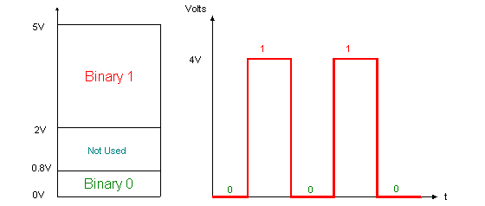
Typical Voltage Assignment
Binary 1: Any voltage between 2V to 5V
Binary 0: Any voltage between 0V to 0.8V
Not used: Voltage between 0.8V to 2V, this may cause error in a digital circuit.

Slide 15
Timing Diagram
Indicates how a signal varies over time.
Use to show the relationship between two or more digital signals in the same circuit or system.
Displayed on an oscilloscope or logic synthesizer.

Slide 16
Digital Circuits
Digital circuits are designed to produce output voltages that fall within the prescribed 0 and 1 voltage ranges.
A digital circuit responds to an input’s binary level (0 or 1) and not to its actual voltage.
The manner in which a digital circuit responds to an input is referred to as the circuit’s logic.
Each type of digital circuit obeys a certain set of logic rules.
For this reason, digital circuits are also called logic circuits.

Slide 17
Digital Integrated Circuits
Almost all of the digital circuits used in modern digital systems are integrated circuits (ICs).
Several fabrication technologies are used:
  TTL
  CMOS
  NMOS
  ECL
Will learn about these IC families in Chapter 8.

Slide 18
Parallel and Serial Transmission
Parallel Transmission
Serial Transmission:
Circuit A
Circuit B
A
B

Slide 19
Tradeoff
Speed versus circuit simplicity

Slide 20
Memory
The change of state remains even after the input is removed.
The property of retaining its response to a momentary input is called memory.
Refer to Figure 1-10.
Latches or flip-flops

Slide 21
Major Parts of a Computer
Input unit
Memory unit
Control unit
Arithmetic/logic unit
Output unit

Slide 22
Types of Computers
Microcomputer
Minicomputer (workstation)
Mainframe
Microcomputer and microprocessor
Microcontroller is not a general-purpose computer, it’s designed to be used as a dedicated or embedded controller which helps monitor and control the operation of an equipment.

