Slide 1
Flip-Flops and Related Devices
Wen-Hung Liao, Ph.D.

Slide 2
Objectives
Construct and analyze the operation of a latch flip-flop made from NAND or NOR gates.
Describe the difference between synchronous and asynchronous systems.
Understand the operation of edge-triggered flip-flops.
Analyze and apply the various flip-flop timing parameters specified by the manufacturers.
Understand the major differences between parallel and serial data transfers.
Draw the output timing waveforms of several types of flip-flops in response to a set of input signals.

Slide 3
Objectives
Recognize the various IEEE/ANSI flip-flop symbols.
Use state transition diagrams to describe counter operation.
Use flip-flops in synchronization circuits.
Connect shift registers as data transfer circuits.
Employ flip-flops as frequency-division and counting circuits.
Understand the typical characteristics of Schmitt triggers.
Apply two different types of one-shots in circuit design.
Design a free-running oscillator using a 555 timer.
Recognize and predict the effects of clock skew on synchronous circuits.
Troubleshoot various types of flip-flop circuits.
Program a PLD using CUPL's state transition format for circuit description.

Slide 4
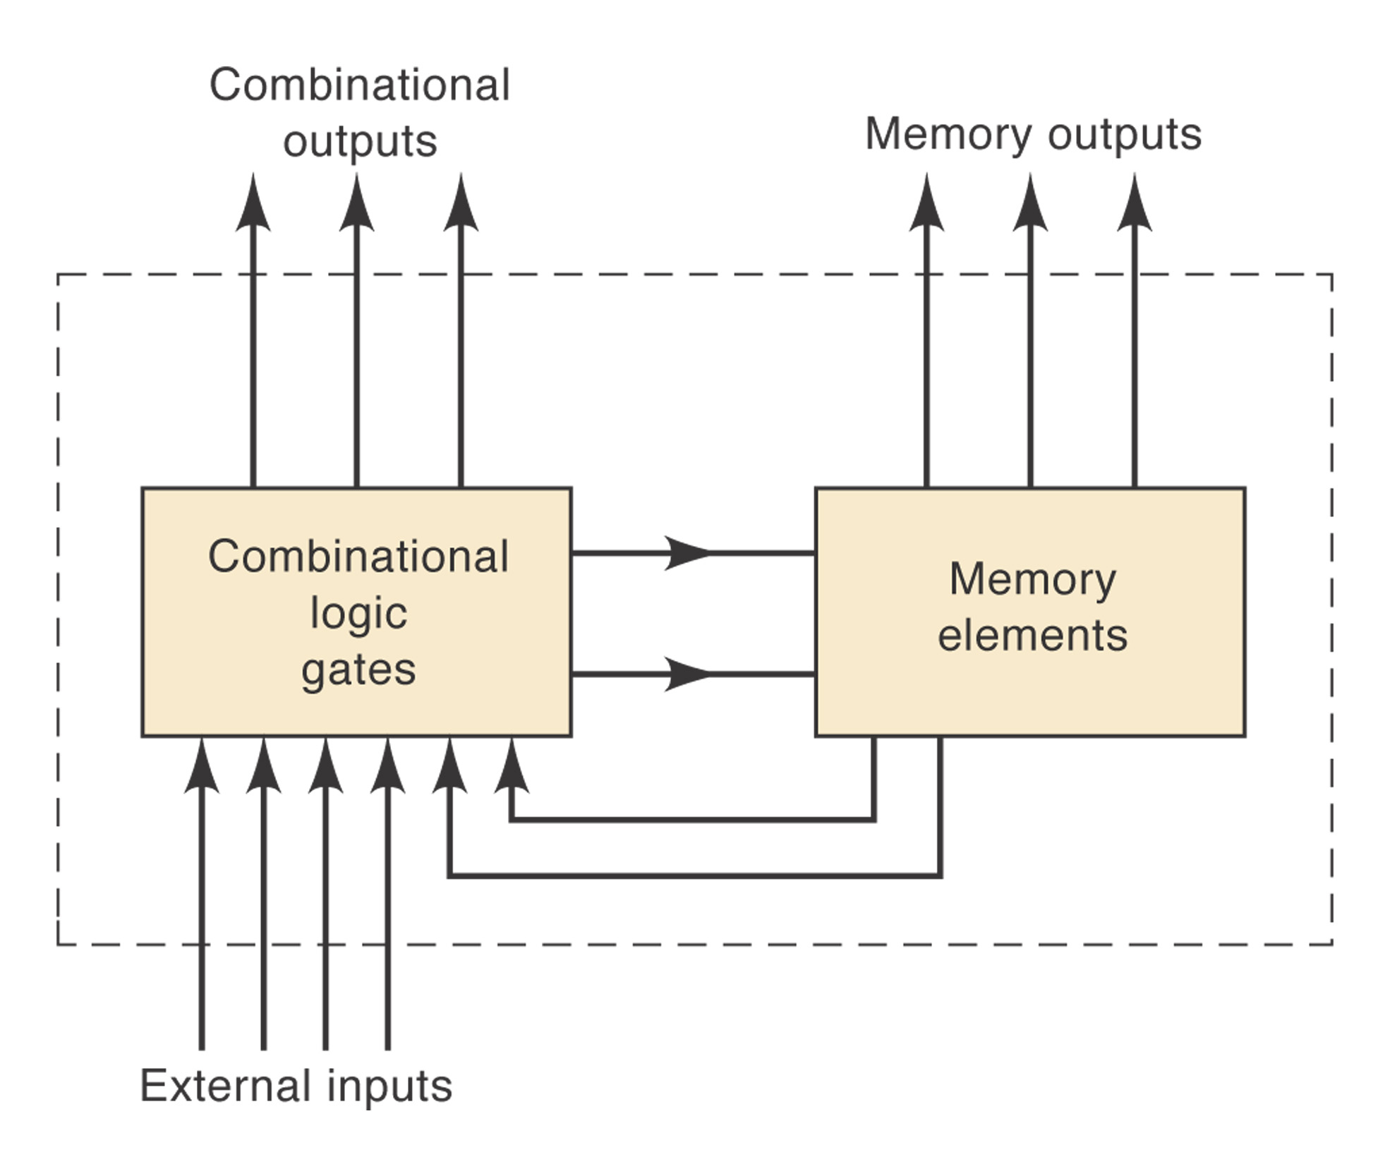
Introduction
General digital system diagram: consists of combinational logic gates and memory elements.

Slide 5
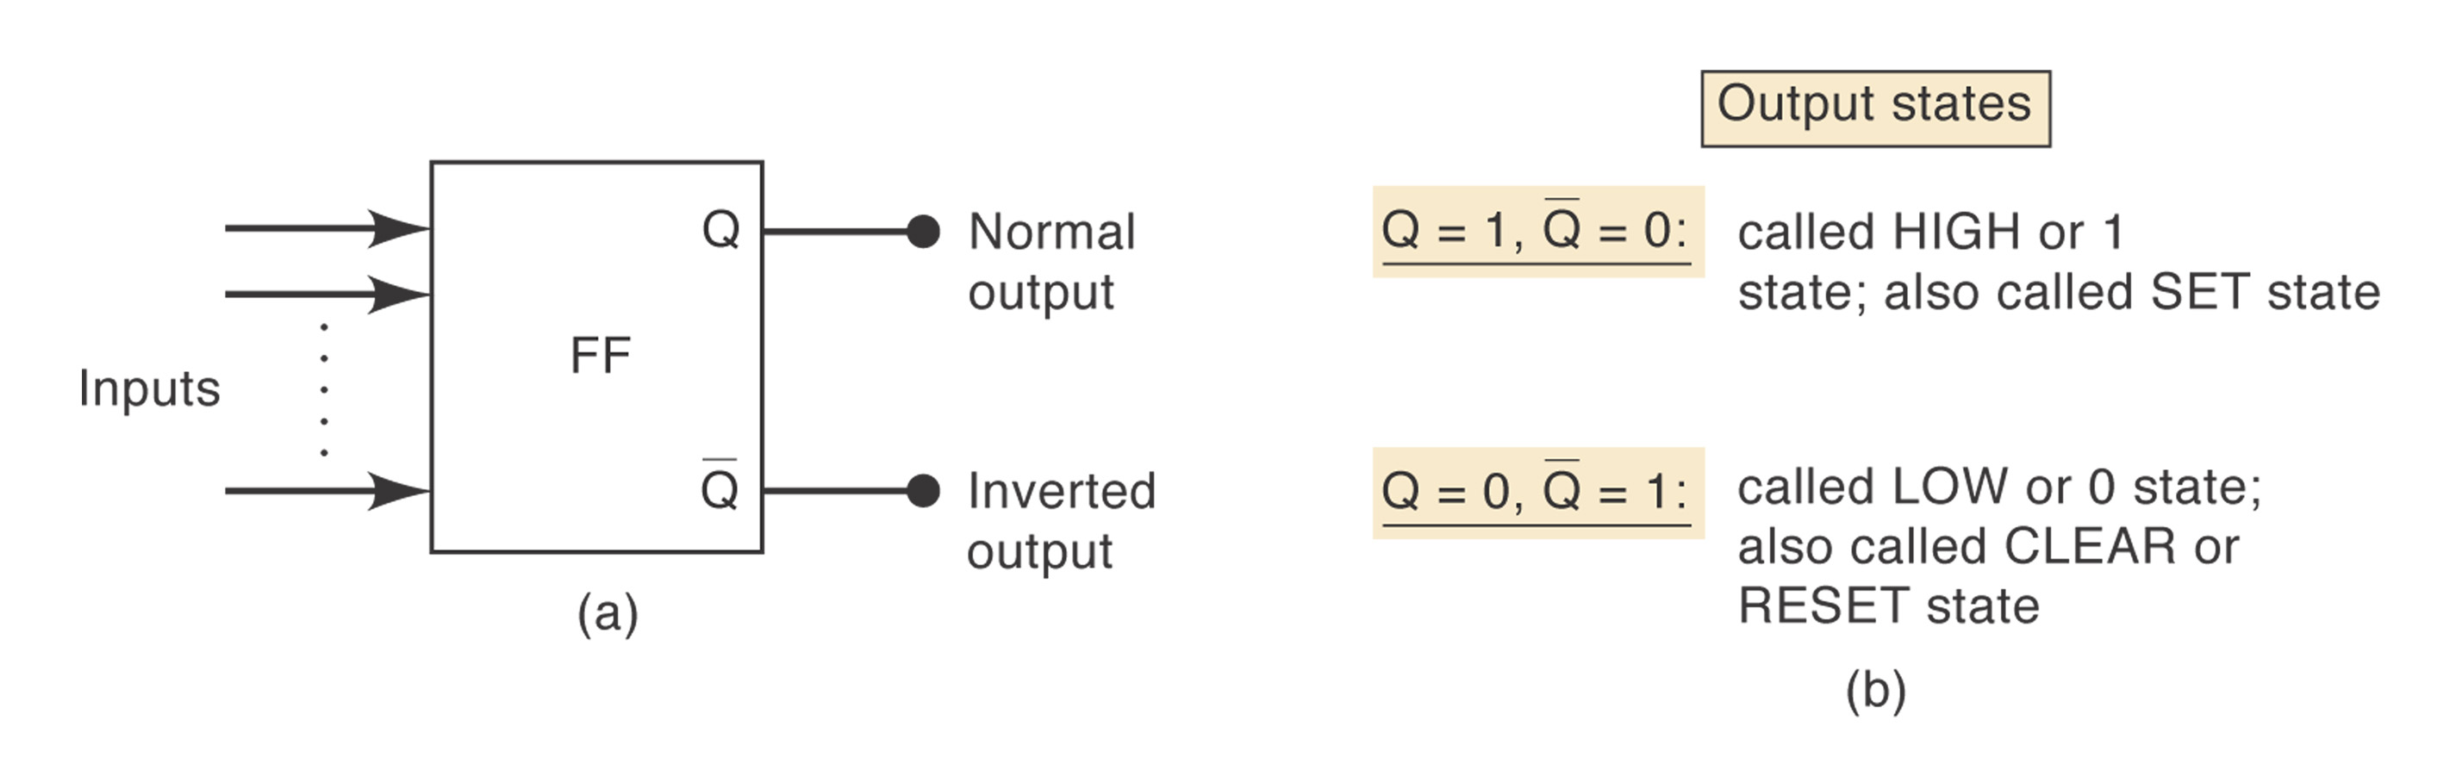
Flip-Flops
The most important memory element is the flip-flop, which is made up of an assembly of logic gates.
General flip-flop symbol
SET/CLEAR(RESET) input

Slide 6
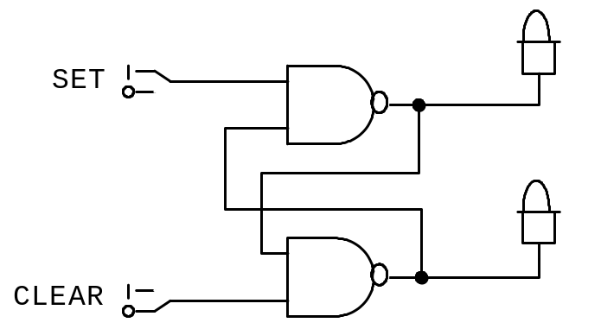
NAND Gate Latch
Constructed using two NAND gates.
Active-LOW
Set | Clear | Output
1 | 1 | No change
0 | 1 | Q=1
1 | 0 | Q=0
0 | 0 | Invalid
Q

Slide 7
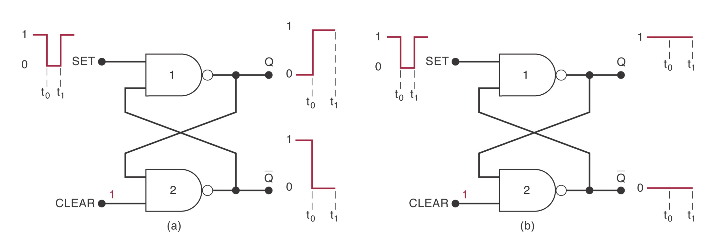
Setting the Latch (FF)

Slide 8
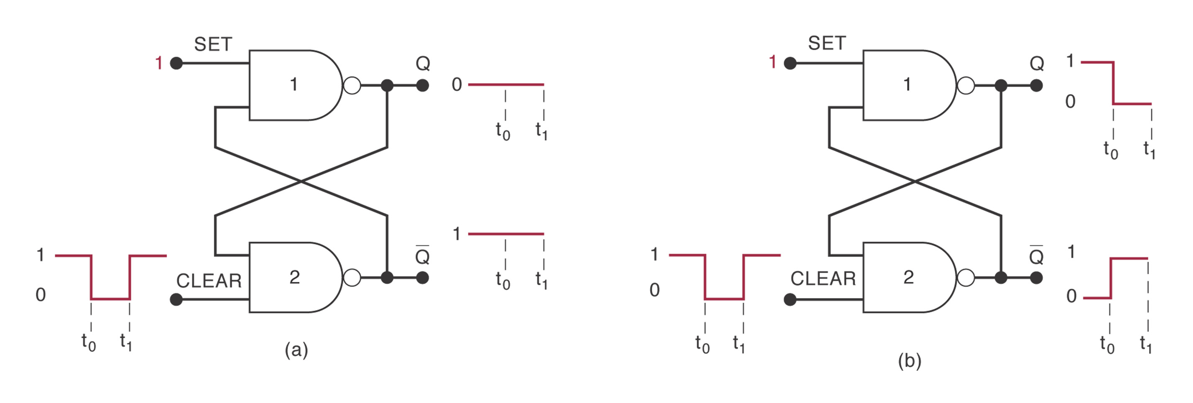
Clearing the Latch (FF)

Slide 9
Simultaneous Setting and Clearing
Q=Q’=1: undesired condition.

Slide 10
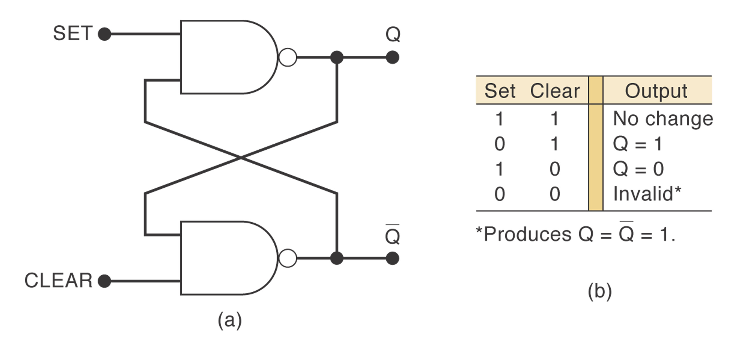
NAND Latch

Slide 11
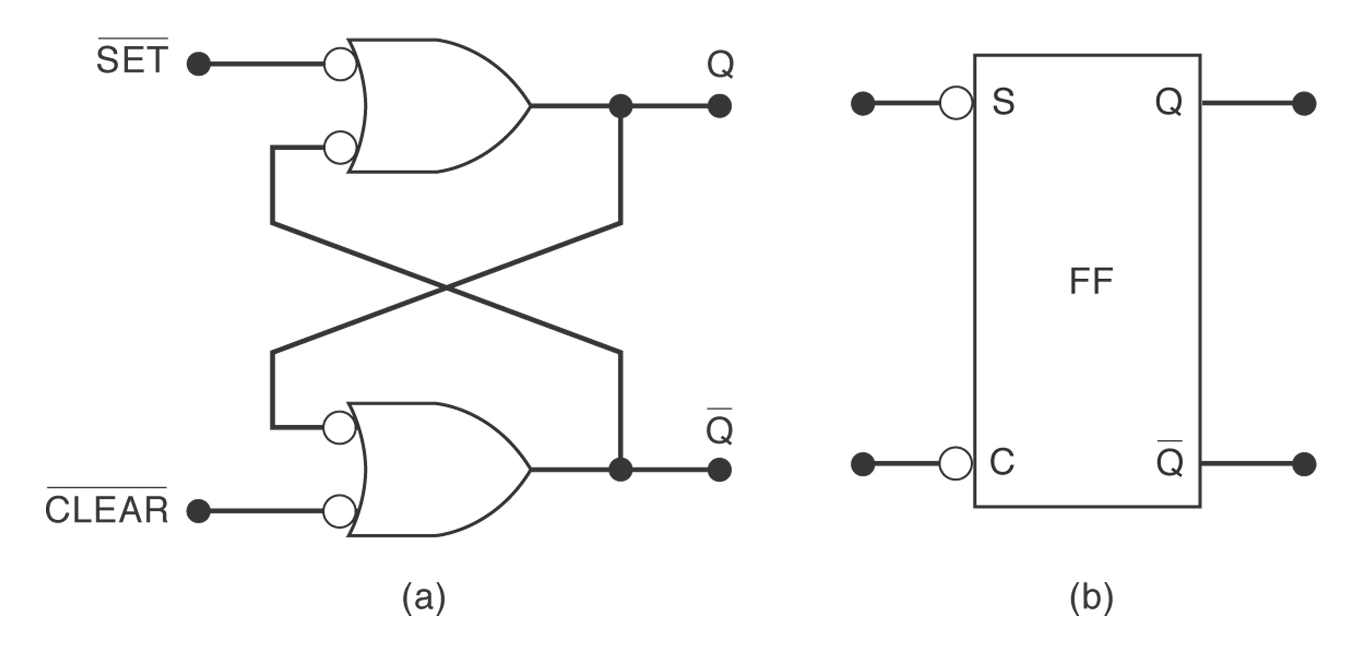
NAND Latch Equivalent Representation

Slide 12
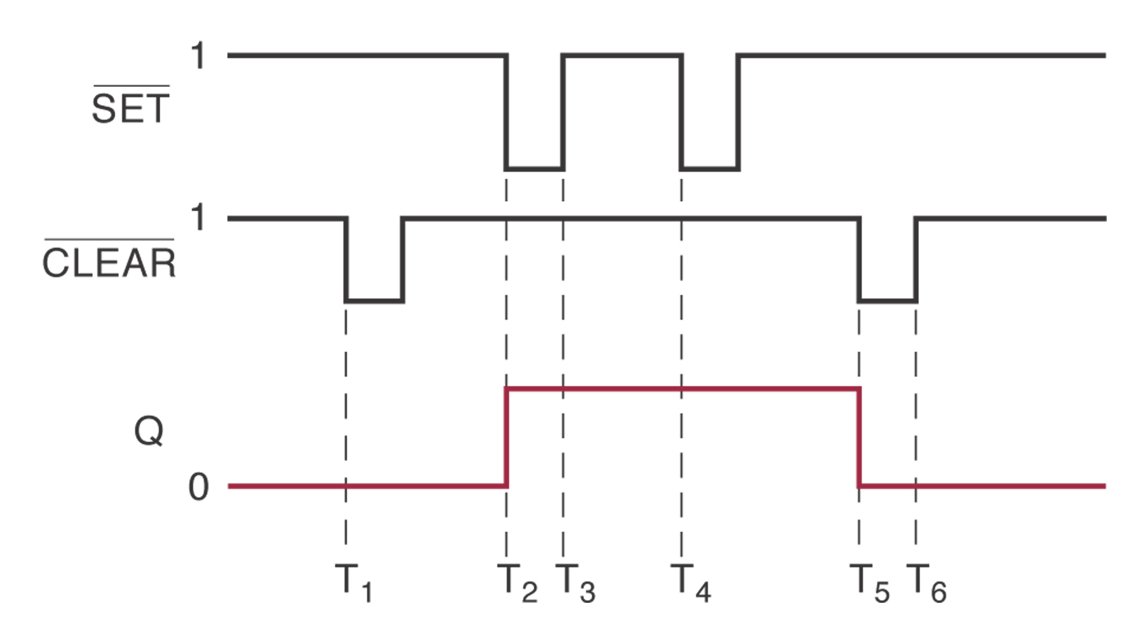
Applications
Example 5-1 shows that the latch output remembers the last input that was activated and will not change states until the opposite input is activated.

Slide 13
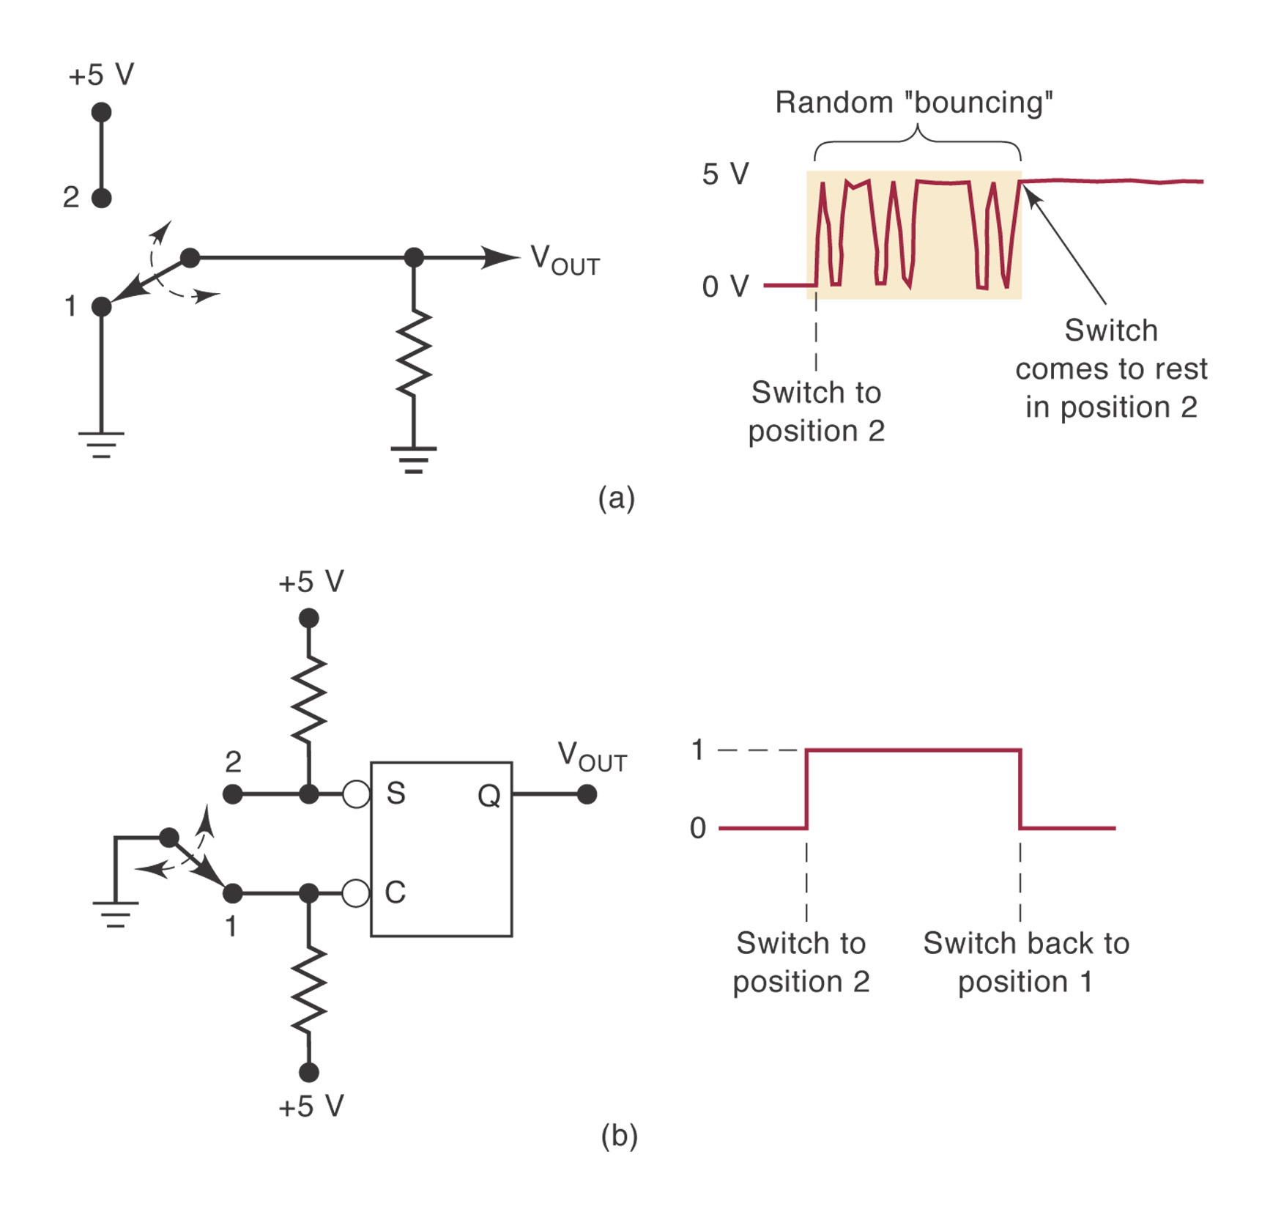
Example 5-2
Switch debouncing circuit

Slide 14
NOR Gate Latch
Constructed using two NOR gates.
Active-HIGH
Set | Clear | Output
0 | 0 | No change
1 | 0 | Q=1
0 | 1 | Q=0
1 | 1 | Invalid

Slide 15
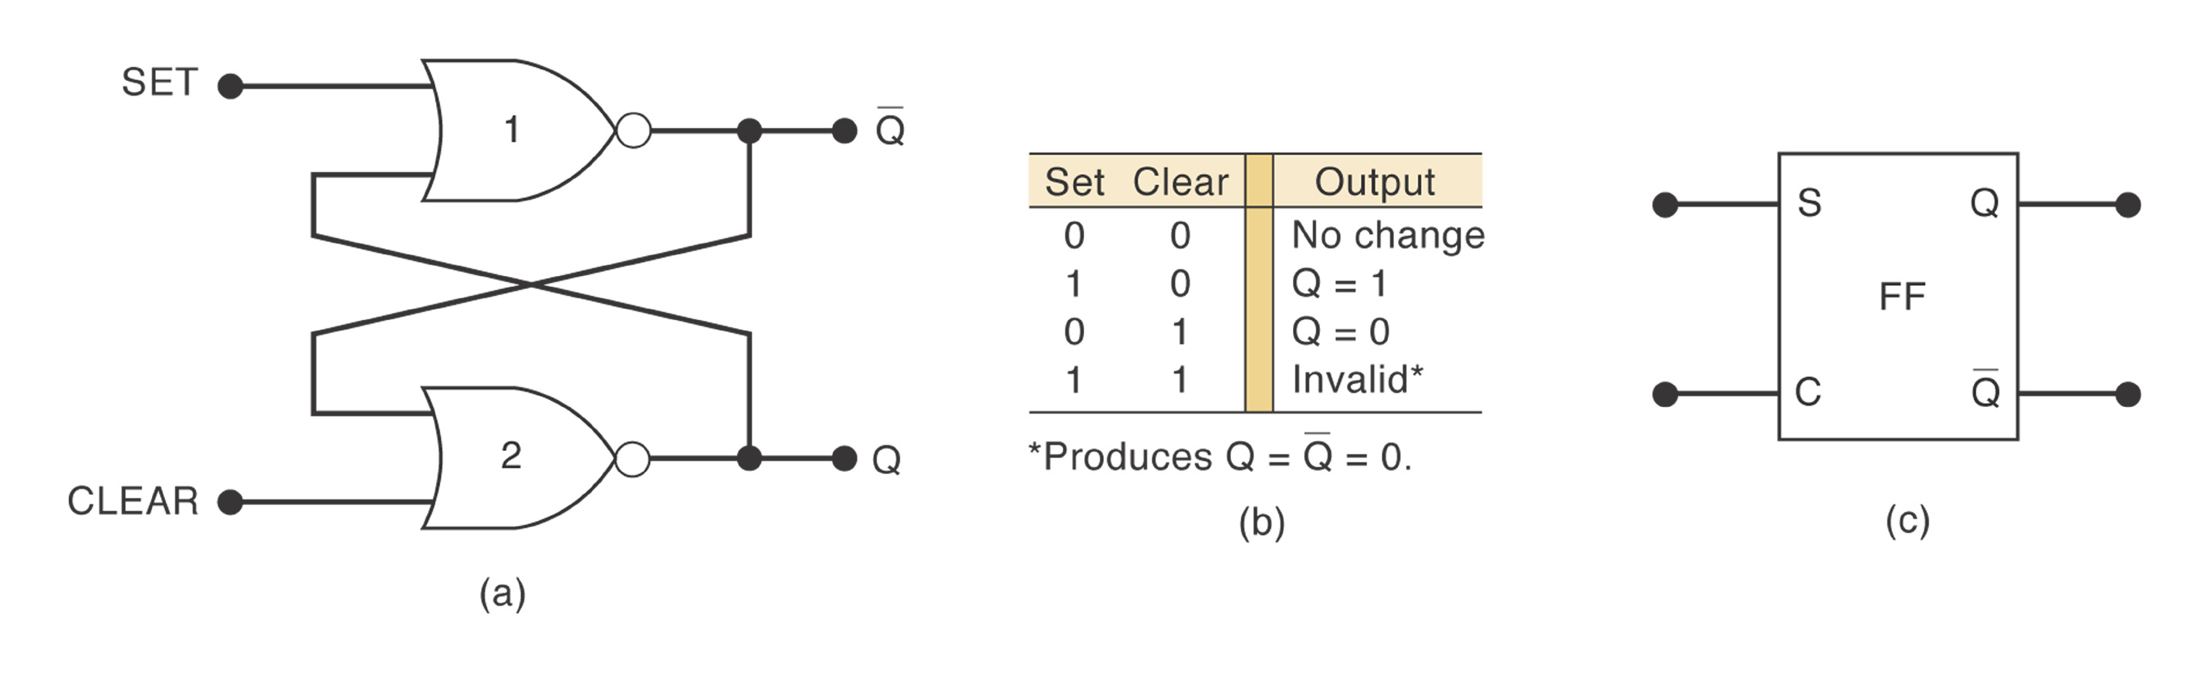
NOR Latch

Slide 16
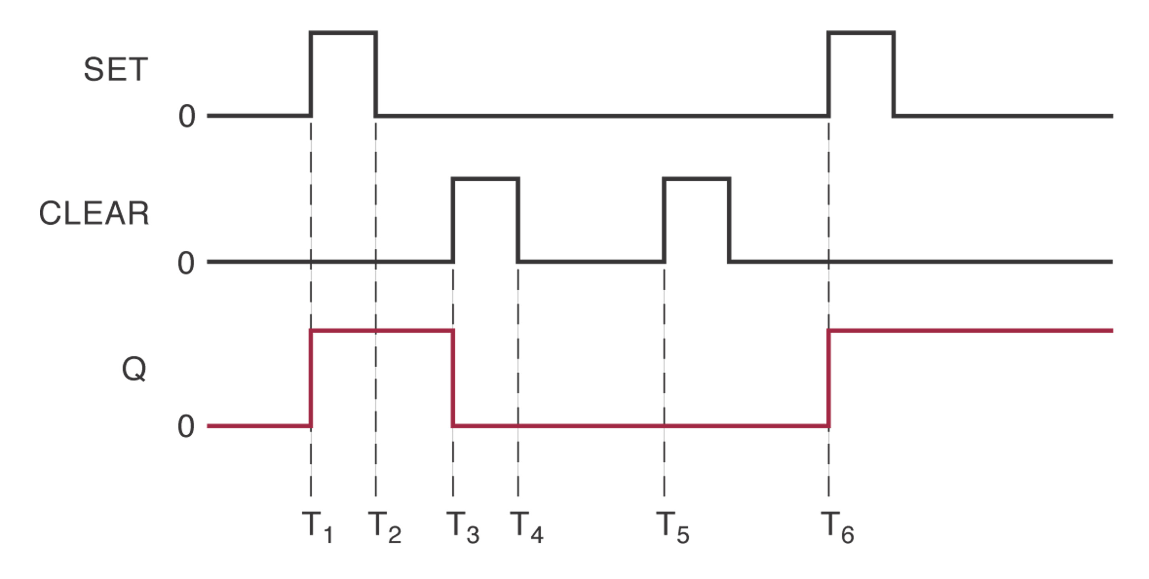
Example 5.3 Q Waveform for NOR latch

Slide 17
Flip-Flop State on Power-up
Do not know the starting state of a flip-flop’s output.

Slide 18
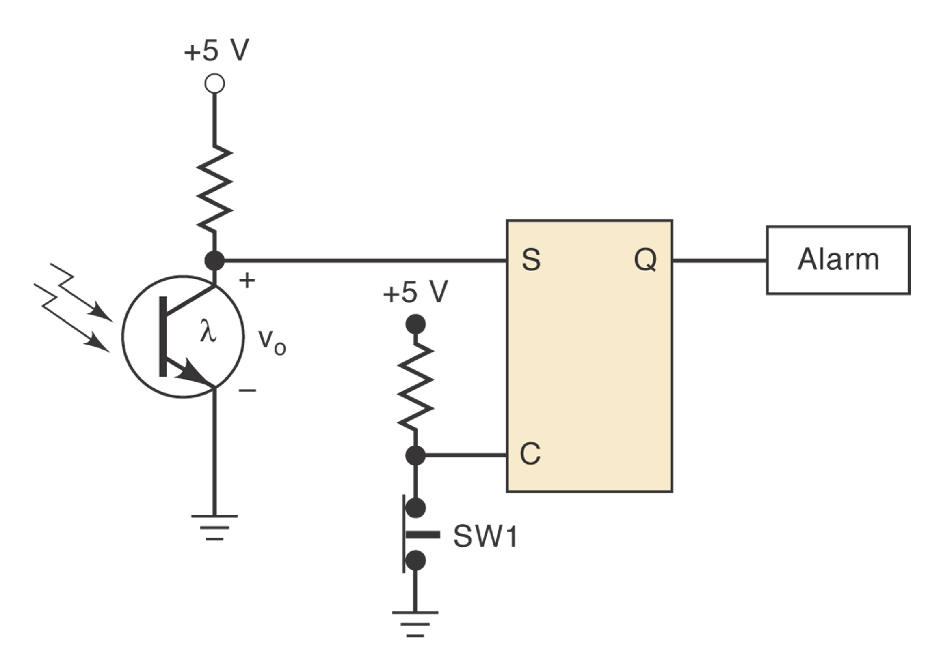
Example 5.4

Slide 19
Clock Signals and Clocked FFs
Asynchronous system: outputs of logic circuit can change state any time one or more of the inputs change. More difficult to design and troubleshoot.
In synchronous systems, the exact times at which any output change change states are determined by a signal commonly called the clock.

Slide 20
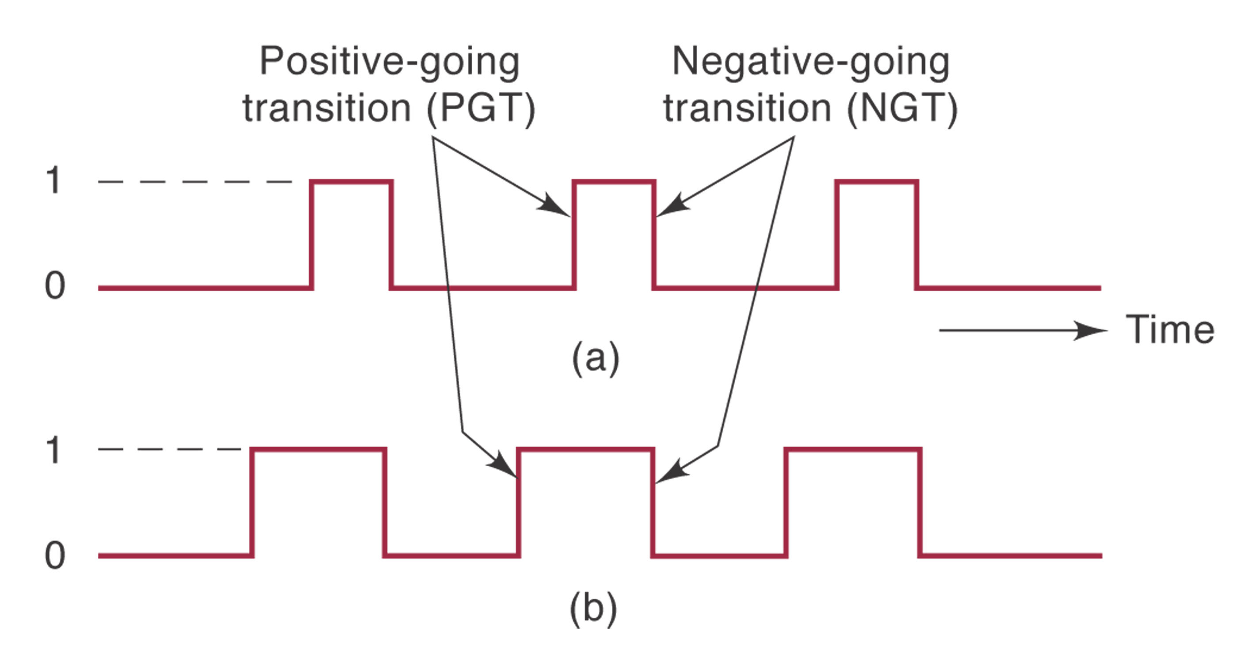
Clock
System outputs can change states only when the clock makes a transition.
Positive-going transition
Negative-going transition
Most digital systems are principally synchronous.

Slide 21
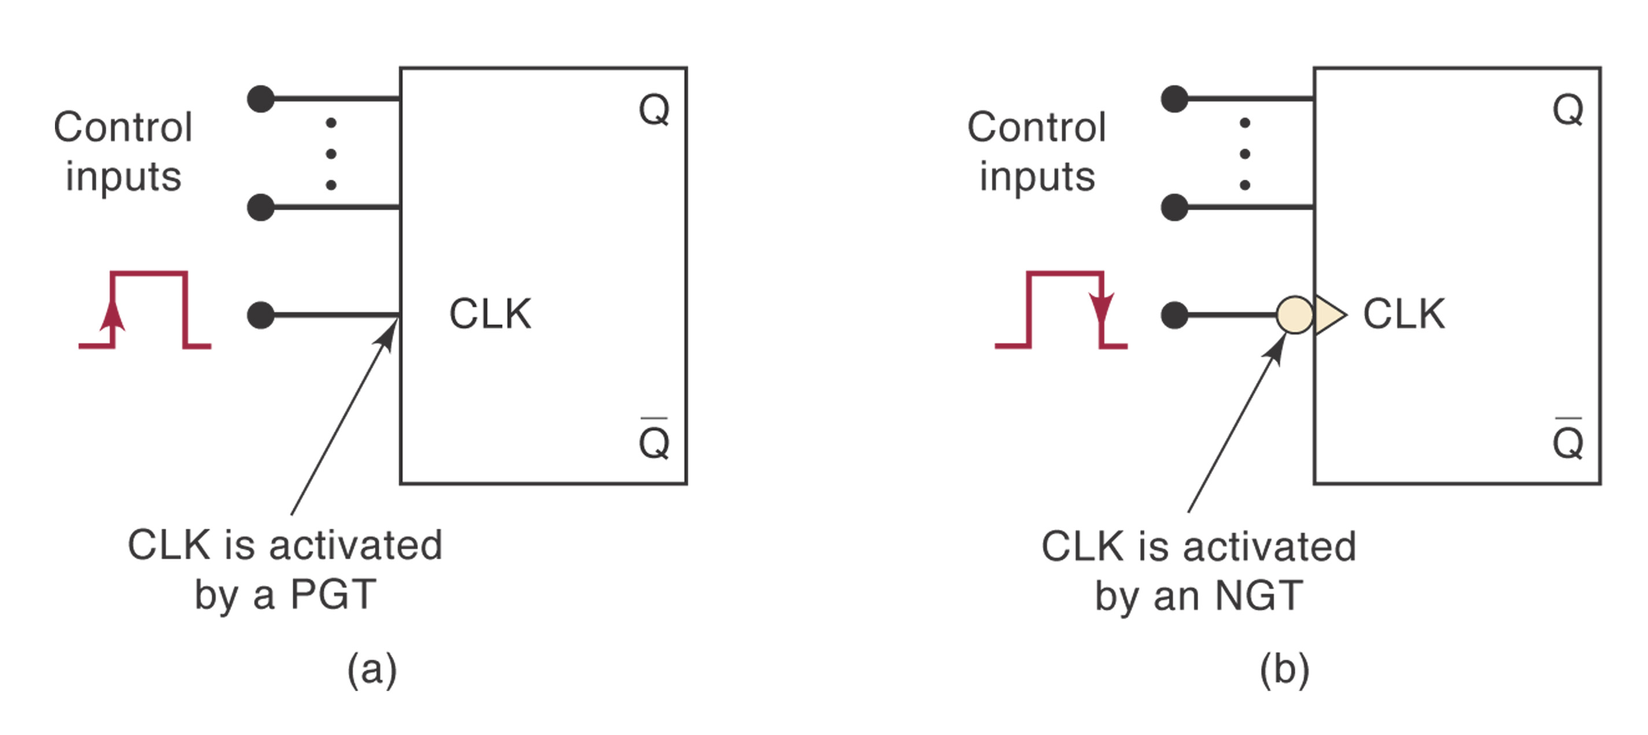
Clocked Flip-Flops
Controlled inputs + CLK
Setup and Hold times
Clocked S-C Flip-Flop
Clocked J-K Flip-Flop
Clocked D Flip-Flop

