Slide 1
AHDL (Chapters 6 & 7)

Slide 2
Using TTL Library Functions with HDL
MSI chips such as adders and ALU ICs are the building blocks of digital systems.
How to use these components in HDL? ➔ macrofunction
A macrofunction is a self-contained description of a logic circuit with all its inputs, outputs and operational characteristics defined.
Good documentation on the macrofunction is critical.

Slide 3
Function Prototype
Example: 74382 (p. 343) 4-bit ALU with 8 different operations.
FUNCTION 74382(s[2..0], a[3..0],b[3..0],cin))
RETURNS (ovr, cn4, f[3..0])

Slide 4
AHDL Macrofunctions
Comments/documentation first
Then Function prototype
Then constant and global definitions
INCLUDE derivative is allowed.
Includes files with extension: .inc

Slide 5
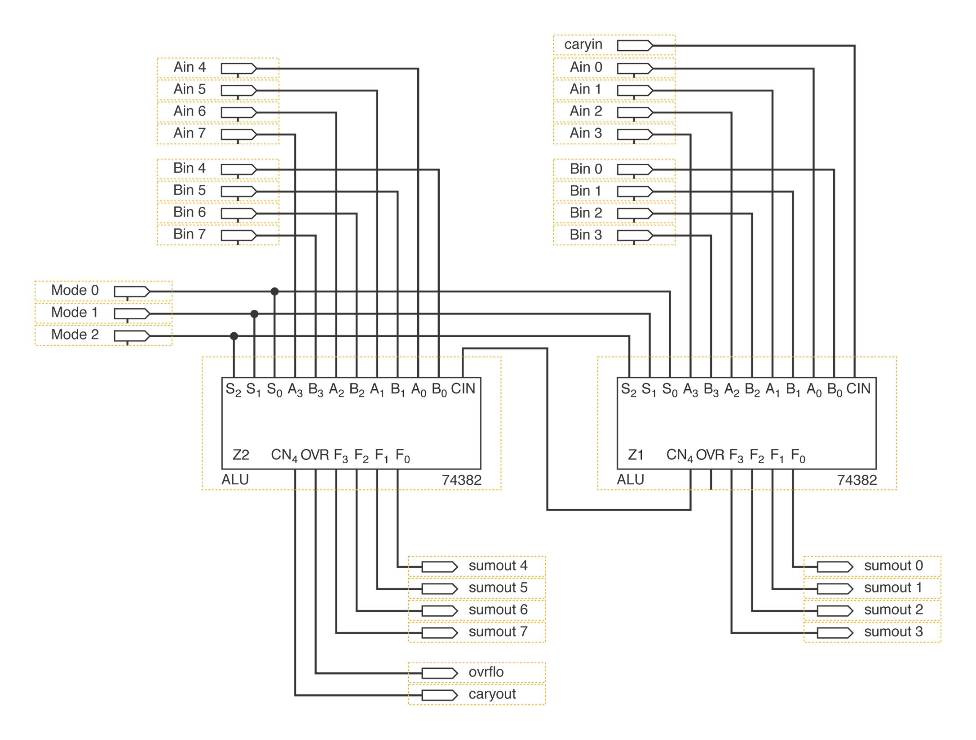
Graphic Description of an 8-bit ALU

Slide 6
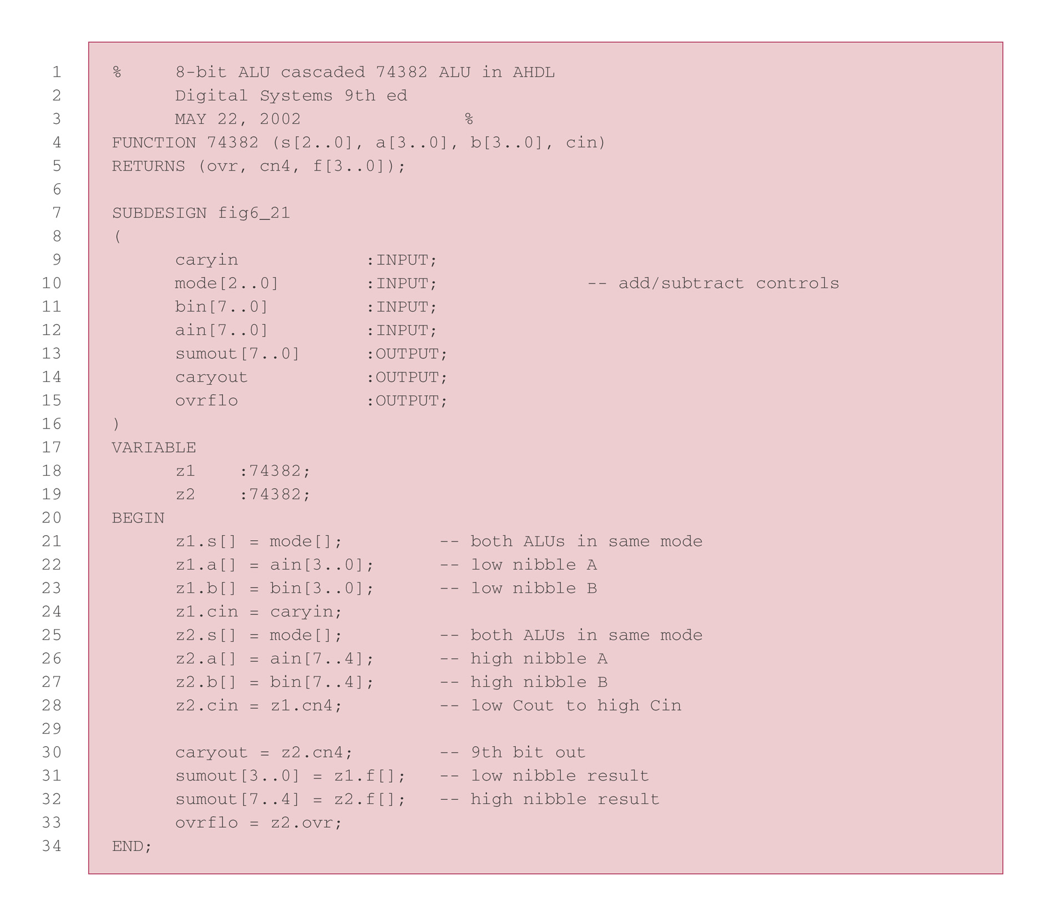
AHDL definition of an 8-bit ALU

Slide 7
Logic Operation on Bit Arrays
SUBDESIGN bitwise_and
( d[3..0], g[3..0] : INPUT;
xx[3..0] : OUTPUT;)
BEGIN
xx[]= d[] & g[];
END; -- Note: x is a reserved identifier in AHDL, use xx

Slide 8
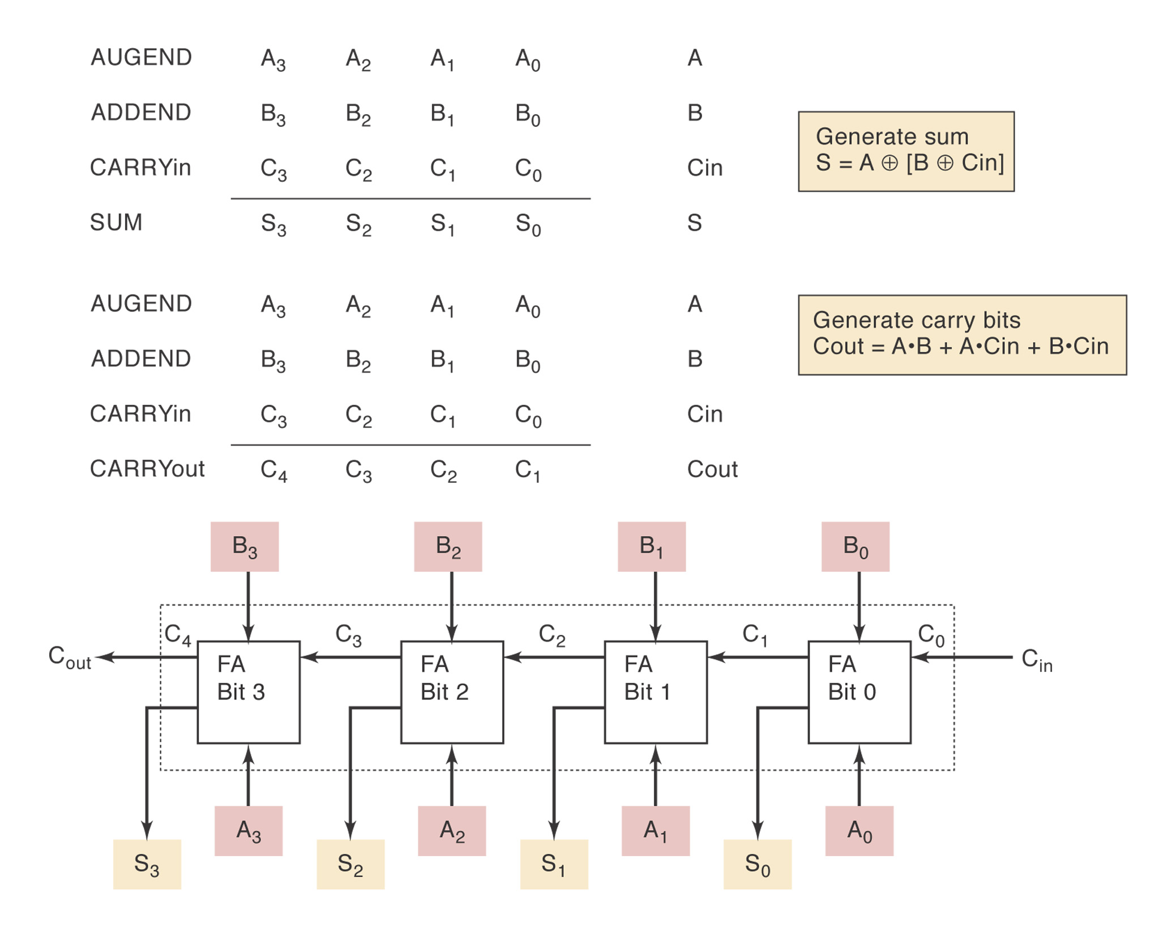
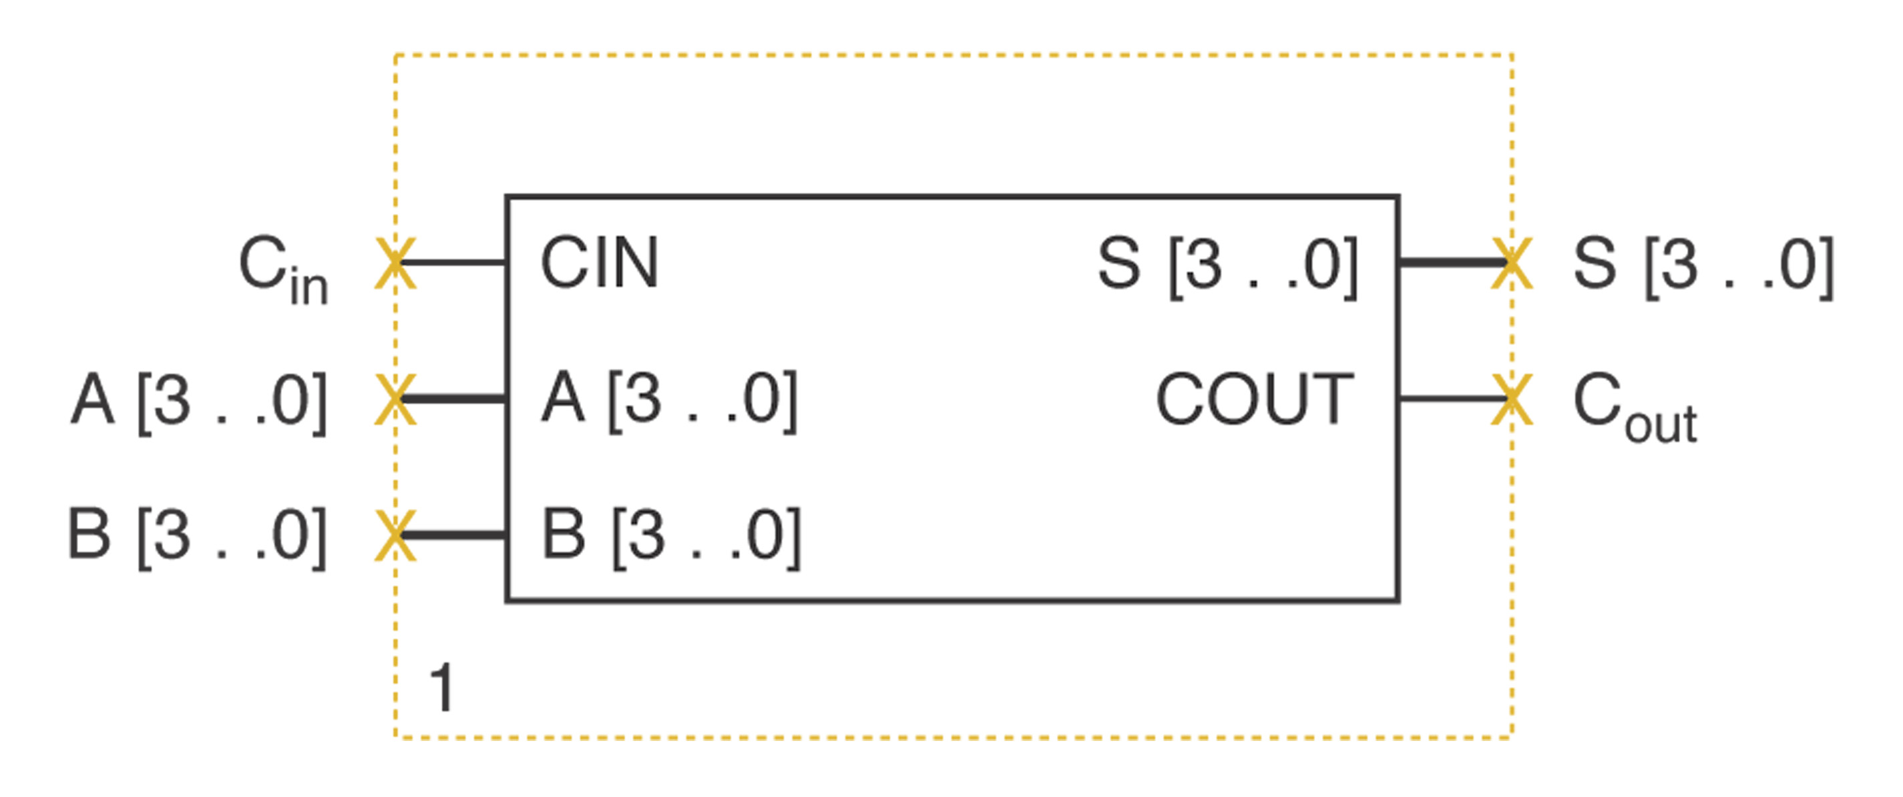
HDL Adders
Block Symbol

Slide 9
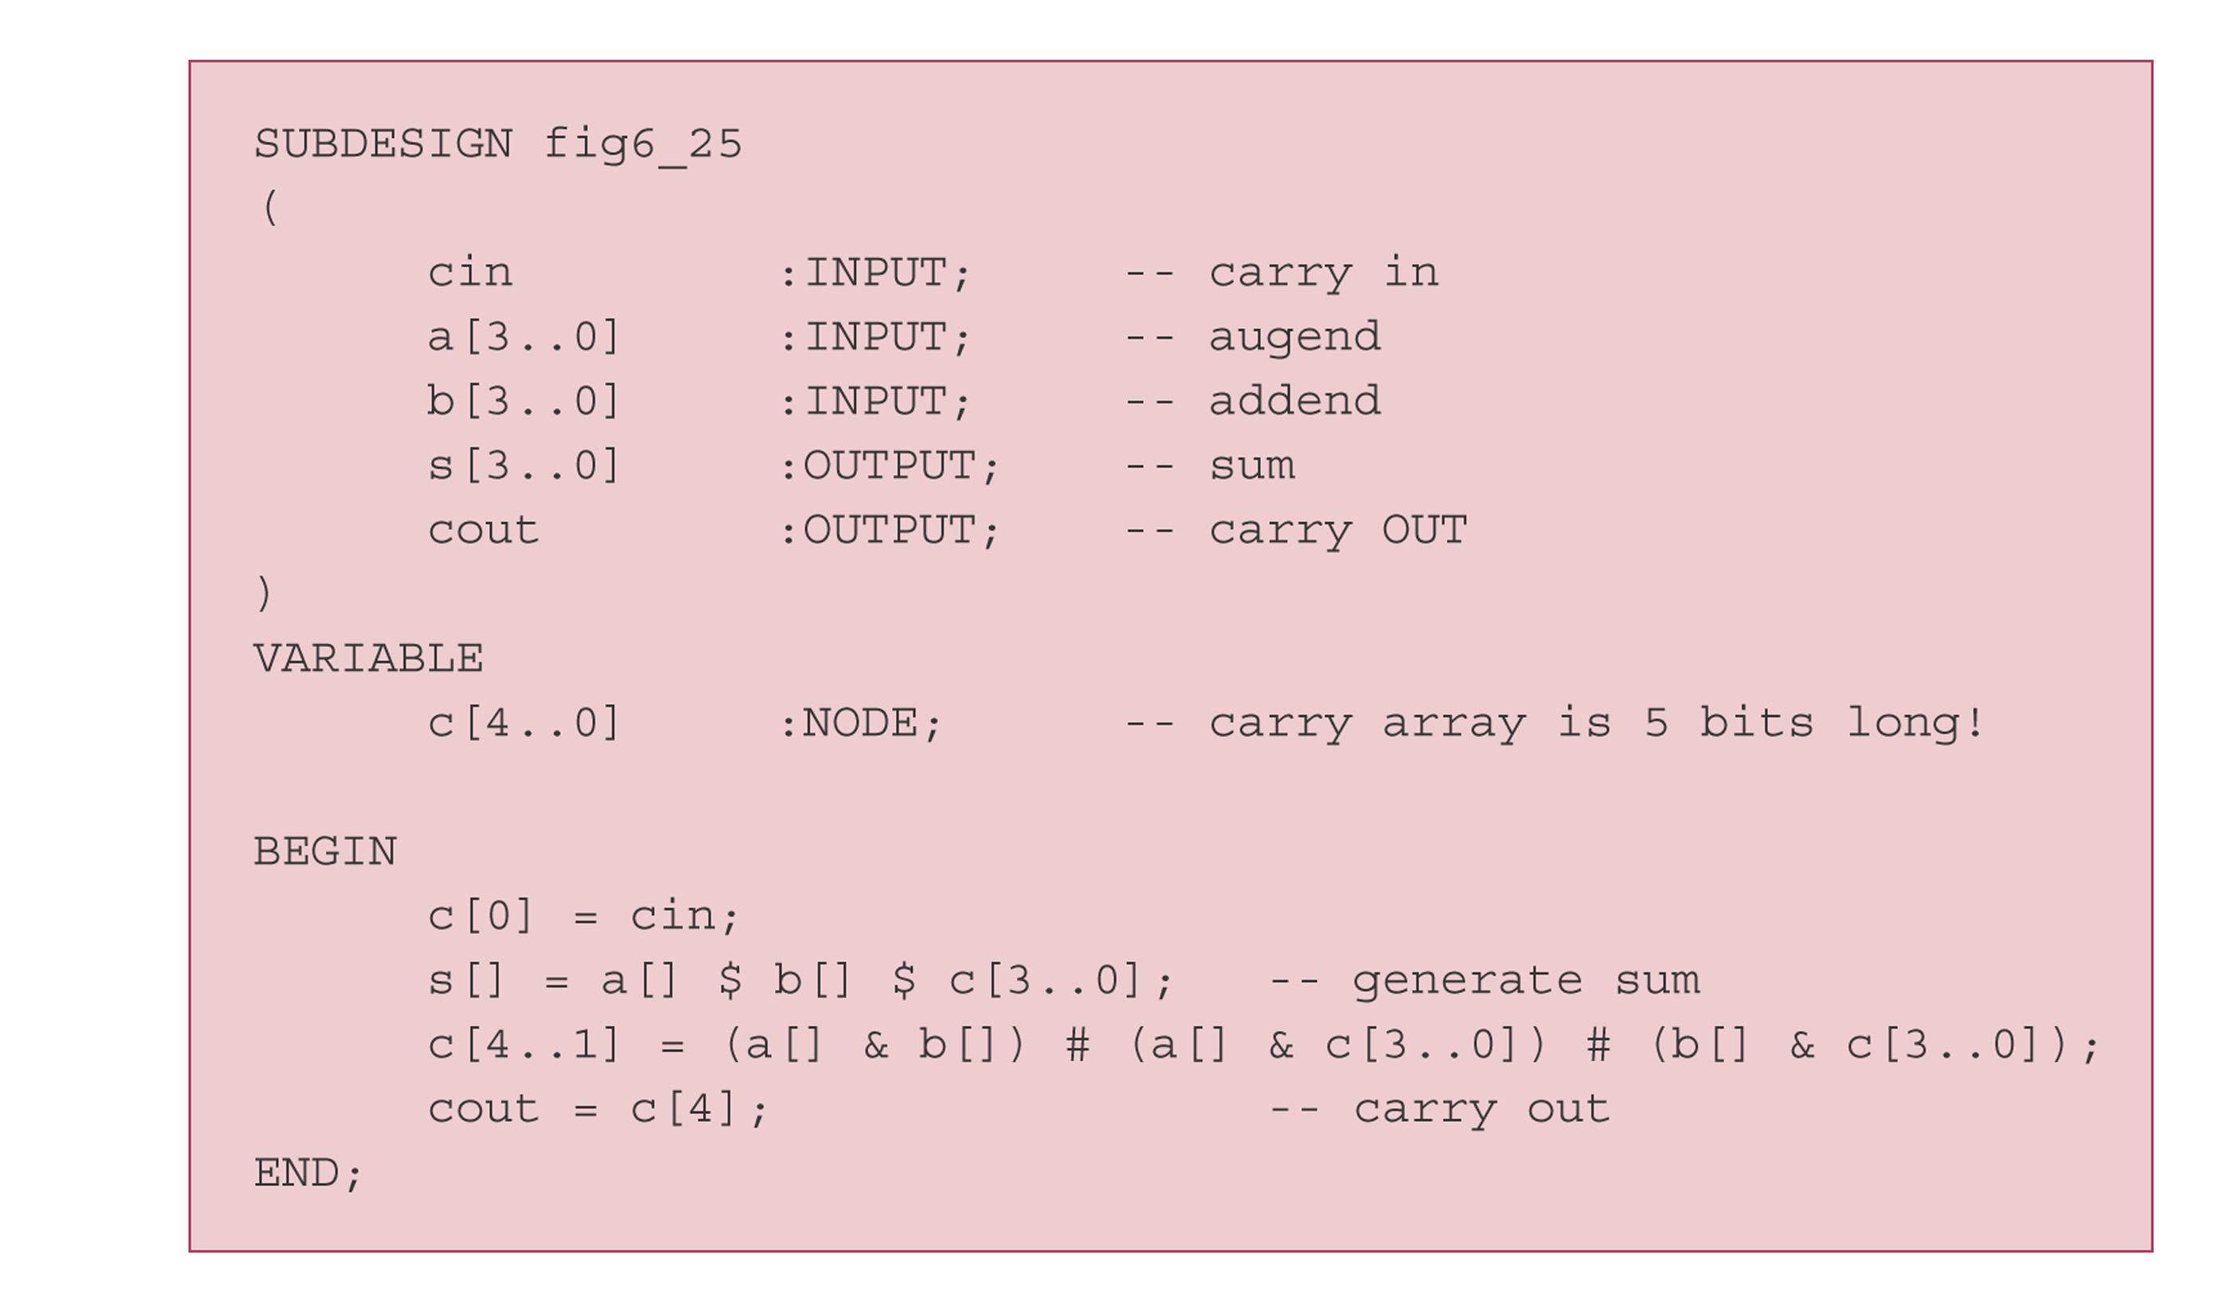
AHDL 4-bit Adder

Slide 10
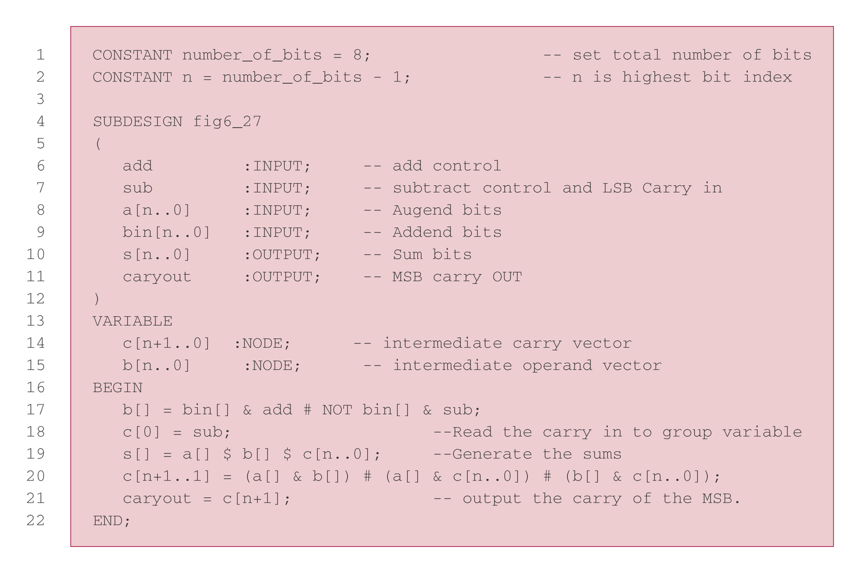
N-bit Adder/Subtractor

Slide 11
Library of Parameterized Modules
Megafunctions: include a library of parameterized modules (LPMs)
Offers a generic solution for the various types of logic circuits that are useful in digital systems.
Parameterized means that when you instantiate a function from the library, you are specify some parameters that define certain attributes for the circuit.
Example: LPM_ADD_SUB megafunction has a parameter LPM_WIDTH.

Slide 12
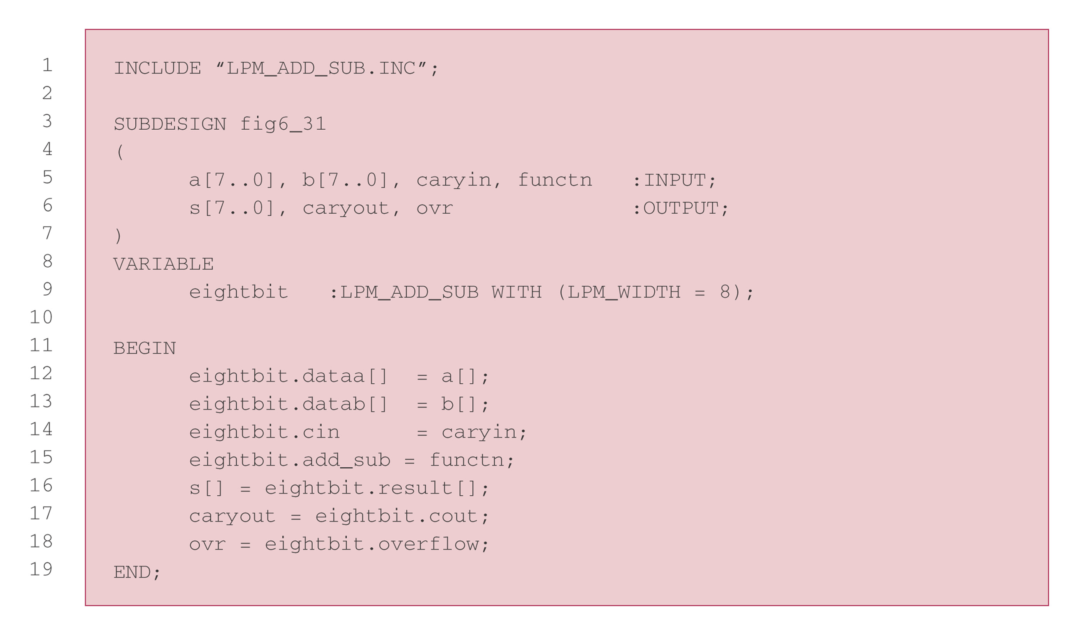
AHDL LPM Adder/Subtractor

Slide 13
Basic Counters in HDL
Counters are constructed with FFs.
In Chapter 5, we describe the FFs using AHDL.
Becomes too tedious if we have to use multiple FFs.
Describe circuits with a higher-level of abstraction.
Will consider synchronous counters only.

Slide 14
Synchronous Counter Design with D FF
Easier than using J-K FFs.
The NEXT state of the D FF is the same as its PRESENT D input values.
Example: Table 7-7

Slide 15
State Transition Description Methods
List the PRESENT state/NEXT state table.

Slide 16
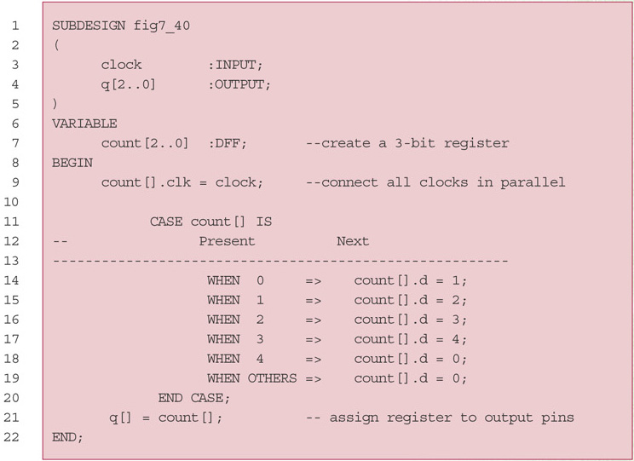
AHDL MOD-5 Counter

Slide 17
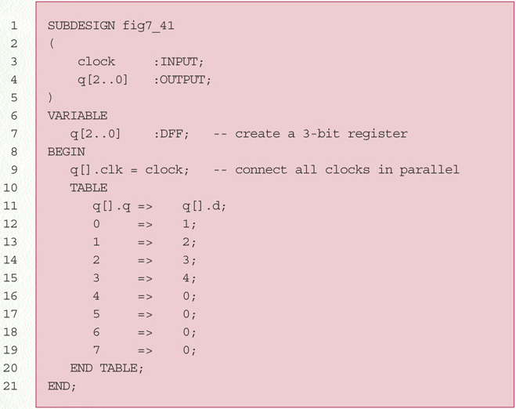
Another Version of MOD-5 Counter

Slide 18
Behavioral Description
The behavioral level of abstraction is a way to describe circuit by describing its behavior in terms very similar to the way you might describe its operation in English.
Deals more with the cause-and-effect relationship than with the path of data flow or wiring details.

Slide 19
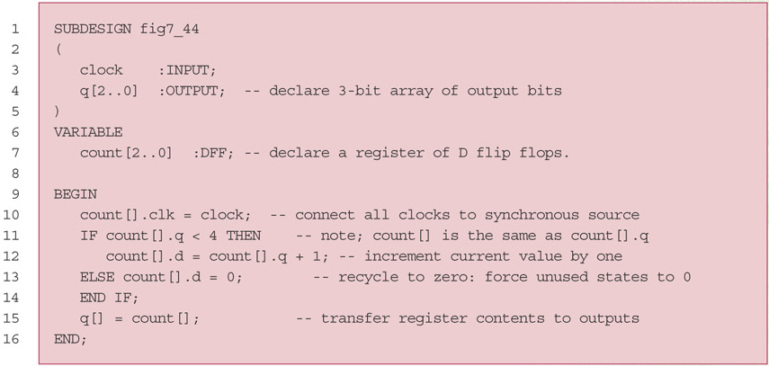
Behavioral Description of a Counter

Slide 20
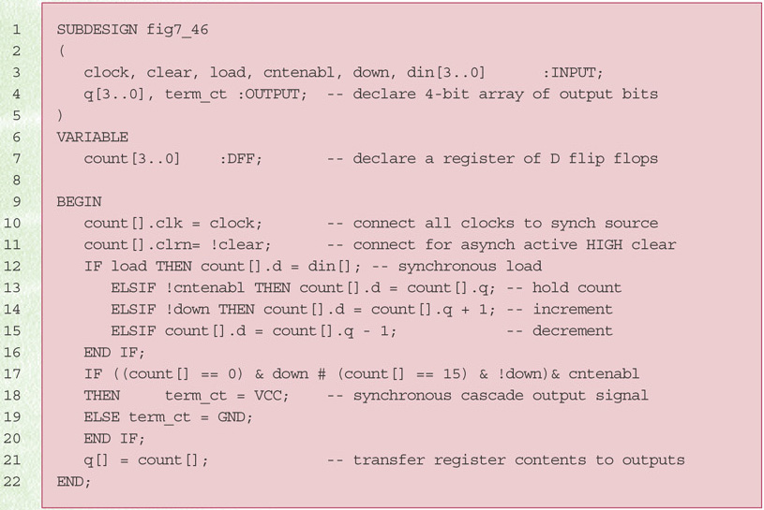
AHDL Full-Featured Counter

Slide 21
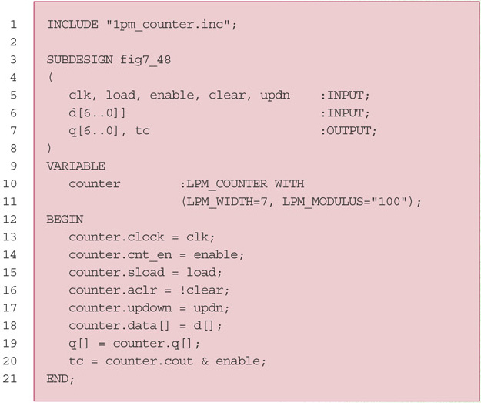
LPM Counters

Slide 22
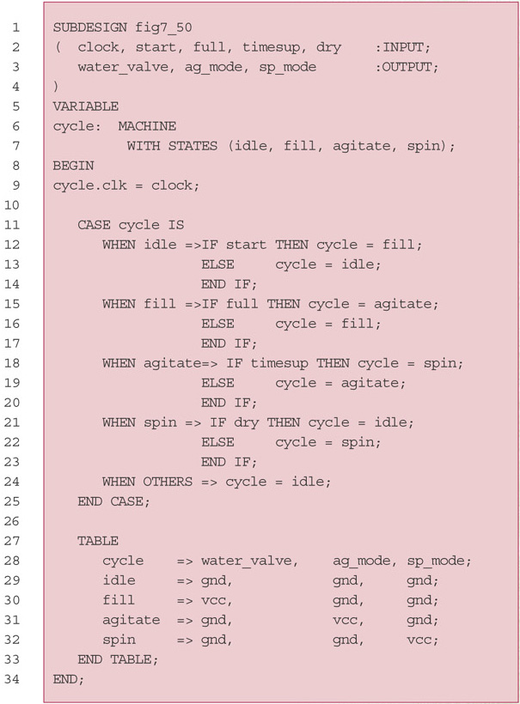
State Machines

Slide 23
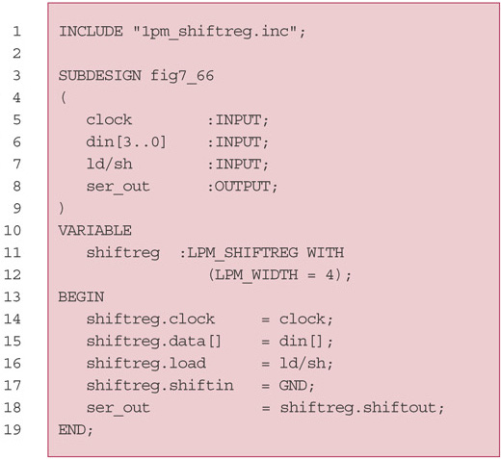
AHDL Registers

Slide 24
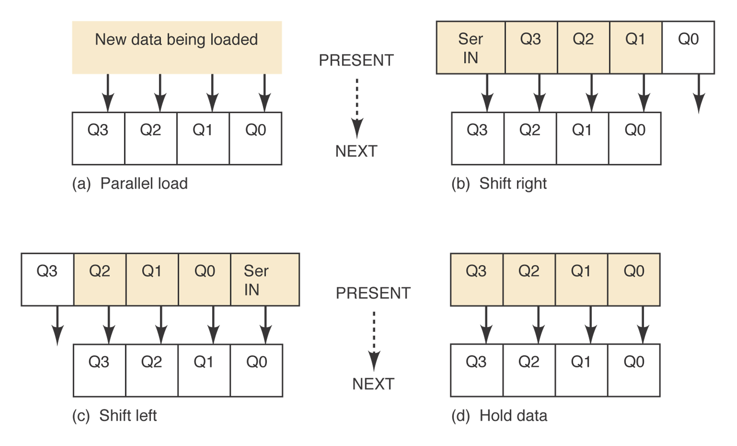
Data Transfers on Shift Registers

Slide 25
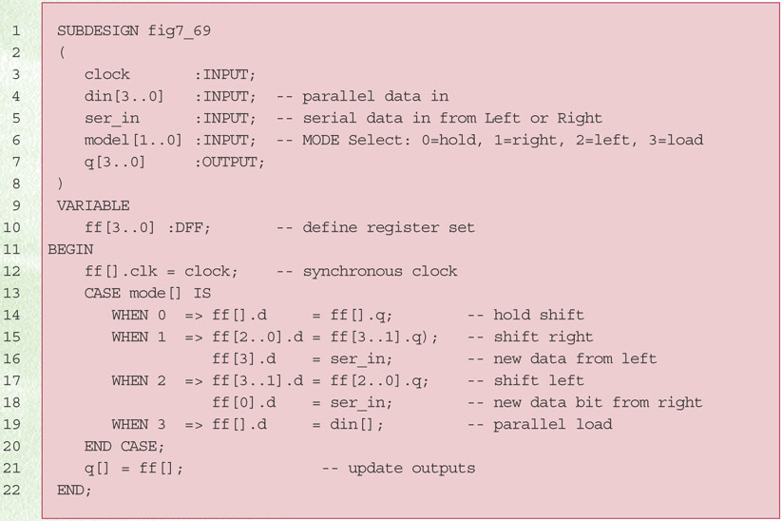
AHDL Bidirectional Shift Register

Slide 26
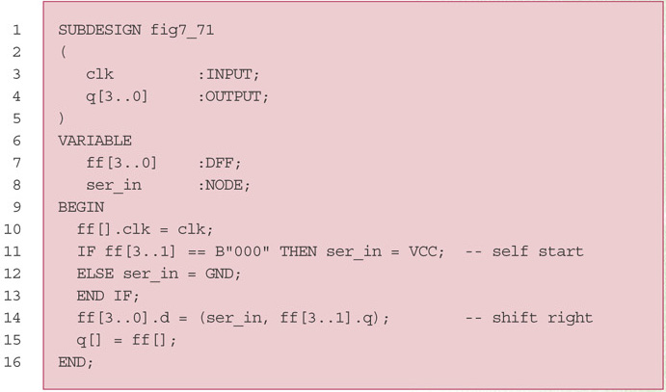
AHDL 4-Bit Ring Counter

Slide 27
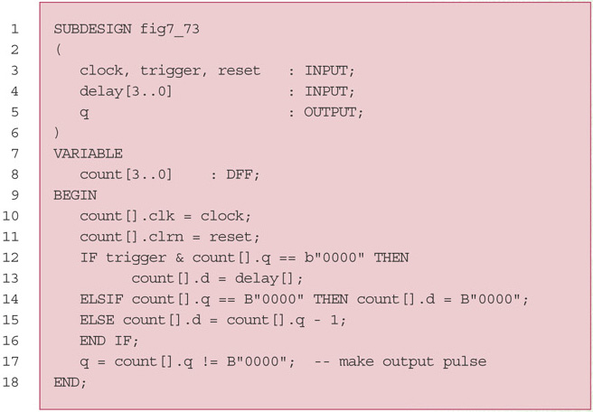
AHDL Nonretriggerable One-Shot

Slide 28
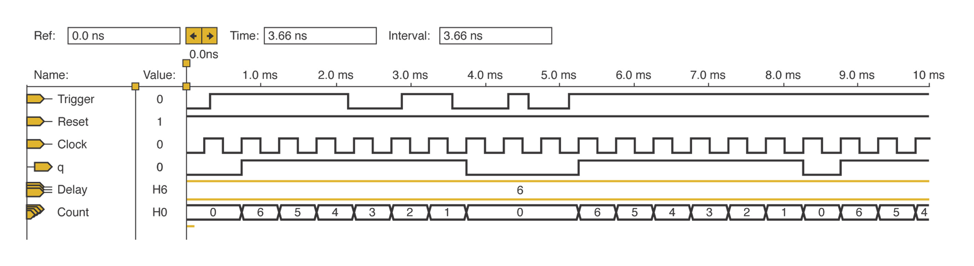
Simulation

Slide 29
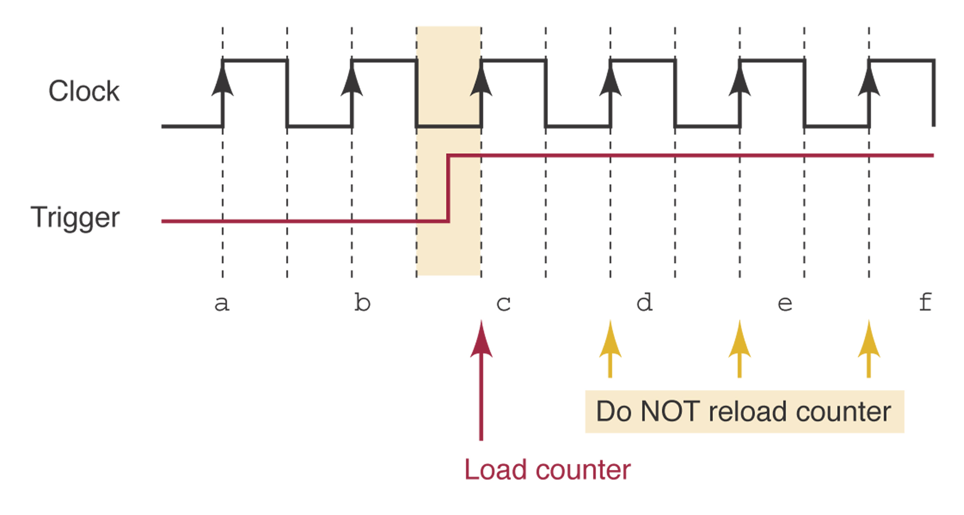
Detecting Edges

Slide 30
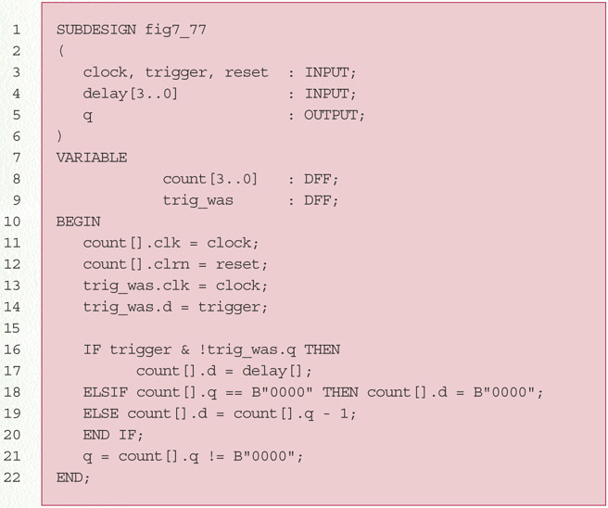
AHDL Retriggerable, Edge-Triggered One-Shot

