Slide 1
Digital Systems:
Digital IC Characteristics
Wen-Hung Liao, Ph.D.

Slide 2
Basic Characteristics of Digital ICs
Digital ICs are a collection of resistors, diodes and transistors fabricated on a single piece of semiconductor material called a substrate, which is commonly referred to as a chip.
The chip is enclosed in a package.
Actual silicon chip is much smaller than the protective package.
Dual-in-line package (DIP)

Slide 3
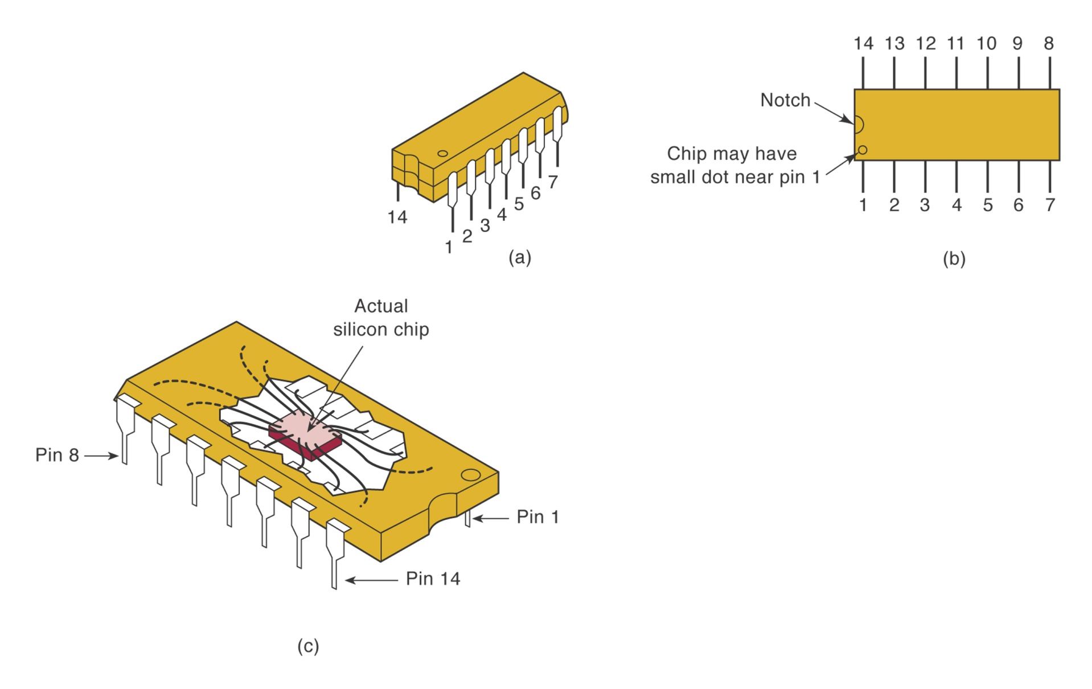
Dual-In-Line Package

Slide 4
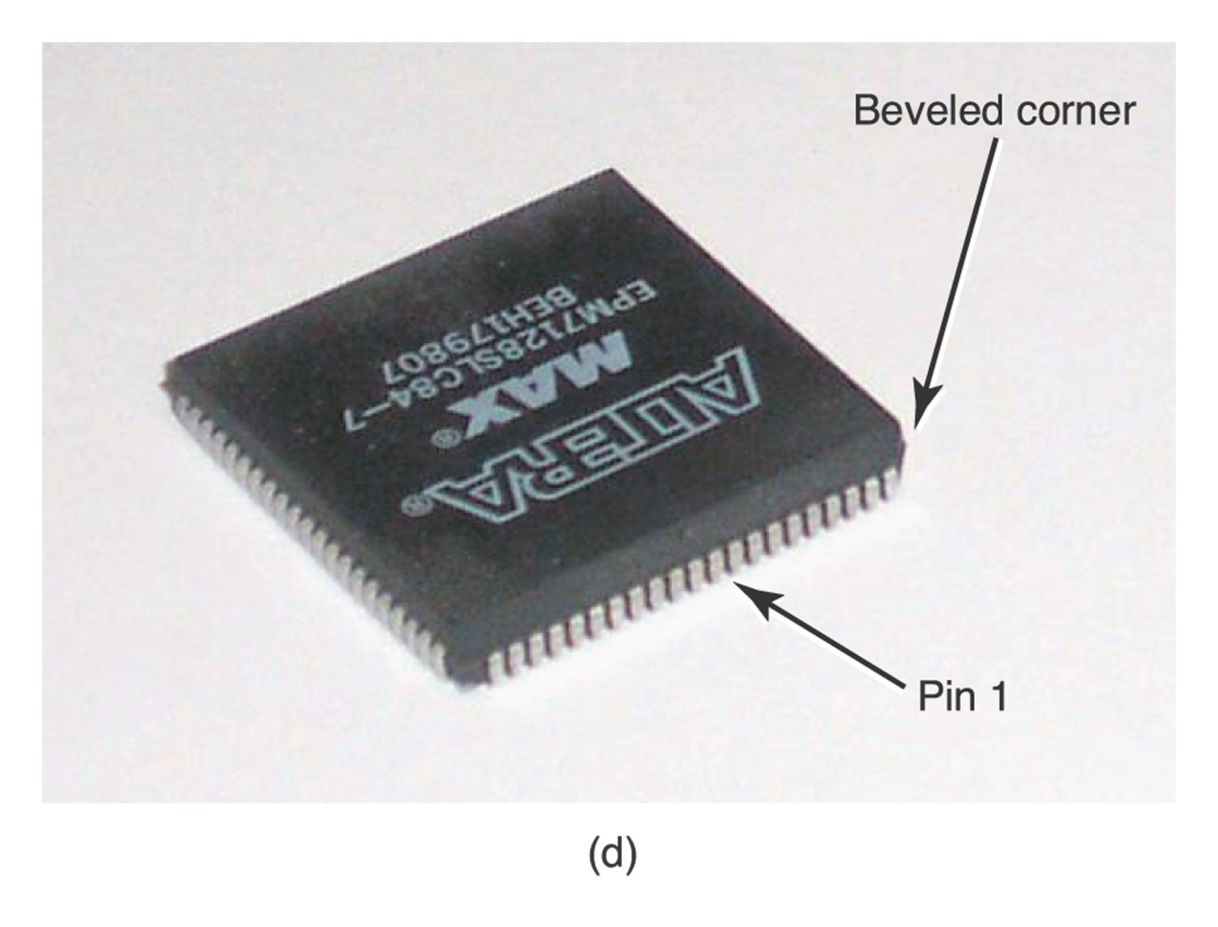
Plastic Leaded Chip Carrier Package

Slide 5
Integrated Circuits
Complexity | Number of Gates
Small-scale integration(SSI) | <12
Medium-scale integration(MSI) | 12 to 99
Large-scale integration(LSI) | 100 to 9999
Very large-scale integration(VLSI) | 10,000 to 99,999
Ultra large-scale integration(ULSI) | 100,000 to 999,999
Giga-scale integration (GSI) | 1,000,000 or more

Slide 6
Bipolar and Unipolar Digital ICs
Categorized according to the principal type of electronic component used in their circuitry.
Bipolar ICs are those that are made using the bipolar junction transistor (PNP or NPN).
Unipolar ICs are those that use the unipolar field-effect transistors (P-channel and N-channel MOSFETs).

Slide 7
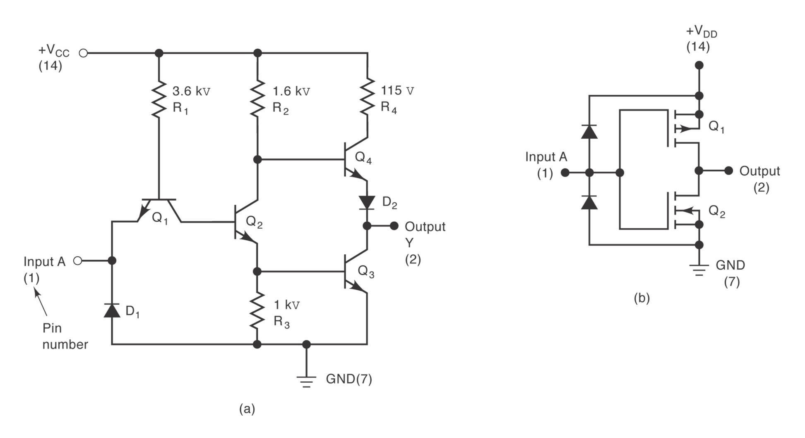
TTL and CMOS Inverters

Slide 8
IC Families
TTL Family: bipolar digital ICs (Table 4-6)
CMOS Family: unipolar digital ICs (Table 4-7)
TTL and CMOS dominate the field of SSI and MSI devices.

Slide 9
TTL Family (Table 4-6)
TTL Series | Prefix | Example IC
Standard TTL | 74 | 7404 (hex inverter)
Schottky TTL | 74S | 74S04
Low-power Schottky TTL | 74LS | 74LS04
Advanced Schottky TTL | 74AS | 74AS04
Advanced low-power Schottky TTL | 74ALS | 74ALS04

Slide 10
CMOS Family (Table 4-7)
CMOS Series | Prefix | Example IC
Metal-gate CMOS | 40 | 4001(Quad NOR)
Metal-gate, pin-compatible with TTL | 74C | 74C02
Silicon-gate, pin-compatible with TTL, high-speed | 74HC | 74HC02
Silicon-gate, high-speed, pin-compatible and electrically compatible with TTL | 74HCT | 74HCT02
Advanced-performance CMOS, not pin or electrically compatible with TTL | 74AC | 74AC02
Advanced-performance CMOS, not pin but electrically compatible with TTL | 74ACT | 74ACT02

Slide 11
Power and Ground
To use digital IC, it is necessary to make proper connection to the IC pins.
Power: labeled V_{cc} for the TTL circuit, labeled V_{DD} for CMOS circuit.
Ground

Slide 12
Logic-level Voltage Ranges
For TTL devices, V_{CC} is normally 5V.
For CMOS circuits, V_{DD} can range from 3-18V. (Many newer CMOS ICs have power compatible with that of TTL, i.e., V_{DD}=5V)
For TTL, logic 0 : 0-0.8V, logic 1:2-5V
For CMOS, logic 0 : 0-1.5V, logic 1:3.5-5V

Slide 13
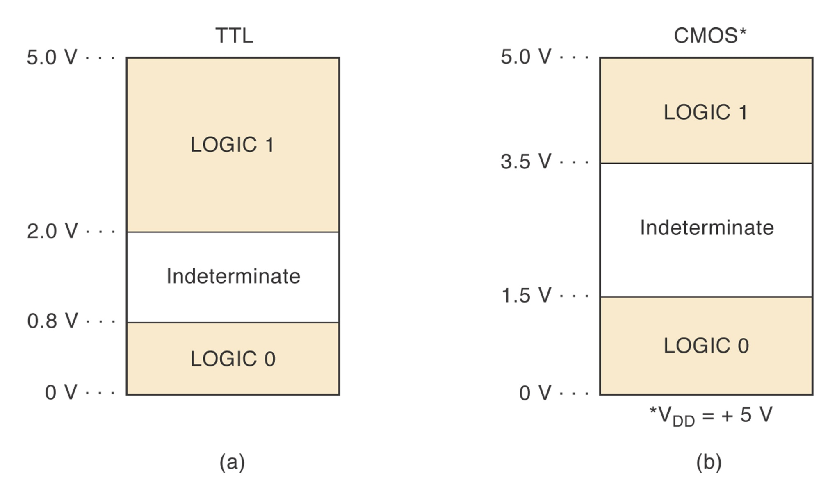
Logic Level Input Voltage Ranges

Slide 14
Unconnected Inputs
Also called floating inputs.
A floating TTL input acts like a logic 1, but measures a DC level of between 1.4 and 1.8V.
A CMOS input cannot be left floating.

Slide 15
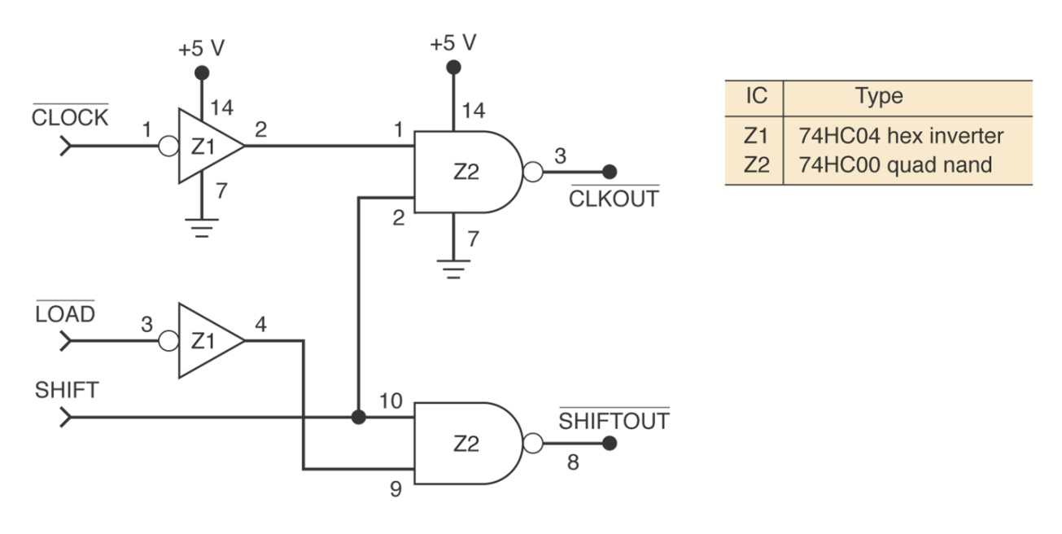
Logic-Circuit Connection Diagrams
A connection diagram shows all electrical connections, pin numbers, IC numbers, component values, signal names, and power supply voltages.
See Figure 4-32.

Slide 16
Troubleshooting Digital Systems
Fault detection
Fault isolation
Fault correction
Good troubleshooting techniques can be learned only through experimentation and actual troubleshooting of faulty circuits.

Slide 17
Troubleshooting Tools
Logic probe
Oscilloscope
Logic pulser
Current tracer
… and your
BRAIN!
LEDS |  |  | Logic Level
Red | Green | Yellow
OFF | ON | OFF | LOW
ON | OFF | OFF | HIGH
OFF | OFF | OFF | INTERMEDIATE
x | x | FLASHING | PULSING

Slide 18
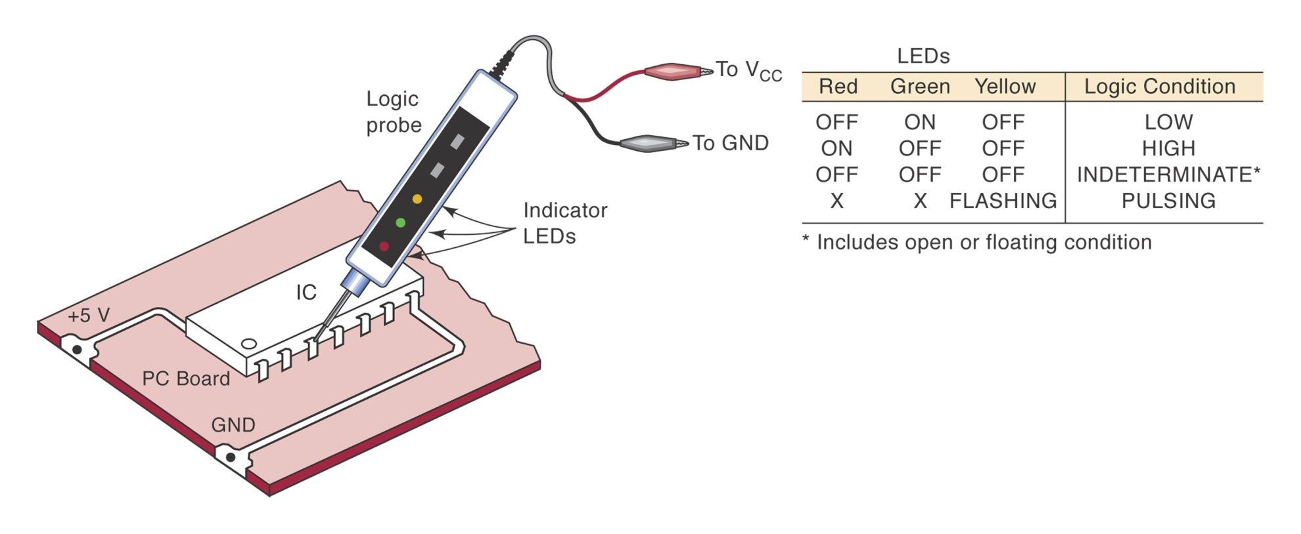
Logic Probe

Slide 19
Internal IC Faults
Malfunction in the internal circuitry.
Inputs or outputs shorted to ground or V_{cc} (Figure 4.35(a)-(d))
Inputs or outputs open-circuited (Figure 4.37)
Short between two pins (other than ground or V_{cc}): whenever two signals that are supposed to be different show the same logic-level variations. (Figure 4.39)

Slide 20
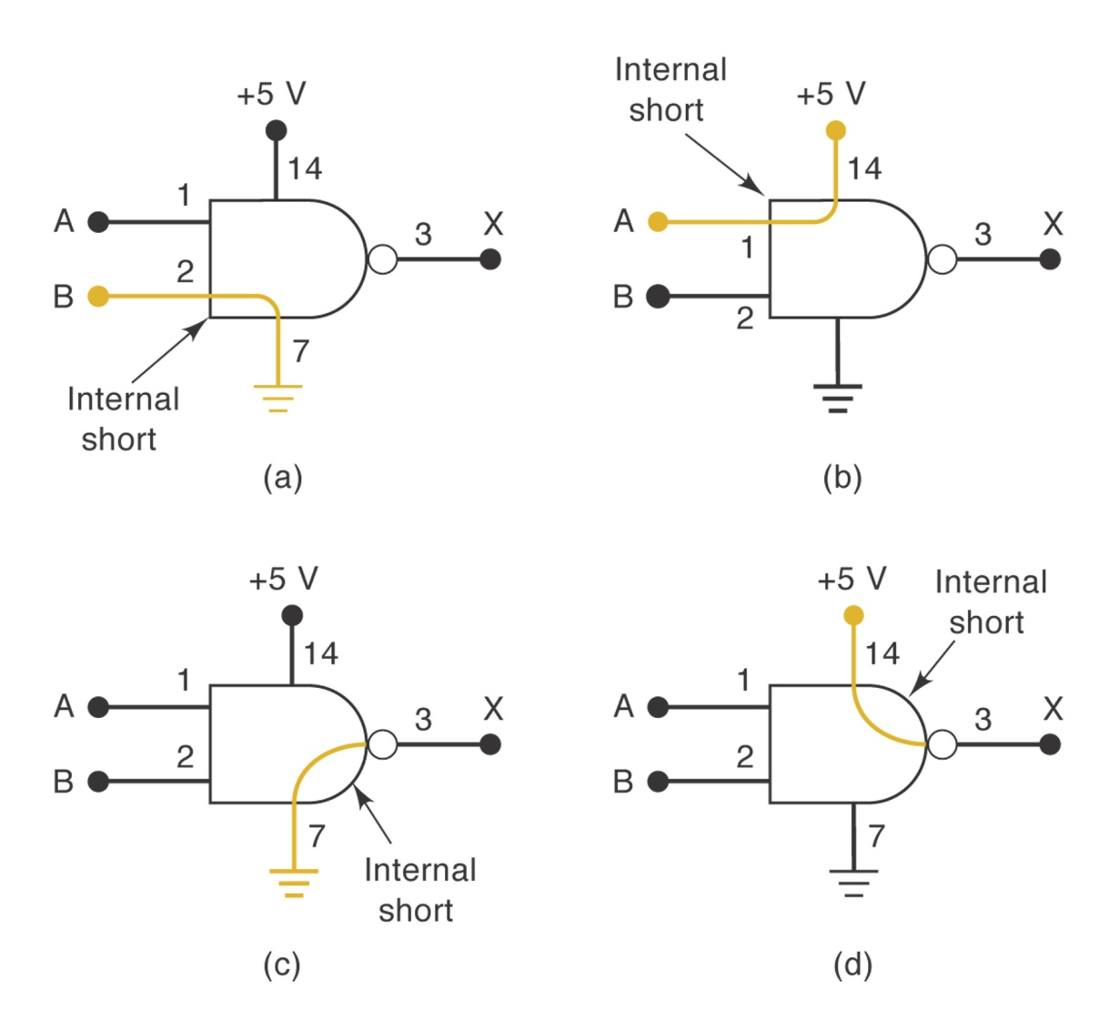
FIGURE 4-35
(a) IC input internally shorted to ground; (b) IC input internally shorted to supply voltage. These two types of failures force the input signal at the shorted pin to stay in the same state. (c) IC output internally shorted to ground; (d) output internally shorted to supply voltage. These two failures do not affect signals at the IC inputs.

Slide 21
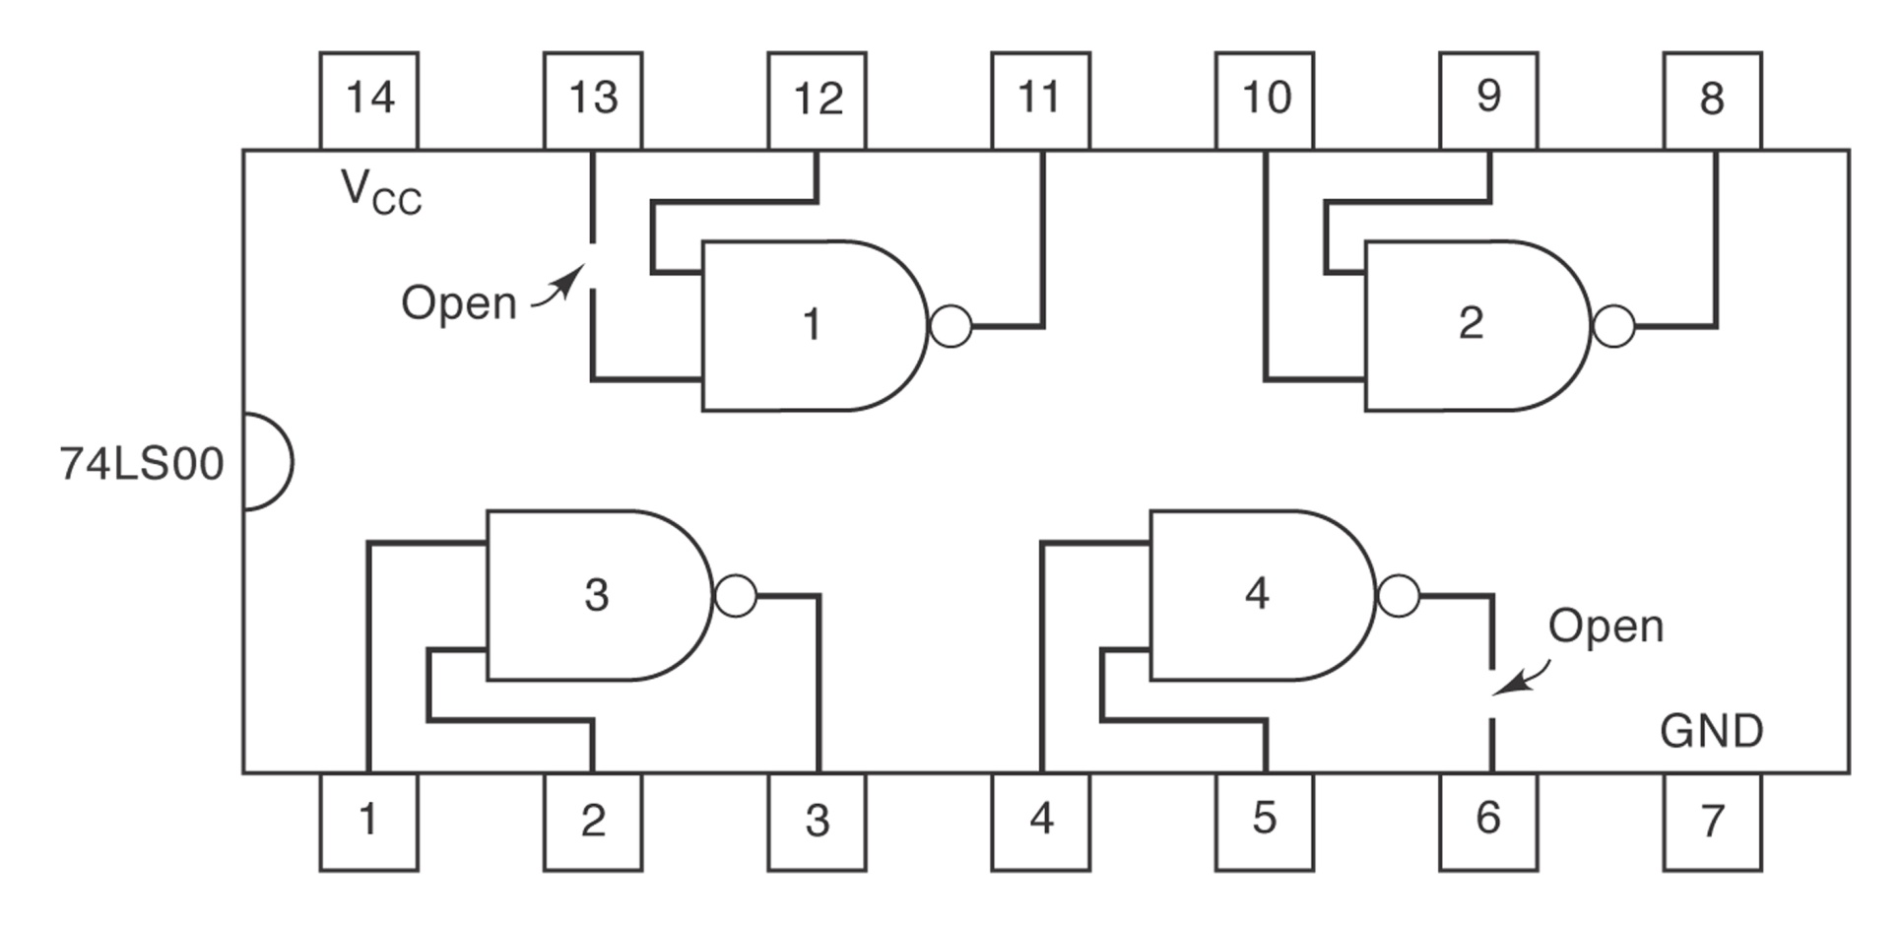
Figure 4.37
Inputs or outputs open-circuited

Slide 22
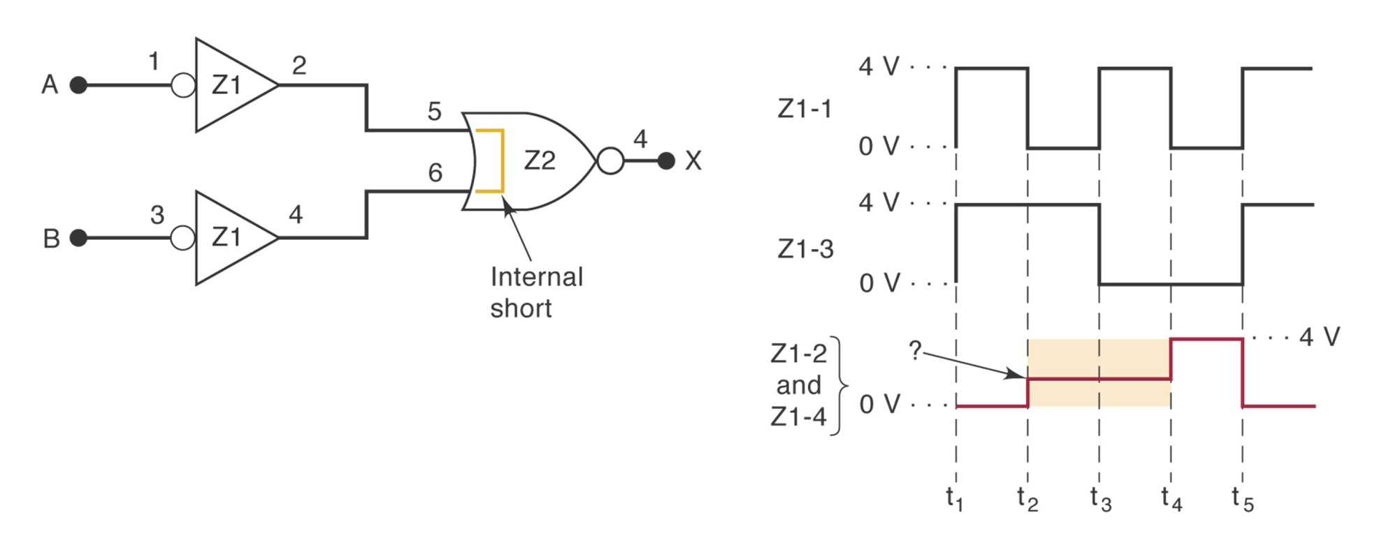
Figure 4.39
When two input pins are internally shorted, the signals driving these pins are forced to be identical, and usually a signal with three distinct levels results.

Slide 23
External Faults
Open signal lines: Broken wire, Poor solder connection, Crack or cut trace on a printed circuit board, Bend or broken pin on a IC, faulty IC socket.
Shorted signal lines: sloppy wiring, solder bridges, incomplete etching.
Faulty power supply
Output loading: when an output is connected to too many IC inputs.

