Slide 1
Counters and Registers
Wen-Hung Liao, Ph.D.

Slide 2
Objectives
Understand several types of schemes used to decode different types of counters.
Anticipate and eliminate the effects of decoding glitches.
Compare the major differences between ring and Johnson counters.
Analyze the operation of a frequency counter and of a digital clock.
Recognize and understand the operation of various types of IC registers.

Slide 3
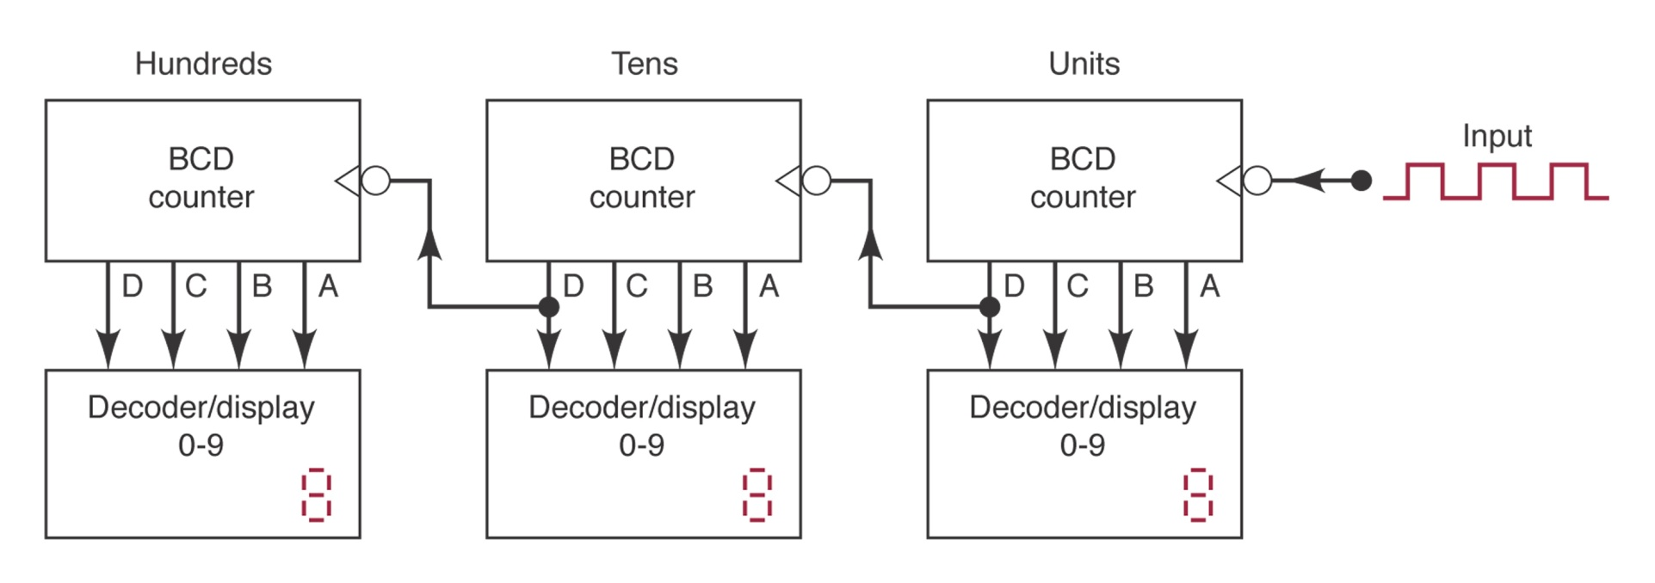
Cascading BCD Counters
Figure 7-32: a multistage arrangement that counts from 000 to 999.
How does it work?

Slide 4
Synchronous Counter Design
J-K flip-flop excitation table
Transition | Present State | Next State | J | K
0→0 | 0 | 0 | 0 | X
0→1 | 0 | 1 | 1 | X
1→0 | 1 | 0 | X | 1
1→1 | 1 | 1 | X | 0

Slide 5
Design Procedure
Step1: Determine the desire number of bits (FFs) and the desired counting sequence.
Step2: Draw the state transition diagram showing all possible states, including those that are not part of the desired counting sequence.
Step 3: Use the state-transition diagram to set up a table that lists all PRESENT states and their NEXT states.

Slide 6
Design Procedure (cont’d)
Step4: Add a column to the above table for each J and K input to produce a circuit excitation table.
Step 5: Design the logic circuits to generate the levels required at each J and K input.
Step 6: Implement the final expressions.

Slide 7
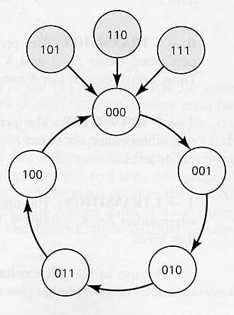
Example
MOD-5 synchronous counter
000→001→010→011→100→000→…
State transition diagram

Slide 8
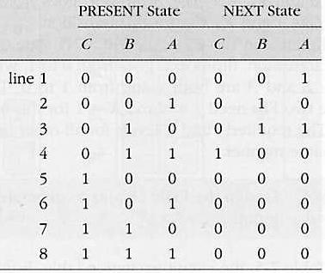
Present and Next States

Slide 9
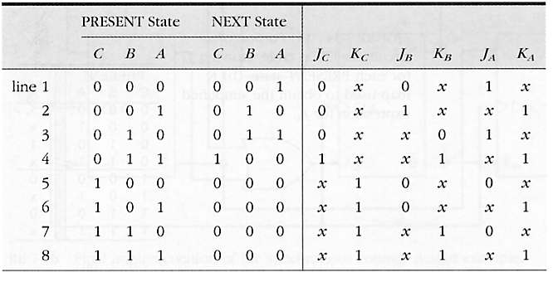
Circuit Excitation Table

Slide 10
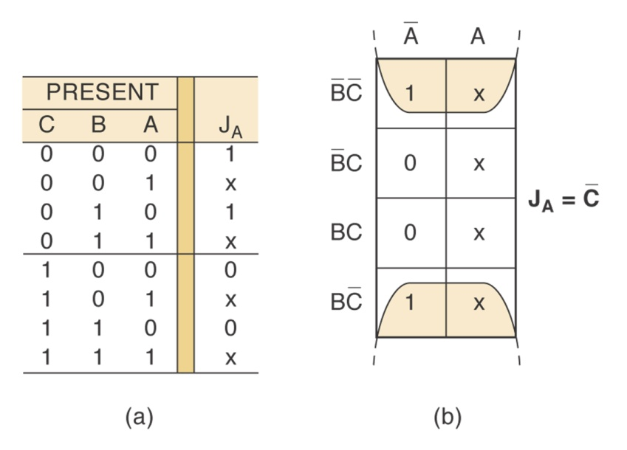
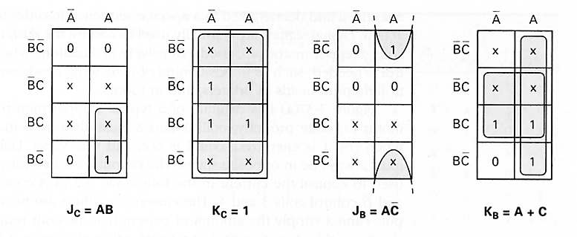
K-maps
J_{A}=C’, K_{A}=1 (Figure 7-27)

Slide 11
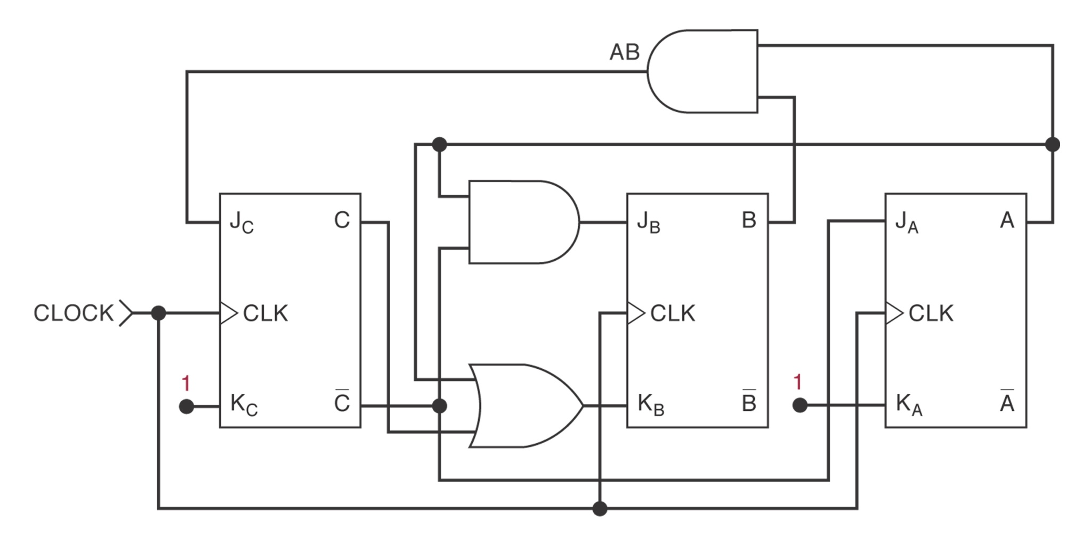
Final Implementation

Slide 12
Step Motor Control
A step motor is a motor that rotates in steps rather than in a continuous motion, typically 15 degrees per step.
Used in positioning of read/write heads on magnetic tapes, in controlling print heads…
Figure 7.30: CW rotation and CCW rotation.
Apply the design procedure to generate the circuit.

Slide 13
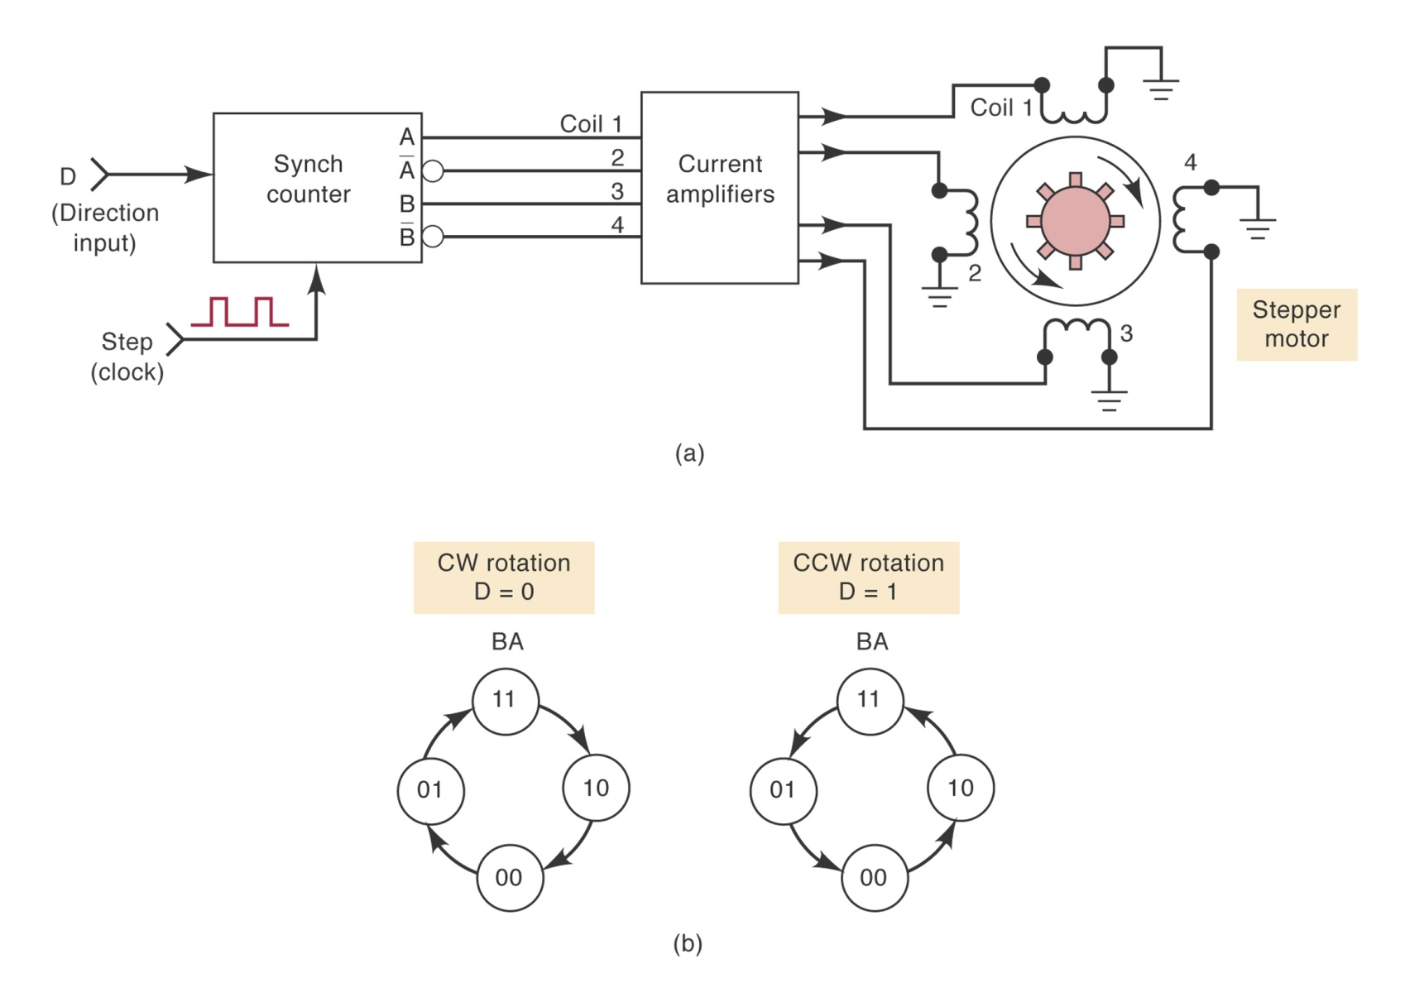
Step Motor Control (cont’d)

Slide 14
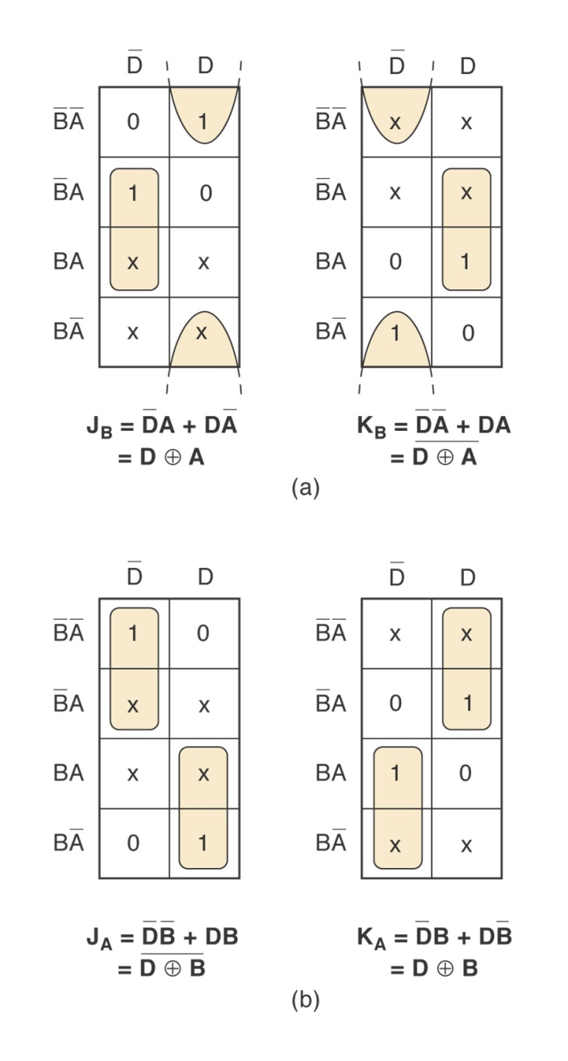
FIGURE 7-31 (a) K maps for J_{B} and K_{B}; (b) K maps for J_{A} and K_{A} .

Slide 15
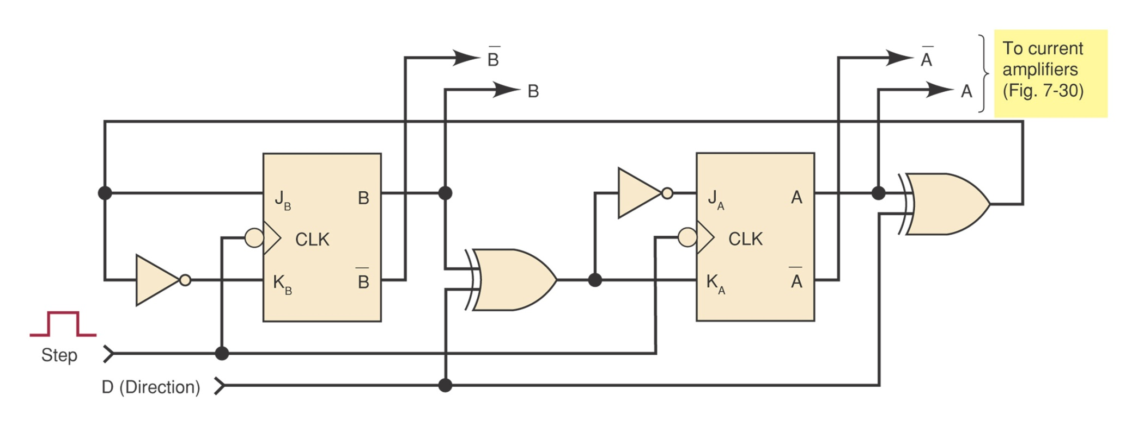
Final Implementation

Slide 16
Synchronous Counter Design with D FF
Easier than using J-K FF.
Steps 1-3 same as using J-K FF.
Step 4 is trivial since the necessary D inputs are the same as the desired NEXT state.
Step 5 is to generate the logic expressions from the PRESENT state/NEXT state table for D inputs.

Slide 17
MOD-5 Counter using D FF
PRESENT State |  |  | NEXT State |  |  | Control Inputs
C | B | A | C | B | A | D_{C} | D_{B} | D_{A}
0 | 0 | 0 | 0 | 0 | 1 | 0 | 0 | 1
0 | 0 | 1 | 0 | 1 | 0 | 0 | 1 | 0
0 | 1 | 0 | 0 | 1 | 1 | 0 | 1 | 1
0 | 1 | 1 | 1 | 0 | 0 | 1 | 0 | 0
1 | 0 | 0 | 0 | 0 | 0 | 0 | 0 | 0
1 | 0 | 1 | 0 | 0 | 0 | 0 | 0 | 0
1 | 1 | 0 | 0 | 0 | 0 | 0 | 0 | 0
1 | 1 | 1 | 0 | 0 | 0 | 0 | 0 | 0
D_{C}= C’BA, D_{B}=C’B’A+C’BA’, D_{C}=C’B’A’+C’BA’=C’A’

Slide 18
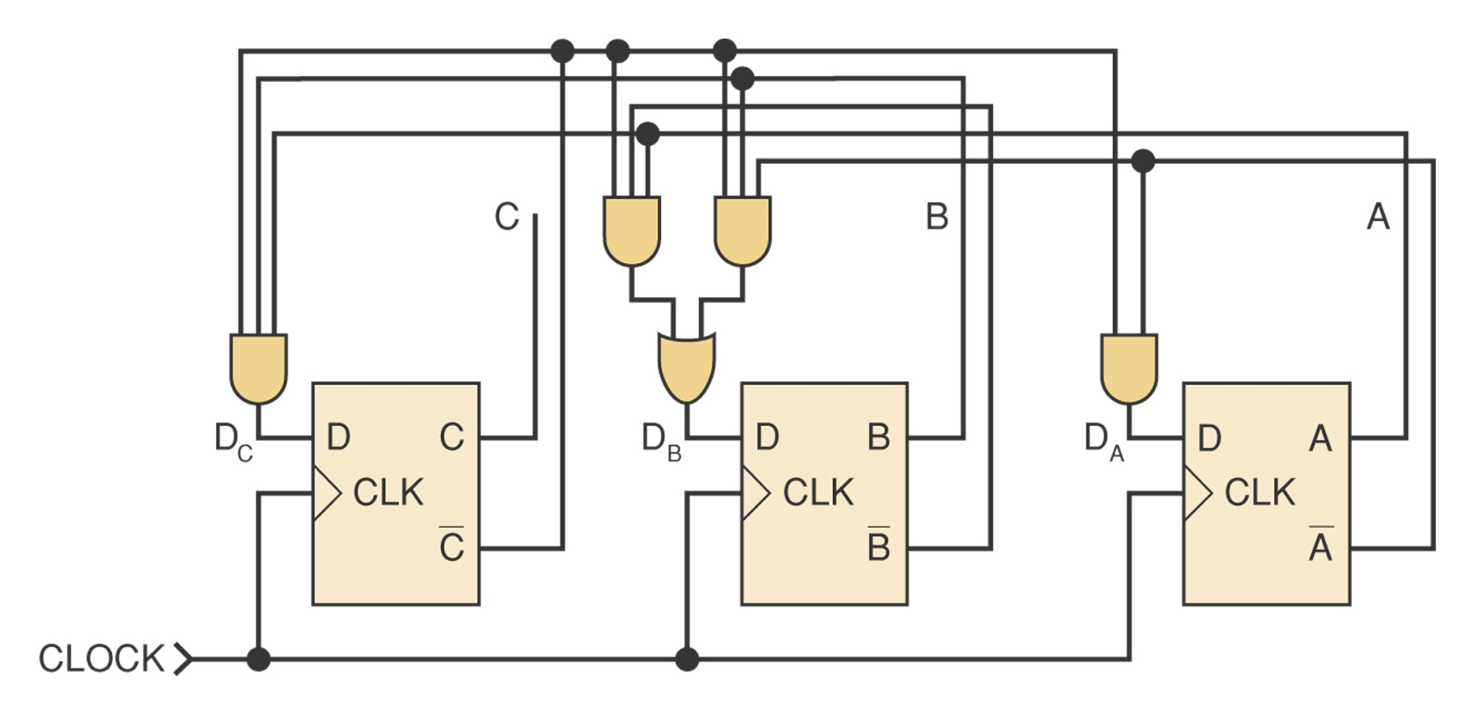
MOD-5 Counter

Slide 19
Basic Counters using HDL
Will discuss this part later.

Slide 20
Integrated-Circuit Registers
Parallel in/Parallel Out (PIPO): 74174 and 74178
Serial in/Serial Out (SISO): 4731B
Parallel in/Serial Out (PISO):74165,74LS165,74HC165
Serial in/Parallel Out (SIPO): 74164,74LS164,74HC164

Slide 21
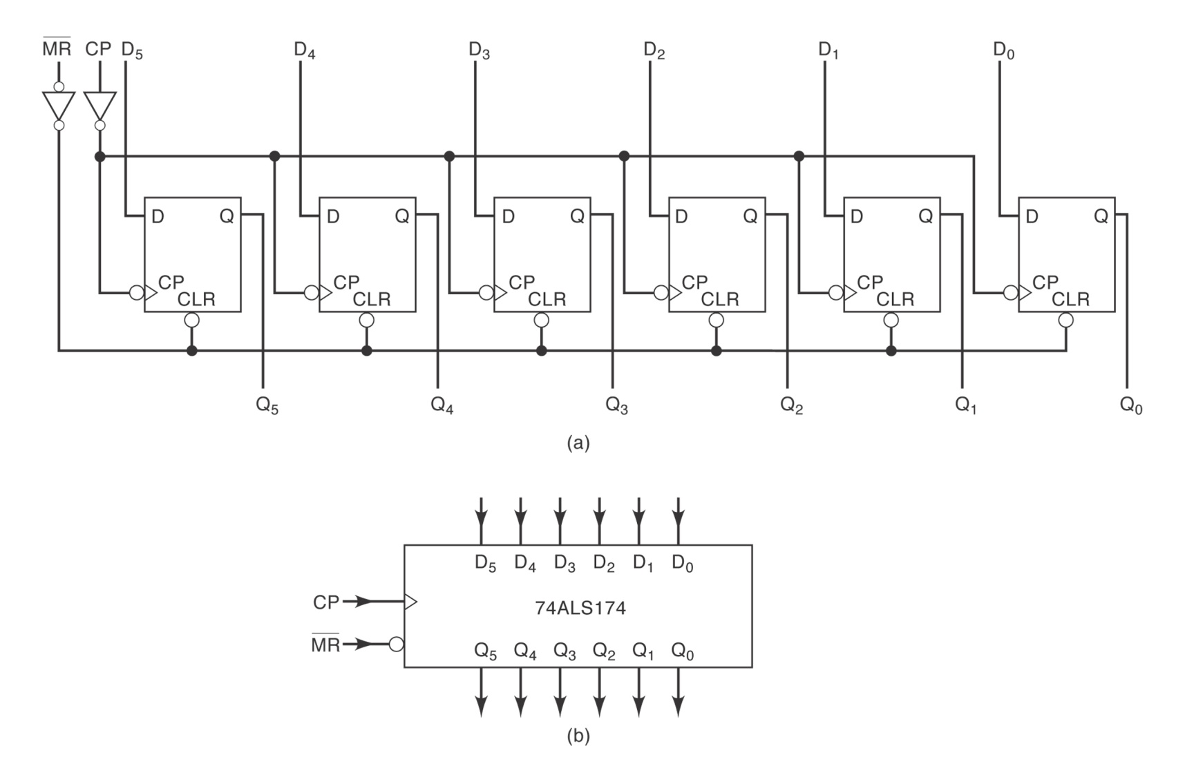
PIPO Register (Fig. 7-62)

Slide 22
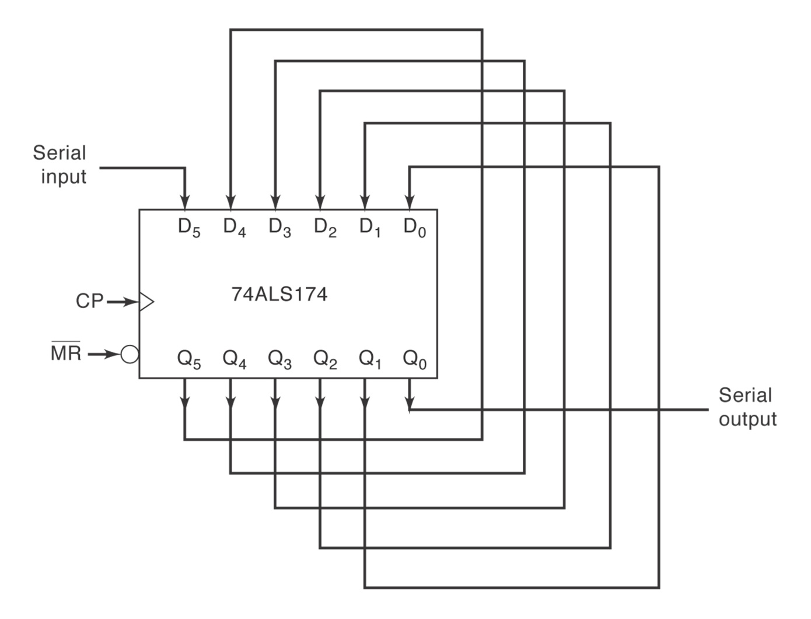
74ALS174 Wired as a Shift Register (Fig. 7-63)

Slide 23
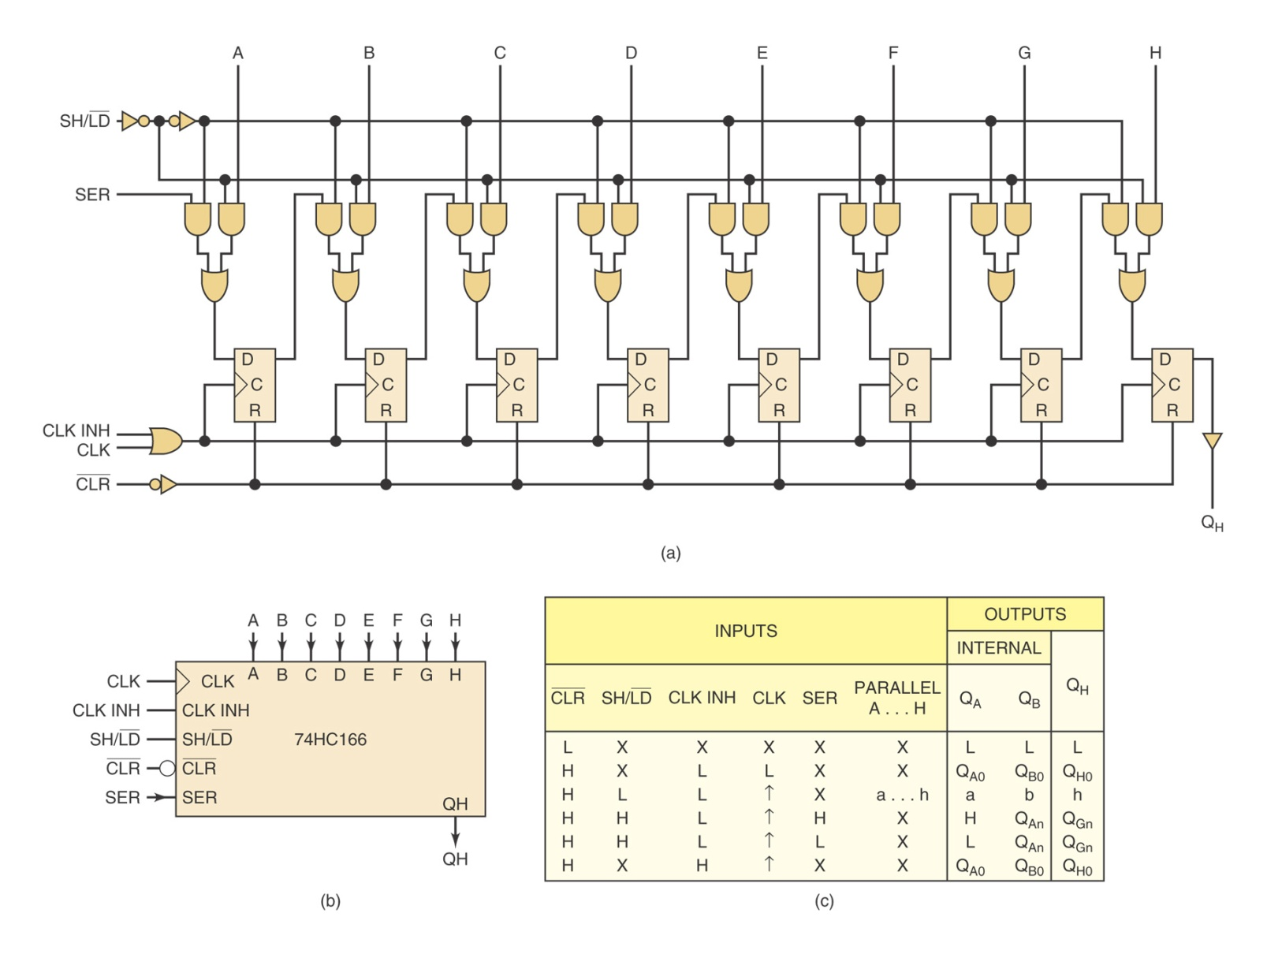
SISO Register (74HC166)

Slide 24
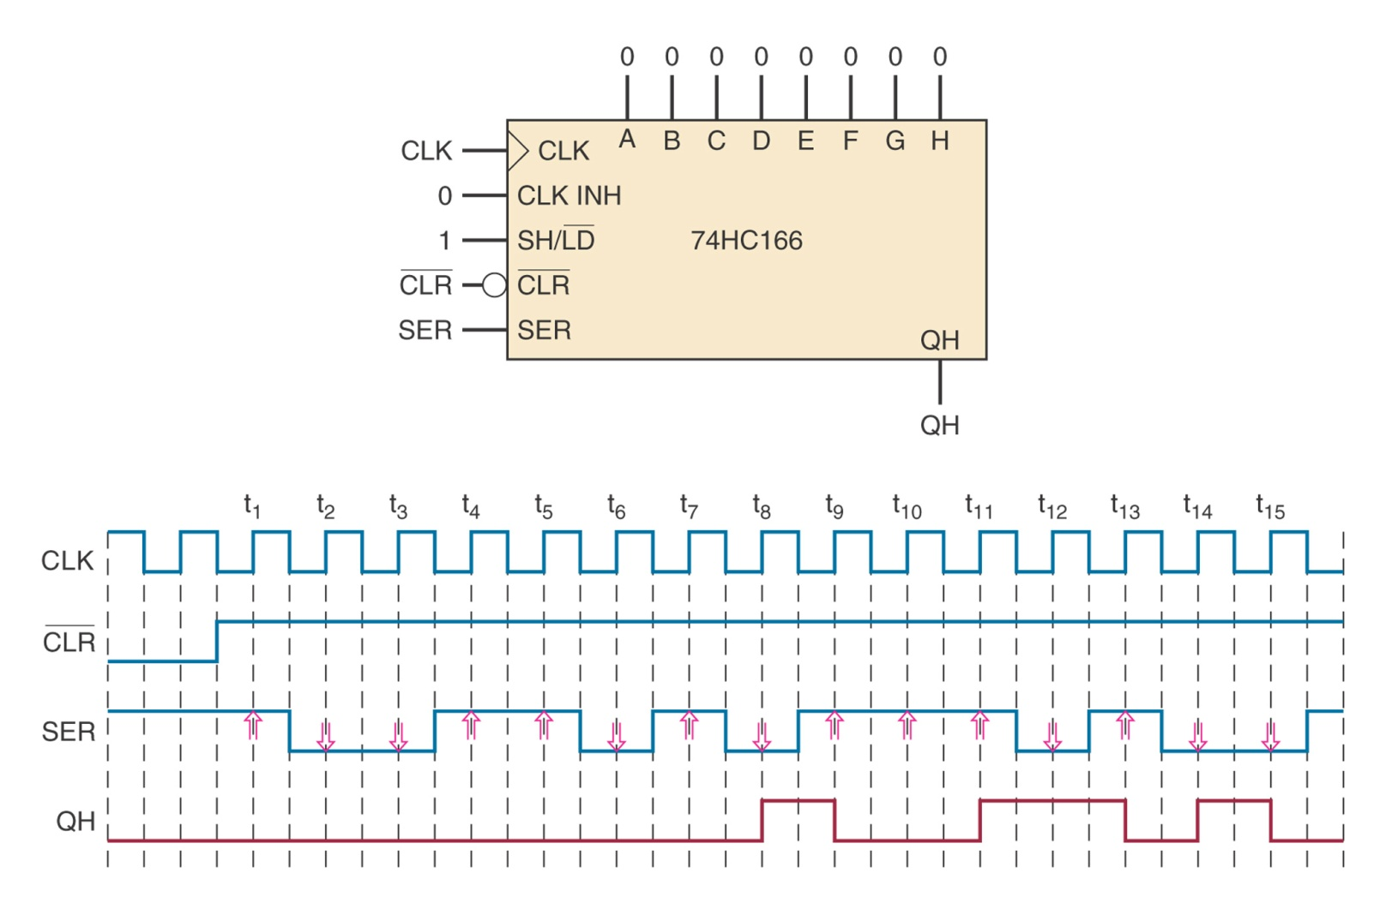
Example 7-18

Slide 25
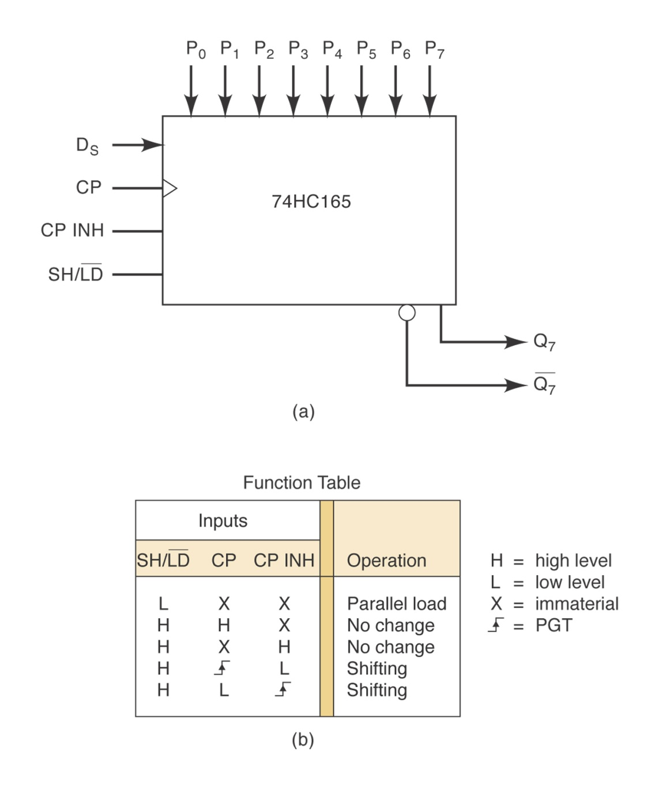
PISO Register

Slide 26
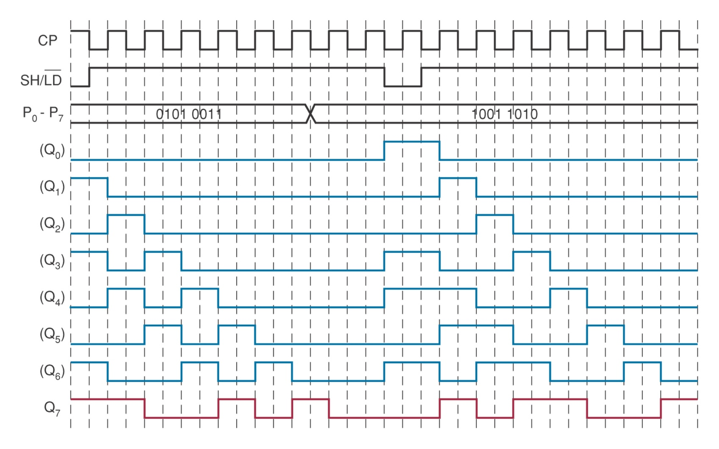
Example 7-20

Slide 27
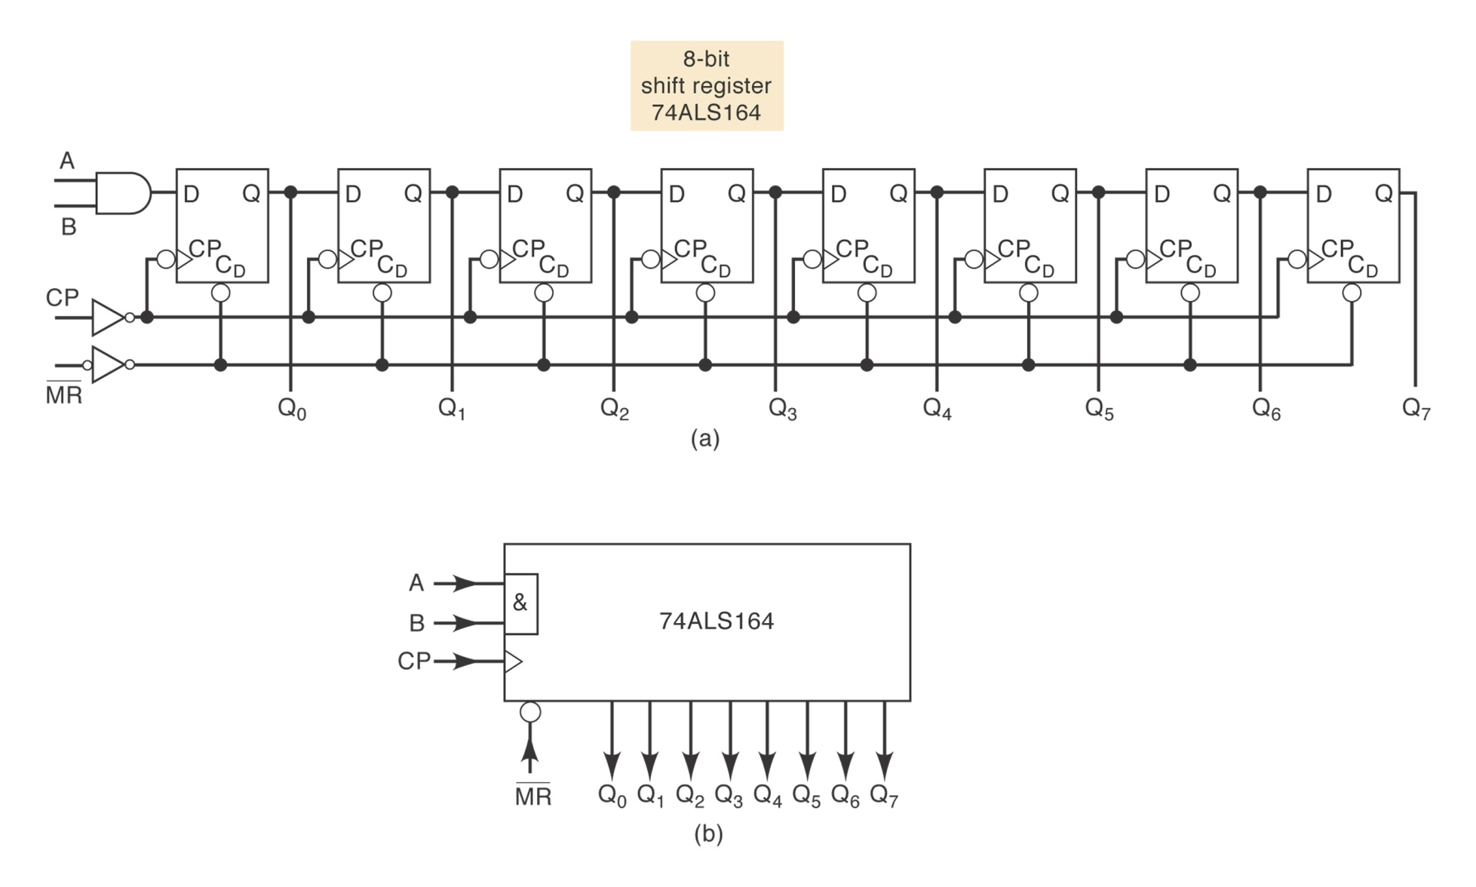
SIPO Register

Slide 28
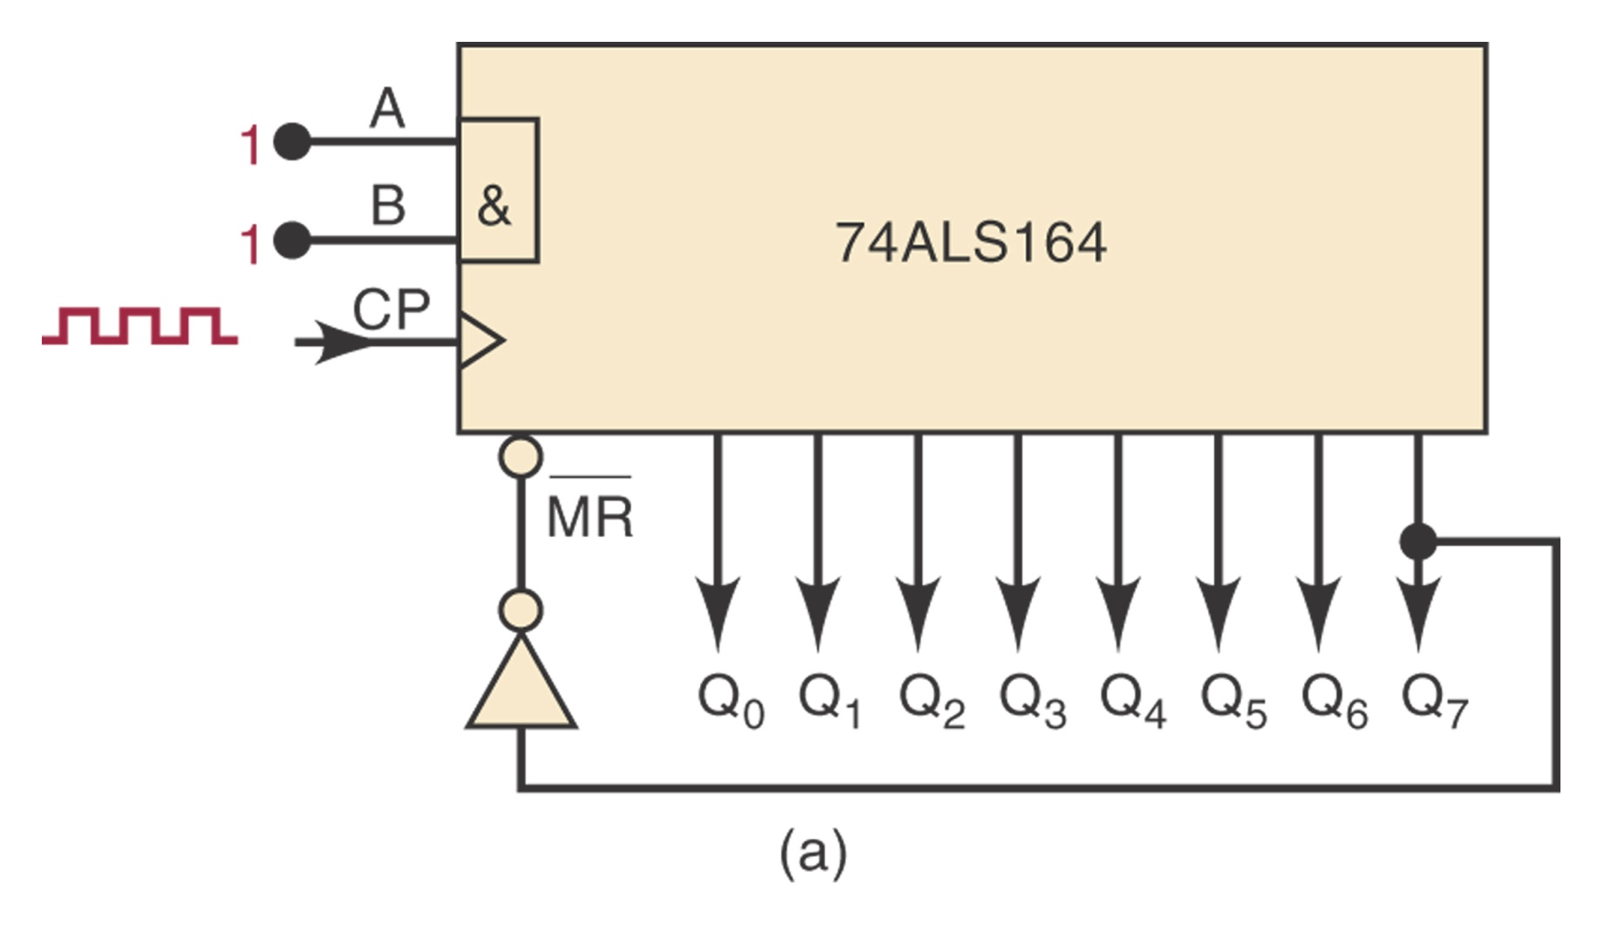
Example 7-21

Slide 29
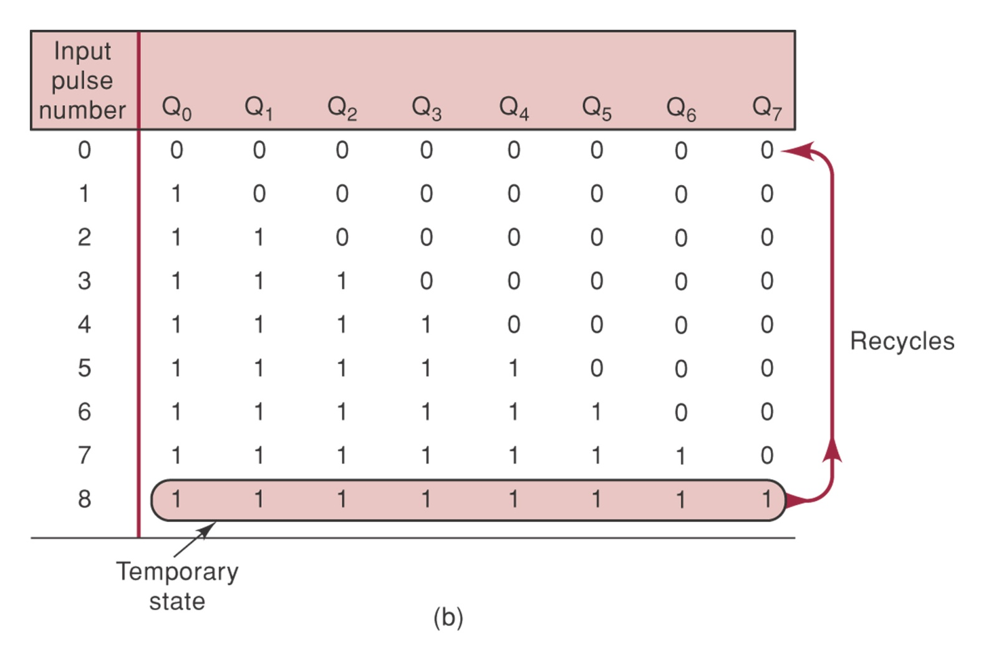
Example 7-21: Solution

Slide 30
Shift-Register Counters
Use feedback, output of last FF is connected back to the first FF in some way.
Ring counter: circulating shift register.
See Figure 7-70.
Why is it still a counter?

Slide 31
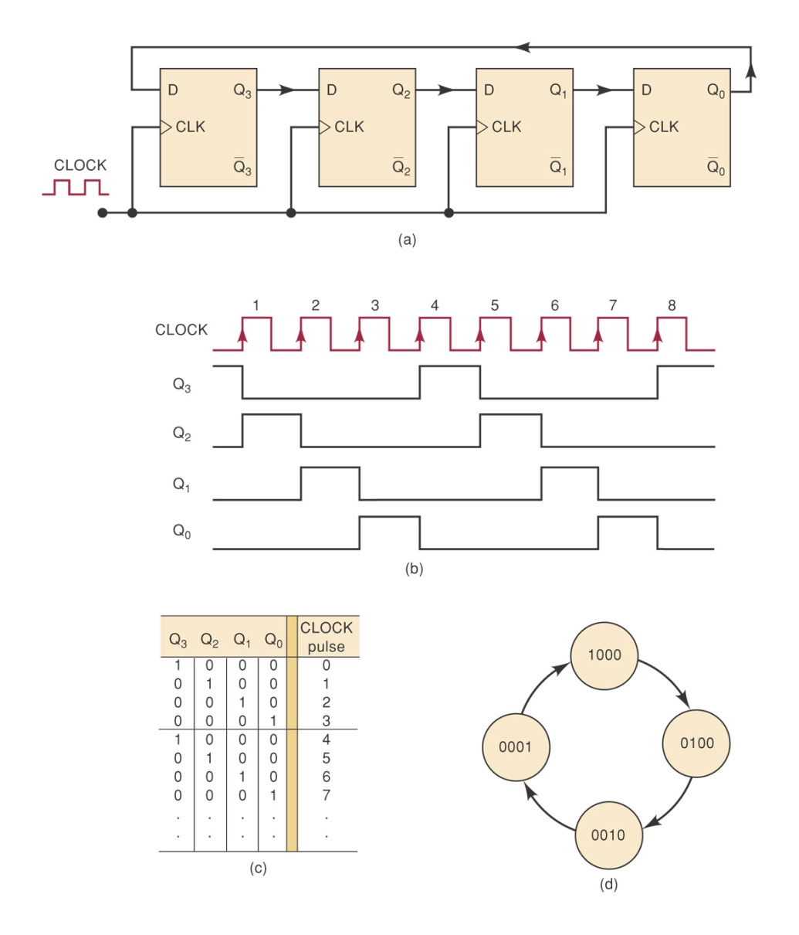
Four-Bit Ring Counter
MOD-4 Counter
Does not require decoding gates

Slide 32
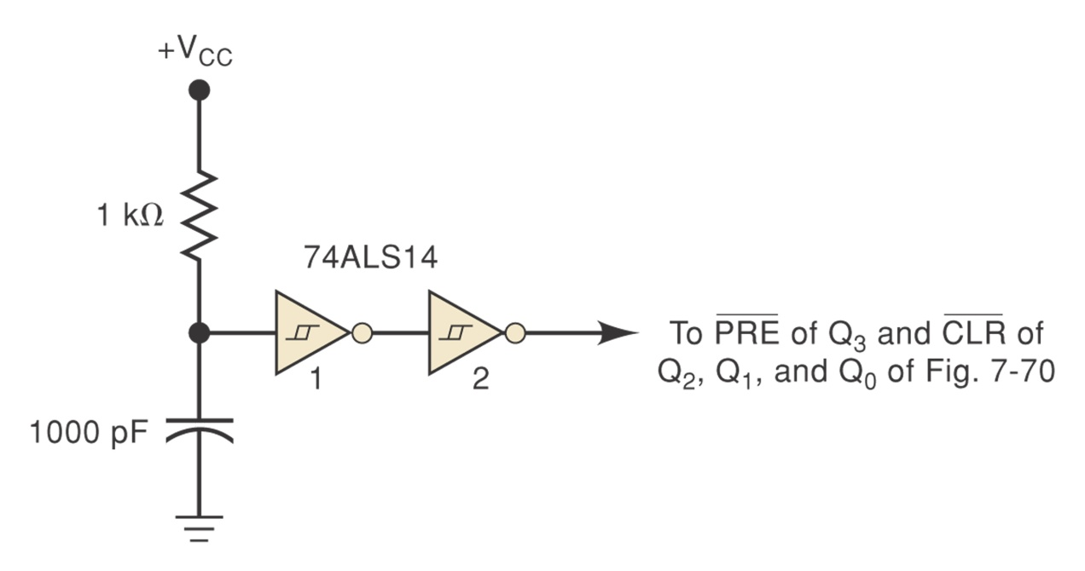
Starting a Ring Counter
Start off with only one FF in the 1 state and all others in the 0 state.
Use PRE and CLR inputs and Schmitt-trigger INVERTERS.

Slide 33
Johnson Counter
Also known as the twisted-ring counter.
Same as the ring counter except that the inverted output of the last FF is connected to the input of the first FF.
Counting sequence: 000→100→110→111→011→001→000
A MOD-6 counter (twice the number of FFs)
Needs decoding gates.
Figure 7-72

Slide 34
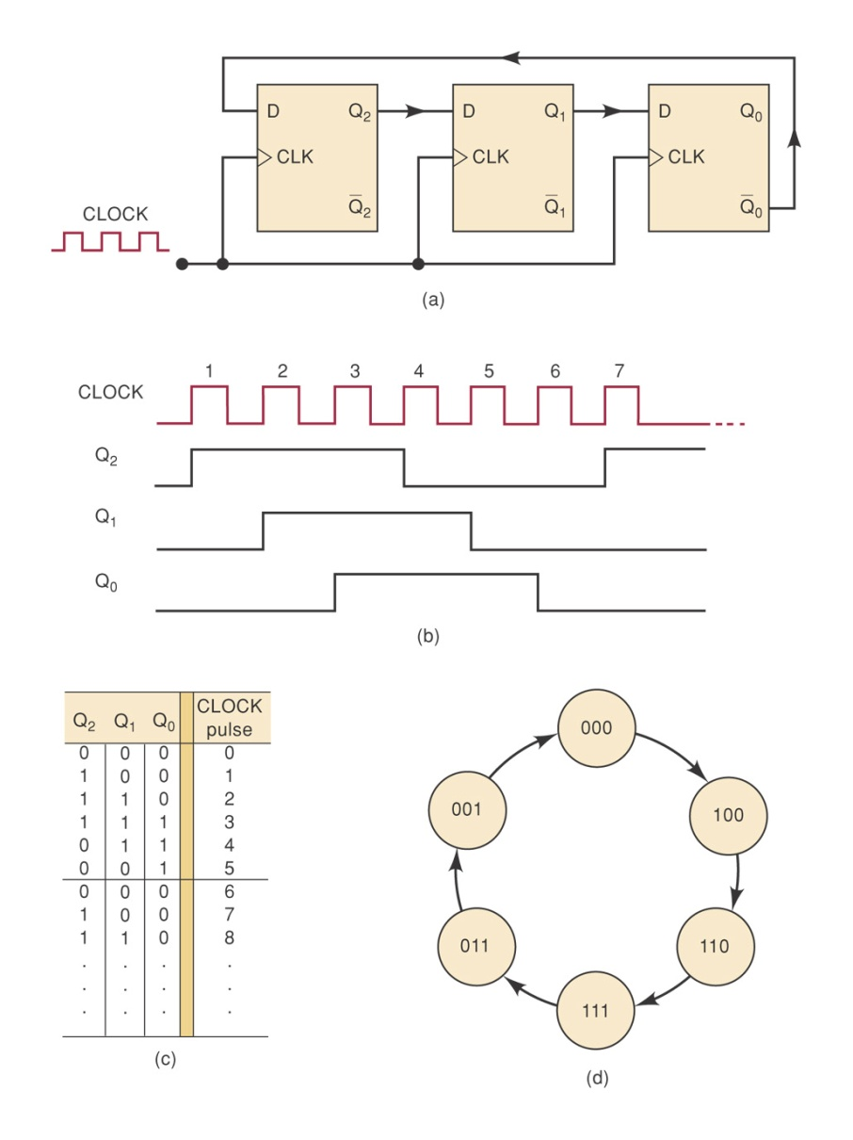
MOD-6 Johnson Counter

Slide 35
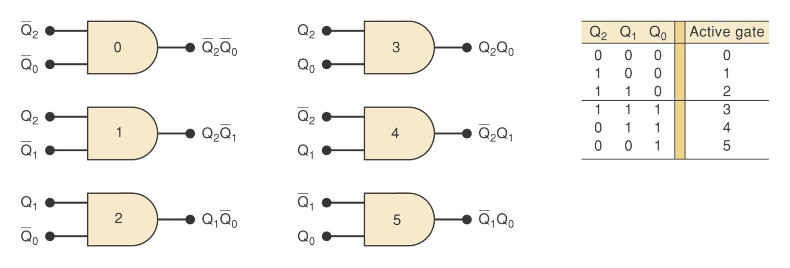
Decoding a Johnson Counter
Each decoding has only two inputs.
It can be shown that for any size Johnson counter, the decoding gates will have only two inputs.

