Slide 1
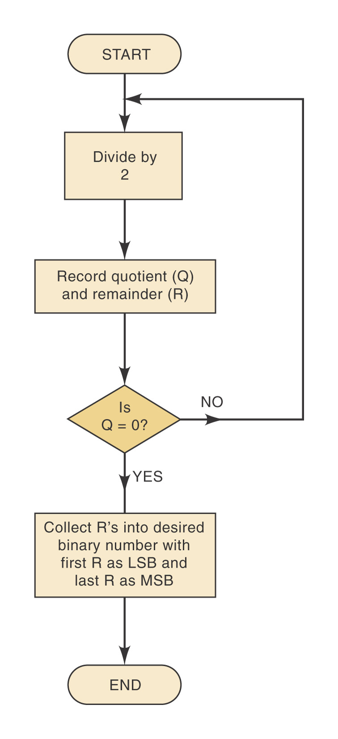
FIGURE 2-1 Flowchart for repeated-division method of decimal-to-binary conversion of integers. The same process can be used to convert a decimal integer to any other number system.
Ronald Tocci/Neal Widmer/Gregory Moss
Digital Systems: Principles and Applications, 9e
Copyright ©2004 by Pearson Education, Inc.
Upper Saddle River, New Jersey 07458
All rights reserved.

Slide 2
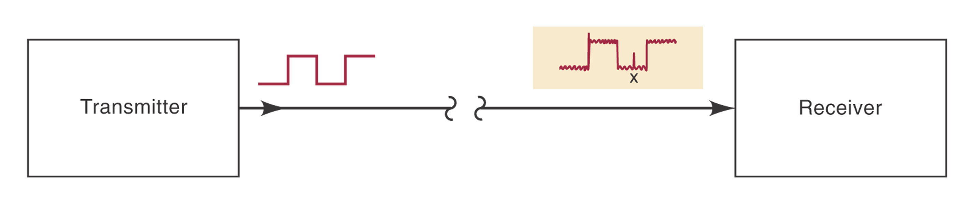
FIGURE 2-2 Example of noise causing an error in the transmission of digital data.
Ronald Tocci/Neal Widmer/Gregory Moss
Digital Systems: Principles and Applications, 9e
Copyright ©2004 by Pearson Education, Inc.
Upper Saddle River, New Jersey 07458
All rights reserved.

