Slide 1
AHDL (Chapter 9)

Slide 2
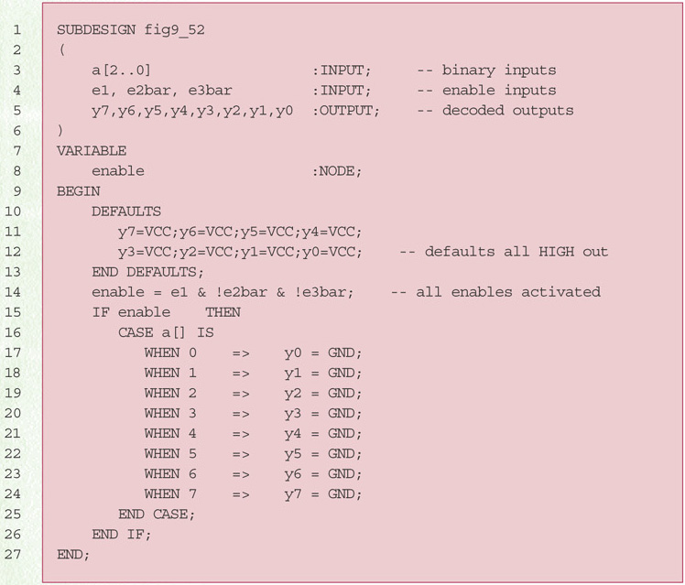
AHDL Decoder using CASE

Slide 3
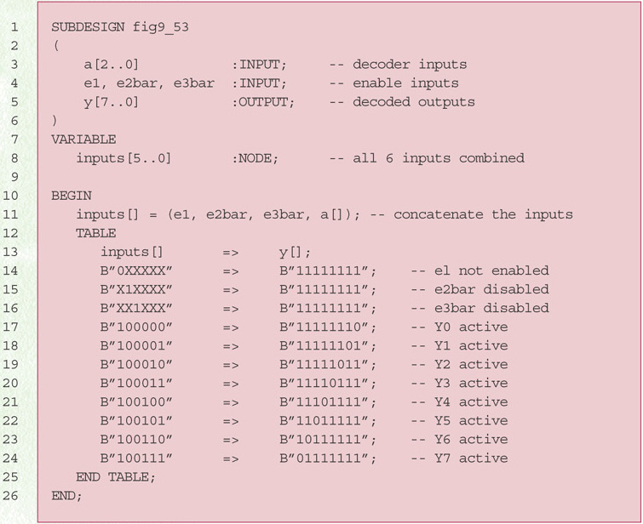
AHDL Decoder using a TABLE

Slide 4
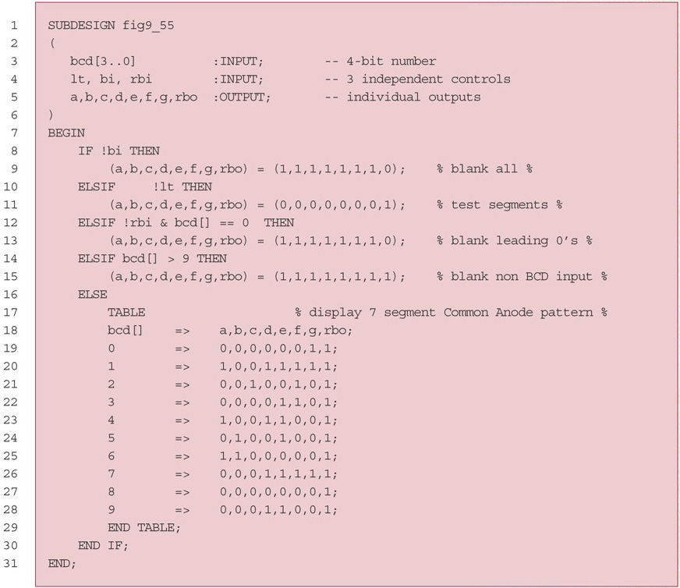
AHDL 7-Segment Decoder/Driver

Slide 5
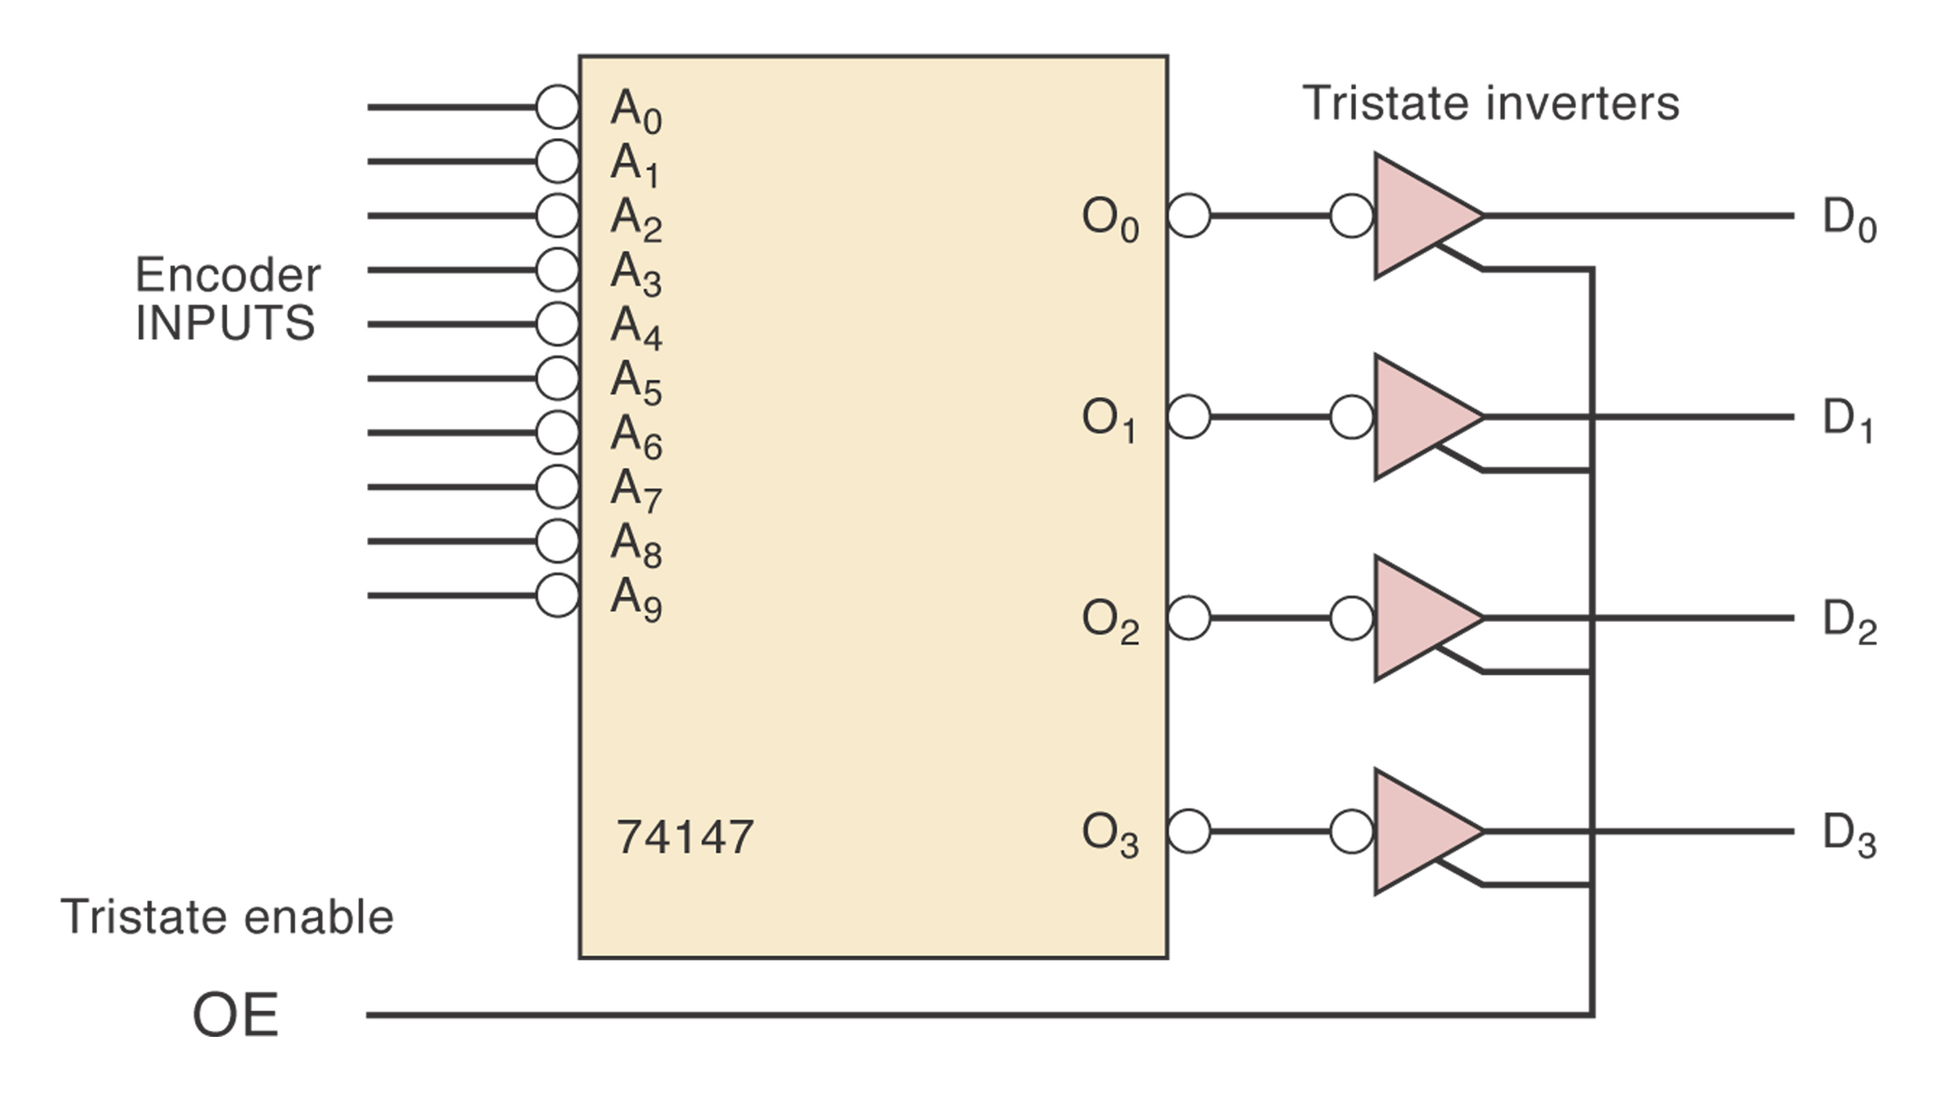
Encoder with Tristate Outputs

Slide 6
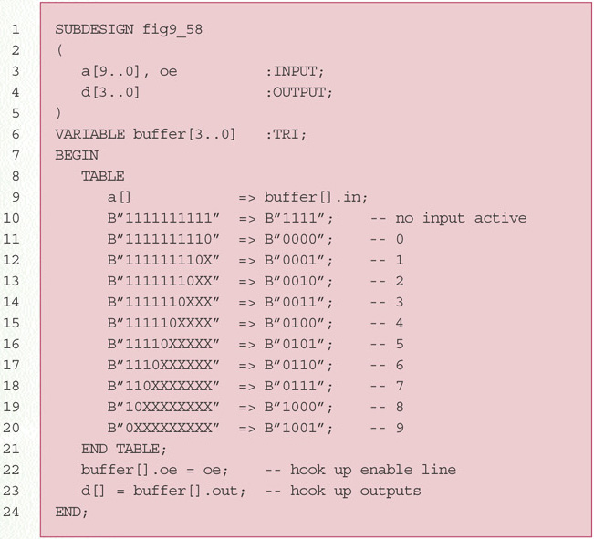
AHDL Priority Encoder (TABLE)

Slide 7
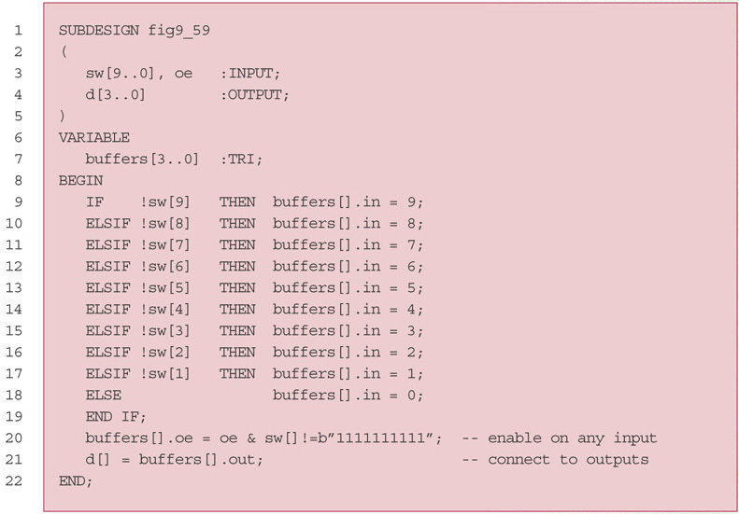
AHDL Priority Encoder (IF/ELSE)

Slide 8
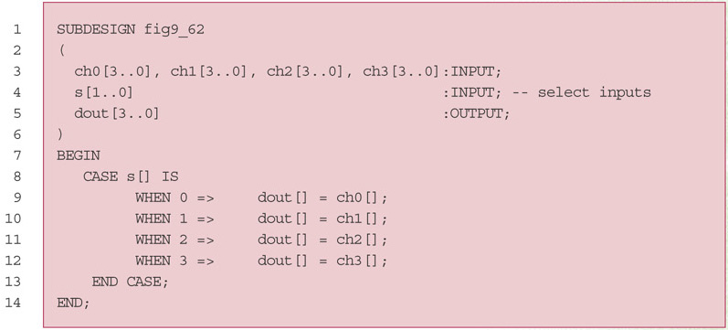
AHDL MUX

Slide 9
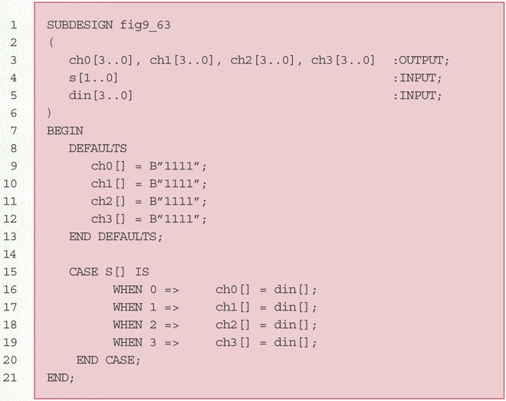
AHDL DEMUX

Slide 10
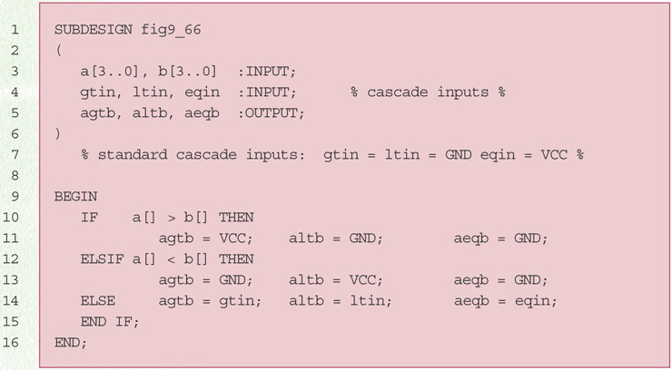
AHDL Magnitude Comparator

Slide 11
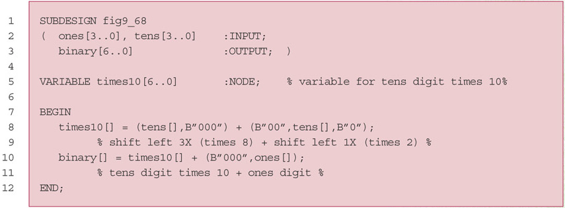
BCD to Binary Code Converter
numx10=numx8 + numx2
numx8 === shift left 3x
numx2 === shift left 1x

