Slide 1



Slide 2
Chapter 9 – MSI Logic Circuits

Slide 3
Chapter 9 Objectives
Selected areas covered in this chapter:
  Analyzing/using decoders & encoders in circuits.
  Advantages and disadvantages of LEDs and LCDs.
  Observation/analysis techniques to troubleshoot
  digital circuits.
  Operation of multiplexers and demultiplexers
  in circuit applications.
  Comparing two binary numbers by using the magnitude comparator circuit.
  Function and operation of code converters.
  Precautions when connecting digital circuits using
  the data bus concept.
  Using HDL to implement MSI logic circuits equivalents.

Slide 4
Chapter 9
Digital systems obtain data and information continuously operated on in some manner:
  Decoding/encoding.
  Multiplexing/demultiplexing,.
  Comparison; Code conversion; Data busing.
These and other operations have been facilitated by the availability of numerous ICs in the MSI (medium-scale-integration) category.

Slide 5
9-1 Decoders
Decoders are used when an output or a group of outputs is to be activated only on the occurrence of a specific combination of input levels.
  Often provided by outputs of a counter or a register.

Slide 6
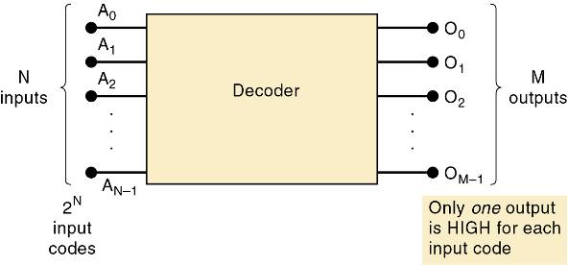
9-1 Decoders
A decoder accepts a set of inputs that represents a binary number—activating only the output that corresponds to the input number.
For each of these input combinations, only one of the M outputs will be active (HIGH); all the other outputs are LOW.
Many decoders are designed to produce active-LOW outputs,
where only the selected output is LOW while all others are HIGH.

Slide 7
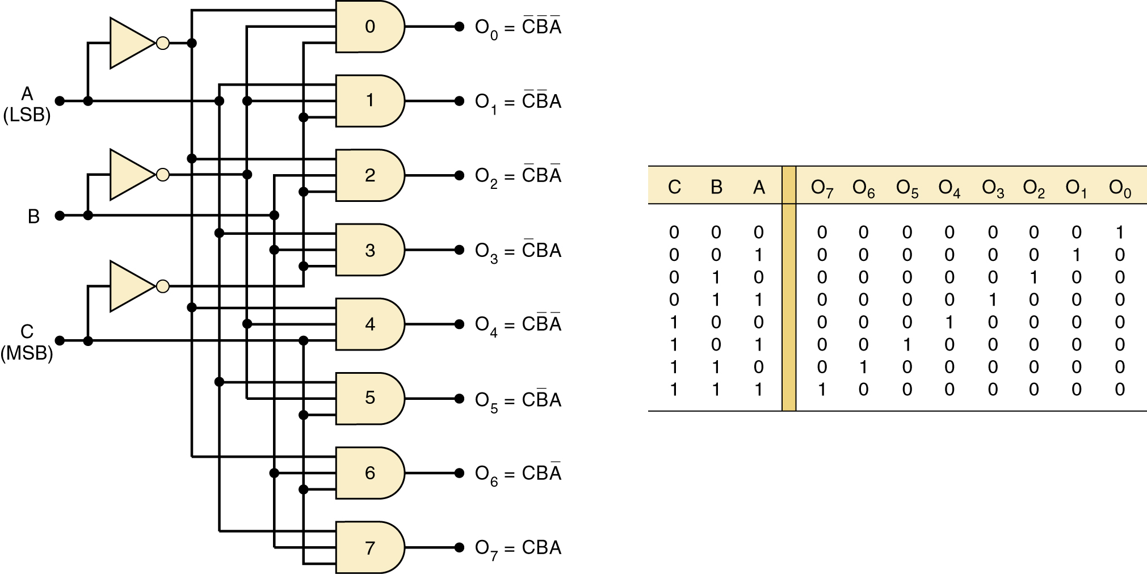
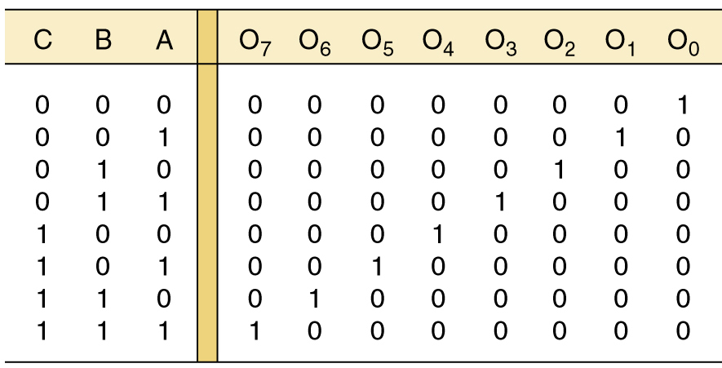
9-1 Decoders
Circuitry for a decoder with three inputs and 8 outputs.
It uses all AND gates, so outputs are active-HIGH
Output O₆ goes HIGH only
when CBA 110₂ = 6₁₀.

Slide 8
9-1 Decoders
Circuitry for a decoder with three inputs and 8 outputs.
This can be called a 3-line-to-8-line decoder—it has three input lines and eight output lines.
Also called a binary-to-octal decoder or converter—taking three-bit binary input code
and activating one of eight
(octal) outputs.
Also referred to as a 1-of-8 decoder—only 1 of the 8 outputs is activated at one time.

Slide 9
9-1 Decoders
Some decoders have one or more enable inputs used to control the operation of the decoder.
  The decoder is enabled only if ENABLE is HIGH.
With common ENABLE line connected to a fourth input of each gate:
  If ENABLE is HIGH, the decoder functions normally.
    A, B, C input will determine which output is HIGH.
  If ENABLE is LOW, all outputs will be forced LOW.
    Regardless of the levels at the A, B, C inputs.

Slide 10
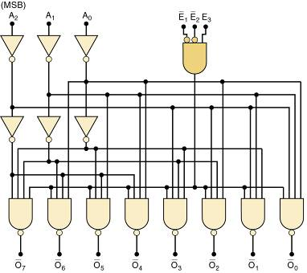
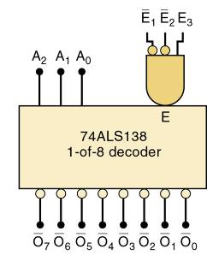
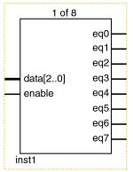
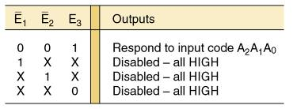
9-1 Decoders
The 74ALS138 decoder.
ENABLE
inputs

Slide 11
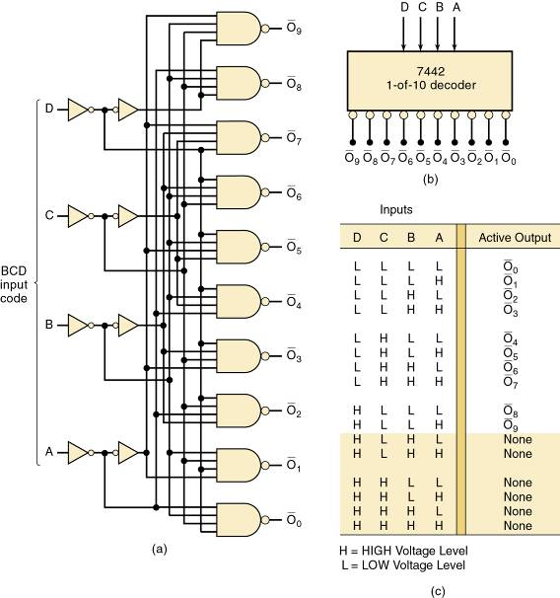
9-1 Decoders
7442
BCD-to-decimal decoder.
This decoder does not have
an enable input.

Slide 12
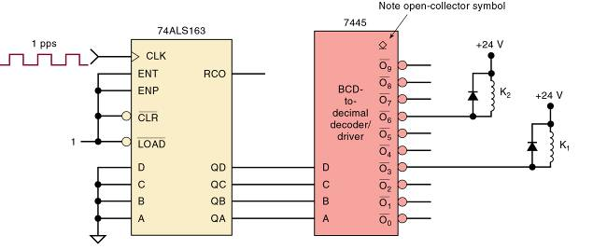
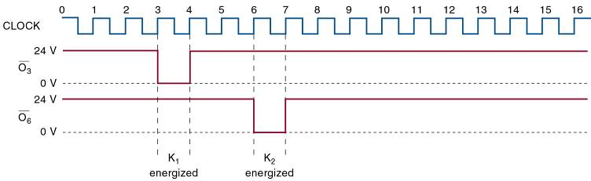
9-1 Decoders
7445 BCD-to-decimal decoder/driver.
Suitable for directly driving loads such as indicator LEDs or lamps, relays,
or dc motors.
Termed a driver because this IC has open-collector outputs that operate at higher current/voltage limits than a normal TTL output.

Slide 13
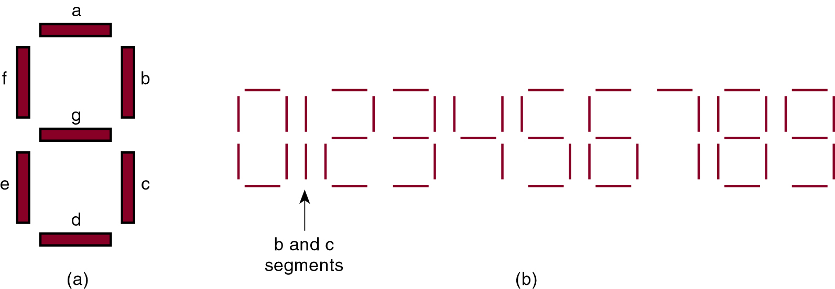
9-2 BCD-to-7 Segment Decoder/Drivers
The 7-segment display is a common way to display decimal or hexadecimal characters.
  One common arrangement uses light emitting diodes (LEDs) for each segment.
Diodes allow current to flow in one direction,
but block flow in the other direction.
When the LED anode is more positive than the cathode by approximately 2 V, the LED will light up.

Slide 14
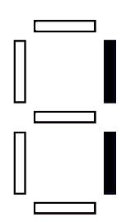
9-2 BCD-to-7 Segment Decoder/Drivers
The 7-segment display is a common way to display decimal or hexadecimal characters.
  One common arrangement uses light emitting diodes (LEDs) for each segment.
By controlling current through each LED, some segments are turned on & emit light, while others are turned off, which
generates the desired character pattern.

Slide 15
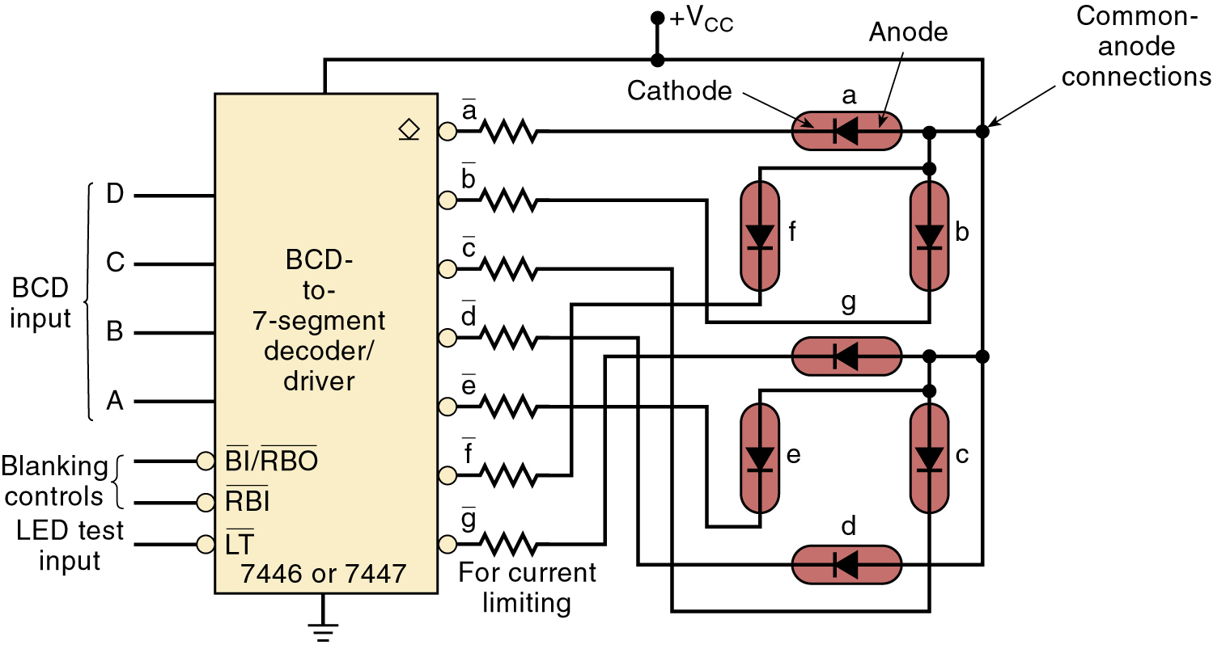
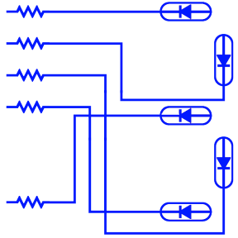
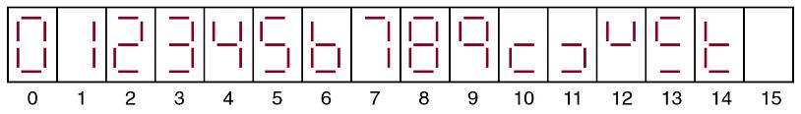

9-2 BCD-to-7 Segment Decoder/Drivers
BCD-to-7-segment decoder/driver.
The 7446/47 activates specific segment patterns
in response to
input codes

Slide 16
9-2 BCD-to-7 Segment Decoder/Drivers
BCD-to-7-segment decoder/driver.
This is a common-anode LED display.
The anodes all of segments are tied together to V_{CC} .
Another type uses a common-cathode method, with
each segment requiring 10 to 20 mA of current.
TTL/CMOS devices are normally not used to drive a common-cathode display directly—a transistor interface circuit is often used

Slide 17
9-3 Liquid Crystal Displays
A liquid-crystal display (LCD) controls reflection
of available light.
  The light may be ambient (room, sun) light.
    Reflective LCDs use ambient light.
  Available light might be provided by a small light source—part of the display unit.
    Backlit LCDs use this method.
LCDs have gained wide acceptance due to their very low power consumption—compared to LEDs.
  LEDs have the advantage of a much brighter display that is easily visible in dark or poorly lit areas.

Slide 18
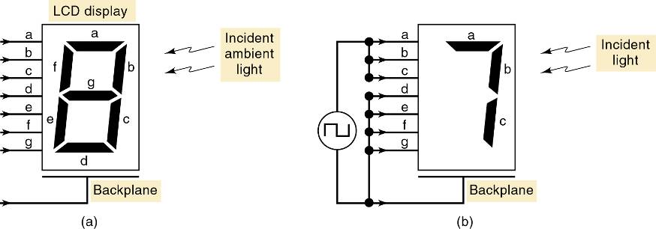
9-3 Liquid Crystal Displays
Liquid-crystal display.
Basic
arrangement.
Applying voltage between the segment and the backplane turns the segment ON.
Zero voltage turns the segment OFF.

Slide 19
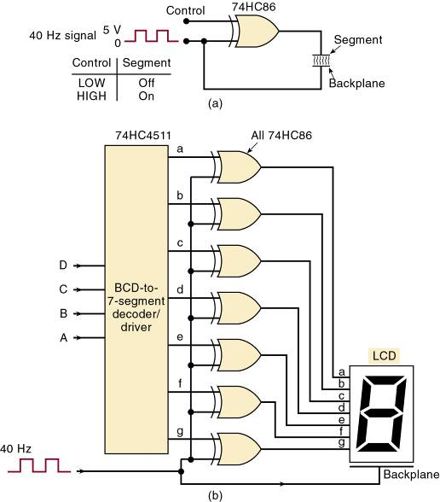
9-3 Liquid Crystal Displays
Driving a 7-segment display.
It is common to produce required ac voltage by applying out-of-phase square waves to the segment and the backplane.

Slide 20
9-3 Liquid Crystal Displays
Liquid crystals are available as multidigit 7- segment decimal numeric displays.
  Alphanumeric LCD modules are available in
  many formats—up to 4 lines by 40 characters.
Other LCD modules allow the user to create a graphical display by controlling individual dots on the screen called pixels.
Larger LCD panels can be scanned at a high rate, producing high quality video motion pictures.
  Control lines are arranged in rows & columns.
A digital system must activate a matrix row/column to control the amount of light at each pixel.

Slide 21
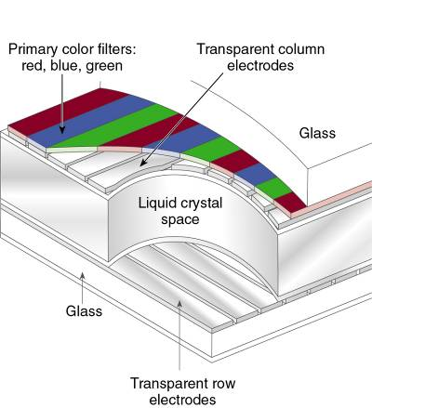
9-3 Liquid Crystal Displays
Each pixel on a color display is made up of three subpixels, which control light passing through a red, green, or blue filter to produce pixel color.
A 640 x 480 LCD screen would have 640 x 3 connections for columns and 480 connections for rows—a total of 2400 connections to the LCD.

Slide 22
9-3 Liquid Crystal Displays
Older screens are called Twisted Nematic (TN)
or Super Twisted Nematic (STN).
  Referred to as passive LCDs.
Newer displays are called active matrix TFT LCDs.
  An active element on the display is used to switch pixels on and off.
Other display technologies—vacuum fluorescent, gas discharge plasma, and electroluminescence.
  Optical physics for each of these displays varies.
    The means of controlling all of them is the same.

Slide 23
9-4 Encoders
9-4 Encoders
Most decoders accept an input code & produce a HIGH (or LOW) at one and only one output line.
  A decoder identifies, recognizes, or detects a particular code.

Slide 24
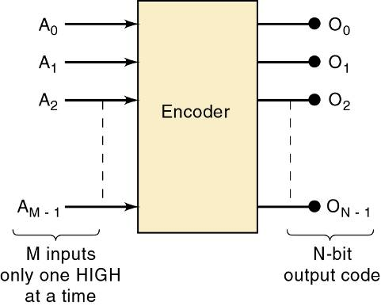
9-4 Encoders
9-4 Encoders
The opposite of decoding process is encoding.
  Performed by a logic circuit called an encoder.
An encoder has a number of input lines, only one of which is activated at a given time.
Shown is an encoder with M inputs and N outputs.
Inputs are active-HIGH, which means that they
are normally LOW.
It produces an N-bit output code, depending on which input is activated.

Slide 25
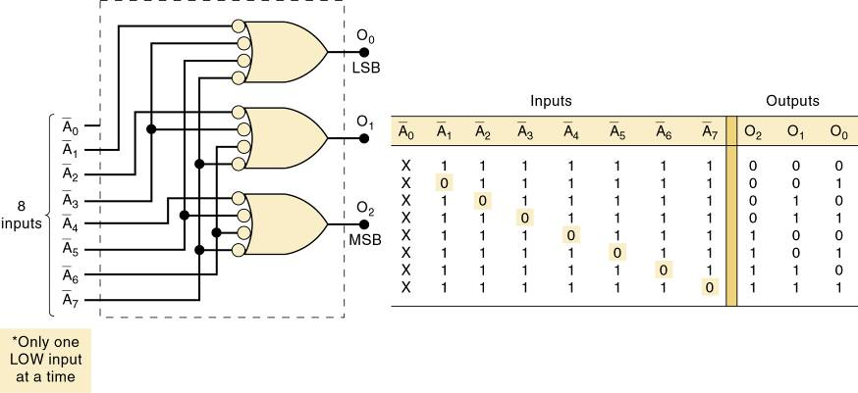
9-4 Encoders
An octal-to-binary encoder (8-line-to-3-line encoder) accepts eight input lines, producing a three-bit output code corresponding to the input.
Logic circuit for an octal-to-binary (8-line-to-3-line) encoder.
Only one input should be active at one time.

Slide 26
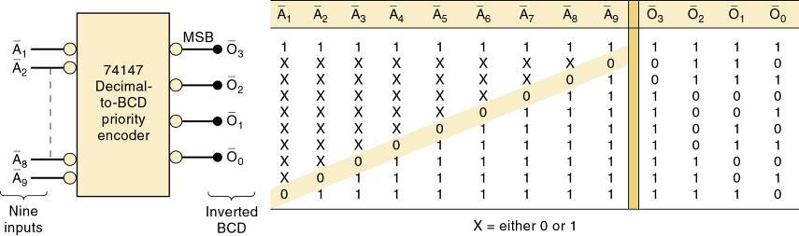
9-4 Encoders
A priority encoder ensures that when two or more inputs are activated, the output code will correspond to the highest-numbered input.
It has nine active-LOW inputs represent decimal digits
1 through 9, producing inverted BCD code corresponding
to the highest-numbered activated input.

Slide 27
9-4 Encoders
A switch encoder can be used when BCD data must be entered manually into a digital system.
  The 10 switches might be the keyboard switches
  on a calculator—representing digits 0 through 9.

Slide 28
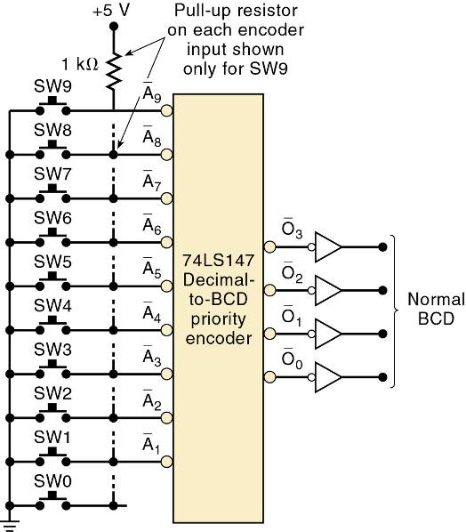
9-4 Encoders
The switches are of the normally open type, so
the encoder inputs are
all normally HIGH.
BCD output is 0000.
When a key is depressed, the circuit will produce the BCD code for that digit.
The 74LS147 is a priority encoder, so simultaneous
key depressions produce the BCD code for the higher-numbered key.

Slide 29
9-5 Troubleshooting
More complex circuitry increases possible reasons for failure
  Applying observation and analysis will narrow the focus and simplify testing
After using observation and analysis to determine the possible faults, repeatedly use the divide and conquer technique to reduce possible causes by half.

Slide 30
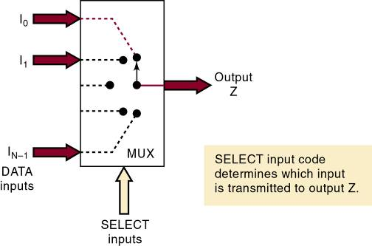
9-6 Multiplexers (Data Selectors)
A multiplexer (MUX) selects 1 of N input data sources and transmits the selected data to a single output—called multiplexing.
  A digital multiplexer or data selector is a logic circuit that performs the same task.
Routing control of desired data
input to output by SELECT
inputs—referred to as
ADDRESS inputs.

Slide 31
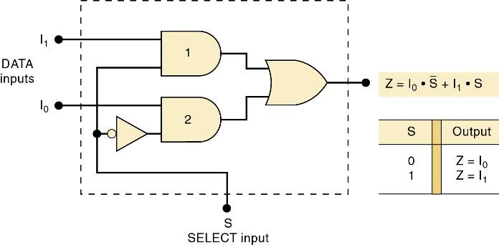
9-6 Multiplexers (Data Selectors)
A two-input MUX could be used in a digital system that uses two different MASTER CLOCK signals.
  A high-speed clock in one mode and a slow-speed clock for the other.

Slide 32
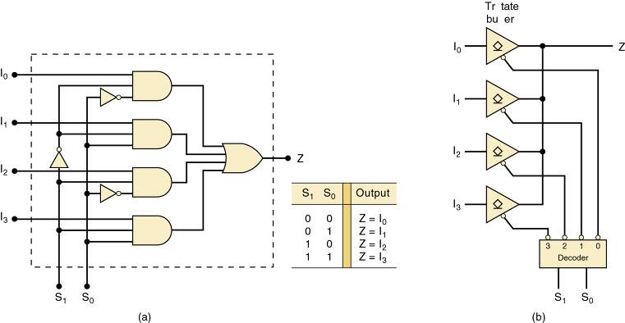
9-6 Multiplexers (Data Selectors)
Two-, four-, eight-, and 16-input multiplexers are available in the TTL and CMOS logic families.
  These basic ICs can be combined for multiplexing
  a larger number of inputs.

Slide 33
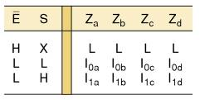
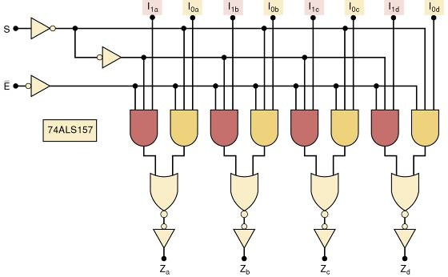
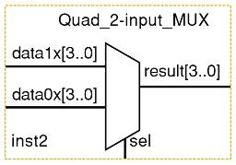
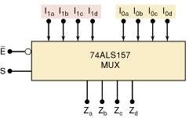
9-6 Multiplexers (Data Selectors)
The 74ALS157 contains four two-input multiplexers

Slide 34
9-7 Multiplexer Applications
Multiplexer circuits find numerous and varied applications in digital systems of all types.
  Data selection/routing, parallel-to-serial conversion.
  Operation sequencing.
  Waveform/logic-function generation.

Slide 35
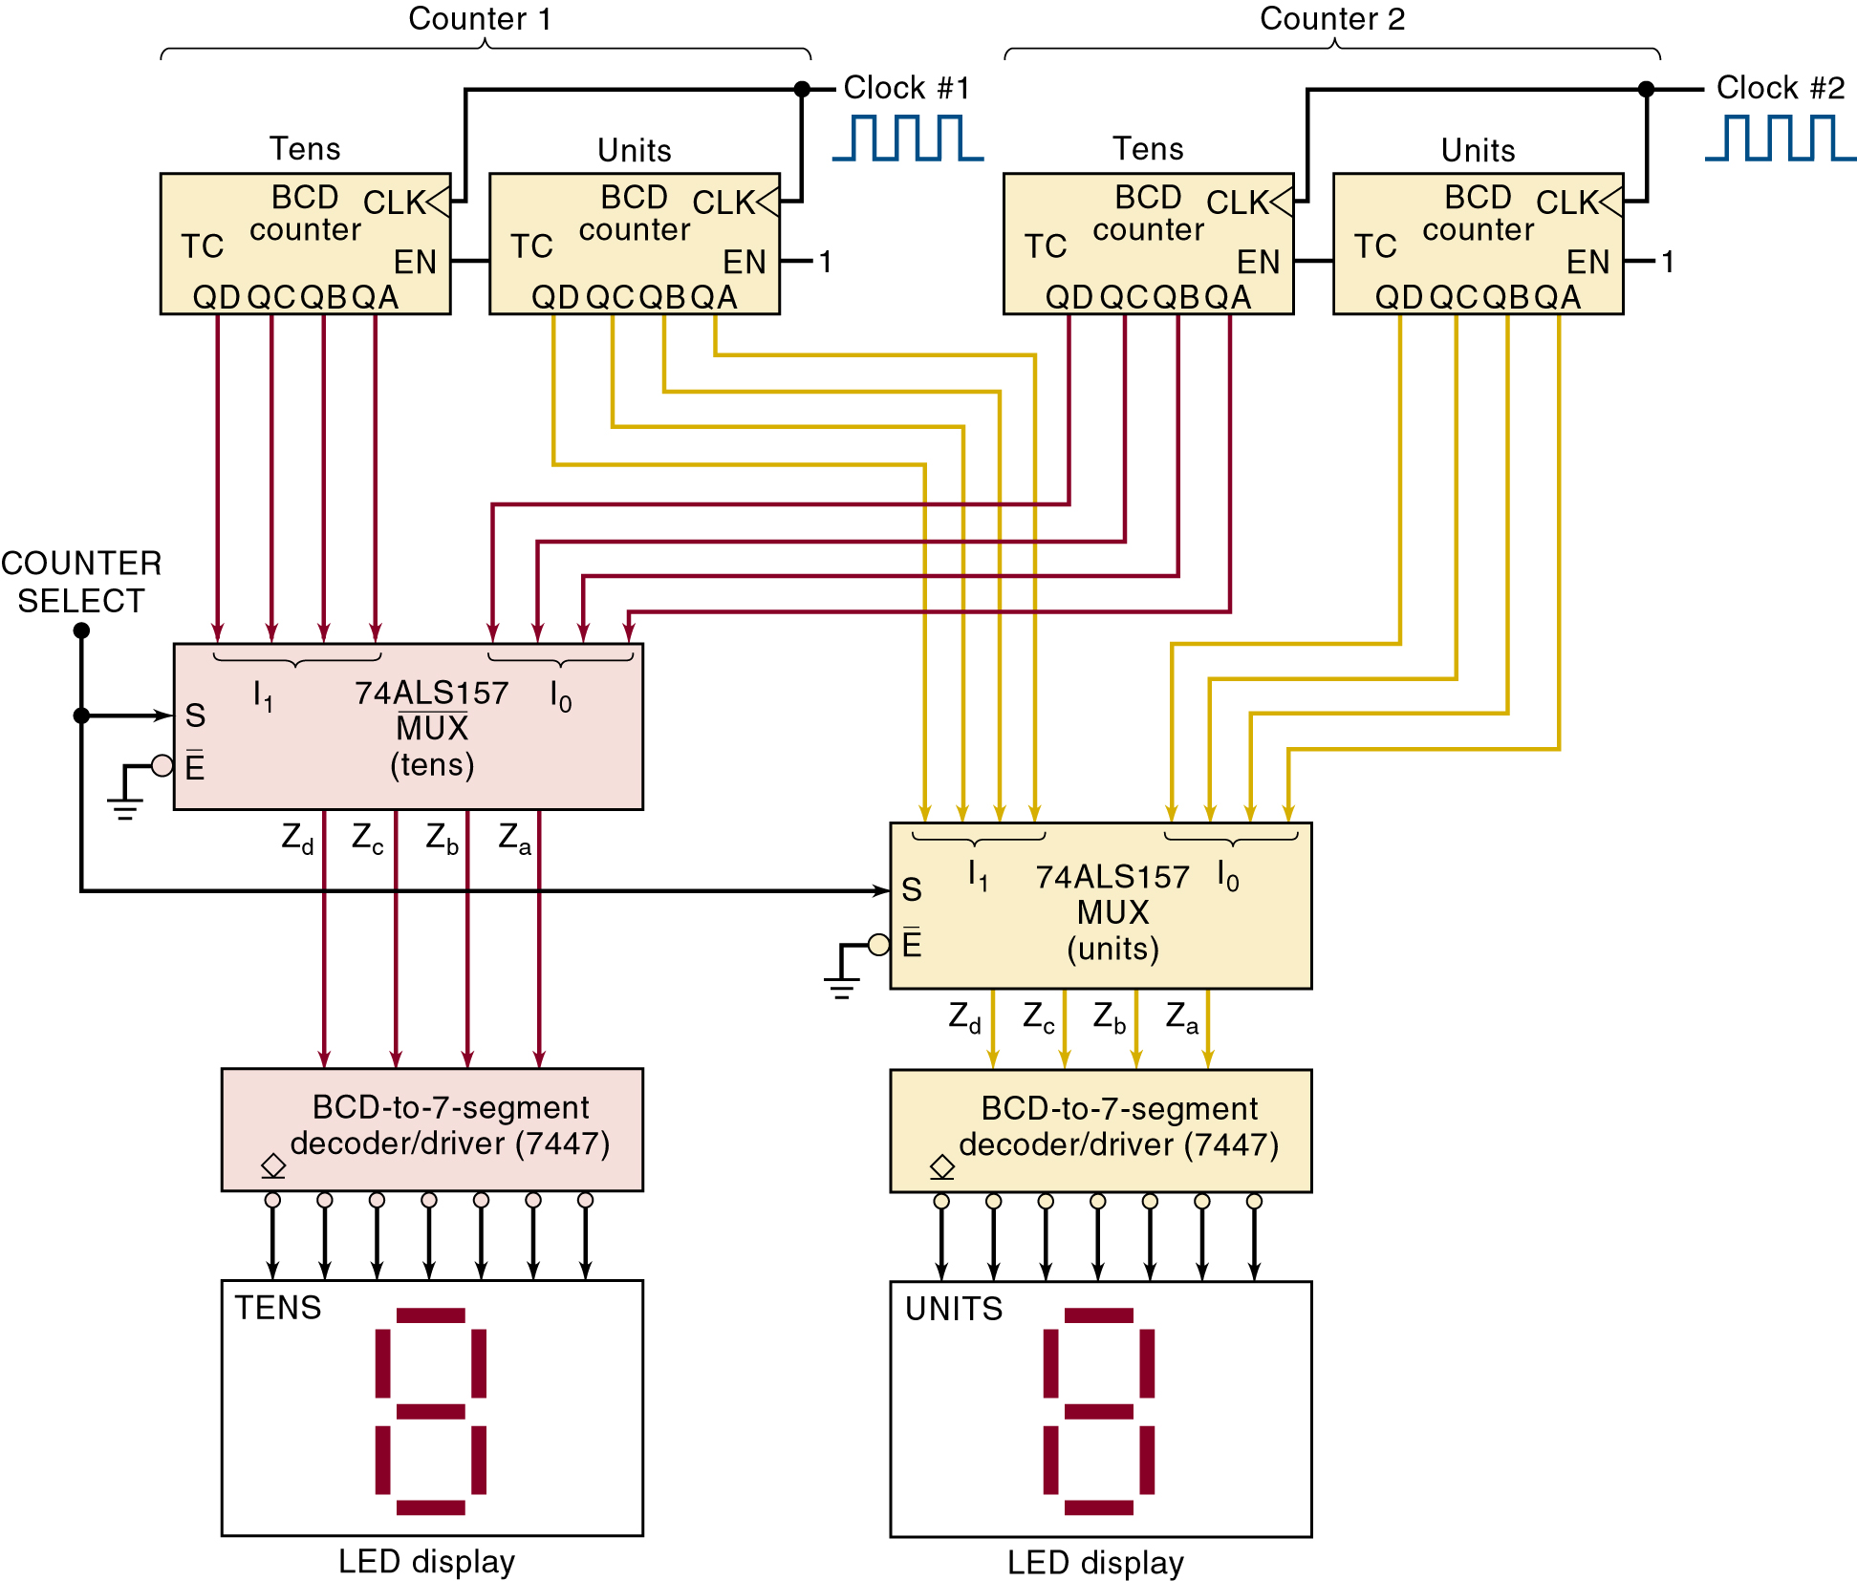
9-7 Multiplexer Applications
System for displaying two multidigit BCD counters one at a time.

Slide 36
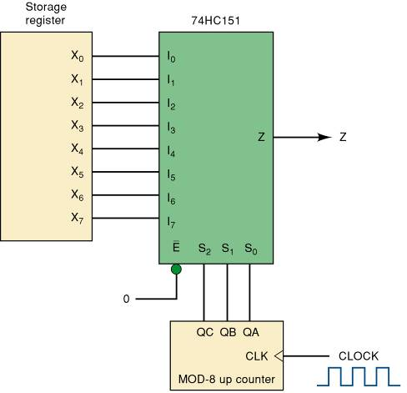
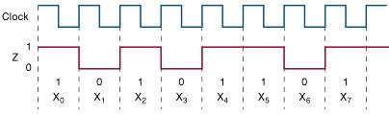
9-7 Multiplexer Applications
Parallel-to-serial converter.
Waveforms for
X₇X₆X₅X₄X₃X₂X₁X₀
10110101

Slide 37
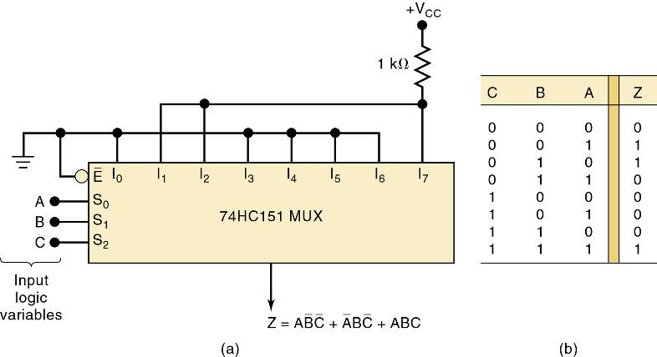
9-7 Multiplexer Applications
Multiplexer used to implement a logic
function described by the truth table.

Slide 38
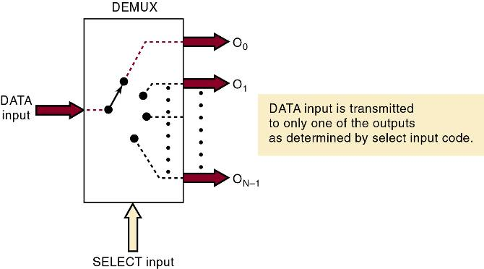
9-8 Demultiplexers (Data Distributors)
A demultiplexer (DEMUX) takes a single input and distributes it over several outputs.
  The select input code determines to which output
  the DATA input will be transmitted.

Slide 39
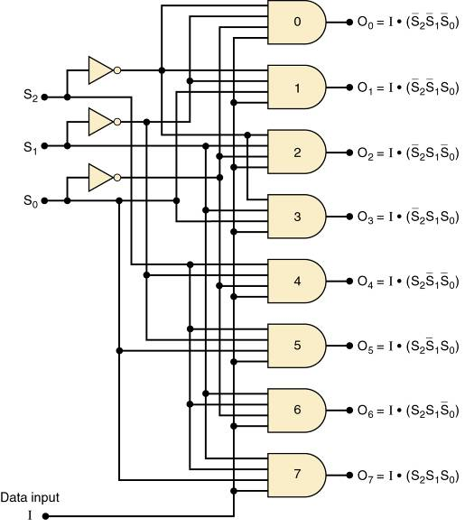
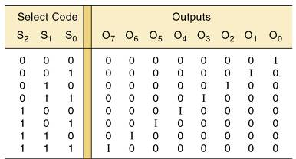

9-8 Demultiplexers (Data Distributors)
A 1 line to 8 line demultiplexer.

Slide 40
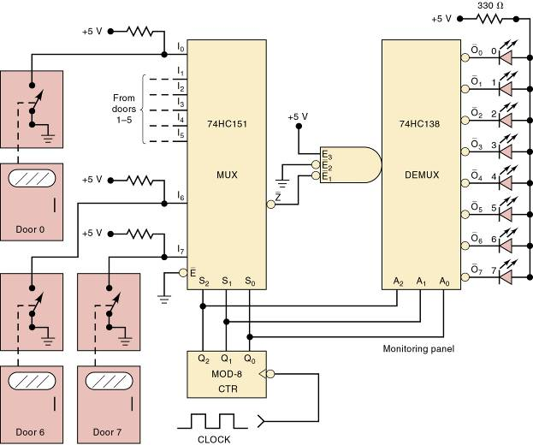
9-8 Demultiplexers (Data Distributors)
Security monitoring system using the 74ALS138.
The system shown can handle eight
doors, but can be expanded to
any number.
The door switches are data inputs
to the MUX.
They produce a HIGH when a door
is open and a LOW when it is closed.

Slide 41
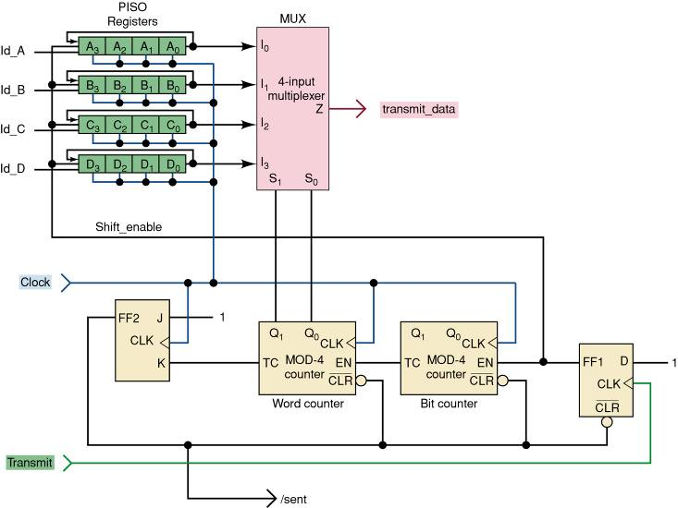
9-8 Demultiplexers (Data Distributors)
A synchronous data transmission system that is used to transmit four, four-bit words serially from a transmitter to a remote receiver.

Slide 42
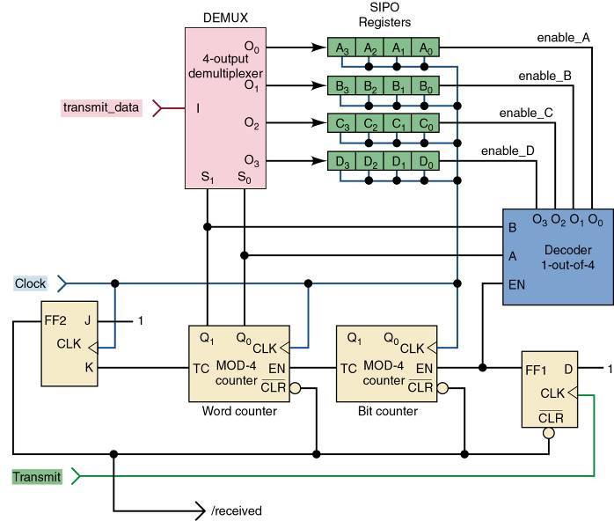
9-8 Demultiplexers (Data Distributors)
Synchronous data transmission system
receiver block

Slide 43
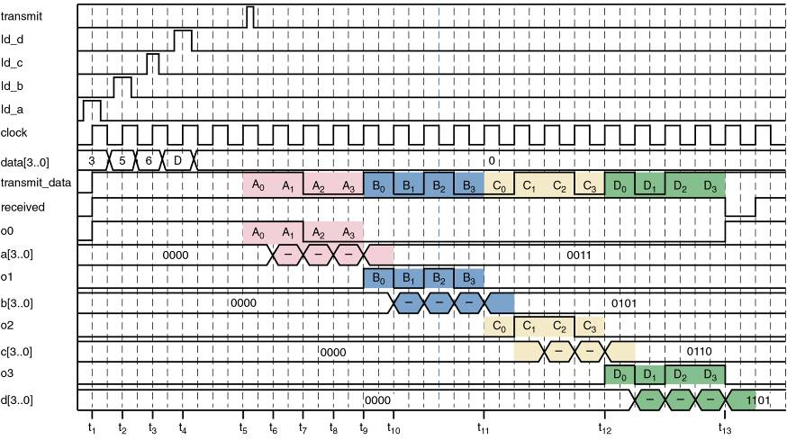
9-8 Demultiplexers (Data Distributors)
This timing diagram shows the parallel data loaded into the transmitter, the serial data stream, and distribution/storage
of the four data values in the receiver registers.

Slide 44
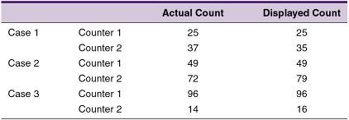
9-9 More Troubleshooting
Apply observation and analysis to this example:
A test on the circuit
yields the result shown.
What is the probable
circuit fault?

Slide 45
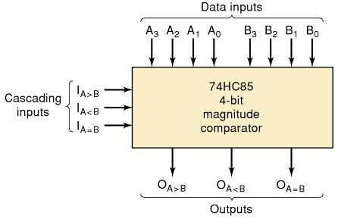
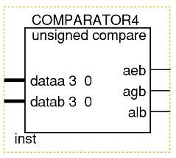
9-10 Magnitude Comparator
Another useful MSI is a magnitude comparator.
  A combinational logic circuit that compares two input binary quantities and generates outputs to indicate which one has the greater magnitude.
Megafunction
symbol.
Cascading inputs are not necessary
on a megafunction—simply specify
larger data input ports.

Slide 46
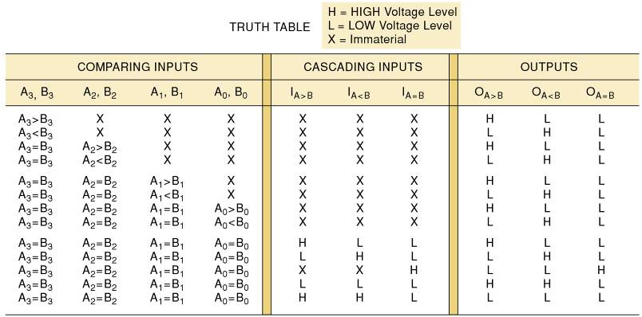
9-10 Magnitude Comparator
Another useful MSI is a magnitude comparator.
  A combinational logic circuit that compares two input binary quantities and generates outputs to indicate which one has the greater magnitude.

Slide 47
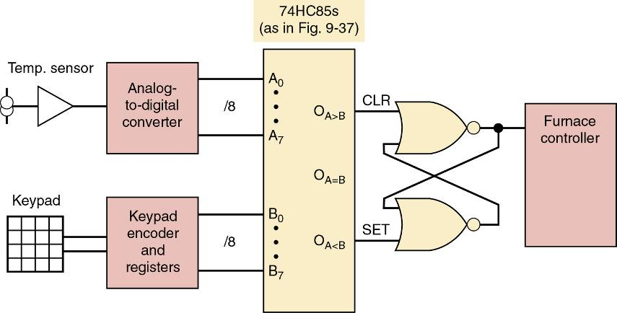
9-10 Magnitude Comparator
Magnitude comparator used in a digital thermostat.

Slide 48
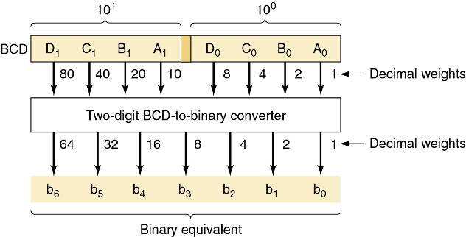
9-11 Code Converters
A code converter is a logic circuit that changes data presented in one type of binary code to another type of binary code.
Basic idea
of a two-digit BCD-to-binary
converter.

Slide 49
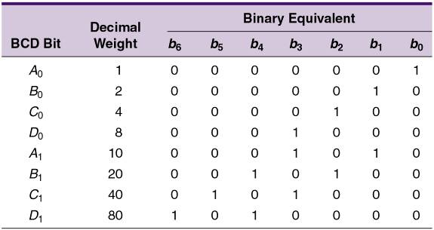
9-11 Code Converters
The bits in a BCD representation have decimal weights that are 8, 4, 2, 1 within each code group.
  That differ by a factor of 10 from one code group (decimal digit) to the next.
The decimal weight
of each bit in the
BCD representation
can be converted to
its binary equivalent.

Slide 50
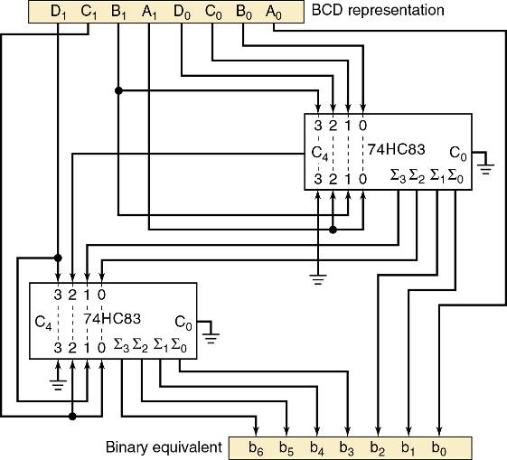
9-11 Code Converters
One way to implement the logic circuit that performs conversion
process is to use binary adder circuits.

Slide 51
9-12 Data Busing
In computers, transfer of data takes place over a common set of connecting lines called a data bus.
  Devices tied to the data bus will often have tri-state outputs, or be tied to the data bus by tristate buffers.
Devices commonly connected to a data bus:
  Microprocessors; Semiconductor memory chips.
  Digital-to-analog and analog-to-digital converters.

Slide 52
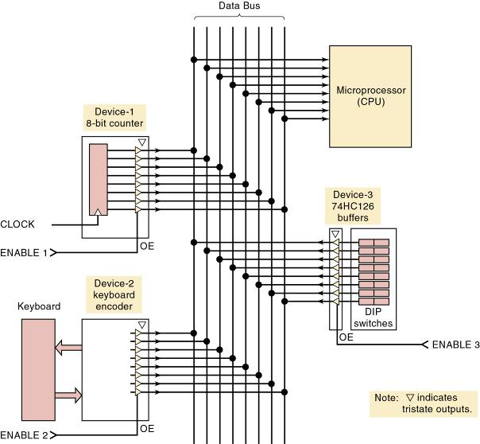
9-12 Data Busing
Three different devices can transmit eight-bit data over an eight-line data bus to a microprocessor.
Only one device at a time is enabled—so bus
contention is avoided.

Slide 53
9-13 The 74ALS173/HC173 Tristate Register
The devices connected to a data bus will contain registers (usually flip-flops) that hold device data.
  Outputs of these registers are usually connected to tristate buffers allowing them to be tied to a data bus.

Slide 54
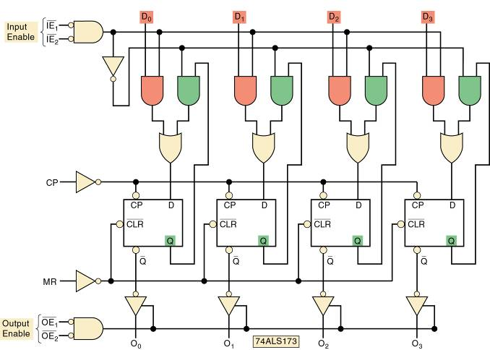
9-13 The 74ALS173/HC173 Tristate Register
TTL 74ALS173 tristate register.

Slide 55

9-14 Data Bus Operation
Tristate registers connected to a data bus.
The contents of any one of the three registers can be parallel-transferred over the data bus
to one of the other registers through proper application
of logic levels to the
register enable inputs.

Slide 56

9-14 Data Bus Operation
The timing diagram shows various signals involved in the transfer of the data 1011
from register A to register C.

Slide 57


9-14 Data Bus Operation
Simplified representation of bus arrangement.
Simplified way to show signal
activity on data bus lines.

Slide 58

9-14 Data Bus Operation
Manufacturers have developed ICs that connect inputs & outputs internal to the chip.
  To reduce the number of IC pins & bus connections.
Each I/O line will function
as an input or an output depending on the states
of the enable inputs— bidirectional data lines.

Slide 59
END

