Slide 1
Digital Systems:
Combinational Logic Circuits
Wen-Hung Liao, Ph.D.

Slide 2
Objectives
Convert a logic expression into a sum-of-products expression.
Perform the necessary steps to reduce a sum-of-products expression to its simplest form.
Use Boolean algebra and the Karnaugh map as tools to simplify and design logic circuits.
Explain the operation of both exclusive-OR and exclusive-NOR circuits.
Design simple logic circuits without the help of a truth table.

Slide 3
Objectives (cont’d)
Implement enable circuits.
Cite the basic characteristics of TTL and CMOS digital ICs.
Use the basic troubleshooting rules of digital systems.
Deduce from observed results the faults of malfunctioning combinational logic circuits.
Describe the fundamental idea of programmable logic devices (PLDs).
Outline the steps involved in programming a PLD to perform a simple combinational logic function

Slide 4
Combinational Logic Circuits
The logic level at the output depends on the combination of logic levels present at the inputs.
A combinational circuit has no memory, so its output depends only on the current value of its inputs.
We will not spend a great deal of time discussing how to troubleshoot the combinational circuits. (That’s what the lab is for.)

Slide 5
Sum-of-Products (SOP) Form
Sum → OR
Product → AND
Each of the sum-of-products expression consists of two or more AND terms that are ORed together.
Examples: ABC+A’BC’
AB+A’BC’+C’D’+D
Note that one inversion sign cannot cover more than one variable in a term. AB is not allowed.

Slide 6
Product-of-Sums (POS) Form
Each of the product-of-sums expression consists of two or more OR terms that are ANDed together.
Examples: (A+B’+C)(A+C)
(A+B’)(C’+D)F
Will use sum-of-products form in logic circuit simplification.

Slide 7
Simplifying Logic Circuits
Goal: reduce the logic circuit expression to a simpler form so that fewer gates and connections are required to build the circuit.
Example: 4.1(a) and 4.1(b) are equivalent, but 4-1(b) is much simpler.

Slide 8
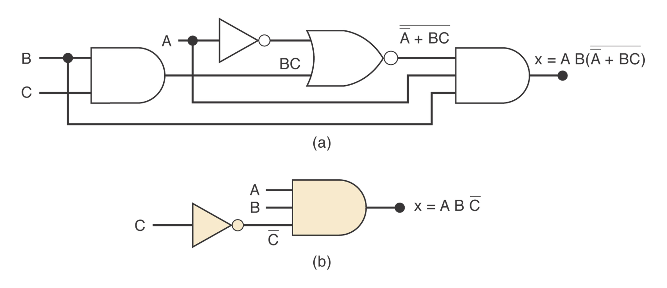
Figure 4.1

Slide 9
Circuit Simplification Methods
Boolean algebra: greatly depends on inspiration and experience.
Karnaugh map: systematic, step-by-step approach.
Pros and Cons

Slide 10
Algebraic Simplification
Use the Boolean algebra theorems introduced in Chapter 3 to help simplify the expression for a logic circuit.
Based on experience, often becomes a trial-and-error process.
No easy way to tell whether a simplified expression is in its simplest form.

Slide 11
Two Essential Steps
The original expression is put into the sum-of-products form by repeated application of DeMorgan’s theorem and multiplication of terms.
The product terms are checked for common factors, and factoring is performed whenever possible.

Slide 12
Examples 4-1 to 4-4
Original | Simplified
ABC+AB’(A’C’)’ | A(B’+C)
ABC+ABC’+AB’C | A(B+C)
A’C(A’BD)’+A’BC’D’+AB’C | B’C+A’D’(B+C)
(A’+B)(A+B+D)D’ | BD’

Slide 13
Examples 4-5, 4-6
(A’+B)(A+B’): equivalent form A’B’+AB
AB’C+A’BD+C’D’: cannot be simplified further.

Slide 14
Designing Combinational Logic Circuits
Set up the truth table.
Write the AND term for each case where the output is a 1.
Write the sum-of-products expression for the output.
Simplify the output expression.
Implement the circuit for the final expression.

Slide 15
Example 4-8
Design a logic circuit that is to produce a HIGH output when the voltage (represented by a four-bit binary number ABCD) is greater than 6V.

Slide 16
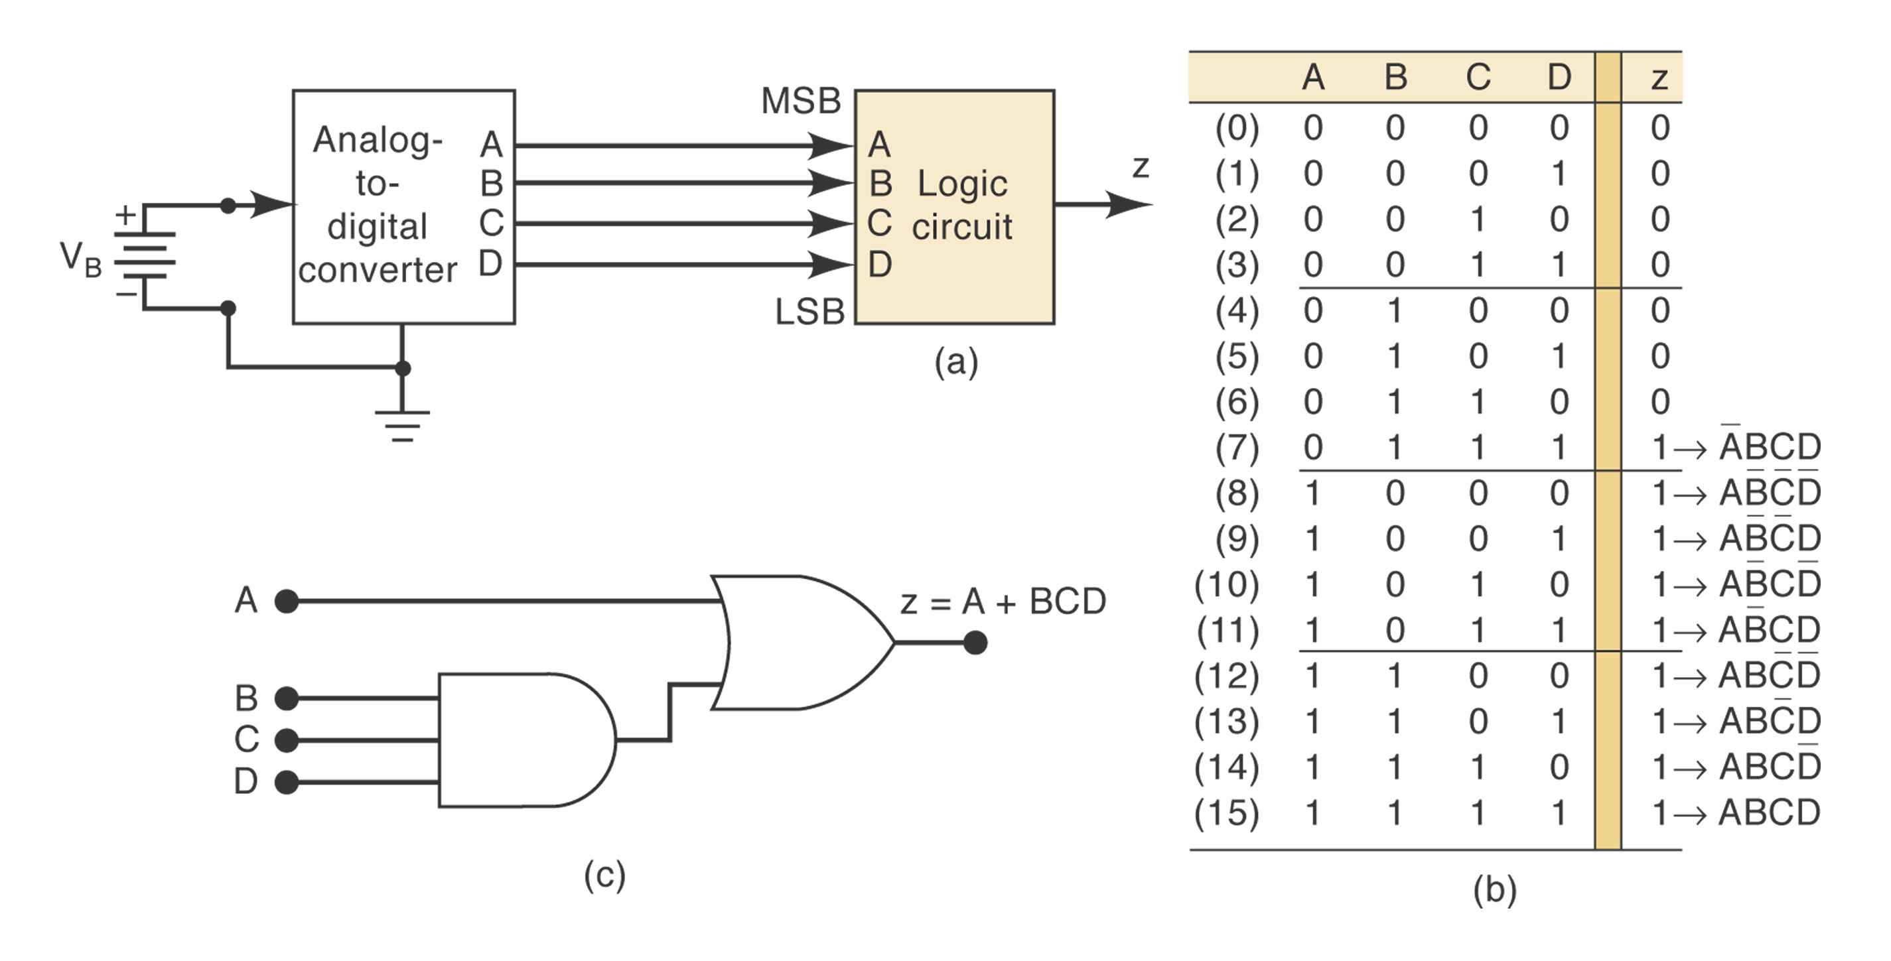
Example 4-8: Answer

Slide 17
Example 4-9
Generate the STOP signal and energize an indicator light whenever either of the following conditions exists: (1) there is no paper in the paper feeder tray; or (2) the two micro-switches in the paper path are activated, indicating a jam.

Slide 18
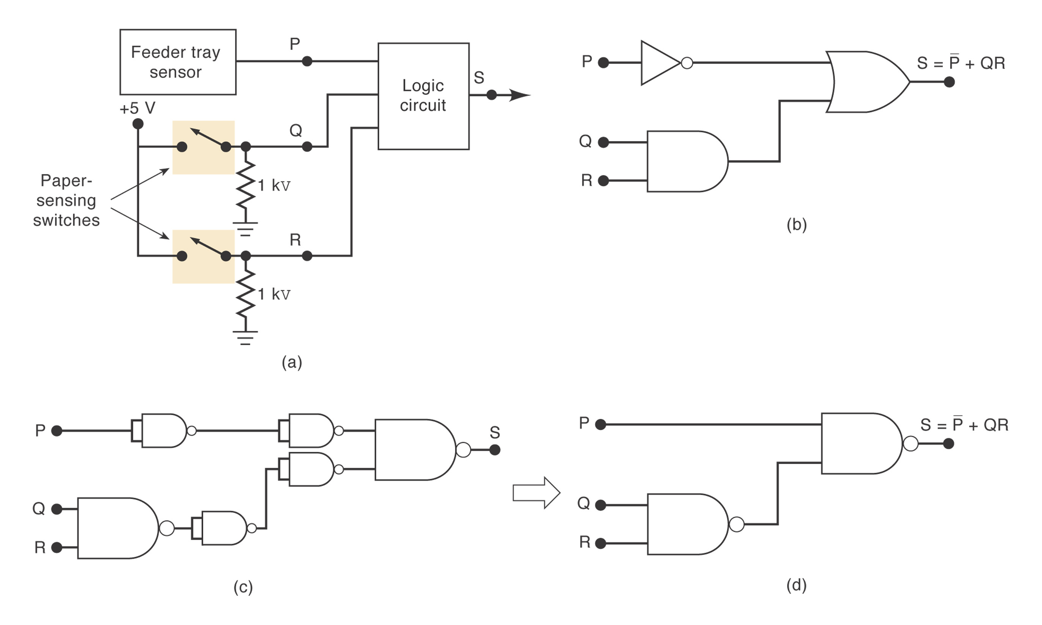
Example 4-9: Answer

Slide 19
Karnaugh Map Method
A graphical device to simplify a logic expression.
Will only work on examples with up to 4 input variables.
From truth table to logic expression to K map.
Figure 4.11 shows the K map with 2,3 and 4 variables.

Slide 20
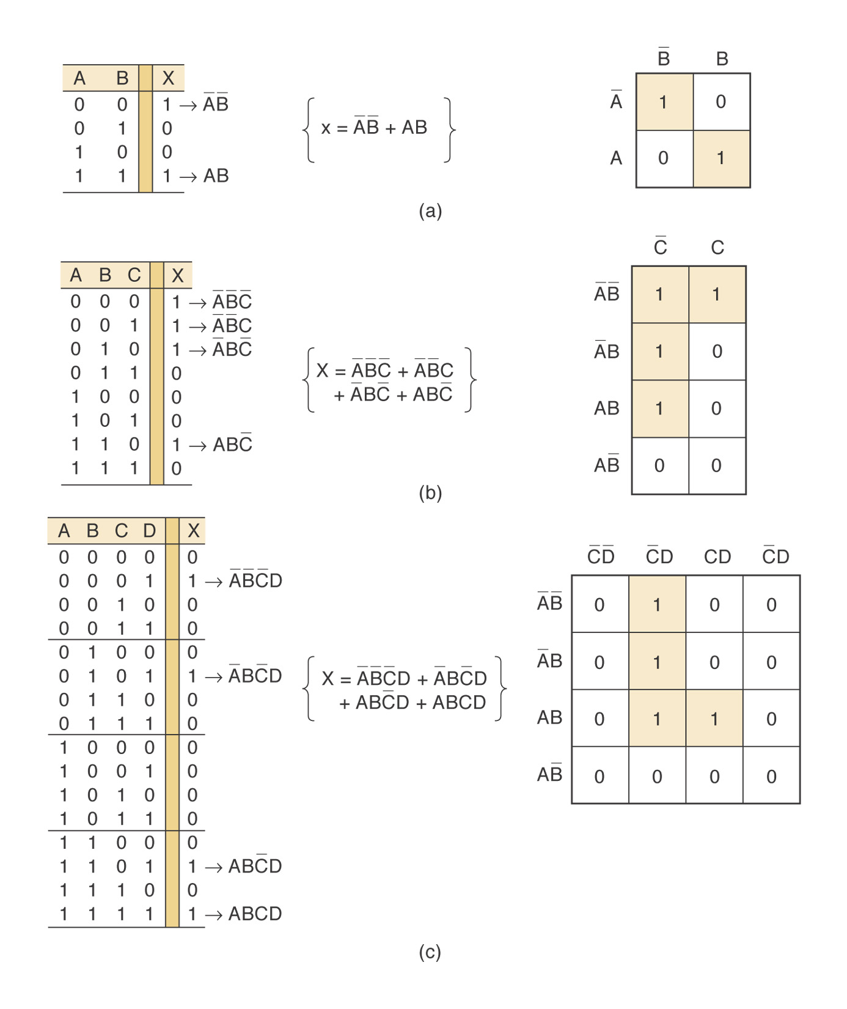
Figure 4.11

Slide 21
Looping
The expression for output X can be simplified by properly combining those squares in the K map which contain 1s. The process of combining these 1s is called looping.
Looping groups of two (pairs) → eliminate 1 variable
Looping groups of four (quads) → eliminate 2 variables
Looping groups of eight (octets)→ eliminate 3 variables
See Figure 4-12 to 4-14.

Slide 22
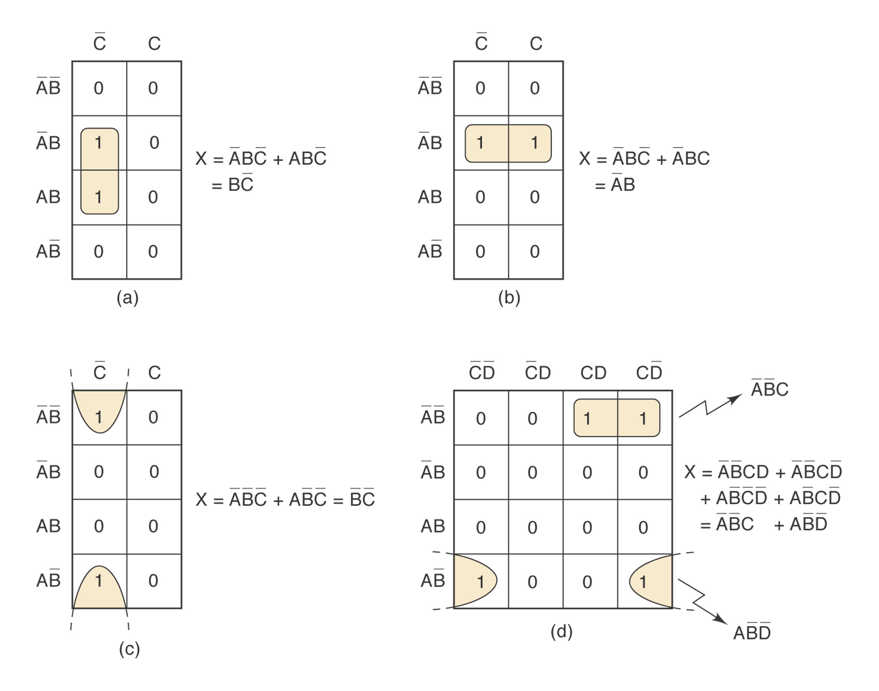
Figure 4-12: Looping Pairs

Slide 23
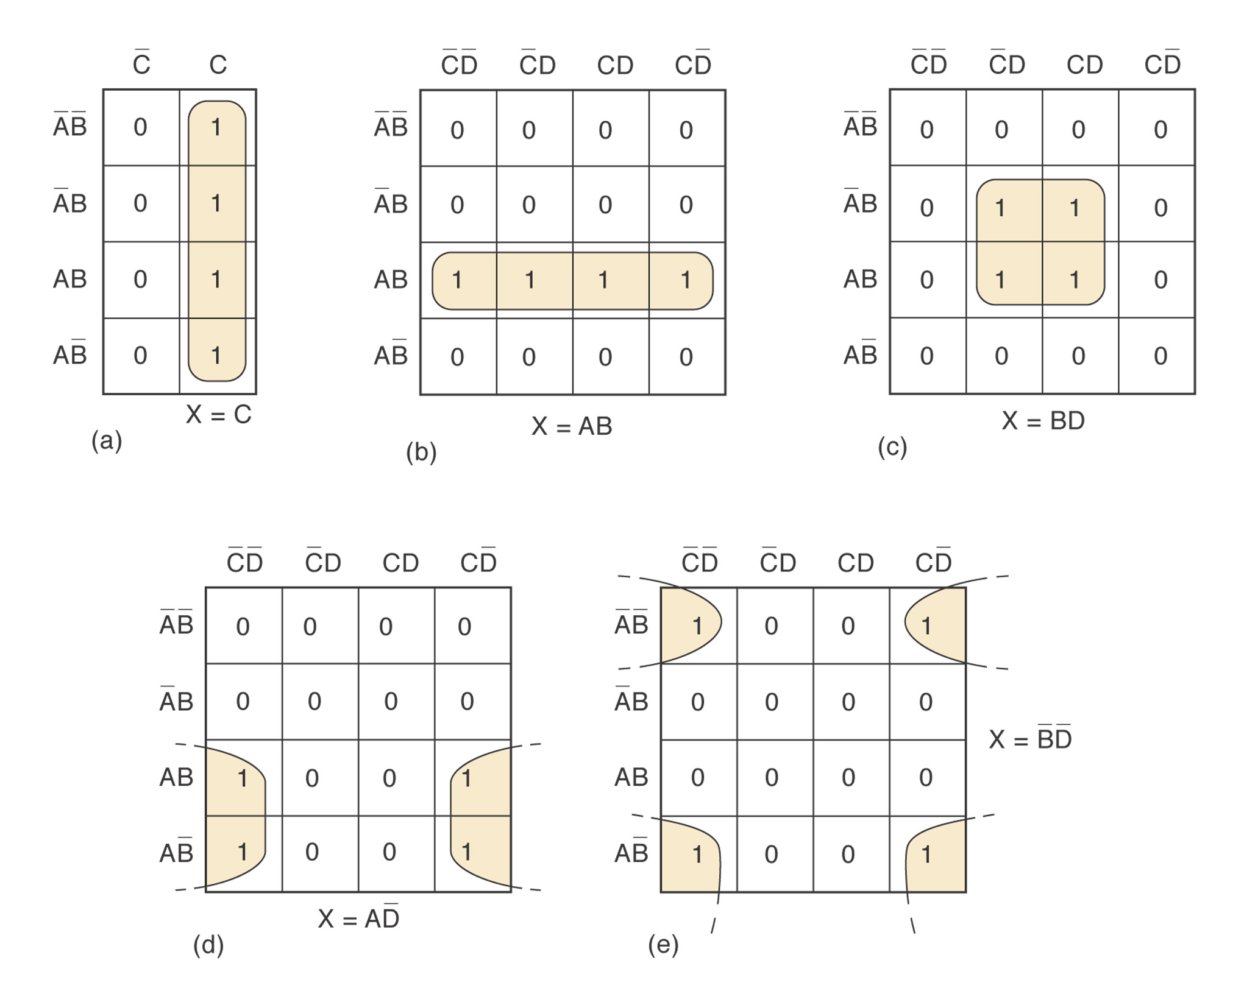
Figure 4-13: Looping Quads

Slide 24
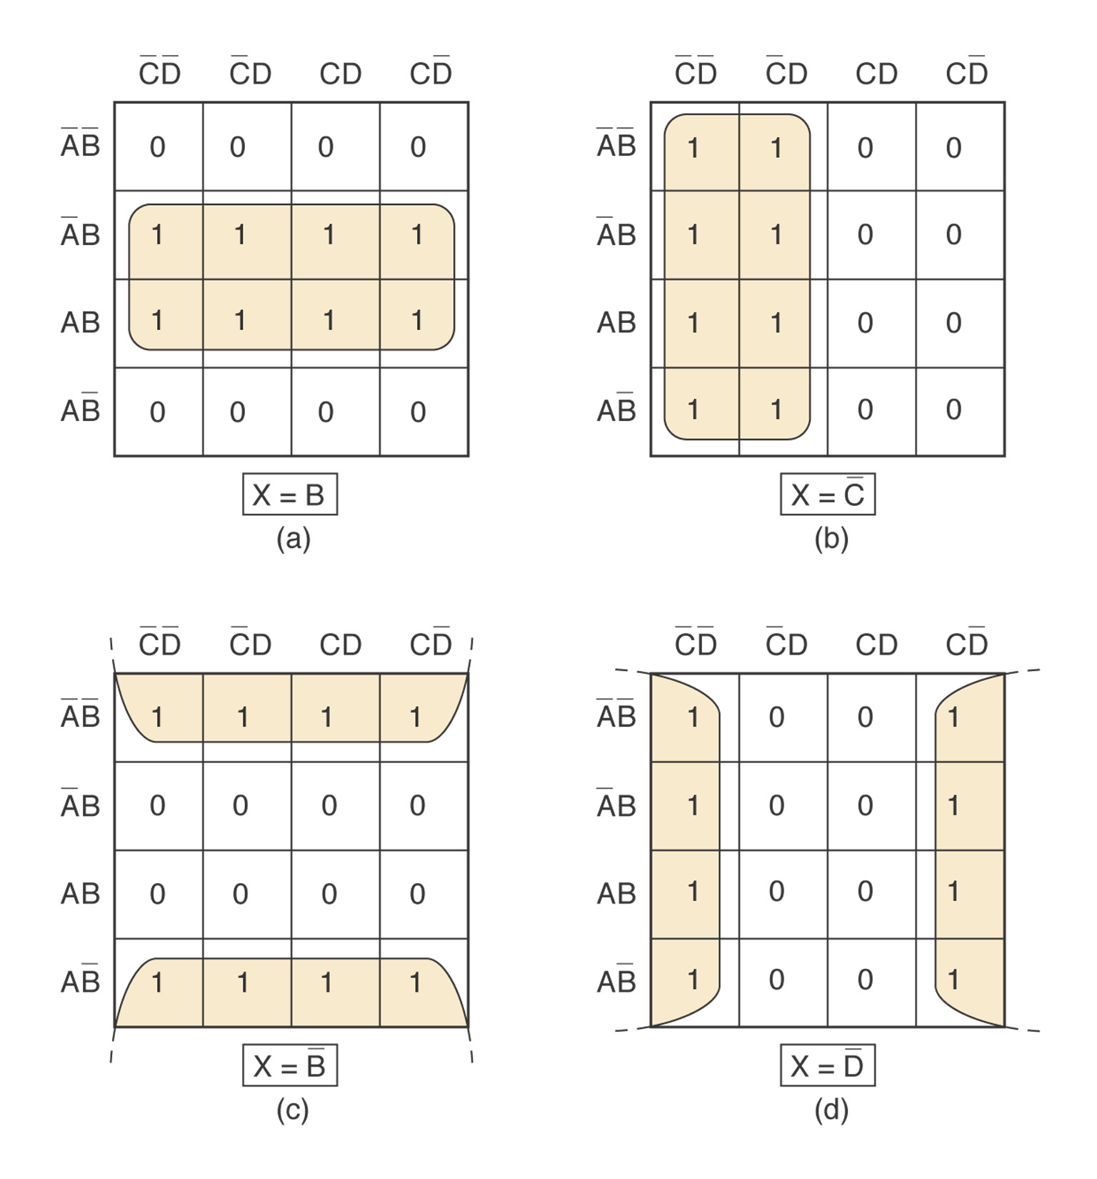
Figure 4-14: Looping Octets

Slide 25
Complete Simplification Process
Step 1: Construct the K map and places 1s in those squares corresponding to the 1s in the truth table. Places 0s in the other squares.
Step 2: Examine the map for adjacent 1s and loop those 1s which are not adjacent to any other 1s. (isolated 1s)
Step 3: Look for those 1s which are adjacent to only one other 1. Loop any pair containing such a 1.
Step 4: Loop any octet even when it contains some 1s that have already been looped.

Slide 26
Complete Simplification Process
Step 5: Loop any quad that contains one or more 1s that have not already been looped, making sure to use the minimum number of loops.
Step 6: Loop any pairs necessary to include any 1s have not already been looped, making sure to use the minimum number of loops.
Step 7: Form the ORed sum of all the terms generated by each loop.

Slide 27
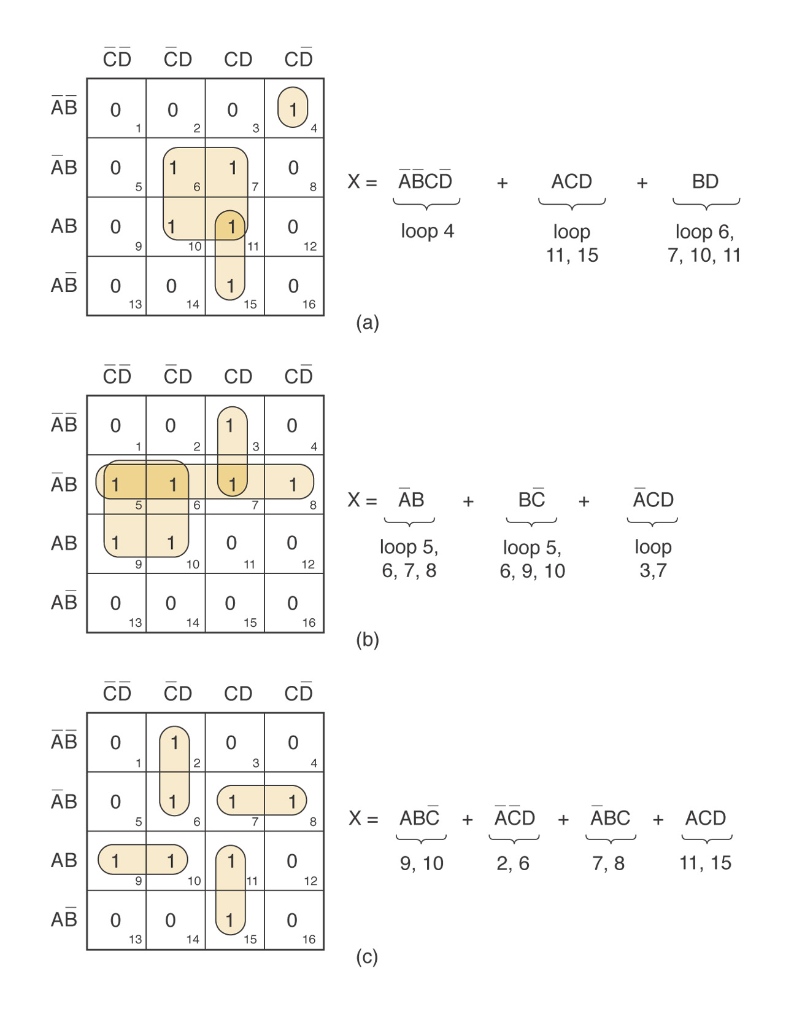
Examples

Slide 28
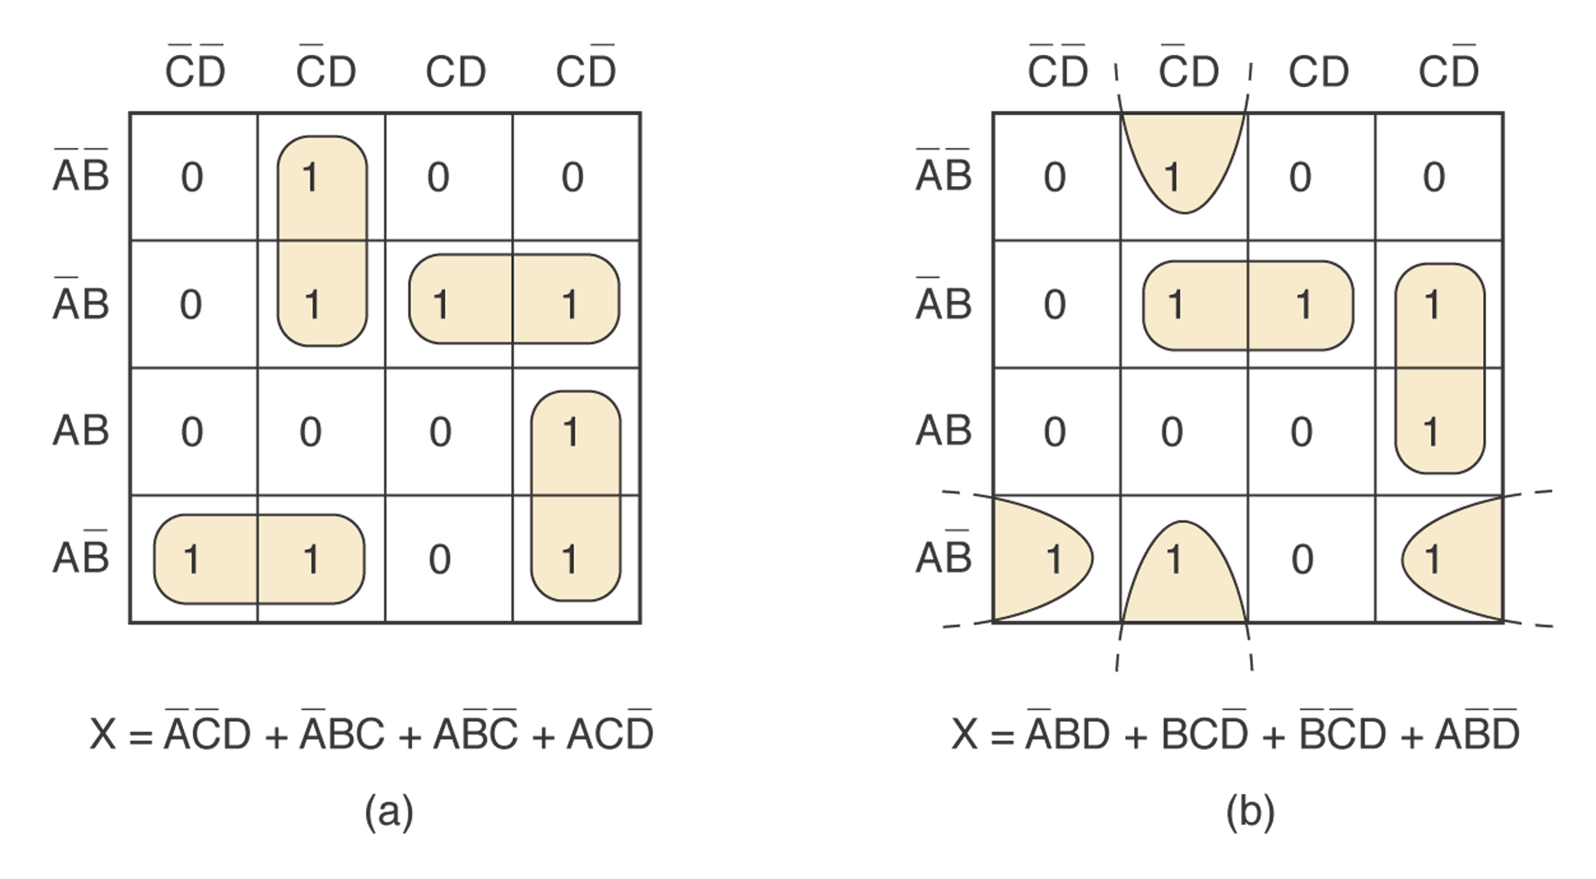
More Examples

Slide 29
Filling K Map from Output Expression
What to do when the desired output is presented as a Boolean expression instead of a truth table?
Step 1: Convert the expression into SOP form.
Step 2: For each product term in the SOP expression, place a 1 in each K-map square whose label contains the same combination of input values. Place a 0 in other squares.
Example 4-14: y=C’(A’B’D’+D)+AB’C+D’

Slide 30
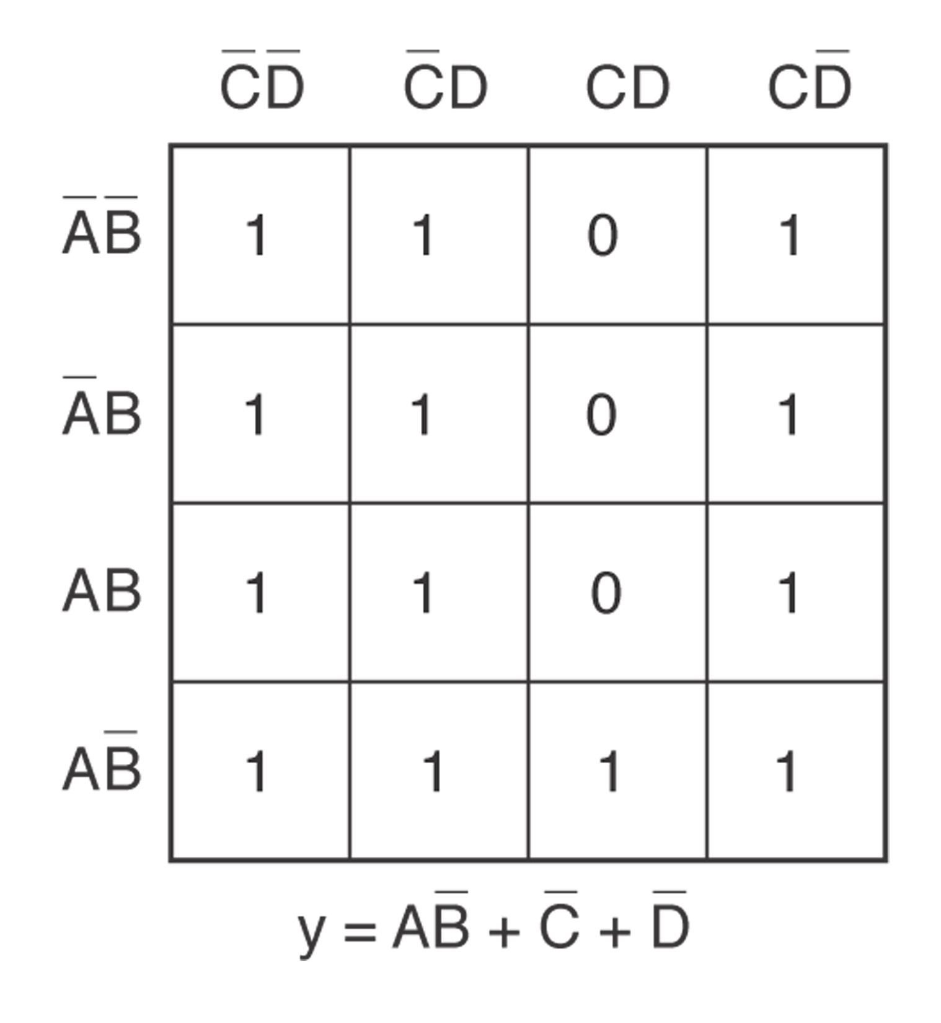
Example 4-14

Slide 31
Don’t-Care Conditions
Some logic circuits can be designed so that there are certain input conditions for which there are no specified output levels.
A circuit designer is free to make the output for any don’t care condition either a 0 or a 1 in order to produce the simplest output expression.
Figures 4-18,19.

Slide 32
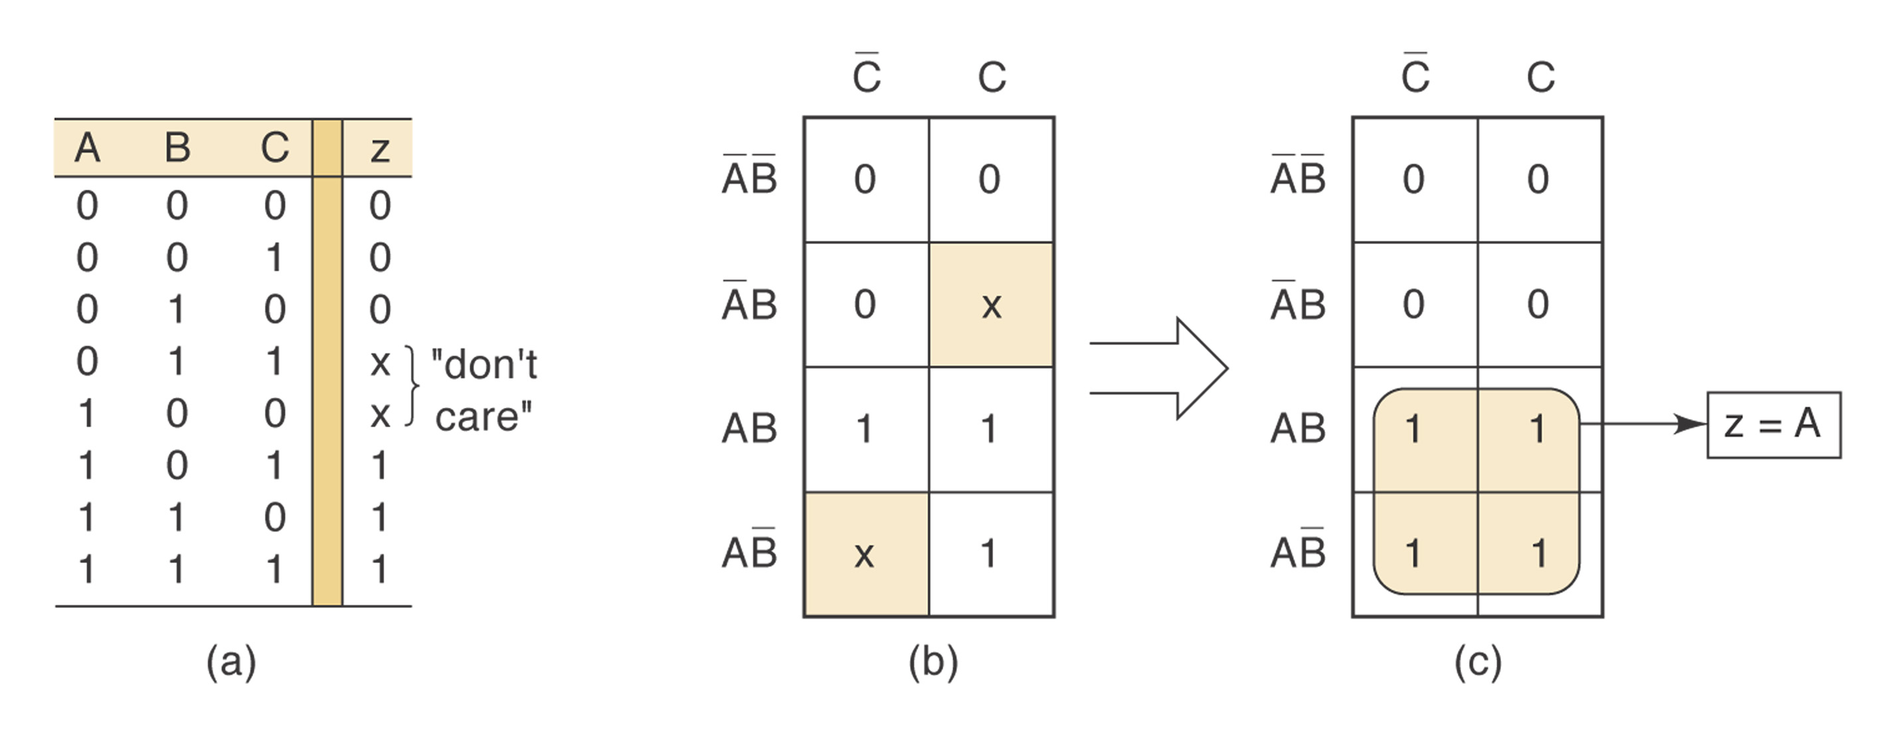
Figure 4-18

Slide 33
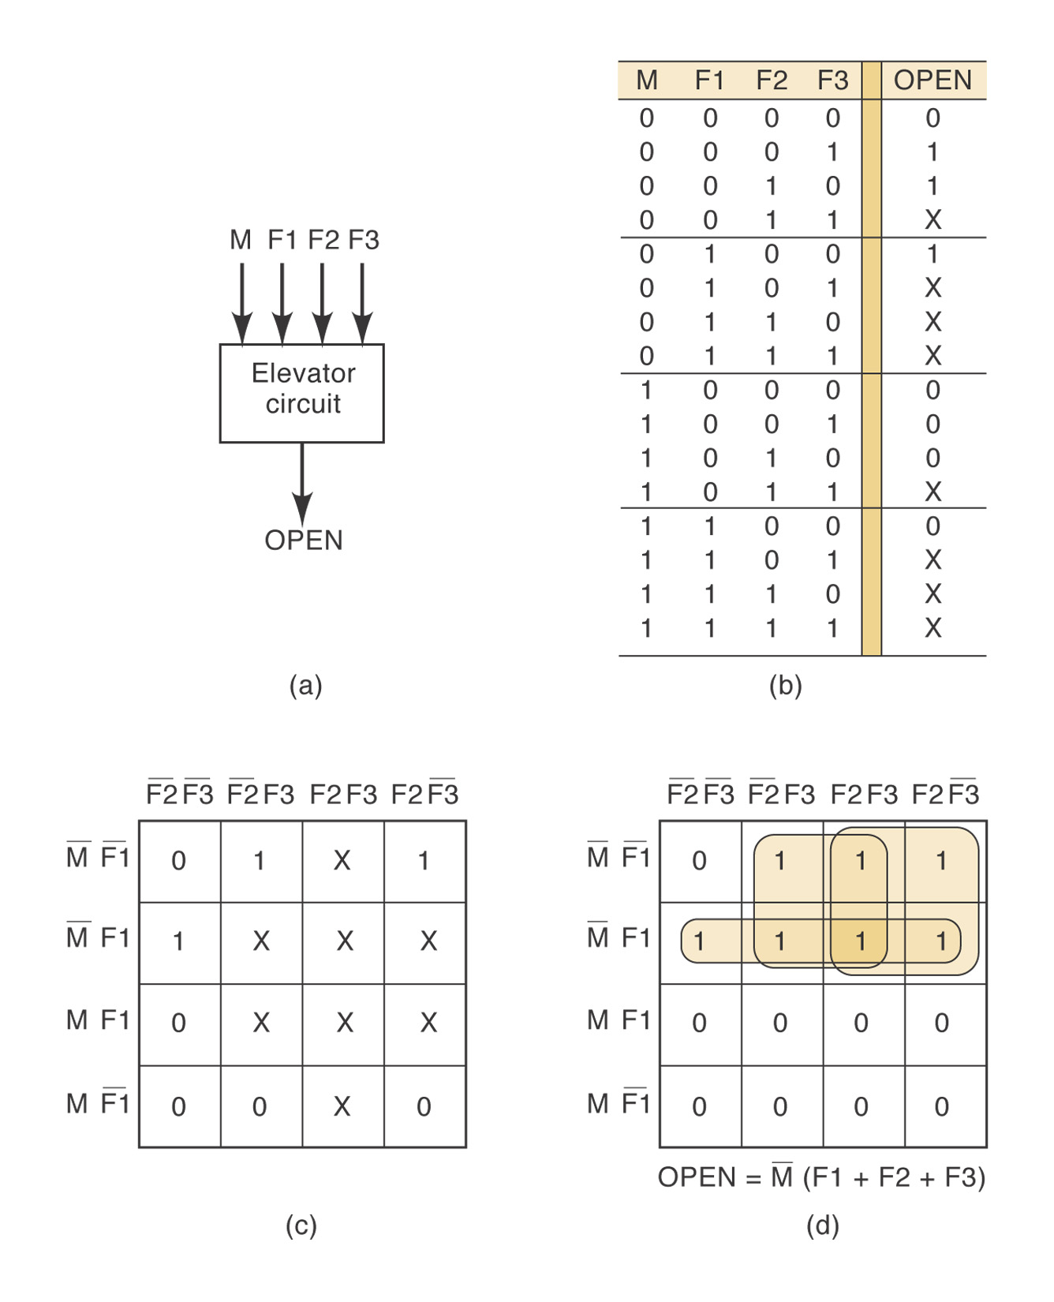
Figure 4-19

Slide 34

Exclusive-OR
Exclusive-OR (XOR)
x = A’B+AB’
Timing diagram
XOR
A | B | x
0 | 0 | 0
0 | 1 | 1
1 | 0 | 1
1 | 1 | 0
=1

Slide 35
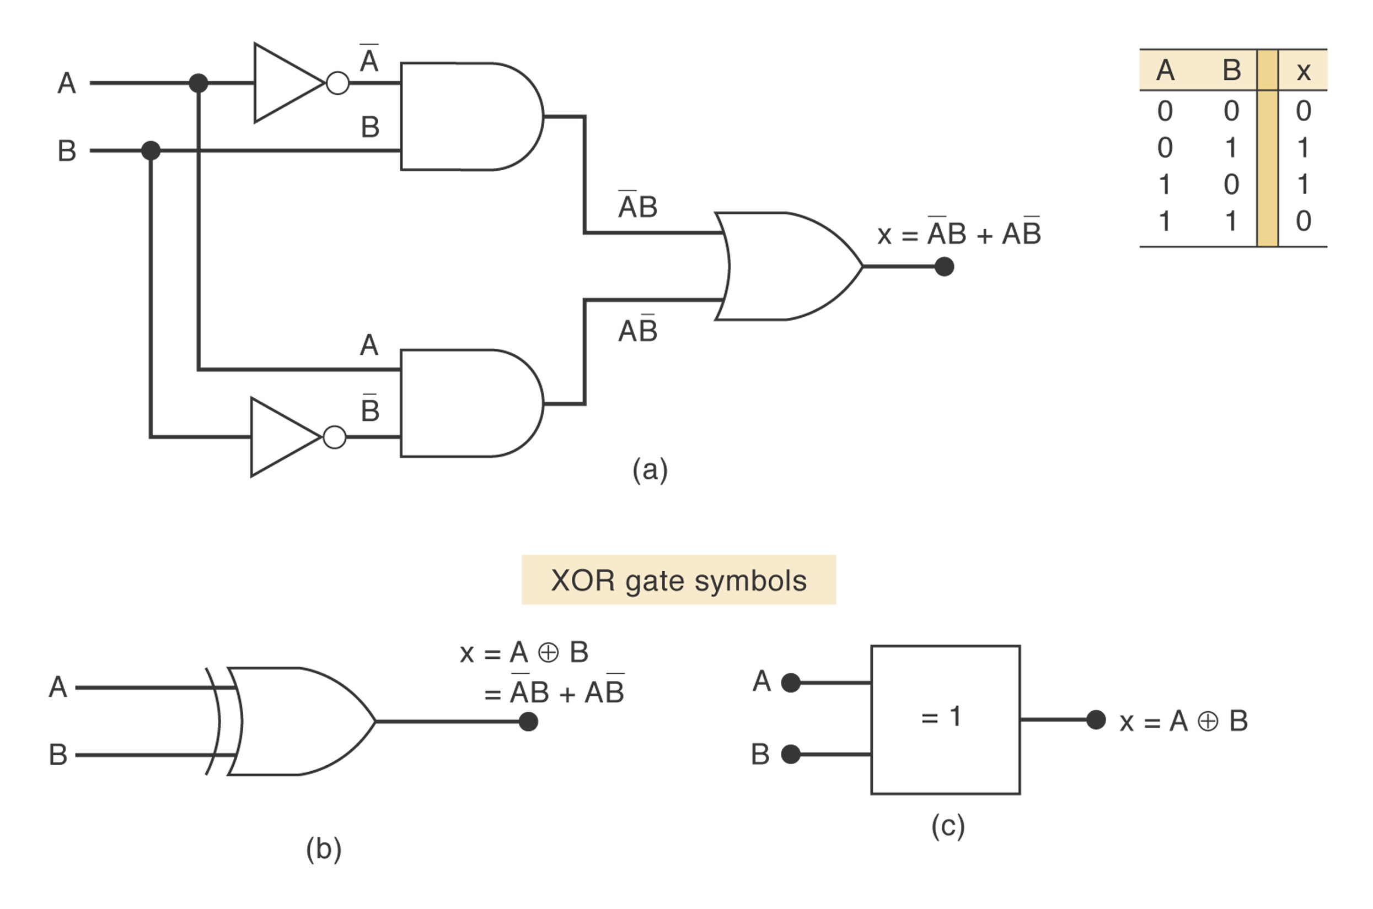
XOR

Slide 36

Exclusive-NOR
Exclusive-NOR (XNOR)_x000b_
x = (A’B+AB’)’
XNOR
A | B | x
0 | 0 | 1
0 | 1 | 0
1 | 0 | 0
1 | 1 | 1
=1

Slide 37
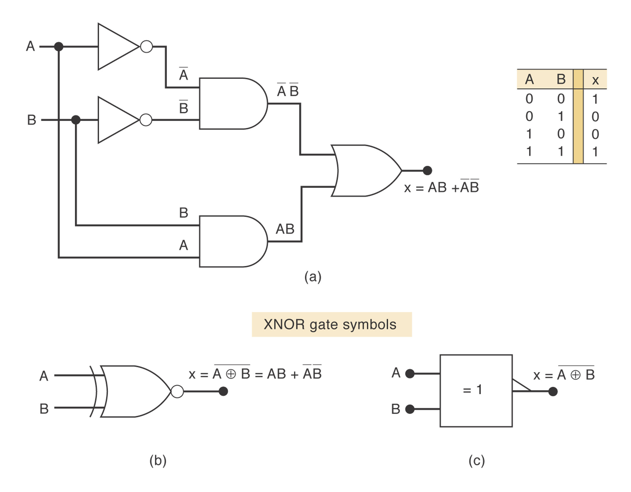
XNOR

Slide 38
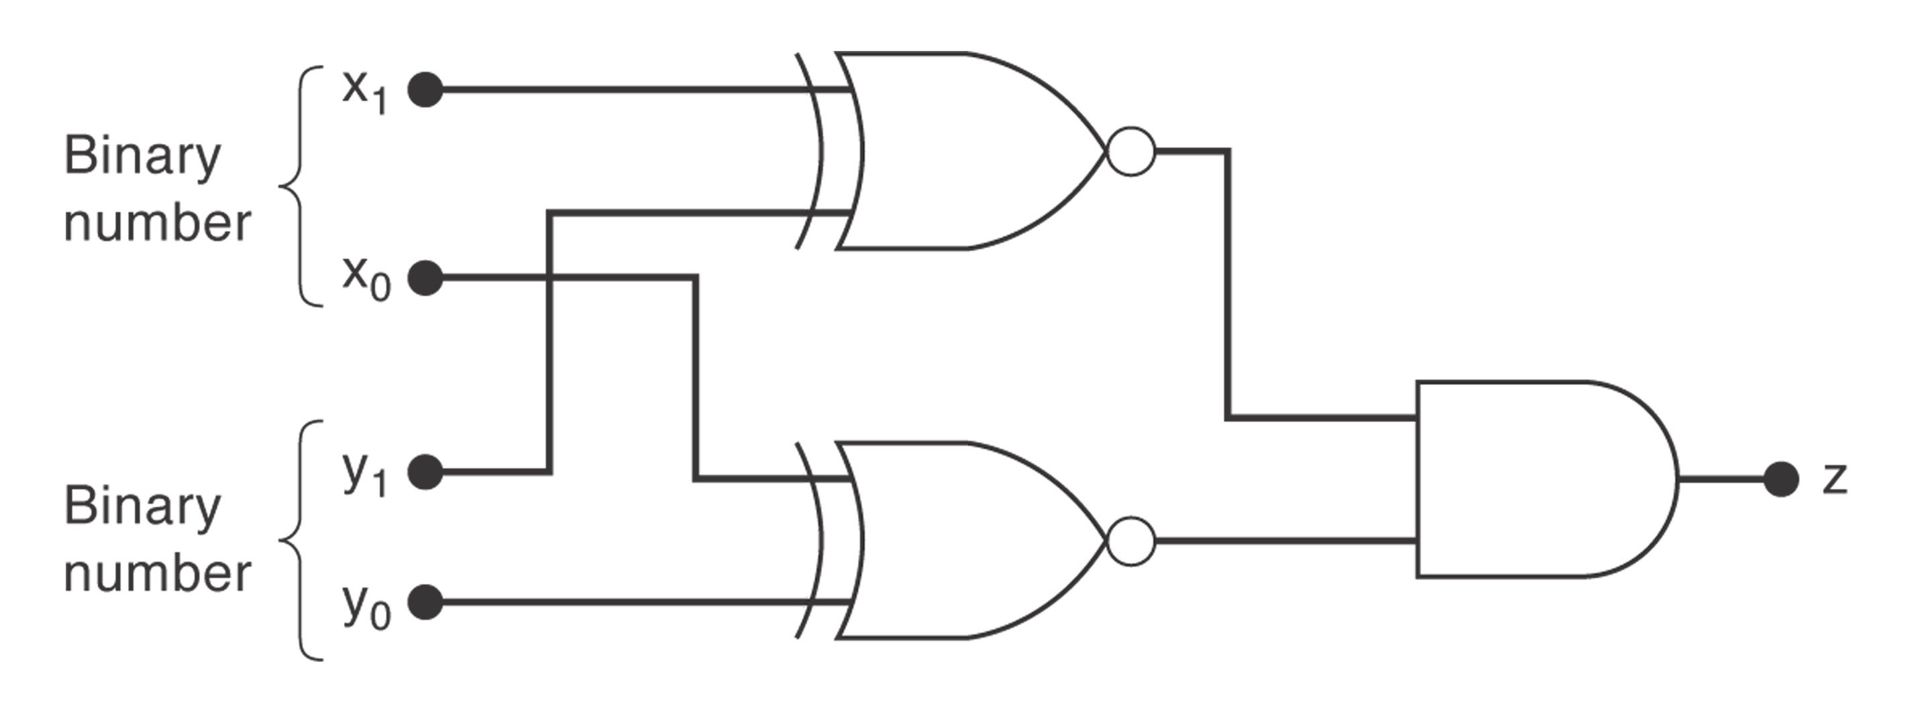
Example 4-17
Design a logic circuit, using x₁, x₀, y₁ and y₀ inputs, whose output will be HIGH only when the two binary numbers x₁x₀ and y₁y₀ are equal.
Hint: use XNOR gates (Figure 4-23)

Slide 39
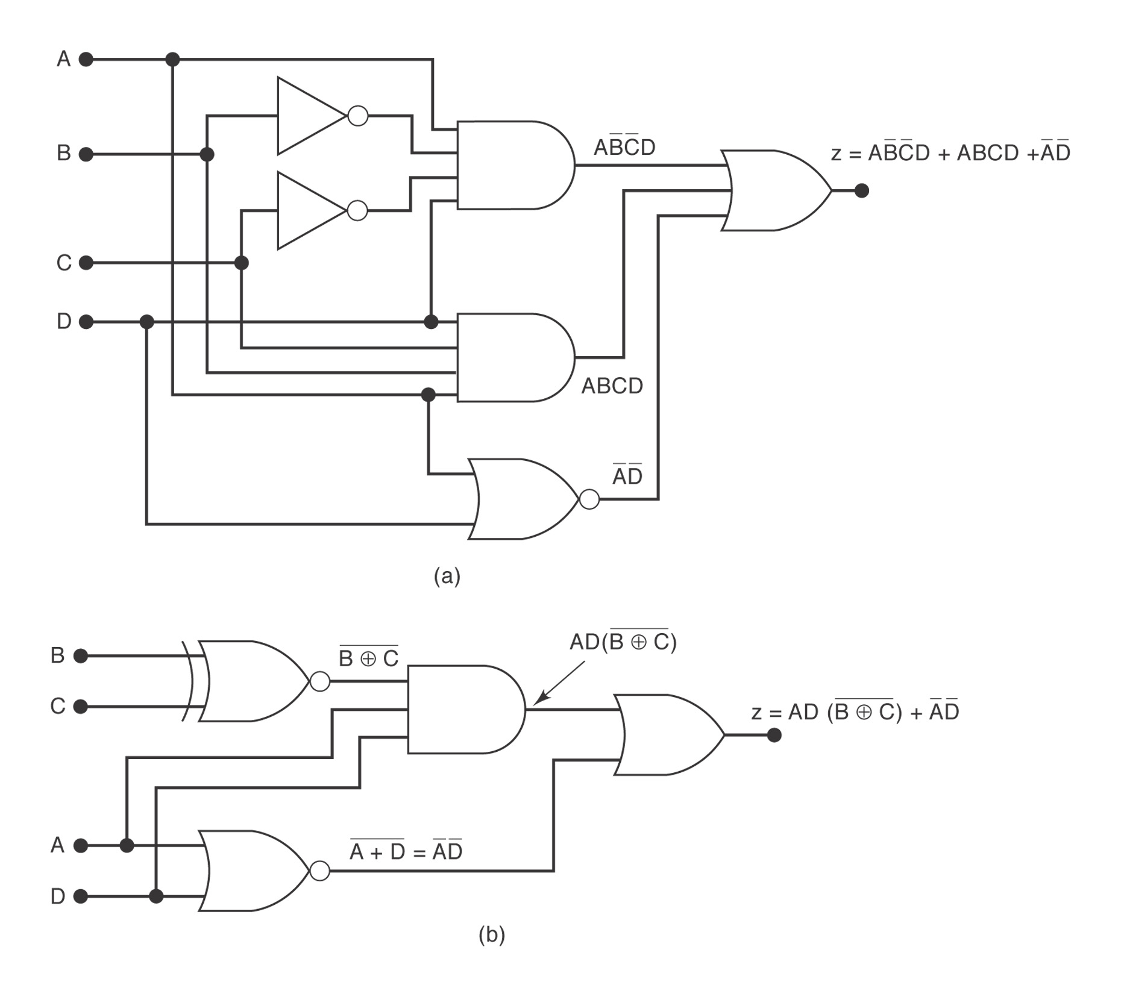
Using XNOR to Simplify Circuit Implementation
Example 4-18

Slide 40
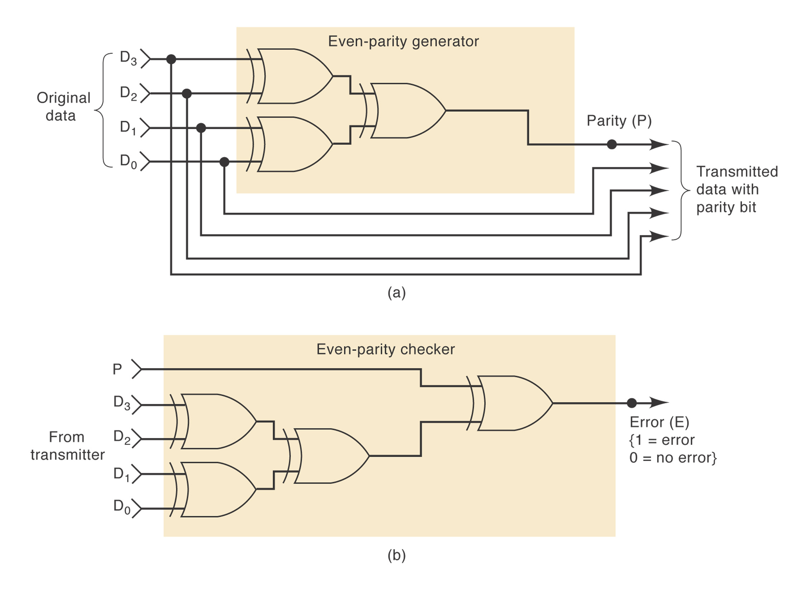
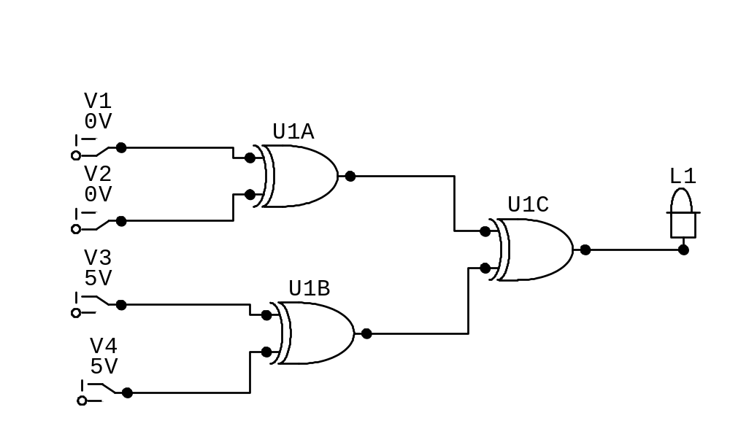
Parity Generator and Checker

Slide 41
Enable/Disable Circuits
Each of the basic logic gates can be used to control the passage of an input logic signal through to the output.
A: input, B: control (Figure 4-26)
The logic level at the control input determines whether the input signal is enabled to reach the output or disabled from reaching the output.

Slide 42
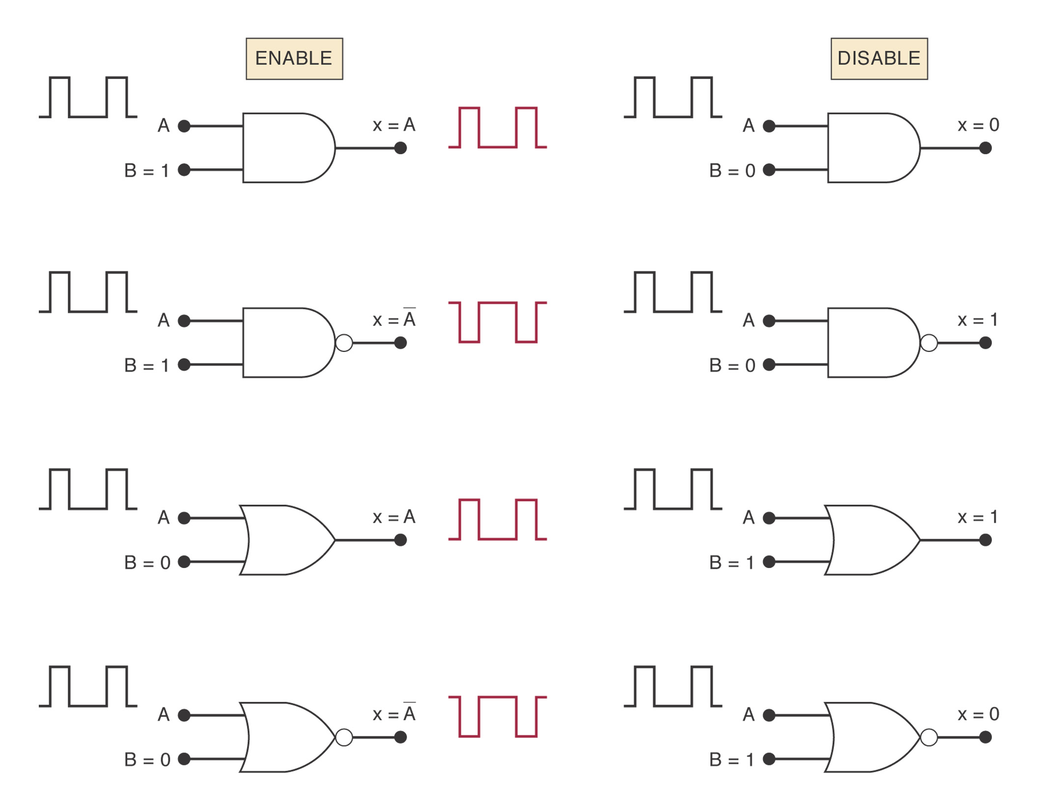
Figure 4-26

