Slide 1



Slide 2
Chapter 3 – Describing Logic Circuits

Slide 3
Chapter 3 Objectives
Selected areas covered in this chapter:
  Operation of truth tables for AND, NAND, OR, and NOR gates, and the NOT (INVERTER) circuit.
  Boolean expression for logic gates.
  DeMorgan’s theorems to simplify logic expressions.
  Universal gates (NAND or NOR) to implement a circuit represented by a Boolean expression.
  Concepts of active-LOW & active-HIGH logic signals.
  Describing and measuring propagation delay time.
  Differences between an HDL and a computer programming language.

Slide 4
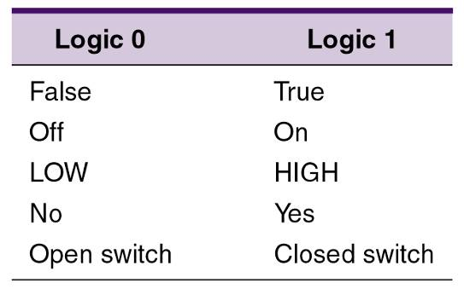
3-1 Boolean Constants and Variables
Boolean algebra allows only two values—0 and 1.
  Logic 0 can be: false, off, low, no, open switch.
  Logic 1 can be: true, on, high, yes, closed switch.
The three basic logic operations:
  OR, AND, and NOT.

Slide 5
3-2 Truth Tables
A truth table describes the relationship between the input and output of a logic circuit.
The number of entries corresponds to the number of inputs.
  A 2-input table would have 2² = 4 entries.
  A 3-input table would have 2³ = 8 entries.

Slide 6
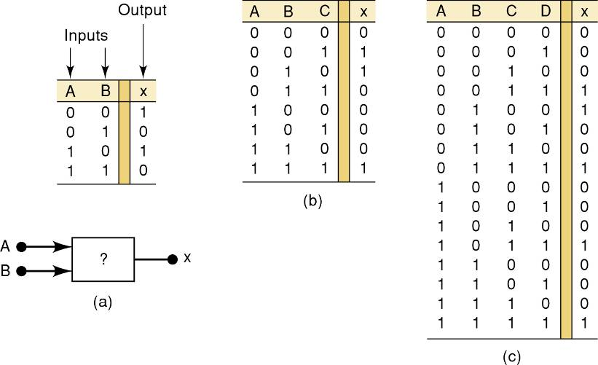
3-2 Truth Tables
Examples of truth tables with 2, 3, and 4 inputs.

Slide 7
3-3 OR Operation With OR Gates
The Boolean expression for the OR operation is:
    X = A + B — Read as “X equals A OR B”
The + sign does not stand for ordinary
addition—it stands for the OR operation
The OR operation is similar to addition, but when A = 1 and B = 1, the OR operation produces:
1 + 1 = 1 not 1 + 1 = 2
In the Boolean expression x = 1 + 1 + 1 = 1…
    x is true (1) when A is true (1) OR B is true (1) OR C is true (1)

Slide 8
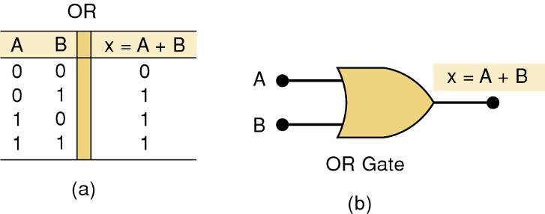
3-3 OR Operation With OR Gates
An OR gate is a circuit with two or more inputs, whose output is equal to the OR combination
of the inputs.
Truth table/circuit symbol for a two input OR gate.

Slide 9
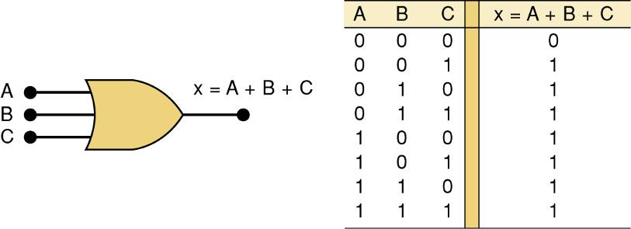
3-3 OR Operation With OR Gates
An OR gate is a circuit with two or more inputs, whose output is equal to the OR combination
of the inputs.
Truth table/circuit symbol for a three input OR gate.

Slide 10
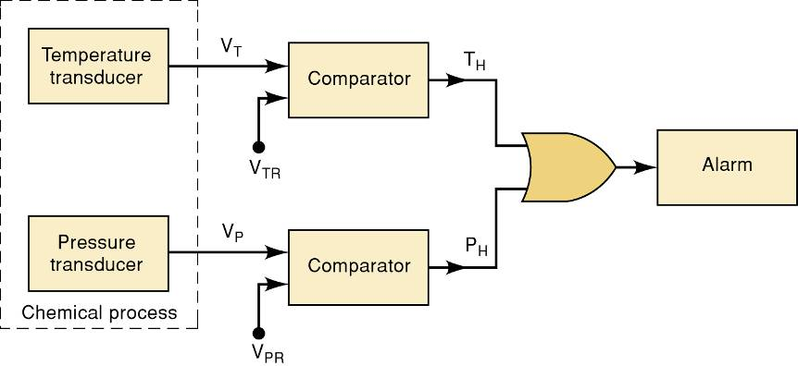
3-3 OR Operation With OR Gates
Example of the use of an OR
gate in an alarm system.

Slide 11
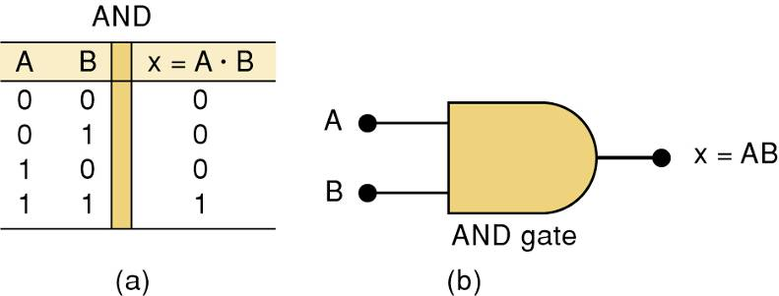
3-4 AND Operations with AND gates
The AND operation is similar to multiplication:
X = A • B • C — Read as “X equals A AND B AND C”
The + sign does not stand for ordinary
multiplication—it stands for the AND operation.
    x is true (1) when A AND B AND C are true (1)
Truth table — Gate symbol.

Slide 12
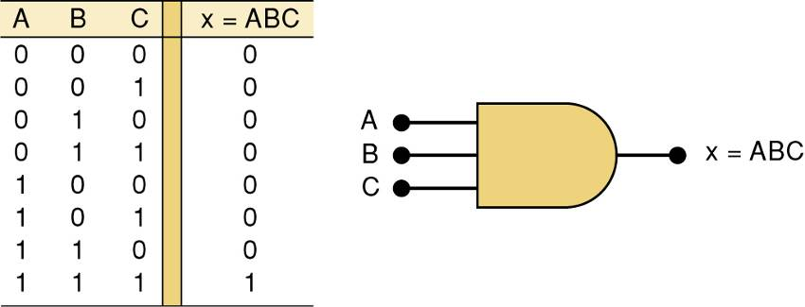
3-4 AND Operations with AND gates
Truth table/circuit symbol for a three input AND gate.

Slide 13
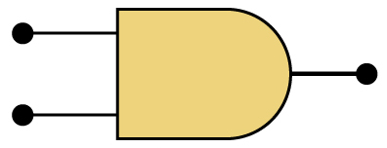
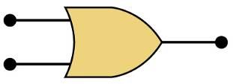
AND / OR
The AND symbol on a logic-circuit diagram tells you output will go HIGH only
when all inputs are HIGH.
The OR symbol means the output will go HIGH when
any input is HIGH.

Slide 14
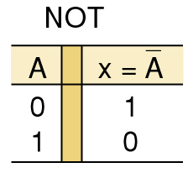
3-5 NOT Operation
The Boolean expression for the NOT operation:
X = A
— Read as:
“X equals NOT A”
“X equals the inverse of A”
“X equals the complement of A”
The overbar represents
the NOT operation.
A' = A
Another indicator for inversion is the
prime symbol (').
    NOT Truth Table

Slide 15
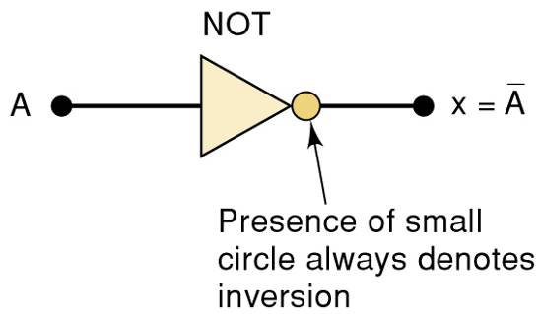
3-5 NOT Operation
A NOT circuit—commonly called an INVERTER.
This circuit always has only a single input, and the out-put
logic level is always opposite to the logic level of this input.

Slide 16
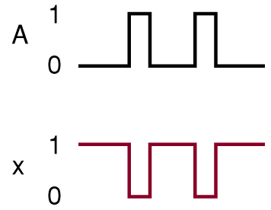
3-5 NOT Operation
The INVERTER inverts (complements) the
input signal at all points on the waveform.
Whenever the input = 0, output = 1, and vice versa.

Slide 17
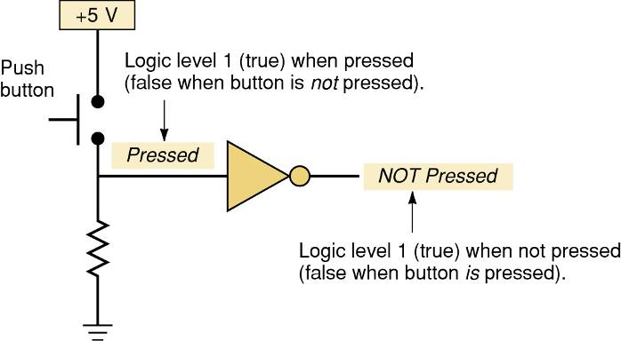
3-5 NOT Operation
Typical application of the NOT gate.
This circuit provides an expression that
is true when the button is not pressed.

Slide 18
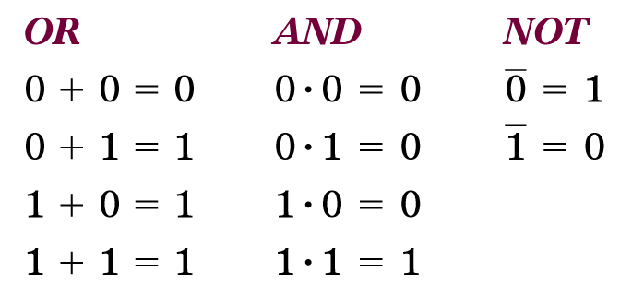
Boolean Operations
Summarized rules for OR, AND and NOT
These three basic Boolean operations
can describe any logic circuit.

Slide 19
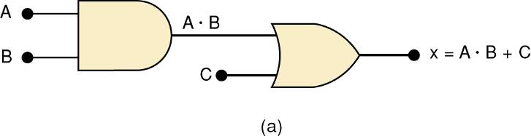
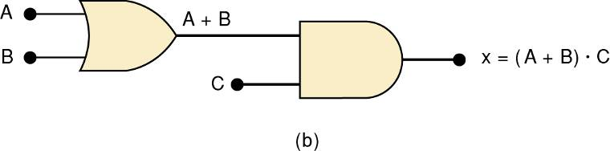
3-6 Describing Logic Circuits Algebraically
If an expression contains both AND and OR gates, the AND operation will be performed first.
Unless there is a parenthesis in the expression.

Slide 20
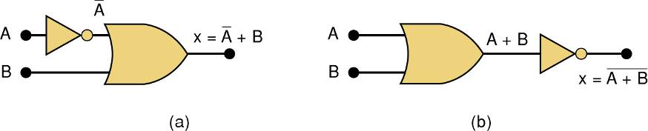
3-6 Describing Logic Circuits Algebraically
Whenever an INVERTER is present, output is equivalent to input, with a bar over it.
  Input A through an inverter equals A.

Slide 21
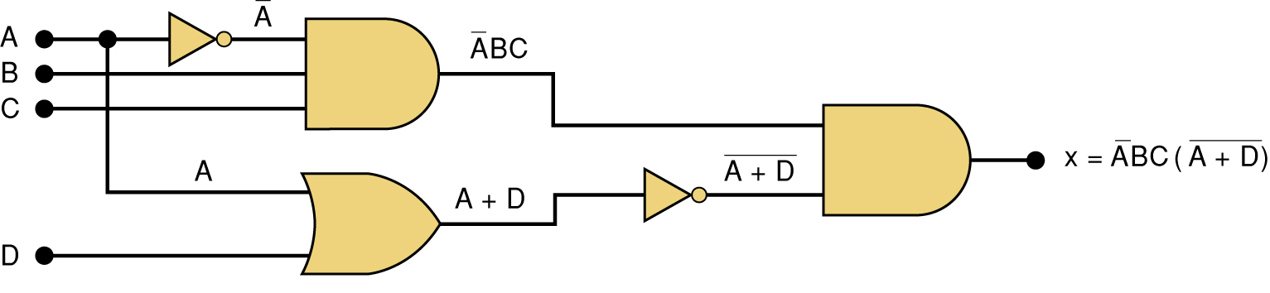
3-6 Describing Logic Circuits Algebraically
Further examples…

Slide 22
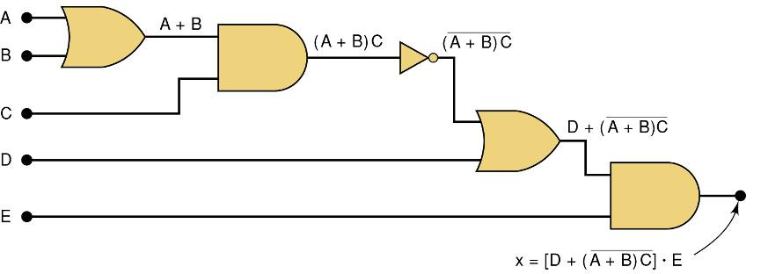
3-6 Describing Logic Circuits Algebraically
Further examples…

Slide 23
3-7 Evaluating Logic Circuit Outputs
Rules for evaluating a Boolean expression:
  Perform all inversions of single terms.
  Perform all operations within parenthesis.
  Perform AND operation before an OR operation unless parenthesis indicate otherwise.
  If an expression has a bar over it, perform operations inside the expression, and then invert the result.

Slide 24
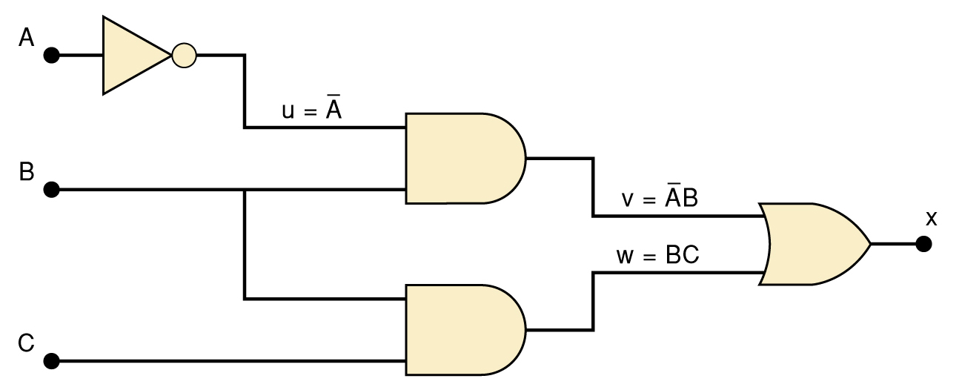
3-7 Evaluating Logic Circuit Outputs
The best way to analyze a circuit made up of multiple logic gates is to use a truth table.
  It allows you to analyze one gate or logic
  combination at a time.
  It allows you to easily double-check your work.
  When you are done, you have a table of tremendous benefit in troubleshooting the logic circuit.

Slide 25
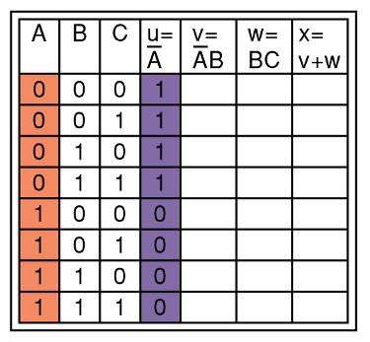
3-7 Evaluating Logic Circuit Outputs
The first step after listing all input combinations
is to create a column in the truth table for each intermediate signal (node).
Node u has been filled as the complement of A

Slide 26
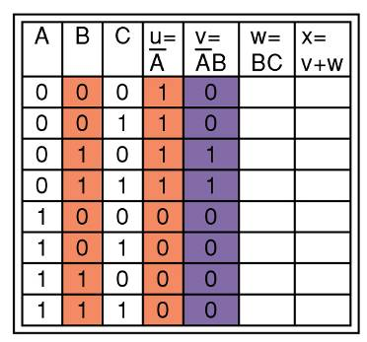
3-7 Evaluating Logic Circuit Outputs
The next step is to fill in the values for column v.
v =AB — Node v should be HIGH
when A (node u) is HIGH AND B is HIGH

Slide 27
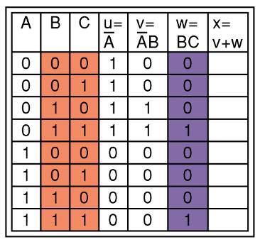
3-7 Evaluating Logic Circuit Outputs
The third step is to predict the values at node w which is the logical product of BC.
This column is HIGH whenever B is HIGH AND C is HIGH

Slide 28
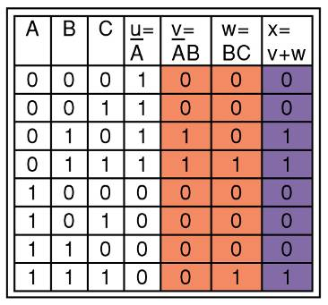
3-7 Evaluating Logic Circuit Outputs
The final step is to logically combine columns v and w to predict the output x.
Since x = v + w, the x output will be HIGH when v OR w is HIGH

Slide 29
3-7 Evaluating Logic Circuit Outputs
Output logic levels can be determined directly from a circuit diagram.
  Output of each gate is noted until final output is found.
    Technicians frequently use this method.

Slide 30
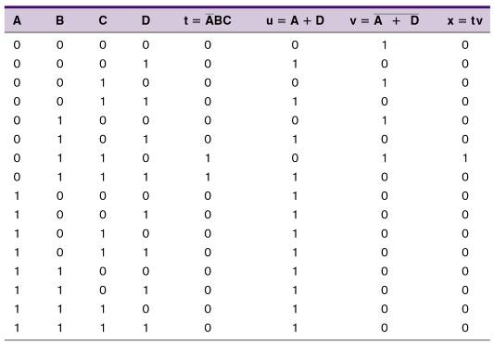
3-7 Evaluating Logic Circuit Outputs
Table of logic state
at each node of the
circuit shown.

Slide 31
3-8 Implementing Circuits From Boolean Expressions
It is important to be able to draw a logic circuit from a Boolean expression.
  The expression X = A • B • C, could be drawn
  as a three input AND gate.
  A circuit defined by X = A + B, would use a two-input OR gate with an INVERTER on one of
  the inputs.

Slide 32
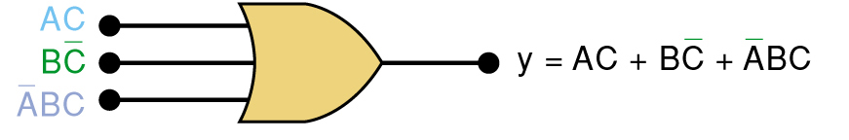
3-8 Implementing Circuits From Boolean Expressions
A circuit with output y = AC + BC + ABC
contains three terms which are ORed together.
…and requires a three-input OR gate.

Slide 33
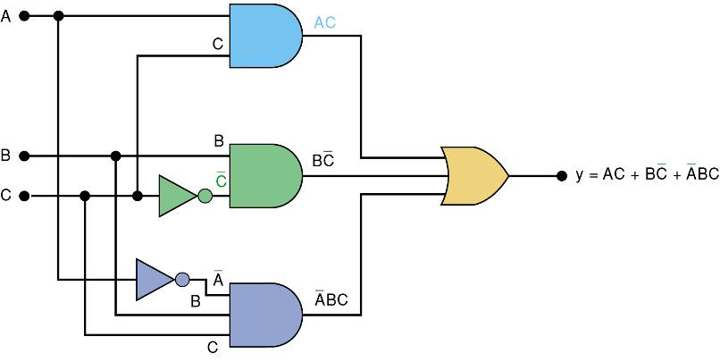
3-8 Implementing Circuits From Boolean Expressions
Each OR gate input is an AND product term,
  An AND gate with appropriate inputs can be
  used to generate each of these terms.

Slide 34
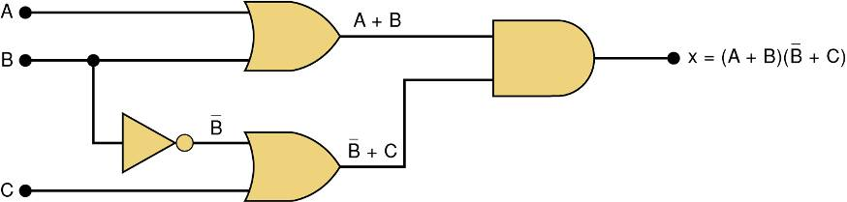
3-8 Implementing Circuits From Boolean Expressions
Circuit diagram to implement x = (A + B) (B + C)

Slide 35
3-9 NOR Gates and NAND Gates
Combine basic AND, OR, and NOT operations.
  Simplifying the writing of Boolean expressions
Output of NAND and NOR gates may be found
by determining the output of an AND or OR
gate, and inverting it.
  The truth tables for NOR and NAND gates show the complement of truth tables for OR and AND gates.

Slide 36
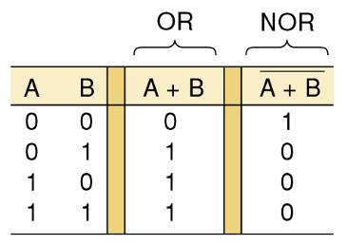
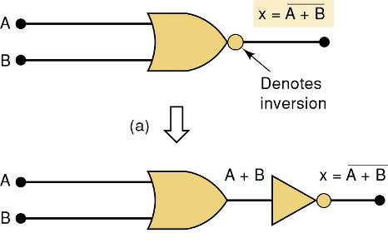
3-9 NOR Gates and NAND Gates
The NOR gate is an inverted OR gate.
  An inversion “bubble” is placed at the output
  of the OR gate, making the Boolean output expression x = A + B

Slide 37
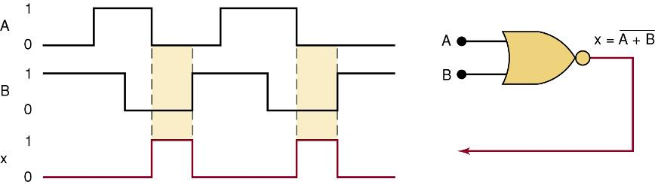
3-9 NOR Gates and NAND Gates
Output waveform of a NOR gate for
the input waveforms shown here.

Slide 38
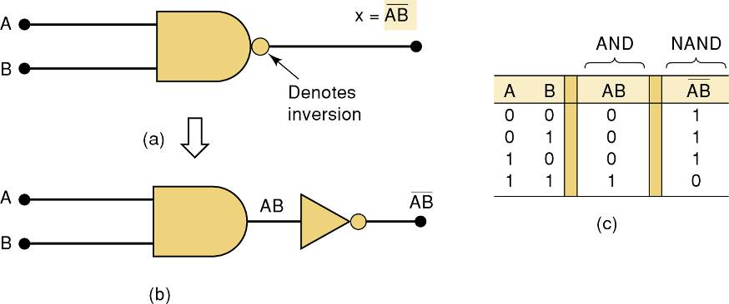
3-9 NOR Gates and NAND Gates
The NAND gate is an inverted AND gate.
  An inversion “bubble” is placed at the output
  of the AND gate, making the Boolean output
  expression x = AB

Slide 39
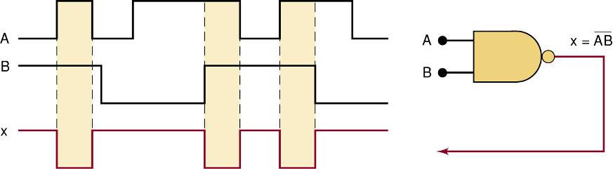
3-9 NOR Gates and NAND Gates
Output waveform of a NAND gate for
the input waveforms shown here.

Slide 40
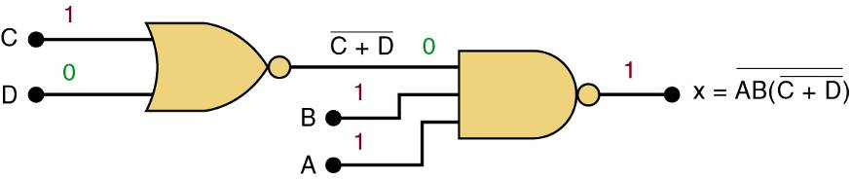
3-9 NOR Gates and NAND Gates
Logic circuit with the expression x = AB • (C + D)
using only NOR and NAND gates.

Slide 41
3-10 Boolean Theorems
The theorems or laws that follow may represent an expression containing more than one variable.

Slide 42
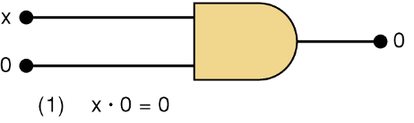
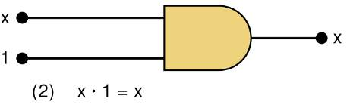
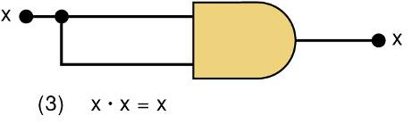
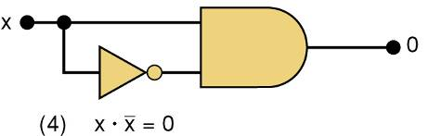
3-10 Boolean Theorems
Theorem (1) states that if any variable
is ANDed with 0, the result must be 0.
Theorem (2) is also obvious
by comparison with ordinary
multiplication.
Prove Theorem (3) by trying each case.
If x = 0, then 0 • 0 = 0
If x = 1, then 1 • 1 = 1
Thus, x • x = x
Theorem (4) can be proved
in the same manner.

Slide 43
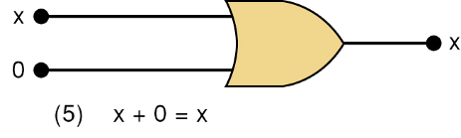
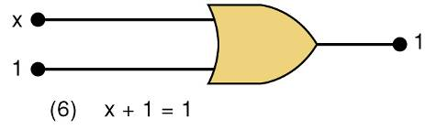
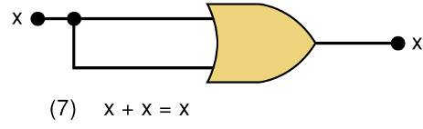
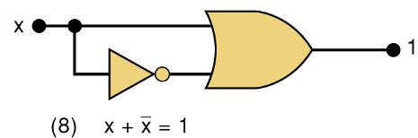
3-10 Boolean Theorems
Theorem (5) is straightforward,
as 0 added to anything does not affect value, either in regular addition or in OR addition.
Theorem (6) states that if any variable
is ORed with 1, the is always 1.
Check values: 0 + 1 = 1 and 1 + 1 = 1.
Theorem (7) can be proved by
checking for both values of x:
0 + 0 = 0 and 1 + 1 = 1.
Theorem (8) can be proved similarly.

Slide 44
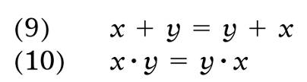


3-10 Boolean Theorems
Multivariable Theorems
Commutative laws
Associative laws
Distributive law

Slide 45
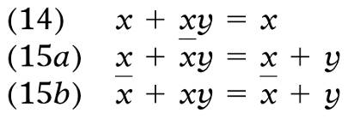
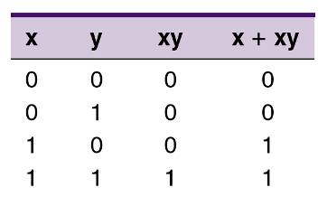

3-10 Boolean Theorems
Multivariable Theorems
Theorems (14) and (15) do not have counterparts
in ordinary algebra. Each can be proved by
trying all possible cases for x and y.
Analysis table & factoring
for Theorem (14)

Slide 46
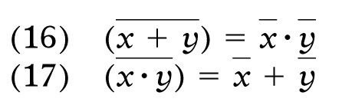
3-11 DeMorgan’s Theorems
DeMorgan’s theorems are extremely useful in simplifying expressions in which a product or
sum of variables is inverted.
Theorem (16) says inverting the OR sum of two variables is the same as inverting each variable individually, then ANDing the inverted variables.
Theorem (17) says inverting the AND product of two variables is the
same as inverting each variable individually and then ORing them.
Each of DeMorgan’s theorems can readily be proven by checking for all possible combinations of x and y.

Slide 47
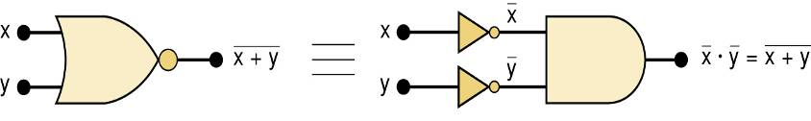
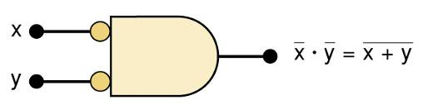
3-11 DeMorgan’s Theorems
Equivalent circuits implied by Theorem (16)
The alternative symbol
for the NOR function.

Slide 48
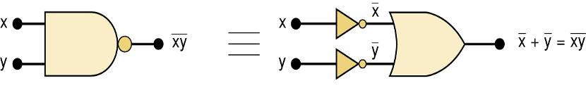
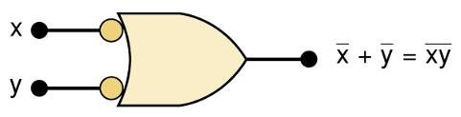
3-11 DeMorgan’s Theorems
Equivalent circuits implied by Theorem (17)
The alternative symbol
for the NAND function.

Slide 49
3-12 Universality of NAND and NOR Gates
NAND or NOR gates can be used to create the three basic logic expressions.
  OR, AND, and INVERT.
    Provides flexibility—very useful in logic circuit design.

Slide 50

3-12 Universality of NAND and NOR Gates
How combinations of NANDs or NORs are
used to create the three logic functions.
It is possible, however, to implement any logic expression using only NAND gates and no other type of gate, as shown.

Slide 51

3-12 Universality of NAND and NOR Gates
How combinations of NANDs or NORs are
used to create the three logic functions.
NOR gates can be arranged to implement
any of the Boolean operations, as shown.

Slide 52

3-12 Universality of NAND and NOR Gates
A logic circuit to generate a signal x, that will go HIGH whenever conditions A and B exist simultaneously, or whenever conditions C and D exist simultaneously.
The logic expression will be x = AB + CD.
Each of the TTL ICs shown here will fulfill the function. Each IC is a quad, with four identical gates on one chip

Slide 53



3-12 Universality of NAND and NOR Gates
Possible Implementations # 1

Slide 54


3-12 Universality of NAND and NOR Gates
Possible Implementations #2

Slide 55

3-13 Alternate Logic-Gate Representations
To convert a standard symbol to an alternate:
  Invert each input and output in standard symbols.
    Add an inversion bubble where there are none.
    Remove bubbles where they exist.

Slide 56
3-13 Alternate Logic-Gate Representations
Points regarding logic symbol equivalences:
  The equivalences can be extended to gates with
  any number of inputs.
  None of the standard symbols have bubbles on
  their inputs, and all the alternate symbols do.
  Standard & alternate symbols for each gate represent the same physical circuit.
  NAND and NOR gates are inverting gates.
    Both the standard and the alternate symbols for each will have a bubble on either the input or the output.
  AND and OR gates are noninverting gates.
    The alternate symbols for each will have bubbles
    on both inputs and output.

Slide 57
3-13 Alternate Logic-Gate Representations
Active-HIGH – an input/output has no inversion bubble.
Active-LOW – an input or output has an inversion bubble.

Slide 58

3-13 Alternate Logic-Gate Representations
Interpretation of the two NAND gate symbols.

Slide 59

3-13 Alternate Logic-Gate Representations
Interpretation of the two OR gate symbols.

Slide 60




3-14 Which Gate Representation to Use
Proper use of alternate gate symbols in the circuit diagram can make circuit operation much clearer.
Original circuit using standard NAND symbols.
Equivalent representation
where output Z is
active-HIGH.
Equivalent representation where output Z is
active-LOW.

Slide 61
3-14 Which Gate Representation to Use
When a logic signal is in the active state (HIGH or LOW) it is said to be asserted.
When a logic signal is in the inactive state (HIGH or LOW) it is said to be unasserted.
A bar over a signal means asserted (active) LOW.
Absence of a bar means asserted (active) HIGH
RD
RD

Slide 62
3-14 Which Gate Representation to Use
An output signal can have two active states,
with an important function in the HIGH state,
and another in the LOW state.
  It is customary to label such signals so both
  active states are apparent.
A common example is the read/write signal.
RD/WR
When this signal is HIGH, the read operation (RD) is performed;
when it is LOW, the write operation (WR) is performed.

Slide 63
3-14 Which Gate Representation to Use
When possible, choose gate symbols so bubble outputs are connected to bubble input.
  Nonbubble outputs connected to nonbubble inputs.

Slide 64

3-14 Which Gate Representation to Use
The logic circuit shown activates an
alarm when output Z goes HIGH.
Modify the circuit diagram
so it represents the circuit
operation more effectively.
The NOR gate symbol should be
changed to the alternate symbol with a nonbubble (active-HIGH) output to match the nonbubble input of AND gate 2.
The circuit now has nonbubble outputs
connected to nonbubble inputs of gate 2.

Slide 65
3-15 Propogation Delay
Propagation delay is the time it takes for a system to produce output after it receives an input.
  Speed of a logic circuit is related to propagation delay.
Parts to implement logic circuits have a data
sheet that states the value of propagation delay.
  Used to assure that the circuit can operate fast enough for the application.

Slide 66
3-17 Description vs. Programming Languages
HDL – Hardware Description Languages allow rigidly defined language to represent logic circuits.
  AHDL – Altera Hardware Description Language.
    Developed by Altera to configure Altera Programmable Logic Devices (PLDs).
    Not intended to be used as a universal language
    for describing any logic circuit.
  VHDL – Very High Speed Integrated circuit Hardware Description Language.
    Developed by U.S. Department of Defense (DoD).
    Standardized by IEEE.
    Widely used to translate designs into bit patterns that program actual devices.

Slide 67
3-17 Description vs. Programming Languages
It is important to distinguish between hardware description languages & programming languages
  In both, a language is used to program a device.
Computers operate by following a list of tasks, each of which must be done in sequential order.
  Speed of operation is determined by how fast the computer can execute each instruction.
A digital logic circuit is limited in speed only by how quickly the circuitry can change outputs in response to changes in the inputs.
  It is monitoring all in-puts concurrently & responding to any changes.

Slide 68
3-17 Description vs. Programming Languages
Comparing operation of a computer and a logic circuit in performing the logical operation of y = AB.
A
y
B
The logic circuit is an AND gate. The output y will be
HIGH within about 10 nanoseconds of the point
when A and B are HIGH simultaneously.
Within approximately 10 nanoseconds after either
input goes LOW, the output y will be LOW.

Slide 69

3-17 Description vs. Programming Languages
Comparing operation of a computer and a logic circuit in performing the logical operation of y = AB.
The computer must run a program of
instructions that makes decisions.
Each shape in the
flowchart represents
one instruction.
If each takes 20 ns, it
will take a minimum of two or three instructions (40–60 ns) to respond to changes in the inputs.

Slide 70
3-18 Implementing Logic Circuits With PLDs
Programmable Logic Devices (PLDs) are devices that can be configured in many ways to perform logic functions.
  Internal connections are made electronically to program devices.

Slide 71

3-18 Implementing Logic Circuits With PLDs
PLDs are configured electronically & their internal circuits are “wired” together electronically to form a logic circuit.
This programmable
wiring can be thought
of as thousands of connections, either connected (1), or
not connected (0).
Each intersection of
a row (horizontal wire) &
column (vertical wire) is a
programmable connection.

Slide 72
3-18 Implementing Logic Circuits With PLDs
The hardware description language defines the connections to be made.
  It is loaded into the device after translation by a compiler.
The higher-level hardware description language, makes programming the PLDs much easier than trying to use Boolean algebra, schematic drawings, or truth tables.

Slide 73
3-19 HDL Format and Syntax
Languages that are interpreted by computers must follows strict rules of syntax.
  Syntax refers to the order of elements.

Slide 74

3-19 HDL Format and Syntax
On the left side of the diagram is the set of inputs, and on the right is the set of outputs.
The symbols in the middle define its operation.

Slide 75

3-19 HDL Format and Syntax
Format refers to a definition of inputs, outputs & how the output responds to the input (operation).
Format of HDL files.

Slide 76
3-19 HDL Format and Syntax
In a text-based language, the circuit described must be given a name.
  The definition of the operation is contained in a set of statements that follow the input/output (I/O) definition.
Inputs & outputs (ports) must be assigned names and defined according to the nature of the port.
  The mode defines whether it is input, output, or both.
The type refers to the number of bits and how those bits are grouped and interpreted.
  A single bit input, can have only two values: 0 and 1.
  A four-bit binary number can have any one of 16 different values (0000₂ - 1111₂).

Slide 77

3-19 HDL Format and Syntax - AHDL
The keyword SUBDESIGN gives a name to the circuit block, which in this case is and_gate.
  The name of the file must also be and_gate.tdf.
In AHDL, input/output definition
is enclosed in parentheses.
Variables for inputs are separated
by commas & followed by :INPUT;
In AHDL, the single-bit type is
assumed unless the variable
is designated as multiple bits.
Single-output bit is declared
with the mode :OUTPUT;

Slide 78
3-19 HDL Format and Syntax - AHDL
The keyword SUBDESIGN gives a name to the circuit block, which in this case is and_gate.
  The name of the file must also be and_gate.tdf.
Statements describing operation
of the AHDL circuit are contained
in the logic section between
the keywords BEGIN and END.
END must be followed by a semicolon.
Statements between BEGIN
and END are evaluated
constantly and concurrently.
The order in which they are
listed makes no difference.

Slide 79

3-19 HDL Format and Syntax
The basic
Boolean operators.

Slide 80

3-19 HDL Format and Syntax - VHDL
The keyword ENTITY gives a name to the circuit block, which in this case is and_gate.
  Variables named by the compiler should be lowercase.
The keyword PORT tells the compiler that we are defining in-puts
and outputs to this circuit block.

Slide 81
3-19 HDL Format and Syntax - VHDL
The keyword ENTITY gives a name to the circuit block, which in this case is and_gate.
  Variables named by the compiler should be lowercase.
The BIT description tells the compiler that
each variable in the
list is a single bit.

Slide 82
3-19 HDL Format and Syntax - VHDL
The keyword ENTITY gives a name to the circuit block, which in this case is and_gate.
  Variables named by the compiler should be lowercase.
The ARCHITECTURE declaration is used to describe the operation of everything inside the block.
Every ENTITY must have at least one ARCHITECTURE associated with it.

Slide 83
3-19 HDL Format and Syntax - VHDL
The keyword ENTITY gives a name to the circuit block, which in this case is and_gate.
  Variables named by the compiler should be lowercase.
Within the body (between BEGIN and END) is the description of the block’s operation.

Slide 84

3-20 Intermediate Signals
In many designs, there is a need to define signal points “inside” the circuit block—called buried nodes or local signals.
  Points in the circuit that may be useful as a reference point, that are not inputs or outputs.

Slide 85
3-20 Intermediate Signals - AHDL
AHDL local signals:
  Comments are enclosed by % characters.
  Text after two dashes is for documentation only.
  Keyword VARIABLE defines intermediate signal.
  Keyword NODE designates the nature of the variable.

Slide 86

3-20 Intermediate Signals - AHDL

Slide 87
3-20 Intermediate Signals - VHDL
VHDL local signals:
  Text after two dashes is for documentation only.
  Keyword SIGNAL defines intermediate signal.
  Keyword BIT designates the type of signal

Slide 88

3-20 Intermediate Signals - VHDL

Slide 89
END

